Slide 1

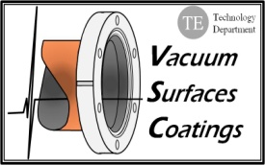
LHeC Experimental Beam Pipe
Paul Cruikshank,
Technology Department ,
Vacuum, Surfaces & Coatings Group
(based on LHeC presentations, CDR and inputs from R.Veness, J.Bosch & P.Kostka)

Slide 2
LHeC CDR – ‘Vacuum’ Chapter
9.8 Vacuum
  Vacuum Requirements
  Synchrotron radiation
    Synchrotron radiation power
    Photon-induced desorption
    Vacuum cleaning and beam scrubbing
  Vacuum engineering issues
    Vacuum pumping
    Vacuum diagnostics
    Vacuum protection
    HOM and Impedance implications
    Bake-out of vacuum system
    Shielding issues
    Corrosion resistance
9.9 Beampipe Design
  Requirements
  Choice of materials for beampipes
  Beampipe geometries
  Vacuum instrumentation
  Synchrotron Radiation Masks
  Installation and Integration
Today

Slide 3
LHC/LHeC Experimental Vacuum Requirements
Machine Requirements
  The LHC/LHeC beam vacuum system design requires control of a number of dynamic vacuum issues
    Ion induced desorption, electron stimulated desorption & electron cloud, photon stimulated desorption
  The primary factor in this control is low desorption yields from vacuum chamber surfaces
Experimental Vacuum
  LHC/LHeC experimental chambers require low Z materials (transparency, background)
  Low Z, ultra-high vacuum compatible materials (e.g. aluminium, beryllium) have high desorption yields
    Titanium would be a possible exception
  LHC overcame this by using thin-film TiZrV NEG coatings, but these require activation by heating the chamber to ~220°C
Radiation
  LHC experimental interaction chambers are designed for in the order of 1 MGy per year (at nominal luminosity), mainly from collisions
  Low Z results in lowest possible residual activation of the highly exposed chamber.

Slide 4
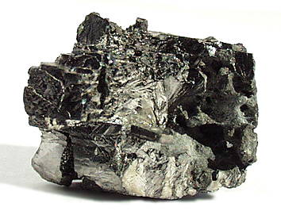
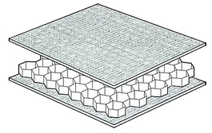
Preliminary Analysis
Beampipe material choice
  The combination of transparency, temperature resistance, radiation resistance, UHV compatibility, plus mechanical requirements resulted in the choice of NEG coated beryllium and/or aluminium for the critical central parts of LHC detector beampipes
    However, Beryllium is expensive, toxic and limited in supply!
  Composite beam pipes are not excluded but much more R&D is necessary

Slide 5
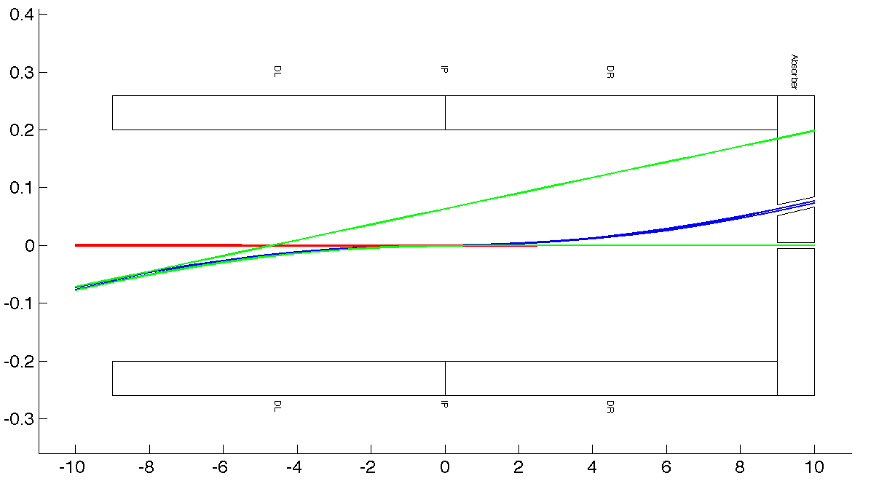
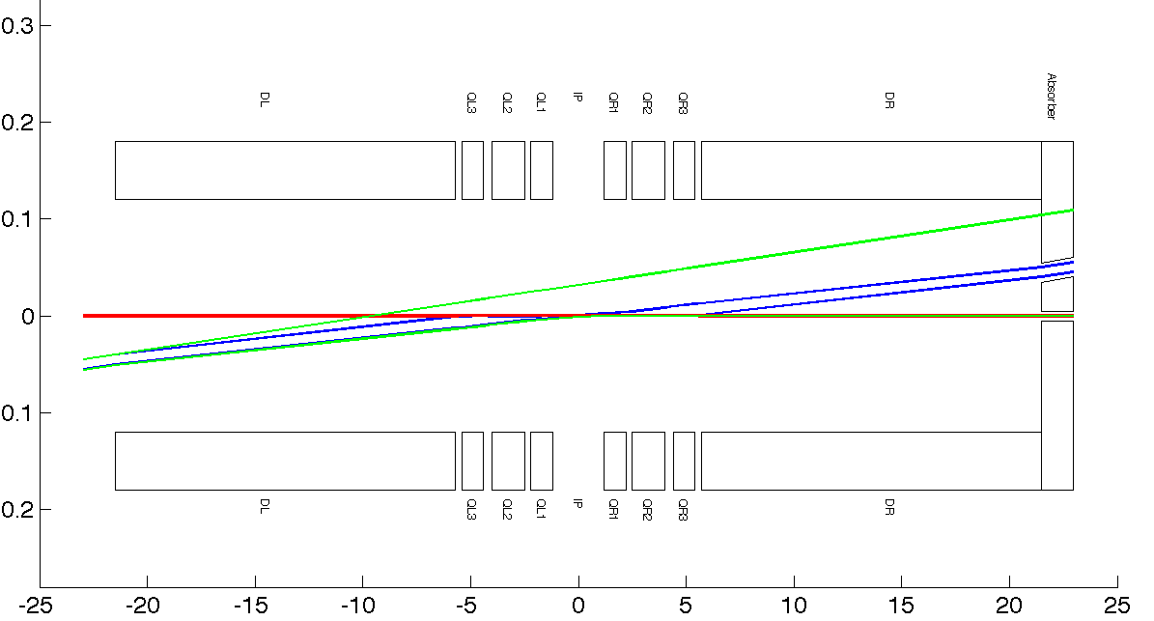
LR, RR option – Beams & SR
LR Option - Beam & Fan Envelopes
e p
SR Fan growth with z
x [mm]
Triplet Position z= ~10m
RR Option - Beam & Fan Envelopes
z [mm]
e p
Legend : Dipole
x [mm]
SR Fan growth with z
(high luminosity case)
Triplet Position z= ~22m
z [mm]

Slide 6
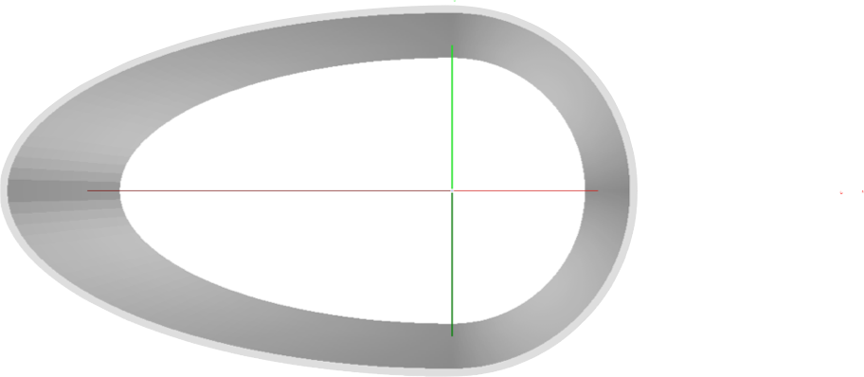
Beam Pipe RR Variant¹
LR - Inner Dimensions
Circular(x)=22 mm; Elliptical(-x)=-55 mm, y=22 mm
housing beam/SR envelopes;
beam pipe dimensions reduced - using static / movable masks;
10 mm safety margin ( mech tol, alignment, sag, cavern, etc)
y=22 mm
x= -55 mm
x=22 mm
1. Peter Kostka. et al

Slide 7
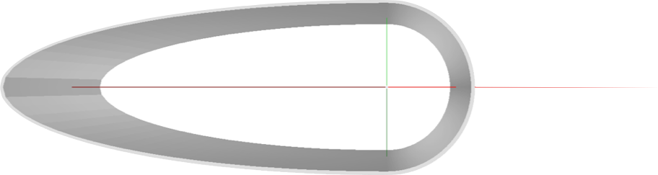
Beam Pipe LR Variant¹
LR - Inner Dimensions
Circular(x)=22 mm; Elliptical(-x)=-100 mm, y=22 mm
housing beam/SR envelopes;
beam pipe dimensions reduced - using static / movable masks;
10 mm safety margin ( mech tol, alignment, sag, cavern, etc)
y=22 mm
x= -100 mm
x=22 mm
1. Peter Kostka. et al

Slide 8
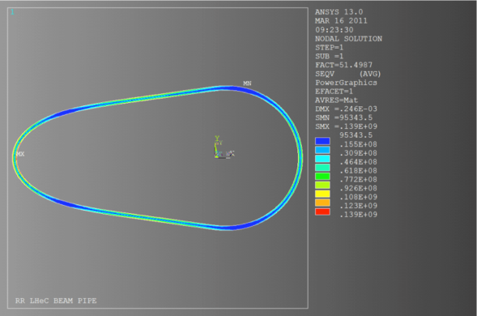
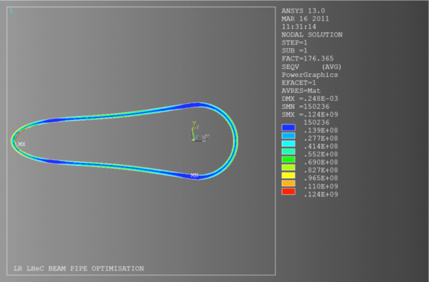
LHeC Beampipe Geometry
Proposed LHeC experimental chamber geometries¹
Analysis:
R.Veness,
J.Bosch
RR – 1.3 to 1.5 mm Be wall
LR – 2.5 to 3.0 mm Be wall
  Assumptions:
    Beryllium
    Central beam pipe ~ 6 meters
    Constant x-section
    TiZrV NEG coated
    Periodic bakeout/NEG activation at ~220C (permanent system?)
    Wall protected from primary SR (upstream masks)
    Minimised end flanges, minimised supports
1. Peter Kostka. et al

Slide 9
Composite Pipes
Composites
  Motivation to reduce cost in materials and manufacture
  Possibly improve radiation transparency
    Sandwiches constructions – but increased wall thickness
  Long-term R&D on low Z composite chambers is under way at CERN which may provide an alternative.
  Carbon-fibre composites (aluminium, glass/ceramic in matrix)
  Carbon-carbon composites (with/without metal liners)
  Glassy (vitreous) carbon
  Sandwich constructions (honeycombe & metal foam cores with thin skins )
  Recent development of unbaked coatings may be advantageous wrt to known temperature limitations of some composites – a-C coating used in SPS.¹
Amorphous Carbon Coatings for mitigation of electron cloud in the CERN SPS, C. Yin Vallgren et al.

Slide 10
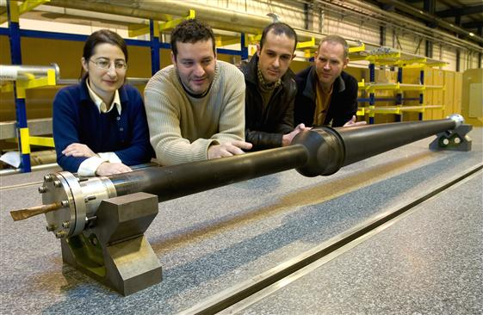
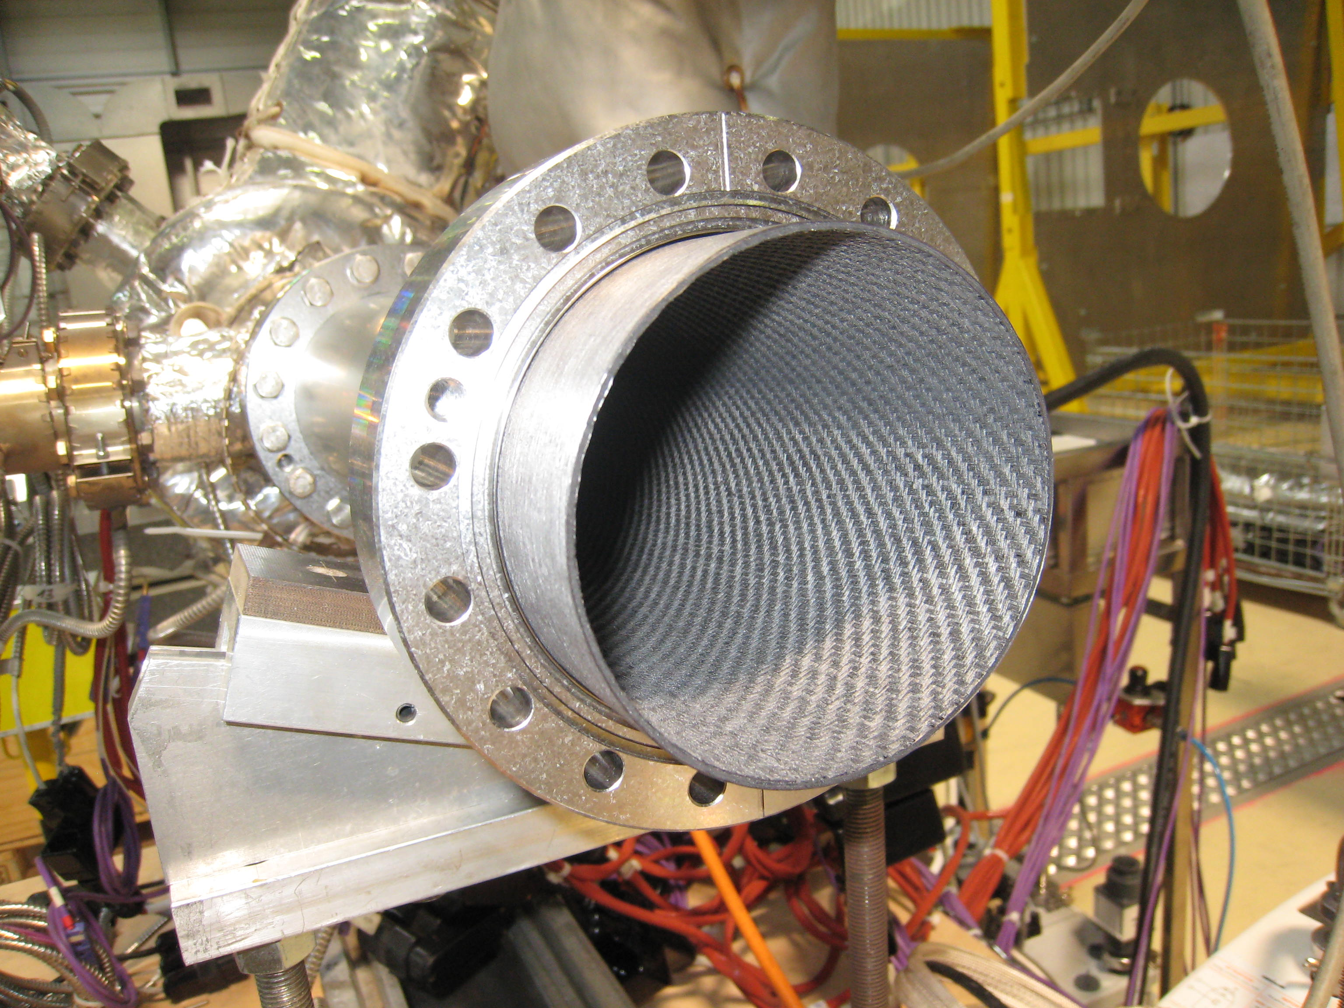
Alternative Beam Pipe Solutions
CHAMBER COST
½ cylinder, ½ ellipse tapering
Variable wall thickness
½ cylinder, ½ ellipse
C-C with ext liner
Ellipse
Racetrack
Cone
Cylinder
LHCb UX85/1
Bi-conical Be
Carbon-fibre, Carbon-Carbon
Sandwich structures, Glassy carbon
Beryllium
Composites
EXECUTION TIME, RISK

Slide 11
LHeC Beampipe Timescale
A tentative timescale (months)............
CDR
Typical Be solution (3-4 yrs)
12?
12?
vac studies
vac tests
eng, layouts, integration
composite studies
prototypes
eng design
approval
tender
manu
coating
24?
24?
6
3
12
12-24
3
Low Z materials R&D
(C. Garion)
LEB WG
(M. Galillee)
Additional manpower is necessary to advance on LHeC eng & vacuum physics issues

Slide 12
How to advance on vacuum system?
The next steps for LHeC experimental area
  Additional VSC engineering resources
    Layouts, Integration, Supports, Instrumentation, Alignment, Heat Loads, Masks, Bakeout, Pumps, Gauges, etc. (triplet to triplet)
    Parallel engineering studies with other detector technologies.
  Additional vacuum physics resources
    Vacuum stability, simulations, experimental validations, coatings, etc.
The next steps for the LHeC machine
  Additional VSC engineering & vacuum physics resources
    SR heat loads, vacuum stability, dipole chamber design, heat extraction, etc.
⇨ Fellows support in 2013 & 2014
⇨ Budget for design & prototyping work

Slide 13
Beampipe Summary
  The combined requirements of LHC/LHeC machine and experiments place a serious limit on the choice of materials for beampipes
  The baseline for the central beampipe can be considered as a solid beryllium chamber, NEG coated and in-situ baked.
  Preliminary calculations have been made for simple ‘solid’, half-cylindrical half-elliptical geometries.
  In beryllium, thickness in the order of 1.3 to 1.5 mm (RR) and 2.5 to 3 mm (LR) appear feasible.
  Experience with LHCb conical chambers does not rule out complex shapes.
  Ongoing R&D for new materials and coatings may give other options, but will require several years.
  Vacuum physics & engineering studies must be made in parallel with detector (& machine) studies.
  Additional vacuum resources (personnel & material) are required to continue with the these studies.

Slide 14

Thanks for listening
Any Questions?
Paul Cruikshank - TE/VSC – paul.cruikshank@cern.ch
Acknowledgements – R.Veness, J.Bosch, P.Kostka

Slide 15
Material | Radiation length X₀ [cm] | Notes
Beryllium | 35
Epoxy | 30-36 | Very low E !
Carbon | 29 | Includes C-C & Glassy
Carbon/Al (90/10) | 24 | Impregnated C matrix
Carbon/Al (60/40) | 17 | Impregnated C matrix
AlLi | 10-11
Al | 9
Al2O3 | 7
SiC | 8

