Slide 1
LHeC Linac-ring Beamdynamics
D. Schulte

Slide 2
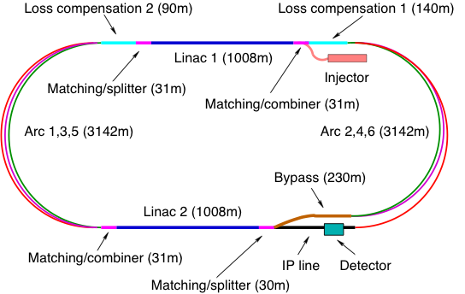
LHeC Layout

Slide 3
Reasoning
Reacceleration after turn-arounds
  With no synchrotron radiation energies of beam before and after collision can be matched pair-wise
  Does not work with uncompensated synchrotron radiation
  Compensation at last 60GeV arc would be more efficient before arc, but space constraints need to be addressed
Dedicated reacceleration sectors
  Using the linacs for compensation does not save power because real reacceleration is affected
    Off-phase acceleration creates beamloading
    There is no perpetuum mobile
  Dedicated sectors allow simple tuning, coupling only two turns not all of them
    E.g. easier energy ramping
  But some additional cost
Circumference choice is C_{LHC}/n with n=3
  Explained later

Slide 4
Note: Reacceleration Frequency Choice
Reacceleration at 60GeV turn-around can be fundamental frequency
  Only one beam
Other compensation stations require other frequency
  Rule:
    Linac frequency = n (2m+1) f₀
      Create n buckets for accelerated beam
      And n for decelerated beam
    Compensation frequency = n (2k) f₀
      Will accelerate both beams
  Baseline are 721.42 and 1442.84 MHz
  But could use 721.42 and 801.58 MHz (50ns spacing)
  Or 721.42 and 961.89 MHz (25ns spacing)
  Or …

Slide 5
Energy Loss in Arcs
Baseline Arc designs from A. Bogacz
Alternative design by V. Litvinenko et al.
Incoherent synchrotron radiation in arcs (ρ=764m)
Total loss about 2GeV
i.e. 12.2MW beam power
Impact of energy spread and tail at dump needs to be studies
increase of injection energy would help

Slide 6
Coherent Synchrotron Radiation
Use simple one-dimensional free space model leads (Ch. Mayes, G. Hoffstaetter)
  Assume same effect in drifts as in magnets
  Should be conservative
  A. Latina did similar calculation using other derivation
For a bunch length of 600μm, N=2x10⁹
  RMS energy spread at dump of ~5MeV
  Average energy loss for all turns of ~8MeV
  Much smaller than incoherent radiation
Combination of wakefields and coherent synchrotron radiation not studied

Slide 7
Emittance Growth in Arcs
Incoherent synchrotron radiation only
Growth before the interaction point: 7μm
Total growth: 26μm
Numbers should be fine

Slide 8
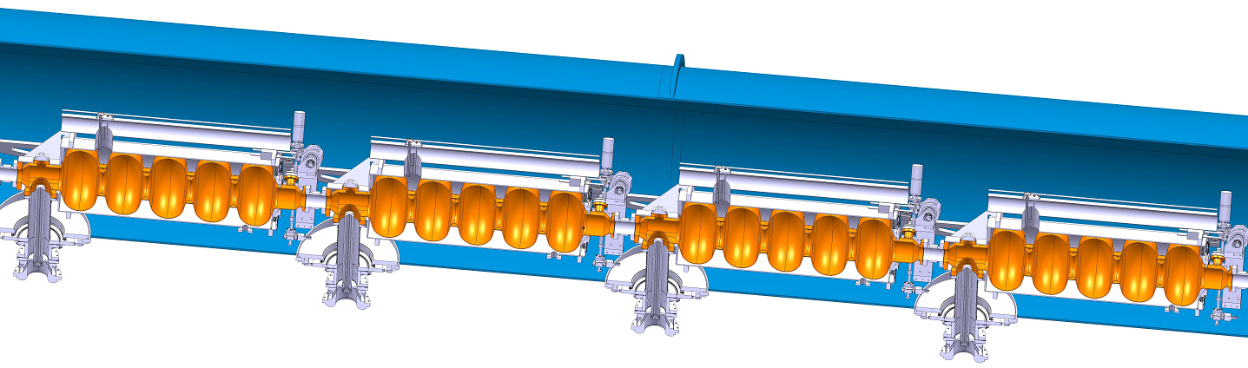
Linac Design
8 1.06m long cavities per module, 2 modules per quadrupole pack
Quadrupole spacing 33m
60 modules per 990m-long linac (480 cavities)
Beam physicists assumed slightly different parameters (576 cavities at 18MV/m, quadrupole spacing of 28m and 72 modules)
Results are only slightly affected by the difference

Slide 9
Linac Lattice
Optimised for beam stability by minimising
Lattice from A. Bogacz used
Alternative optics exists with no focusing in linac (V. Litvinenko et al.)

Slide 10
Short-range Wakefields
Difficult to compute
Hence use scaled ILC wakefields (from RDR studies)
Simple scaling with aperture:
Transverse
Longitudinal

Slide 11
Wakefield-induced Energy Spread
Simple PLACET simulation
Arcs are not included
Fine, somewhat large at dump

Slide 12
Single-bunch Emittance Growth
Emittance growth due to initial offset Δx=σ_{x}
PLACET simulation, arcs are not included
Fine

Slide 13
Long-range Wakefields
Thanks to M. Schuh for the modes
Q=10⁵ assumed (consistent with ILC cavities)
0.1% mode detuning
Longitudinal modes need also to be studied

Slide 14
Multi-bunch Beam Break-up
New code developed
Point-like bunches
Impact of single offset bunch on other studied
Beam is stable

Slide 15
Multi-bunch Beam Break-up
Damping and detuning are essential

Slide 16
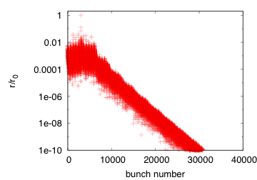
ILC Cavities
f [GHz] | k [V/(pCm^2)] | Q
1.6506 | 19.98 | 7e4
1.6991 | 301.86 | 5e4
1.7252 | 423.41 | 2e4
1.7545 | 59.86 | 2e4
1.7831 | 49.2 | 7.5e3
1.7949 | 21.70 | 1e4
1.8342 | 13.28 | 5e4
1.8509 | 11.26 | 2.5e4
1.8643 | 191.56 | 5e4
1.8731 | 255.71 | 7e4
1.8795 | 50.8 | 1e5
2.5630 | 42.41 | 1e5
2.5704 | 20.05 | 1e5
2.5751 | 961.28 | 5e4
Note: A translation error in one cell
of the the lattice file from excel to RTF
led to different results in the past
TESLA TDR
Beam is stable

Slide 17
Static Imperfections
Can assume the same tolerances as for ILC
ILC achieves nm emittance growth using complex beam-based
alignment, see below
Need BPMs that can resolve the bunches from the different turns
-> Do not expect any issue

Slide 18
Cavity Tilts
The combination of cavity tilt and gradient jitter leads to transverse deflection of the beam
Approximate estimate using the simple formula (assuming averaging over beam phase):
For
a reasonable RMS tilt of 300μradian
a not so small 1% RMS gradient jitter
one obtains RMS beam jitter of O(5%σ_{y}) at the interaction point

Slide 19
Fast Beam-ion Instability
Positive ions that are trapped in the beam can
  Change the phase advance of the different bunches
  Can lead to a multi-bunch instability
Studies need to
  Check whether ions are trapped
    Bunch to bunch and turn to turn
  How much damage they do while being trapped

Slide 20
Fast Beam-ion Instability
Ions are trapped from bunch to bunch if f_{c}<f_{limit}
Frequency f_{c} is shown for continuous train
-> All gases are trapped
-> likely will need to add a gap in the train

Slide 21

Beam Pulse
Could use 20μs trains and 10μs gaps
  Beam loading in injectors 0.6% for 720MHz cavities
  Increase bunch charge by 50%
  This fixes LHeC circumference to be 1/n of LHC
    Each LHC bunch always or never collides with electron bunches
Need to study consequences on RF
Still need good vacuum (O(10⁻¹¹hPa)) in linacs, more study needed

Slide 22
Clearing of Ions in the Gap
Replace many thin focusing lenses of beam by a thick long lens:
Ions will be cleared if this long lens is over-focusing
Note: derivation differs from what I found in literature

Slide 23
Ion Clearing
Ions are cleared almost everywhere
Longitudinal drift will get rid of remaining ions

Slide 24
Phase Advance Error
Assume ions are lost in first gap passage (optimistic)
Ions are trapped within each train, look at last bunch before the gap
The relative phase advance error can be approximated for
round beams as (G. Hoffstaetter, M. Liepe, NIM A 557 (2006) 205–212):
With no clearing ions will accumulate until the beam is neutralised:
i.e. ϑ=1 -> Δϕ/ϕ=16 -> not acceptable
With gap one finds for p=10⁻⁹hPa (warm) and p=10⁻¹¹hPa (cold):
ϑ=3.3x10⁻⁵ -> Δϕ/ϕ=7x10⁻⁴ -> acceptable

Slide 25
Multi-bunch Instability
Can calculate the instability rise time for the n^{th} bunch in a train
(F. Zimmermann et al., SLAC-PUB-7617)
Average the rise time along the machine
Pessimistic: detuning ignored
Assume beam to be stable if instability rise length L=τ_{c}c is longer than
beam travel length

Slide 26
Rise Length
Note: the rise length
Is proportional to the
Pressure, here 10⁻¹¹hPa
Rise length for
CH₄⁺: 14km
H₂⁺: 25km
Total length of travel in
linacs is 12km
p=10⁻¹¹hPa is marginally OK
Measurements show 6x10⁻¹¹,1x10⁻¹¹, 0.05x10⁻¹¹ hPa
for LEP (N. Hilleret), HERA (B. Holzer), LHC (V. Baglin)

Slide 27
Rise Length in the Arcs
Calculation is similar than in the linac
But only two beams in each arc
Total length in arcs is 33km
For p=10⁻⁹hPa
H₂⁺: 70km
N₂⁺,CO⁺:50km
CO₂⁺: 60km
p=10⁻⁹hPa is marginally OK

Slide 28
Beam-beam Effects
Electron bunch changes size during the collision
GUINEA-PIG simulation
Luminosity is slightly above target
L~1.35x10³³ cm⁻²s⁻¹
Emittance growth is not large
But strong mismatch, so need
Average energy loss ~0.2MeV

Slide 29
Beam-beam Offsets
GUINEA-PIG simulation
Deflection of electron beam centroid
Maximum deflection is about 300μradian
Maximum deflection of proton centroid is about 30nradian
(=4x10⁻⁴σ’)

Slide 30
Some Things To Do
Include the beam-beam effects and arcs in the main linac stability studies
Study the impact of energy spread/tail at the dump
Study the fast beam-ion instability
Protection of linac from arc synchrotron radiation
Study of imperfections and mitigation in presence of different energy beams

Slide 31
Simulation Tools
Focus is usually either on rings or transfer lines
  Few turns with interleaving bunches is normally not simulated
Currently use dedicated code for multi-bunch studies
  Point-like bunches
  No beam-beam interaction
PLACET for single bunch studies
  Has multi-bunch wakefields, coherent synchrotron radiation, imperfections, correction techniques, can call beam-beam, is fully programmable
  Cannot handle interleaved trains
  Will have to add this for the CLIC drive beam in the combiner rings
GUINEA-PIG for beam-beam interaction
  Easily integrated in PLACET
  But takes some seconds per collision
FASTION (G. Rumolo)
  Can simulate fast beam-ion instability in transfer lines
  Planned to be integrated into PLACET
  Does currently not allow to use interleaved trains

Slide 32
Conclusion
Did not find any show stopper
Do not expect to find a show stopper
But a number of studies remain to be done
  Requires some resource
  Some synergy with CLIC studies

Slide 33
Reserve

Slide 34
Beam-loading in the Gap
In the linacs no basic beam loading exists
  All gaps fall on top of each other
For the control RF and the injector one can estimate
-> Variation is about 0.6%

