Slide 1

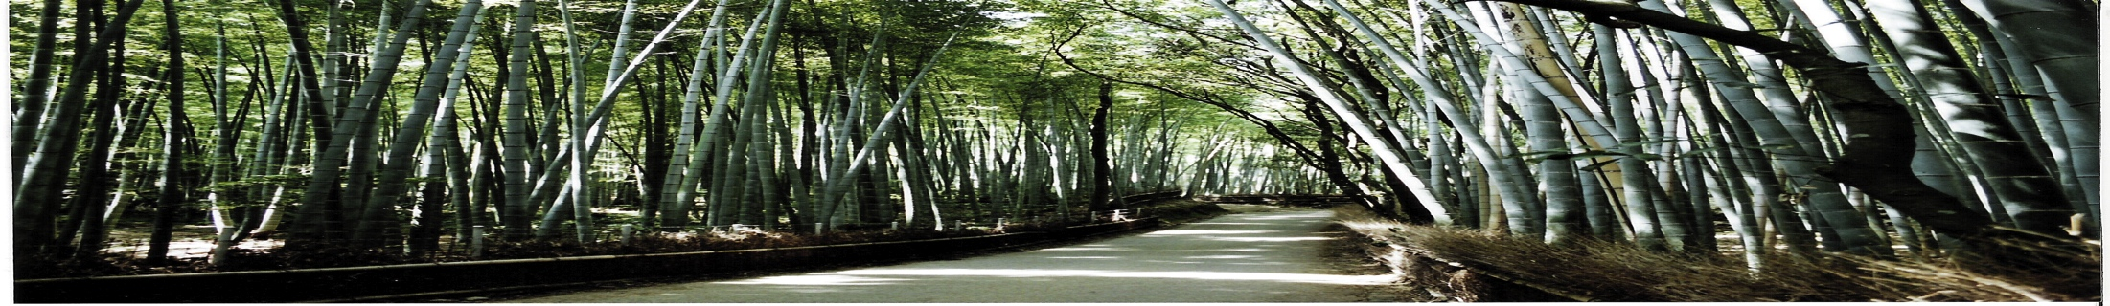
Beam-Beam dynamics in the LHeC
T.Pieloni with help from W. Herr, Y. Hao and W. Fischer (BNL)

Slide 2
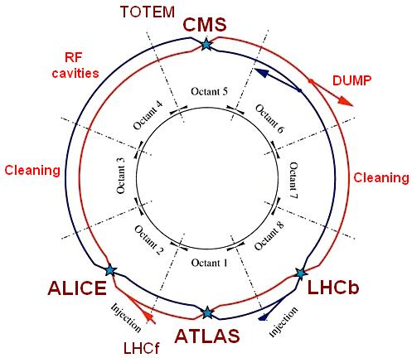
Beam-Beam interactions in the LHeC
Hadron Colliders:
  Beam Losses (dynamic aperture )
  Beam Lifetime
  External noise very important
  Landau damping properties
  Coherent modes
  …
  IR: 3 Head-on collisions
  30 long-range interaction
Head-On
Long Range

Slide 3
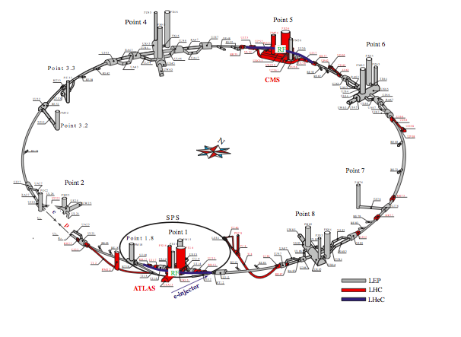
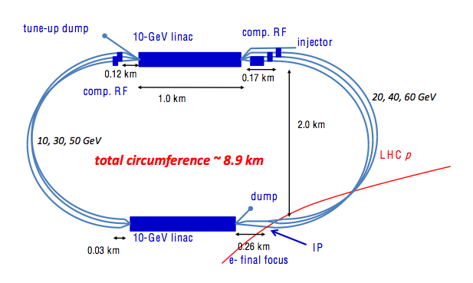
Beam-beam interactions in the LHeC options
RING-RING Option
LINAC-RING Option
  Crossing angle needed (S factor 86-75%)
  One head-on interaction at IP
  Long range encounters every 3.75 m in IR
  e-beam acts as noise source
  No crossing angle
  One head-on interaction at IP
  No Long-range encounters
  e-beam noise source
  No worry of stability of e-beam
  LHC pp Beam-beam effects:
  2 Head-on collisions & 60 Long-range interactions at least

Slide 4
LHeC Beam-beam complications:
Large Number of bunches in both beams (2808)
Simultaneous collisions of ep and pp of one proton beam
  pp collisions in IR1 and IR5
  ep collisions at another IR
Long term stability of
proton beams:
dominated by non linear effects
Long term stability of RR e-beam
and mismatch of e-beam in LR
Different beam-beam properties

Slide 5
Known performance issues :
Optical matching (SPS, Hera and Tevatron experience)
  σ_{x}^{e} = σ_{x}^{p}
  σ_{y}^{e} = σ_{y}^{p}
Since different emittances for p and e then the beta functions at IP have to be different for the two beams (Hourglass effect)
  Restricts choice on β_{e}
Electron emittance must be controlled (coupling H/V ):
  Might be ok for RR option
  Not obvious for LR option
ep collision introduces asymmetry HV in Hadrons beam-beam effects

Slide 6
Beam-Beam effects
e-beam
e-beam
Tune shifts/spread
Long Range interaction effects
Noise
Tune shift/spread
Mismatch
Disruption
p-beam
Tune shifts/spread
Landau Damping properties
Long Range interaction effects
Noise from ep collisions

Slide 7
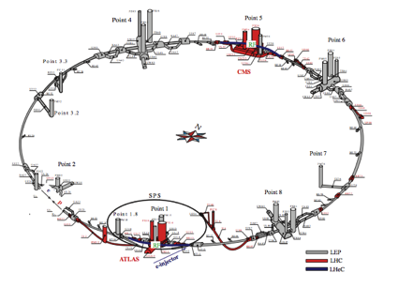
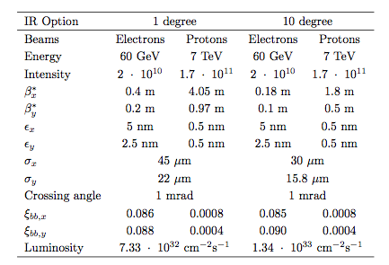
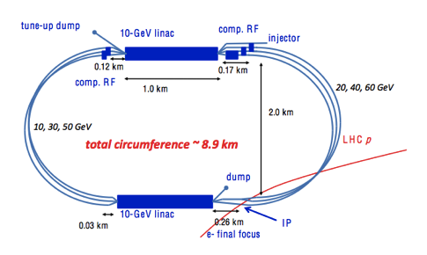
Beam-beam parameter:
ep Tune shift 1e-4 on proton beam less than 1% of pp collision effect
(LR CdR D. Schulte & Co)
Could become important ingredient to consider when lack of Landau Damping or when pinch effect considered in the e-beam
ep tune shift goes opposite direction respect to pp collisions

Slide 8
BB parameter and Tune Shifts:
Head-on beam-beam parameter achieved so far:
From Experience | LHC pp collisions | LEP (90 GeV) electron
_{ξx,y} | 0.07 - 0.017 /IP | 0.03 – 0.07 /IP
  Electrons higher than what achieved in LEP (tune shifts of 0.04):
  1 degree option optimistic but significant reduction from dynamic
  beta and small number of IP can make it feasible
  10 degree option too high tune shift for the electrons
  Protons tune shift from e-beam in shadow of head-on pp collisions and opposite direction (decreases pp tune spread) assuming designed transverse size 0.0001.
    Pinch Effect can enhance the compensating effect and/or will act differently on particles
Electron effect on protons tune spread is an important ingredient for Landau Damping even if small should be studied in details!

Slide 9
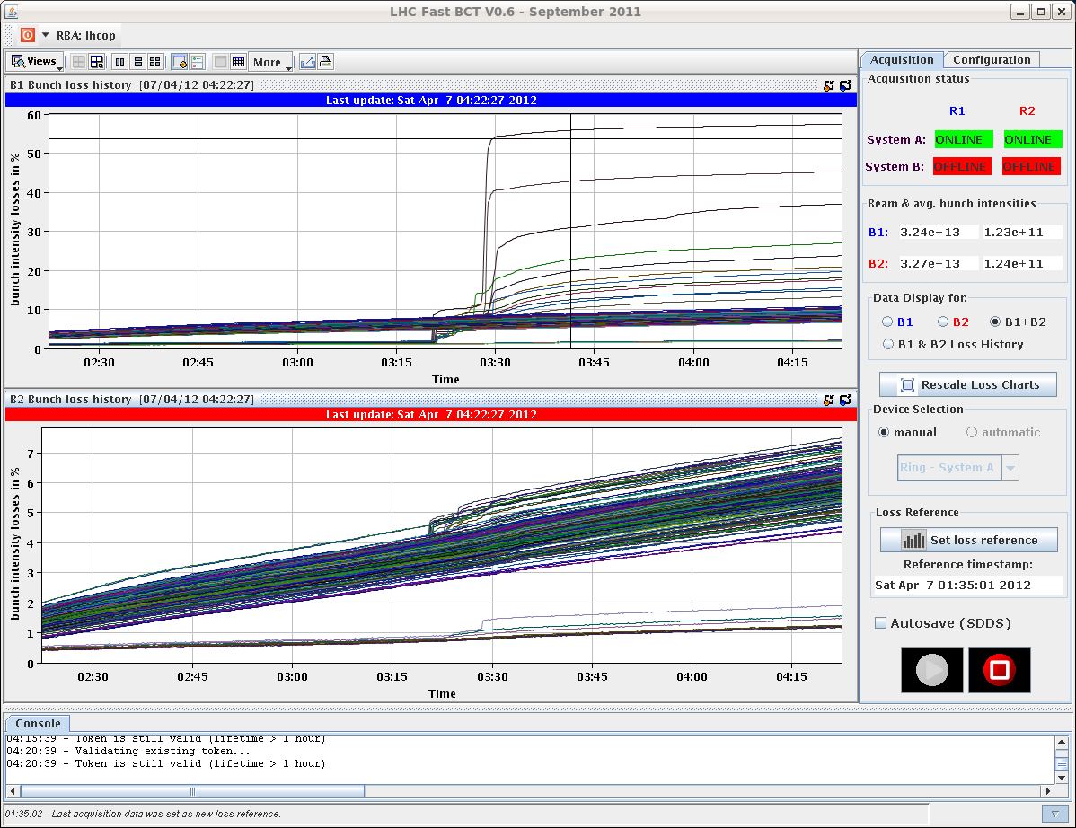
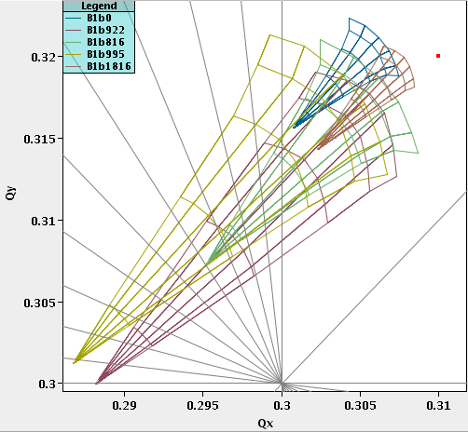
Tune spread and Landau Damping
Head-on beam-beam only sufficient to provide tune spread for Landau Damping at collision energy
If a head-on collision is not guaranteed then lack of Landau damping drives the beam unstable as observed in the LHC 2012 operation
Cortesy of X. Buffat
ep collisions compensate a fraction of the spread of pp collisions (as e-lenses)

Slide 10
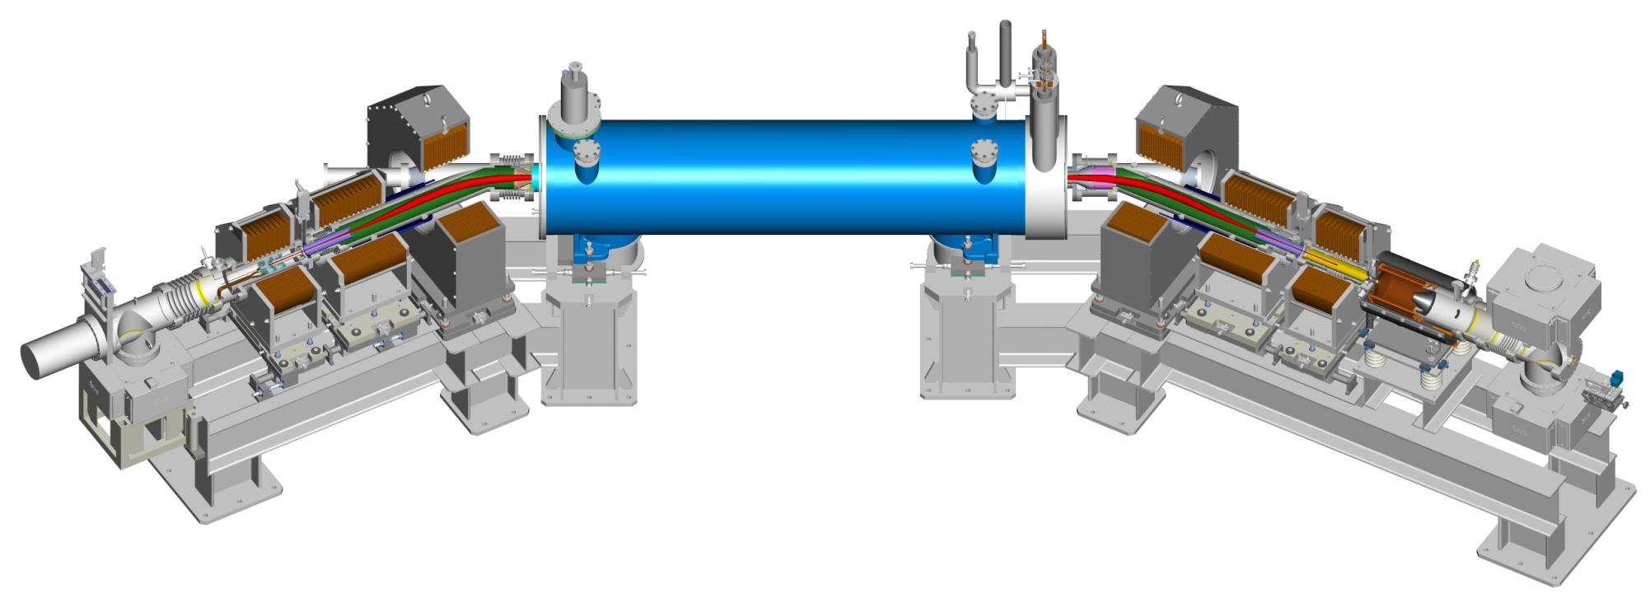
Experimental studies: e-lenses in RHIC
Perfect test bench to study:
the interplay between pp and ep collision dynamics
compensation of tune spread
effect of transverse mismatch between p and e beams
e-lenses at RHIC perfect test bench for studying experimentally the dynamics of
ep collisions with pp collisions
p
p
e⁻
e⁻
e⁻
Curtesy of W. Fischer

Slide 11

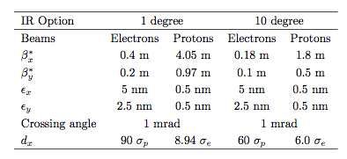
Parasitic Encounters Separation
Proton Beam
Long range encounters every 3.75m in IR
α
d
3.75 m
Electron Beam
1 degree option preferable due to larger separation
10 degree option separation smaller, important the interplay with many other LRs
Dynamic Aperture studies define the effects of the long-range encounters and an optimum set of parameters for the LHeC operation

Slide 12
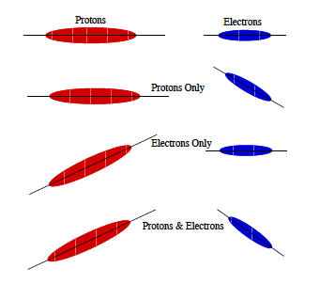
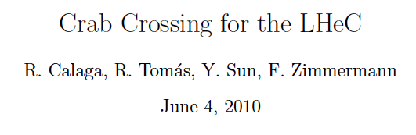
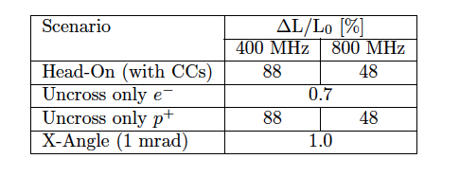
Increase d or crab cavities?
  Increase further the crossing angle and crab cross
  Crab cavities could an option to gain luminosity geometrical reduction due to crossing angle and reduce bb long-range effects
Full study of the effects of crab cavities deflection on the proton beams should be performed

Slide 13
Noise on pp collisions
Hadron colliders performances/luminosity deteriorates in the presence of transverse noise as known from past experience in Spps, Tevatron, RHIC
A source of noise (as the e-beam in LHeC RR or LR options, crab cavities, the 2nd proton beam etc) can lead to:
Emittance increase
Reduced tune shifts achievable
Analytical models: simple case cannot describe the LHC/LHeC configurations
Numerical models could have all ingredients (head-on, long-range effects etc) but detailed study does not exist yet (PhD thesis on-going for LHC X. Buffat)
Main components to be addressed:
  Any excitation of one beam will give → dipolar kicks to the other beam
  Jitter of e-beam intensity and/or sizes → quadrupolar error for the proton beam
  Crab cavities (if an option)
  Any other unavoidable source of noise
Luminosity deterioration
Detail study is fundamental by use of numerical models for all colliders

Slide 14
LHeC case e-beam is a noise generator for the protons
  e-lenses give the possibility to test in controlled way also effects of electron intensity and/or sizes jitters on proton-proton collisions
p
p
e⁻
e⁻
e⁻
Curtesy of W. Fischer
Installation foreseen summer 2012 then commissioning in 2013 run
Experimental benchmark of existing models in the LHC or at RHIC with the e-lenses is a key ingredient to define predictive power of numerical tools

Slide 15
Beam-beam issues to be addressed
Dynamic of pp and ep collisions to be studied self consistently with numerical tools and where possible with experimental studies (RHIC e-lenses)
Dynamic aperture tracking studies (define best WP and parameters) for the two options
Detail study on noise effects on the protons by numerical models and where possible experimental benchmark
Long Range beam-beam effects from RR option
Multiple bunch effects (colliding with same bunches)
Long term stability of e-beam
Effect of pinched e-beam on proton dynamics (tune shift and spread, etc)
e-beam deflection on p-beam

Slide 16
Thank you

