Slide 1
LHeC as an electron-nucleus
(e-A and e-D) Collider
John Jowett
CERN
Thanks to Detlef Kuchler, Alessandra Lombardi,
Max Klein, Nestor Armesto,

Slide 2
From LHeC CDR, Section 7.13.1
With the first collisions of lead nuclei (²⁰⁸Pb⁸²⁺) in 2010, the LHC has already demonstrated its capability as a heavy-ion collider and this naturally opens up the possibility of electron-nucleus (e-A) collisions in the LHeC.
In order to avoid interference with the high luminosity proton-proton operation, this mode of operation would naturally be included in the annually-scheduled ion operation period of the LHC. (~ 1 month)
In principle, the CERN complex could provide A-A (or even p-A) collisions to the LHC experiments while the LHeC operates with e-A collisions.

Slide 3
Present LHC Ion Injector Chain
ECR ion source
  Provide highest possible intensity of Pb²⁹⁺
RFQ + Linac 3
  Adapt to LEIR injection energy
  strip to Pb⁵⁴⁺
LEIR
  Accumulate and electron-cool
  Prepare bunch structure for PS
PS
  Define LHC bunch structure
  Strip to Pb⁸²⁺
SPS
  Define filling scheme of LHC
Protons come from different source via Linac2 (later Linac4) and PS Booster to PS
Notes:
Performance of LHC depends on quality of beam that can be injected

Slide 4
Heavy ion beams available in LHC
Mainly ²⁰⁸Pb⁸²⁺ (now colliding in LHC)
  Pb beam parameters quite well known, most interest
  First p-Pb run expected this year
Soon ⁴⁰Ar¹⁸⁺ or ¹²⁹Xe⁵⁴⁺ for SPS fixed target
  Ar-Ar collisions planned for 2021 in LHC
  No solid intensity values for now
  Other species possible in principle but it takes time to switch present source (~ 1 species /year)
  (Additional source discussed later for deuterons)
One can imagine doing e-A with LHeC while LHC is doing A-A or p-A where A and A are any of above
  (But Pb-Pb collisions reduce integrated e-Pb luminosity.)

Slide 5
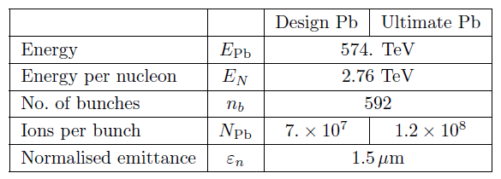
Luminosity estimate for e-Pb in Ring-Ring (1)
Assume design Pb beam, 100 ns bunch spacing
  more or less achieved although 200 ns may be better and 100 ns not yet used in LHC
  Same geometric beam size as nominal protons so easy to take over optics and luminosity considerations
  In practice Pb more blown up by IBS at injection
  Since e-A physics focused on low x, using the RR High Acceptance (1° optics)

Slide 6
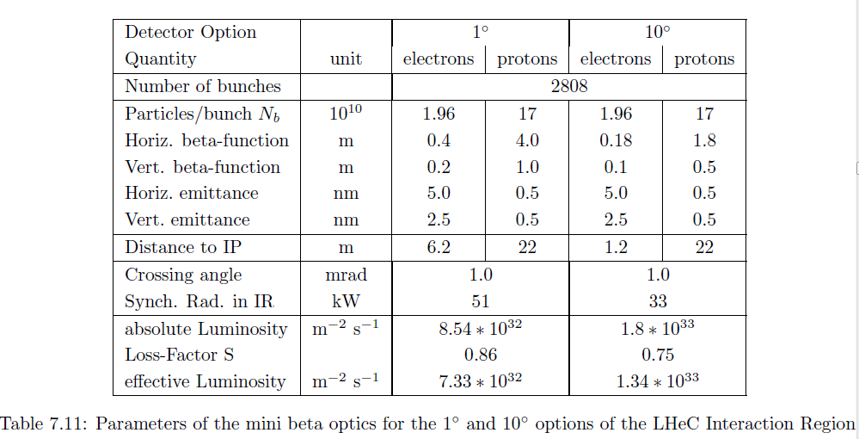
Luminosity estimate for e-Pb in Ring-Ring (2)
  Assume e- injectors can create matching bunch train
  Increase electron bunch intensity by factor 2808/592 to use the have same total current and total RF power
9.5

Slide 7

Luminosity estimate for e-Pb in Ring-Ring (3)
This gives us an idea of the peak luminosity that can be expected electron-nucleon luminosity
N.B. electron-nucleus luminosity (usually quoted for Pb-Pb at LHC) is 208 times less
Can hope for more with an upgraded (more bunches? cooled?) Pb beam
Luminosity lifetime determined by intensity decay of Pb due to Pb-Pb collisions in LHC (about twice Pb-Pb value)
Could be higher in dedicated e-A mode
  Even growing luminosity thanks to strong radiation damping for Pb ions (twice that of protons)

Slide 8
Electron-deuteron (e-D) collisions
No deuteron beams in present CERN complex
Linac4 cannot accelerate D, even with a D- source
Linac2 should be shut down, eventually
Only possibility with existing accelerators is to use present heavy ion Linac3
  Requires new D source, RFQ, switchyard,
  Several years’ lead time to develop
  Uncertain how LEIR would perform with D
  Present studies of new light ion source (He to Ne) under way (medical use of LEIR), might be extended to D if officially requested (presently no formal request for LHC)
Possible alternative (D. Kuchler): cyclotron injecting ~1 mA D directly to PS synchrotron
  Could be cheaper, even table-top if injecting to LEIR

Slide 9
Luminosity estimate for e-D (1)
Very rough for now … help from D. Kuchler
However, this gives a big margin in fields and there are no losses from stripping.
If source is intense enough and losses in Linac can be tolerated, can hope for 200-500 µA at end of linac (with somewhat degraded beam quality).
Take safety reduction factor 5 for unknowns in PS, SPS, etc.

Slide 10
Luminosity estimate for e-D (2)
Again assume similar geometrical emittances as for p and Pb
Assume electron beam as for Pb
Can hope for electron-nucleon luminosity of order
Perhaps a few times more with cyclotron option, etc.

Slide 11
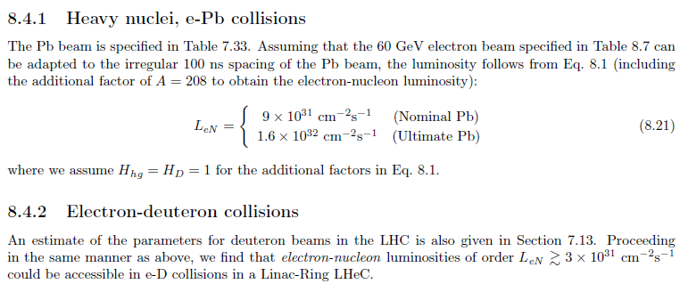
Luminosity estimate for e-Pb in Linac-Ring (1)
Verify ERL frequency tunability for p → Pb bunch frequency in LHC
  Very small, probably OK

Slide 12
Future work
Ensure that capabilities of HI injector chain and LHC are maintained / upgraded up to LHeC era
  High Pb intensity at high energy (collimation losses in LHC, losses from luminosity at LHC experiments, …)
  Cooling of HI beams in LHC (stochastic cooling, coherent electron cooling, …) ?
Launch studies for deuteron source and performance of injector chain (Linac3 to SPS)
Evaluate performance at lower electron beam energy
  N. Armesto’s talk

Slide 13
Summary
Assuming that the electron beams can be adapted to the filling scheme of the LHC’s heavy ion beams, the LHeC could operate as an electron-ion collider in parallel with normal operation as heavy-ion collider
  Integrated luminosity could be better in dedicated mode
Deuterons require a study on source and pre-injectors to be started with several years lead time
⁴He beams may be easier if acceptable for physics ??

