Slide 1
Warm magnets for LHeC
Attilio Milanese
14 Jun. 2012

Slide 2
Overview
Ring-Ring magnets
dipoles
quadrupoles
Linac-Ring magnets
dipoles
quadrupoles
Conclusion and discussion
Many thanks to Davide Tommasini, Miriam Fitterer and Alex Bogacz for the optics, the colleagues of TE-MSC and BINP that built and measured the dipole models, and Neil Marks.

Slide 3
RR dipoles: requirements and challenges
number of magnets | 3080
free aperture | 90×40 mm²
flux density | 0.0127 T (10 GeV) to 0.0763 T (60 GeV)
magnetic length | 5.35 m
field quality | 2·10⁻⁴ in GFR of ±10×6 mm²
field reproducibility at inj. | better than ±0.1·10⁻⁵ T
LEP main dipoles:
5.75 m per core × 3280 cores (steel/concrete length 27%)
gap 100 mm, flux density 0.0220 T (20 GeV) to 0.1100 T (100 GeV)
Challenges
compact and light magnets, to fit in the existing LHC tunnel
sufficient mechanical stability in a light structure
compatible with emitted synchrotron radiation
satisfactory field homogeneity from injection to collision energy
satisfactory field reproducibility from cycle to cycle

Slide 4
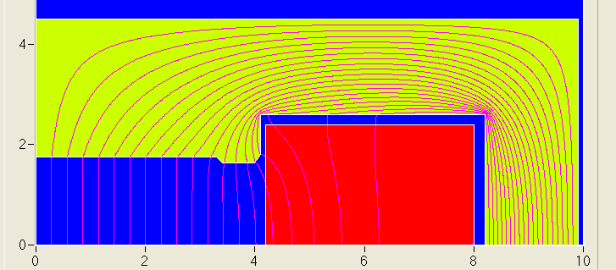
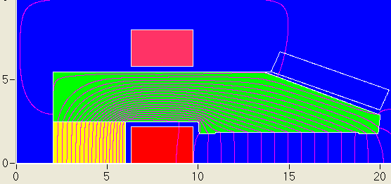
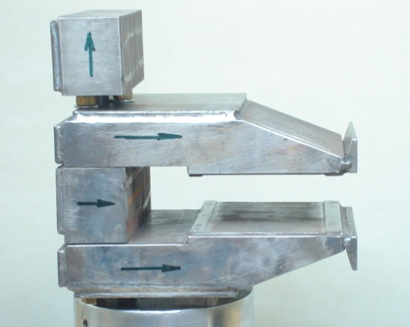
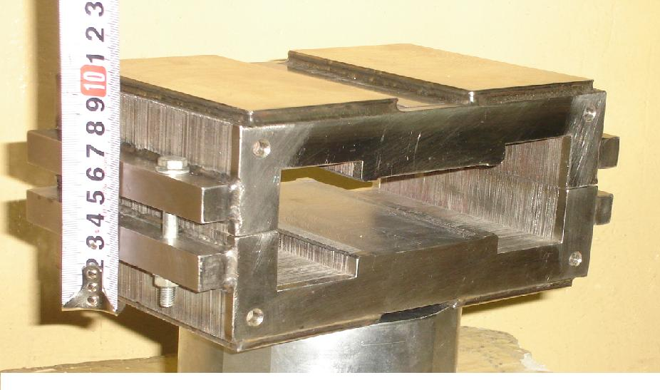
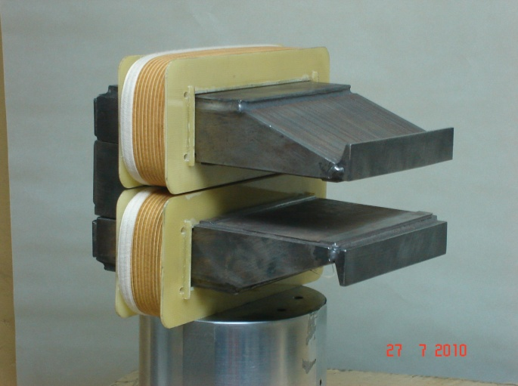
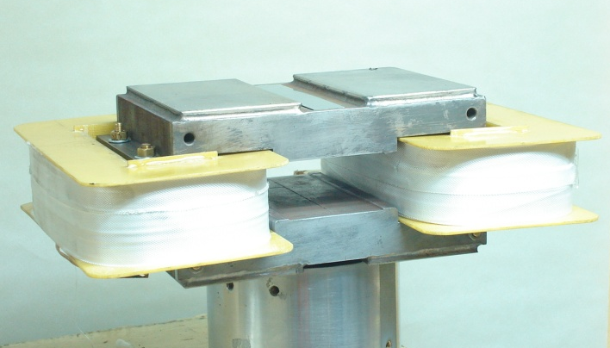
RR dipoles: BINP models
3408 grain oriented steel
0.35 mm thick laminations
22 A/m
6 A/m
After cycles of different amplitude, the remanent field is of about 1 Gauss in all cases.
The measured reproducibility of the injection field is about ± 0.075 Gauss.

Slide 5
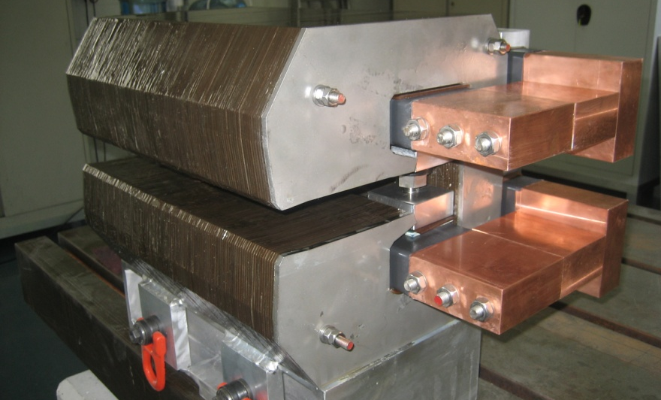
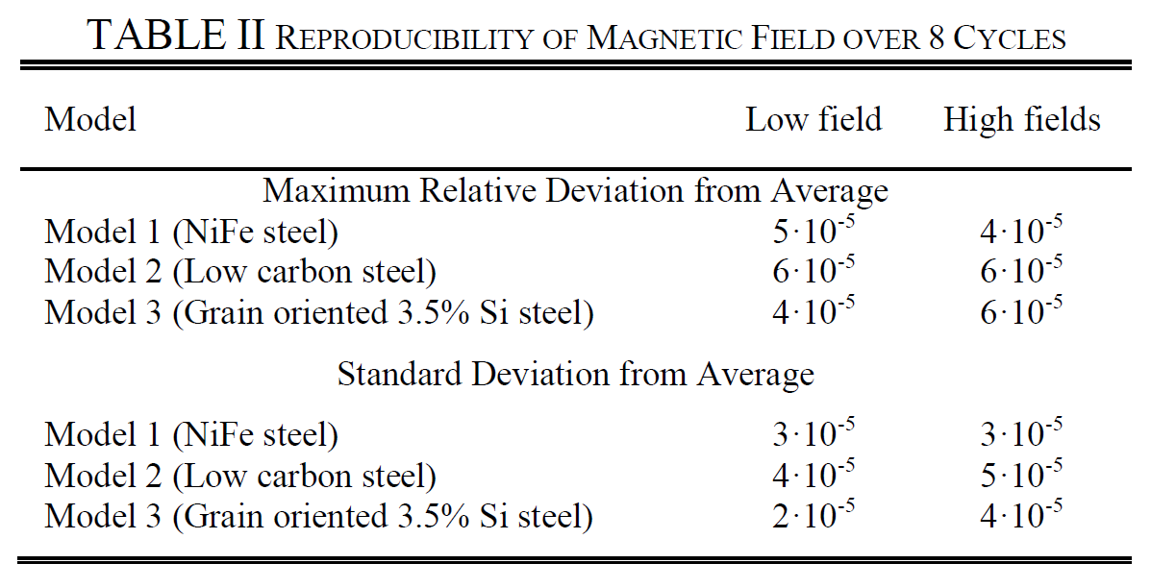
RR dipoles: CERN models
one-turn conductor, air cooled
interleaved laminations (1 mm iron, 2 mm plastic)
Three 400 mm long models with different types of iron:
NiFe, H_{c} < 6 A/m
low C, H_{c} ≈ 70 A/m
grain oriented, H_{c} ≈ 7-22 A/m
Within this range of field levels the value of H_{c} does not seem to play a major role in the cycle to cycle reproducibility and all three models meet the LHeC specifications.

Slide 6
RR dipoles: design
beam energy | 10 to 60 GeV
flux density in the centre | 0.0127 to 0.0763 T
magnetic length | 5.35 m
vertical aperture | 40 mm
pole width | 150 mm
mass | 1400 kg
number of magnets | 3080
current @ 0.0763 T | 1300 A
number of turns per pole | 1
current density @ 0.0763 T | 0.4 A/mm²
conductor material | Aluminium
inductance | 0.13 mH
resistance | 0.18 mΩ
power @ 60 GeV | 300 W
total power @ 60 GeV | 0.92 MW
cooling | Air

Slide 7
RR quadrupoles: requirements
Arc | QF | QD
number of magnets | 336 | 336
aperture radius | > 20 mm | > 20 mm
maximum gradient | 10.28 T/m | 8.40 T/m
magnetic length | 1.0 m | 1.0 m
Insertion / by-pass | QF | QD
number of magnets | 148 | 148
aperture radius | > 20 mm | > 20 mm
maximum gradient | 18 T/m | 18 T/m
magnetic length | 1.0 m | 0.7 m
Compactness is needed in particular for the arc quadrupoles.

Slide 8
RR quadrupoles: design (arc)
beam energy | 10 to 60 GeV
field gradient @ 60 GeV (QF/QD) | 10.28 / 8.40 T/m
magnetic length | 1.0 m
aperture radius | 30 mm
pole width | 32 mm
mass | 400 kg
number of magnets (QF/QD) | 336 / 336
current @ 60 GeV | 380 / 310 A
number of turns per pole | 10
current density @ 60 GeV (QF/QD) | 4.0 / 3.3 A/mm²
conductor material | copper
inductance | 4 mH
resistance | 16 mΩ
power @ 60 GeV (QF/QD) | 2.3 / 1.5 kW
total power @ 60 GeV (QF/QD) | 0.77 / 0.52 MW
cooling | water

Slide 9
RR quadrupoles: design (insert. & by-pass)
beam energy | 10 to 60 GeV
field gradient @ 60 GeV | 19 T/m
magnetic length (QD/QF) | 1.0 / 0.7 m
aperture radius | 30 mm
pole root width | 58 mm
mass (QD/QF) | 560 / 390 kg
number of magnets (QD/QF) | 148 / 148
current @ 19 T/m | 420 A
number of turns per pole | 17
current density @ 19 T/m | 4.6 A/mm²
conductor material | copper
inductance (QD/QF) | 15 / 10 mH
resistance (QD/QF) | 30 / 23 mΩ
power @ 19 T/m (QD/QF) | 5.3 / 3.9 kW
total power @ 19 T/m (QD/QF) | 0.78 / 0.58 MW
cooling | water

Slide 10
LR dipoles: requirements
 | # | flux density [T] | length [m]
Arc 1 (10.5 GeV) | 584 | 0.046 | 4.0
Arc 2 (20.5 GeV) | 584 | 0.089 | 4.0
Arc 3 (30.5 GeV) | 584 | 0.133 | 4.0
Arc 4 (40.5 GeV) | 584 | 0.177 | 4.0
Arc 5 (50.5 GeV) | 584 | 0.221 | 4.0
Arc 6 (60.5 GeV) | 584 | 0.264 | 4.0
Proposed solution
one type of bending magnets for the six arcs, possibly
with different conductors

Slide 11
LR dipoles: design (recirculator)
beam energy | 10.5 to 60.5 GeV
flux density in the centre | 0.046 to 0.264 T
magnetic length | 4.0 m
vertical aperture | 25 mm
pole width | 80 mm
mass | 2000 kg
number of magnets | 6 × 584 = 3504
current @ 60.5 GeV | 2700 A
number of turns per pole | 1
current density @ 0.264 T | 0.7 A/mm²
conductor material | copper
inductance | 0.08 mH
resistance | 0.08 mΩ
power @ 60.5 GeV | 585 W
total power 6 arcs (10.5 to 60.5 GeV) | 0.87 MW
cooling | air

Slide 12
LR quadrupoles: requirements
Linacs FODO Arcs FMC | Q0 |  |  | Q1 |  |  | Q2 |  |  | Q3
 | # | G [T/m] | L [m] | # | G [T/m] | L [m] | # | G [T/m] | L [m] | # | G [T/m] | L [m]
LINAC 1 | 18 | 2.2 | 1.0 |  |  |  | 18 | 2.2 | 1.0
LINAC 2 | 18 | 2.2 | 1.0 |  |  |  | 18 | 2.2 | 1.0
Arc 1 (10.5 GeV) | 60 | 3.2 | 1.0 | 60 | 10.5 | 1.0 | 60 | 11.1 | 1.0 | 60 | 10.5 | 1.0
Arc 2 (20.5 GeV) | 60 | 6.2 | 1.0 | 60 | 20.5 | 1.0 | 60 | 21.6 | 1.0 | 60 | 20.6 | 1.0
Arc 3 (30.5 GeV) | 60 | 12.4 | 1.0 | 60 | 17.5 | 1.0 | 60 | 24.6 | 1.0 | 60 | 17.9 | 1.0
Arc 4 (40.5 GeV) | 60 | 16.5 | 1.0 | 60 | 23.2 | 1.0 | 60 | 32.6 | 1.0 | 60 | 23.8 | 1.0
Arc 5 (50.5 GeV) | 60 | 29.2 | 1.0 | 60 | 28.9 | 1.0 | 60 | 40.8 | 1.0 | 60 | 29.7 | 1.0
Arc 6 (60.5 GeV) | 60 | 35.0 | 1.0 | 60 | 34.6 | 1.0 | 60 | 48.9 | 1.0 | 60 | 35.5 | 1.0
Proposed solution
one type of quadrupoles for the Linacs
one type of quadrupoles for the arcs in two different lengths
Q2 1.2 m
Q0, Q1 and Q3 0.9 m

Slide 13
LR quadrupoles: design (recirculator)
beam energy | 10.5 to 60.5 GeV
field gradient | 41 T/m
magnetic length (short/long) | 0.9 / 1.2 m
aperture radius | 20 mm
pole root width | 57 mm
mass (short/long) | 750 / 980 kg
number of magnets (Q0+Q1+Q2+Q3) | 6 × 240 = 1440
current @ 41 T/m | 400 A
number of turns per pole | 17
current density @ 41 T/m | 4.8 A/mm²
conductor material | copper
inductance (short/long) | 17 / 22 mH
resistance (short/long) | 30 / 40 mΩ
power @ 60.5 GeV (short/long) | 4.8 / 6.4 kW
total power 6 arcs (10.5 to 60.5 GeV) | 3.17 MW
cooling | water

Slide 14
LR quadrupoles: design (linac)
field gradient | 10 T/m
magnetic length | 0.250 m
aperture radius | 70 mm
pole root width | 78 mm
mass | 440 kg
number of magnets | 37 + 37 = 74
current @ 10 T/m | 460 A
number of turns per pole | 44
current density @ 10 T/m | 5.0 A/mm²
conductor material | copper
Inductance | 24 mH
resistance | 25 mΩ
power @ 10 T/m | 5.3 kW
cooling | water

Slide 15
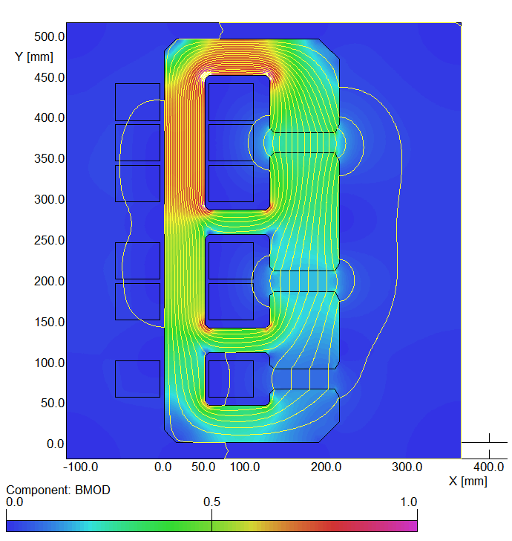
LR dipoles: three apertures (not in the CdR)
First conceptual cross-section
flux density in the gaps | 0.264 T 0.176 T 0.088 T
magnetic length | 4.0 m
vertical aperture | 25 mm
pole width | 85 mm
number of magnets | 584
current | 1750 A
number of turns per aperture | 1 / 2 / 3
current density | 0.7 A/mm²
conductor material | copper
resistance | 0.36 mΩ
power | 1.1 kW
total power 20 / 40 / 60 GeV | 642 kW
cooling | air

Slide 16
Conclusion
RR magnets
For the dipoles, several short models have been built at BINP and at CERN. The reproducibility of the (low) injection field has been met. The CERN design is light and compact, but an optimization of its support (considering structural, logistic and economic constraints) would be important.
LR recirculator magnets
These magnets are operated in DC and, at this stage, do not represent an issue. Other solutions (for example involving multiple apertures or permanent magnets) can be investigated.

Slide 17
Discussion / next steps
LR recirculator dipoles and quadrupoles
New requirements (aperture, field)?
Use of permanent magnets?
Combined apertures?
Combined functions (for example, dipole + quad)?
LR linac quadrupoles and correctors
New requirements (aperture, field)?
More compact magnets, maybe with at least two
families for quadrupoles?
Permanent magnets / superconducting for quads?
Magnets for ERL test stand?

Slide 18
Thank you.

