Slide 1
Spin Rotator for LHeC: Ring-LINAC Option
M. Bai, C-A Department
Brookhaven National Lab, Upton, NY

Slide 2
Outline
Introduction
  LHeC requirement
Options
  Low energy spin flipper
  HERA type
  RHIC type
Conclusion

Slide 3
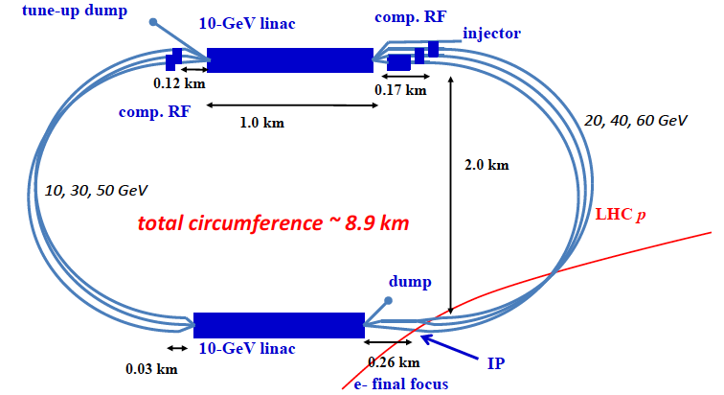
Requirement on polarized electron beam
Longitudinally polarized 60 GeV electron beam at IP

Slide 4
Spin motion of e Beam in ERL
For a spin vector in the horizontal plane, it precesses at its nth path through arcs by
G = 0.00115
energy gain per turn
γ_{i} is the initial energy
Beam Energy[GeV] | Φ [degrees] | Spin direction before IP
20 | 14.64 | 120.6
40 | 242.0 | 348.0
60 | 359.1 | 105.1

Slide 5
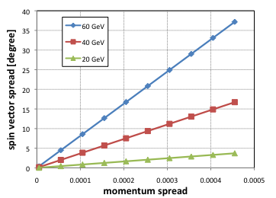
Option 1: Low Energy Spin Rotator
Wien-filter in the injector to control the spin direction
  Pros: economical and straightforward
  Cons: spin spread due to different
  amount of spin rotation for
  particles with different
  energy, ie. momentum
  spread
Spin rotation by an magnetic field

Slide 6
Option 2: High Energy Spin Rotator
Low energy spin rotator to bring
High energy
Spin rotator
Final dipole

Slide 7
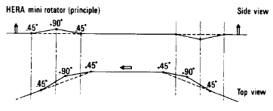
HERA Spin Rotator: Steffen
Consists of a series of dipoles
-H
-V
H
H
-H
-V
V
V

Slide 8
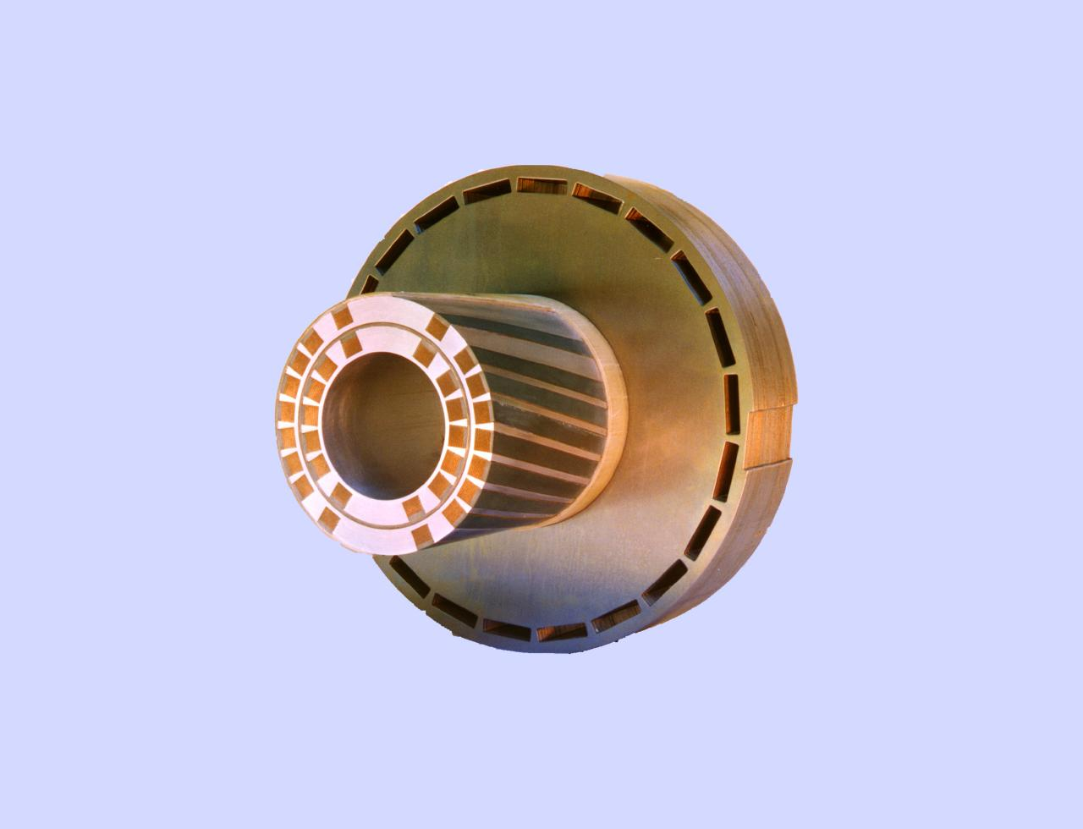
RHIC Spin Rotator
Consists of four helical dipoles to rotate spin vector by 90 degrees around an axis in the horizontal plane
2.4m
For each helical dipole,

Slide 9

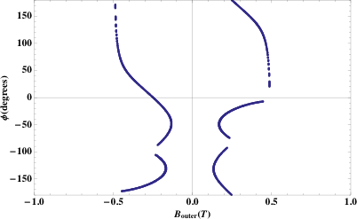
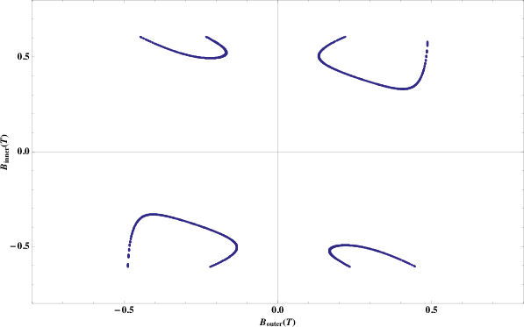
High Energy Spin Rotator: RHIC Type
For each helical, L = 15 m
Total length: ~ 60 m
B inner
Angle of spin vector from longitudinal at IP[degrees]
B outer
B outer = 0.46 T
B inner = 0.37 T
SR power = 0.31 Mwatt

Slide 10
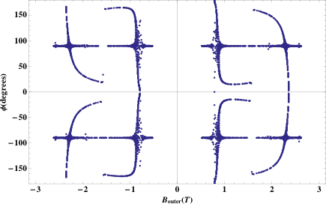
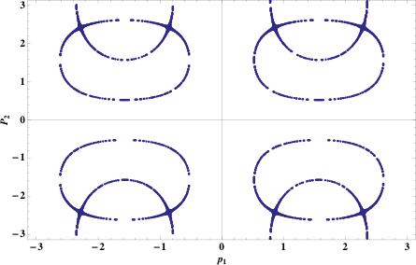
High Energy Spin Rotator: HERA Type
Each dipole is 5 meter long, total length is ~40 m
Angle of spin vector from longitudinal at IP[degrees]
Spin rotation of the 1st V bend [rad]
BH = 0.67 T
BV = 0.68 T
SR power = 0.81 Mwatt

Slide 11
High Energy Spin Rotator: Modified HERA Type
Each dipole is 5 meter long, total length is ~60 m
-H
-V
-H
-V
H
H
-H
-v
-H
-v
y
y
Spin rotation of the 1st V bend [rad]
BH = 0.46 T
BV = 0.56 T
SR power = 0.39 Mwatt

Slide 12
Summary
High energy spin rotator options
 | Length of spin rotator [m] | Maximum orbit excursion [mm] | SR power [Mwatt]
RHIC type | 60 | 82 | 0.31
HERA type | 40 | >100 | 0.81
Modified HERA type | 60 | >100 | 0.39
It is a challenge of building a spin rotator for 60 GeV e beam
With the same space, RHIC type seems to be more practical and flexible for controlling the spin direction at IP
Needs more detailed study on how to meet the SR budget

