Slide 1

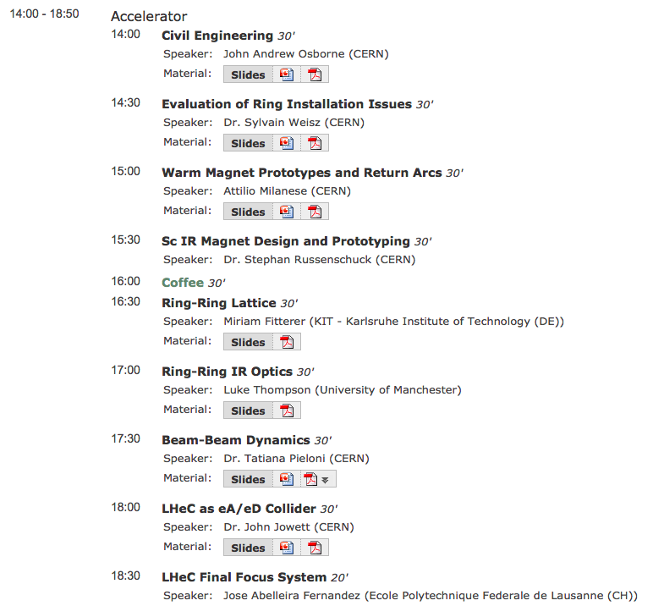
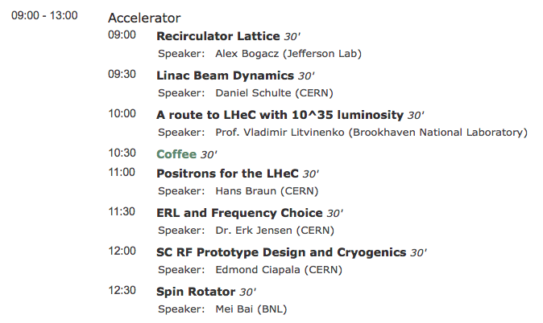
LHeC
16 Presentation
Impressive Progress for RR and LR!
Most of the Work done on Good Will
and during ‘free’ time
Large Thanks to Everybody!!
(CERN staff & external collaborators)
LHeC Workshop, 14th – 15th June 2012, Chavannes de Bogis
Oliver Brüning, CERN
1

Slide 2
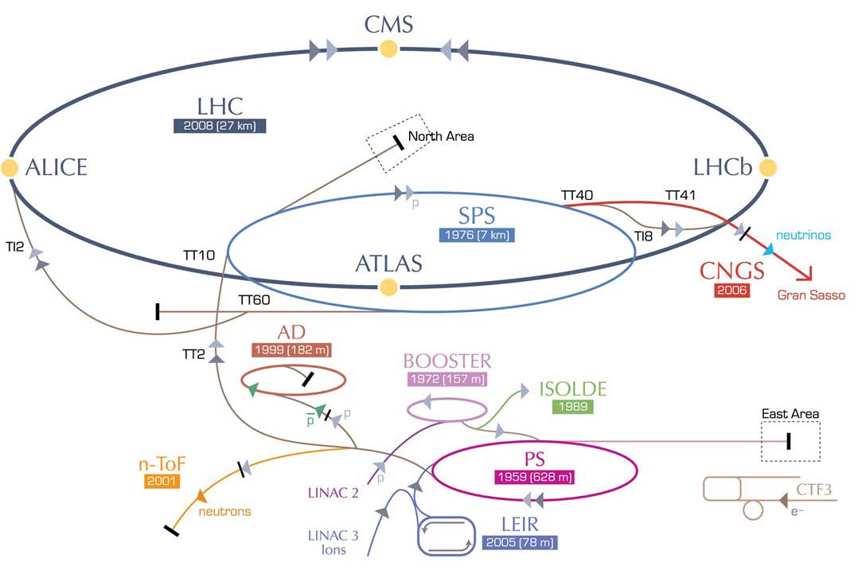
LHeC options: RR and LR
RR LHeC:
new ring in
LHC tunnel,
with bypasses
around
existing
experiments
RR LHeC
e-/e+ injector
10 GeV,
10 min. filling time
LR LHeC:
recirculating
linac with
energy
recovery,
or straight
linac
Frank Zimmermann, UPHUK4 Bodrum 2010
2

Slide 3
Two LHeC Options
Ring-Ring:
-Confident to reach luminosity goal
-Proven technology for most part
-Integration and cohabitation with HL-LHC
-Bypass length (LHCb?) and ring position in tunnel
-Timing and schedule
-Polarization
Linac-Ring:
-Construction to large extend decoupled from LHC operation
-New infrastructure and long term asset
-Challenging and new technology (SC RF & SC magnets)
-Positrons
Both options demonstrated general feasibility (provided technical components are validated in R&D)
➔ the final decision on LR versus RR is driven by schedule and integration issues
Will focus summary on these issues
LHeC Workshop, 14th – 15th June 2012, Chavannes de Bogis
Oliver Brüning, CERN
3

Slide 4
LHeC Technology Requirements
Warm magnets:
-Compact & light weight & high reproducibility ✔
Cold magnets:
-SC mirror magnets & aperture for non-colliding beams ✔
-High gradient ➔ Nb3Sn technology & mechanical stress
➔ R&D
SC RF:
-Frequency Choice!
-High Q₀ cavities with CW operation
-BI and feedbacks for ERL operation
LHeC Workshop, 14th – 15th June 2012, Chavannes de Bogis
Oliver Brüning, CERN
4

Slide 5
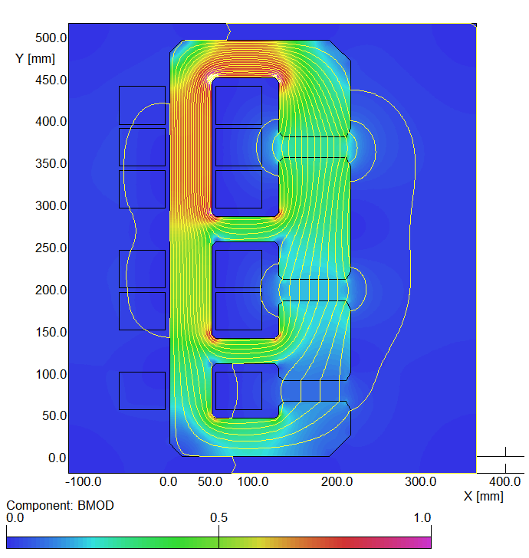
LR dipoles: three apertures (not in the CdR)
First conceptual cross-section
flux density in the gaps | 0.264 T 0.176 T 0.088 T
magnetic length | 4.0 m
vertical aperture | 25 mm
pole width | 85 mm
number of magnets | 584
current | 1750 A
number of turns per aperture | 1 / 2 / 3
current density | 0.7 A/mm²
conductor material | copper
resistance | 0.36 mΩ
power | 1.1 kW
total power 20 / 40 / 60 GeV | 642 kW
cooling | air

Slide 6
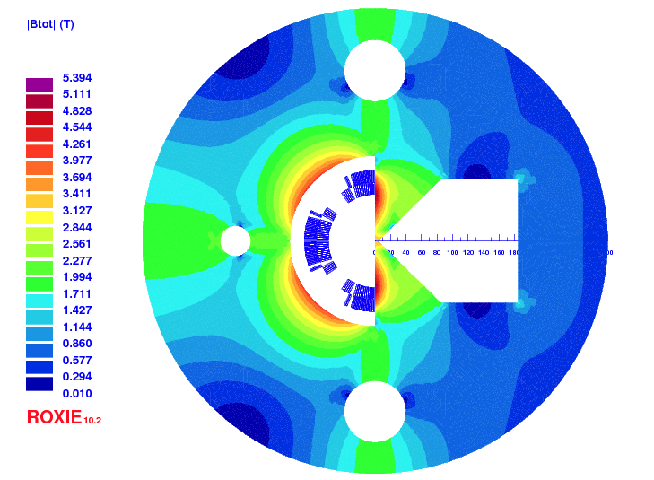
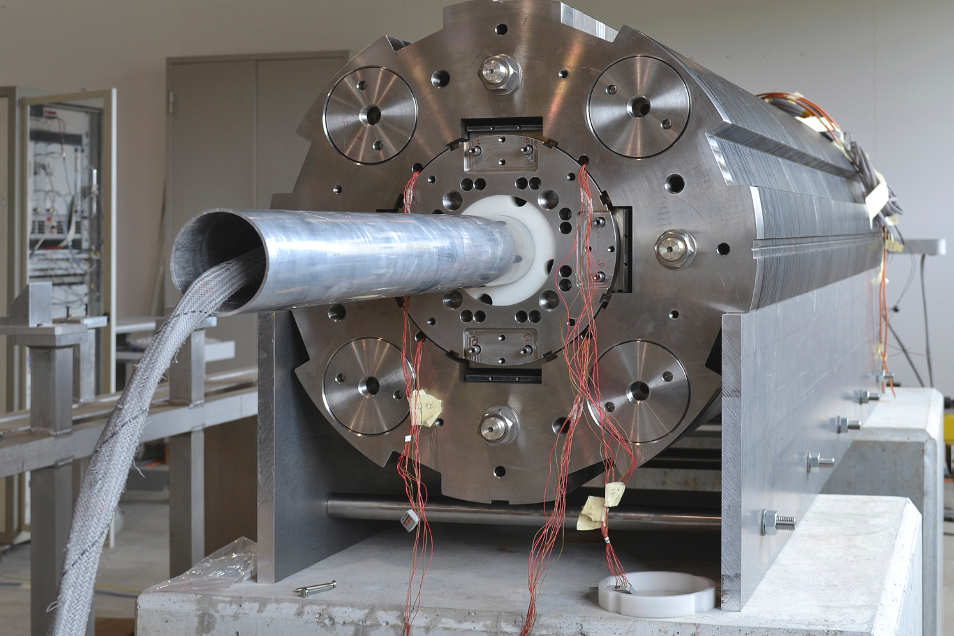
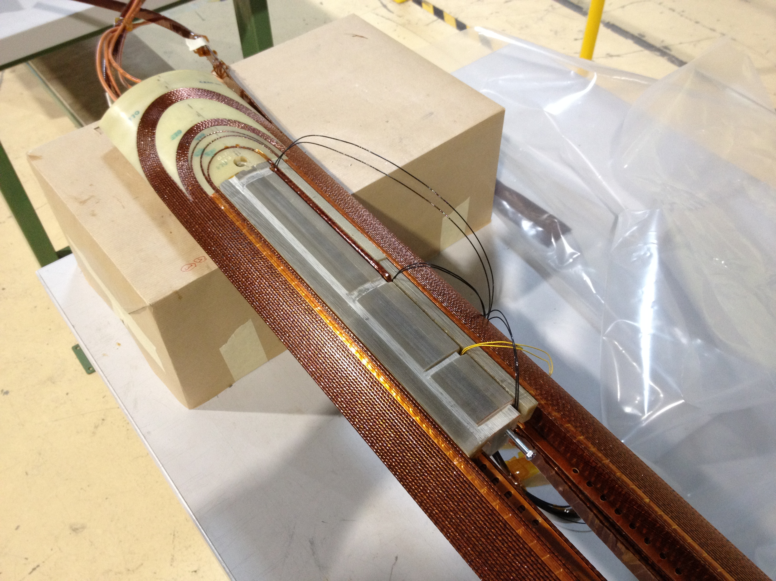
Model Magnet with MQXC (LHC Upgrade Option)
Gradient of 97 T/m and 2.7 T dipole field compared to 120 T/m achieved with MQXC (full) quadrupole but
Not so far from the conceptual design using MQY cable (110 T/m)
Conductor, end-spacers, winding and curing tooling available

Slide 7
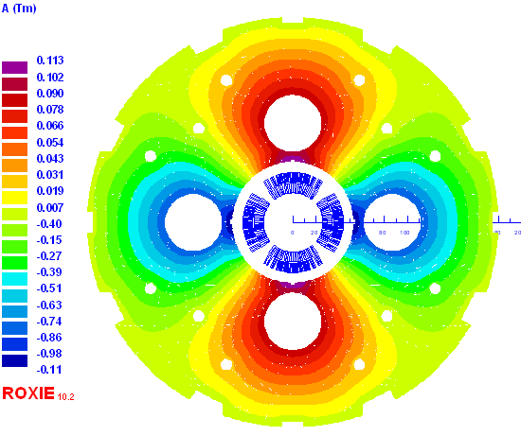
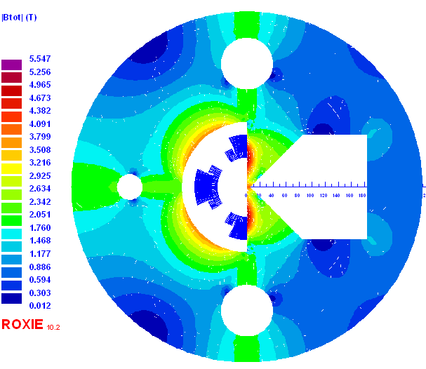
Linac-Ring Nb3Sn
Q2
Q1
8600 A, 311 T/m, at 78% on load-line | 5700 A, 175 T/m, 4.7 T at 79% on LL (4 layers)
23 mm aperture 87 mm beam separation | 46 mm (half) aperture 57 mm beam separation
0.09 T, 9 T/m in p1/e-beam pipe | 0.5 T, 25 T/m in p1/e-beam pipe

Slide 8
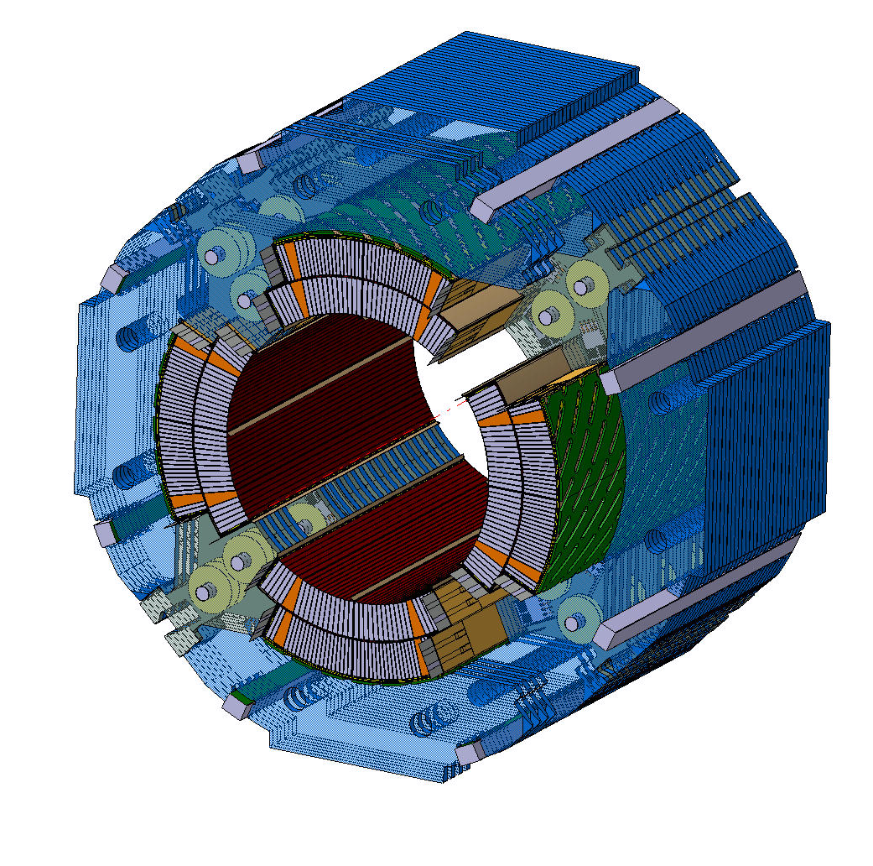
Conclusion
Ring-ring option: Nb-Ti magnets can be built with LHC cable (either MQY cable [stock?] or LHC main dipole cable [if not used for the Upgrade Triplets]). Single aperture magnet is a straight-forward engineering design effort, mirror quad requires validation with a short model.
Consider building a full-scale model (2-m-long) with MQXC like coils (CEA-Saclay has tooling).
Linac-ring option: Nb3Sn technology requires R&D efforts (synergies with LHC upgrade, Fresca II, US-LARP). Long lead times for the production of strands and cables, large tooling costs for coil production and curing.
Any decision must be based on outcome of said R&D efforts (milestone 2014-2015).
Consider increasing the beam separation (crossing angle) and lowering the gradient in Q1 (to limit saturation of the mirror). Check collision optics for field errors.
Serious model magnet (2-m-long) program required.

Slide 9
Which frequency?
700 MHz vs. 1300 MHz
Advantages 700 MHz
Advantages 1300 MHz
Synergy SPL, ESS, JLAB, eRHIC
Smaller BCS resistance
Less trapped modes
Smaller HOM power
Beam stability
Smaller cryo power
Power couplers easier
Synergy ILC, X-FEL
Cavity smaller
Larger R/Q
Smaller RF power (assuming same Q_{ext})
Less Nb material needed

Slide 10
LHeC Lattice and Optics Studies
Ring-Ring:
-Well advanced including studies on correction systems ✔
-Spin Rotators and SR
-Iteration on SR absorbers with spin rotators and doglegs
-Field quality specification for magnets (triplet)
Linac-Ring:
-Proof of principle IR ✔
-Integration of proton layout and optics with HL-LHC optics
-Correction circuits
-Field quality specifications for magnets (triplet)
-Beam dynamics and operation studies (still many new ideas!!!)
LHeC Workshop, 14th – 15th June 2012, Chavannes de Bogis
Oliver Brüning, CERN
10

Slide 11
Summary
(LHeC as Ion Collider)
Assuming that the electron beams can be adapted to the filling scheme of the LHC’s heavy ion beams, the LHeC could operate as an electron-ion collider in parallel with normal operation as heavy-ion collider
  Integrated luminosity could be better in dedicated mode
Deuterons require a study on source and pre-injectors to be started with several years lead time
⁴He beams may be easier if acceptable for physics ??

Slide 12
LHeC p-Ion collider
Personal comments:
RF tuneability for coping with different revolution frequencies of p & ions! ✔ (probably not an issue but needs to be looked at)
Ion program during HL-LHC phase without ALICE?
-CDR assumption was that LHeC runs parasitically to HL-LHC
LHeC Workshop, 14th – 15th June 2012, Chavannes de Bogis
Oliver Brüning, CERN
12

Slide 13
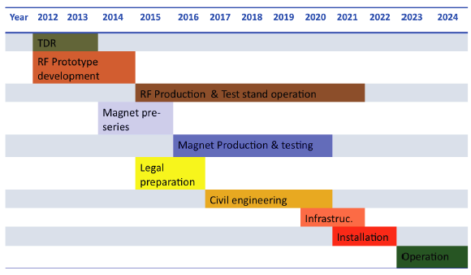
LHeC Tentative Time Schedule
LS3 --- HL LHC
LHeC Workshop, 14th – 15th June 2012, Chavannes de Bogis
Oliver Brüning, CERN
13

Slide 14
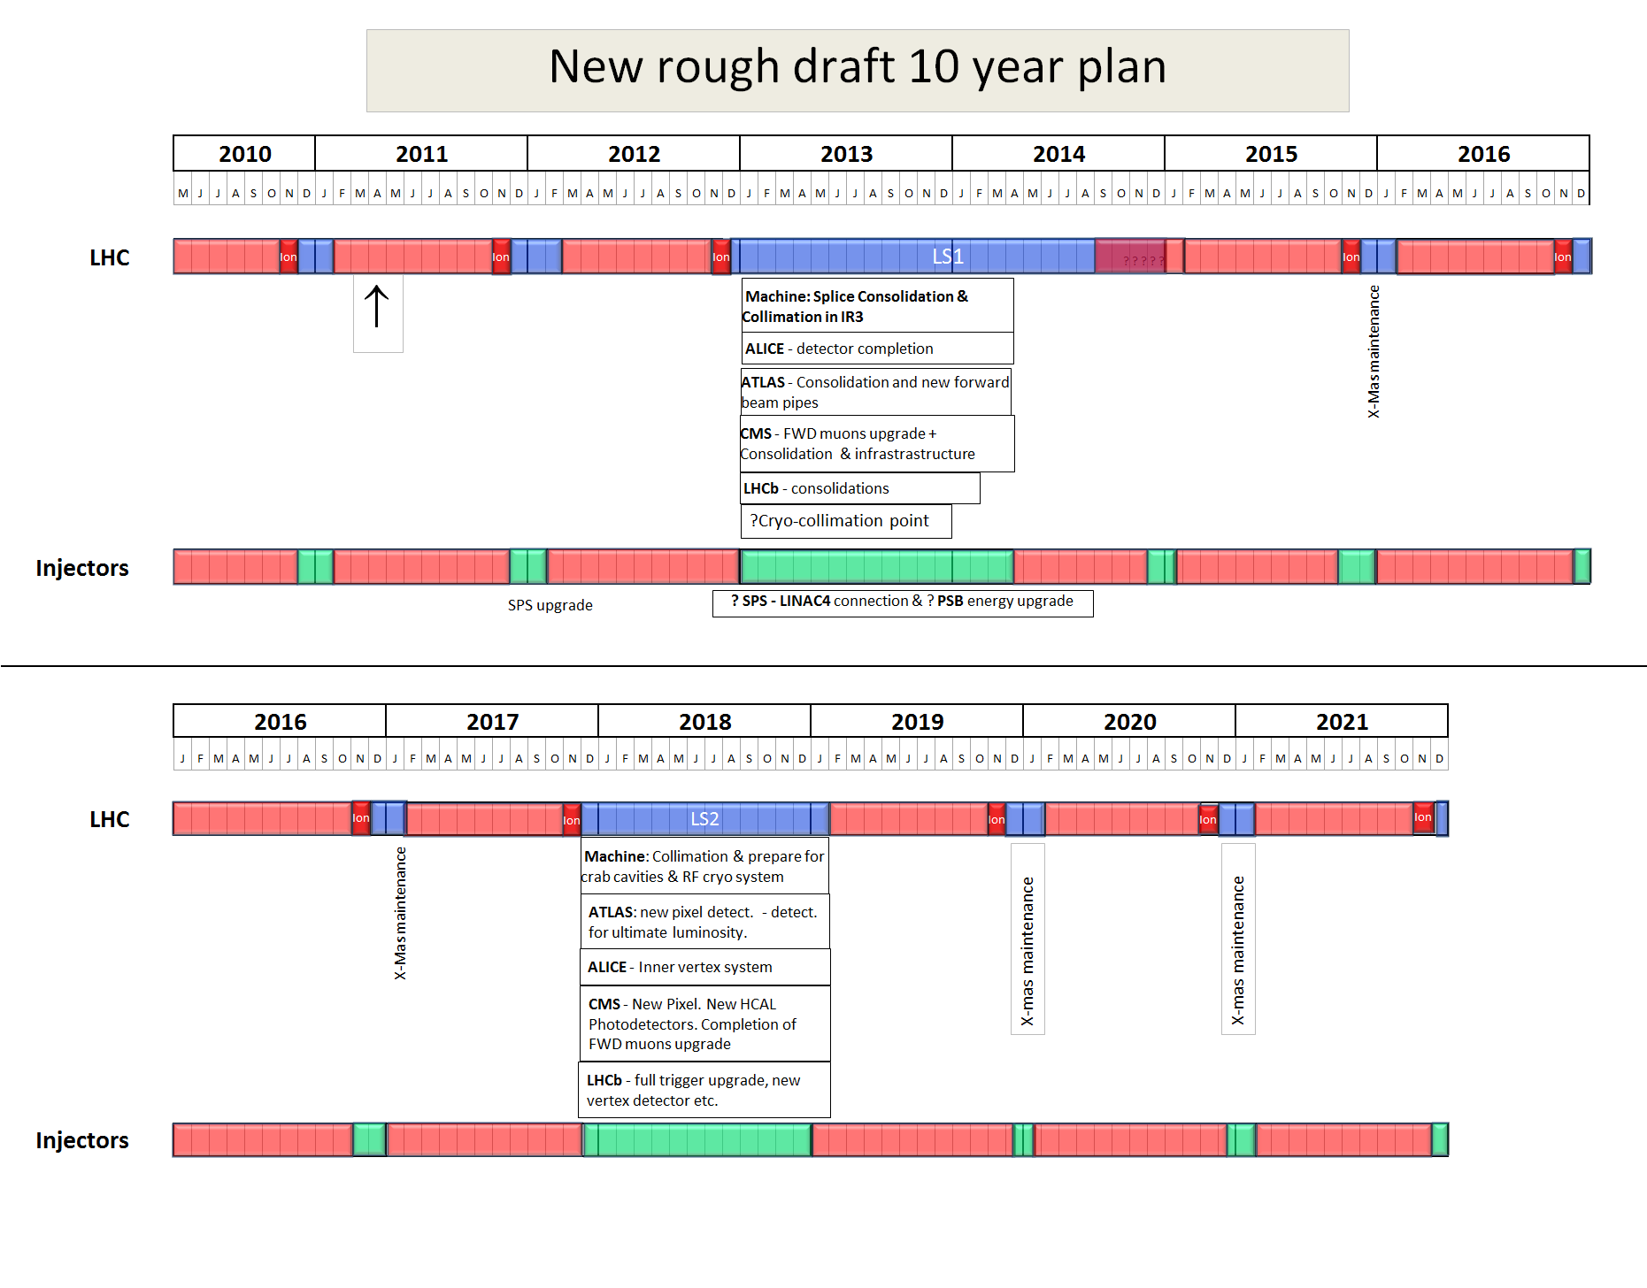
LS1 and LS2 too close to be effectively used for LHeC activities inside LHC tunnel!
Leaves essentially only one long shutdown for LHeC installation in / connection with
LHC tunnel
2022
LS3
Installation of the HL-LHC hardware Installation of LHeC Preparation for HE-LHC
LHeC Workshop, 14th – 15th June 2012, Chavannes de Bogis
Oliver Brüning, CERN
14

Slide 15
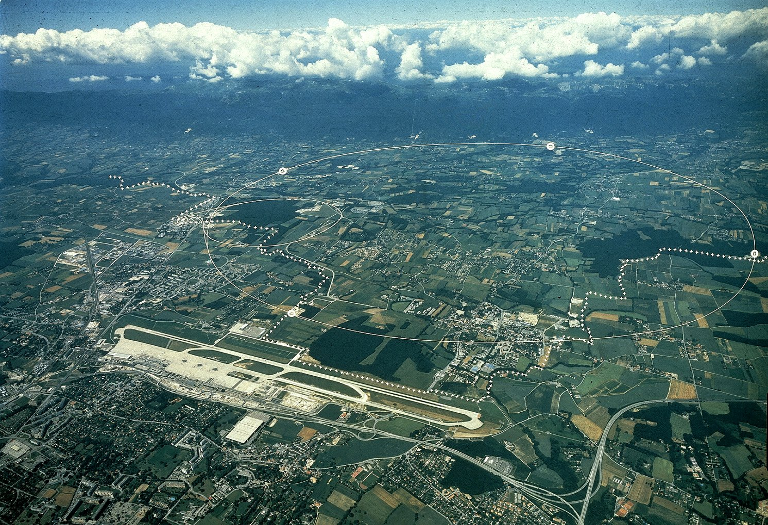
Site Features Location
Location: By-pass tunnels for Ring-Ring
Jura
P2 IR
P5
P1
bypass tunnels
bypass tunnels
Border
Bypass tunnel IR8?

Slide 16
Site Features Location
Location: Linac-Ring ERL
Jura
P2 IR
Border

Slide 17
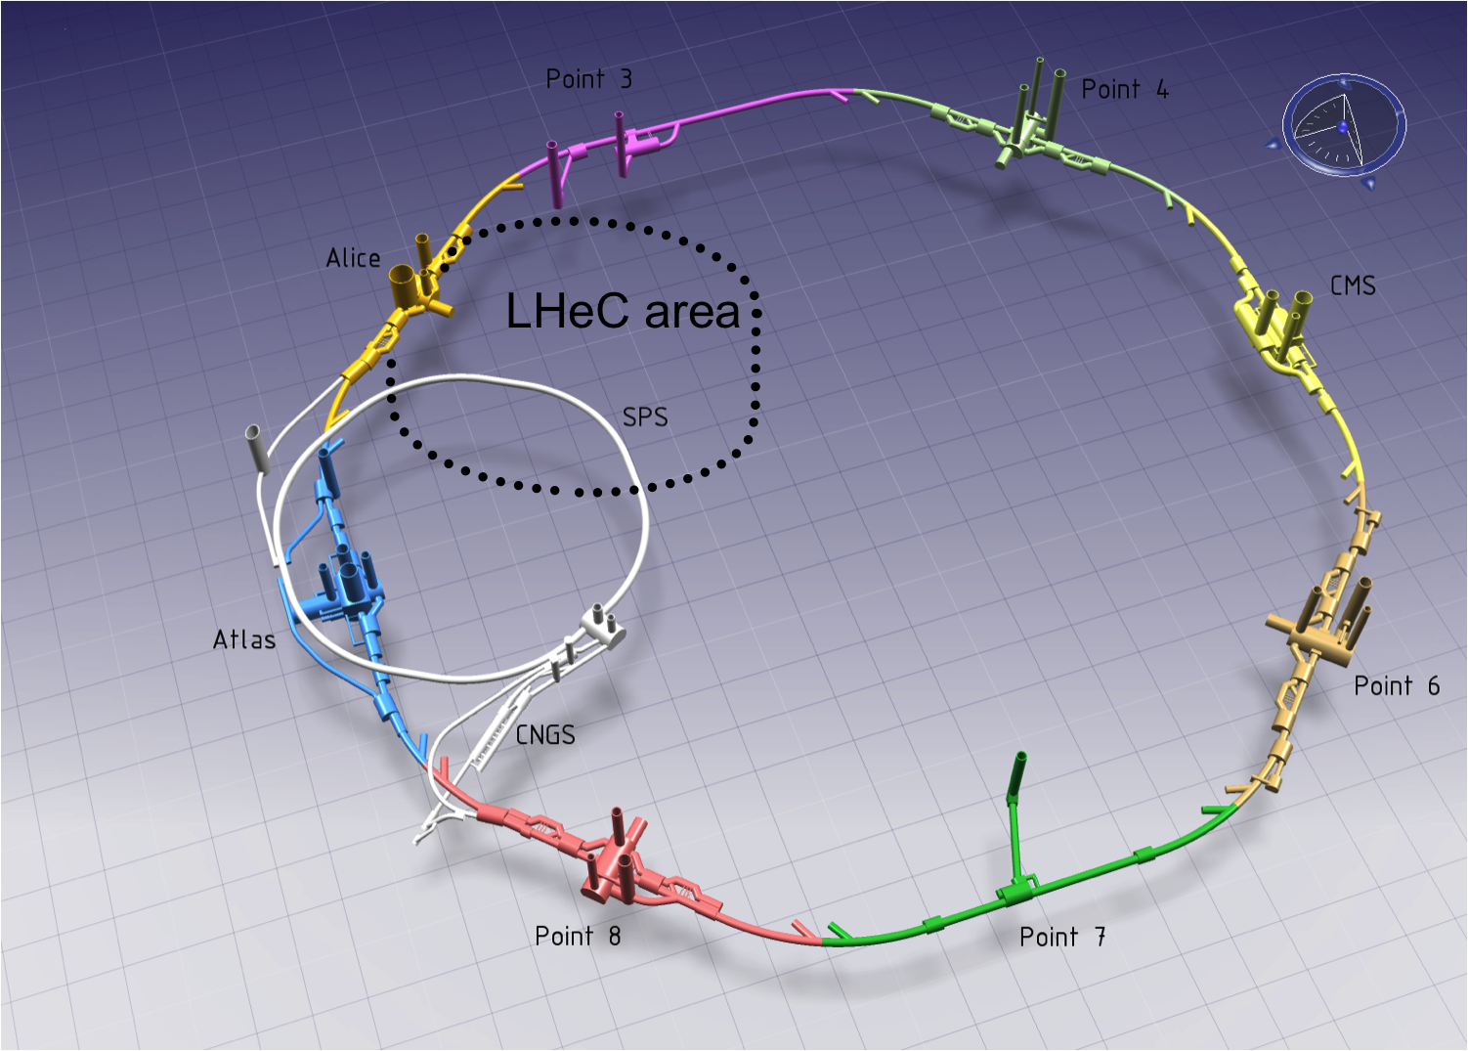
Civil Construction Linac-ring scheme
Linac– Ring: Injection point at P2
Tunnel mostly horizontal

Slide 18
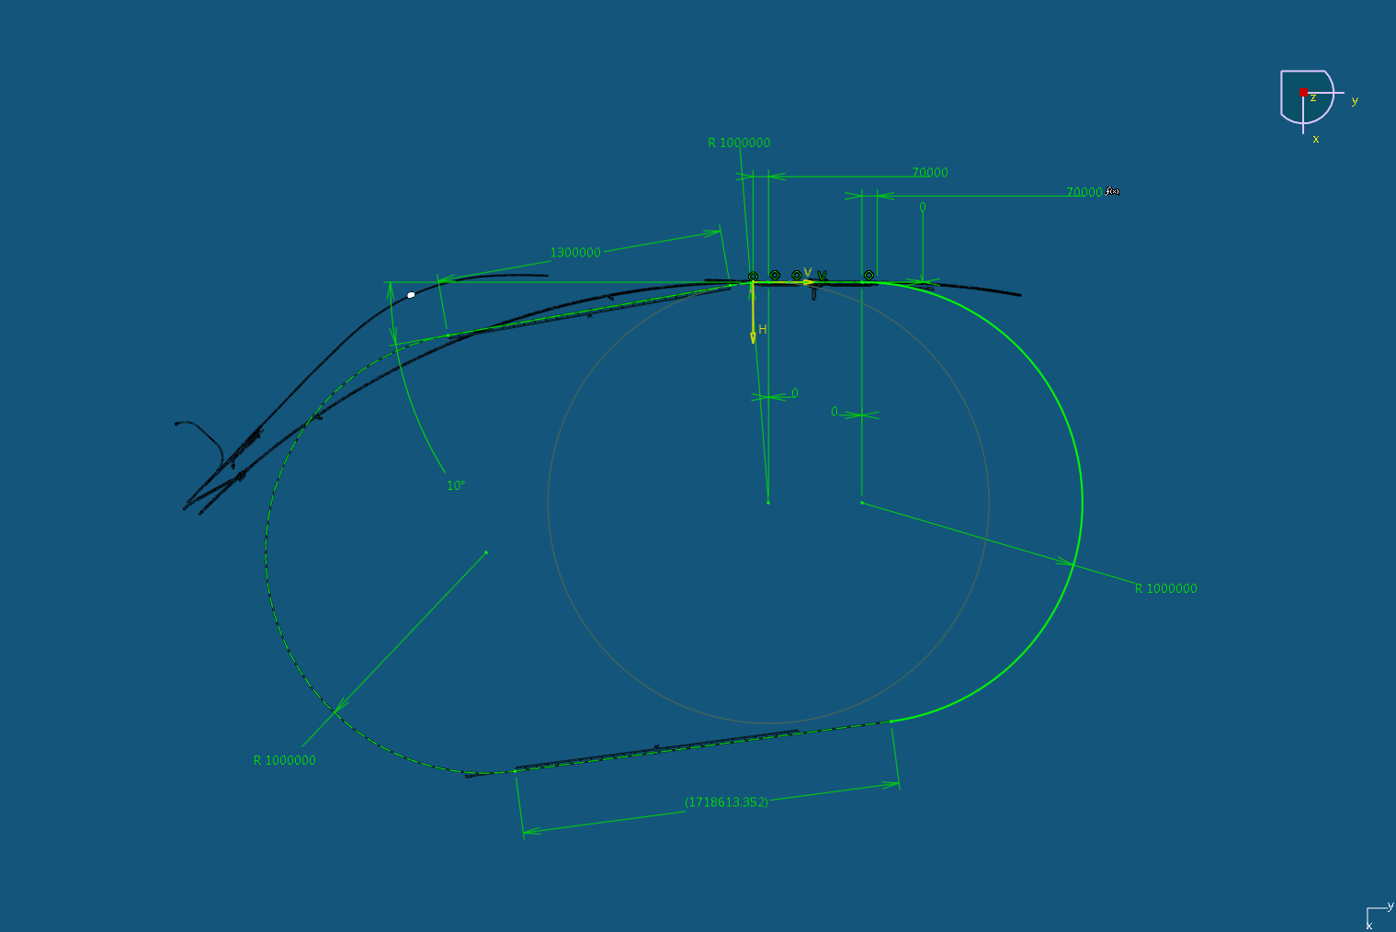
Linac– Ring: Dimensions

Slide 19
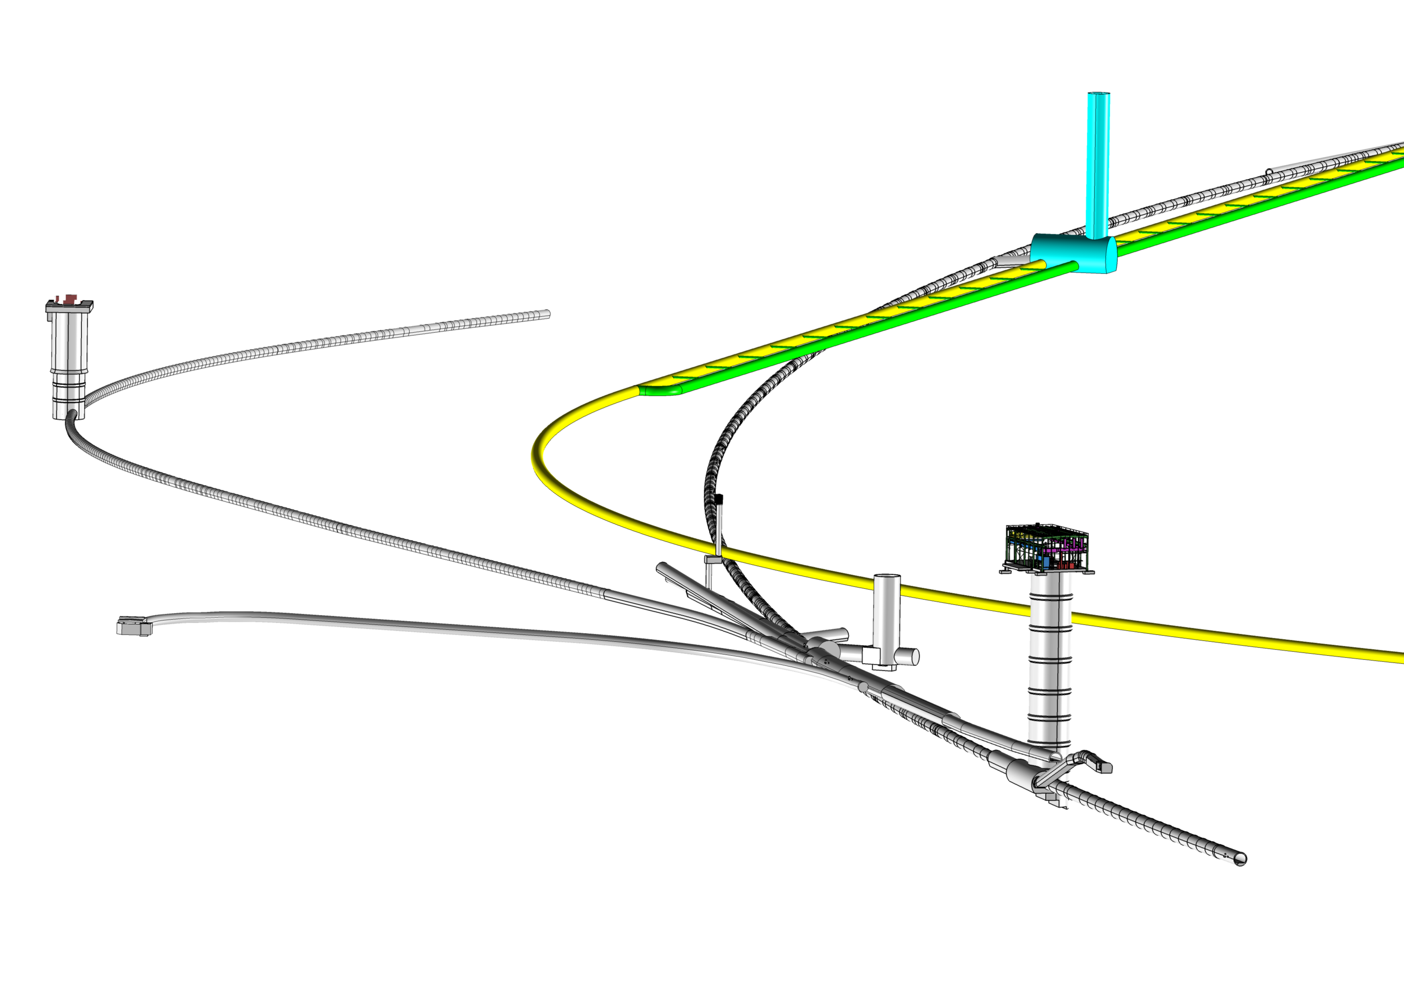
Civil Construction Linac-ring scheme
Linac– Ring:
PMI 2
TI 2
PM 18

Slide 20
Linac–Ring: Dimensions/Layout
J. Osborne
IP
Arc 6 (60 GeV)
Arc5 (50 GeV)

Slide 21

Costing and Planning Preliminary LHeC underground costs
 | Ring – Ring * |  |  | Linac-Ring
 | P1 (Atlas) | P5 (CMS) | Total |  | Total
Underground | 40,156 | 38,445 | 78,602 |  | 226,983
Consultancy | 4,059 | 3,886 | 7,946 |  | 22,945
Total KCHF | 44,216 | 42,331 | 86,547 |  | 249,928
* Ring-Ring costs do not include : Bypass tunnels at Point 8 (LHCb) or Injection Complex
No surface structures included in this cost estimate. Integration with other services (Cooling & Ventilation, Electricity etc) needed in the next phase to better define underground volumes and surface building requirements.
Cost estimation by Amberg Engineering.

Slide 22
Costing and Planning LHeC planning
LHeC construction planning | YEAR 1 | YEAR 2 | YEAR 3 | YEAR 4 | YEAR 5 | YEAR 6 | YEAR 7
Land negotiations
Environmental Impact Study
Building permits
Detailed design & tendering
Construction
4 year Construction schedule for either LHeC option:
Ring-ring:
  Assuming 2 roadheaders with excavation progress of 30m/week
Linac-Ring:
  Assuming 2 roadheaders and 1 shielded TBM (TBM excavation progress of 150m/week)

Slide 23
Conclusions & Next Steps for Civil Engineering
Both the Ring-Ring and Linac – Ring options are feasible.
  Ring-Ring: cheaper, but increased risk to LHC activity
  Linac-Ring: lower risk to LHC, but more expensive + more time needed for :
    building permits
    environmental impact study
More studies needed for
  Integration with all services (EL,CV, transport, survey etc).
  Geology
  Understanding vibration risks
  Environmental impact assessment
7 year program for CE works, so if machine is to be operational by 2023, dedicated CE team must be in place by 2014 !

Slide 24
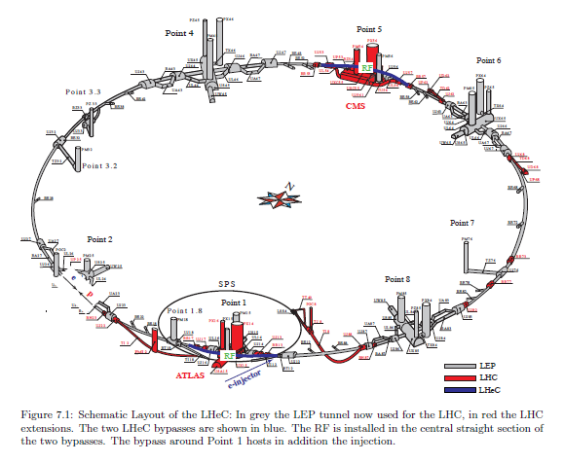
Geometry of the LHeC Ring-Ring option
Two by-passes foreseen in the CDR
CMS
LHCb
ATLAS
Need to consider a 3rd by-pass

Slide 25
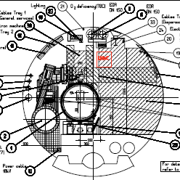
LHeC Ring-Ring Geometry:
compensation for additional by-pass lengths
e beam offset of 61cm / LHC mean axis
3rd by-pass length compensation
would move the beam ~30cm
further into the transport reserved area
Space originally allocated to a future e ring

Slide 26
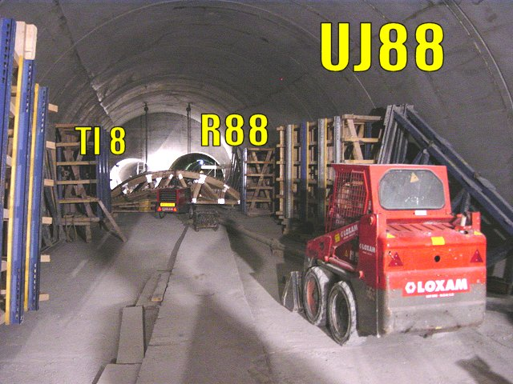
Junction of the e-ring by-passes with LHC tunnel
LHC main tunnel
Injection line at Point 8
Thickness of separation wall is about 1 m

Slide 27
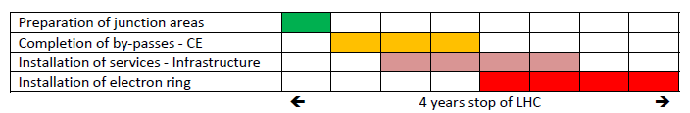
Installation schedule:
Interference with LHC operation
CE to complete the first junction areas (digging, water-proofing, concreting) would take ~6 months;
The completion of the 3 by-passes (1km each) and of the 6 junction areas would take another year (see John Osborne)
The installation of services for the e-ring can be evaluated to last 2 years (LEP and LHC experience), out of which 1 year overlaps with civil engineering;
The installation of the e-ring elements would also take 2 years, out of which half could overlap with the services:
➔ ~1 year of installation on the critical path
➔ the re-installation and commissioning of LHC could occur in // (managing of co-activities will be challenging)

Slide 28
LHeC Options: Executive Summary
Ring-Ring option:
-We know we can do it: ➔ LEP 1.5
-Challenge 1: integration in tunnel and co-existence with LHC HW
-Challenge 2: installation within LHC shutdown schedule
-Challenge 3: Spin rotators and polarization
Linac-Ring option:
-Installation decoupled from LHC operation and shutdown planning
-Infrastructure investment with potential exploitation beyond LHeC
-Challenge 1: technology ➔ high energy SC ERL; SC magnets
-Challenge 2: Positron source
LHeC Workshop, 14th – 15th June 2012, Chavannes de Bogis
Oliver Brüning, CERN
28

Slide 29
LHeC: Possible Next Steps
Launch SC RF and ERL R&D and Establish collaborations:
-SC RF R&D has direct impact on cryo power consumption
  -Synergy with ESS and SPL
  -Synergy with research activities in other laboratories (e.g. JLab; BNL etc)
-ERL is a hot topic with many applications
  -Synergy with other national research plans:
  e.g. BNL, JLab, Cockcroft, etc.
LHeC Workshop, 14th – 15th June 2012, Chavannes de Bogis
Oliver Brüning, CERN
29

Slide 30
LHeC: Possible Next Steps
Magnet R&D activities:
-Normal conducting compact magnet design ✔
-Superconducting IR magnet design
  synergy with HL-LHC triplet magnet development and USLARP
Civil Engineering:
-Develop further the layout and integration studies
-Develop integration plan for experimental cavern
LHeC Workshop, 14th – 15th June 2012, Chavannes de Bogis
Oliver Brüning, CERN
30

Slide 31
LHeC: Possible Next Steps
Design an LHeC ERL test facility:
-Optimum choice for LHeC RF frequency
-Option for testing some of the proposed LR operation scenarios
(Daniel, Alex and Vladimir’s presentations -> still many new ideas)
-Synergy with other research plans: ESS and SPL
Develop a TDR:
-requires technical choice (RR versus LR)!
-requires dedicated resources (manpower)
➔ can not be done in the same way we did the CDR!
LHeC Workshop, 14th – 15th June 2012, Chavannes de Bogis
Oliver Brüning, CERN
31

Slide 32
Accelerator Session Conclusion
LHeC planning: LR as Plan ‘A’
-Launch R&D studies for key technologies so that a decision
can be taken end 2015 (13-14TeV CM energy results from LHC)
➔ prototype construction for key components!
-Develop Civil Engineering studies for LR option
-Continue lattice and beam dynamics studies for ERL option
(integration with HL-LHC ATS optis & spin rotators)
-Launch design studies for an LHeC ERL test facility
Ed’s Conclusions (SC RF Prototype Design and Cryo):
‘Much of what is needed is in place and the time is right to embark, jointly with collaborating institutes, on construction of an ERL test facility’
Requires: -CERN mandate
-some CERN resources in ATS
-Material Budget
-Collaboration agreements
LHeC Workshop, 14th – 15th June 2012, Chavannes de Bogis
Oliver Brüning, CERN
32

Slide 33
Reserve Transparencies
LHeC Workshop, 14th – 15th June 2012, Chavannes de Bogis
Oliver Brüning, CERN
33

Slide 34
Installation schedule:
Interference with LHC operation
CE for new shafts and klystron galleries can probably proceed while LHC is running;
However, it is not the case of the by-passes:
➔ we need 7m of earth to shield a working area from an accidental LHC beam loss;
Need to dismount LHC in the junction areas to be digged:
  The cryo-magnets would be disconnected and stored on surface,
  The cryo-line would also be dismounted,
  All services have to be removed,
  The CE work-site has to be sealed for dust, but ventilation must be maintained in the LHC to control temperature/dew point.
  ➔ Assume ~6 months before CE can start in the junction areas

Slide 35
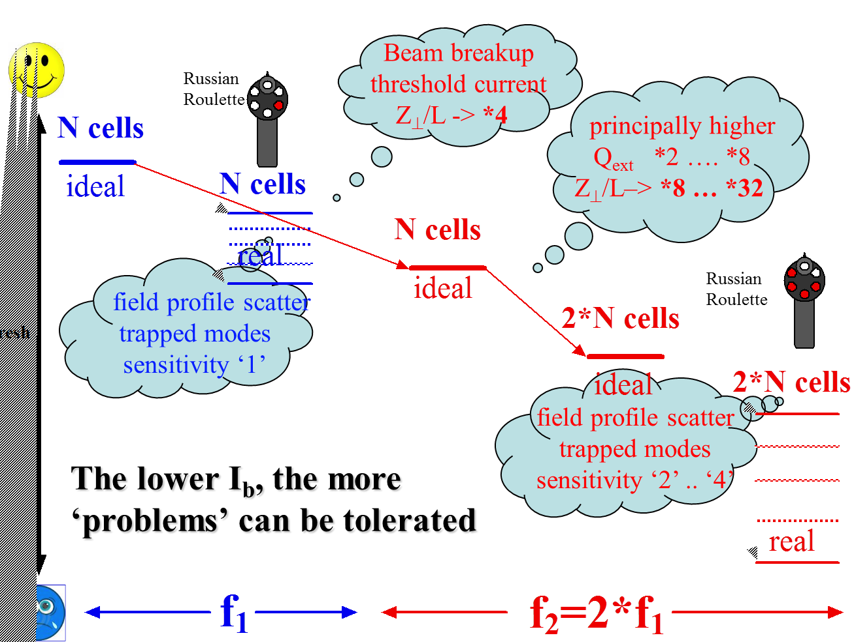


Lower f, larger currents possible
Stable beam current limit

Slide 36
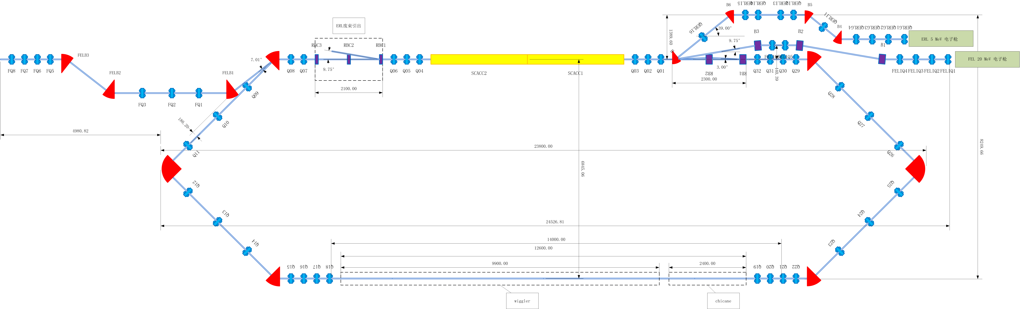
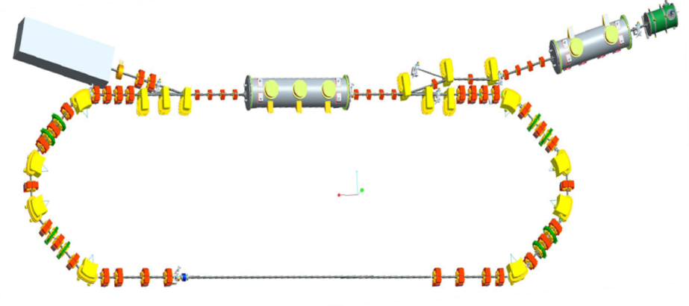
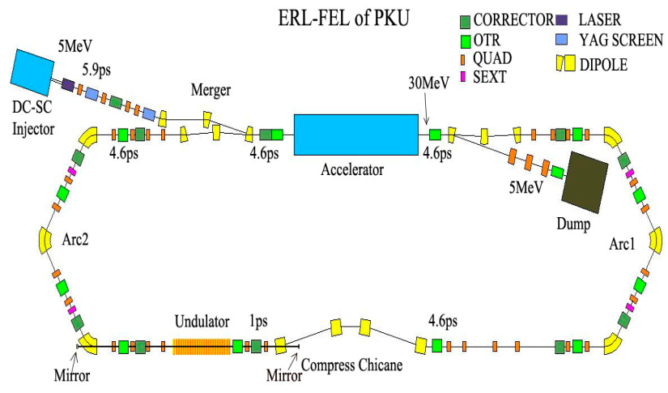
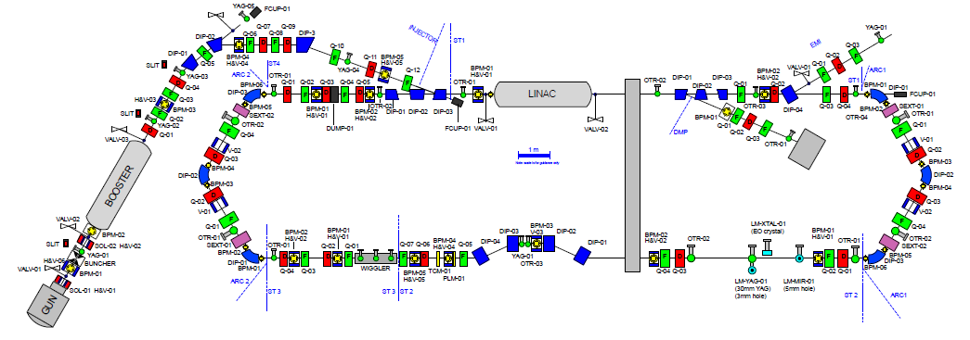
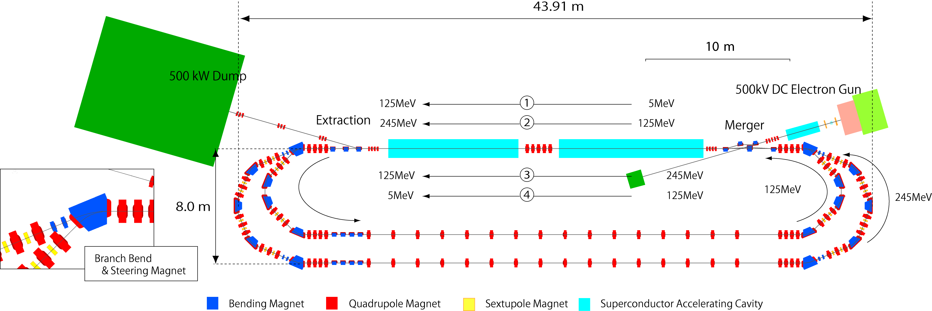
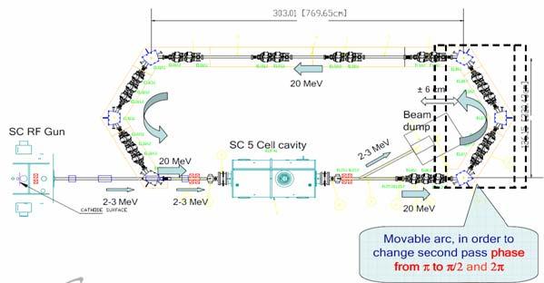
Low Energy ERL’s and ERL test facilities
IHEP ERL, Beijing
BERLinPro
2 x 7 cell 1.3 GHz + DC Gun
10mA, 35MeV, 2ps
3 x 7 cell cavities, 1.3 GHz
100mA, 50MeV, 1 mm mrad (norm), 2ps
Peking ERL-FEL
ALICE, Daresbury
1 x 9 cell, 1.3 GHz
60 pC, 30 MeV, 2 ms bunch train
2 x 9 cell, 1.3 GHz
100 pC, 10 MeV, 100 µs bunch train
2loop-CERL, KEK
Brookhaven ERL
1 x 5 cell, 704 MHz
0.7-5 nC, 20 MeV, CW
9 cell, 1.3 GHz cavities, 4 modules
77 pC, 245 MeV, 1-3 ps

Slide 37
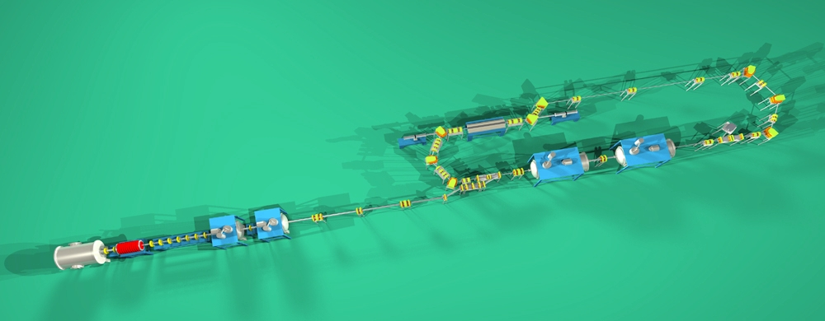
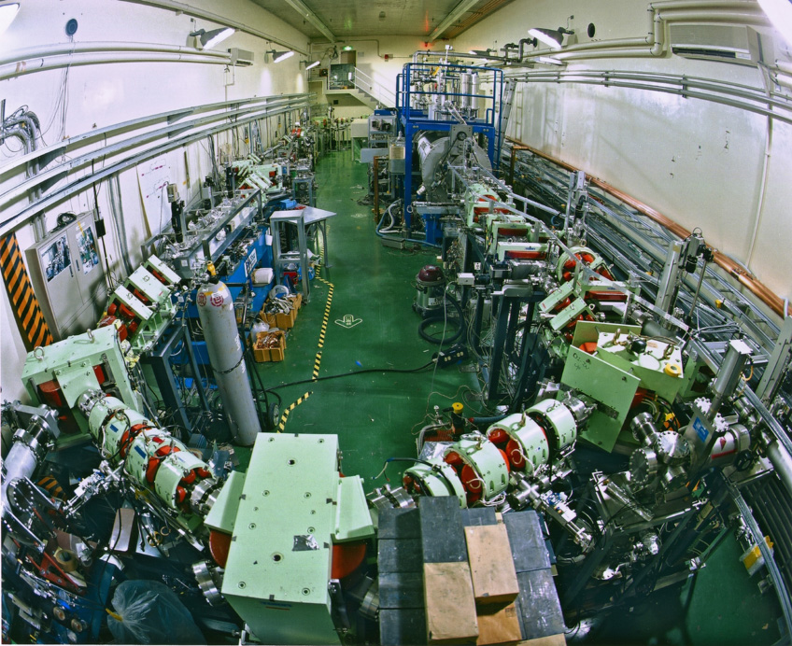
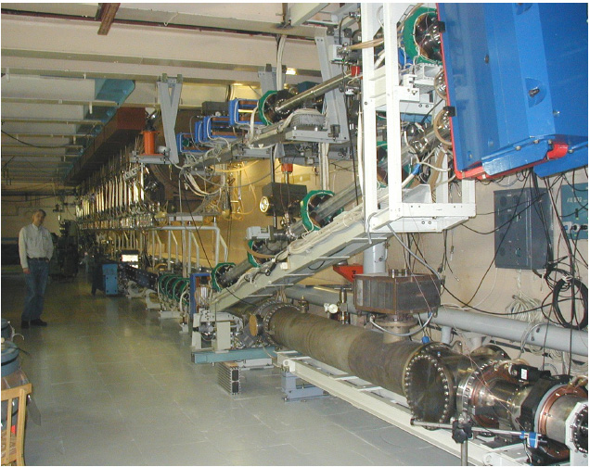
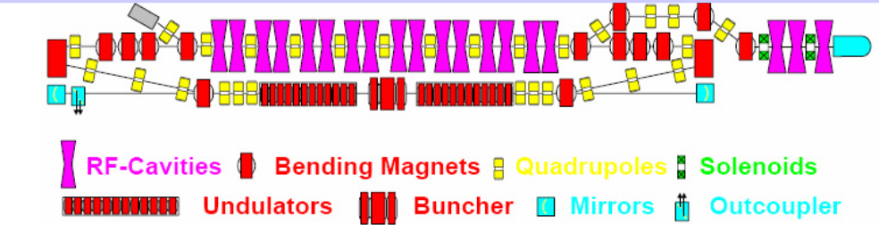
Low Energy ERL’s and ERL test facilities (contd.)
500 MHz + DC Gun
5 mA, 17 MeV, 12 ps
JAERI, Tokai
Normal Conducting 180 MHz + DC Gun
30 mA, 11 MeV, 70-100 ps
BINP, Novosibirsk

Slide 38
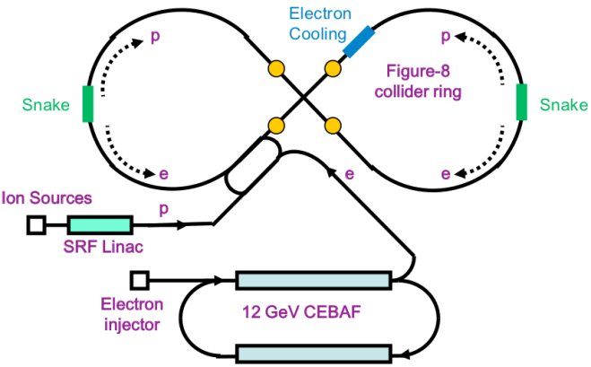
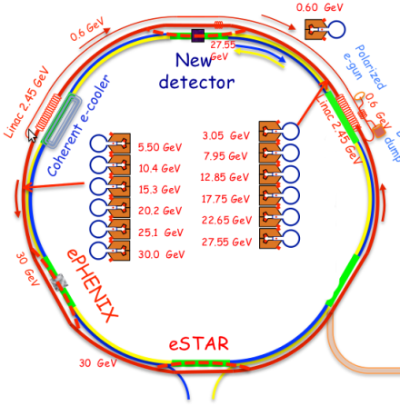
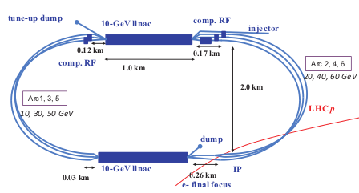
High Energy ERL’s, EIC’s (election-ion)
JLAB, MEIC
BNL, eRHIC
JLab MEIC | BNL eRHIC | CERN LHeC
5-10 GeV | 20 GeV | 60 GeV
750 MHz ? passes | 704 MHz 6 passes | 704 MHz 3-passes
3 A | 50 mA | 6.4 mA
4 nC | 3.5 nC | 0.3 nC
7.5 mm | 2 mm | 0.3 mm
Planned | Planned | Planned
CERN, LHeC

Slide 39
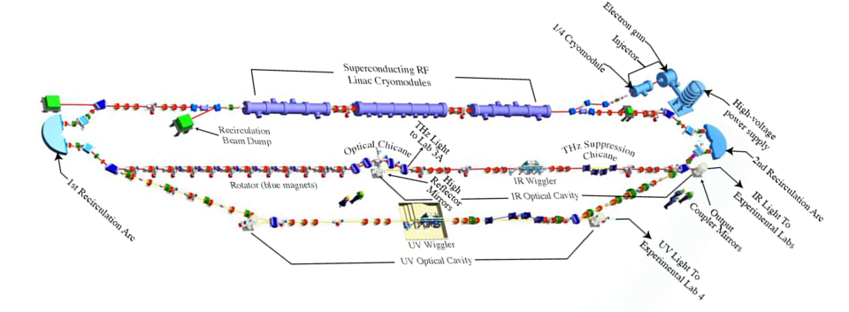
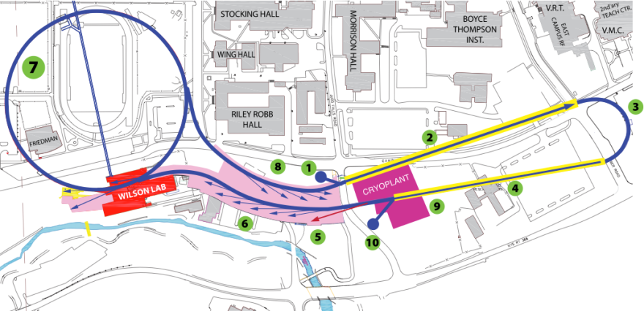
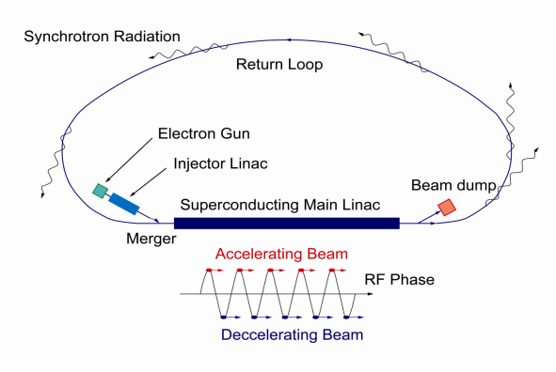
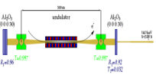
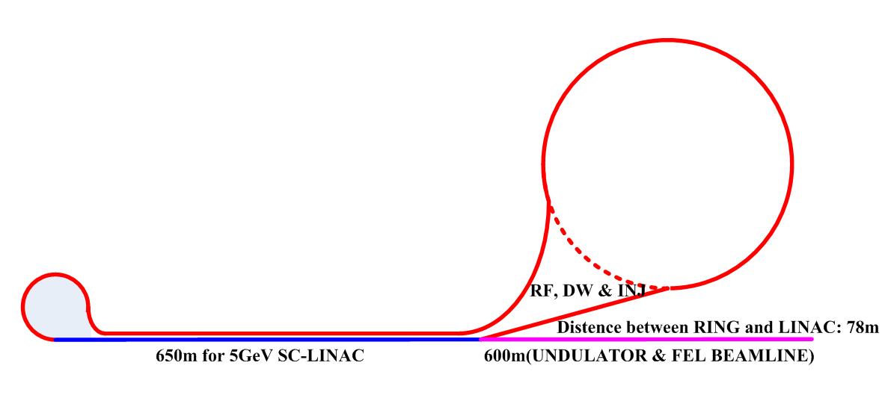
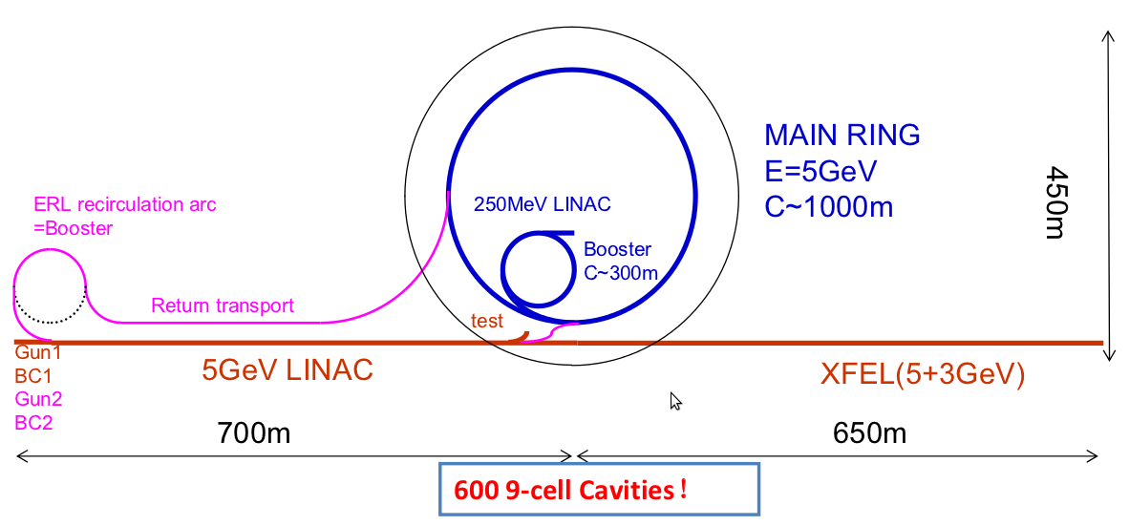
High Energy ERL’s, Light sources, FEL
Cornell ERL Light Source, 5 GeV
JLAB, FEL, 160 MeV
KEK-JAEA
XFEL-O 2nd Phase
7GeV
Double Acc.
3GeV ERL
First Stage
APS-ERL Upgrade
5 GeV, 1-2 passes
APS
Beijing Advanced
Photon Complex

Slide 40
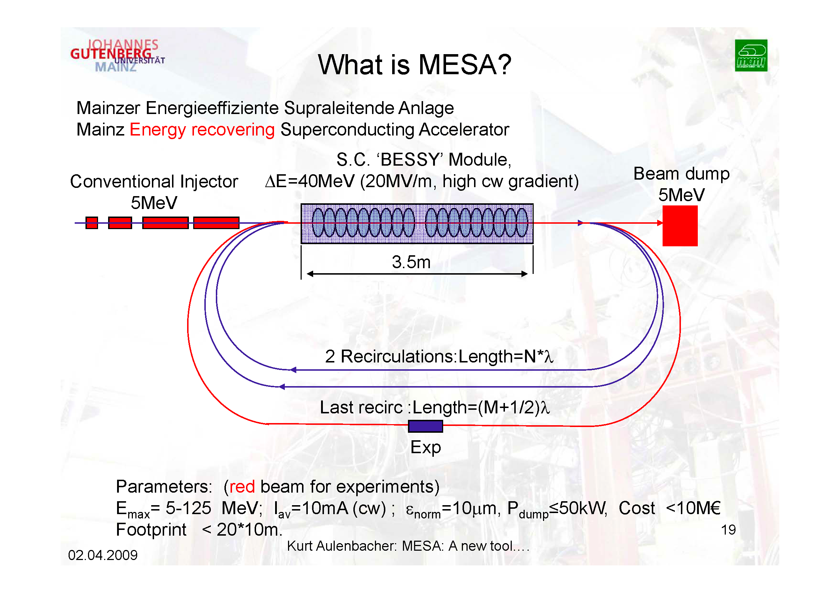
MESA Project at MAMI Mainz
MESA
LHeC Workshop, 14th – 15th June 2012, Chavannes de Bogis
Oliver Brüning, CERN
40

Slide 41
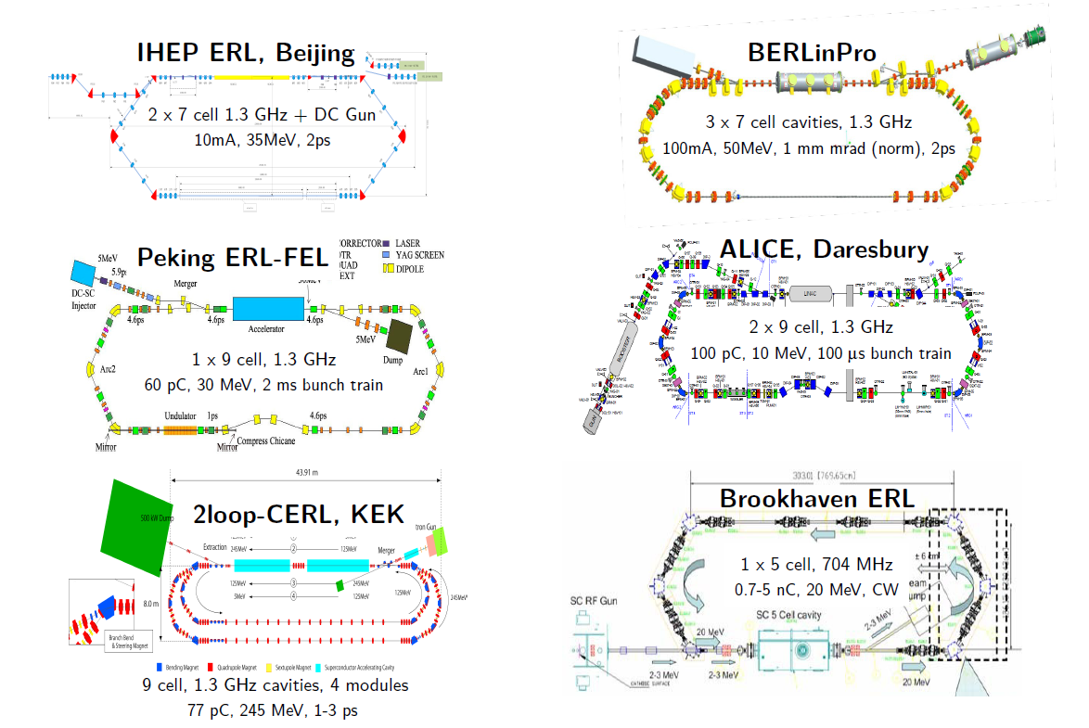
ERL Facilities around the World
Planned Test Facilities and Installations:
Frequency choice!
LHeC Workshop, 14th – 15th June 2012, Chavannes de Bogis
Oliver Brüning, CERN
41

Slide 42
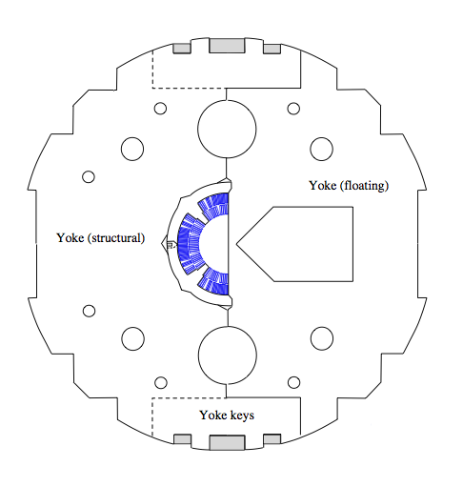
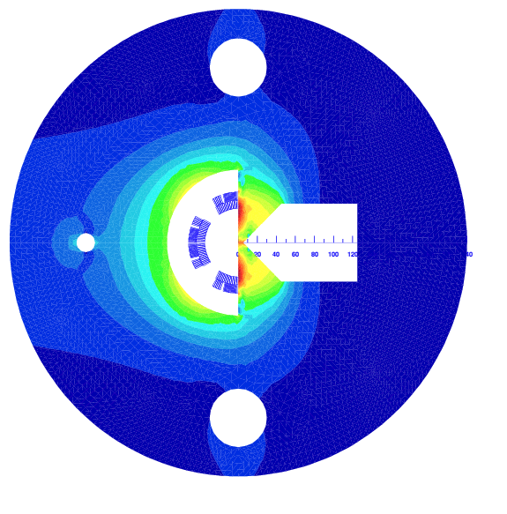
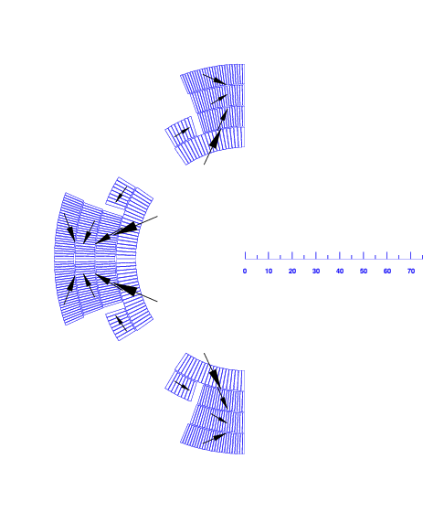
LHeC IR quad R&D work ?
Luca Bottura @
Chamonix 2012
Half-quad with field-free region, assembled using MQXC coils
  2.5 FTE
  500 kCHF
  approx. 2 years till test
Large resultants on the magnetic wedge (> 50 tons/m)

Slide 43
ERL Test Facility at CERN
Rama Calaga, Ed Ciapala,
Erk Jensen,
J. Tückmantel
Physics Motivation:
ERL demonstrator,
e-cooling (@PS/SPS energies),
ultra-short electron bunches
strong synergy with SPL-ESS & BNL activities
High energies & CW (100 – 400 MeV)
Multi-cavity cryomodule layout (validation + gymnastics)
MW class power coupler tests in non-ERL mode (vector feedback?)
Complete HOM characterization and instability studies
FEL & gamma-ray source
LHeC Workshop, 14th – 15th June 2012, Chavannes de Bogis
Oliver Brüning, CERN
43

Slide 44
Summary LHeC Planning and Timeline
Questions and required R&D activities for coming years:
-Superconducting RF with high Q ➔ 1.3 GHz versus 720 MHz?
➔ synergies with ESS, SPL, XFEL
-ERL operation in GeV regime (new territory [tens of MeV]!)
➔ beam stability, tolerances on beam shape, diagnostics, RF control etc.
-Test facility for Energy recovery operations
➔ synergy with other facilities: Cornell, BNL, Daresbury, Berlin-Pro, MESA
-Compact injector complex
➔ synergy with plasma network?
-High intensity polarized positron sources
➔ synergy with CLIC and ILC activities
The first 3 points fit well into overall strategy for
developing SC RF expertise at CERN!
The fourth point can also be addressed by an ERL test facility
LHeC Workshop, 14th – 15th June 2012, Chavannes de Bogis
Oliver Brüning, CERN
44

Slide 45
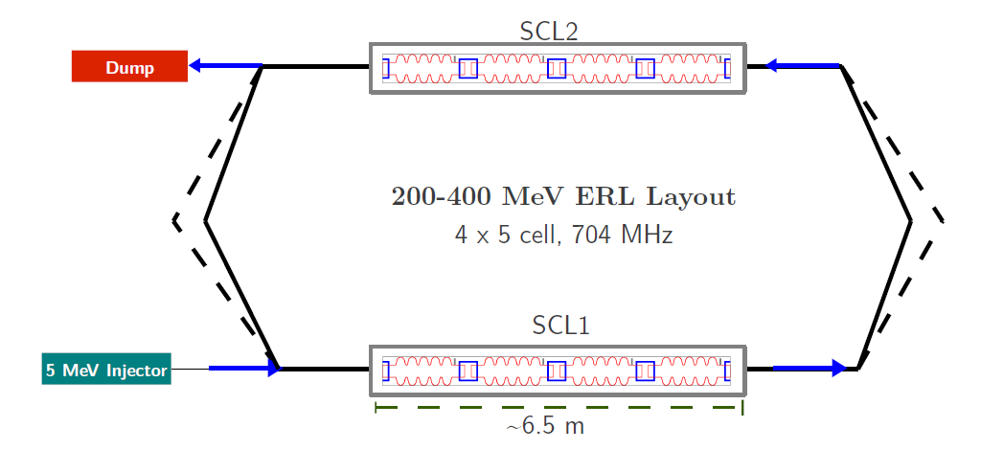
ERL Test Facility at CERN
Erk Jensen
Potential layout:
LHeC Workshop, 14th – 15th June 2012, Chavannes de Bogis
Oliver Brüning, CERN
45

Slide 46
ERL (from BerlinPRO website)
ERLs hold the promise of becoming the future backbone of modern
accelerator facilities, satisfying the needs of the user community in applied science and fundamental research.
They combine the efficiency advantage of storage rings with the improved
beam quality achievable in a linac. The next-generation accelerator facilities must circumvent the equilibrium beam properties of a storage ring, i.e., the beam must be discarded before the equilibrium is established. A single-pass linear accelerator (linac) represents the most extreme example of such a device….
Superconducting RF (SRF) cavities are the enabling technology that allows
Continuous Wave (CW) ERLs to implement energy recovery without storing
the beam.
ERLs thus combine two important properties:
High-brightness electron beam and high-power electron beam capabilities.
As such, it has the potential to be applied to a large number of uses, notably
particle collider, compact Compton sources and the next generation of
synchrotron light sources.
Existing ERLs and planned Test Facilities operate with 10MeV – 150MeV beam energies
➔ long way to go got a 60 GeV beam
LHeC Workshop, 14th – 15th June 2012, Chavannes de Bogis
Oliver Brüning, CERN
46

Slide 47
ERL Topics & Questions
Rama Calaga, Ed Ciapala,
Erk Jensen
Specific questions in the context of an ERL for LHeC :
What is the optimum Q₀ at medium gradients?
  BCP and/or electro-polishing
  Surface inspection (optical microscopy or by other means)
Optimum frequency (we think 704 MHz a good choice - gradients of 15-20 MV/m can be achieved with good Q₀)
  Synergy with ESS, SPL, BNL!
  downside may be the physical size and amount of niobium needed… but:
Studies of material other than bulk niobium e.g. HiPIMMS ? Nb₃Sn ?
  HiPIMMS is ongoing CERN/Legnaro/Sheffield.
  Nb₃Sn could be studied at CERN (Quad resonator) in collaboration with others, e.g. HZB.
  This has strong synergy with the general need to re-establish and strengthen SRF technology at CERN.
LHeC Workshop, 14th – 15th June 2012, Chavannes de Bogis
Oliver Brüning, CERN
47

Slide 48
ERL Test Facility at CERN
Specific LHeC questions:
What is the best practical choice for Q_{ext} (Stability, RF power, microphonics, feedback)
  5 MeV injector: P_{beam} 50 kW (10 mA)
  Main LINAC (with zero beam loading):
  with Q_{ext}=5E6, we get to 50 kW and thus in the realm of commercial television IOT’s. This exists at BNL and a similar system at 800 MHz is studied at CERN for SPS.
What are the losses and what is the resulting average power needed. Study of the mechanisms - e.g. Beam/phase errors, beam loss, switch-on switch-off transients, …
What are the failure modes – how to mitigate?
  Slow failures (power cut)
  Fast failures (arc) – beam current reduction? Power increase?
  …
LHeC Workshop, 14th – 15th June 2012, Chavannes de Bogis
Oliver Brüning, CERN
48

Slide 49
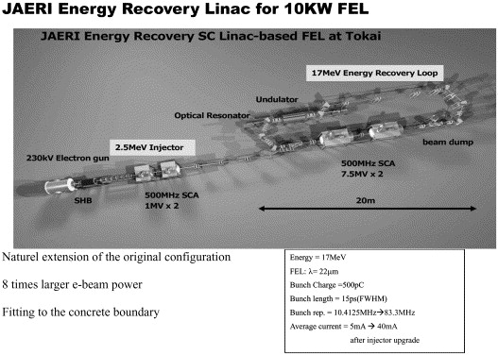
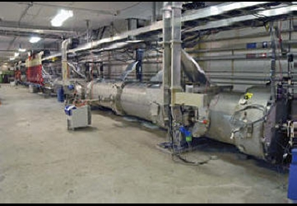
ERL Facilities around the World
Existing Test Facilities and Installations:
TJNAF ERL-FEL @ JLAB, USA, 200 MeV
LHeC Workshop, 14th – 15th June 2012, Chavannes de Bogis
Oliver Brüning, CERN
49

Slide 50
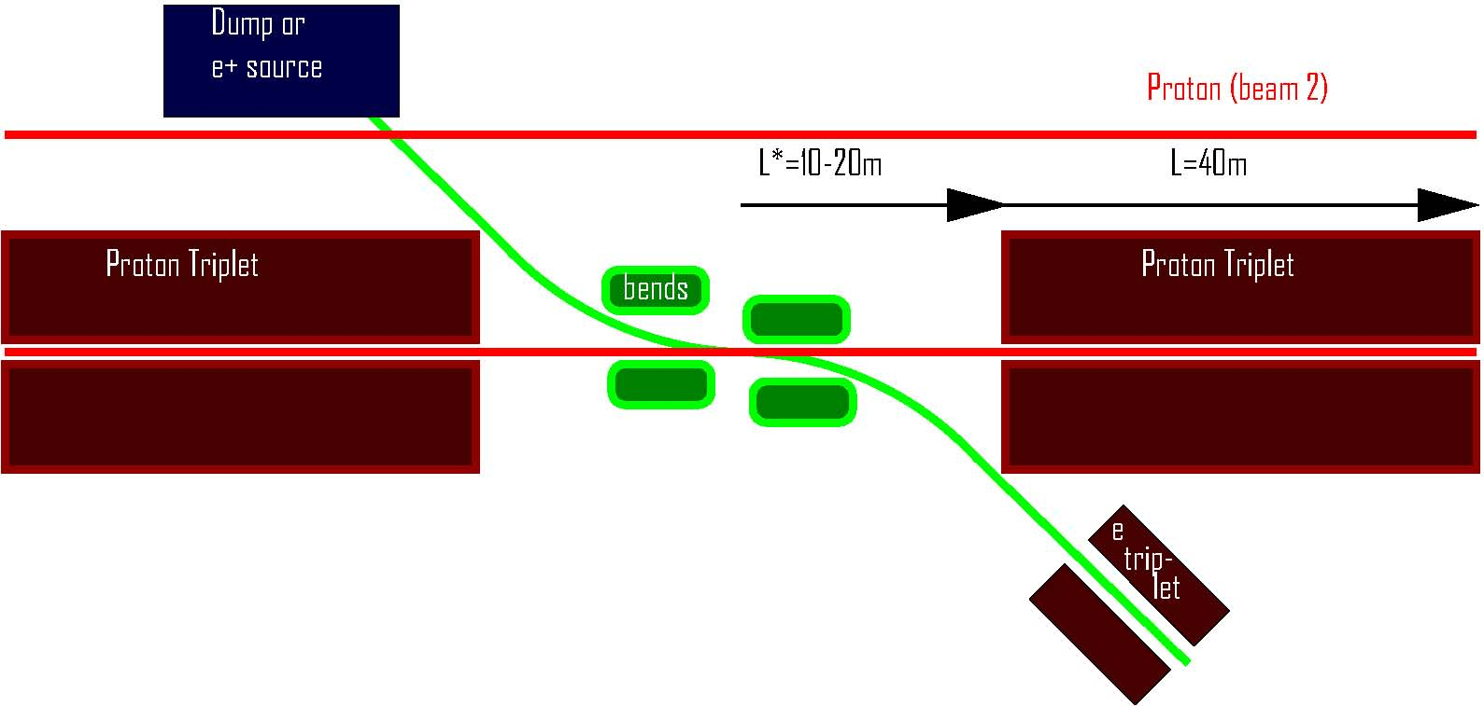
interaction region (2008)
R. Tomas, F.Z.
or return loop
small e- emittance → relaxed β_{e}* → L_{e}* > L_{p}*, can&must profit from ↓β_{p}* ; single pass & low e-divergence → parasitic collisions of little concern; → head-on e-p collision realized by long dipoles

Slide 51
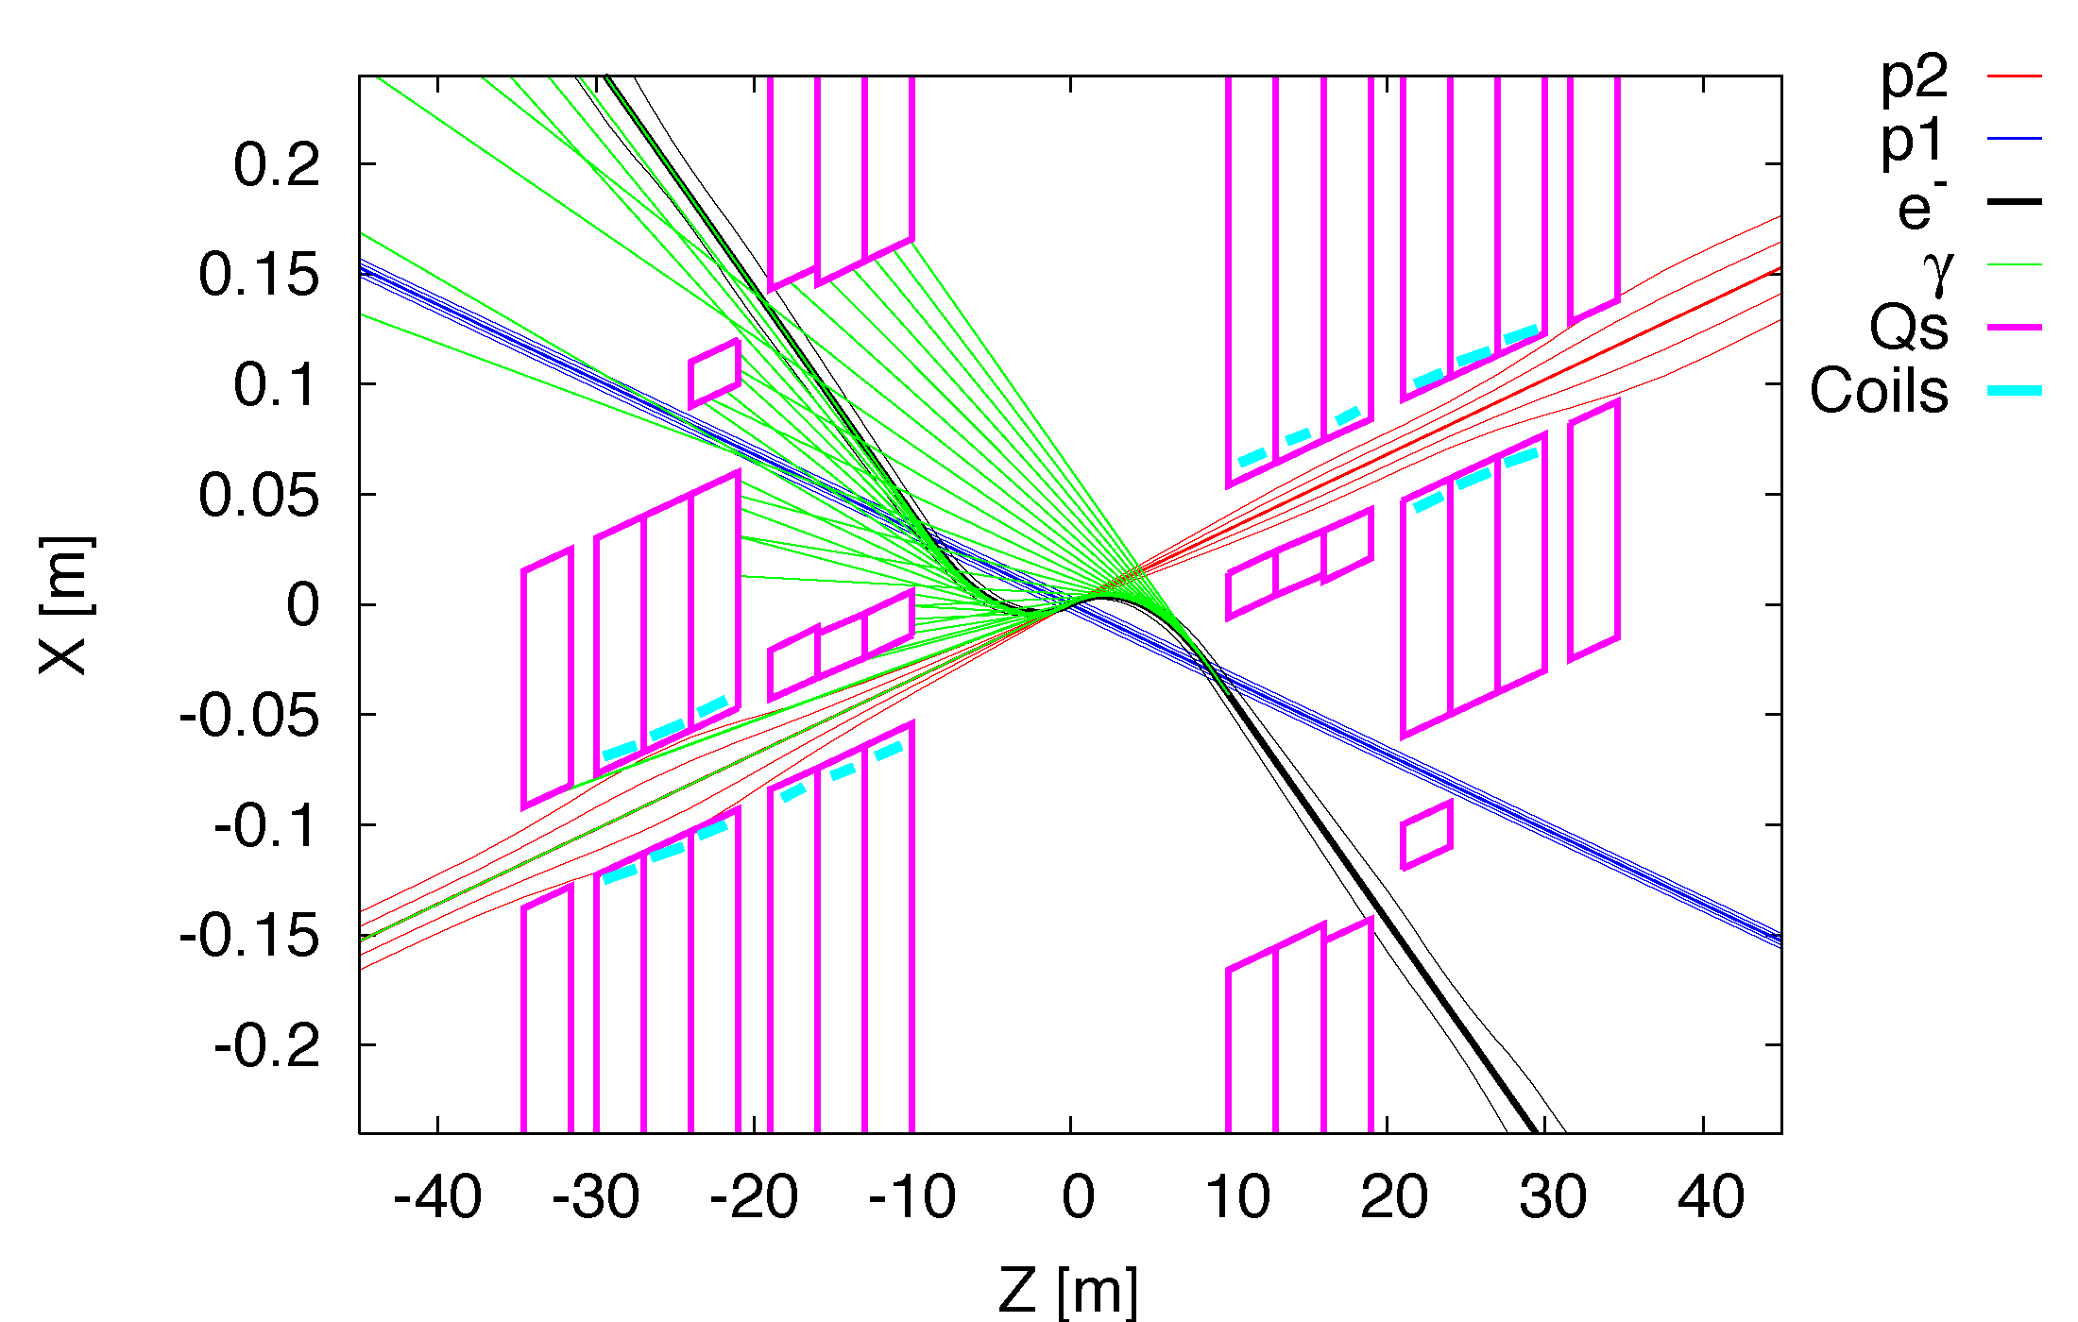
Interaction Region: Synchrotron Radiation
Radiation Fan: Example Linac-Ring
Oliver Brüning, CERN
51

Slide 52

Interaction Region: Synchrotron Radiation
Significant power: > 20 kW. Example Ring-Ring
Focus of current activity
First design of SR masks exists.
But still require more detailed vacuum and background studies for such high SC radiation power.
LHeC Workshop, 14th – 15th June 2012, Chavannes de Bogis
Oliver Brüning, CERN
52

Slide 53


Bypassing CMS: 20m distance to Cavern
RF
ca. 1.3 km long bypass
ca. 300m long dispersion free area for RF installation
LHeC Workshop, 14th – 15th June 2012, Chavannes de Bogis
Oliver Brüning, CERN
53

Slide 54
Design Parameters
electron beam | RR** | LR | LR*
e- energy at IP[GeV] | 60 | 60 | 140
luminosity [10³² cm⁻²s⁻¹] | 0.9 | 10 | 0.44
polarization [%] | 40 | 90 | 90
bunch population [10⁹] | 20 | 2.0 | 1.6
e- bunch length [mm] | 6.88 | 0.3 | 0.3
bunch interval [ns] | 25 | 50 | 50
transv. emit. γε_{x,y} [mm] | 0.26, 0.15 | 0.05 | 0.04
rms IP beam size σ_{x,y} [μm] | 30, 16 | 7 | 7
e- IP beta funct. β*_{x,y} [m] | 0.4, 0.2 | 0.12 | 0.14
full crossing angle [mrad] | 1.0 | 0 | 0
geometric reduction H_{hg} | 0.86 | 0.91 | 0.94
repetition rate [Hz] | N/A | N/A | 10
beam pulse length [ms] | N/A | N/A | 5
ER efficiency | N/A | 94% | N/A
average current [mA] | 100 | 6.6 | 5.4
tot. wall plug power[MW] | 100 | 100 | 100
proton beam | RR | LR
bunch pop. [10¹¹] | 1.7 | 1.7
tr.emit.γε_{x,y} [μm] | 3.75 | 3.75
spot size σ_{x,y} [μm] | 30, 16 | 7
β*_{x,y} [m] | 1.8,0.5 | 0.1
bunch spacing [ns] | 25 | 25
Final parameter set to be developed as we gain experience with LHC operational (beam-beam, spacing etc)
The goal here is to demonstrate that realistic sets exist for both LHeC versions
“ultimate p beam”
1.7 probably conservative
Design also for deuterons
(new) and lead (exists)
RR= Ring – Ring
LR =Linac –Ring
Ring uses 1º as baseline : L/2
Linac: clearing gap: L*2/3
*) pulsed, but high energy ERL not impossible; ** ) 1º acceptance optics
LHeC Workshop, 14th – 15th June 2012, Chavannes de Bogis
Oliver Brüning, CERN
54

Slide 55
LHeC Planning and Timeline
CERN Medium Term Plan:
-Only 2 long shutdowns planned before 2022
-Only 10 years for the LHeC from CDR to project start.
(Other smaller projects like ESS and PSI XFEL plan for 8 to 9 years [TDR to project start] and the EU XFEL plans for 5 years from construction to operation start)
LHeC planning:
-Should start R&D work as soon as possible in order to keep project
viable for operation start in mid 2020ies
-Eventually need to decide on one option ➔ management decision
LHeC Workshop, 14th – 15th June 2012, Chavannes de Bogis
Oliver Brüning, CERN
55

Slide 56

IR magnets
Luca Bottura @ Chamonix 2012
Ring-ring
  G=140 T/m
  A=70 mm
  B_{fringe} = 30 mT
  O(15) kW SR power in the proton aperture
NbTi suitable for this medium gradient option
Mechanics ?
Heat removal ?
Linac-Ring
  G=250-300 T/m
  A=90 mm
  B_{fringe} = 500 mT
  O(2) kW SR power in the proton aperture
100 tons/m
NbTi or Nb3Sn ?
Large aperture ?
Mechanics ?
Heat removal ?
By courtesy of S. Russenschuck

