Slide 1
LHeC : Muon Systems
L. Pontecorvo

Slide 2
Outline
Review of LHC Muon Systems
  Different Magnetic Field configurations
  ATLAS & CMS
  Installation and Commissioning
  Performance
Review of Muon Detector Technologies
  Technologies considered for the LHC experiments Upgrades.
Muon Physics at LHeC
Possible Muon System for LHeC

Slide 3
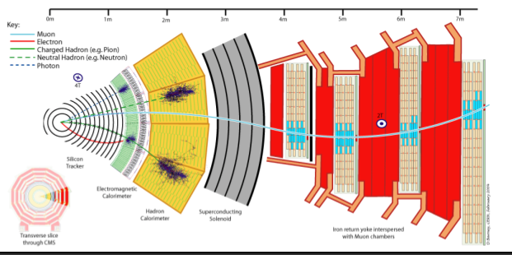
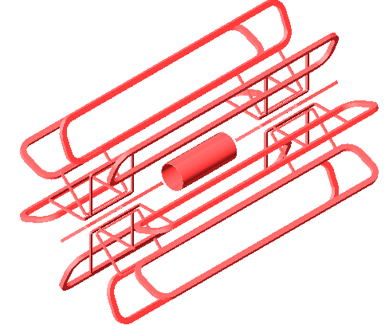
The magnetic field choice
Central solenoid with muon measurement in the Iron used for Flux return (CMS)
  Compact detector
  Very good muon identification capability
  No need of very high resolution detectors
  High precision muon measurement rely on the inner tracker (ITK) measurement.
  Pt resolution quite dependent on η
Air Core Toroid (ATLAS)
  Excellent Stand Alone momentum measurement
  Quite uniform resolution even at large η
  But… Need very large detector
  Very not-uniform Field Map
  Very demanding on detectors performances, calibration and alignment

Slide 4
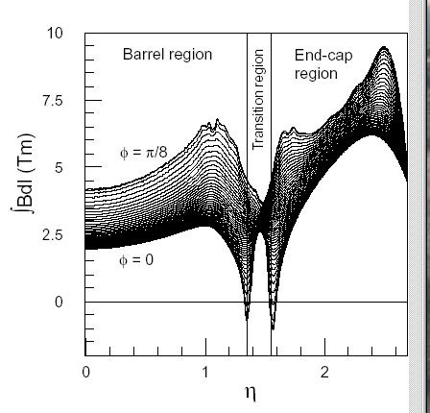
The magnetic field choice
Air Core Toroids:
  Inhomogeneous Field integral in the tracking volume
  Calibration dependent from the non bending coordinate
  Precision tracking more difficult: very accurate knowledge of B field required
Central Solenoid with Iron return Flux:
  Very homogeneous in the Central region, but high gradients in the Forwards Region.
  The Bending Power in the ITK is small in the Forward: Pt resolution is limited by MS in the Iron Yoke .
Field Integral vs η

Slide 5
The ATLAS muon spectrometer
Precision Chambers: from 3 Stations Sagitta in bending plane -> measure P
  Monitored Drift Tubes (MDT)+ Cathode Drift Chambers (CSC) 2.0<η<2.7
Trigger Chambers: LVL1 μ trigger + coordinate in non-bending plane
  Resistive Plate Chambers (RPC) |η|<1+Thin Gas Chamber (TGC) 2.4>|η|>1

Slide 6
The CMS Muon Spectrometer
Fast trigger chambers: RPC (<10 ns time resolution).
Tracking detectors: CSC, DriftTubes ( 100 μm spatial resolution).
Laser alignment of muon and ITK with 200 μm precision.
Pseudorapidity coverage: |η|<2.4.

Slide 7
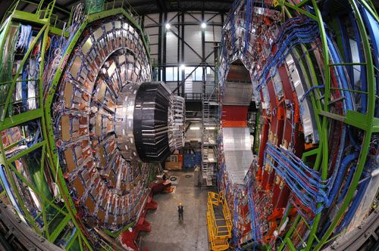
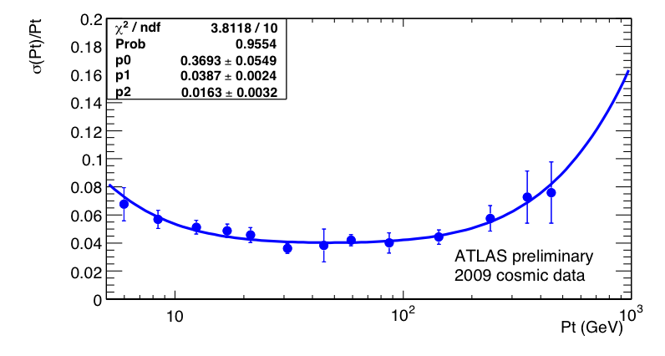
Installation and Commissioning
Installation of both ATLAS and CMS took years
  Ex. The Construction of the ATLAS Muon Spectrometer started in 2005 (Barrel) and ended in 2008 (End Cap).
ATLAS Barrel Resolution with Cosmic rays
Very long years of commissioning with Cosmic rays were essential to be able to efficiently record and understand data from the very first collision.
This has to be considered in building the schedule for the construction and commissioning of the LHeC detector

Slide 8
Muon Reconstruction
1. Definition of regions of activity (RoA).
2. Reconstruction of local straight segments in the RoA.
3. Combination of local segments.
4. Global fit in the muon system.
Final combination/global fit with the Inner Tracker (ITK)
  - to refine the momentum measurement
  - to identify low-pt muons
  - to identify isolated muons and remove fakes (π, K decays)
Muon Definitions
Segment tagged (Tag) : Pt Measured only by ITK, high efficiency
Combined (CB): Pt measured combining ITK and MS, best Momentum determination over the full range high purity
Stand Alone (SA): Muon measured only in the MS (High eta region in ATLAS)

Slide 9
Performance

Slide 10
Combined Pt Resolution
Combined Muons:
  excellent Pt measurement up to 1 TeV σ(p_{t})/p_{t}<12%.
Better Combined resolution in CMS Barrel mainly due to higher B field.
Better Combined End Cap Resolution in ATLAS due to Air Core Toroid

Slide 11
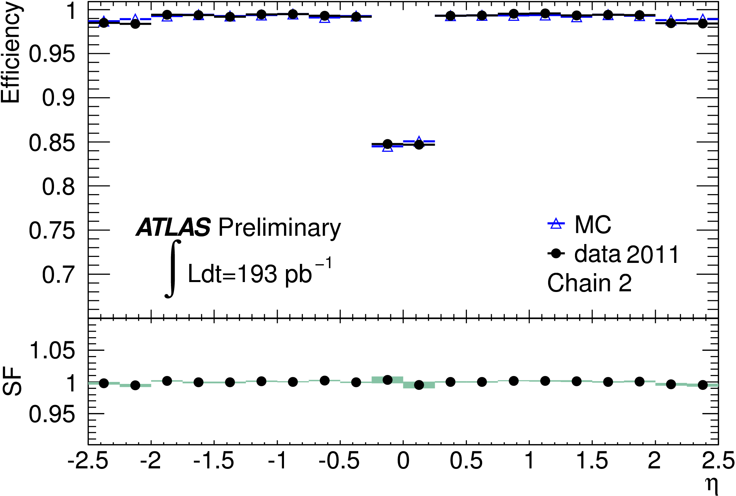
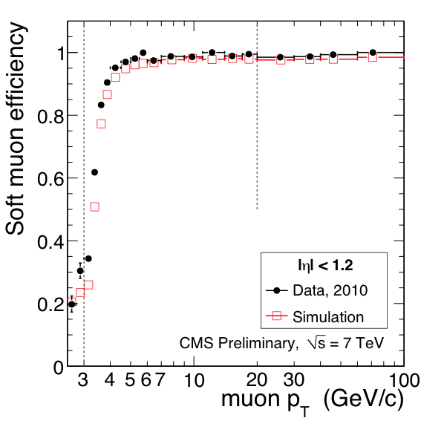
Tracking efficiency: Tag and Probe
Combined + segment tagged muons
  very high and uniform tracking efficiency
Very high efficiency down to low transverse momenta.

Slide 12
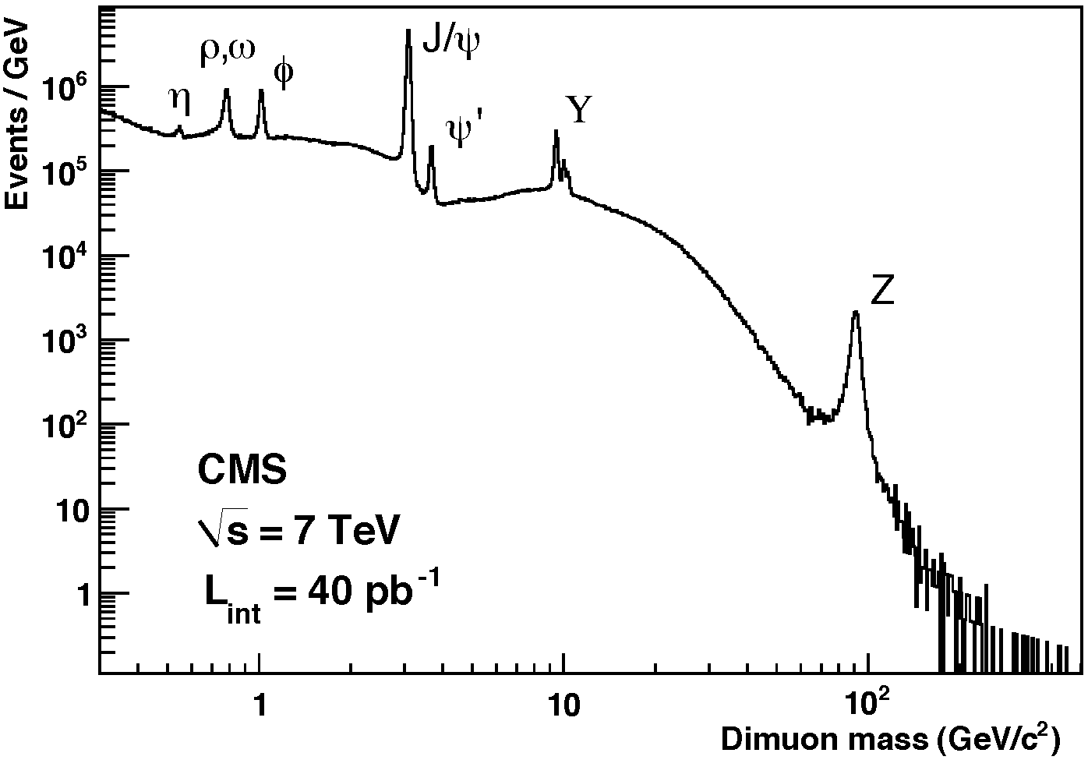
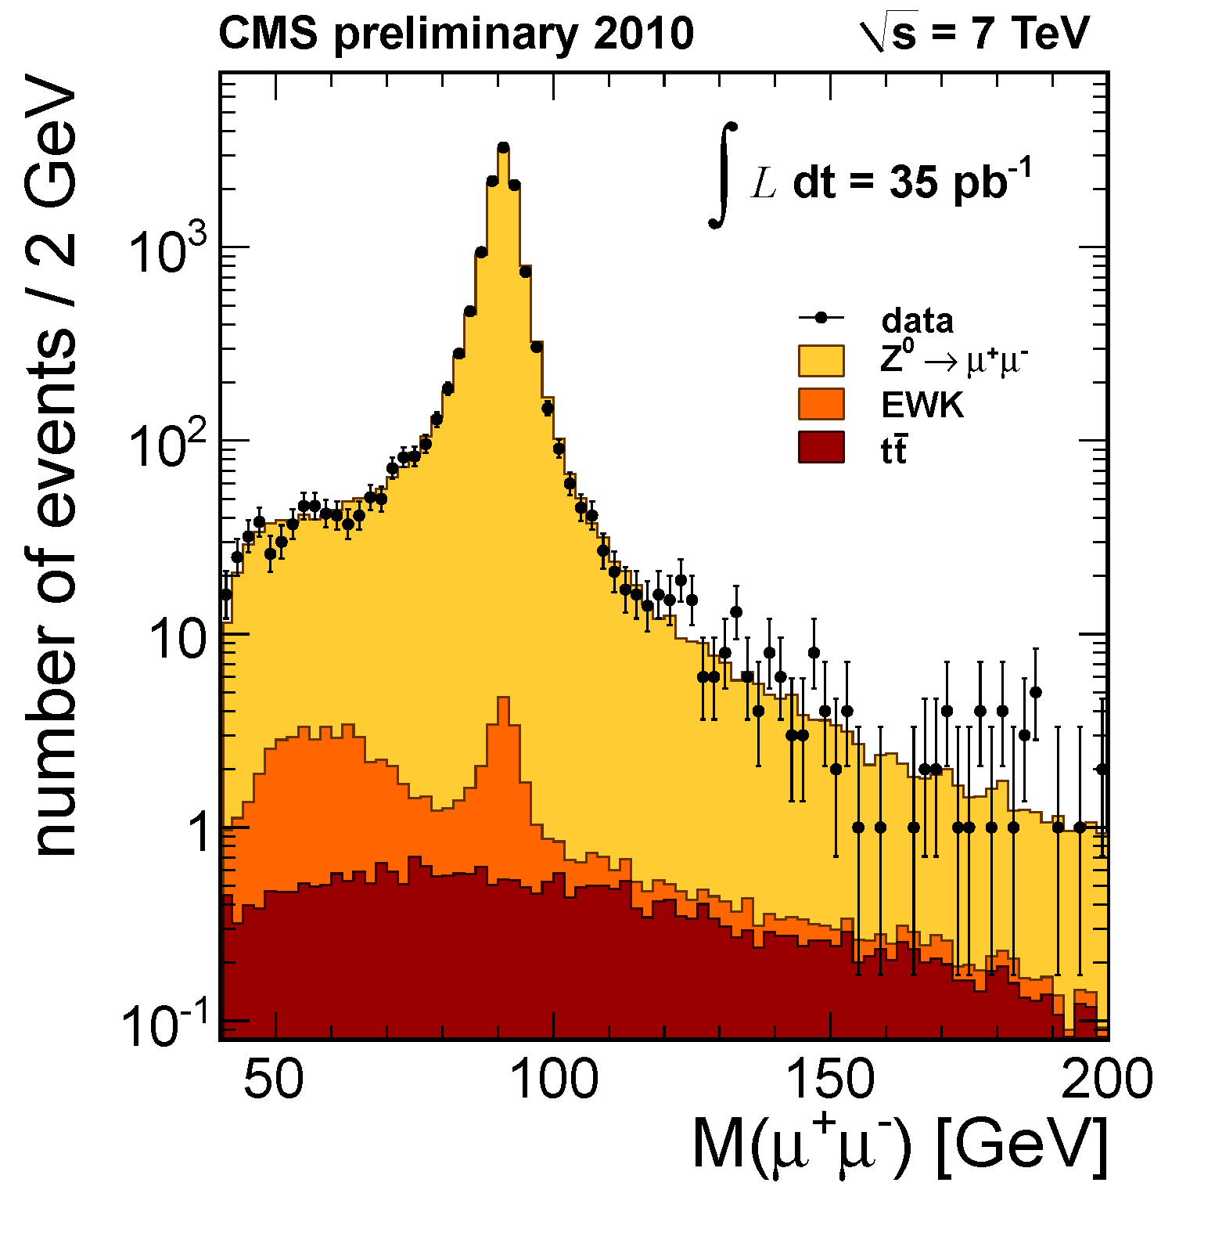
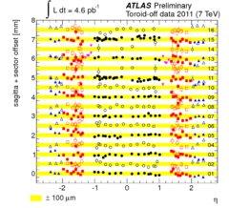
Resolution
Spectacular Di-muon Spectrum
Well understood Z mass resolution
Resolution at High Momentum very close to design value
Limited by alignment and calibration accuracy
  Muon Chambers alignment in ATLAS < 100 μm

Slide 13
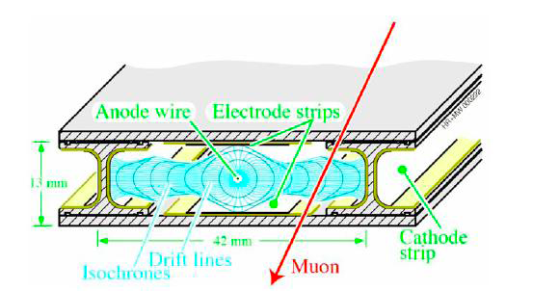
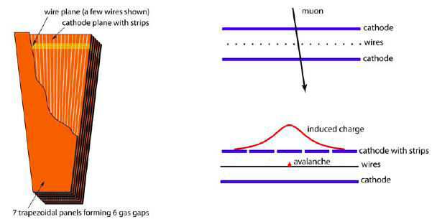
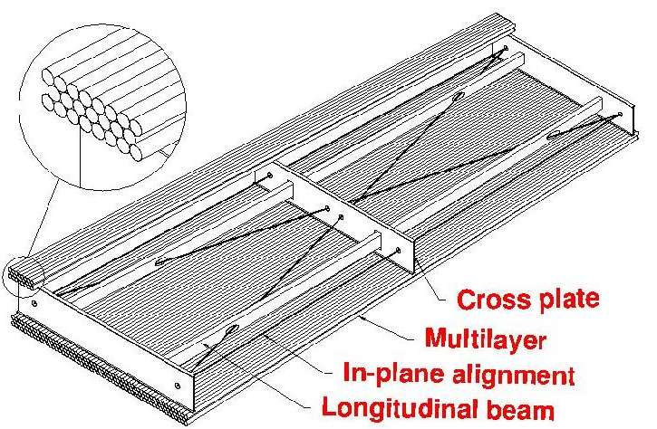
Detector technologies: Tracking
All the detector technologies used for the present LHC detectors can be re-used (at least in the Central-End Cap Region) in a LHeC muon system.
  Both CMS and ATLAS are Using Drift Tubes and CSC for precision tracking.

Slide 14
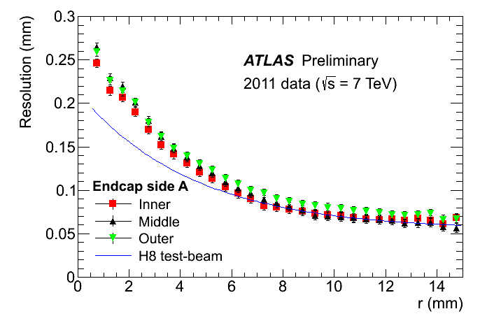
Detector technologies: Tracking
Drift Tube Example: ATLAS MDT.
Operating Conditions
Gas Mixture: 93 % Ar 7% CO₂
Absolute pressure: 3 Bar
HV: 3080 V
Gas Gain: 2x10⁴
Threshold: 25 electrons
Single Hit resolution
Drift tubes mechanical parameters:
Tube Radius : 15 mm
Tube thickness 400 μm
Wire diameter. 50 μm
Tube length: 1-6 mt
Chamber mech. Precision 20 μm
Two Multilayers of 3 or 4 layers each.

Slide 15
Detector technologies: Tracking
MDT performance vs hit rate
  Perfectly adequate for the rates foreseen in the Barrel and part of End Cap region
  Not enough rate capabilities for the inner region of the End Cap at luminosities exceeding 2x10³⁴ cm⁻¹s⁻¹
  Using smaller diameter tubes can enhance the rate performance
  Using Drift Tubes in the Central-Forward region of an LHeC muon detector should not be a problem.

Slide 16
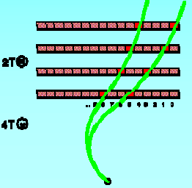
Detector Technologies: Trigger
Trigger chambers requirements:
  Time resolution adequate to resolve the Bunch ID (few ns)
  Moderate Space resolution to define Coincidence Roads (cm)
Both ATLAS and CMS use RPC (+DT, CMS) in the Barrel Region
ATLAS uses TGC (|η|<2.4) due to better rate capabilities and CMS uses RPC in the End Cap region (|η|<1.6).
New developments on RPC and TGC will improve both Spatial and Time resolution on these Detectors
  Possibility to use these detectors both for triggering and tracking in the Central-Forward region of the LHeC Muon detector

Slide 17

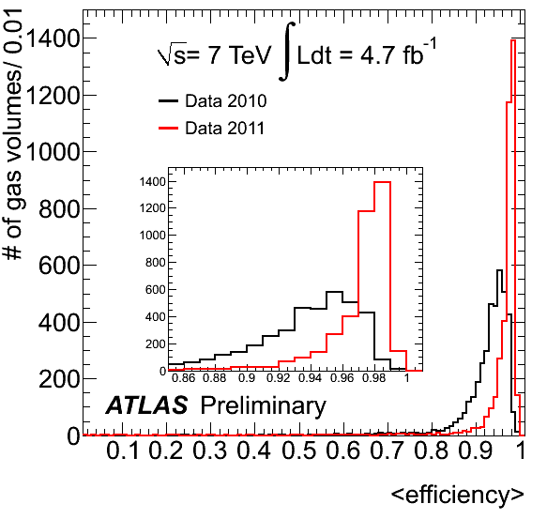
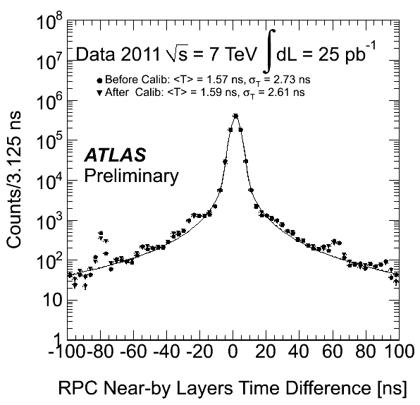
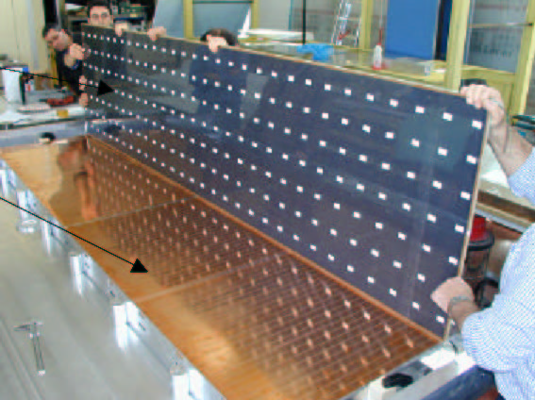
Detector Technologies: Trigger
RPCs: High efficiency and excellent time resolution
Bakelite Plates
Operating Conditions
(E_{gas}~ 5 KV/mm)
Gas: C₂H₂F₄ 95% - C₄H₁₀ 4.5% - SF₆ 0.5% ;
ρ_{bakelite} ~ 2x10¹⁰ Ωcm ;
Gas Gap d = 2 mm ;
Graphite coated HV electrodes
Cu read out strips 30 mm pitch
Time resolution ~2.0 ns
X readout strips
Gas
HV
Foam
Grounded planes
Y readout strips
PET spacers
Graphite electrodes

Slide 18
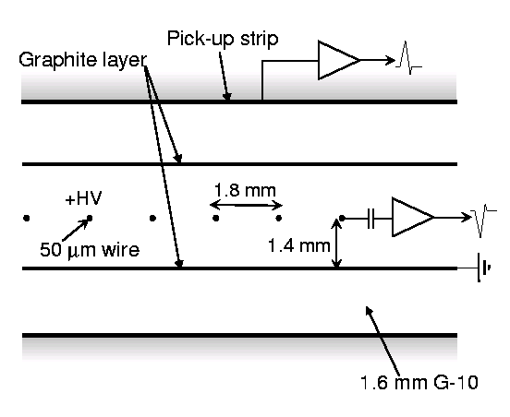
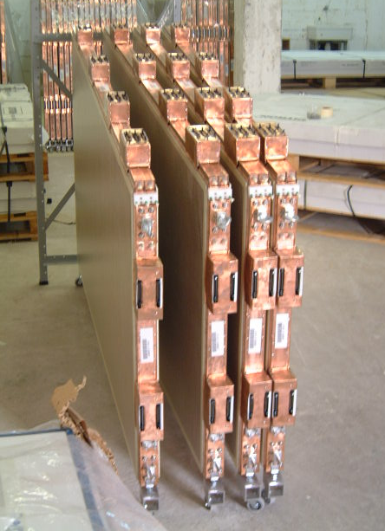
Detector Technologies: Trigger
MWPC with small cathode-cathode distance:
Anode pitch: 1.8 mm
Anode-Cathode dist: 1.4 mm
Cathode-Cathode dist: 2.8 mm
Operating conditions
Gas : 55 % CO₂ , 45 % N-Pentane
HV: 3.1 KV
Saturated avalanche mode
Very short drift time due to the thin gap: ensures the good time resolution needed for Bunch Crossing ID
Wire signal used to provide the trigger
Strip signals used for the second coordinate (< cm resolution)

Slide 19
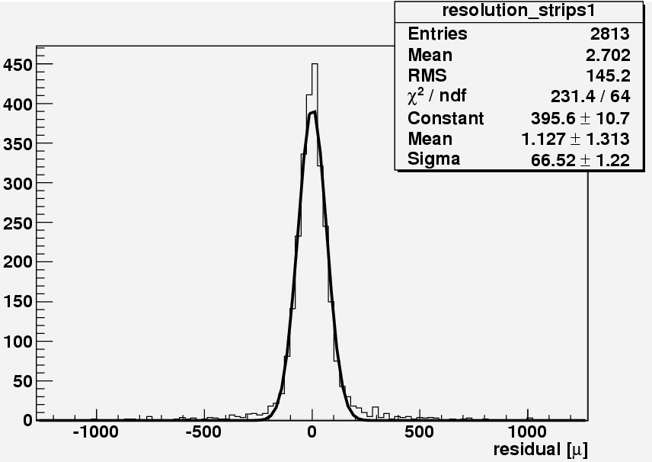
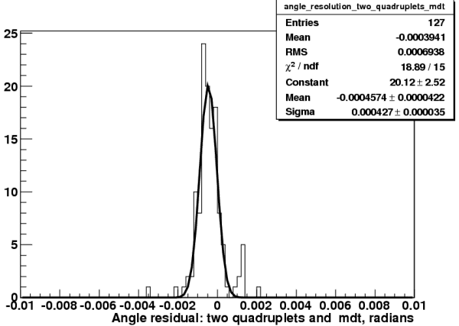
Detectors for the Upgrade
Test Beam Result :
Space Resolution< 100 μm
sTGC:
  Small strips TGC are considered for tracking and trigger in the ATLAS New Small Wheel project.
  Charge on 3 mm strips, read-out with Time over Threshold technique will ensure ~100 μm space resolution at trigger level.
  Time resolution (same as for Standard TGC) adequate for BC ID.
Test Beam Result :
Angular Resolution< 0.5 mrad

Slide 20
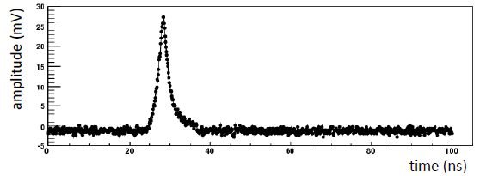
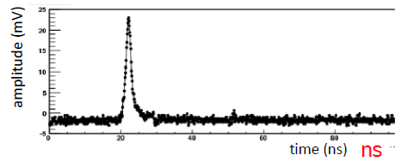
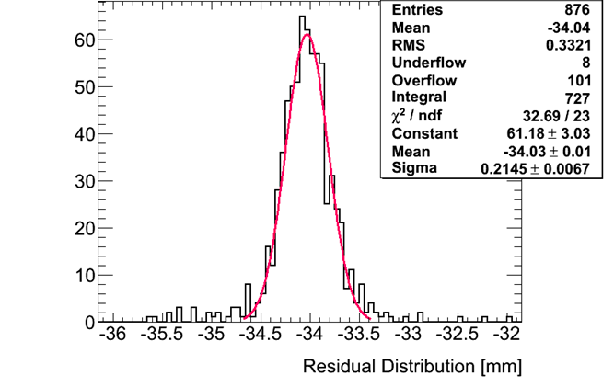
Detectors for the Upgrade
mRPC:
  Use of new Front End electronics extends the Rate Capability in the 10 KHz/cm² range
  Time resolution improvements down to sub ns range (New electronics and smaller backelite thickness )
  Space resolution using COG technique with 3 mm strips in the 100 μm range
Signal for 2 mm backelite
Signal for 1 mm backelite
Position resolution 200 μm with 3 mm strips

Slide 21
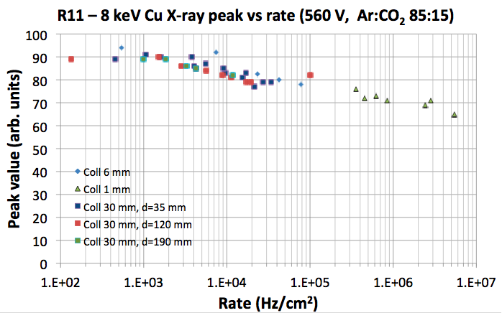
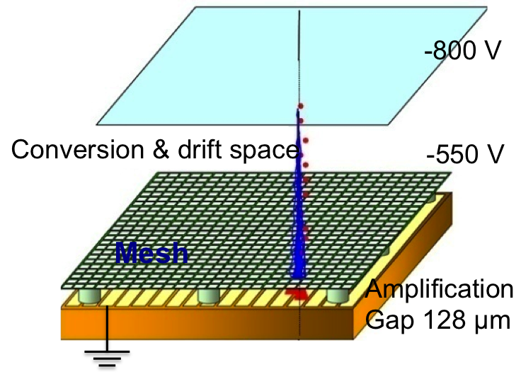
Detectors for the Upgrade
Micromegas: Tracking (+Trigger)
  Excellent Position resolution
  Very high granularity (excellent 2 track separation)
  Very good rate capability.
  Use of resistive strips improved dramatically Spark behaviour
  Chosen for the ATLAS Phase 1 upgrade: Technology under development
500 µm
strip pitch

Slide 22
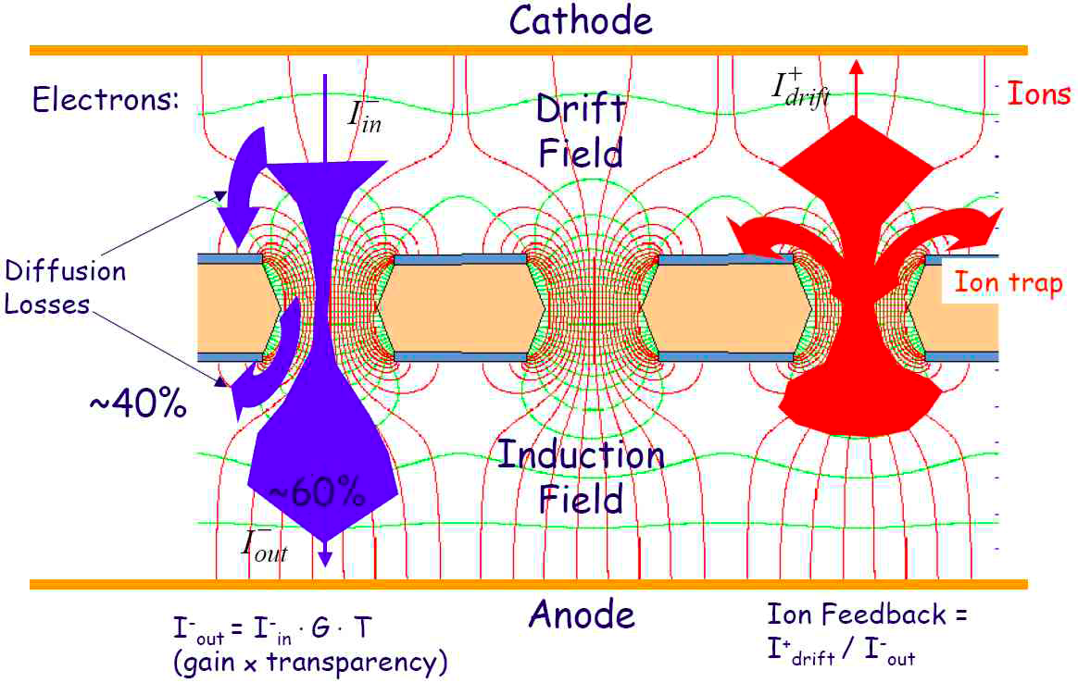
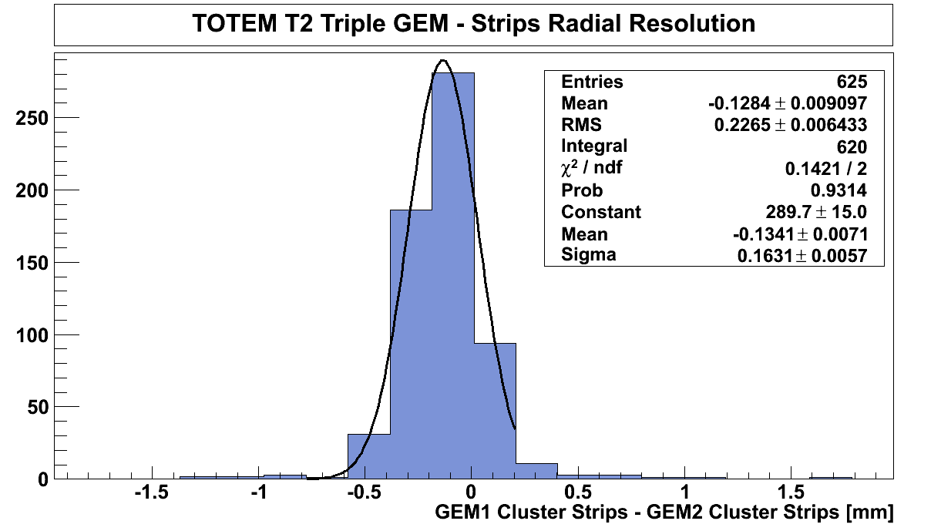
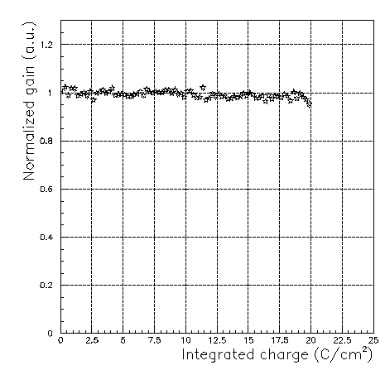
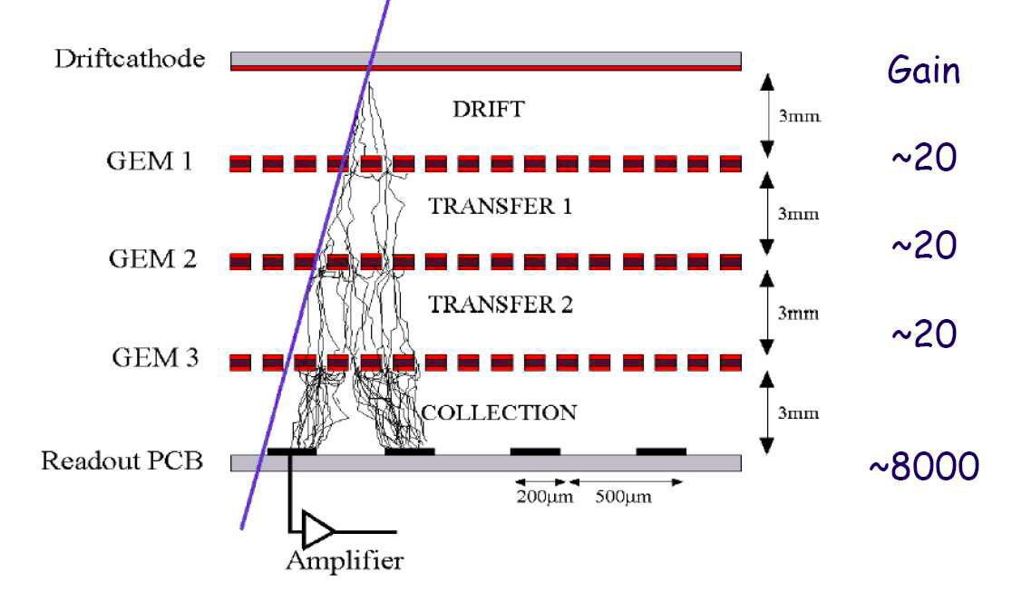
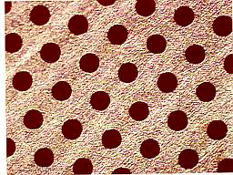
Detectors for the Upgrade
Triple GEMs: Tracking+Trigger
  Good Position and time resolution
  Very high granularity (excellent 2 track separation)
  Very good rate capability.
  Chosen for the CMS Phase 1 upgrade: Technology under development
0.4 mm strip
σ_{s}~115 μm
Ageing properties
Stable Gain vs very large integrated charge

Slide 23
Examples of Muon Physics at LHeC
Heavy Flavour production and Gluon PDFs
Top Production
  Precision measurement of Mass and Cross Section
Vector mesons: J/Psi and Y
Higgs
  Possibility to study Higgs coupling (e.g to bb) in a cleaner environment wrt LHC
General features: Interesting events at very small/large polar angle, high momentum muons emitted very forward.
  Need to further study and simulate these physics channels to better asses the muon detector requirements

Slide 24
LHeC Muon Detector requirements
Very large acceptance down to 1º and 179º
Muon Identification through matching of Inner tracker track with muon Segments in the muon system.
Stand alone muon measurement in the very forward region
Muon trigger
Integration in the proposed magnet systems (Central Solenoid + 2 Dipoles)
Very mild requirements on rate capabilities compared with LHC muon detectors

Slide 25
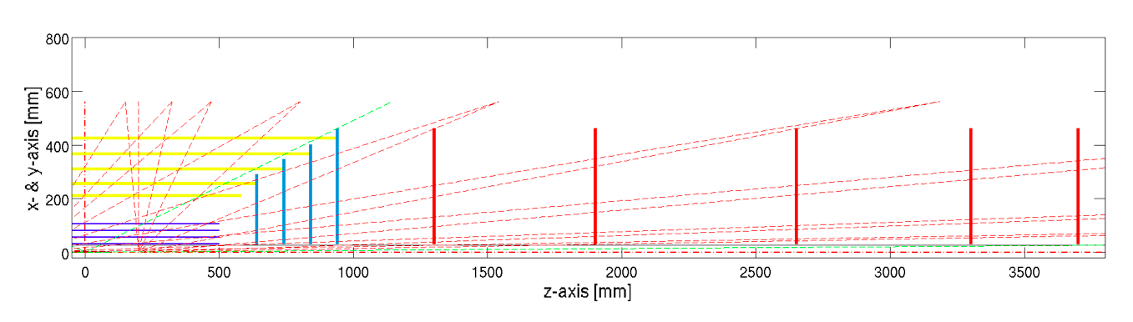
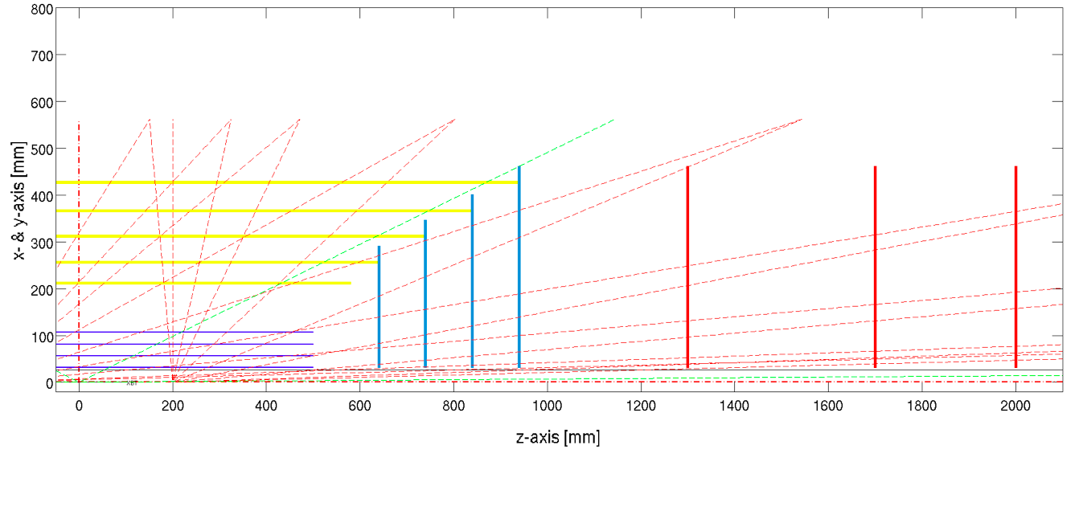
Possible Muon Systems
Barrel and End Cap Region (up to 10º<θ< 170º)
  Region Covered by Inner Tracker Acceptance
  Good momentum, impact parameter and polar angle measurement up to ~TeV. Need Muon identification
Forward tracker
Backward tracker
σp_{t}/p_{t}² vs Polar Angle
σIP vs Polar Angle
1 GeV
10 GeV
1000 GeV
<10 μm@ 1 TeV
60% @ 1 TeV

Slide 26
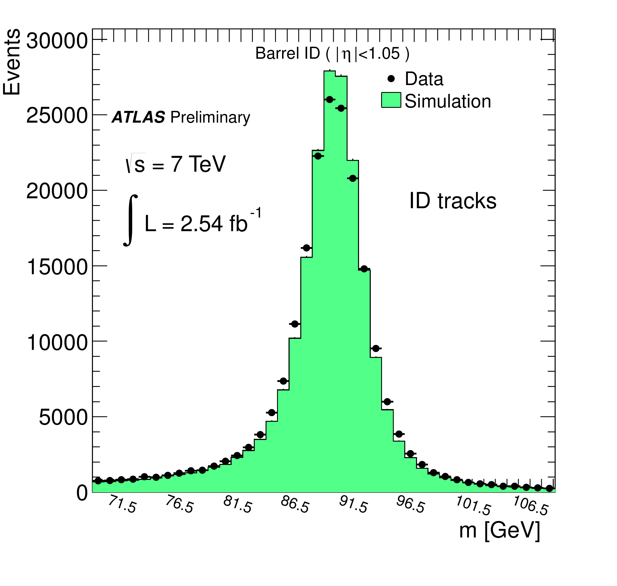
Possible Muon Systems
Barrel and End Cap Region
Option 1)
  Muon Tagger
    Trigger and tracking detectors with good time resolution and rough space resolution
      mRPC or sTGC good candidates (see previous slides) OR
      Drift Tubes and RPC for triggering
    Matching the ID muon track with the Muon catcher segments using only position information (within a given time window)
    No Pt matching.
Tagging Efficiency
Z mass with segment tagged μ

Slide 27
Possible Muon Systems
Barrel and and End Cap Region
Option 1 cntd)
    Three stations of triggering and tracking detectors spaced by iron absorbers.
    Can possibly profit from an Existing Magnet As Absorber
~2 λ
∼17 X₀
Iron 30-40 cm
Density 7.87 g/cm³
Radiation length 1.76 cm
Interaction Length 131.9 g/cm²
dE/dx 1.45 MeV/g/cm²
3 Stations
3-4 layers of measuring planes per station
No momentum selection from trigger only geometrical coincidences.
Pointing to IP

Slide 28

Possible Muon Systems
Barrel and End Cap Region (up to10º<θ< 170º)
Option 2) (Ferrari Solution)
  Muon Spectrometer with Stand Alone capabilities
    Use of 2 coupled Solenoid one in the inner region (ID) and the other one in the Muon Region.
    Excellent Field configuration (very uniform) 1.5 T. Coverage of bending power down to very small angles.
    Precise momentum measurement from few GeV to 500 GeV.
    Trigger and tracking detectors with good time resolution and excellent space resolution
    Matching the ID muon track with the Muon Spectrometer track both in position and in momentum
    Three stations of triggering and tracking detectors
    Need sophisticated and excellent alignment system to exploit the stand alone capability.

Slide 29
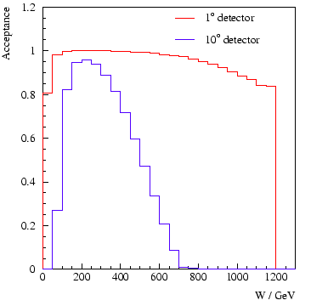
Very Forward region
Coverage up to 1º<θ < 10º and 170º< θ<179º for superior acceptance of vector mesons, Top decay products, Leptoquarks etc.
Stand alone momentum measurements needed
  Poor performance of Inner tracker in this region
Some overlap with the Forward region
  needed to understand efficiencies, fakes and resolution of Stand Alone muons.
In Forward direction high momentum muons, opening angles between muons very small
  Very good two tracks resolution
    Highly segmented detectors
    Micromegas or GEMs
High momentum resolution can be achieved with air core toroids.
Vector meson Acceptance

Slide 30
Possible Magnetic configurations
Air Core Toroid
  Excellent stand alone momentum resolution
  Need of excellent space resolution, segmentation and alignment on detector side
  More Complex
  Possible interference of the fringe field on Beam
Iron Toroid
  Easy and Chip
  No Fringe Field on Beam
  Limited Pt resolution due to Multiple Scattering: > 10%
  Higher production of δ rays
  Need of average spatial resolution and mild requirements on alignment.
Beam Pie
Tracking Chambers
Micromegas or Triple Gem
Iron toroids

Slide 31
Conclusions
The LHeC muon detector has to be further studied and optimized against the relevant physics channels.
The present technologies used for the LHC detectors are perfectly adequate for most of the acceptance
  No special requirements on resolution or alignment, a good Muon Catcher combined with the Inner tracker should be enough for the physics goals.
Need very high angular coverage
  Very segmented detectors coupled with Toroids should allow stand alone muon measurement in the very forward region.
  On a personal note: It was very interesting for me to prepare this talk and I wish you all
  Good Luck

Slide 32
Back Up

Slide 33
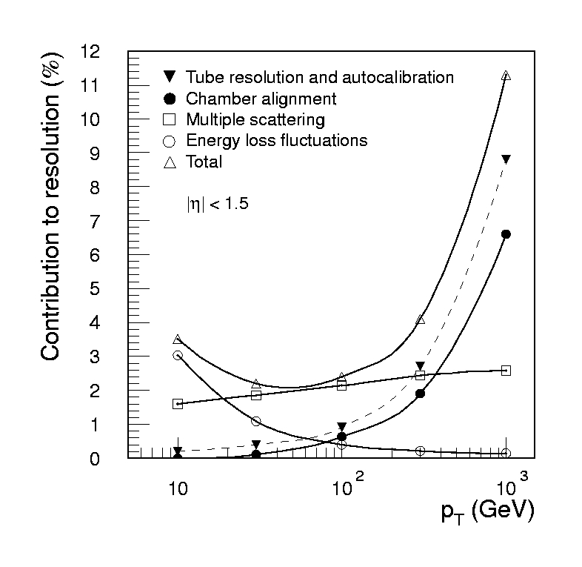
Momentum measurements basic formulae
(Δp/p)_{Mis} : Gets better for larger L (1/L²)
(Δp/p)_{MS} : Gets better for low mass detectors
For the Best part of ATLAS air core spectrometer
  B=0.6 T L= 5 m σ= 50 μm x = 0.2 X₀
  Δp/p_{MS} dominates resolution up to 250 GeV
Δp/p_{MS} = 2.7 %
Δp/p_{Mis =} Δp/p_{MS} @ 270 GeV
Δp/p_{Mis} = 10 % for p = 1 TeV/c
Multiple scattering
Energy loss fluctuations
Chamber resol and align.

