Slide 1

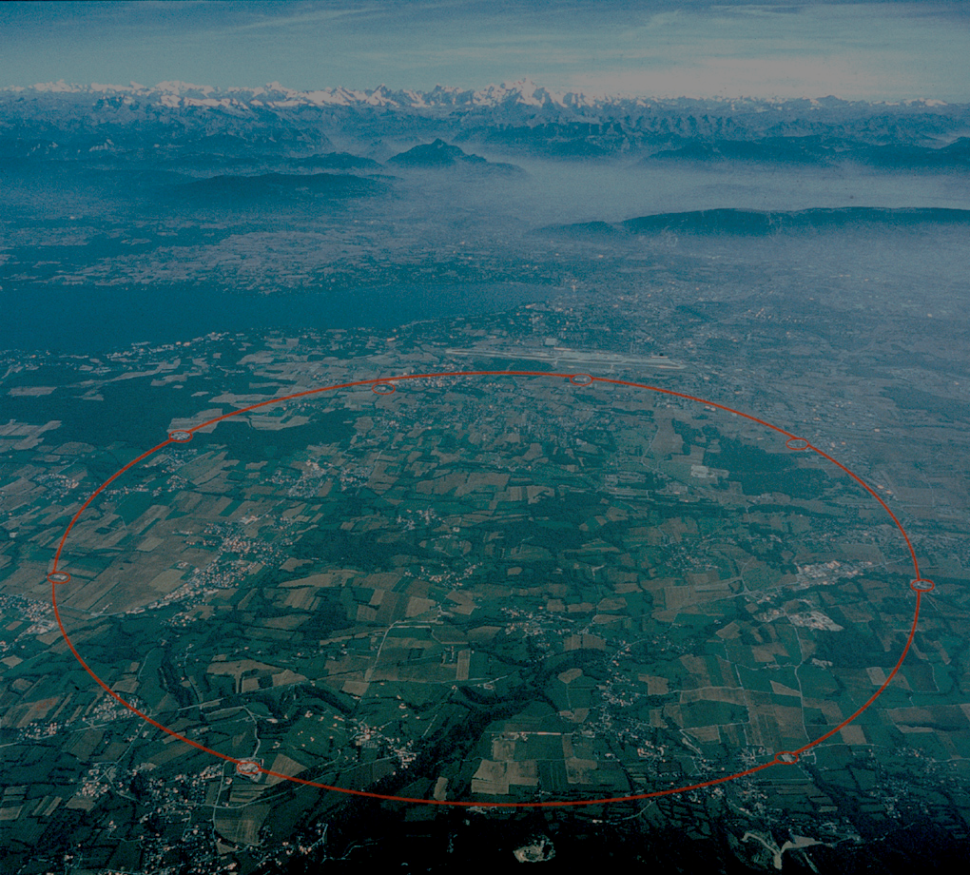
LHeC Accelerator Overview
Frank Zimmermann
LHeC Workshop 2012
Chavannes-de-Bogis
Many contributors:
Jose Abelleira, Chris Adolphsen, Husnu Aksakal, Rob Appleby, Mei Bai, Desmond Barber Nathan Bernard, Alex Bogacz, Luca Bottura, Chiara Bracco, Hans Braun, Oliver Brüning, Eugene Bulyak, Helmut Burkhardt, Swapan Chattopadhyay, Ed Ciapala, Kenan Ciftci, Reina Ciftci, John Dainton, Anders Eide, Emre Eroglu, Miriam Fitterer, Hector Garcia, Brennan Goddard, Yue Hao, Friedrich Haug, Bernhard Holzer, Erk Jensen, Miguel Jimenez, John Jowett, Dmitry Kayran, Max Klein, Peter Kostka, Vladimir Litvinenko, Karl Hubert Mess, Zafer Nergiz, John Osborne, Tatiana Pieloni, Alessandro Polini, Vadim Ptitsin, Louis Rinolfi, Lucio Rossi, Stephan Russenschuck, Daniel Schulte, Ilkyoung Shin, Peter Sievers, Mike Sullivan, Saleh Sutansoy, Hugues Thiesen, Luke Thompson, Rogelio Tomas, Davide Tommasini, Dejan Trbojevic, Joachim Tückmantel, Alessandro Variola, Ferdinand Willeke, Vitaly Yakimenko, Fabian Zomer, … ++

Slide 2
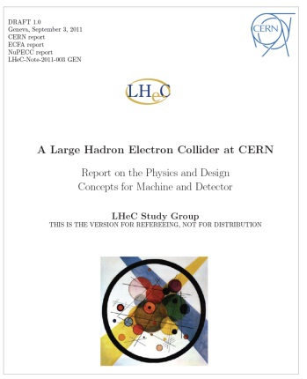

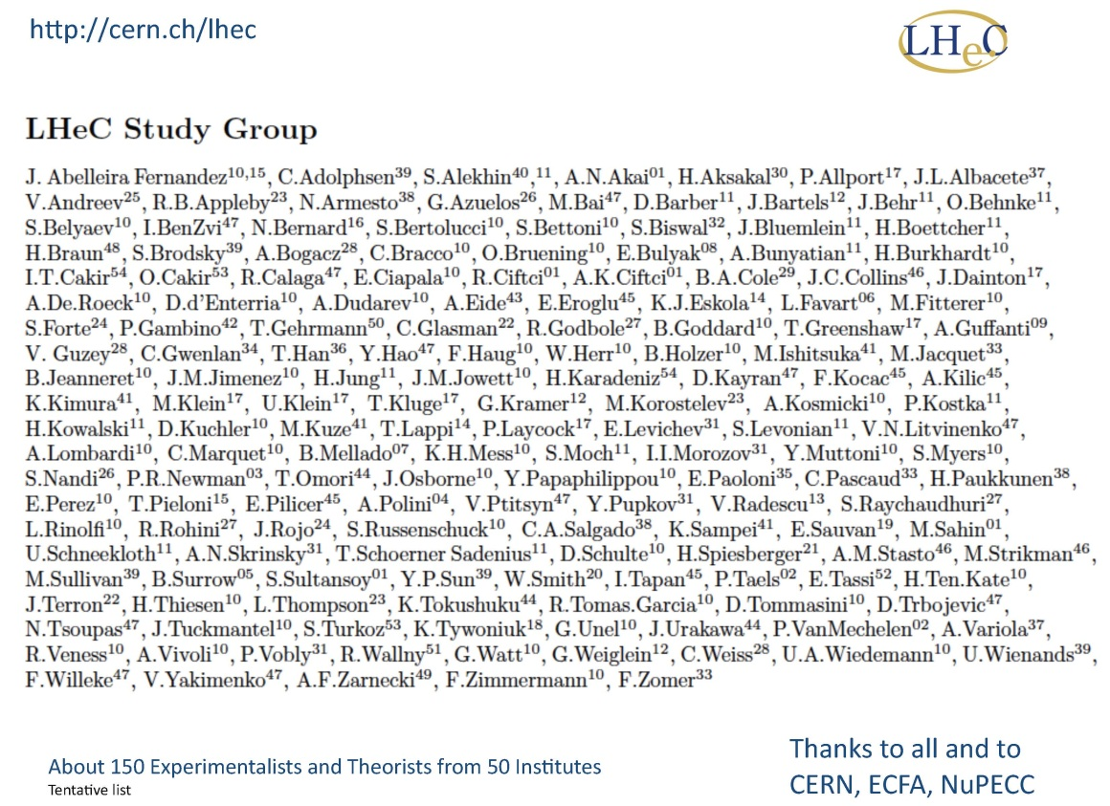
Large Hadron electron Collider (LHeC)
LHeC CDR completed (~600 pages);

Slide 3
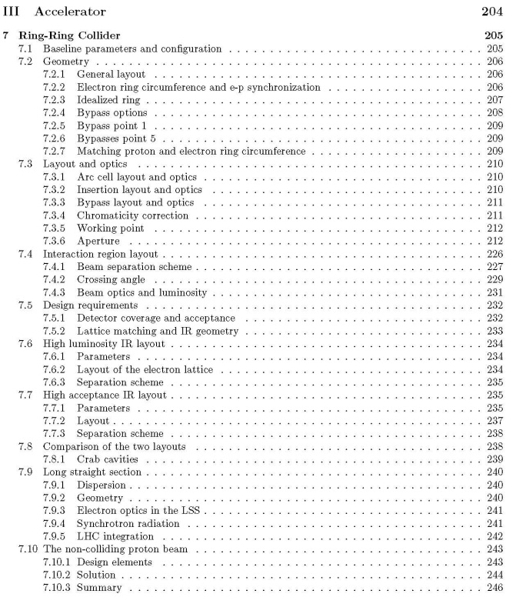
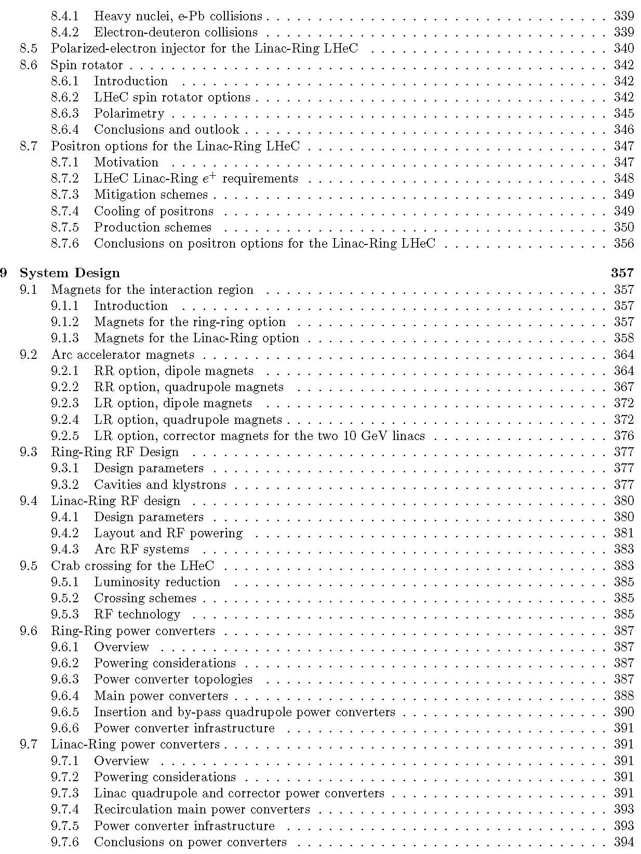
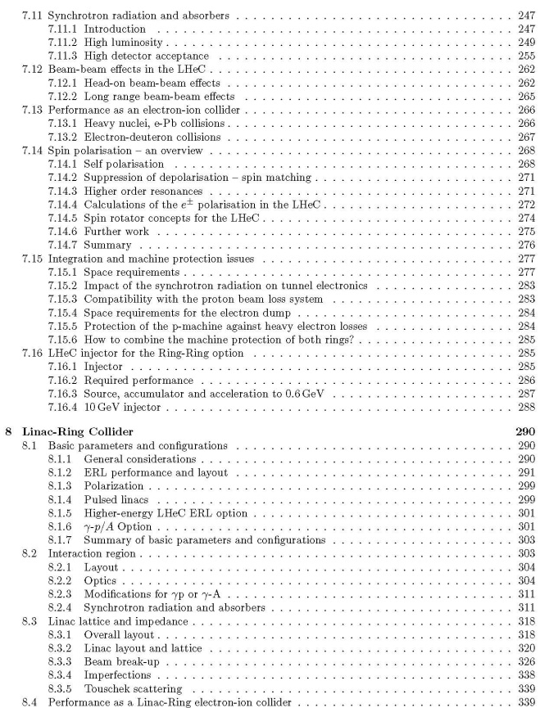
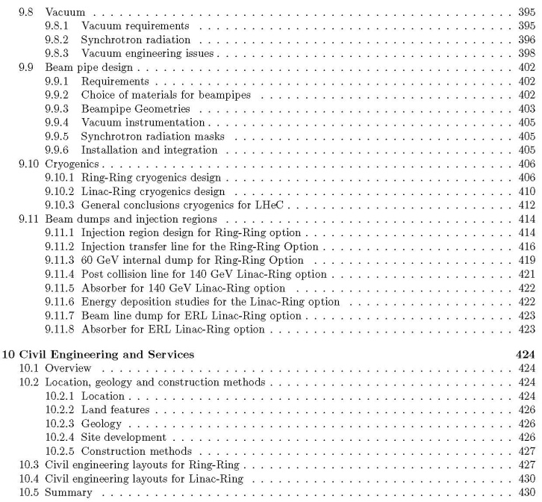
LHeC CDR
Accelerator
Part:
table of
contents;
4 chapters;
226 pages

Slide 4
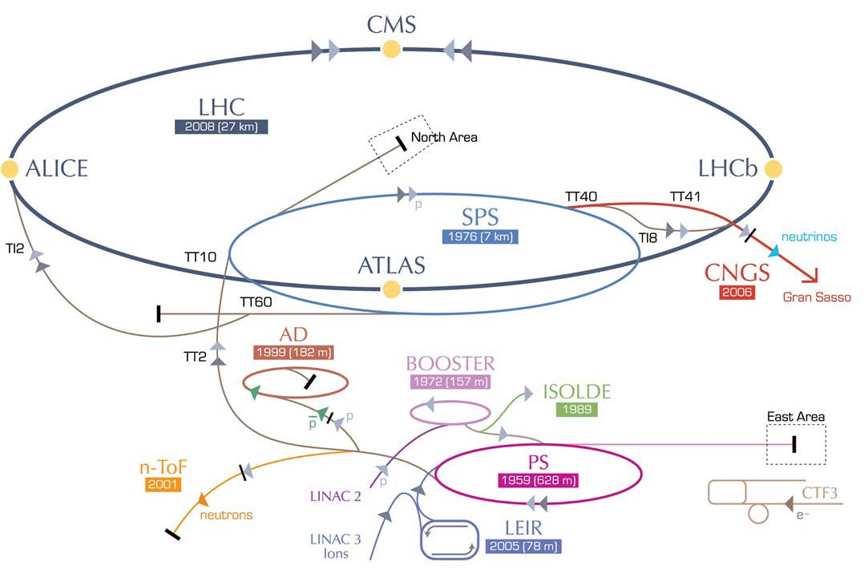
Large Hadron electron Collider
RR LHeC:
new ring
in LHC tunnel,
with bypasses
around
experiments
LR LHeC:
recirculating
linac with
energy
recovery
RR LHeC
e-/e+ injector
10 GeV,
10 min. filling time

Slide 5
performance targets
e- energy ≥60 GeV
luminosity ~10³³ cm⁻²s⁻¹
total electrical power for e-: ≤100 MW
e⁺p collisions with similar luminosity
simultaneous with LHC pp physics
e⁻/e⁺ polarization
detector acceptance down to 1º

Slide 6
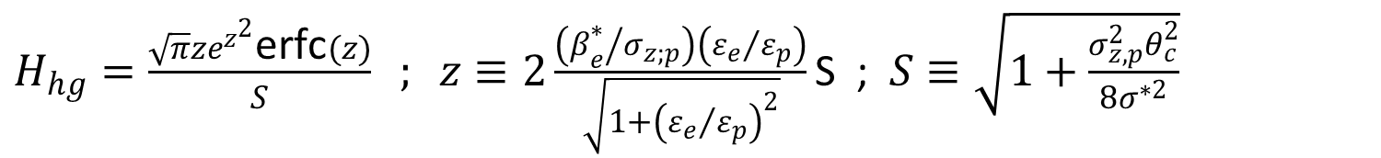
colliding unequal beams
ring-ring
ε_{e}>>ε_{p}
ring-linac
ε_{e}≈ε_{p}
minimum beta function
and beam size
limited by hourglass effect;
small crossing angle acceptable;
little disruption
smaller beta function
and beam size possible;
head-on collision required;
significant disruption
$H_{hg}=\frac{\sqrt{π}ze^{z^{2}}\text{erfc}(z)}{S} ; z≡2\frac{\left({β_{e}^{∗}}/{σ_{z;p}}\right)\left({ε_{e}}/{ε_{p}}\right)}{\sqrt{1+{\left({ε_{e}}/{ε_{p}}\right)}^{2}}}\text{S}$ ; $S≡\sqrt{1+\frac{σ_{z,p}^{2}θ_{c}^{2}}{8σ_{}^{∗2}}}$

Slide 7
R-R LHeC road map to 10³³ cm⁻²s⁻¹
luminosity of RR collider:
H_{D}~1
(flat beams)
highest proton
beam brightness “permitted”
(ultimate LHC values)
γε=3.75 μm
N_{b}=1.7x10¹¹
bunch spacing
25 or 50 ns
average e⁻
current
limited by SR
I_{e}=100 mA
maximize
geometric
factor with nonzero
crossing angle
and hourglass
effect (small be*)
β*_{x,y (p)}=4, 1 m

Slide 8
L-R LHeC road map to 10³³ cm⁻²s⁻¹
luminosity of LR collider:
H_{D}~1.3
(round beams)
D. Schulte
LHeC2010
average e⁻
current
limited by
energy
recovery
efficiency
I_{e}=6.4 mA
maximize geometric
overlap factor
head-on collision
small e- emittance
θ_{c}=0
H_{hg}≥0.9
highest proton
beam brightness “permitted”
(ultimate LHC values)
γε=3.75 μm
N_{b}=1.7x10¹¹
bunch spacing
25 or 50 ns
smallest conceivable
proton β* function:
reduced l* (23 m → 10 m)
squeeze only one p beam
new magnet technology Nb₃Sn
β*_{p}=0.1 m

Slide 9
LHeC design parameters
*) pulsed, but high energy ERL not impossible
electron beam | RR | LR | LR*
e- energy at IP[GeV] | 60 | 60 | 140
ep luminosity [10³² cm⁻²s⁻¹] | 8 | 10 | 0.4
eN luminosity [10³² cm⁻²s⁻¹] | 0.45 | 1 | 0.04
polarization for e⁻ (e⁺) [%] | 40 (40) | 90 (0) | 90 (0)
bunch population [10⁹] | 20 | 1.0 | 0.8
e- bunch length [mm] | 6 | 0.3 | 0.3
bunch interval [ns] | 25 | 25 | 25
transv. emit. γε_{x,y} [mm] | 0.59, 0.29 | 0.05 | 0.1
rms IP beam size σ_{x,y} [μm] | 45, 22 | 7 | 7
e- IP beta funct. β*_{x,y} [m] | 0.4, 0.2 | 0.12 | 0.14
full crossing angle [mrad] | 0.93 | 0 | 0
geometric reduction H_{hg} | 0.87 | 0.91 | 0.94
disruption enhancement | 1.0 | 1.3 | ~1.0
repetition rate [Hz] | N/A | N/A | 10
beam pulse length [ms] | N/A | N/A | 5
ER efficiency | N/A | 94% | N/A
average current [mA] | 100 | 6.4 | 5.4
tot. wall plug power[MW] | 100 | 100 | 100
proton beam | RR | LR
bunch pop. [10¹¹] | 1.7 | 1.7
tr.emit.γε_{x,y} [μm] | 3.75 | 3.75
spot size σ_{x,y} [μm] | 30, 16 | 7
β*_{x,y} [m] | 4.0,1.0 | 0.1
bunch spacing [ns] | 25 | 25
50 ns & N_{b}=1.7x10¹¹
probably conservative
design also for deuterons
(new) and lead (exists)
RR= Ring – Ring
LR =Linac –Ring
higher-L
design exists
β*~0.025 m possible in IP3 or 7
using ATS optics (S. Fartoukh);
+ also going to 2 μm emittance
(H. Damerau, W. Herr),
→L~10³⁴ cm⁻²s⁻¹ within reach!

Slide 10
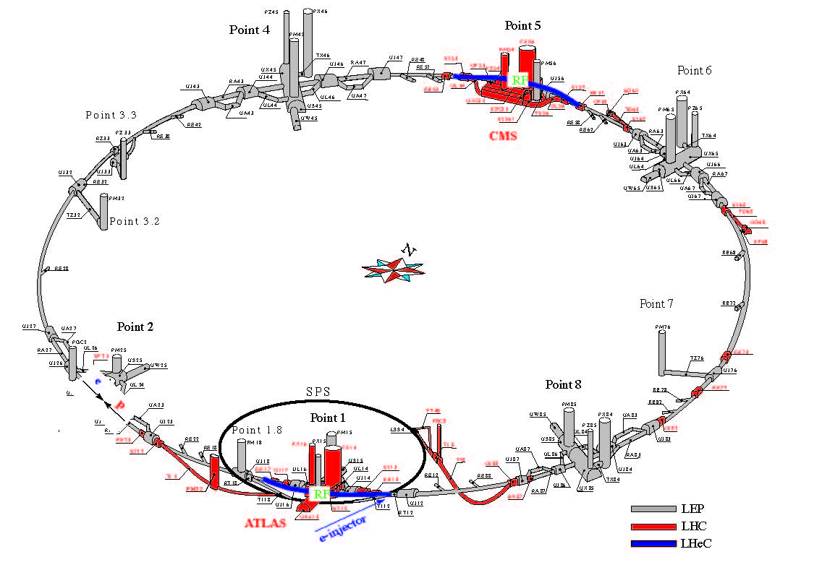
LHeC Ring-Ring Layout
H. Burkhardt,
M. Fitterer, B. Holzer,
J. Jowett
Two LHeC bypasses shown in blue - each 1.3 km long. RF in the central straight sections of the two bypasses (<500 m total). The bypass around Point 1 also hosts the injection.

Slide 11
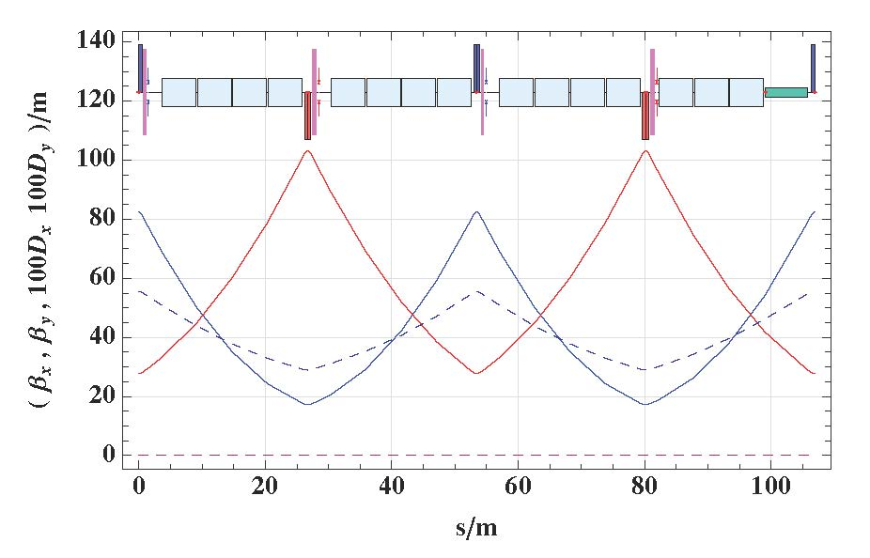
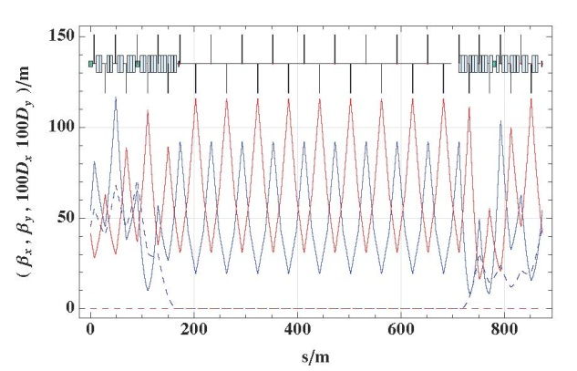
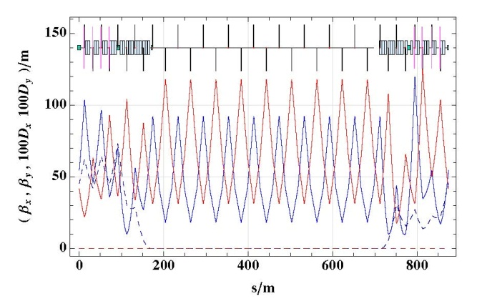
LHeC Ring-Ring Arc Optics
even IR
2 LHeC FODO cells = 1 LHC FODO cell
odd IR
H. Burkhardt,
M. Fitterer,
B. Holzer,
J. Jowett
ε_{x,LHeC}<1/3 ε_{x,LEP1.5}

Slide 12
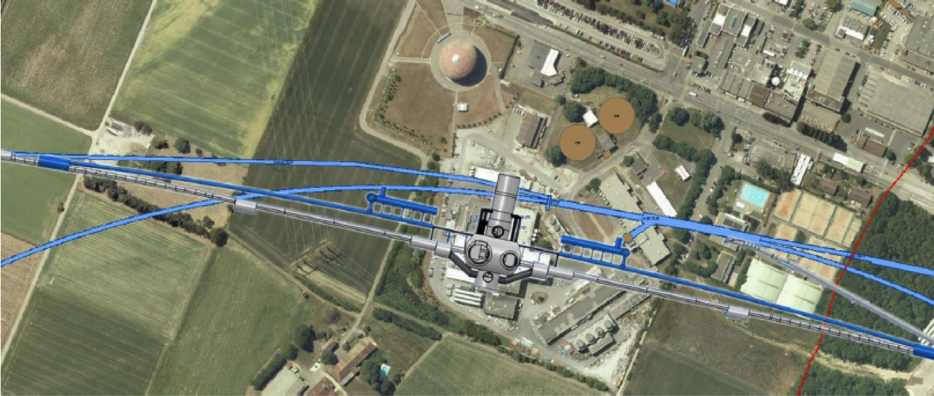
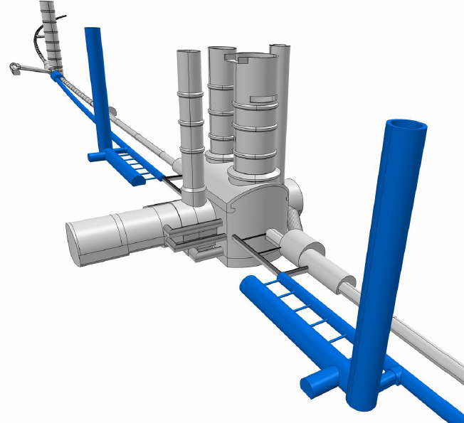
LHeC R-R: Bypassing LHC detectors
Oliver Brüning,
ED 20 March 12
Without using the survey gallery the ATLAS bypass would need to be 100m away from the IP or on the inside of the tunnel!
For the CDR the
bypass concepts
were decided to be confined to
ATLAS and CMS
ca. 1.3 km long bypass
ca. 170m long dispersion free area for RF

Slide 13
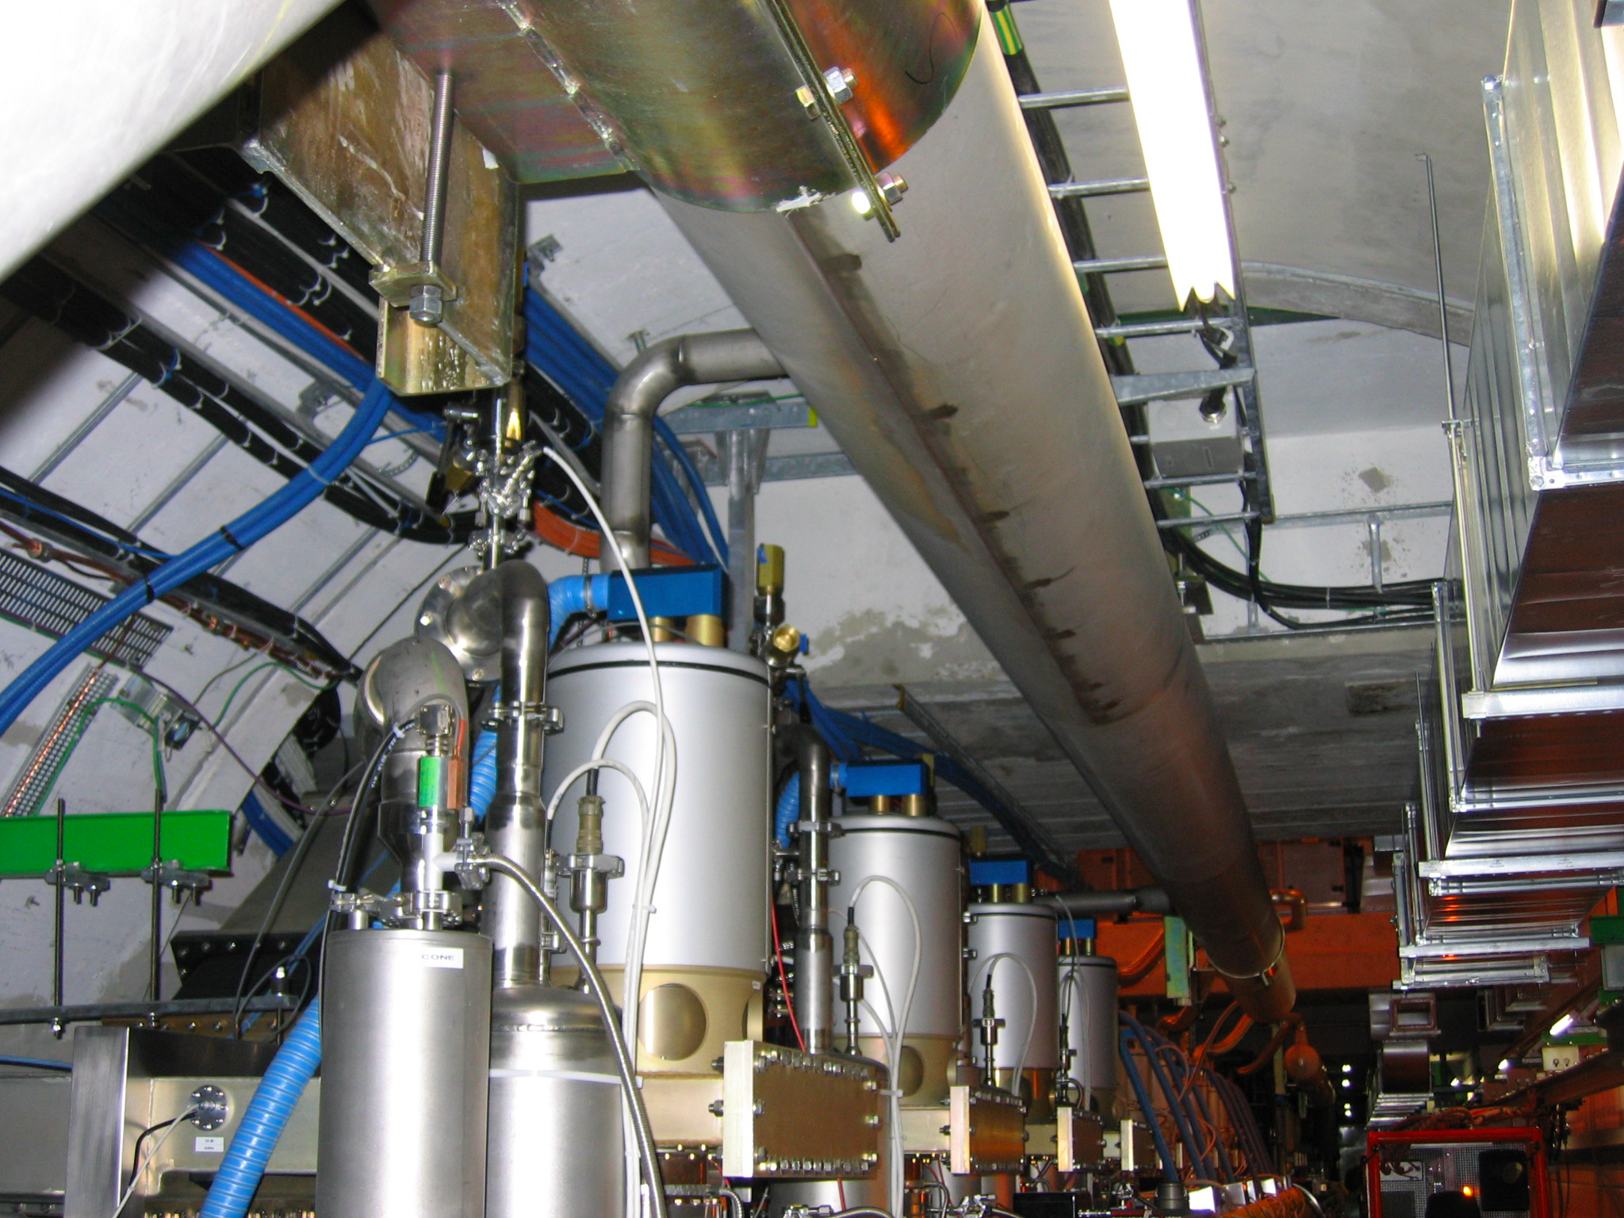
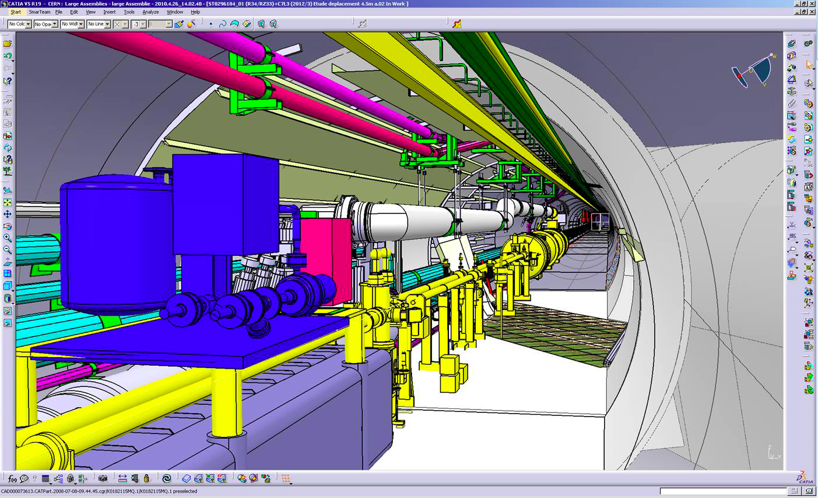
LHeC R-R: Integration in LHC tunnel
RF Installation in IR4
Cryo link in IR3
Oliver Brüning,
ED 20 March 12

Slide 14
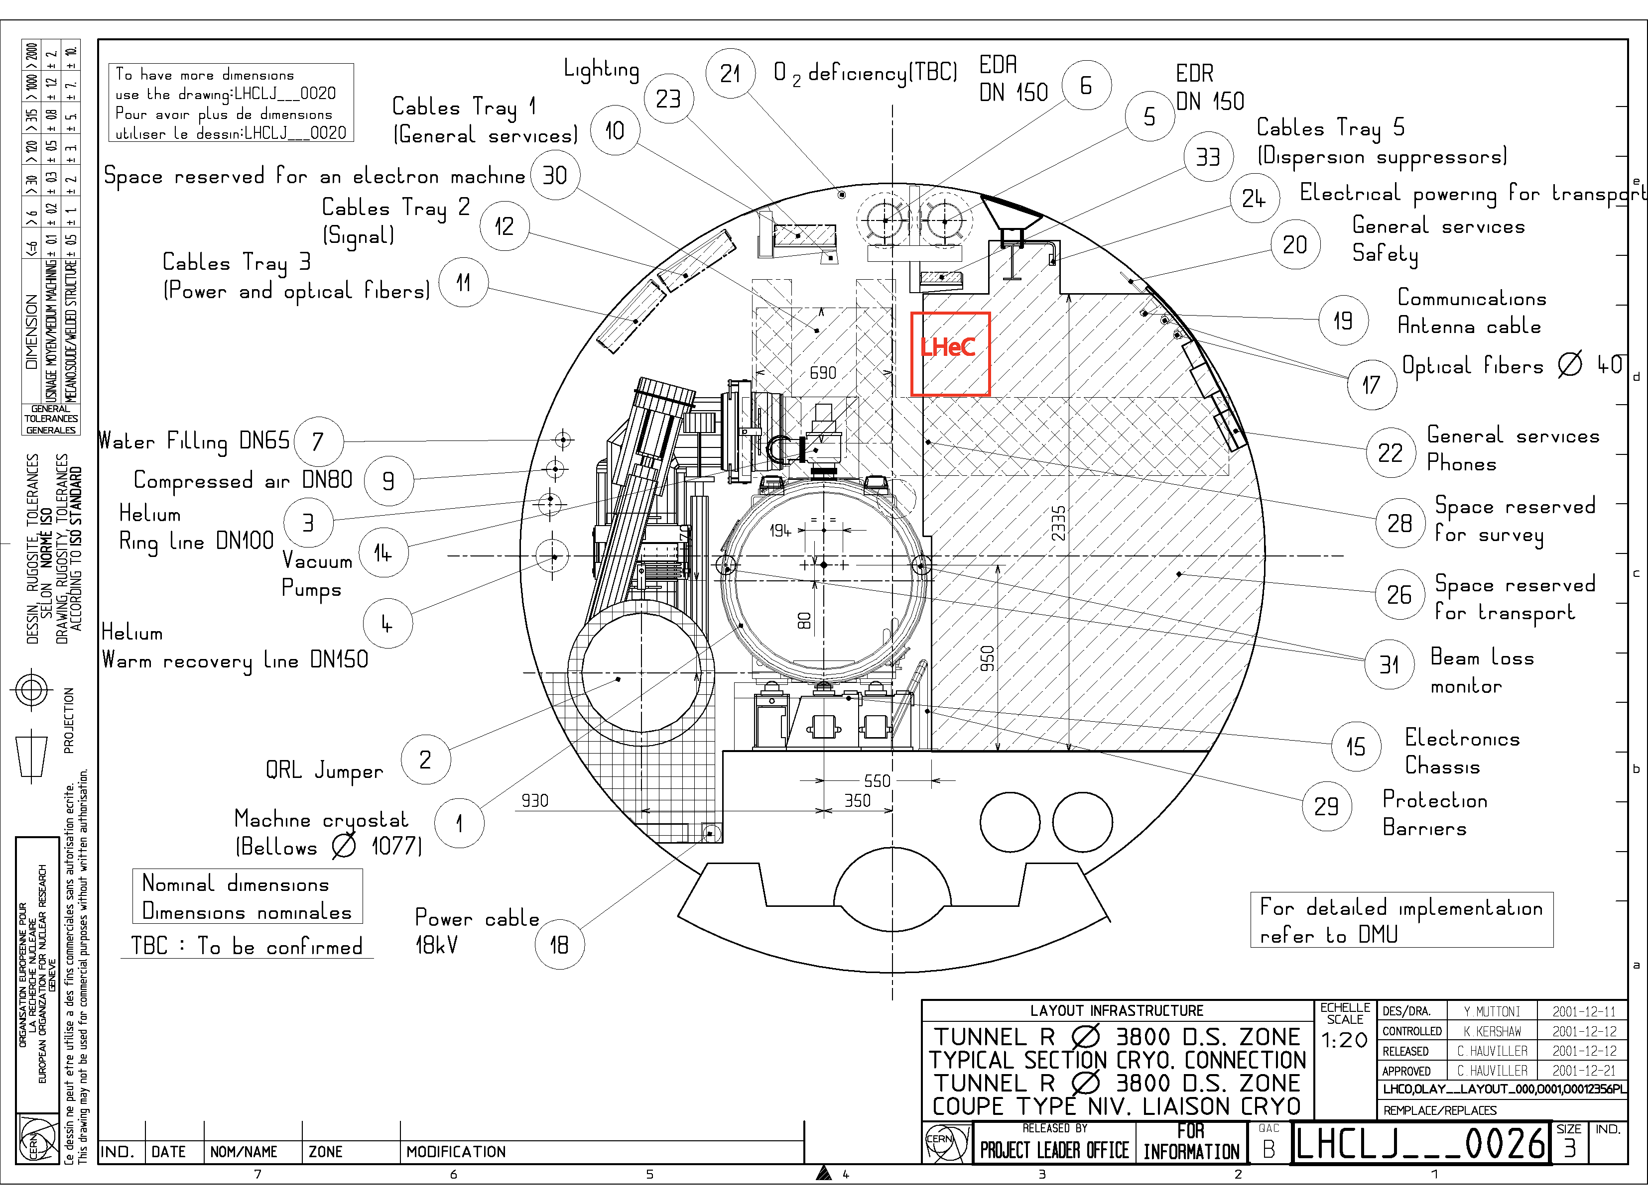
LHeC R-R: Matching LHC circumference
requires:
support
structure
with
efficient
montage
and
compact
magnets
to transport LHC cryo equipment e⁻ ring may need to be
shifted 30 cm to the outside ; semi-automatic movement
& expansion joints

Slide 15
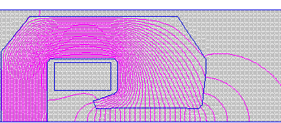
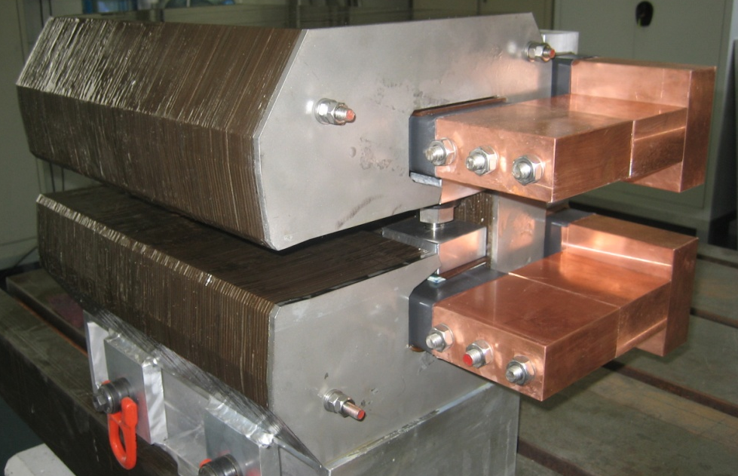
LHeC R-R dipole magnets: 400 mm long CERN model
interleaved ferromagnetic laminations
air cooled
two turns only, bolted bars
0.4 m models with different types of iron
30 cm
[Davide Tommasini]
Magnet Parameters of the full length magnet
Beam Energy [GeV] | 70
Magnetic Length [m] | 5.45
Magnetic field [Gauss] | 127-763
Number of magnets | 3080
Vertical aperture [mm] | 40
Pole width [mm] | 150
Number of coils | 2
Number of turns/coil | 1
Current [A] | 1500
Conductor section [mmxmm] | 92x43
Conductor material | aluminum
Magnet Inductance [mH] | 0.15
Magnet Resistance [mΩ] | 0.2
Power per magnet [W] | 450
Cooling | air
Weight [tons] | 1.5
Manufacture & tests of 3 models

Slide 16
LHeC Ring-Ring Challenges
bypassing the main LHC detectors
  CMS: 20 cm distance to cavern, 1.3 km bypass, 300 m for RF installation
  ATLAS: using the survey gallery, 1.3 km bypass, 170 m for RF installation; similar schemes for LHCb & ALICE
integration into the LHC tunnel
  cryo jumpers taken into account in arc-cell design
installation matching LHC circumference
  avoiding Hirata-Keil resonances, arcs ~4000 magnets
  no show stopper found; 3D integration needed
  compact magnet design & prototypes (BINP & CERN)
  installation within LHC shutdown schedule

Slide 17
LHeC Ring-Ring Conclusions
Low-emittance optics compatible with LHC
Light arc magnet prototypes from Novosibirsk and CERN show that required field quality and reproducibility is achievable
No fundamental problem found for R-R LHeC
But RR still needs a full 3-D integration study!
Planning integration into LS2 and LS3 might be challenging!
40% polarization to be demonstrated
Oliver Brüning,
ED 20 March 12

Slide 18
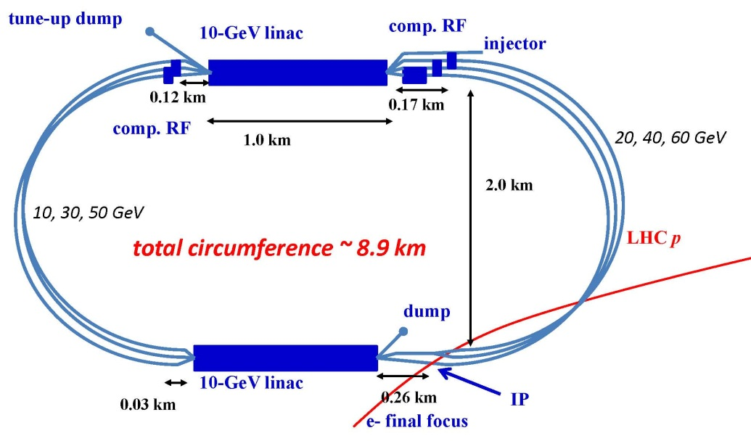
LHeC Linac-Ring Option: ERL layout
two 10-GeV SC linacs, 3-pass up, 3-pass down; 6.4 mA, 60 GeV e-’s collide w. LHC protons/ions
A. Bogacz, O. Brüning,
M. Klein, D. Schulte,
F. Zimmermann, et al
(C=1/3 LHC allows for ion clearing gaps)

Slide 19
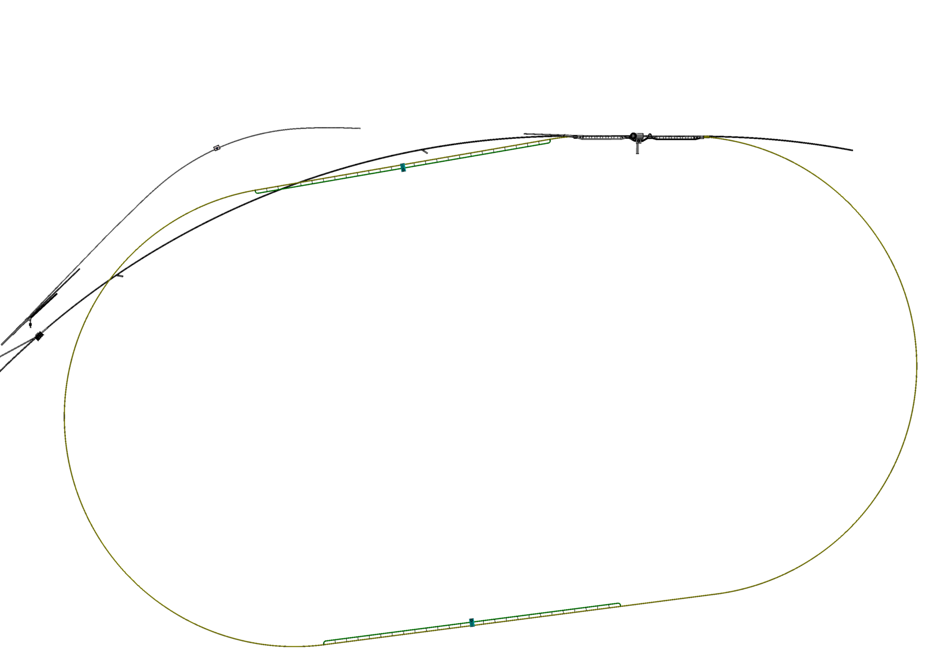
LHeC RL option: underground layout / integration with LHC;
example: Point 2
TI2
Alice
LHC
Prevessin site
J.Osborne / A.Kosmicki CERN/GS

Slide 20
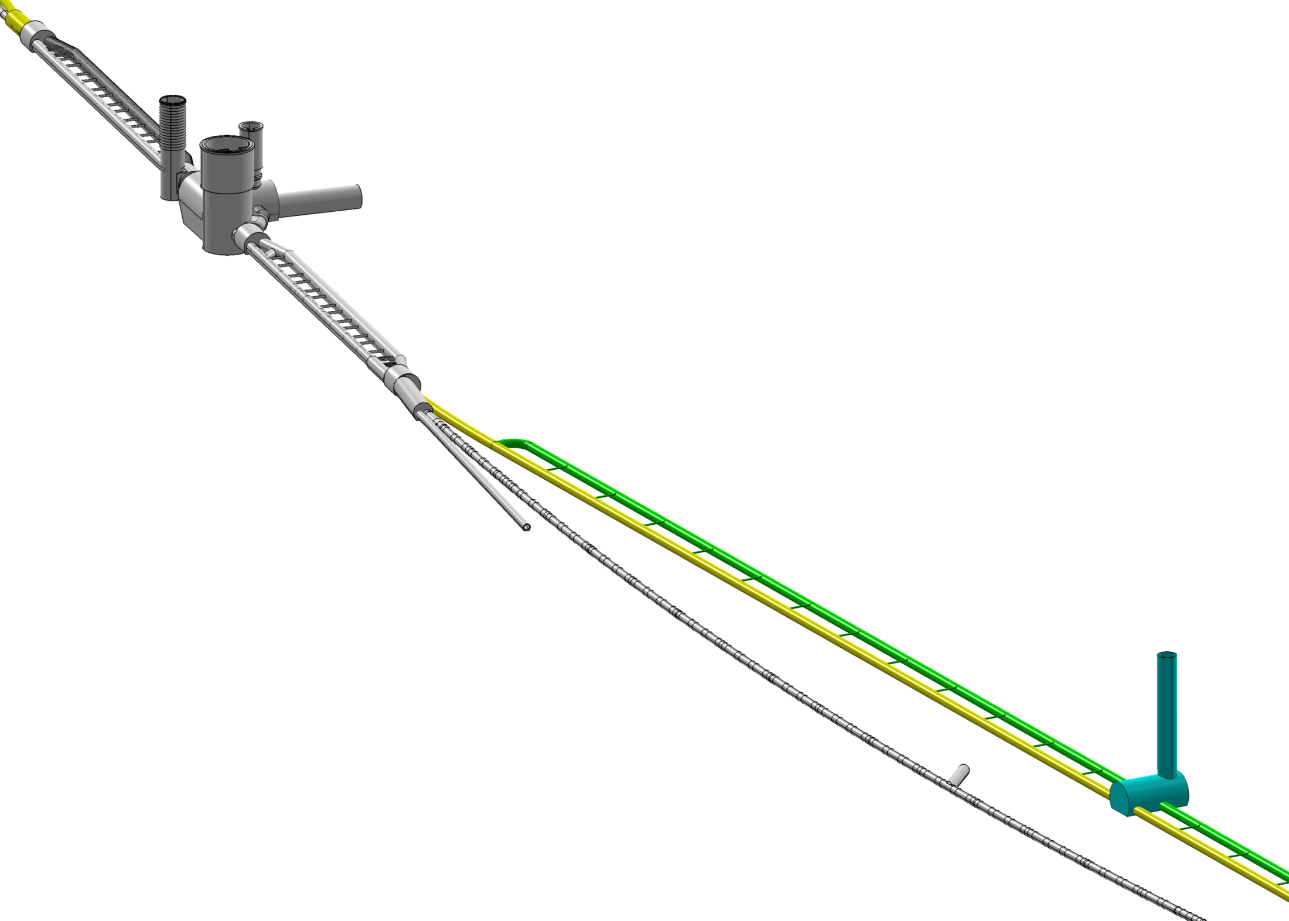
underground layout / integration with LHC;
example: Point 2
Alice
TI2
J.Osborne / A.Kosmicki CERN/GS

Slide 21
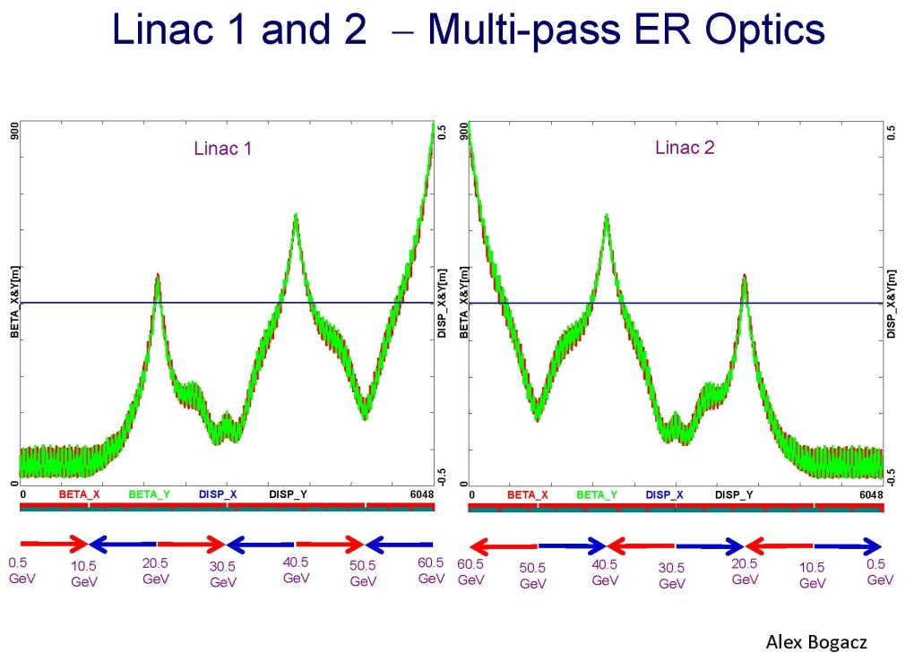
LHeC L-R Option: ERL Linac Optics

Slide 22
LHeC L-R: Vertical Separation of Arcs
& Spreader Optics
Arc 1 (10 GeV)
Arc 3 (30 GeV)
Arc 5 (50 GeV)
Alex Bogacz

Slide 23
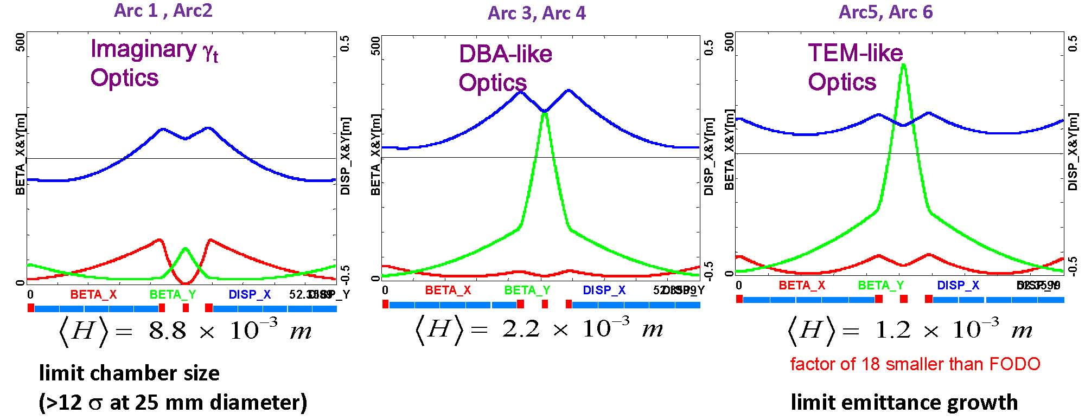
LHeC L-R Option: ERL Arc Optics
flexible momentum compaction cell; tuned for small beam size (low energy) or low Δε (high energy)
A. Bogacz

Slide 24
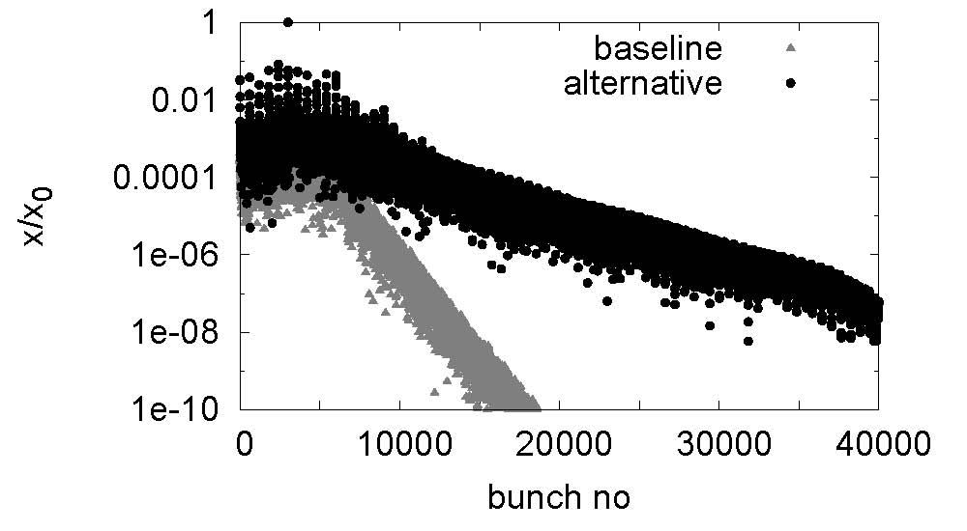
LHeC L-R Option: ERL Beam Dynamics
BBU: beam stability requires both damping (Q~10⁵) & detuning (Δf/f_{rms}~0.1%) , 720 MHz
(no focusing)
D. Schulte

Slide 25
LHeC Linac-Ring Challenges
2 x 10 GeV SC Energy Recovery Linacs
  SC linac: synergies with ESS, SPL, XFEL, JLAB, ILC, eRHIC
  linac size similar to XFEL at DESY; cryo power ~1/2 LHC
  less current than other ERL designs (CESR-ERL, eRHIC)
return arcs
  total circumference ~ 9 km, 3 passes
  same magnet design as for RR option, >4500 magnets
  installation fully decoupled from LHC operation
e⁺p luminosity: e⁺ production & recycling
  IP e+ rate ~100 times higher than for CLIC or ILC
  several schemes proposed to achieve this

Slide 26
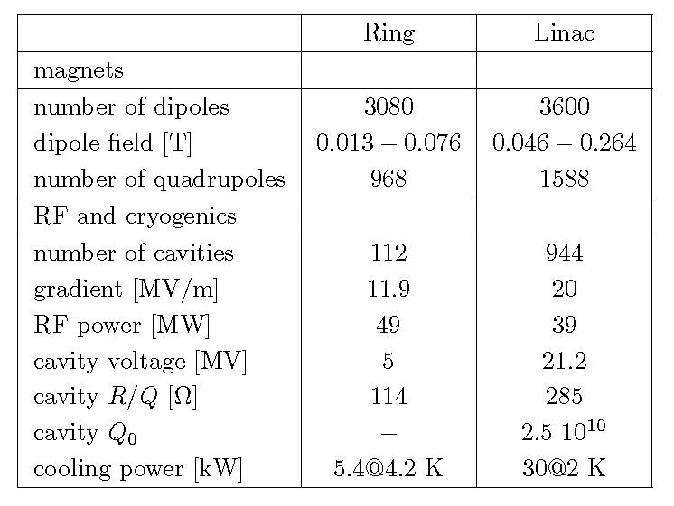
L-L&R-L LHeC arc magnets & RF cavities

Slide 27
electrical power
 | ring-ring | linac-ring
cryogenics | 1 MW | 21 MW
RF (microphonics + SR) | 79 MW | 58-80 MW*
injector | ? | 7 MW
magnets | 2 MW | 4 MW
total | 82 MW | 91-113 MW
*Erk Jensen, Chamonix’12

Slide 28
LHeC L-R & R-R Joint IR Challenges
interaction region layout for 3 beams
  exit holes & optics, R-L: detector integrated dipole
final quadrupole design
  Q1 half quadrupole design
  synergy with HL-LHC developments (Nb₃Sn)
IR synchrotron radiation shielding
  IR SR ~50 kW for both; E_{c}~163 (R-R) or 718 keV (R-L)
  minimize backscattering into detector
  shielding of SC quadrupoles
  SC masking to be further optimized (vac & det. bkgd)
  spin rotator (including SR)

Slide 29
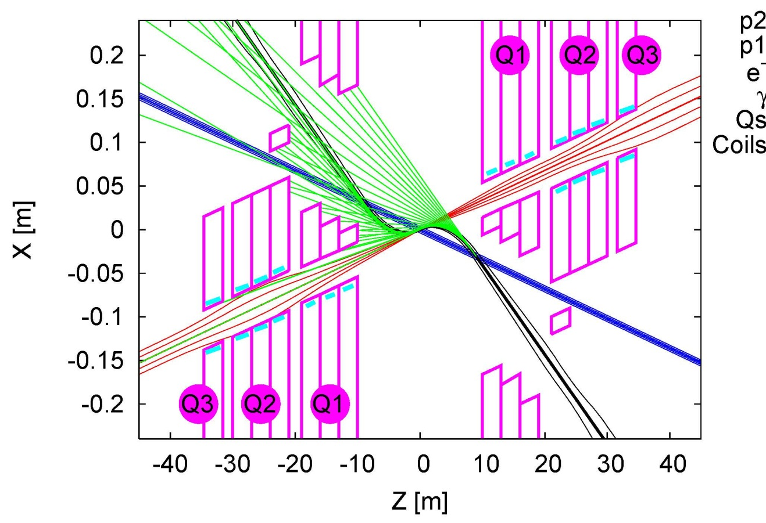
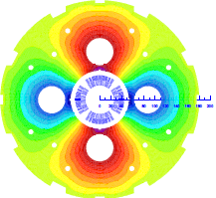
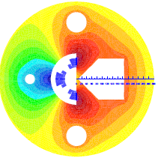
LR LHeC IR layout & SC IR quadrupoles
R. Tomas
Exit hole for electrons & non-colliding protons
Synchrotron radiation
S. Russenschuck
Q2
Electron beam
Q1
Q2
Q1
Nb3Sn (HFM46): 5700 A, 175 T/m, 4.7 T at 82% on LL (4 layers), 4.2 K | Nb3Sn (HFM46): 8600 A, 311 T/m, at 83% LL, 4.2 K
46 mm (half) ap., 63 mm beam sep. | 23 mm ap.. 87 mm beam sep.
0.5 T, 25 T/m | 0.09 T, 9 T/m
colliding proton beam
Non-colliding proton beam
Inner triplets
Inner triplets
High-gradient SC IR quadrupoles based on Nb3Sn for colliding proton beam with common low-field exit hole for electron beam and non-colliding proton beam
detector integrated dipole: 0.3 T over +/- 9 m

Slide 30
LHeC Linac-Ring e⁺ source
 | SLC | CLIC (3 TeV) | ILC (RDR) | LHeC
Energy | 1.19 GeV | 2.86 GeV | 5 GeV | 60 GeV
e⁺/ bunch at IP | 40 x 10⁹ | 3.72x10⁹ | 20 x 10⁹ | 2x10⁹
e⁺/ bunch before DR inj. | 50 x 10⁹ | 7.6x10⁹ | 30 x 10⁹ | N/A
Bunches / macropulse | 1 | 312 | 2625 | N/A
Macropulse repet. rate | 120 | 50 | 5 | CW
Bunches / second | 120 | 15600 | 13125 | 20x10⁶
e⁺ / second | 0.06 x 10¹⁴ | 1.1 x 10¹⁴ | 3.9 x 10¹⁴ | 400 x 10¹⁴
X 18
X 65
X 6666
L. Rinolfi

Slide 31
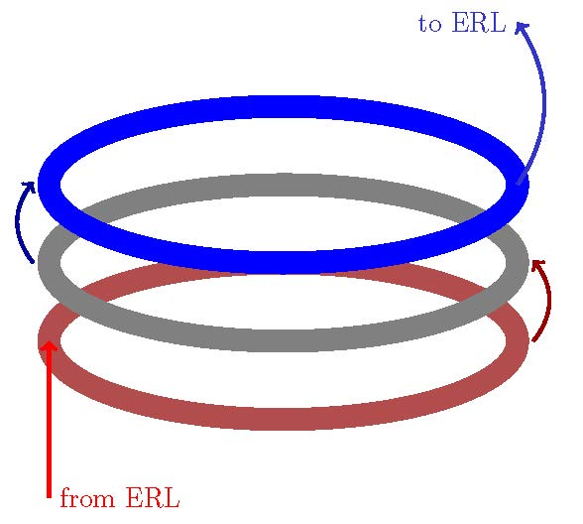
linac e+ source options
recycle e+ together with energy, multiple use,
  damping ring in SPS tunnel w τ⊥~2 ms
Compton ring, Compton ERL, coherent pair production, or undulator for high-energy beam
3-ring transformer & cooling scheme
(D. Schulte)
(Y. Papaphilippou)
(H. Braun,
E. Bulyak,
T. Omori,
V. Yakimenko)
extraction ring (N turns)
fast cooling ring (N turns)
accumulator ring (N turns)
(E. Bulyak)

Slide 32
some arguments for linac or ring
energy-recovery linac
    novel far-reaching energy-efficient technology
    no interference with LHC operation & HL-LHC work
    synergies w SPL, CEBAF+, ESS, XFEL, eRHIC, SPL, ILC, …
    new technology, great investment for future (e.g. neutrino factory, linear collider, muon collider, 20-GeV SC proton linac, HE-LHC injector, higher-energy LHeC, proton-driven plasma acceleration,…)
ring
    conventional, little risk, less demanding p optics
    synergies with LEP3 Higgs factory in LHC tunnel

Slide 33
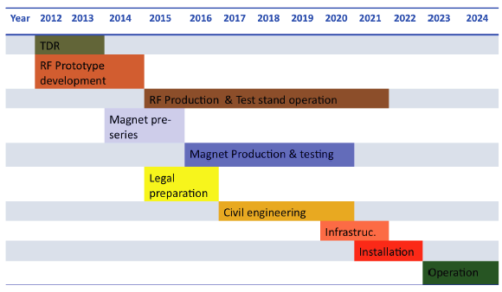
draft LHeC time schedule (11/2011)
-Only 2 long shutdowns planned before 2022
-Only 10 years for the LHeC from CDR to project start.
LS3 --- HL LHC
O. Brüning, ECFA meeting, 25 November 2011

Slide 34
LHeC Priority R&D
R&D activities:
-Superconducting RF with high Q & strategic partnerships ➔ 1.3 GHz versus 720 MHz
-Normal conducting compact magnet design ✔
-Superconducting 3-beam IR magnet design
➔ synergy with HL-LHC triplet magnet R&D
-Test facility for Energy Recovery operation and/or for compact injector complex
- R&D on high intensity polarized positron sources

Slide 35
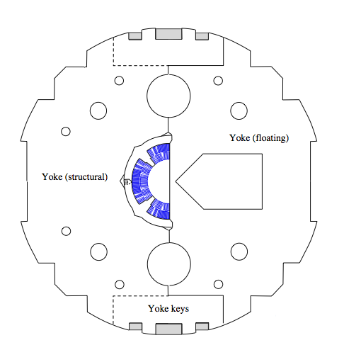
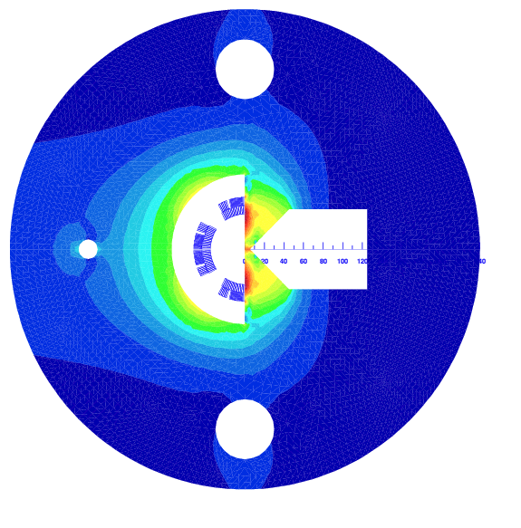
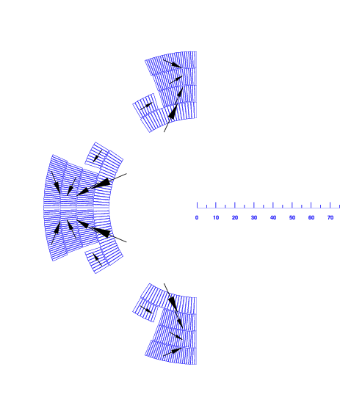
LHeC IR quad R&D work ?
Luca Bottura @
Chamonix 2012
Half-quad with field-free region, assembled using MQXC coils
  2.5 FTE
  500 kCHF
  approx. 2 years till test
Large resultants on the magnetic wedge (> 50 tons/m)

Slide 36
ERL Test Facility at CERN
R. Calaga,
E. Ciapala,
E. Jensen,
J. Tückmantel
ERL demonstrator
e-cooling (@PS/SPS energies)
ultra-short electron bunches
strong synergy with SPL-ESS & BNL activities
High energies & CW (100 – 400 MeV)
Multi-cavity cryomodule layout (validation + gymnastics)
MW class power coupler tests in non-ERL mode (vector feedback?)
Complete HOM characterization and instability studies
FEL & gamma-ray source

Slide 37
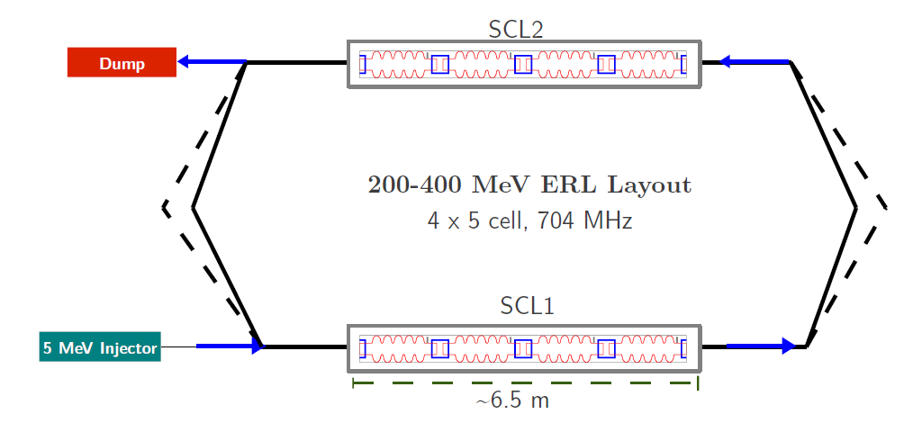
ERL Test Facility at CERN
Erk Jensen
Potential layout:

Slide 38
LHeC key decision points
2012: choice of IR: Point 2 (or 7 or 3?)
2012: choice between linac and ring
20xx: decision to go ahead with production
2012: choice of IR: Point 2 (or 7 or 3?)

Slide 39
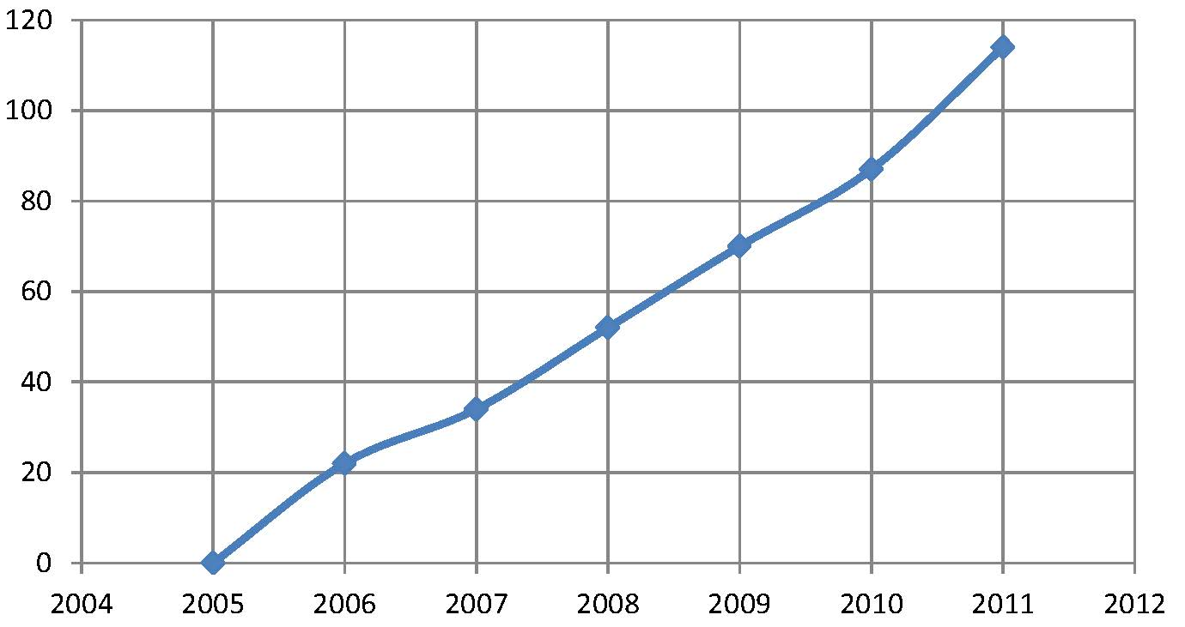
thank you for your attention!
“LHeC” in google scholar / year

