Slide 1


WP6.4 - Status of energy deposition studies.
Effect of isotopic composition of B in MgB₂
_{F.Broggi (INFN)}
2nd Joint HiLumi LHC-LARP Annual Meeting
_{Frascati 14-16 November 2012}

Slide 2
Outline
Cold Powering via Superconducting Links
Possible Material Solutions
Progress since last meeting (June/July 2011)
Expected particle fluences (neutrons) from LHC 7+7 TeV p-p collision
Nuclear reactions and effects of neutrons on MgB₂. Is it worth considering the isotopic separation on B for MgB₂ ?
Conclusion and future perspectives

Slide 3
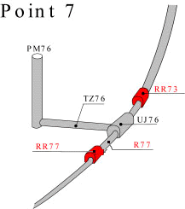
Cold Powering via Superconducting Links
Betatron cleaning Insertion
Advantages of remote powering:
Safer long-term operation of powering
equipment (power converters, current leads
and associate auxiliary devices) located in a
radiation-free environment;
Safer access of personnel to equipment for maintenance, repair, diagnostic and routine tests interventions;
Reduced time of interventions on power converters, current leads and DFBs if the powering equipment is located outside of the tunnel areas – gain in machine availability ;
- Free space in the beam areas which becomes available for other equipment.
P7L
P7R
Courtesy of Amalia Ballarino

Slide 4
Possible Material Solutions
Superconducting lines are mandatory because of the length
HTC Superconductors (Experience on the LHC current leads)
MgB₂, BSCO, YBCO …

Slide 5
What do we know about HTC SC
Cryogenic and magnetic characteristics are well established (CERN experience in LHC Current leads)
Radiation effects ????
Some MgB₂ and YBCO irradiation data
But, in general, there is a lack in data on HTS (R.Flukiger Wamsdo 2011)

Slide 6
Magnets: Nb₃Sn
Bi-2212 (strong progress needed)
Current leads (Link): (NbTi): T_{c} too low, small T reserve
MgB₂ : T_{op} = 10 K (under investigation)
R.E.BCuO: T_{op} = 77K (under investigation)
The critical current density of the superconducting wire or tape
as a function of fluence and energy:
neutrons most known data ≤ 14 MeV
protons few data on Nb₃Sn ≤ 2 MeV
pions unknown
electrons superconductor: small effects expected*)
photons superconductor: small effects expected*)
*) OK for ≤ 2 MeV. Unknown for 100 MeV
From R. Flukiger WAMSDO 2011 addressing

Slide 7
Today status
Yesterday status
As presented at HiLumi LHC Extended Steering Committee CERN 23rd July 2012
• Create the material library (MgB₂, BSCCO, YBCCO etc) with the correct isotopic composition etc. etc…… IN PROGRESS
• Academic exercise of evaluating a n beam effect on MgB₂ with ¹⁰B, ¹¹B and ^{nat}B IN PROGRESS (B10 data already presented at the June meeting see next slides)
• Create the FLUKA geometry for the SC links (waiting for input from CERN)
A tentative layout is necessary

Slide 8
Today status
• Create the material library (MgB₂, BSCCO, YBCCO etc) with the correct isotopic composition etc. etc…… STILL IN PROGRESS
• Academic exercise of evaluating a n beam effect on MgB₂ with ¹⁰B, ¹¹B and ^{nat}B DONE (results in the next slides)
• Create the FLUKA geometry for the SC links (Received input from CERN : IN PROGRESS )
A tentative layout is necessary : IN PROGRESS

Slide 9
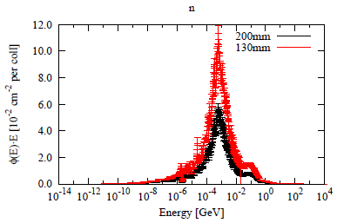
Neutrons on MgB₂
Neutron spectra in the coil of the insertion quadrupole for different apertures (F.Cerutti)
Neutrons
For the problem of the SC links, the neutron spectra where the links will be located (Iron Yoke and outside the magnets) most of the neutrons are thermal

Slide 10
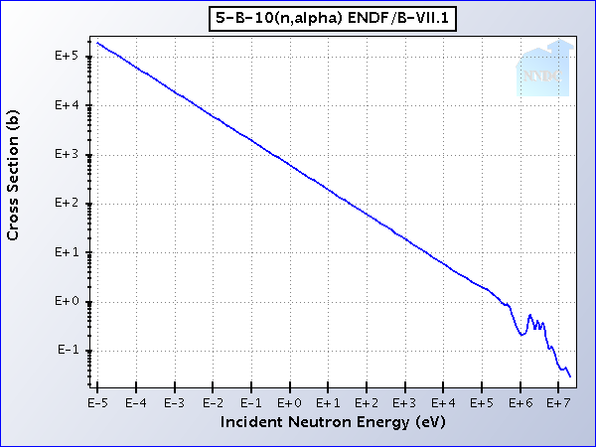
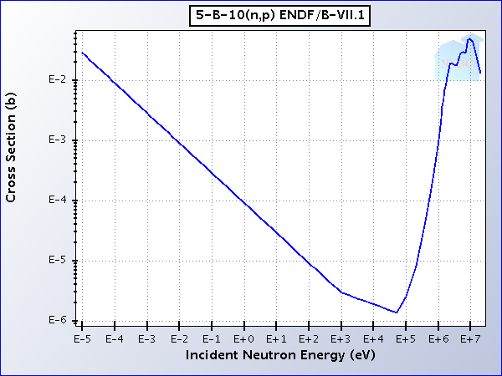
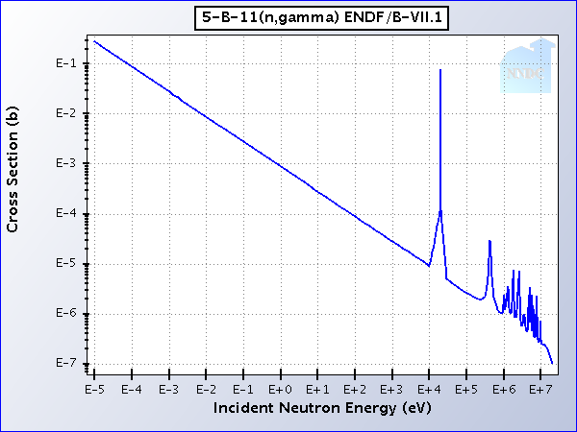
Concerns of Neutrons on MgB₂
B natural isotopic composition is : 80% ¹¹B - 20% ¹⁰B
Mg natural isotopic composition is : 78.99% ²⁴Mg – 10% ²⁵Mg - 11.01% ²⁶Mg
¹⁰B has a very high thermal neutron
capture cross section for ¹⁰B(n,α)⁷Li
1 MeV
Thermal
Data from National Nuclear Data Center http://www.nndc.bnl.gov/

Slide 11
Reactions occurring
σ_{term} (b) | σ_{1MeV} (b)
5.7E-2 | 3.3E-4
2.2E-1 | 3E-4
4.3E-2 | 3.7E-4
4.2E3 | 2.2E-1
6.4E-4 | 9.6E-4
5.8E-1 | //
6.1E-3 | 2.2E-6
²⁷Mg → ²⁷Al + β⁻ + ν
²⁷Mg t_{1/2}= 9.5 min
¹⁰Be → ¹⁰B + β⁻ + ν
²⁷Be t_{1/2}= 1.39 x10⁶ y
¹²B → ¹²C + β⁻ + ν
¹²B t_{1/2}= 20.2 ms
Data from National Nuclear Data Center http://www.nndc.bnl.gov/

Slide 12
Neutrons on MgB₂
Cases studied
BEAM
Thermal Neutrons – 1MeV Neutrons
Neutron beam spot : 2 cm ; Fluence2x10⁹ n/s x 1 d
TARGET (2x2x1 cm³)
MgB₂ with only ¹⁰B
MgB₂ with only ¹¹B
MgB₂ with natural composition of B (80% ¹¹B – 20% ¹⁰B)

Slide 13
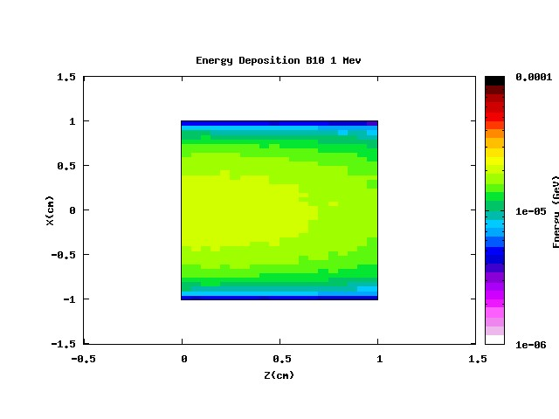
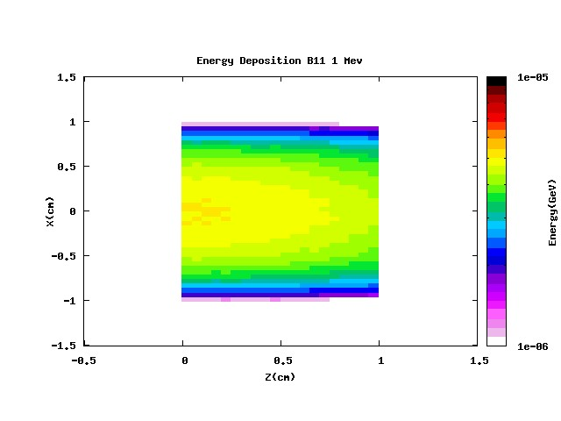
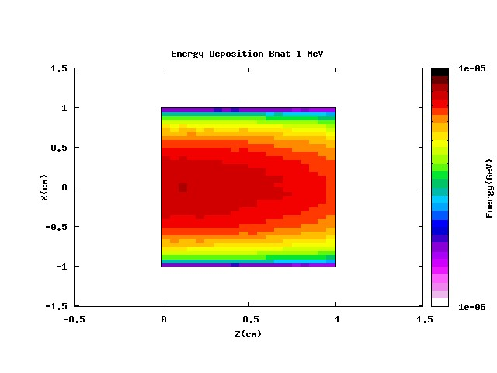
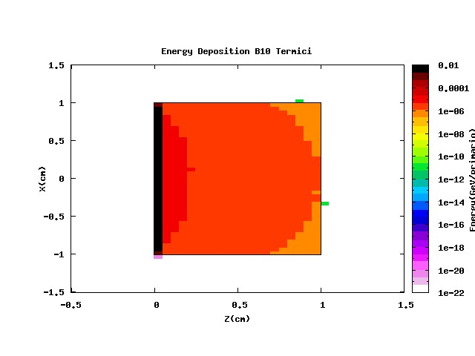
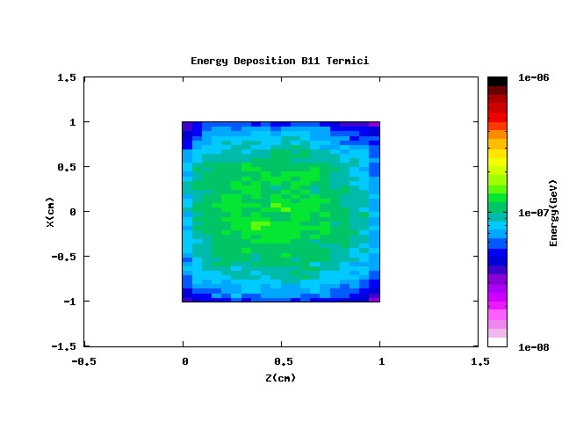
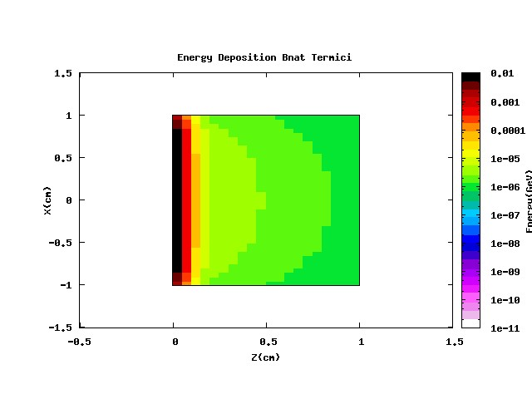
Energy Deposition
1 MeV
¹⁰B
¹¹B
B_{nat}
Thermal n
Effect of the high neutron capture

Slide 14
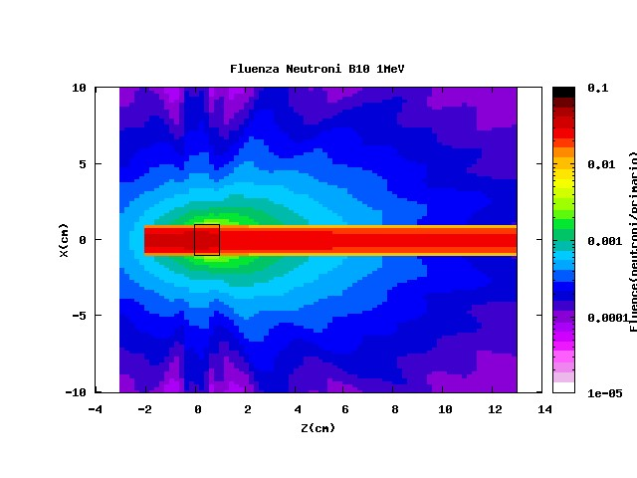
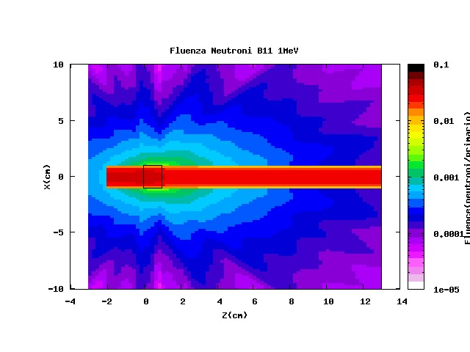
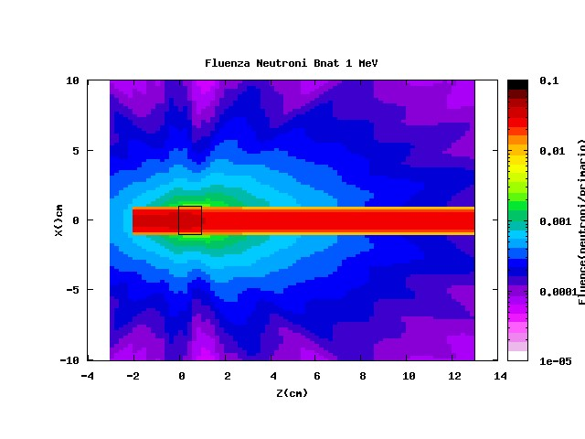
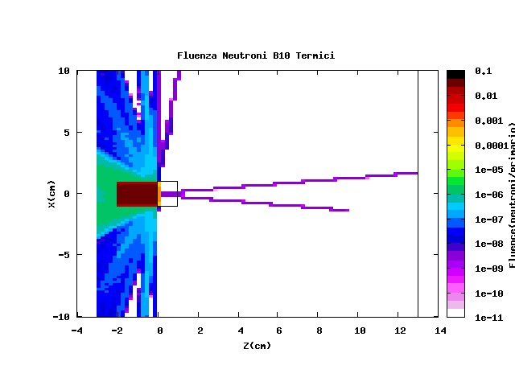
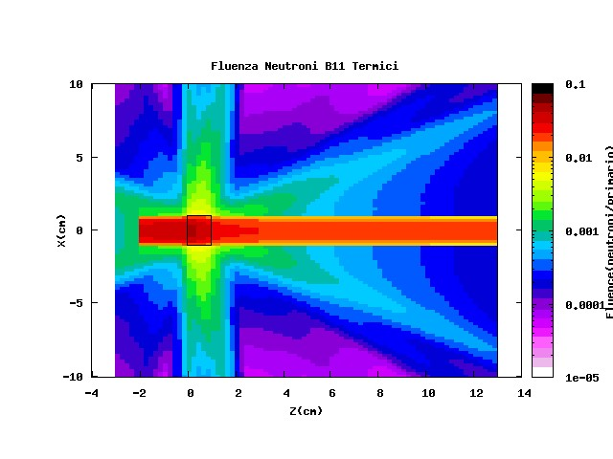
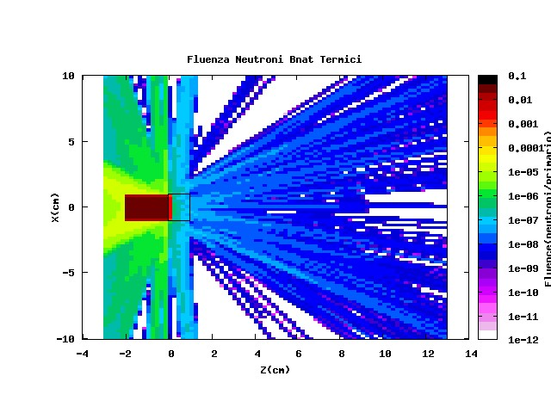
Neutron Fluence
1 MeV
¹⁰B
¹¹B
B_{nat}
Thermal n
Effect of the high neutron capture

Slide 15
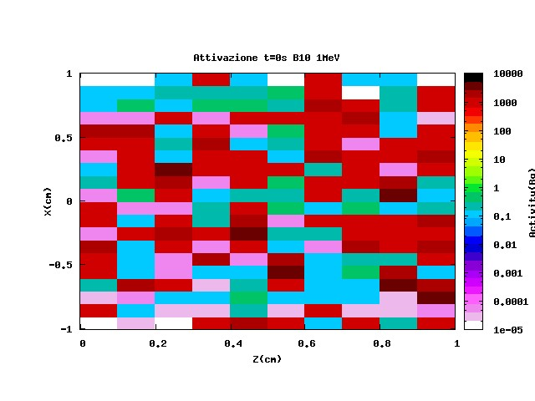
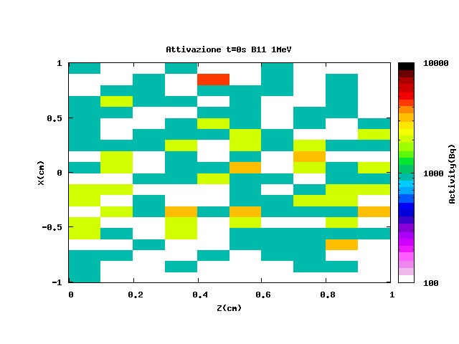
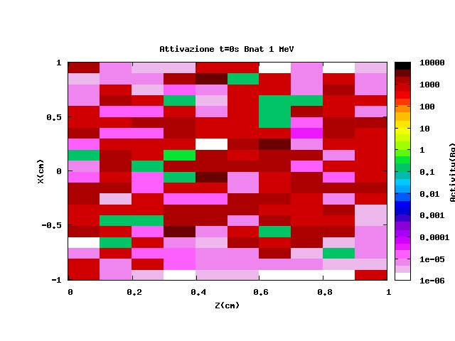
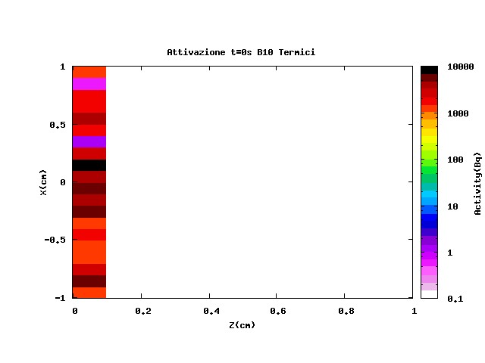
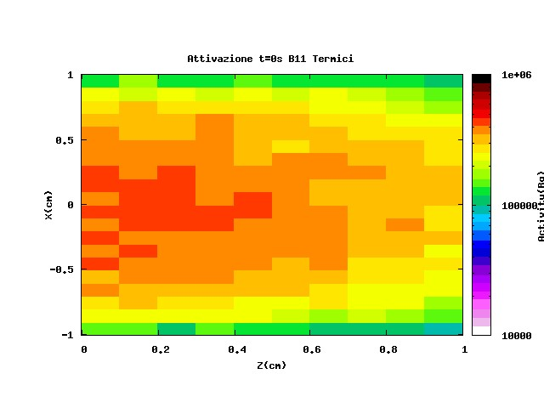
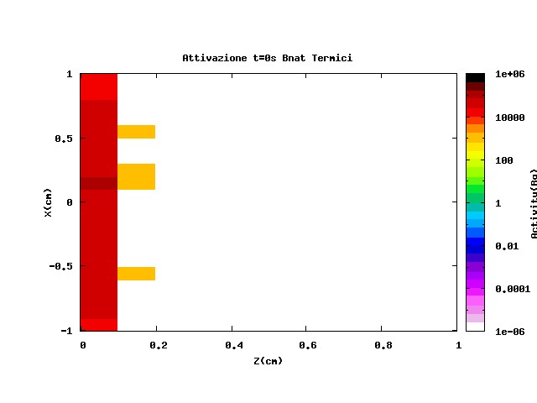
Activation (at t=0)
1 MeV
¹⁰B
¹¹B
B_{nat}
Thermal n
Effect of the high neutron capture
(occurring at the surface of the target)

Slide 16
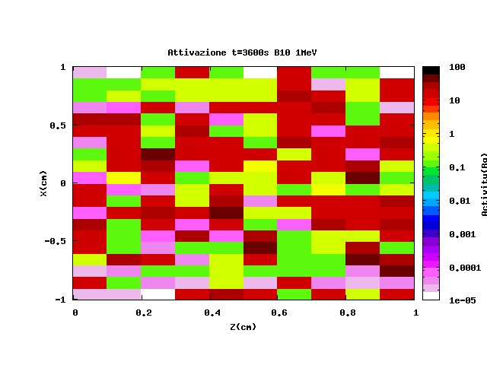
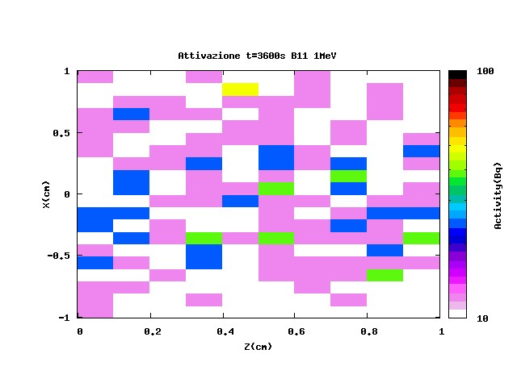
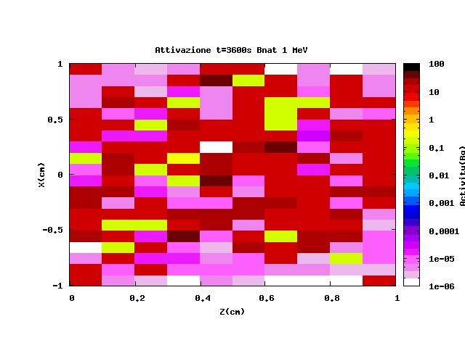
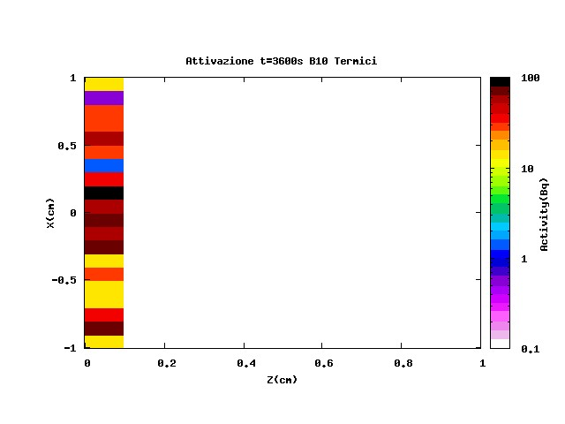
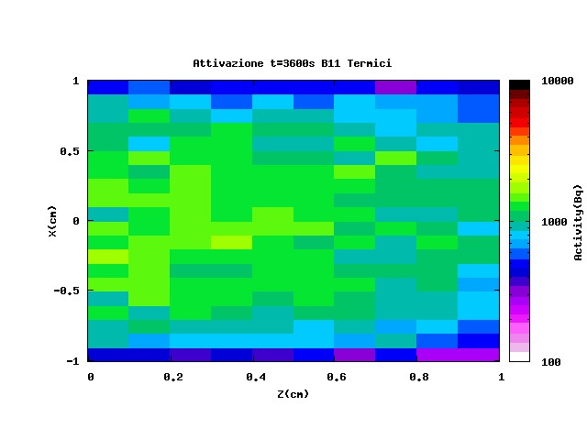
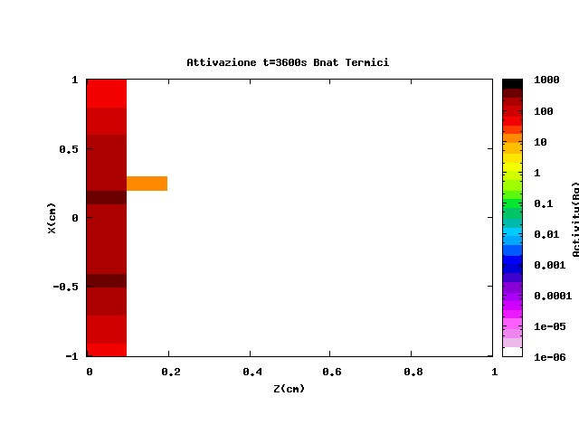
Activation (at t=3600 s)
1 MeV
¹⁰B
¹¹B
B_{nat}
Thermal n
About a factor 100 less

Slide 17
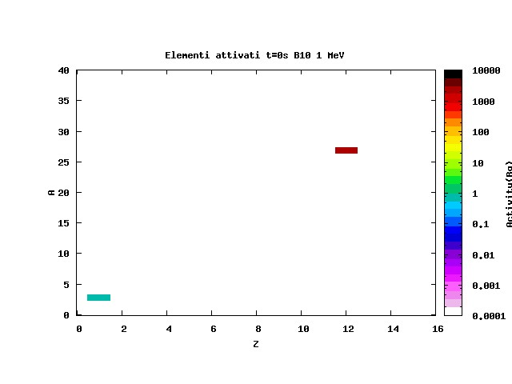
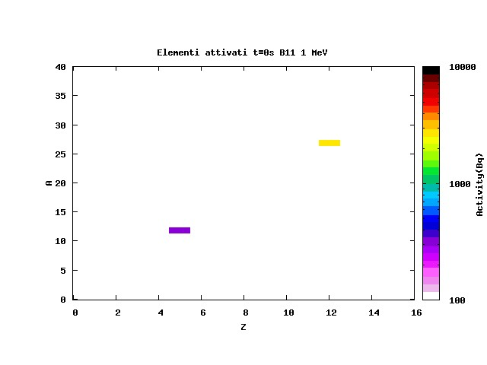
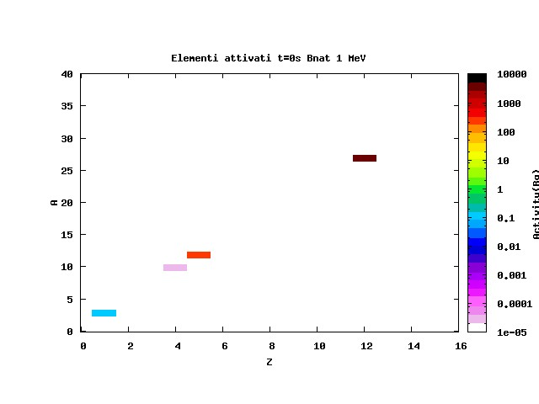
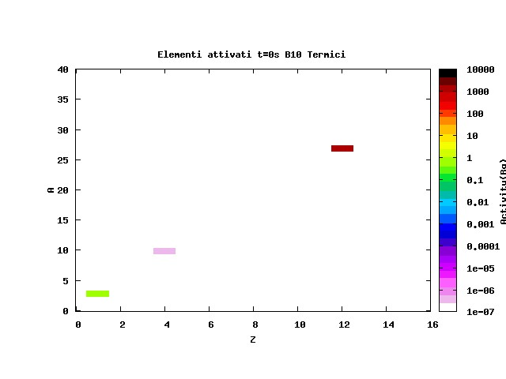
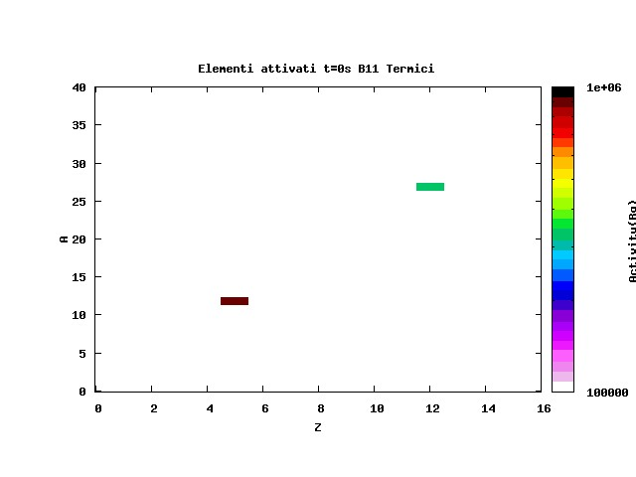
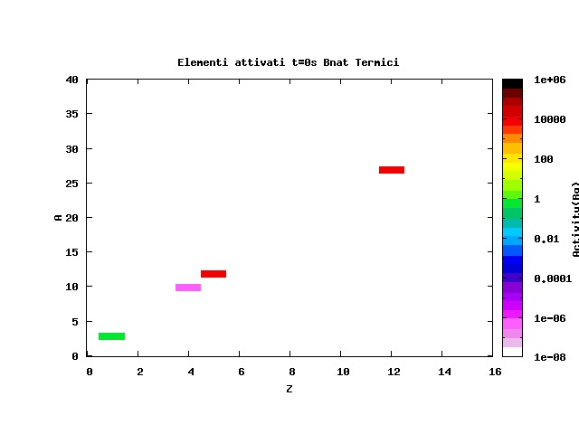
Residual Nuclei (at t=0 s)
1 MeV
¹⁰B
¹¹B
B_{nat}
Thermal n
Protons from

Slide 18
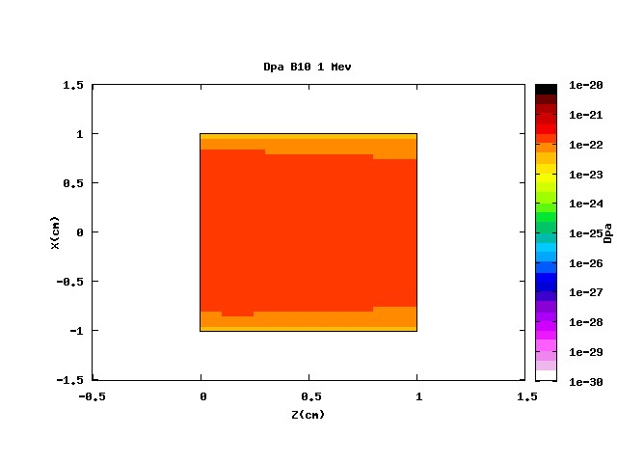
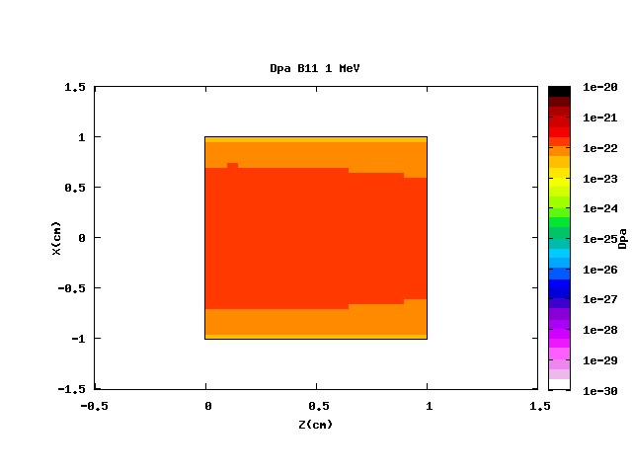
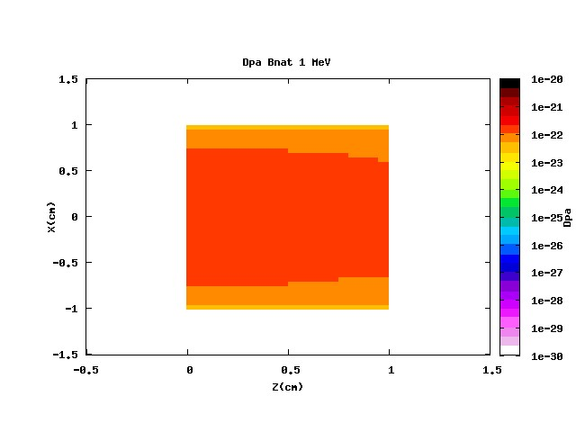
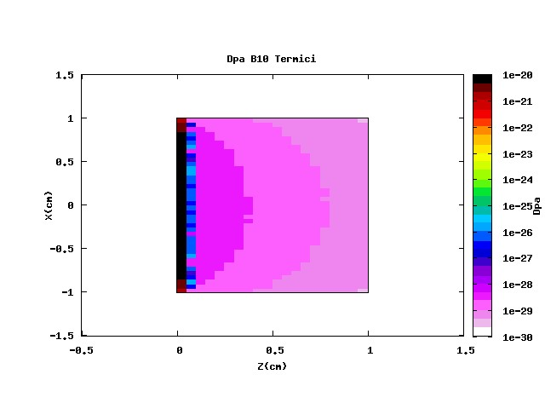
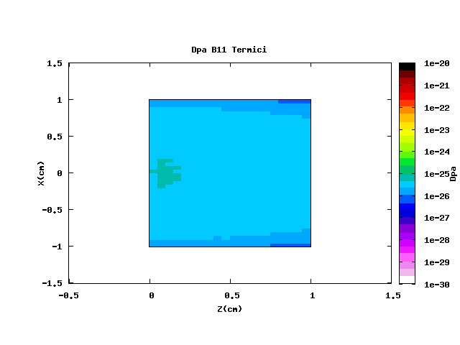
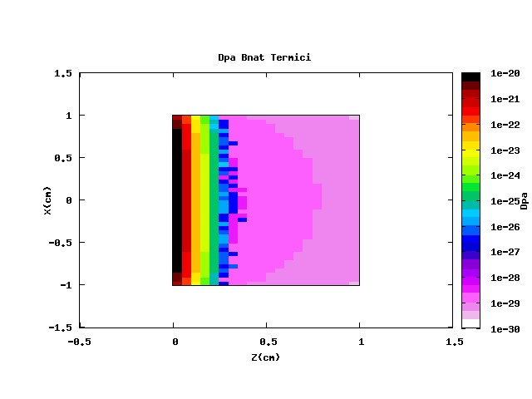
Displacement Per Atom
1 MeV
¹⁰B
¹¹B
B_{nat}
Thermal n
Effect of the high neutron capture
(occurring at the surface of the target)

Slide 19
B consumption
Day consumption
Day consumption
Assuming 200 days/year x 10 years of operation x 10 (Luminosity increasing) a 0.00072% consumption can be espected

Slide 20
Conclusions
MgB2 neutron damage is not a concern about the performance of the SC Links, so no isotopic separation is necessary.
The energy deposition and “damage” are studied in a conservative case of collimated beam on target matching the beam geometry
What informations can be inferred from DPA values ?
How DPA are correlated to SC performance ?
Anyway it is the only parameter we have (R.Flukiger)

Slide 21
Perspectives
Continue the work on MgB2 by studying the proton , pion and combined n, p, π effects
BSCO, YBCO …
Irradiation tests, code benchmarking and correlations with DPA
LHC Layout and geometry in FLUKA

Slide 22
Acknowledgment
Thank You for Your attention
F.Cerutti , LS Esposito (CERN FLUKA Team)
A Bignami (POLIMI)

