Slide 1
Crab Cavity Status
Outcome of the last 2 days
E. Jensen

Slide 2
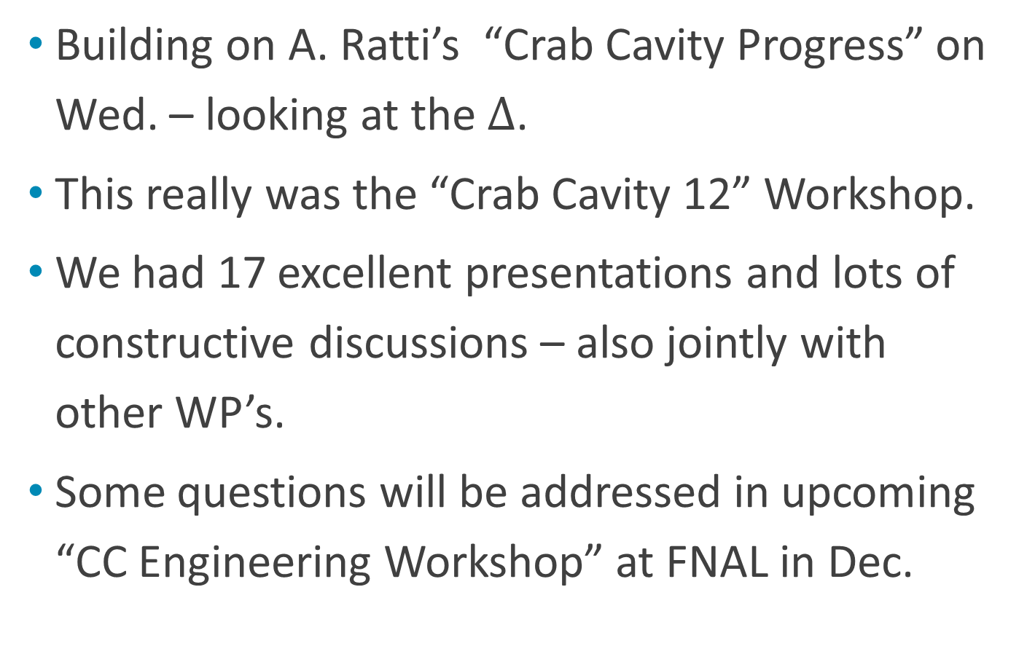
Crab Cavity Status
Building on A. Ratti’s “Crab Cavity Progress” on Wed. – looking at the $∆$.
This really was the “Crab Cavity 12” Workshop.
We had 17 excellent presentations and lots of constructive discussions – also jointly with other WP’s.
Some questions will be addressed in upcoming “CC Engineering Workshop” at FNAL in Dec.
https://indico.cern.ch/conferenceDisplay.py?confId=136807

Slide 3
Required kick voltage
Design kick: 10 MV /side /IP /beam – this is reached with 3 cavities. Our reference numbers!
B. Dalena: Needed for full compensation: 11.8 MV … 13.4 MV; this could be reduced to 8.2 MV with new Q7+ .
Our reference is compatible with the latter – but is this the overall optimum (cost!)?
Let’s see the prototype cavity performance and adapt design parameters then if needed. Keep engineering margin!.
Even with reduced voltage, we should stay with 3 cavities (to reduce impact of single cavity trip)

Slide 4
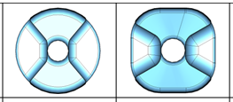
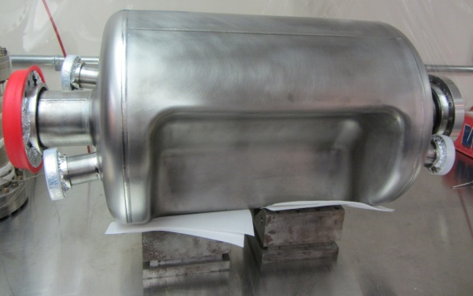
Progress with Double Ridge (SLAC/ODU):
Synergy 3 applications: 400 MHz (HL-LHC), 500 MHz (CEBAF deflector), 750 MHz (MEIC crab)
Evolution from “round” to “squarish”,
field homogeneity can be optimized
with electrode inner profile.
750 MHz prototype tested:
MP manageable, no quench, Q₀ acceptable.
400 MHz prototype ready for
tests at JLAB.
J. Delayen, S. Da Silva

Slide 5
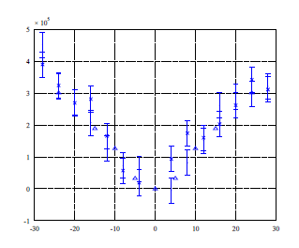
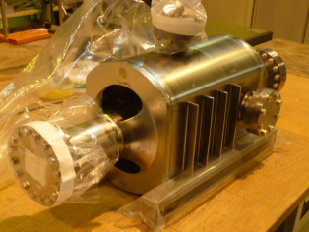
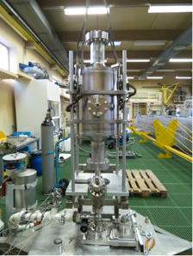
Progress with 4-rod (ULANC):
Field homogeneity can be optimized with
electrode inner profile. Bead pull confirms
field homogeneity in principle but error
bars are large.
Cavity buckling solved by stiffening ribs.
Prototype ready,
heat-treated, rinsed
@ CERN, no BCP;
ready for vertical test.
V_{z}-V/m at U =1J
Offset / mm
4-rod prepared for rinsing @ CERN
G. Burt, B. Hall

Slide 6
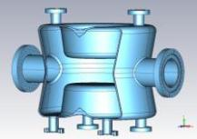
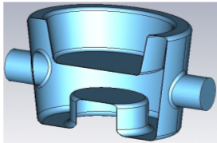
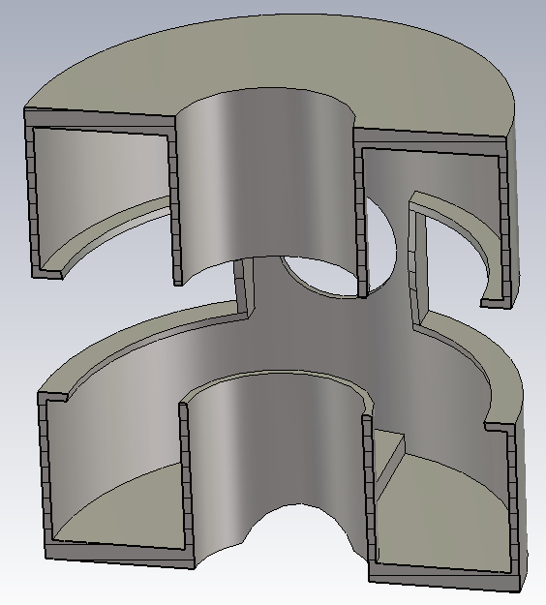
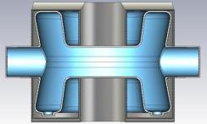
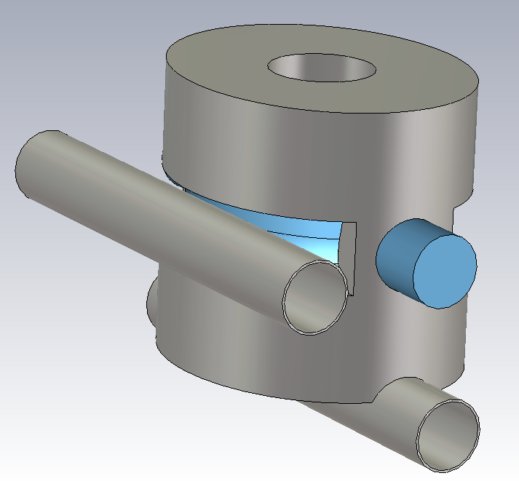
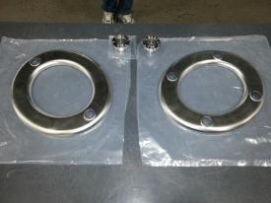
Progress with 1/4 –wave, now DQW (BNL)
Evolution to symmetric;
n-pole error much
reduced.
Stiffening designed:
idea to combine with
He vessel
Prototype: In fabrication;
first pieces received
Q.Wu, I. Ben-Zvi
Pieces for QWR (cheer-up after hurricane Sandy)

Slide 7
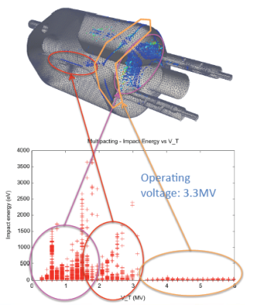
All 3 designs:
Common numerical tools used for comparative studies: HOMs, MP (ACE3P, Z. Li), n-pole (HFSS, M. Navarro-Tapia)
HOM damping: suppression below (demanding) CM18 numbers achieved – also thanks
to newly designed coaxial
high-pass filters and hook-shaped
couplers.
MP simulations indicate:
  MP at low fields is
  “soft” – can be conditioned;
  MP at high fields has
  low impact energy.
Z. Li

Slide 8
Getting ready for SPS tests
SPS test is a must (LHC no best-bed!)
Goal: Confirm that cavity can be made invisible; it would allow to try out operational scenarios.
SPS beam may be
too noisy to test
additional noise
injected from CCs.
Schedule: Prepare during LS1 (RF power, cryo) – install cavities X-mas break 2015/16 – perform tests in 2016
R. Calaga, A. Macpherson

Slide 9
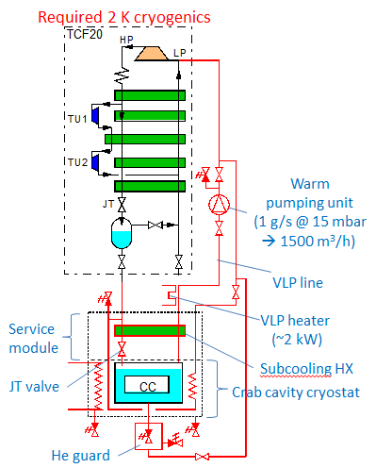
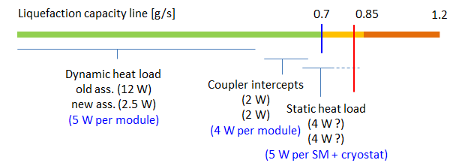
Cryo preparation for SPS tests
Existing TCF20 should do,
but liquefaction test must
be done before 15-Jun-2013.
Dynamic heat load assumed:
2.5 W/module.
Upgrade to 2 K during LS1.
K. Brodzinski

Slide 10
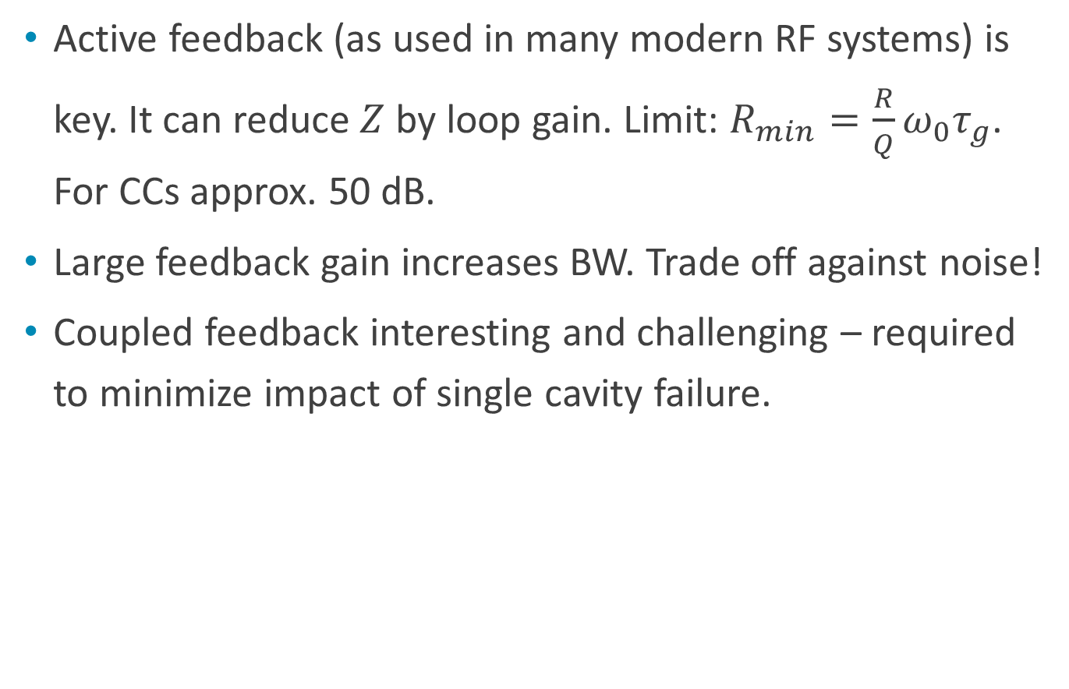
LLRF
Active feedback (as used in many modern RF systems) is key. It can reduce $Z$ by loop gain. Limit: $R_{min}=\frac{R}{Q}ω_{0}τ_{g}$. For CCs approx. 50 dB.
Large feedback gain increases BW. Trade off against noise!
Coupled feedback interesting and challenging – required to minimize impact of single cavity failure.
P. Baudrenghien

Slide 11
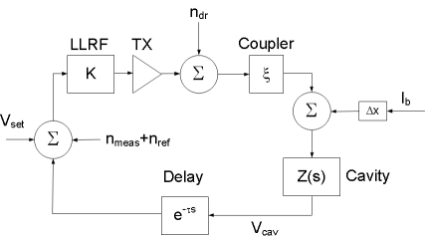
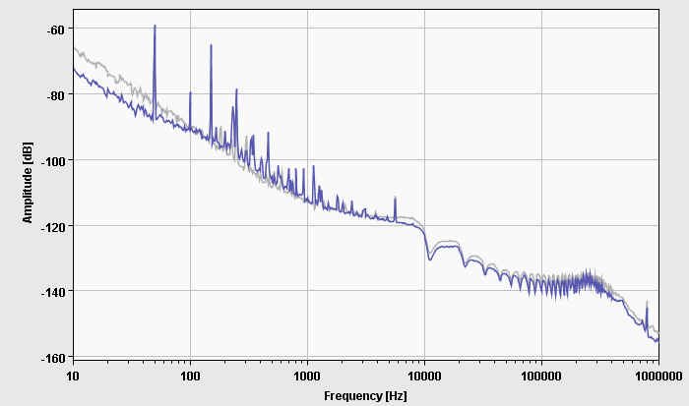
RF Noise
Different noise sources have
different spectra;
1st betatron SB 3 kHz off –
dominated by TX noise.
Tetrode/IOT advantageous..
Scaling from ACS: expected
0.01 ° rms ϕ noise @ 400 MHz.
This looks OK.
Idea for noise measurement: excite on betatron SB.

Slide 12
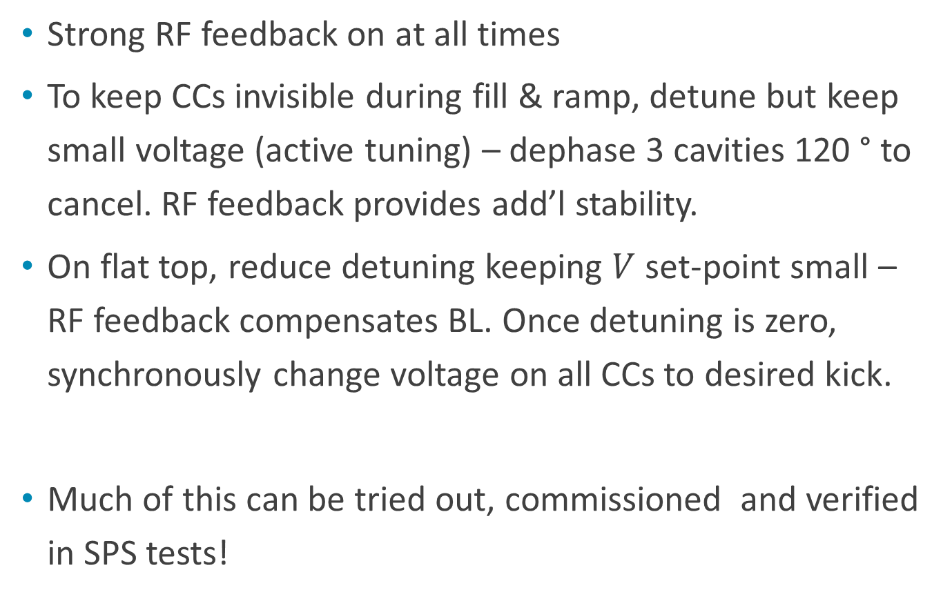
Operational scenario revisited
Strong RF feedback on at all times
To keep CCs invisible during fill & ramp, detune but keep small voltage (active tuning) – dephase 3 cavities 120 ° to cancel. RF feedback provides add’l stability.
On flat top, reduce detuning keeping $V$set-point small – RF feedback compensates BL. Once detuning is zero, synchronously change voltage on all CCs to desired kick.
Much of this can be tried out, commissioned and verified in SPS tests!

Slide 13
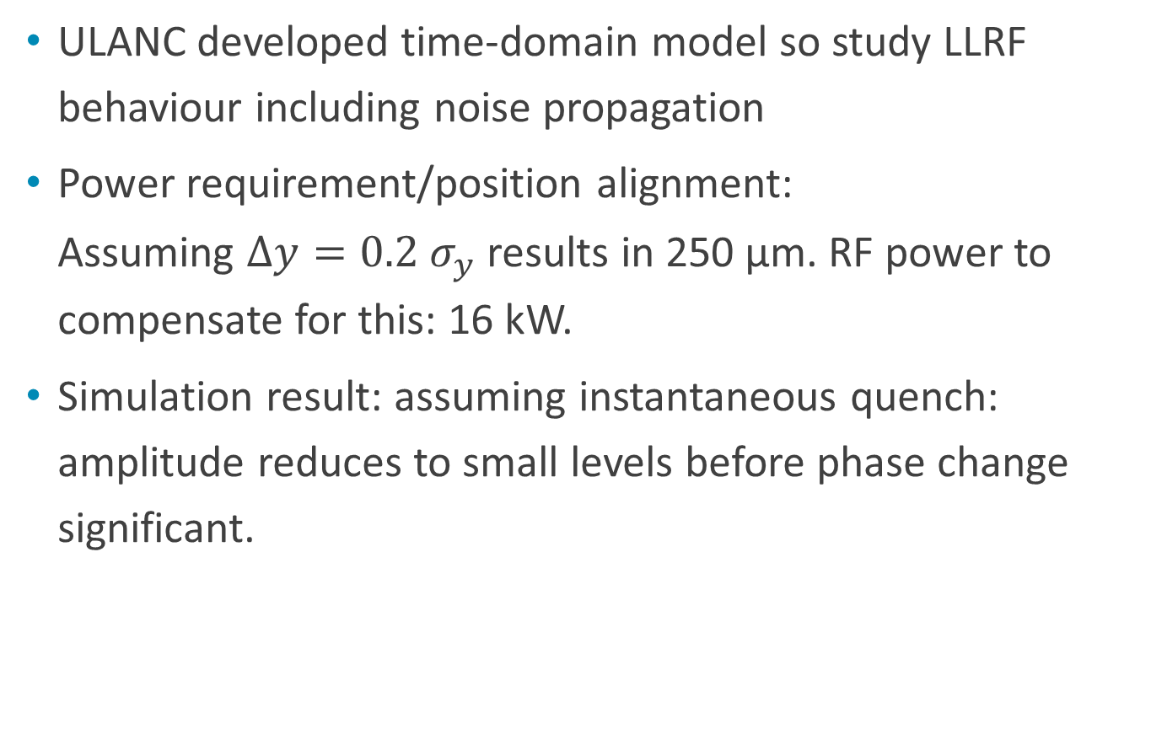
LLRF studies
ULANC developed time-domain model so study LLRF behaviour including noise propagation
Power requirement/position alignment:
Assuming $∆y=0.2 σ_{y}$ results in 250 μm. RF power to compensate for this: 16 kW.
Simulation result: assuming instantaneous quench: amplitude reduces to small levels before phase change significant.
A. Dexter

Slide 14

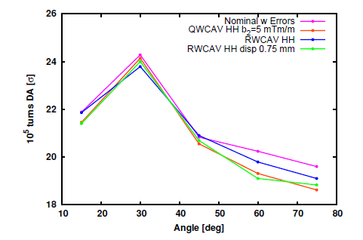
n-pole errors
For the first time, SixTrack simulations could study the effect of n-pole errors on beam. Results can give also tolerable misalignments:
These studies were done with
older versions of the cavities.
n-pole fields with latest
versions of cavities indicate
globally even smaller errors.
J. Barranco, M. Navarro-Tapia

Slide 15
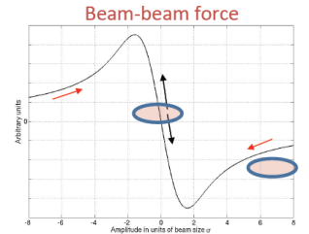
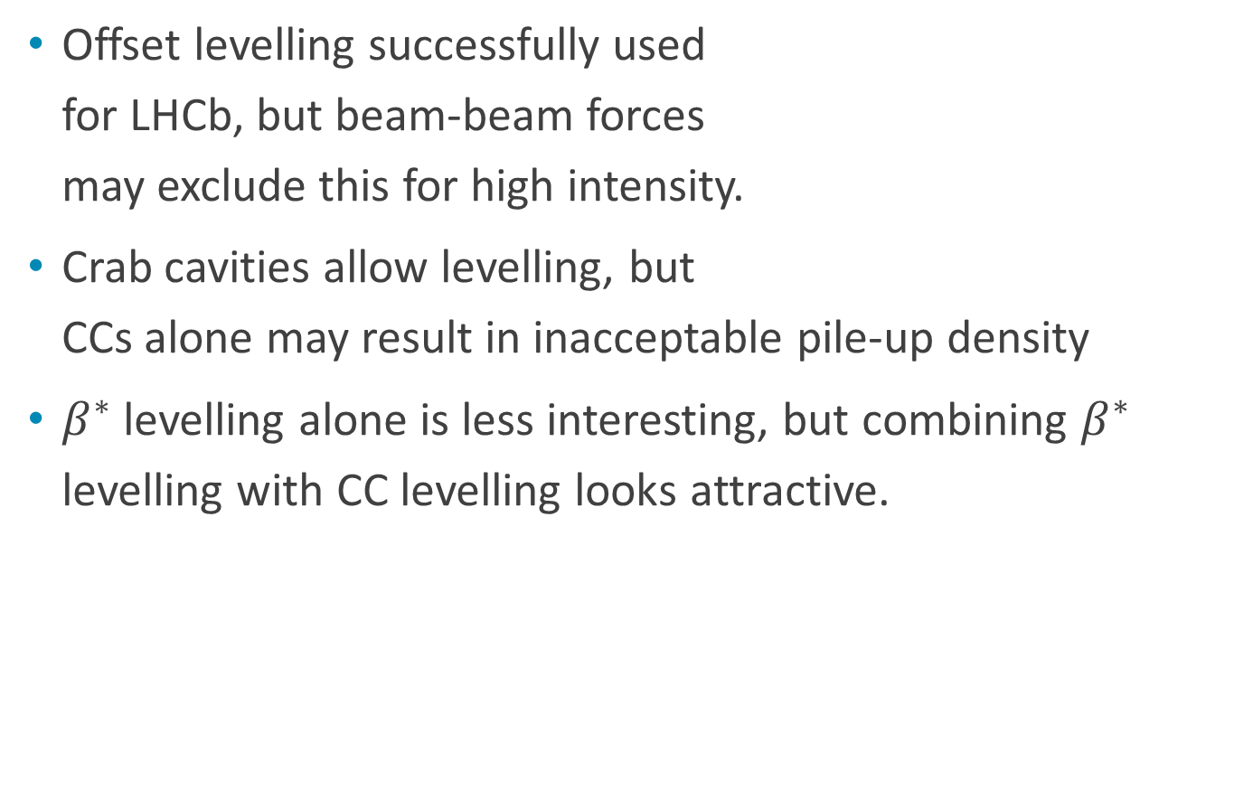
Luminosity Levelling
Offset levelling successfully used
for LHCb, but beam-beam forces
may exclude this for high intensity.
Crab cavities allow levelling, but
CCs alone may result in inacceptable pile-up density
$β^{∗}$ levelling alone is less interesting, but combining $β^{∗}$ levelling with CC levelling looks attractive.
T. Pieloni

Slide 16
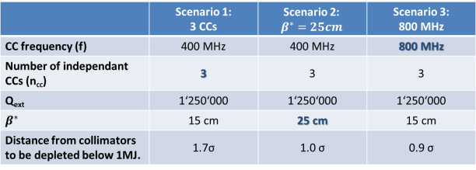
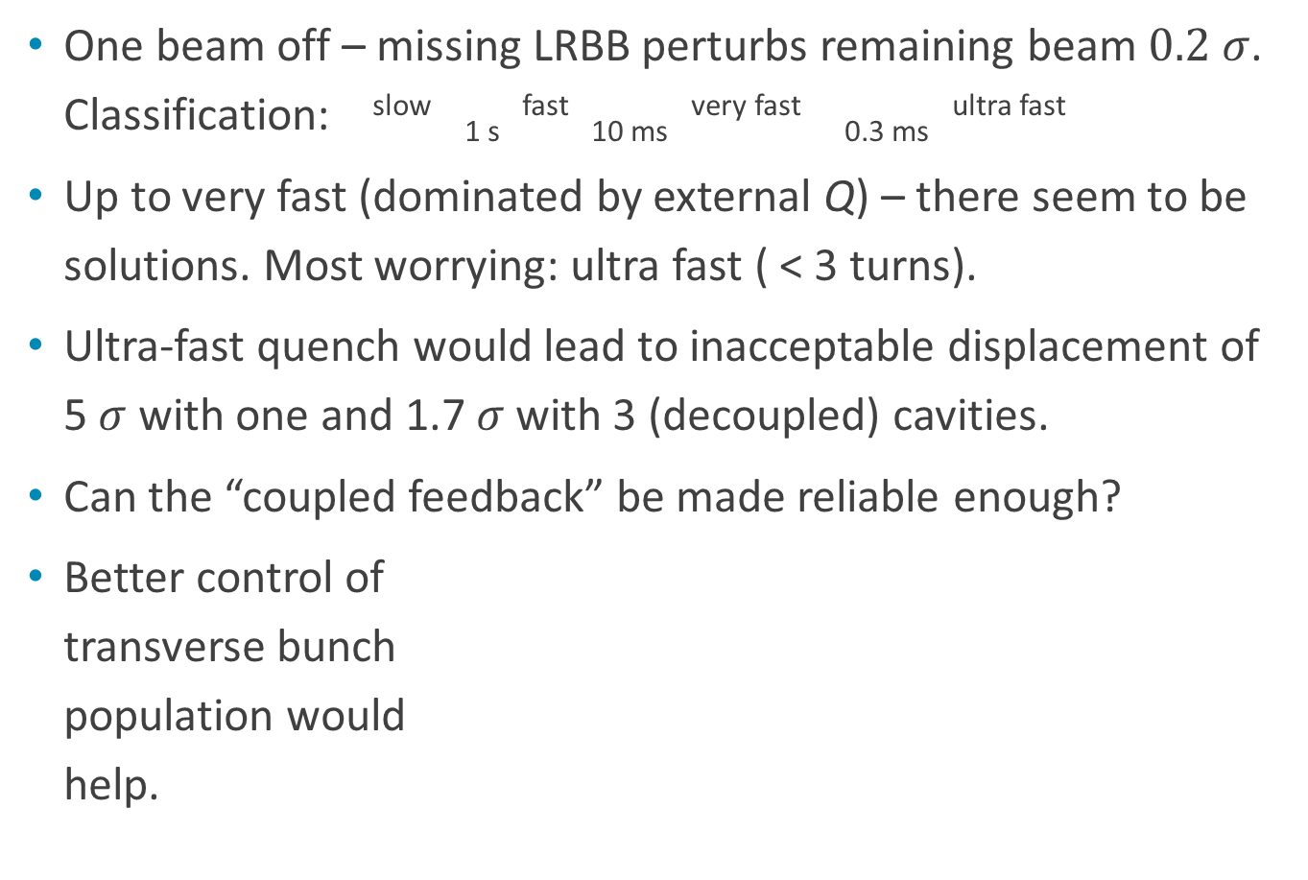
Machine Protection
One beam off – missing LRBB perturbs remaining beam $0.2 σ$. Classification: ^{slow} _{1 s} ^{fast} _{10 ms} ^{very fast} _{0.3 ms} ^{ultra fast}
Up to very fast (dominated by external Q) – there seem to be solutions. Most worrying: ultra fast ( < 3 turns).
Ultra-fast quench would lead to inacceptable displacement of 5 $σ$ with one and 1.7 $σ$ with 3 (decoupled) cavities.
Can the “coupled feedback” be made reliable enough?
Better control of
transverse bunch
population would
help.
T. Baer, B.Y. Rendón

Slide 17
Discussions/brain storming
Lots of productive/critical discussion throughout – this was really a “work”-shop.
What instrumentation do we need for CCs – head-tail monitors, streak camera to measure remaining non-closure? What instrumentation do we need to make the SPS test a success?
We need fast BLMs for MP (diamond?)
We still need better understanding of possible (ultra) fast failure modes – cavity tests and in particular SPS tests will help this understanding.

Slide 18
Summary – Crab Cavity Status
This was a very productive workshop – I have learned a lot.
Progress over the year and also during the last days was remarkable.
I see improved co-ordination of activities and true collaboration between international partners.
Thank you all for this effort.
There remain challenges, but really interesting ones!
Thank you!

