Slide 1
Status of the HL-LHc project
Lucio Rossi
CERN
HL-LHC project coordinator

Slide 2
Content
Recap of the HL-LHC project
Project management update
    TC
    Coordination Group
CERN context
    Two branches project and CtC
EU strategy update context
Progress of work
Discussions for in kind-contribution

Slide 3
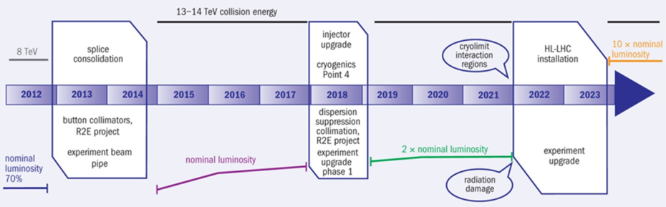
Change of plan from last year…
(official part is till 2015)

Slide 4
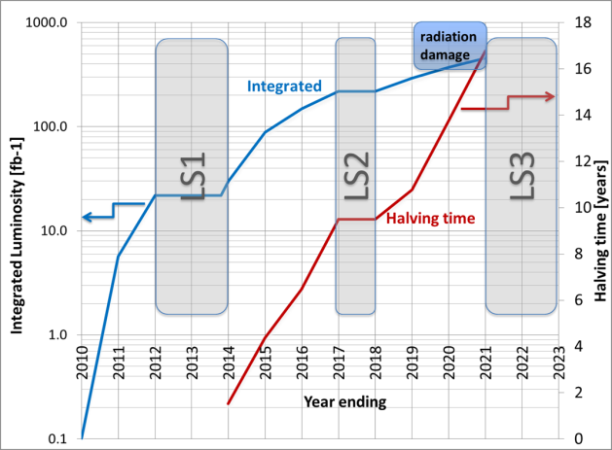
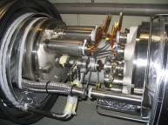
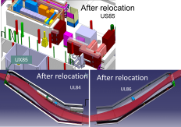
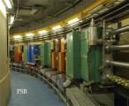
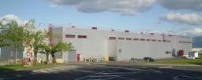
2 Reasons for upgrade:
Performance & Technical (Consolidation)
Shut down to fix interconnects and overcome energy limitation (LHC incident of Sept 2008) and R2E
Full upgrade
Shut down to overcome beam intensity limitation (Injectors, collimation and more…)

Slide 5


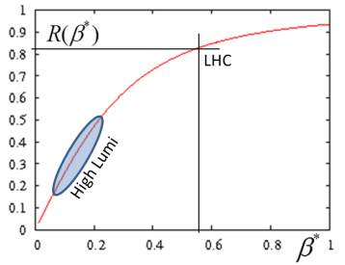

Peak Performance: Luminosity
Beam current
energy
Beam size
Beam current and emittance: involve Inj chain and whole ring
β∗ involve «only» 2 IRs, 600 m (but ATS…)
LHC has been designed for L₀
All systems have singularly designed tentatively for ultimate 2L₀ (almost…)

Slide 6
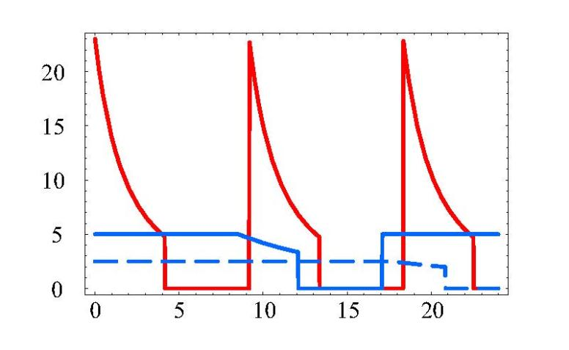
The final performance: ∫Ldt
This requires levelling (<< virtual lumi)
This requires availability and reliability
virtual
peak
luminosity
25 ns
w/o
leveling
t_{lev}
t_{dec}
25 ns
leveled
t_{ta}
50 ns leveled

Slide 7
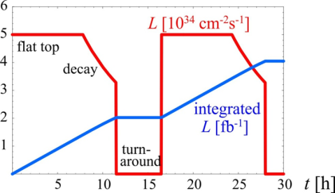
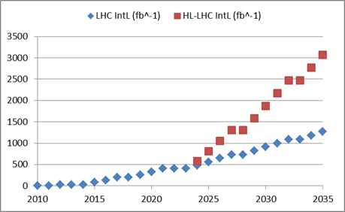
Final goal : 3000 fb⁻¹ by 2030’s…
3 fb-1 per day
60% of efficiency
250 fb-1 /year
300 fb-1/year as «ultimate»
Full project
Enhanced consolidation

Slide 8
Official Beam Parameters
(see PLC by O.Bruning)
Parameter | nominal | 25ns | 50ns
N | 1.15E+11 | 2.2E+11 | 3.5E+11
n_{b} | 2808 | 2808 | 1404
beam current [A] | 0.58 | 1.12 | 0.89
x-ing angle [μrad] | 300 | 590 | 590
beam separation [σ] | 10 | 12.5 | 11.4
β* [m] | 0.55 | 0.15 | 0.15
ε_{n} [μm] | 3.75 | 2.5 | 3.0
ε_{L} [eVs] | 2.51 | 2.5 | 2.5
energy spread | 1.20E-04 | 1.20E-04 | 1.20E-04
bunch length [m] | 7.50E-02 | 7.50E-02 | 7.50E-02
IBS horizontal [h] | 80 -> 106 | 20.0 | 20.7
IBS longitudinal [h] | 61 -> 60 | 15.8 | 13.2
Piwinski parameter | 0.68 | 3.1 | 2.9
geom. reduction | 0.83 | 0.35 | 0.33
beam-beam / IP | 3.10E-03 | 3.9E-03 | 5.0E-03
Peak Luminosity | 1 10³⁴ | 7.4 10³⁴ | 8.5 10³⁴
Virtual Luminosity | 1.2 10³⁴ | 21 10³⁴ | 26 10³⁴
6.2 10¹⁴ and 4.9 10¹⁴
p/beam
sufficient room for leveling
(with Crab Cavities)
Virtual luminosity (25ns) of
L = 7.4 / 0.35 10³⁴ cm⁻² s⁻¹
= 21 10³⁴ cm⁻² s⁻¹ (‘k’ = 5)
Virtual luminosity (50ns) of
L = 8.5 / 0.33 10³⁴ cm⁻² s⁻¹
= 26 10³⁴ cm⁻² s⁻¹ (‘k’ = 10)
(Leveled to 5 10³⁴ cm⁻² s⁻¹
and 2.5 10³⁴ cm⁻² s⁻¹)
28
Events / crossing (peak & leveled L) | 19 | 210 | 475 | 140 | 140

Slide 9
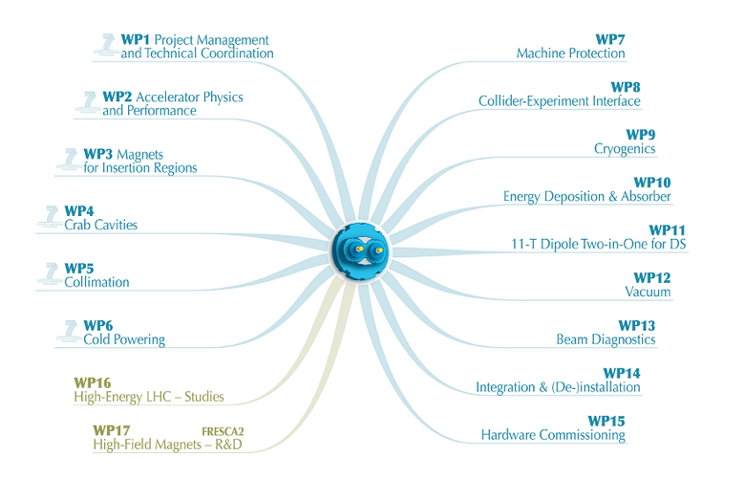
1 project – 1 structure: HL-LHC
FP7 HiLumi Design Study just covers part of it

Slide 10
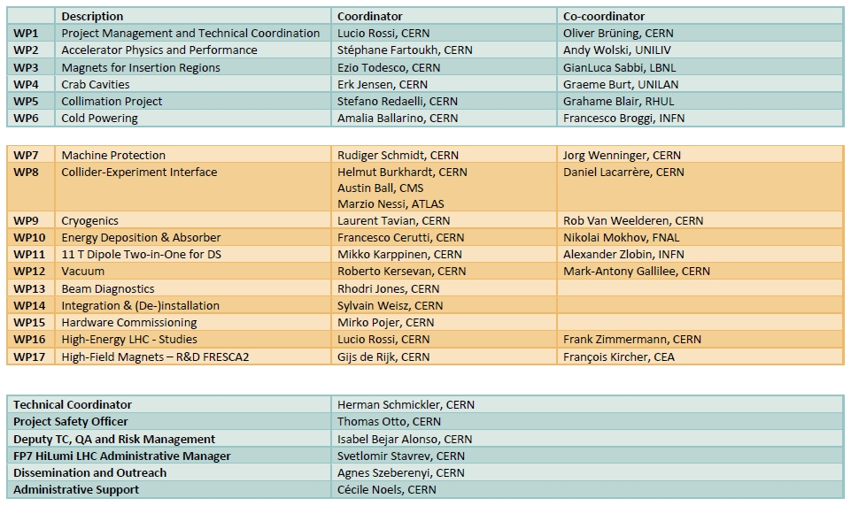
Structure and Management

Slide 11

WP 1 : Project Management
Scientific Advisory Committee (not appointed)
⇒ CERN Machine Advisory Committee
(T. Roser, BNL, chair)
Task 1.2 Parameter and Lay-out Committee
(O.Bruning, chair). Installed by April
Task 1.3 QA plan
    Work in progress (I. Bejar Alonso)
    Study of the LHC QAP and identification of the documents to be updated.
    Comparison of the LHC QAP with the QAP for other research infrastructures today under study/construction on CERN site.
    Comparison of the LHC QAP with the quality assurance guide for project management of the DOE (DOE G 413.3-2) and other DOE guides for the design and construction of research facilities.

Slide 12
WP1 – Project Management – cont.2
Task 1.4 : radiological impact : to be started
Task 1.5 Liaison with:
  Detector Upgrade
    Many contacts (also in Experiment Coll. Meet.)
    HL-LHC Coordination Group (mandate by CERN Directorate) to coordinate consolidation/upgrades in the LHC machine (and Injectors) after LS1. Chaired by HL-LHC coordinator.
    3 meetings: ⇒ New concepts of pile up volume density
    Agreement on the nominal design pile up: 140 (200 max)
    Inclusion of Alice and LHCb plan and Forward detector plan
    See talk of H. Burkhardt, Friday morning
    30 Nov 2012: day workshop on Collider-Experments interface
  LHC Injector Upgrade :
      Two one-day workshops ⇒ «Agreed» parameter list HL-LIU
                See talk by M. Meddahi on Friday

Slide 13



WP1 – Project Management – cont.3
Task 1.6 : Dissemination (Kate ⇒ Agnes)
    Release on CERN Courier
    Release on Acc-News
    > 10 outreach talks
Task 1.6 Information to Industry
    Talks to CERN ILO forum, To Euspen, to German Industry@CERN
    Workshop on SC Technologies
    (Magnet, SCRF, Cryostats)
    4-5 December @ CERN ,
    > 20 firms

Slide 14
WP 1 : project Management
Scientific Advisory Committee (not appointed)
⇒ CERN Machine Advisory Committee
(T. Roser, BNL, chair)
Task 1.2 Parameter and Lay-out Committee
(O.Bruning, chair). Installed by April
Task 1.3 QA plan
    Work in progress (I. Bejar Alonso)
    Study of the LHC QAP and identification of the documents to be updated.
    Comparison of the LHC QAP with the QAP for other research infrastructures today under study/construction on CERN site.
    Comparison of the LHC QAP with the quality assurance guide for project management of the DOE (DOE G 413.3-2) and other DOE guides for the design and construction of research facilities.

Slide 15
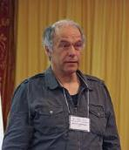
WP1 – Project Management
Technical Coordination
& HL-LHC technical committee
TC: Hermann Schmickler (CERN)
      I. Bejar Alonso (CERN)
      Th. Otto (Safety officer)
      D. Duret (budget and resources plan)
  Coherent set of hardware systems
  Define technical system PBS, ES, QAP, ECR…
  (Remote) Handling radioactivated components

Slide 16
CERN Context
Resources for engineering and construction will be available after LS1
  HiLumi DS, LARP, Eucard for Design and R&D
  Other projects appearing on the scene
    Secure resource for study, engineering and integration is being pursued vigorously
    HiLumi serves a large community already in place and is synchronized to the Detector Upgrade.
    HiLumi is a step forward but is ALSO the natural evolution of LHC. The technical reasons for the upgrade will never disappear and a better performance may even anticipate the technical limitations

Slide 17
HiLumi: Two branches (with overlap)
Enhanced Consolidation upgrade (1000-1200 fb⁻¹)
  Magnet rad. damage and enhanced cooling
  Cryogenics (P4, IP4,IP5) with separation Arc form RF and from IR
  Collimation
  SC links (in part)
  QPS and Machine Prot.
    Kickers
    Interlock system
Full performance upgrade (3000 fb⁻¹)
  Maximum low-β Quads aperture
  Crab Cavities
  HB feedback system (SPS)
  Advanced collimation systems
  E-lens (?)
  SC links (all)
  R2E and remote handling for 3000 fb⁻¹

Slide 18
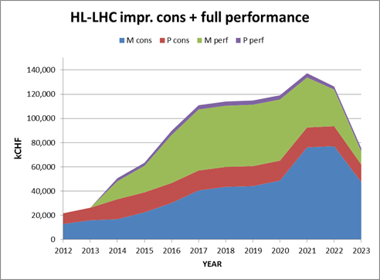
Preliminary budget estimate
 | Improving Consolidation | Full performance | Total HL-LHC
Mat. (MCHF) | 476 | 360 | 836
Pers. (MCHF) | 182 | 31 | 213
Pers. (FTE-y) | 910 | 160 | 1070
TOT (MCHF) | 658 | 391 | 1,049

Slide 19
European Strategy Update
Open symposium in Cracow 10-12 Sept
July 2012: submission of documents:
    CERN-ATS-2012-236
    High Luminosity Large Hadron Collider - A description for the European Strategy Preparatory Group
    CERN-ATS-2012-237
    High Energy LHC - Document prepared for the European HEP strategy update
We work hard to make HL-LHC “unavoidable”: much return in Physics and Accelerator Technology for little (extra)money
HL-LHC is the test bed (on real scale) of new advanced technology: 11T and 13 T Magnets, CCs, new collimation concepts, new diagnostics, SC Links, advanced modelling at the highest energy, all working on a ∼ 1 GJ beam… (vacuum, cryogenics, kickers, protections…)

Slide 20
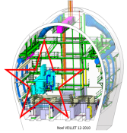
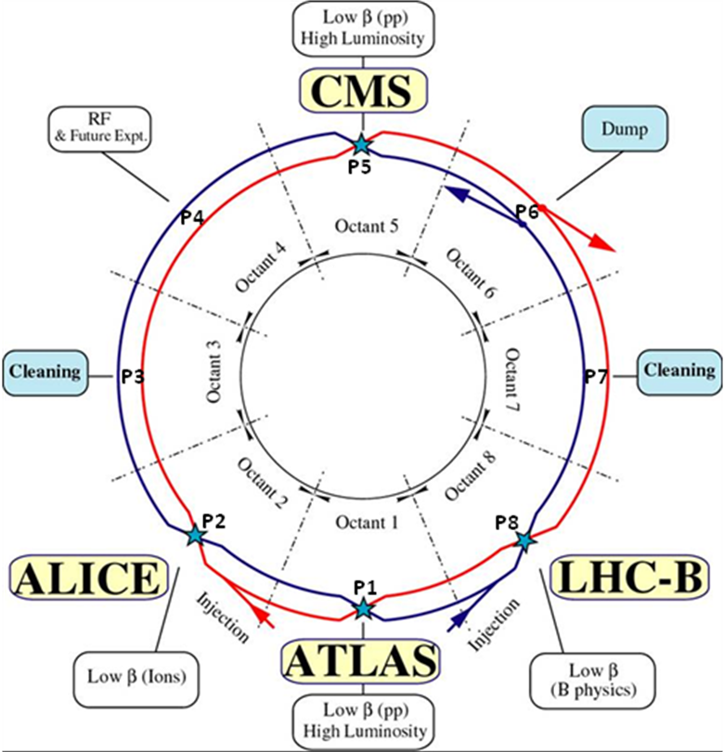
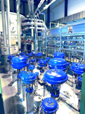
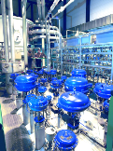
1.2 km of new equipment in the LHC…
6.5 kW@4.5K cryoplant
2 x 18 kW @4.5K cryoplants for IRs

Slide 21
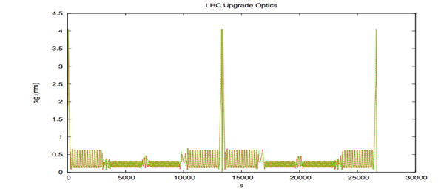
Technical Progress (incomplete …) - 1
WP2
  ATS is fully proved (β* = 15 cm «easy», room for 10-12 cm); optics layout (many magnets to change); field errors (also CC)…
  Strong contribution from EU and LARP…
typical ATS collision optics with IR1 and IR5 squeezed down to b*=10 cm

Slide 22
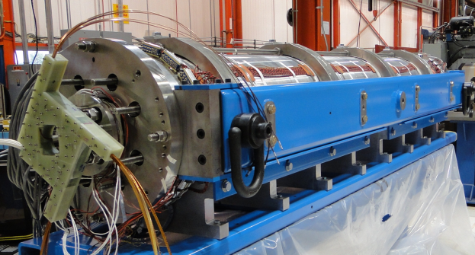
Technical Progress (incomplete …) - 2
WP3
LARP: HQ (1m-120 mm) and LQ3 (3.6 m -90 mm), very positive.
Aperture 150 mm, 4.5+4.5 m long, W-shielded, more rad-dam limited than heat depo limited, new plan for LARP+CERN
EU (CEA, INFN)+ JP
LQS03: 208 T/m at 4.6 K
210 T/m at 1.9 K
1st quench: 86% s.s. limit
3.3 m coils
90 mm aperture
Target:
200 T/m gradient at 1.9 K

Slide 23
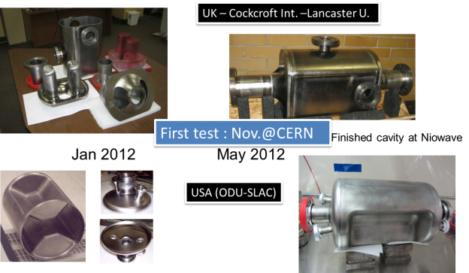
Technical Progress (incomplete …) - 3
WP4
First CC (from UK) arrived at CERN, near under test!
ODU-SLAC CC also very near, BNL under way
Interest from Fermilab for cryomodulization
From virtual to actual reality!

Slide 24
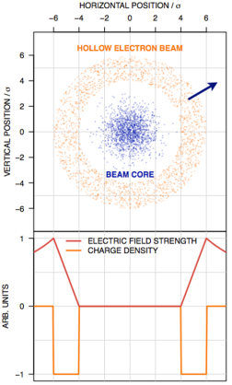
Technical Progress (incomplete …) - 4
WP5
Assessment of collimation needs in LHC after LS1 (Cryocollimators…): review in April 2013
New Material test (HiRadMat)
New concepts : Crystals, e-Lens
Hollow e-lens
Primary collimator

Slide 25
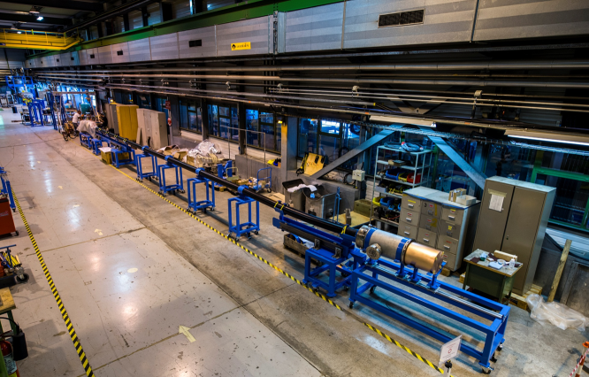
Technical Progress (incomplete …) - 5
WP6
    first proto 20 m – 20 kA under test at CERN!

Slide 26
Technical Progress (incomplete …) - 6
WP7 (Mach. Protection)
    Start analysis CC protection
WP8 (Collider-Experiment Int.)
    Starting now after endorsement from Coordination Group: 30 NOV Workshop
WP9 (Cryogenics)
    SPS cryogenic zone (Coldex) under revamping
    Work for SC link and P4 progressing

Slide 27
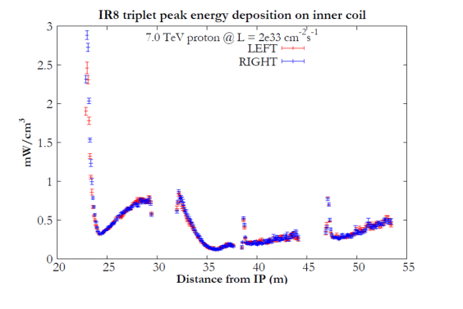
Technical Progress (incomplete …) - 7
WP10 (Energy depo)
Support to all studies
Leading role in IP8 study for LHCb upgrade: no need of TAS for 2e33 of luminosity

Slide 28
Technical Progress (incomplete …) - 8
WP 11 (11 T dipole)
2 m long single bore: test in June/July 2012
10.4 T at low dI/dt,
95% of the goal, coil damage recognized
new 1 m single bore to test in February
Then one 2 m single bore and then 2in1

Slide 29
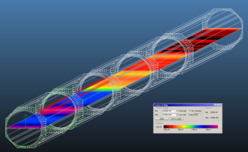
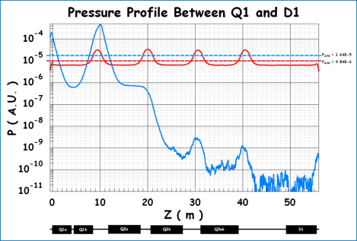
Technical Progress (incomplete …) - 9
WP12 (Vacuum)
Careful study undergoing (for molecular flow and Synchr.Rad.): no issue for the moment
The integrated flux along the ~ 7700 mm-long orbit is F=2.84E+17 ph/s, and the integrated power is P=0.88 W, for the nominal HiLumi current of 860 mA.
Even for a SR-induced outgassing yield η(molec/ph)= 1.0E-4 the corresponding gas load Q_{SR} is Q_{SR}=1.158E-6 mbar·l/s, giving an average pressure rise of ~1.1E-11 mbar, well below the pressure limit of 6.7E-10 mbar.

Slide 30
Technical Progress (incomplete …) - 10
WP13 (Beam Diagnostic) just starting
WP14 (de)Installation and Integration
WP15 HWC
WP16 (HE-LHC Study): Begins in 2013,
    FP7-Eucard2 – WP10 approved: start in May 2013
WP17 : High Field Magnet (technology R&D and 130 mm – 13 dipole for Test station) under FP7 Eucard WP7.

Slide 31
Discussing in-kind contribution
(secure Full Performance Upgrade)
DOE: extremely positive: on 10 July 2012 first public sentence to prepare plan for 200 M$ contribution (project in addition to LARP R&D)
Japan: progressing, proposing 20-50 MCHF with also infrastructure renewal in KEK…
Others? Any possibility welcome!

Slide 32
Progress are enormous:
however we are not engaging all available resources!

