Slide 1
ISSUES IN QXF PROTECTION
Frascati, 15th November 2012
QXF session
E. Todesco
With contributions from
H. Bajas, H. Felice, T. Salmi, M. Sorbi

Slide 2
QXF: DUMP RESISTOR
Short magnets have been always tested with extraction through dump resistor
  Non negligible fraction of energy extracted
  For long magnets situation can be different
Estimate for the QXF
  800 V as maximal voltage on the magnet, current of 17 kA, 50 mΩ dump resistor
  1-m-long → half of energy extracted
  8-m-long negligible effect
We must work in the hypothesis of no (negligible) dump resistor

Slide 3
QXF: HOTSPOT TEMPERATURE
Time margin for protection: how long we can stay at nominal
  Before having all magnet quenched
  And before reaching T_{max}=300 K at I(t)=0
  Time is ~30 ms: improved situation w.r.t. HQ and TQ, similar to 11T

Slide 4
QXF: HOTSPOT TEMPERATURE
We have ~33 ms to quench all magnet
  Quench detection (time to reach 100 mV): typically 1-2 ms in HQ
    [but up to 7 ms in one case at CERN]
    With 30% larger cable cross-section, this time should increase by 30%
  Validation window: 10 ms in LHC, possibly to be reduced at 5 ms
  Switch opening: 2 ms (hardware)
  Delay between firing heaters
  and quench onset: ~7 ms (HQ data)
So ~15 ms to start quench outer layer
Another ~15 ms available to quench the inner layer
  Data analysis of HQ needed
We still plan to avoid the inner layer quench heater
Measured delay [H. Felice, T. Salmi, et al.]

Slide 5
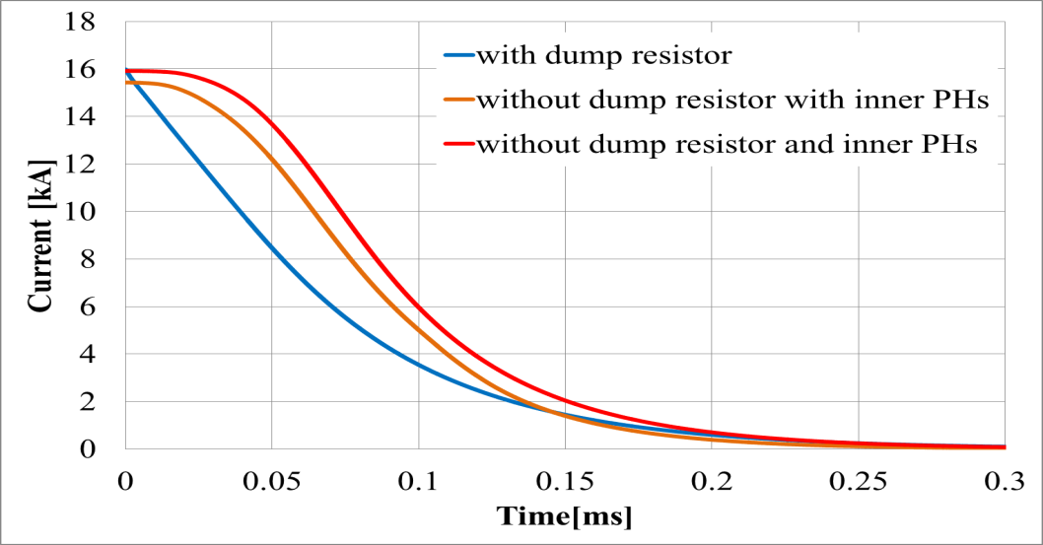
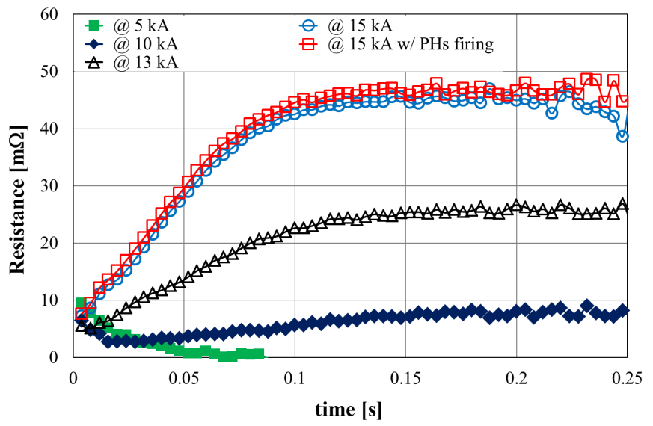
QXF: HOTSPOT TEMPERATURE
High MIITS test in HQ01e showed that in absence of dump resistor we are below 300 K
  But this magnet has strong quenchback (quench induced by heat created by cable eddy currents due to dI/dt)
  So this test is not conclusive
  Test with cored cable will be conclusive
18.3 MIITs
13.2 MIITs
16.9 MIITs
High MIITs test [H. Bajas, M. Bajko, et al.]
Evidence of quenchback[H. Bajas, M. Bajko, et al.]

Slide 6
QXF: VOLTAGE
Voltage scale with magnet length
  So we could have effects that we do not see on 3.4-m-long but are a killer at 8 m
  Analysis of an extreme case: outer layer totally quench, no quench on inner – for 8-m-long QXF we are still safe in this case
    Anyway inner layer must quench within 20 ms, where we are at 200 V

Slide 7
CONCLUSIONS
Protection is a very critical aspect for QXF
  Scheme: little energy can be extracted – we have to work in the scenario of negligible dump resistor
    Important to test magnets without dump resistor!
  Hotspot temperature: ~30 ms allowed to quench all magnet to stay below 300 K
    Main issues:
      Analysis of time to get above threshold and quench velocity
      Analysis of propagation from outer to inner
      Only data for magnet with cored cable will be conclusive
  Voltage: estimated in a worse case with 8-m-long magnet seem to pose no problem (well within 1kV)
    Additional verification work is needed to really find the worst case

