Slide 1
Status and prospective of cryogenics for cold-powering systems at LHC P7, P1 and P5
R. van Weelderen and U. Wagner
CERN

Slide 2
Cold powering systems
Foreseen at LHC Points 1 and 5
  Replacement of ARC and IT current feed boxes from LHC tunnel to surface building.
    Arc: ~ 220 kA total current;
    IT: ~ 100 kA total current
    ~ 400 m SC link line incl. ~100 m vertical shaft
Foreseen at LHC point 7
  Replacement of ARC current feed boxes from LHC tunnel to distant underground cavern.
    ~ 32 kA total current; ~ 500 m “semi horizontal” SC link line.
For each point:
  A new cryostat must be integrated in the tunnel for the energy extraction and the connection between magnet LTS and link.
Notes:
Recall of the basic requirements as known of today.
For the ARC DFB P1/P5 and the DFB for P7 we assume the total current is the same as today.
For the IT feed box the total current is still in discussion. According to Amalia the mentioned 100 kA is the most probable.
(total current in all leads under nominal conditions -> defines the helium flow)
The moving of the DFBs in P1 / P5 is connected to the high lumi upgrade; the moving for P7 is actually an R2E project.

Slide 3
Locations I: P7
New current feed box (DFB) to be placed in distant underground cavern
Cryogenic supply from existing refrigerators at P6 and P8
Available fluids for cooling defined by existing infrastructure
Notes:
Here I recall the locations more or less as Laurent has shown.
The important point is that we have to take the helium at the far end from the refrigerator and will have to feed all helium for the cooling of link and feed box back at ambient through the warm recovery line.
The reference solution the DFBL in P3; the link in MgB2 allows some savings in either helium consumption or TL design.
The NEXANS design is liked by all except CRG as it can solve some headache for installation.
We can do with an Mgb2 link, or as we did in P3 for the DFBL.

Slide 4
Locations II: P1 and P5
New current feed boxes (DFB) to be placed on surface level
Cryogenic supply possible:
  From existing refrigerators at P18, P4, P6 and P8
  From new refrigerator at P1 and P5
Available fluids for cooling defined only for the existing infrastructure
Liberty to define new refrigerator according to needs
Notes:
The new refrigerator opens the option to design as would be optimum for cooling, plus it has basically no capacity limit.
Anyway we will use it probably only for the IT and MS magnet feed box.

Slide 5
Locations II: P1 and P5 (continued)
In principle three possibilities for cooling of the cold powering line (link) and DFB.
    All from existing refrigerators
    All from new refrigerator
    Part from new, part from old
Probable solution (to allow separation of ARC and LSS cryogenics) :
    DFB / link for arc supplied by the existing refrigerators
    DFB / link for new magnets supplied by the new refrigerator
Please refer to the presentation of L. Tavian (plenary on 16 Nov.)
Notes:
Self expaling

Slide 6
Assumptions as of today
Link SC is MgB₂
  Splice LTS to MgB₂ (magnet to link) requires liquid helium bath.
Max MgB₂ temperature 20K
  Max. helium temperature 17 K
He consumption for current lead cooling: 0.06 g/s per kA
Notes:
Well these are the assumptions.
The assumed flow per kA is rather at the high end.
But the current leads we need do not exist at this date.
The critical point for the leads is we cool with gas and have no thermal buffer from a two- phase volume. For transients or variations this may later prove a pain in the ..
The other unresolved issue for high current and lots of leads (arc DFB) seems to be the possible cross talk on the link.

Slide 7
Conclusions from 2011 presentation
Two cases can be distinguished
High current case P1 and P5
  The cooling for the current lead defines the helium flow.
  Heat load on transfer lines of second order.
  Invest design effort to obtain a current lead with low coolant consumption.
Low current case
  Heat load on transfer lines defines the cooling flow.
  Flow in excess for current lead cooling is heated to ambient. (“wasted”)
  Invest design effort to obtain a transfer line with low heat leak.
    Complex custom design transfer line
    Shield circuit using 60 K, 18 bar gas (as already realised for existing 520 m long link in P3)*
* see “OPERATIONAL EXPERIENCE WITH THE LHC SUPERCONDUCTING LINKS AND EVALUATION OF POSSIBLE CRYOGENIC SCHEMES FOR FUTURE REMOTE POWERING OF SUPERCONDUCTING MAGNETS” A. Perin, R. van Weelderen, S. Claudet, IPAC 2010
Notes:
Last hear I did not consider the IT DFB as there is the option to design as neded on the refrigerator side.
For the arc DFB in P1 /P5 the MgB2 allows us actually to install a crappy transfer line as the cooling flow for the leads is so high.
I had urged to study options with LN2 cooling for the lead, or a combined cooling.
I basically understand those who are on it will not consider LN2.
We will basically get a “modified LHC lead” no real development envisaged here.
Just between us two.
For the P7 solution, either we get a MgB2 link or we can do as in P3.

Slide 8
Transfer line options
“Nexans like” (semi rigid) transfer line
  Advantage: easier to install.
  Disadvantage: high heat load.
    Relevant for “low current cases”.
Custom build rigid transfer line
  Advantage: low heat load.
  Disadvantage: Installation time consuming; space requirement for installation.
Notes:
Just a reminder on the TL issues, as a lot of people will not even think about a rigiit custom made line.

Slide 9
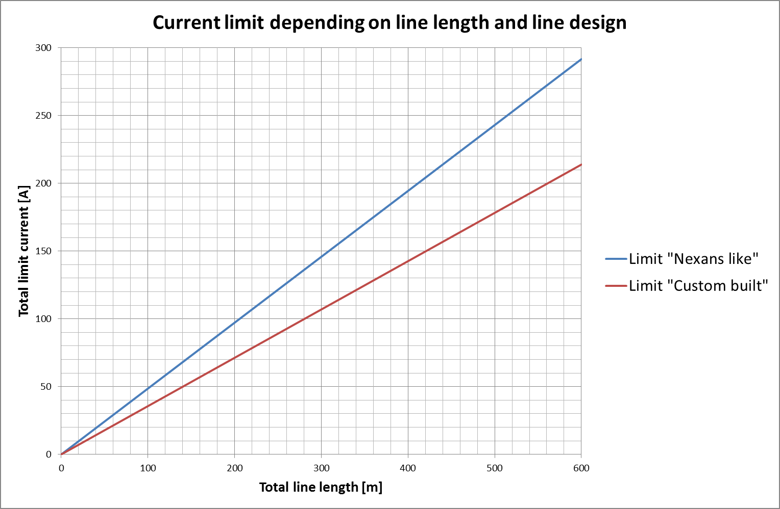
High and low current case
Total current defines coolant flow
ARC DFB P1/P5
IT DFB P1/P5
Link heat load defines coolant flow
DFB P7
Notes:
The are a lot of assumptions here, but the basis is about right.
We have one cooling case where we do not need to bother about the TL performance and two were the link eats more helium than necessary for the lead.
PS: those we study space and integration want a 5 mm TL were one does not need to access for installation.

Slide 10
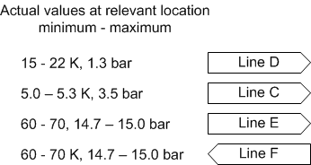
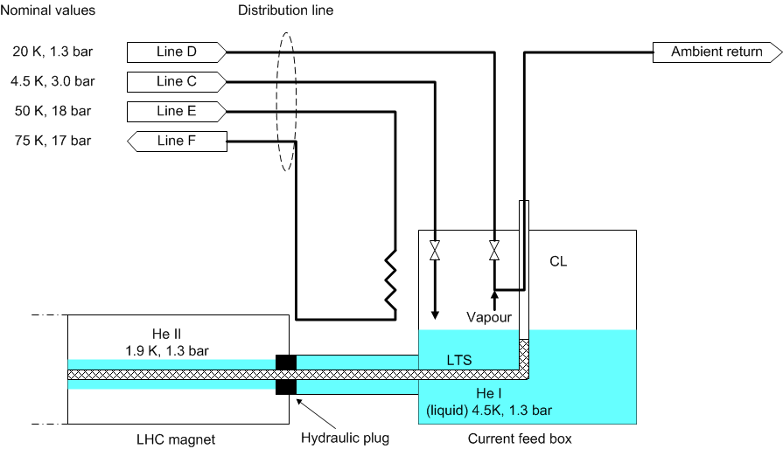
Current situation
DFB in the LHC tunnel
Cooling:
  LTS with 4.5 K 2-phase helium
  Lead with 20 K gas helium
Notes:
Here I recall what we have at the existing.
A very simplified sketch of a DFB
The actual values at the end of the arc are far off the nominal values for the different lines.
Due to heat load and height difference.

Slide 11
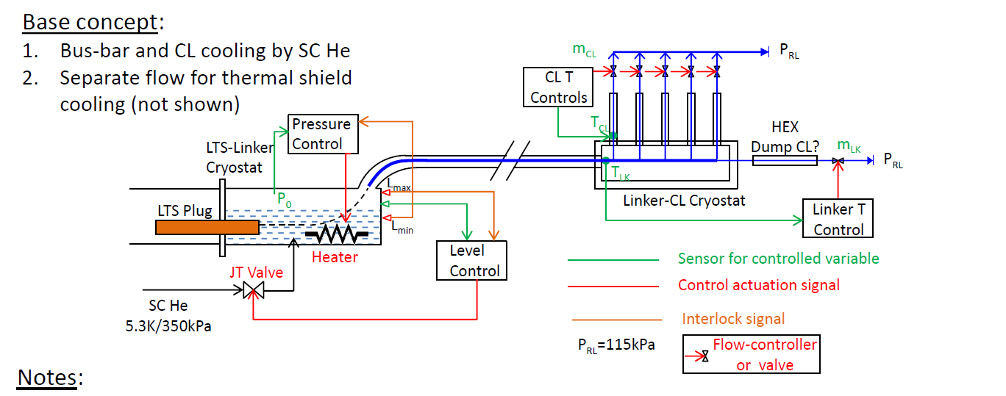
Current Base concept (all sites)
Helium at max. 17 K
Helium from line C
  The (assumed) 17 K limit for the MgB2 link allows only the
  5 K, 3.5 bar helium from line C as coolant.
  The link will be cooled by helium gas created by evaporating the liquid helium in the spice box.
  Thermal shield solution not shown.
Notes:
Here the base concept just issued by the Southampton university.
I show this to make clear we work together, they will show the same picture.
I consider it is very close to what we will end up with.
The control is much too detailed for the moment, but could e done like this.
We have basically no other option than take the gas from line C, expand it to liquid for the cooling of the splice LTS to MgB2 and create sufficient flow for the leads and link by heating away in the bath.
The thermal shield can either be taken from the line D (most probable for a nexans line solution) or from line E back to line F. but this requires a custom TL with two shield gas lines.
For the arc DFB the shield coming from line D will be mixed with the gas for the MgB2 cooling and can then cool the leads.
For the other DFB-s either we cool with line E/F or we have to warm up some of the gas for the link and feed this back to ambient.
For the new refrigerator /IT DFB we can imagine recovering the cold gas through a surface TL> I am even not certain if it will be worth the cost of the TL.

Slide 12
Cooling capacity
The relocated current feed boxes with superconducting link will charge the refrigeration system more than the currently existing feed boxes.
The cooling of the link is not for free.
The existing refrigerators have sufficient margin in the respective temperature range to cover this additional load. (Without proof here, but see L. Tavian’s plenary on 16 Nov)
The new refrigerators can be designed as necessary.
We are certain we can supply the cooling for the relocated current feed boxes.
Notes:
Basically we can allow for the additional cooling charge because:
In P7 we have some margin from the fact that the 1.8 K load is lower than calculated.
This is sufficient for the about 5 g/s taken from 4.5 K and send back at ambient.
At P1/P5 for the ARC DFB the only difference is that instead cooling the lead with gas from 20 to ambient, we cool with the same flow from 4.5 K to ambient.
The fact that we do not need to cool the IT largely gives us the necessary flow between 4.5 K and 20 K.

Slide 13
Cost of cooling for the existing refrigerators
The additional cost of cooling is for all points:
    About 2.0 g/s from 4.5 K, 3.5 bar to 20 K, 1.3 bar
    Equivalent to about 220 W between 4.5 K and 20 K

Slide 14
Uncertainties as of today
  MgB₂ performance and detailed requirements.
  Lead performance and detailed requirements.
  Transfer line design (link cryostat)
Notes:
Basically we have no certainty as concerns anything of link and new lead!

Slide 15
Conclusion
We are certain that we can supply the cooling for the current feed boxes and the corresponding superconducting link.
We do not know precisely what and how we will cool.
In short
  We do not know what we will do, but we know we can do it.
Notes:
Self explaining again

