Slide 1
Part II
Analysis framework
A.Gheata, A.Morsch, C-K. Boesing
v2.0: 26.03.2012
These slides + examples: https://indico.cern.ch/conferenceDisplay.py?confId=183795

Slide 2
Prerequisites
Login to your AFS account on LXPLUS
  ssh -X user@lxplus.cern.ch ->skip
Enable AliRoot v4-16-release
  > source /afs/cern.ch/alice/caf/caf-lxplus.sh v4-16-Release ->skip
Download the tutorial tarball locally:
  >
  > tar xvzf analysis-tutorial.tgz

Slide 3
Analysis
Software
  AliRoot
    Specialized ROOT for ALICE
    AliRoot = ROOT + ALICE libraries
  Your code
What is the data
  Usually ESD, AOD or Monte Carlo kinematics (MC truth)
Where does your analysis code run?
  Local = On your machine
  In PROOF ("Parallel ROOT Facility")
    Parallel analysis on a cluster
    Not related to the Grid
  In the AliEn ("Alice Environment") Grid
    AliEn is the software of ALICE to access the Grid
    As a user job or in an organized analysis

Slide 4
What is organized analysis
Centrally coordinated analysis “train”
  Collected analysis tasks (“train-wagons”) pass over the data
  No chaotic request of data
    Most efficient way for many analysis tasks to read and process the full data set, in particular if resources are sparse
  Optimise CPU/IO ratio
    User can rely on previous “service” and PWG tasks
  Check for data integrity
But also…
  Helps to develop a common well tested framework for analysis
  Develops common knowledge base and terminology
  Helps documenting the analysis procedure and makes results reproducible

Slide 5
Analysis trains
Acceptance and Efficiency Correction Services
Monte Carlo Truth
ESD/AOD
TASK 1
TASK 2
TASK …
TASK N
Start directly from AOD
or start with ESD->AOD Filter
AOD
Possibility to write DeltaAODs

Slide 6
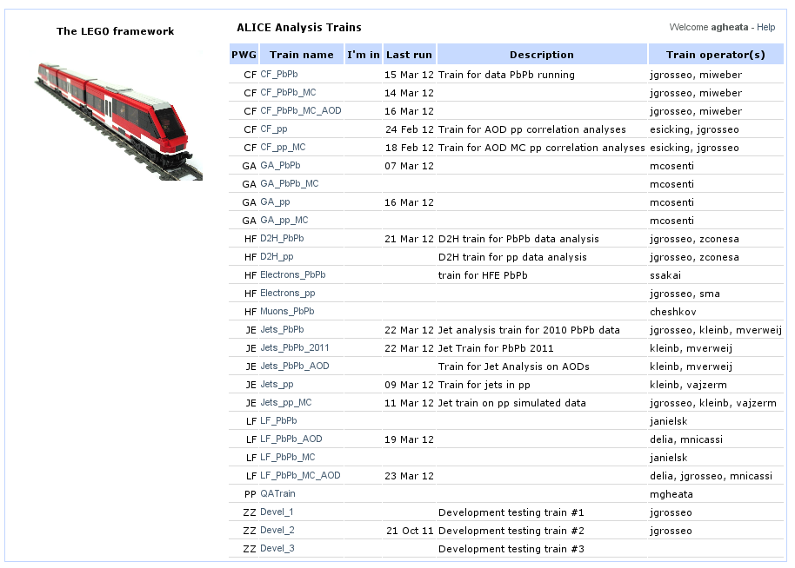
Example: PWG trains
https://alimonitor.cern.ch/trains/

Slide 7
The Basics:
What the Analysis framework does in ALICE
Transparent access to all resources with the same code
  Usage: Local, AliEn grid, CAF/PROOF
Transparent access to different inputs
  ESD, AOD, Kinematics tree (MC truth)
Allow for „scheduled“ analysis
  Common and well tested environment to run several tasks
Defines a common terminology
N.B.: The analysis framework itself has a
very general design, not bound to ALICE software

Slide 8
The single task view
AliAnalyisTask
  User provided code
Input data
  Provided via numbered slots
  Each slot connected to a data container of the corresponding type at run time
  Content can be any TObject
  “Handlers” handle data specific operations
Output data
  Communicated via one or more slots
  Handlers e.g. for AOD output
  Simpler output e.g. histograms
  Output can be disk resident (file) or only memory resident (transient data)
Several of these tasks can be collected in the manager
CONT 0
CONT 1
INPUT 0
INPUT 1
AliAnalysisTask
OUTPUT 0
N:B.: AliAnalysisTask is a general Task
AliAnalysisTaskSE and ME are ALICE specific
CONT 2
Notes:
8

Slide 9
Analysis manager
Several analysis tasks registered to an analysis manager
Top data container(s) storing the initial input data chain (ESD, AOD, kinematics tree, …)
Primary tasks feeding from top containers, executed in serial mode for each event
Possibly secondary tasks feeding from data produced by parent tasks
  e.g. filtered AOD tracks, jets etc.
Handles initialization, execution and termination of all registered tasks
Notes:
9

Slide 10
The overall picture
AliAnalysisManager
AliVEventHandler
AliMultiInputEvent
Handler
I/O via slots
AliESDInputHandler
(AliAODInputHandler)
AliMCEventHandler
AliAODHandler
(Output)
Tasks
Data
AliAnalysisTask
AliVEvent
AliAnalysisTask
AliAnalysisTask
AliAnalysisTask
(or SE/ME)
AliESDEvent
(AliAODEvent)
AliMCEvent
AliAODEvent
AliVParticle
AliESDtrack
AliMCParticle
AliAODtrack

Slide 11
Library structure
ANALYSIS classes split
  ALICE independent: libANALYSIS.so
  ALICE specific: libANALAYSISalice.so
  Load both in your steering macro
Additional layer of inheritance
  YourTask:AliAnalyisTaskSE(:AliAnalysisTask)
  Does some work for you specific for “Single Event” analysis ?

Slide 12
A new layer AliAnalyisTaskSE
Already provides the access to input ESD/AOD/Kinematics and define AOD output
  Inherited from AliAnalyisTaskSE now
  Input event can be cast as needed
    AliESDEvent *esd = dynamic_cast<AliESDEvent*>fInputEvent;
You need to implement at minimum:
  virtual void UserCreateOutputObjects(){;}
  virtual void UserExec(){;}
  …instead of CreateOutputObjects()and Exec()
  Have a look at:
    analysis-tutorial.tgz#analysis-tutorial/TaskSE/
AliVEvent* fInputEvent; //! VEvent Input
AliAODEvent* fOutputAOD; //! AOD out
AliMCEvent* fMCEvent; //! MC

Slide 13
A new layer AliAnalyisTaskSE
Already provides the access to input ESD/AOD/Kinematics and define AOD output
  Inherit from AliAnalyisTaskSE now
Input event can be cast as needed
AliESDEvent *esd = dynamic_cast<AliESDEvent*>fInputEvent;
You need to implement at minimum:
  virtual void UserCreateOutputObjects(){;}
  virtual void UserExec(){;}
  …instead of CreateOutputObjects()and Exec()
Have a look at:
  analysis-tutorial.tgz#analysis-tutorial/TaskSE/
Mandatory to use to profit from centralized utilities (trigger-based event selection)
AliVEvent* fInputEvent; //! VEvent Input
AliAODEvent* fOutputAOD; //! AOD out
AliMCEvent* fMCEvent; //! MC

Slide 14
Analysis framework
… in practice

Slide 15
Evolution of your analysis code
In practice
  Develop your analysis code as AliAnalysisTaskSE and test locally on a few files
  Most debugging done here
When the code works locally, submit to PROOF or AliEn Grid
  PROOF
    Fast response, fast turnaround
    Limited number of files
  AliEn Grid: Access to all files
Optionally, add to the organized analysis

Slide 16
Analysis: Component by Component
What is needed
  The manager: AliAnalysisManager
  The input handler: ESD/AOD supported
  The output handler: AliAODHandler
Optional
  MC Truth handler: AliMCEventHandler
Your Task(s) AliAnalysisTask(SE)
A small execution macro
  Load libraries
  Collect input files (TChain), connect everything to the manager
  Run

Slide 17
AliAnalysisManager
AddTask(AliAnalysisTask *pTask)
  At least 1 task per analysis (top task)
CreateContainer(name, data_type, container_type, file_name)
  Data can be optionally connected to a file
ConnectInput/Output(pTask, islot, pContainer)
  Mandatory for all data slots defined by used analysis modules
InitAnalysis()
  Performs a check for data type consistency and signal any illegal circular dependencies between modules
StartAnalysis(const char *mode)
  Starts the analysis in “local”, “proof” or “grid” mode

Slide 18
Analysis macro
Load libs and create manager
see analysis_tutorial.tgz#Task/jetana.C
// Load libs (more needed when running with root instead of aliroot)
// Minimum need to load libANALYSISalice
gSystem->Load("libANALYSISalice.so");
// Load the task
// AliAnalysisTaskJets is in libJETAN
gSystem->Load("libJETAN.so");
// User tasks usually compiled on the fly at the beginning, not needed here
// gROOT->LoadMacro(”AliAnalysisMyTaskXYZ.cxx+g”);
// Create a Chain of input files ESDs here
// External file list is used
gROOT->LoadMacro("$ALICE_ROOT/PWGUD/macros/CreateESDChain.C");
TChain *chain = CreateESDChain("filelist.txt");
// or Manual chaining:
// TChain *chain = new TChain("esdTree");
// chain->Add(”SomePath/AliESDs.root");
// Create the Analysis manager
AliAnalysisManager *mgr =
new AliAnalysisManager("My Manager", "My Analysis");
Notes:
add libANALYISalice.so for new versions

Slide 19
Analysis macro
Create Input/Output handler
// Define Input Event Handler
AliESDInputHandler* esdHandler = new AliESDInputHandler();
// Define MC Truth Event Handler (optional)
AliMCEventHandler* mcHandler = new AliMCEventHandler();
// Add input handlers to the Task Manager via a multi handler
AliMultiInputEventHandler *mH = new
AliMultiInputEventHandler();
mH->AddInputEventHandler(esdHandler);
mH->AddInputEventHandler(mcHandler);
mgr->SetInputEventHandler (mH);
// Define Output Event Handler (only if filtering specific information in form of a tree to be reprocessed later)
AliAODHandler* aodHandler = new AliAODHandler();
aodHandler->SetOutputFileName("aod.root");
mgr->SetOutputEventHandler (aodHandler);
// Be sure you are told what you are doing
mgr->SetDebugLevel(3);

Slide 20
AOD or Kinematics Analysis?
Same schema works for AOD analysis
  TChain contains AOD files
  User retrieves AliAODEvent directly from the task (fInputEvent)
… and even for Kinematics
  Add galice.root files to TChain
  This “triggers” correct loop over files
  Obtain AliMCEvent from the task (fMCEvent) combining:
    Kinematics tree
    TreeE (Event Headers)
    Track references

Slide 21
Analysis macro:
Define Input/Output
// Declare Common Input TChain
AliAnalysisDataContainer *cinput1 =
mgr->CreateContainer("Chain",TChain::Class(),
AliAnalysisManager::kInputContainer);
// Common Output Tree in common ‘default’ output file aod.root (ONLY NEEDED IF YOUR TASK WRITES AN AOD!)
AliAnalysisDataContainer *coutput1 =
mgr->CreateContainer("tree", TTree::Class(),
AliAnalysisManager::kOutputContainer, "default");
// Private output objects to write to a file
AliAnalysisDataContainer *coutput2 =
mgr->CreateContainer("histos", TList::Class(),
AliAnalysisManager::kOutputContainer, "histos.root");

Slide 22
AliAnalysisDataContainer
Normally a class to be used ‘as is’
  Enforcing a data type deriving from TObject
    Type e.g. given by TChain::Class()
Three types of data containers
  Input – containing input data provided by AliAnalysisManager
  Exchange – containing data transmitted between tasks
  Output – containing final output data of an analysis chain, eventually written to files.
One can specify the output file name in the format: file.root:folder

Slide 23
Analysis Macro
Add an Analysis Task and run
// Create Jet Finder Task task
AliAnalysisTask *jetana = new
AliAnalysisTaskJets("JetAnalysis");
jetana->SetDebugLevel(10);
// Add task to the manager
mgr->AddTask(jetana);
// Connect I/O to the task
mgr->ConnectInput (jetana, 0, cinput1);
mgr->ConnectOutput(jetana, 0, coutput1);
mgr->ConnectOutput(jetana, 1, coutput2);
// Run the task
mgr->InitAnalysis();
mgr->PrintStatus();
mgr->StartAnalysis(“local”,chain);
For jet analyis task see: $ALICE_ROOT/JETAN
AliAnalysisJets.{cxx,h}

Slide 24
Task to be added to a train
Few extra things to be considered when running in a train
  Write the following parts of the analysis macro to a separate file (named: AddTask(…).C
    Creation of the task + possible configuration parameters
    Creation of containers and connection of slots
      Use: mgr->GetCommonFileName() as output file and append the outputs of your task to a specific folder
  TString file = mgr->GetCommonFileName();
  file += “:myFolder”;
  mgr->CreateContainer("histos", TList::Class(),
  AliAnalysisManager::kOutputContainer, file);
    Adding the task to the manager
Check for an example: $ALICE_ROOT/ANALYSIS/macros/AddTaskPIDResponse.C

Slide 25
Hands on: exercise
Download/copy:
  ...analysis-tutorial.tgz
Unpack the file:
  tar xvzf analysis_tutorial.tgz
Look at TaskSE/jetana.C
  Do you recognize everything?
Edit jetana.C
  Put a return; after the mgr->PrintStatus();
  Run the macro
  Look at the output on the screen
Remove the return; and re-run
  Which files are created?
  Have a look in a TBrowser()

Slide 26
Implement task: Method by Method
We have a framework that calls an analysis task with inputs and outputs connected
How do we implement our own analysis ask?
  “Constructor” and “Destructor”
    like any C++ class
  UserCreateOutputObjects()
    Create Histograms
  UserExec()
    The event loop
  Terminate()
    Called at the end, can draw (or fit) e.g. a histogram
We cover here the case for AliAnalysisTaskSE
  Recommended to use TaskSE
  Examples for AliAnalysisTask are in the tarball (Task/) for reference

Slide 27
AliAnalysisTaskSE
Classes derived from AliAnalysisTaskSE can run locally, in PROOF and in AliEn
MyComputer
MyTask(name):AliAnalysisTaskSE(name)
MyTask::LocalInit() // not mandatory
Results.root
MyTask::Terminate() // useful to implement
Worker
MyTask() // no allocations here
MyTask::UserCreateOutputObjects() // book histograms here !
MyTask::UserExec() // Called in a loop
MyTask::FinishTaskOutput() // not mandatory
Worker
MyTask() // no allocations here
MyTask::UserCreateOutputObjects() // book histograms here !
MyTask::UserExec() // Called in a loop
MyTask::FinishTaskOutput() // not mandatory
Merger
Worker
MyTask() // no allocations here
MyTask::UserCreateOutputObjects() // book histograms here !
MyTask::UserExec() // Called in a loop
MyTask::FinishTaskOutput() // not mandatory
Worker
MyTask() // no allocations here
MyTask::UserCreateOutputObjects() // book histograms here !
MyTask::UserExec() // Called in a loop
MyTask::FinishTaskOutput() // not mandatory

Slide 28
Notes about streaming
A task working perfectly locally can fail in distributed mode
  There is an intermediate step for streaming your class object to the workers
What to check:
  Do I initialize all data members in my constructors ?
  I use //! Comments to all histograms and objects that are created on the workers (in UserCreateOutputObjects) but NOT for data members that are initialized in the initial configuration phase (constructor, LocalInit)
  I use ClassDef(MyClass, n) in my header file

Slide 29
Named constructor:
AliAnalysisTaskJets::AliAnalysisTaskJets(const char* name):
AliAnalysisTaskSE(name),
fConfigFile("ConfigJetAnalysis.C"),
fNonStdBranch(""),
fJetFinder(0x0),
fHistos(0x0),
fListOfHistos(0x0)
{
DefineOutput(1, TList::Class()); // 0 slots assigned in parent class
}
Called in the macro via new AliAnalysisTaskJets(“JetAnalysis“)
AliAnalysisTaskSE::AliAnalysisTaskSE(const char* name):…
{
DefineInput (0,TChain::Class());
DefineOutput(0, TTree::Class());
}

Slide 30
Default constructor:
AliAnalysisTaskJets::AliAnalysisTaskJets():
AliAnalysisTaskSE(),
fConfigFile("ConfigJetAnalysis.C"),
fNonStdBranch(""),
fJetFinder(0x0),
fHistos(0x0),
fListOfHistos(0x0)
{
// Default constructor. Initialize all data members correctly. DO NOT allocate objects here, since this is called by ROOT while streaming and will result in memory leaks.
}
N.B.: No DefineInput/DefineOutput in default c‘tor
(important for PROOF/GRID case)

Slide 31
Constructor: additional
User analysis module MUST derive from AliAnalysisTask
  DefineInput/Output(Int_t islot, TClass *type)
  Declared in the named class constructor
  Mandatory at least 1 input & 1 output slots
… or AliAnalysisTaskSE
  Predefined input (TChain) and output (AOD) at slot #0
  User must define at least one extra output slot

Slide 32
UserCreateOutputObjects()
// Book all custom output objects
OpenFile(1); // optional
// This connects all booked histograms/trees to the output
// file and makes sense only for large outputs
…
fHisto = new TH1F(“fHisto”, “My Histo”, 100, 0., 10.);
.......
// Several histograms are more conveniently managed in a
// TList
fListOfHistos = new TList();
fListOfHistos->SetOwner(); // MANDATORY! To avoid leaks in merging
fListOfHistos->Add(fHisto);
PostData(1,fListOfHistos);
// Just to avoid merging problems when the output is not
// produced

Slide 33
UserExec()
void AliAnalysisTaskJets::UserExec(Option_t */*option*/)
{
// Execute analysis for current event
// This actually implements how the analysis module
// processes the current event from input data
// Jet finding is delegated access to input output and
// MC given by TaskSE
fJetFinder->GetReader()->SetInputEvent(InputEvent(), AODEvent(), MCEvent());
fJetFinder->ProcessEvent();
….
fHisto->Fill(pt);
…
// Post the data (it serves as notification message for
// possible client tasks. Unposted data is also not
// written to file.)
PostData(1, fListOfHistos);
}
Called for each event

Slide 34
AliAnalysisTaskJets
This task is already quite elaborated
  Fills an AOD output
  Uses a TList to manage histograms
  Passes data to a AliJetFinder configured by an external macro
Let‘s turn to something simpler…

Slide 35
Analysis framework: hands on
Trivial example: plot the pt of the ESD particles
  Files in the analysis_tutorial.tgz archive (TaskSE)
    AliAnalysisTaskPt.cxx
    AliAnalysisTaskPt.h
    files.txt
    run1.C

Slide 36
Analysis framework: hands on
void run1()
// load analysis framework
gSystem->Load("libANALYSISalice");
gROOT->LoadMacro("$ALICE_ROOT/PWGUD/macros/CreateESDChain.C");
TChain* chain = CreateESDChain("files.txt", 2);
// Create the analysis manager and input handler
AliAnalysisManager *mgr = new AliAnalysisManager("testAnalysis");
// Add multi input handler
AliMultiInputEventHandler *mH = new AliMultiInputEventHandler();
AliESDInputHandler* esdH = new AliESDInputHandler();
mH->AddInputEventHandler(esdH);
mgr->SetInputEventHandler(mH);
// Create task
gROOT->LoadMacro("AliAnalysisTaskPt.cxx+g");
AliAnalysisTask *task = new AliAnalysisTaskPt("TaskPt");
// Add task
mgr->AddTask(task);
// Create containers for input/output
AliAnalysisDataContainer *cinput = mgr->CreateContainer("cchain", TChain::Class(),
AliAnalysisManager::kInputContainer);
AliAnalysisDataContainer *coutput = mgr->CreateContainer("chist", TH1::Class(),
AliAnalysisManager::kOutputContainer,"Pt.ESD.1.root");
// Connect input/output
mgr->ConnectInput(task, 0, cinput);
mgr->ConnectOutput(task, 1, coutput);
// Enable debug printouts
mgr->SetDebugLevel(2);
if (!mgr->InitAnalysis()) return;
mgr->PrintStatus();
mgr->StartAnalysis("local", chain);
}
Have a look at run1.C

Slide 37
Analysis framework: hands on
#ifndef AliAnalysisTaskPt_cxx
#define AliAnalysisTaskPt_cxx
class TH1F;
#include "AliAnalysisTaskSE.h"
class AliAnalysisTaskPt : public AliAnalysisTaskSE {
public:
AliAnalysisTaskPt(const char *name = "");
virtual ~AliAnalysisTaskPt() {}
virtual void UserCreateOutputObjects();
virtual void UserExec(Option_t *option);
virtual void Terminate(Option_t *);
private:
AliESDEvent *fESD; //! ESD object
TList *fOutputList; //! Output list
TH1F *fHistPt; //!Pt spectrum
ClassDef(AliAnalysisTaskPt, 1); // example of analysis
};
#endif
Have a look at
AliAnalysisTaskPt.h

Slide 38
Analysis framework: hands on
//________________________________________________________________________
AliAnalysisTaskPt::AliAnalysisTaskPt(const char *name)
: AliAnalysisTaskSE(name), fHistPt(0)
{
// Constructor
// Define input and output slots here
// Slot #0 works are defined in TaskSE
// Output slot #1 writes into a TH1 container
DefineOutput(1, TH1F::Class());
}
//________________________________________________________________________
void AliAnalysisTaskPt::UserCreateOutputObjects()
{
// Create histograms
// Called once
fOutputList = new TList();
fOutputList->SetOwner(); // otherwise it produces leaks in merging
fHistPt = new TH1F("fHistPt", "P_{T} distribution", 15, 0.1, 3.1);
fHistPt->GetXaxis()->SetTitle("P_{T} (GeV/c)");
fHistPt->GetYaxis()->SetTitle("dN/dP_{T} (c/GeV)");
fHistPt->SetMarkerStyle(kFullCircle);
fOutputList->Add(fHistPt);
PostData(1,fOutputList); // important for merging}
Have a look at
AliAnalysisTaskPt.cxx
Only in the constructor
with the signature (const char *)

Slide 39
Analysis framework: hands on
void AliAnalysisTaskPt::UserExec(Option_t *)
{
fESD = dynamic_cast<AliESDEvent*>(InputEvent());
if (!fESD) {
printf("ERROR: fESD not available\n");
return;
}
printf("There are %d tracks in this event\n", fESD->GetNumberOfTracks());
// Track loop to fill a pT spectrum
for (Int_t iTracks = 0; iTracks < fESD->GetNumberOfTracks(); iTracks++) {
AliESDtrack* track = fESD->GetTrack(iTracks);
if (!track) {
printf("ERROR: Could not receive track %d\n", iTracks);
continue;
}
fHistPt->Fill(track->Pt());
} //track loop
PostData(1, fOutputList);// Main loop
}
Works for ESD Input
How would you change it for
AOD ?

Slide 40
Side Remark: MC truth
void AliAnalysisTaskXYZ::UserExec(Option_t* option )
{
// During Analysis
AliVEvent* mc = MCEvent();
Int_t ntrack = mc->GetNumberOfTracks();
for (Int_t i = 0; i < ntrack; i++)
{
AliVParticle* particle = mc->GetTrack(i);
Double_t pt = particle->Pt();
}
}
Can also read only Kinematics (no need for ESDs),
without ESDs change one line in steering macro:
chain = CreateChain(“TE”,galice_root_list,2);

Slide 41
Analysis framework: hands on
void AliAnalysisTaskPt::Terminate(Option_t *)
{
// Draw result to the screen
// Called once at the end of the query
fHistPt = dynamic_cast<TH1F*>(GetOutputData(1));
if (!fHistPt) {
Printf("ERROR: fHistPt not available");
return;
}
TCanvas *c1 = new TCanvas("AliAnalysisTaskPt","Pt",10,10,510,510);
c1->cd(1)->SetLogy();
fHistPt->DrawCopy("E");
}
Notes:
May go to the analysis framework
Remove SetData(chain)
Add if (manager->InitAnalysis()) manager-StartAnalysis()

Slide 42
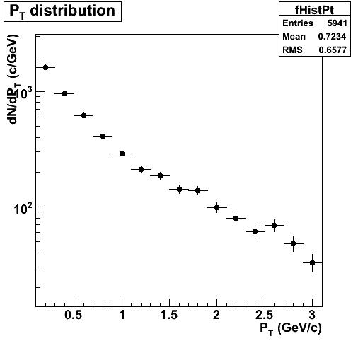
Run the macro run1.C
root[0].x run1.C
Processing run1.C...
task: TaskPt ACTIVE=0 POST_LOOP=0
INPUT #0: TChain <- [cchain]
OUTPUT #0: TH1F -> [chist]
Container: chist type: TH1 POST_LOOP=0
= Data producer: task TaskPt = Consumer tasks: -none-
Filename: Pt.ESD.1.root
StartAnalysis: testAnalysis
===== RUNNING LOCAL ANALYSIS testAnalysis ON TREE esdTree
->AliAnalysisSelector->Init: Analysis manager restored
->AliAnalysisSelector->SlaveBegin() after Restore
->AliAnalysisManager::SlaveBegin()
->AliAnalysisManager::Init(esdTree)
<-AliAnalysisManager::Init(esdTree)
<-AliAnalysisManager::SlaveBegin()
<-AliAnalysisSelector->SlaveBegin()
AliAnalysisManager::Notify() file: AliESDs.root
->AliAnalysisSelector::Process()
== AliAnalysisManager::GetEntry()
AliAnalysisManager::ExecAnalysis
Executing task TaskPt
…
<-AliAnalysisSelector::Process()
->AliAnalysisSelector::SlaveTerminate()
->AliAnalysisManager::PackOutput()
<-AliAnalysisManager::PackOutput: output list contains 0 containers
<-AliAnalysisSelector::SlaveTerminate()
->AliAnalysisSelector::Terminate()
->AliAnalysisManager::UnpackOutput()
Source list contains 0 containers
<-AliAnalysisManager::UnpackOutput()
->AliAnalysisManager::Terminate()
<-AliAnalysisManager::Terminate()
<-AliAnalysisSelector::Terminate()

Slide 43
Hands on: Excercises
Replace AliAnalysisTaskPt by AliAnalysisTaskPtMC in run1.C
  What happens?
  Why?
  How to fix it?
Try to run AliAnalysisTaskPt and AliAnalysisTaskPtMC together
Try to run with root alone instead of aliroot

Slide 44
Hands on: Excercises
Replace AliAnalysisTaskPt by AliAnalysisTaskPtMC in run1.C
  What happens?
  Why?
  How to fix it?
Try to run AliAnalysisTaskPt and AliAnalysisTaskPtMC together
Try to run with root alone instead of aliroot
Add another histogram to the output list of AliAnalysisTaskPt: eta=track->Eta()

Slide 45
Some extras….
Mixed Events and the Correction Framework

Slide 46
Mixed Events
Implemented since v4-13-Release
Needed for any analysis that suffers from combinatorial background
  e.g. photon pair combinations for π⁰ -> γγ analysis
Inherit from AliAnalysisTaskME
  Provides access to a pool of events which are “close” (e.g. in multiplicity) to the current event (tags needed for selction)
  Pool stored independent of user requirements only once.

Slide 47
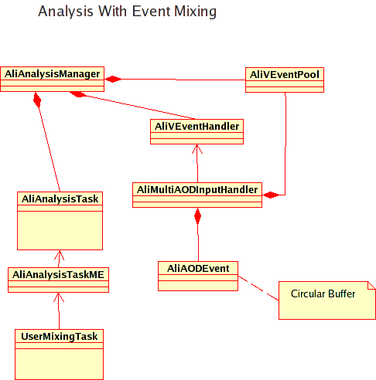
Mixed Events

Slide 48
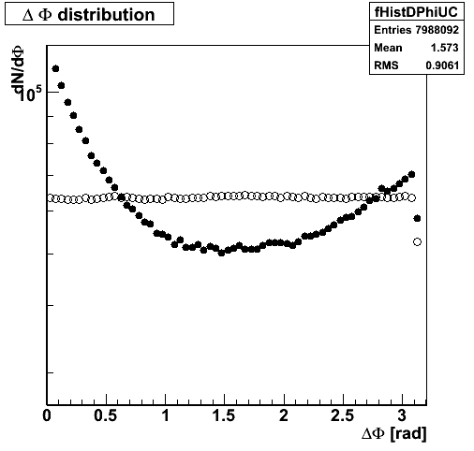
Example Mixed Events
$ALICE_ROOT/ANALYSIS/ (trunk)
  AliAnalysisTaskPhiCorr.{cxx,h}
  DphiAnalysis.C
  Data from /afs/cern.ch/user/m/morsch/public/

Slide 49
Correction framework
In general efficiency is:
  Output(x₁,x₂,x₃…)/Input(x₁,x₂,x₃…)
  (x₁,x₂,x₃…) e.g. (p_{T},η,z,…)
$ALICE_ROOT/CORRFW provides
  Container classes
    n-dim histograms which store distributions with
      MC input
      after acceptance cut (with track references)
      reconstrcuted tracks w/wo cuts
  Cut classes
Basic example:
  analysis-tutorial.tgz#analysis-tutorial/TaskSE/

Slide 50
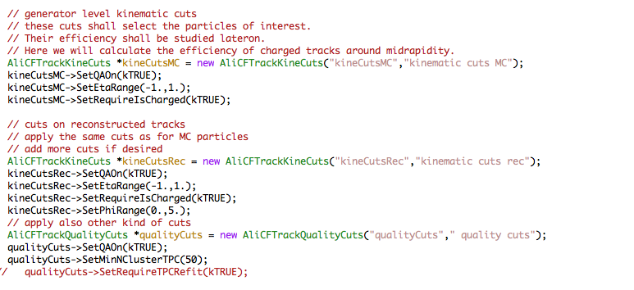
Correction Framework Crash Course
Create the Cuts (see run6.C)

Slide 51
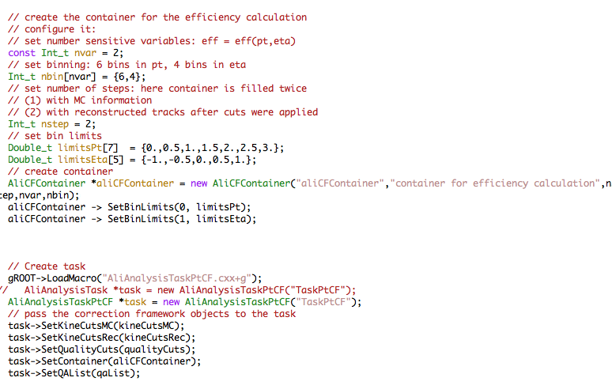
Correction Framework Crash Course
Create the Containers and create the Task (see run6.C)
η,φ,z

Slide 52
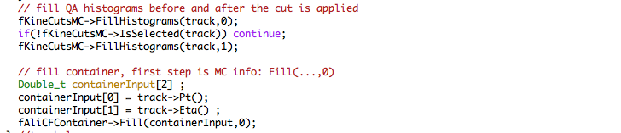
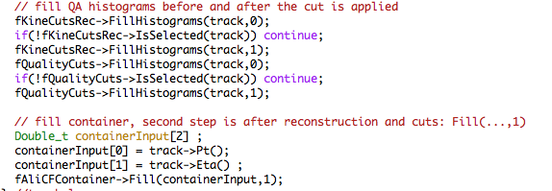
Correction Framework Crash Course
Fill MC information in AliAnaylisTaskCF::UserExec()
after kinematical cuts (see AliAnaylisTaskCF.cxx)
η,φ,z
Fill reconstructed information after QA cuts

Slide 53
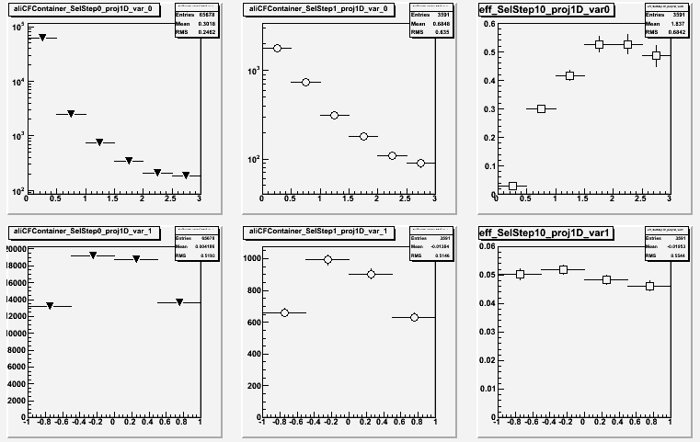
Try it Out
run TaskCF/run6.C and TaskCF/CalcEff_run6.C

Slide 54
To be continued…

Slide 55
Analysis Framework
…technicalities (Backup)

Slide 56
Advanced Structure
Analysis has to be split in functional modules
  At least one
  Deriving from TTask
  Parent task running active
  daughters
Modules are not manually inter-connected
  Connected just to input/output data containers
  A data container has one provider and possibly several clients
  A module becomes active when all input data is ready
TTask
ACTIVE
ACTIVE
INACTIVE
TTask
TTask
TTask
MyTask1
Parent task
Automatic connection via data containers
MyTask2
MyTask3
Daughter tasks
Notes:
56
May -> has to be
Structure -> Advanced structure

Slide 57
AliAnalysisDataContainer
Normally a class to be used ‘as is’
  Enforcing a data type deriving from TObject
  For non-TObject (e.g. basic) types one can subclass and append the needed types as data members
Three types of data containers
  Input – containing input data provided by AliAnalysisManager
  Transient – containing data transmitted between modules
  Output – containing final output data of an analysis chain, eventually written to files.
One can set a file name if the content is to be written
Notes:
57
To connect to the file one has to call OpenFile in AliAnalysisTask::CreateOutputObjets _before_ creating the objets in this container

Slide 58
AliAnalysisTask::ConnectInputData()
// Get the input handler from the manager
AliESDInputHandler* esdH = (AliESDInputHandler*)
((AliAnalysisManager::GetAnalysisManager()
->GetInputEventHandler());
// Get pointer to esd event from input handler
AliESDEvent* fESD = esdH->GetEvent();

Slide 59
EsdFilter
default constructor
copy from afs area
check corrfw
clean up some slides
which aliroot version?
refer to analysis train example

Slide 60
References
This tutorial:
  https://indico.cern.ch/getFile.py/access?contribId=0&resId=1&materialId=slides&confId=183795
Analysis web pages:
  http://aliceinfo.cern.ch/Offline/Activities/Analysis/
Analysis framework:
  http://aliceinfo.cern.ch/Offline/Activities/Analysis/AnalysisFramework/index.html
Analysis train:
  http://aliceinfo.cern.ch/Offline/Activities/Analysis/AnalysisFramework/index.html#train
News and known problems RSS:
  http://aliceinfo.cern.ch/Offline/Activities/Analysis/NewsAndProblems.html
Analysis task force mailing list:
  alice-project-analysis-task-force@cern.ch

