Slide 1
Master Class 2012
Z-path
Innsbruck, 19.04.12
Farid, Maiken et al.

Slide 2
Status
The Z path in general works well, students are happy, and feel they have learned something, teachers are extremely happy and always want to come back (and they do)
The tools worked well. Both HYPATIA and the plotting/upload tool OPloT
Very little technical difficulties this year, a large improvement to last year

Slide 3
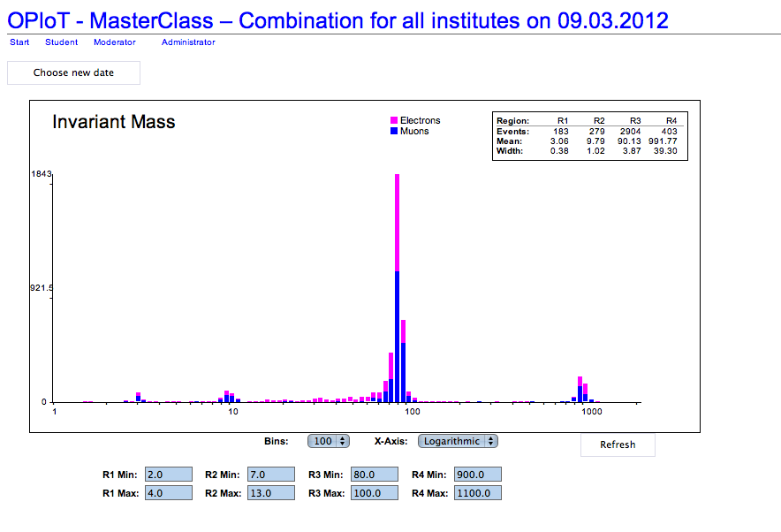

Slide 4
More challenges and closer to the way researchers do
However, we feel that the actual Z-exercise / measurement is too much on the easy and repetitive side, and we would like to improve this. We have thought of several things, but want to minimize need for making new tools, adding too much new.
  The CMS exercise from last year, where they classified events in 3 or 4 classes, as bad, medium, good lepton candidate events,
    challenges more the students need to work harder on each event,
    renders the exercise less automatic.
For this we need to improve our event selection, and add in much more background
Another idea is the looping over many events, and creating a nice invariant mass distribution by using cuts.
  However, this will need manpower to develop, … let’s take it up at some point
  I can convince some student (s) to work on this provided some rewarding …
    Any possibility as part of qualification?

Slide 5
Towards an invariant mass exercise
After
  J/ψ,Υ,Z,Z’
An option
  H→ZZ
  H→γγ

Slide 6
Further improvements
Wonder about the web pages:
  We should further improve these to become more useful for the actual international master class
  Now they contain lots and lots of info, more aiming at standalone master classes.
OPloT
  Some improvements can be made when it comes to the technical solutions, and interface to users.
  More direct access possibly for student upload, …
But overall we feel that the tool does what it needs to do.

Slide 7
Useful comments from France on Exercises
In general, exercises have complicated physics goals but are easy (and repetitive) once the students have understood the procedure
How can we make sure that students won’t think that physicist daily activities are boring? → through some options
Do we expect the exercises to be stable next year/in the coming years? Stable and more challenging
What do we do if the discovery/non-existence of the Higgs is announced by the end of the year ? Interest in H→ZZ an/or H→γγ
Do we anticipate this by preparing ‘light’ (no website, limited translation) exercises just in case or do we postpone this to 2014?
There were some (small) bugs in the exercises during the first sessions. Could authors of each exercise organize a ‘dry session’ prior to first official session to make sure that everything works well? → definitely!

Slide 8
Thanks for the feed-back received so far …
Any further input and suggestions are welcome
Additional comment from our side on the VC: We followed many of them, and the format has really improved a lot. Still some minor improvements can be made (for instance a nicer not so abrupt ending after the quiz), but the overall experience this year was really exceptional!

Slide 9
More feed-back
Seem to have been rather smooth …
Too smooth?

Slide 10
Feedback PL
What was your experience with these measurements? Varying! Please use the same software for all of them next time
Did you find/have clear instructions for combination and discussion of results? Sometimes yes, sometimes. Use the same software to make it more pedagogical and allow to show the individual results and combined results at the same time, otherwise it’s difficult to compare.
Did the combination work, had institutes uploaded their results before the VC? Mostly, using the same software and having a “Problems hotline” to the experts would help. This should be independent of the Masterclass VC so that problems can be fixed in parallel and not spoil the VC for all institutes.
Did you have the impression that institutes were well prepared (report by students, upload results, answer sheets for the quiz distributed…) ? Mostly good but there were some upload problems and sometimes not all of the exercises had been done.

Slide 11
Feedback KR
What was your experience with these measurements?
4 times ATLAS Z, only minor technical problems (see below), the difficulty of the task seems to be appropriate. Almost all institutes got reasonable results, but they were sufficiently diverse to make for an interesting discussion. Very good overall experience.
Did you find/have clear instructions for combination and discussion of results?
yes, the combination was very easy thanks to Maiken’s work, and the interface worked well most of the time. one could probably compile a list of some common features that can appear (for example: tiny/missing peaks for J/psi and Upsilon, different ratios of e/mu, very different amount of poorly reconstructed events). since as a moderator I didn’t follow the Z-path myself, I could only guess at possible reasons for these variations in results.
Did the combination work, had institutes uploaded their results before the VC?
There were a few technical problems, during the early sessions Maiken was working in the background and helped us. As far as I remember, the problems included institutes being unable to upload results and needed to send them to Maiken by email (transmitting an email address by Vidyo was a challenge), On the last conference (24 March) two institutes had uploaded their results to some different pages, we needed to enter the address manually (the page was also located on the uio.no server, so I guess this page had been prepared by Maiken). We could see the results, but they were not included in the combination.
Did you have the impression that institutes were well prepared (report by students, upload results, answer sheets for the quiz distributed…) ?
In general, yes, although the degree of preparation varied a lot, as could be seen from the students’ presentations of the results. Results had almost always been uploaded and results seemed reasonable. Answer sheets seemed to be available in most of the cases.

Slide 12
Feedback KL
What was your experience with these measurements?
ATLAS went a lot more smoothly. Easier to combine results
Did you find/have clear instructions for combination and discussion of results?
ATLAS yes
Did the combination work, had institutes uploaded their results before the VC?
~50% success rate. Lots of institutes had had problems uploading results – a particular problem when there’s only two groups! The CMS system seemed to have more problems than the ATLAS one.
Did you have the impression that institutes were well prepared (report by students, upload results, answer sheets for the quiz distributed…) ?
Variable. Some very prepared, some not at all.

Slide 13
Feedback GM
What was your experience with these measurements?
Both Atlas worked very well, although for one session with W+/W- the data sample was not large enough for an institute to do all groups with independent sub-samples. This resulted in reported results being combined locally in different ways.
Did you find/have clear instructions for combination and discussion of results? Not always, not easy of groups acted diversely
Did the combination work, had institutes uploaded their results before the VC? mostly
Did you have the impression that institutes were well prepared (report by students, upload results, answer sheets for the quiz distributed…) ?Yes

Slide 14
Feedback BL
What was your experience with these measurements? Perfectly fine.
Did you find/have clear instructions for combination and discussion of results? Yes.
Did the combination work, had institutes uploaded their results before the VC? Yes, everything fine. Confusions with the sub groups in Dresden ☺
Did you have the impression that institutes were well prepared (report by students, upload results, answer sheets for the quiz distributed…) ? Yes, everything was fine. The late connections were annoying and could have been avoided by tests. Also, Quite a few mixed the conference room and did not follow our instructions to leave.

Slide 15
Feedback ARV
What was your experience with these measurements? I worked with electron performance
Did you find/have clear instructions for combination and discussion of results? Yes
Did the combination work, had institutes uploaded their results before the VC? Yes
Did you have the impression that institutes were well prepared (report by students, upload results, answer sheets for the quiz distributed…) ? Yes

