Slide 1



2012 IMC Debriefing:
ATLAS W-path
Content
Review 2011 & 2012
Students’ Results
Website statistics
Brief analysis of feedback
First results of evaluation
Interesting topics:
Adaption of exercise on bigger data sample
Very successful Higgs Add-on
W+/W- part needs to be reviewed
First results of evaluation tastes good
What will happen in 2013?

Slide 2
Review 2011
Optimize the procedure: executable MINERVA on the DVD + organizing data samples in a specific event folder (DVD)
I will think about shorter instructions.
We will offer better step by step interpretations of both ratios.
We will prepare better documentation for tutors. - IPPOG database entry
Prepare different data samples for each venue in order to more benefit from combining results (thus we will really see the statistic uncertainty shrinking)
Replace simulated Higgs events by real WW events (but simulated H➔WW and WW events instead)
Offer possibility to students that work on the path at home to discuss and interpret their results (by creating an interactive platform)
I will do a didactic survey on the Masterclasses in 2012

Slide 3
Review 2012
39 W-path Masterclasses with at least 1500 participants in IMC 2012
W-path MC were carried out with two main tasks:
  W+/W- ratio (developed in 2010/11)
  Search for the Higgs (developed for IMC 2012)
Event Display MINERVA was adapted and histogram tool was developed to plot the distribution of opening angles in WW ➔ lνlν events
Spreadsheets were simplified and used online without any problems!
Bigger data sample (6000 events) was offered in order to experience combination of results, which were successfully carried out during video conferences of IMC

Slide 4
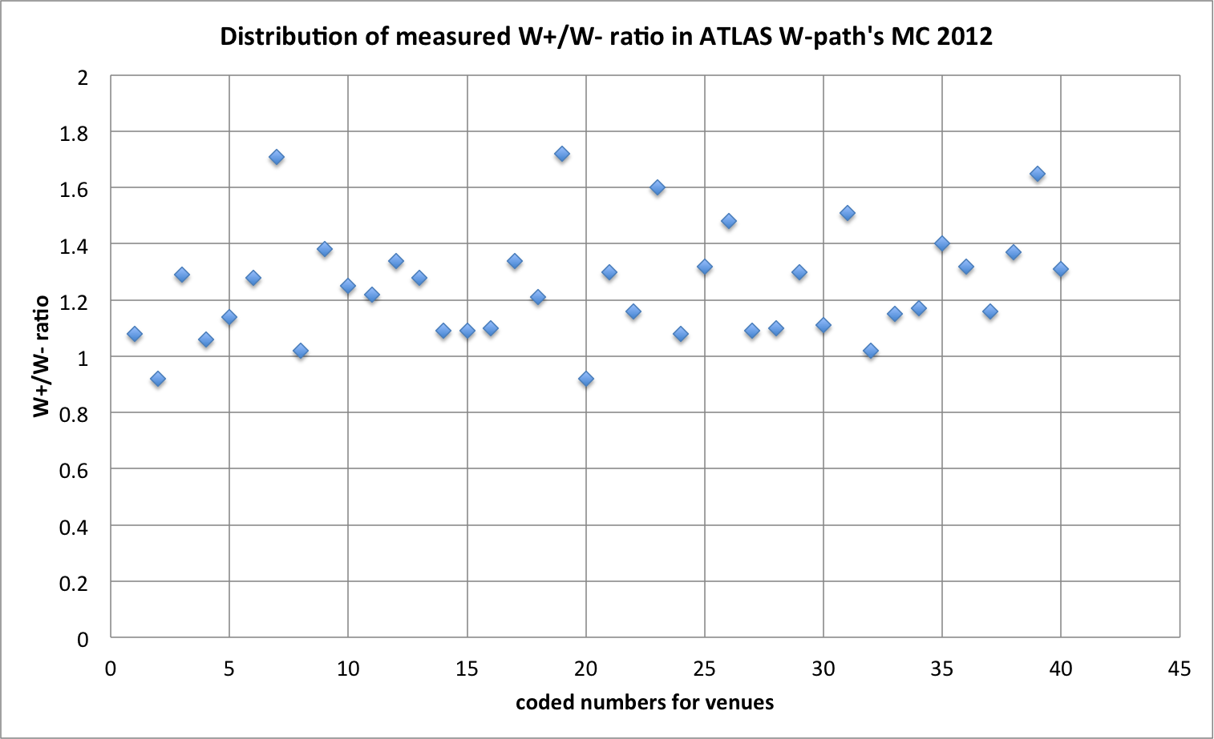
Students’ results 1

Slide 5
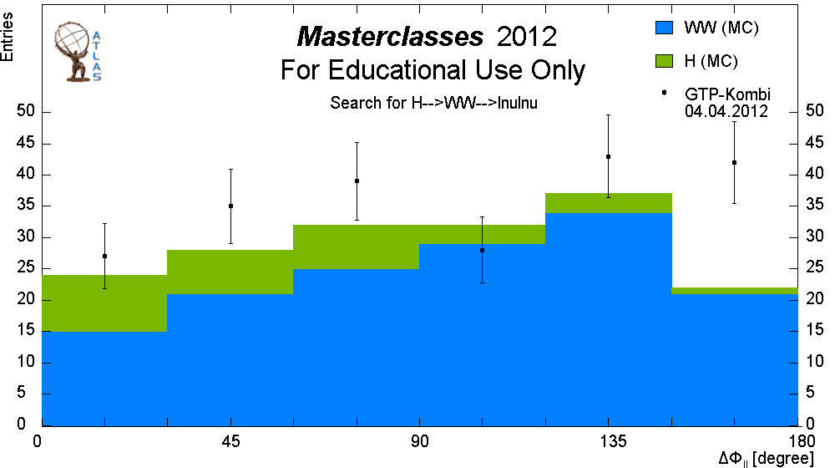
Students’ results 2

Slide 6
Website statistics 1
Unique Visitors 2012 (2011): 3,272 (3,594)
Number of Visits: 4,778 (6,015)
Number of visited pages: 29632 (44,573)
(per visit) (6.2 (7.4))
Bandwidth: 29.2 GB (113.1 GB)
Data valid for the website www.cern.ch/kjende/*.htm and the period between
March 01 and March 31 2012

Slide 7
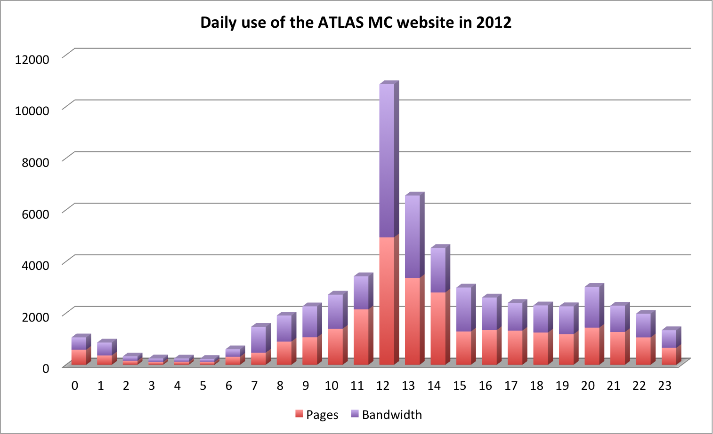
Website statistics 2

Slide 8
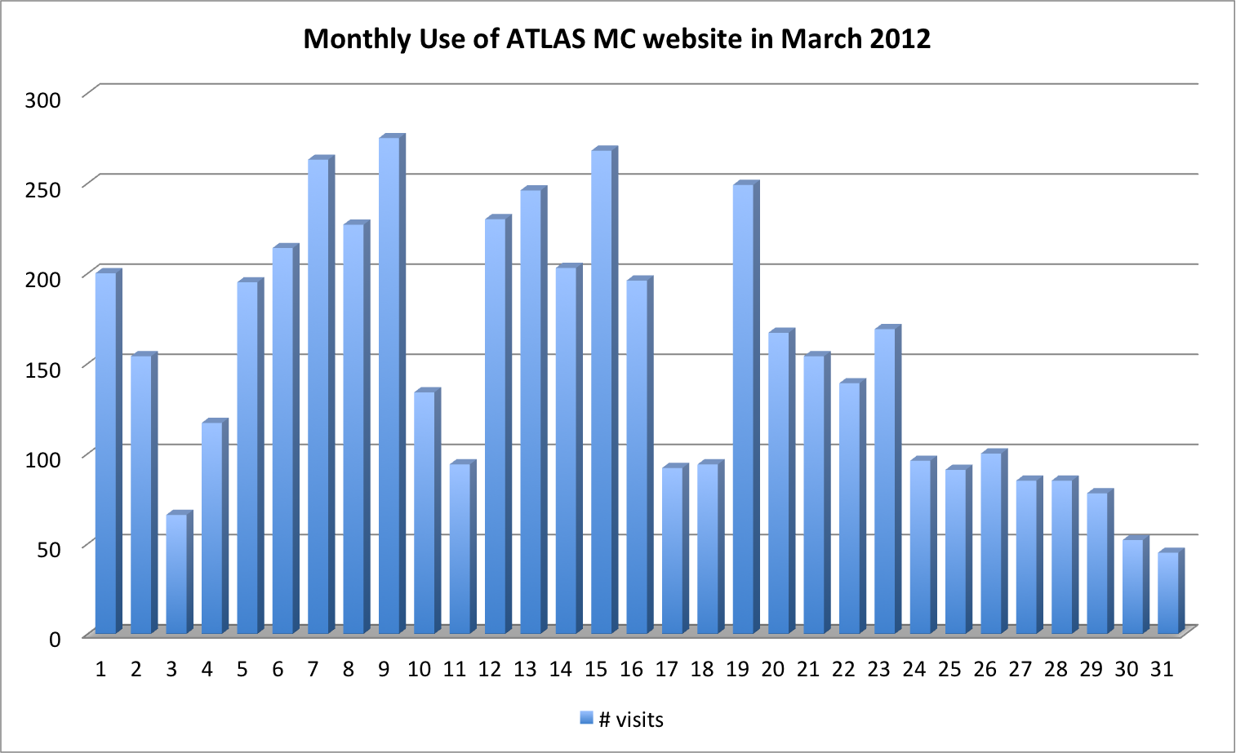
Website statistics 3

Slide 9
Feedback 1
France - Nicolas:
Could the default setting of the event display be changed so that tracks are displayed by default?
Already done! Proper MINERVA version can be downloaded at www.cern.ch/kjende/downloads/minerva2012.zip

Slide 10
Feedback 2
France - Nicolas:
Several people did not understand how the MC WW opening angle histograms were constructed – the shapes looked different from one institute to the other.
Histogram generation was reviewed several times during MC and afterwards

Slide 11
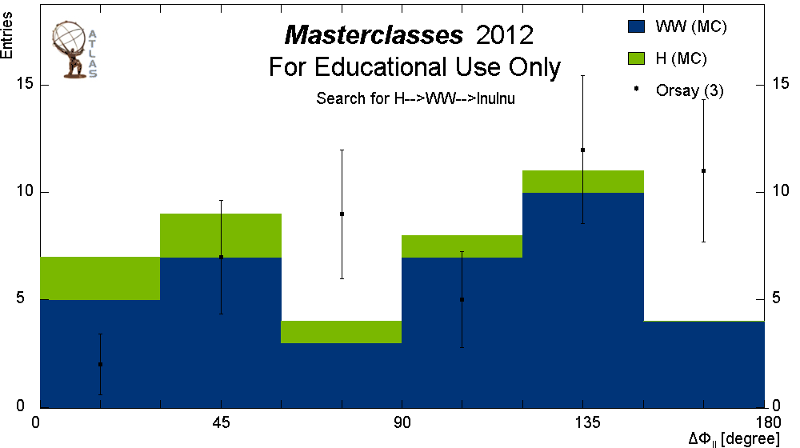
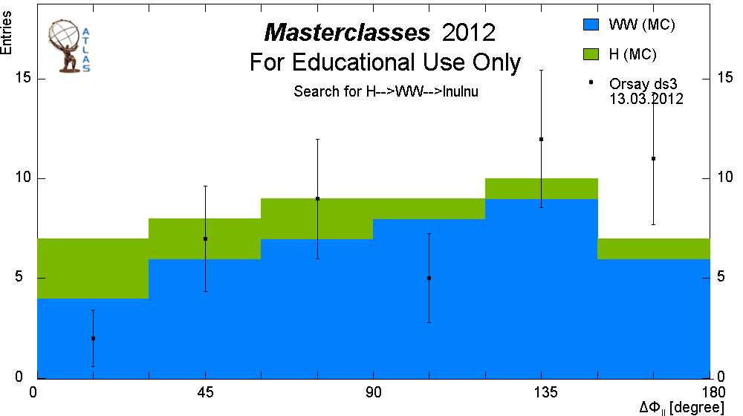
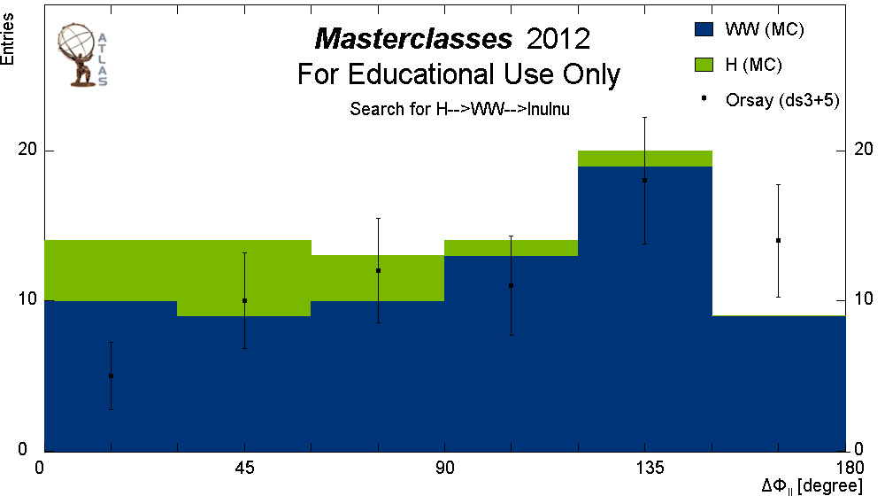
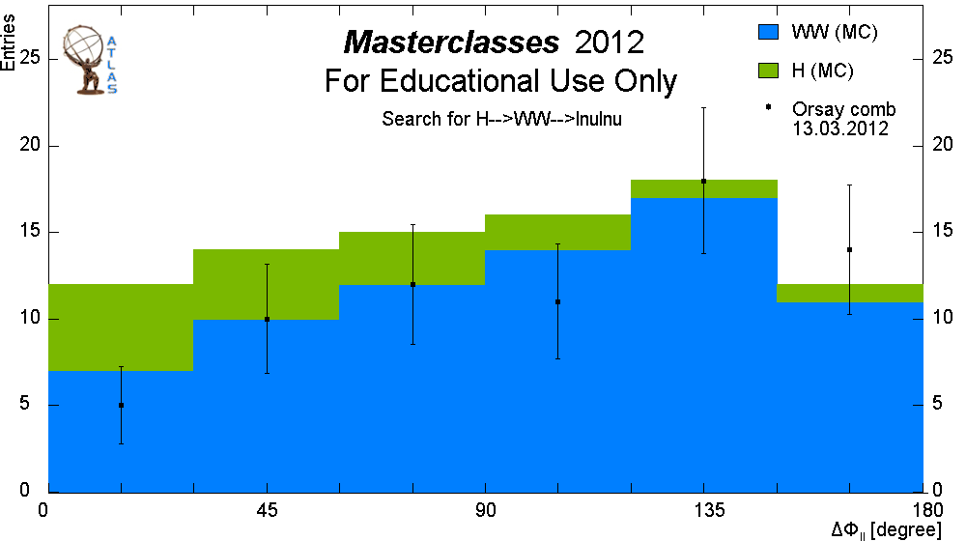
Feedback 3
France - Nicolas:

Slide 12
Evaluation 1
Adaption of pre and post questionnaire (developed for national Masterclasses in German’s particle physics network by Kerstin Gedigk) was used in
Germany
Switzerland
Austria
France
Slovakia
Italy???
Aims:
Investigate development of interest before and after Masterclasses
Feedback for newly structured video conference
General Feedback on the “Masterclasses day”
…

Slide 13
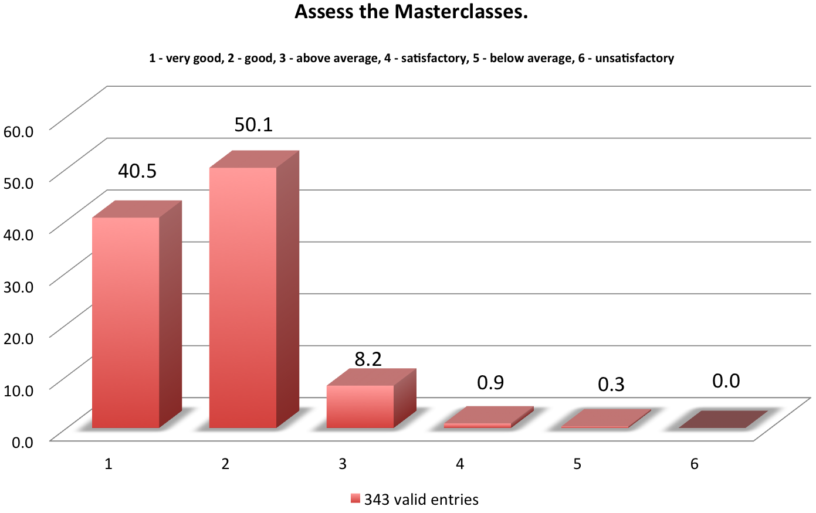
Evaluation 2
Thank you for sending back questionnaires from approx. 800 students!!!
Detailed analysis will last a while.
percentage

Slide 14
Room for your feedback – thank you!

Slide 15
Discussion topics
France - Nicolas:
The exercises have complicated physics goals but they are easy (and repetitive) once the students have understood the procedure. How can we make sure that students won’t think that physicist daily activities are boring?
Do we expect the exercises to be stable next year/in the coming years?
What do we do if the discovery/non-existence of the Higgs is announced by the end of the year ? Do we anticipate this by preparing ‘light’ (no website, limited translation) exercises just in case or do we postpone this to 2014?
There were some (small) bugs in the exercises during the first sessions. Could the authors of each exercise organize a ‘dry session’ prior to the first official session to make sure that everything works well?

