Slide 1


The ALICE Measurement
Looking for strange particles in ALICE
The 2012 version of the measurement
Facts and feedback from the 2012 masterclasses
Ideas for the future

Slide 2
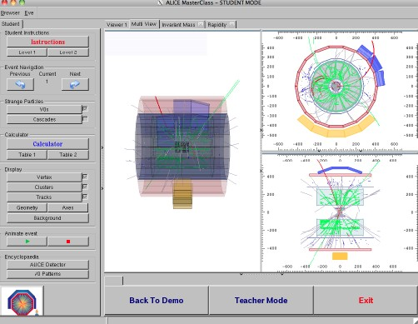
The analysis tool : simplified ALICE event display based on ROOT
3 views of ALICE – 3D, rφ, rz
V0 finder and cascade finder
Highlights V0 (cascade)
Recognise from decay pattern
K⁰_{s}→ π⁺π⁻
→π⁻p
anti Λ→ p⁻π⁺
Ξ⁻→π⁻Λ→ π⁻ p π⁻
Calculate invariant mass
Classify according to mass
Fill tables
Fill histograms

Slide 3
2nd part of exercise
Analyse big event sample (2000 events)
Invariant mass histograms for K_{s}, Λ, anti-Λ
Fit 2nd degree polynomial to background
Fit gaussian to peak
Get number of K_{s}, Λ, anti-Λ after background subtraction
+ option to see combinatorial background
(without common secondary vertex requirement)
Extended email exchanges led to the generation of new event samples
Updated package before the 3rd ALICE day (22.3) with
Sample with 21000 pp events
Sample of 1500 PbPb events

Slide 4
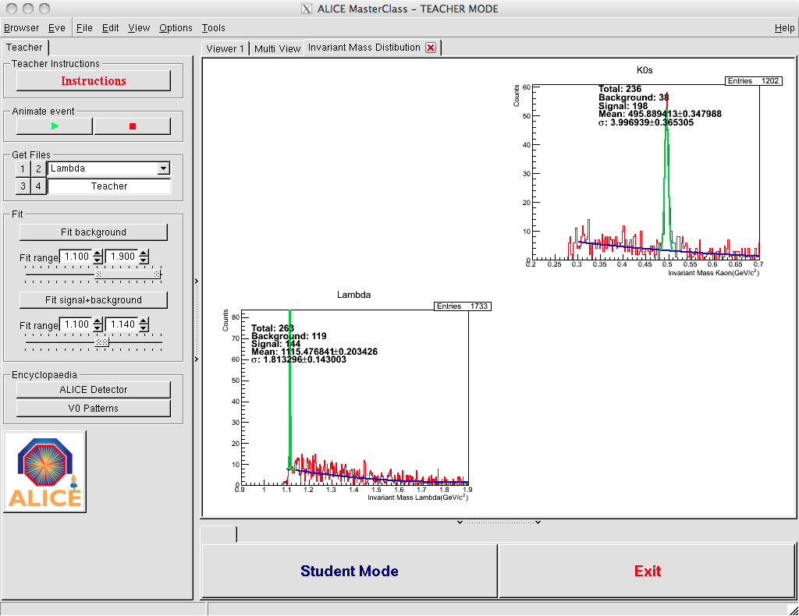

Slide 5
Outline of exercise
Students (each group): Visual analysis of 30 events – tables + invariant mass histograms
Institute (all groups): Add up numbers / merge histograms
30-event samples for visual analysis, 7 TeV proton-proton (6)
5-event sample Pb-Pb (1)
Students (each group): Analysis of 2000 events - invariant mass histograms
Students (each group): Try to fit background / peak / subtract -> find number of particles
Institute (all groups): Merge histograms
Institute (all groups): Fit background / peak / subtract -> find number of particles
2000 event samples 7 TeV proton-proton (7)
1500 event sample lead-lead
Calculate yields of each particle type
(assumptions on initial number of events from which the sample has been extracted
correction factors for efficiency)

Slide 6
ALICE Masterclasses web site
http://aliceinfo.cern.ch/public/MasterCL/MasterClassWebpage.html
Texts in
English
French Many thanks to all those who helped with the translations!
Italian
German
Czech
Portuguese
Instructions for the institutes
Instructions for moderators (masterclasses twiki)

Slide 7
For the collection of all results
http://www.editgrid.com/user/alice-masterclass/results-2012-collection.csv
Institute | Ν(Κ0s) | Ν(Λ) | Ν(anti-Λ) | N(events) | error(Κ0) | error(Λ) | error(Λbar)
1 | 105 | 31 | 20 | 8400 | 10.247 | 5.568 | 4.472
2 | 106 | 32 | 21 | 8400 | 10.296 | 5.657 | 4.583
3 | 104 | 30 | 20 | 8400 | 10.198 | 5.477 | 4.472
4 | 100 | 33 | 19 | 8400 | 10.000 | 5.745 | 4.359
5 | 99 | 31 | 20 | 8400 | 9.950 | 5.568 | 4.472
average | 102.8 | 31.4 | 20 | 8400 | 10.139 | 5.604 | 4.472
Yields | 0.245 | 0.075 | 0.060 |  | 0.030 | 0.017 | 0.013
ALICE pub | 0.184 | 0.048 | 0.047 |  | 0.002 | 0.001 | 0.002
Calculate yields / compare with ALICE results

Slide 8
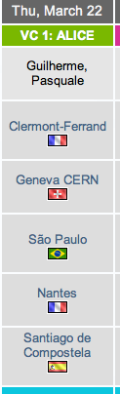
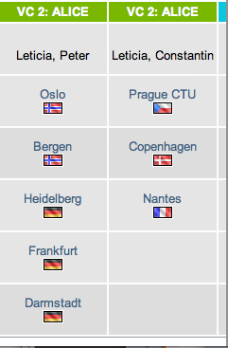
ALICE 3 days on the 2012 schedule
looking for strange particles
R_{AA} exercise

Slide 9
Some facts and numbers
Masterclass in Frascati , early February (outside “International Masterclasses” schedule)
Heidelberg : 29 pupils + 3 teachers (4 tutors)
(had scheduled 3 days ; cancelled 2 ; less participants due to change in school system)
Nantes : 28 students + 2 teachers + 8 tutors (on 7.3; had a 2nd session on 22.3)
Sao Paulo : 30 pupils ; had to come back next day for the video-conference
CERN : 29 pupils + 2 teachers (1ère scientifique Lycée International de Ferney) + 9 tutors
Debriefing meeting (+ EVO) during ALICE week 16.3.2012
Some institutes only proceeded to the second part of the exercise (not enough time)
Problems with vidyo
Oslo could not connect
Heidelberg connected 15 minutes late (3rd login attempt was successful)
Sao Paulo connected 15 minutes late (due to misunderstanding)
Other problems
Software did not run on some systems (dependent on the Scientific Linux version)
Need root version >= 28; wgen root version <27 V0s not displayed

Slide 10
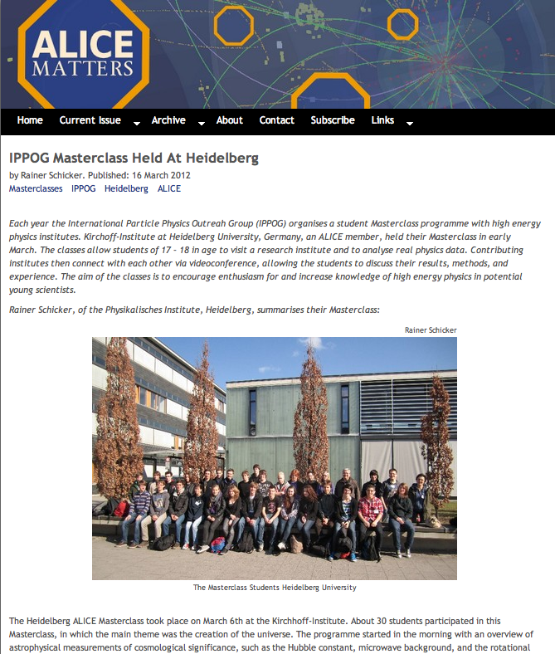
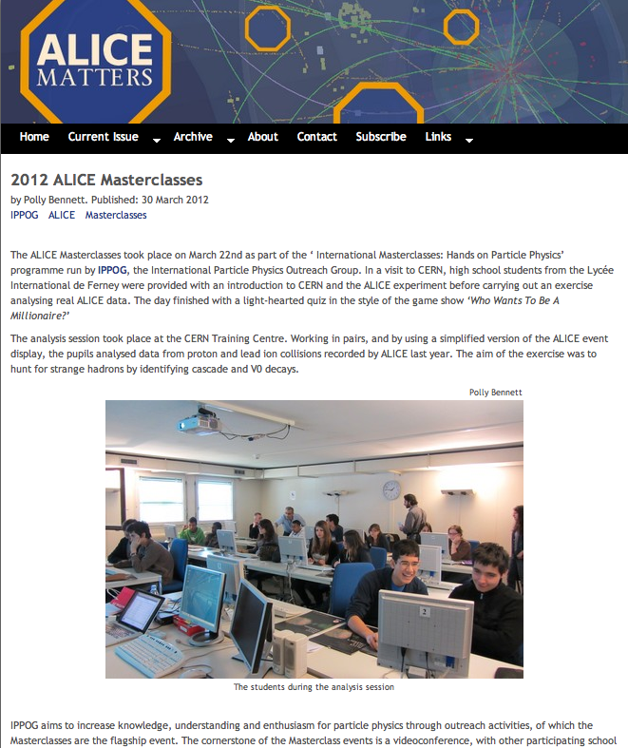

Slide 11
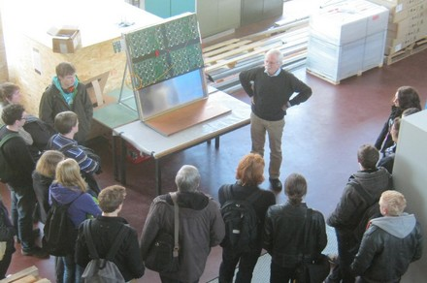
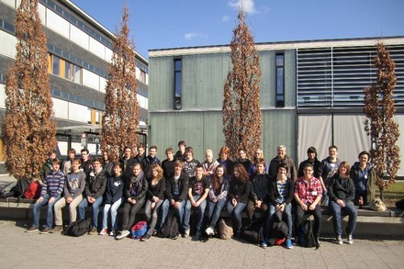
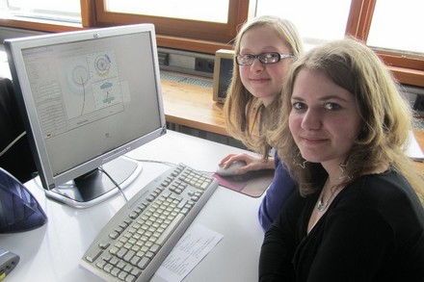
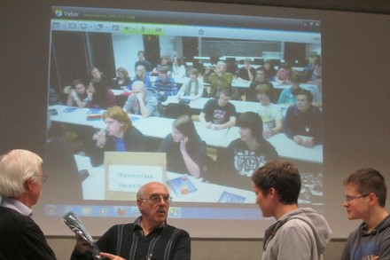
Heidelberg 7.3.2012

Slide 12
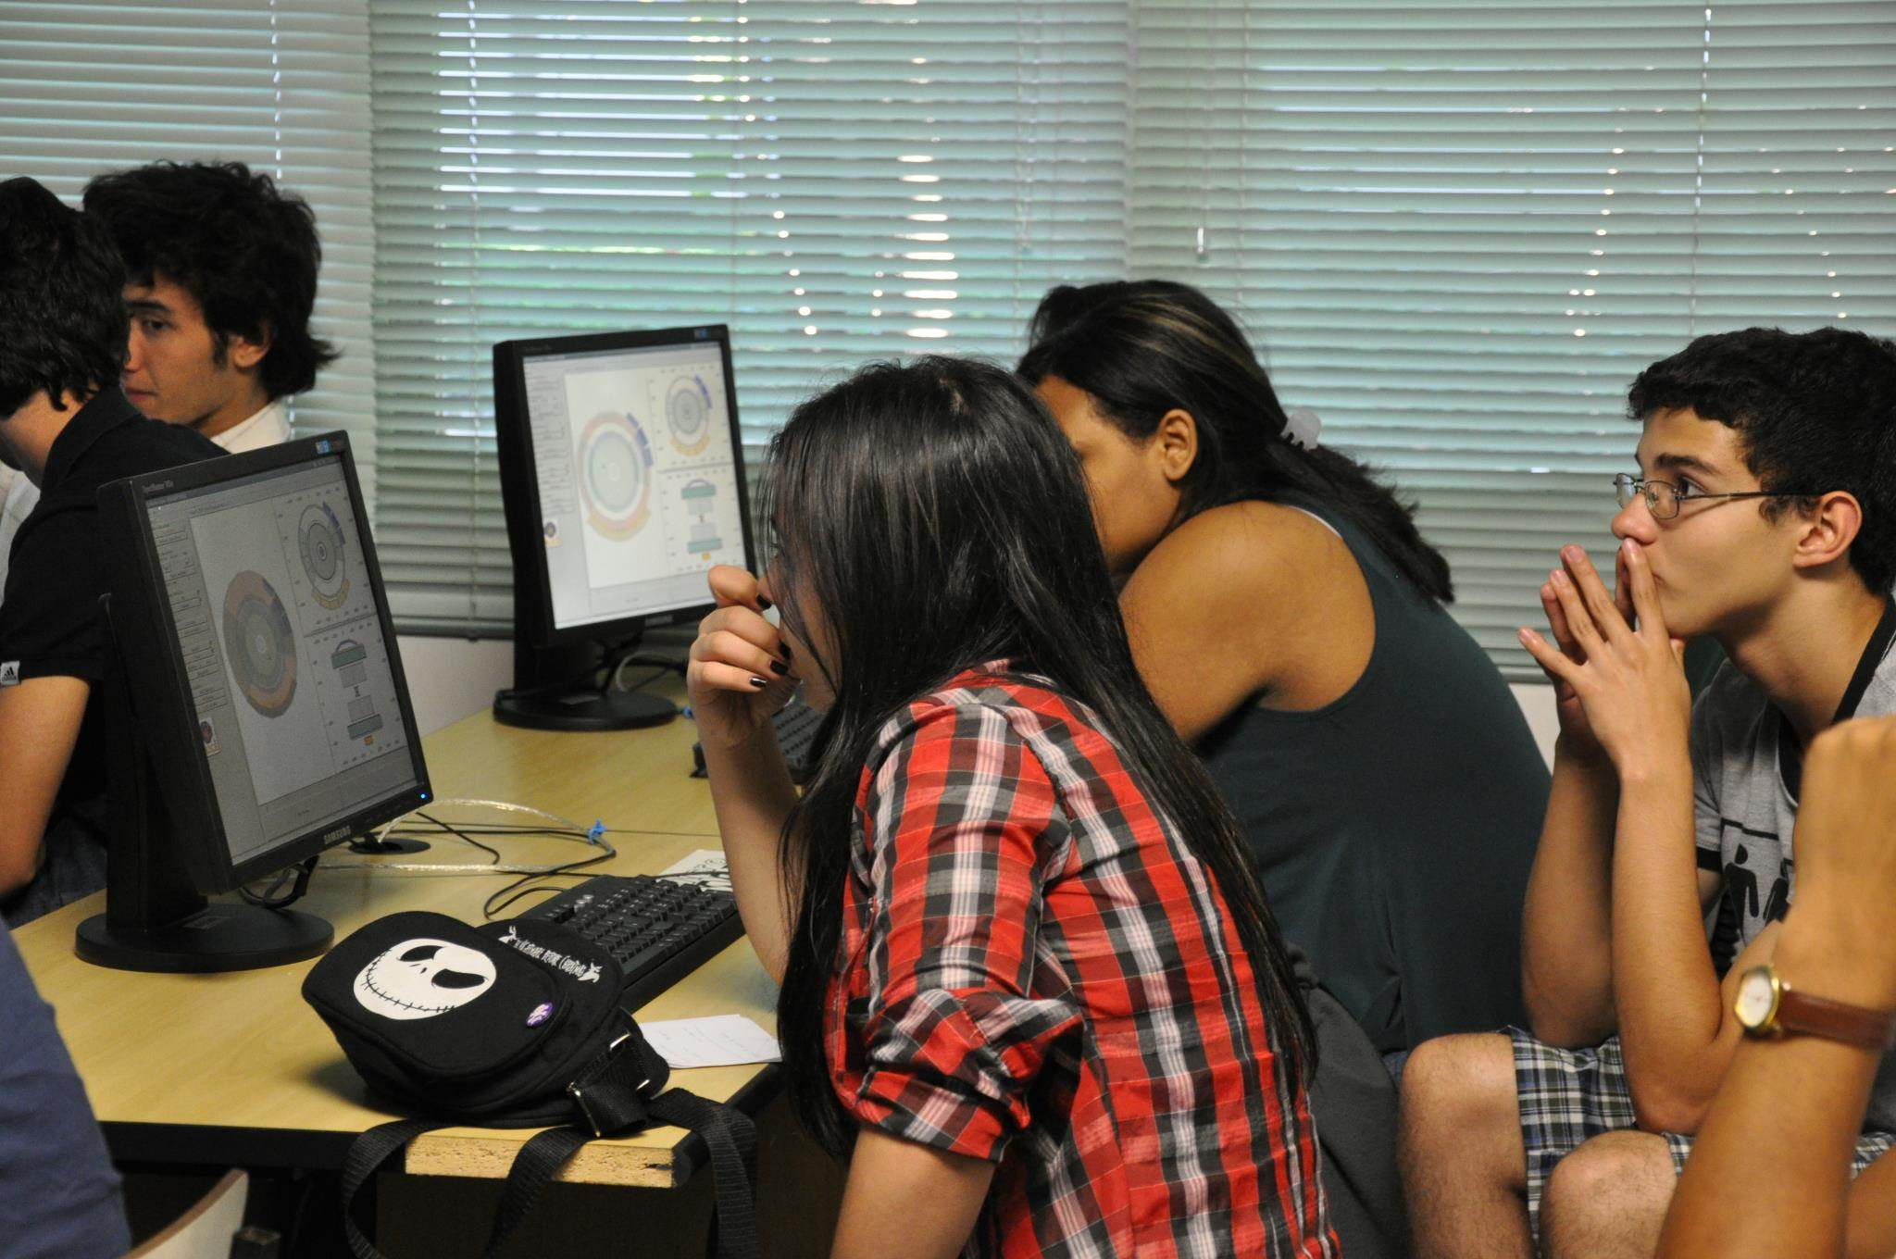
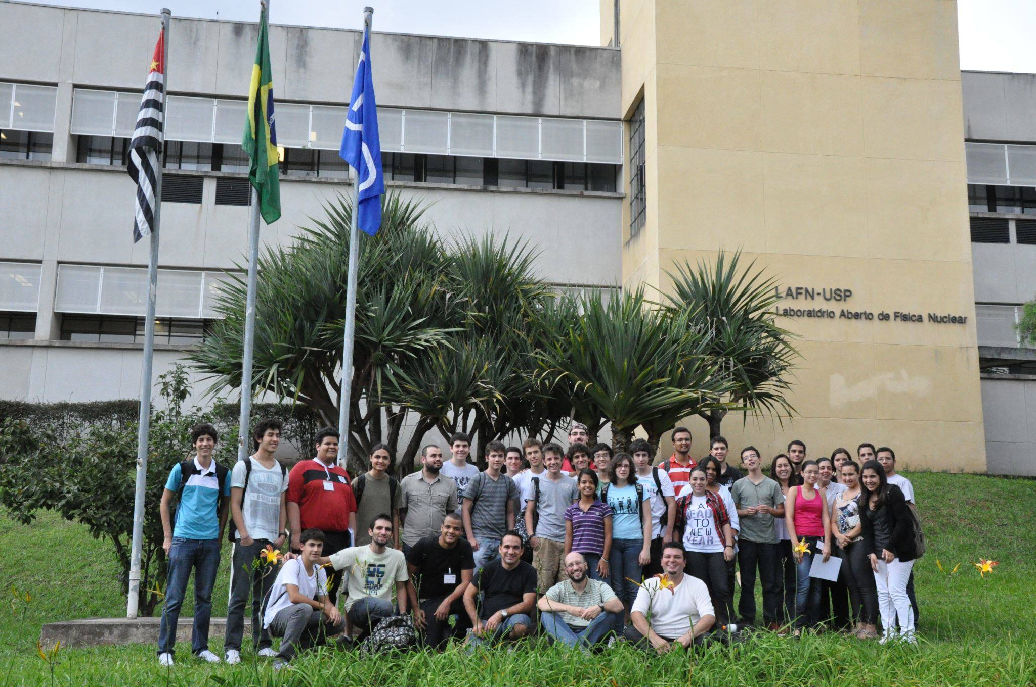
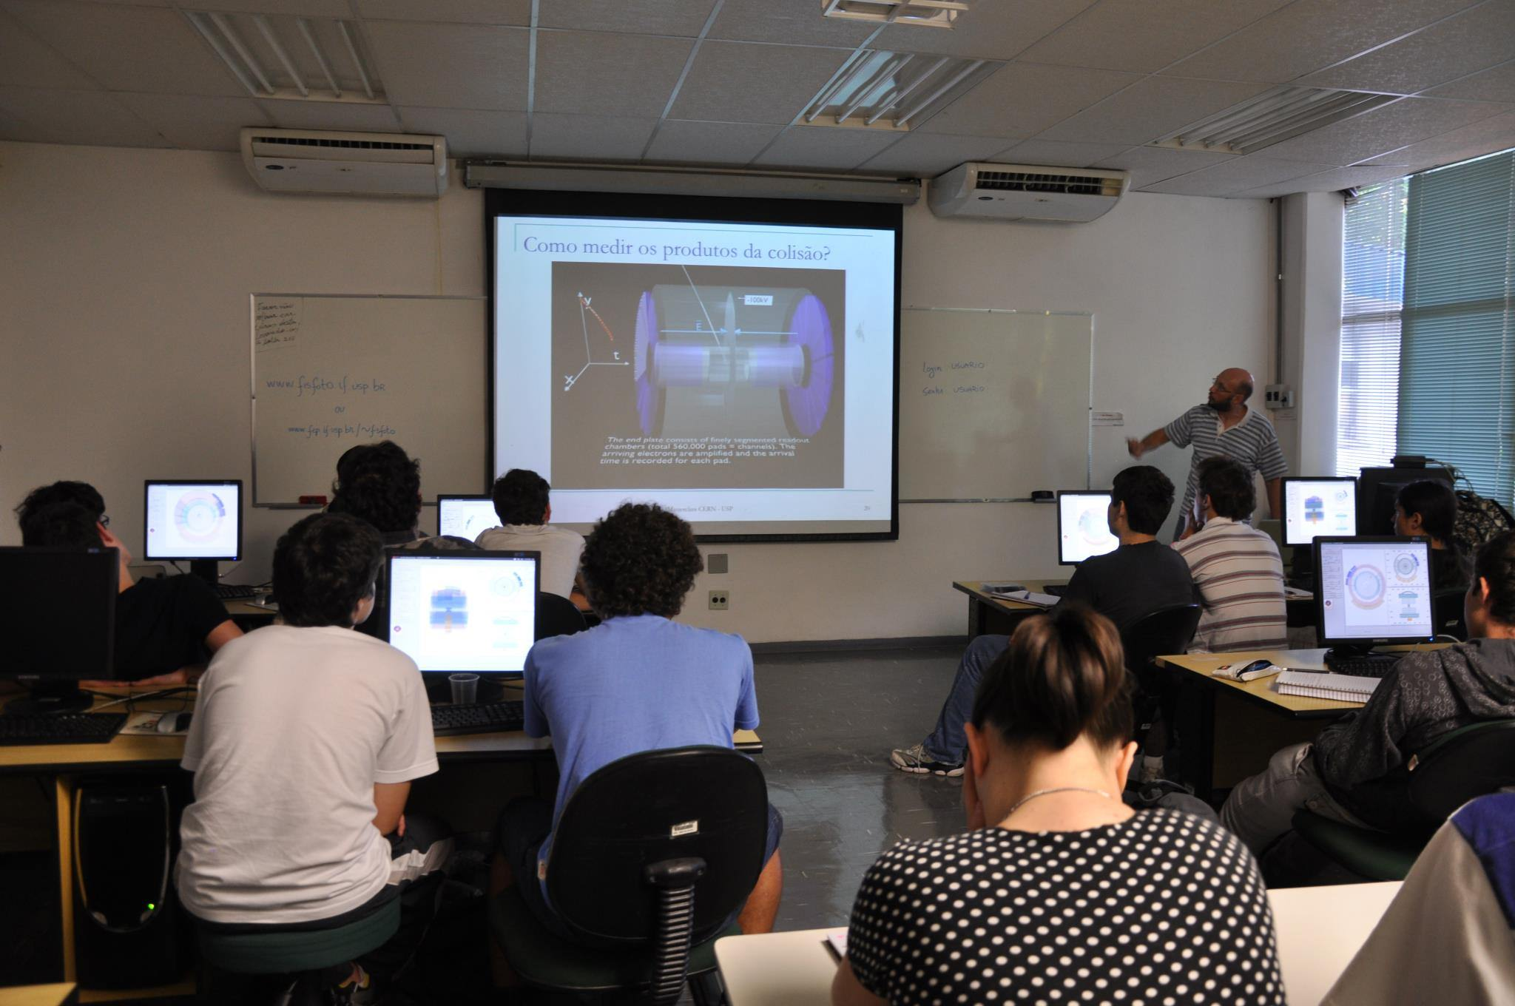
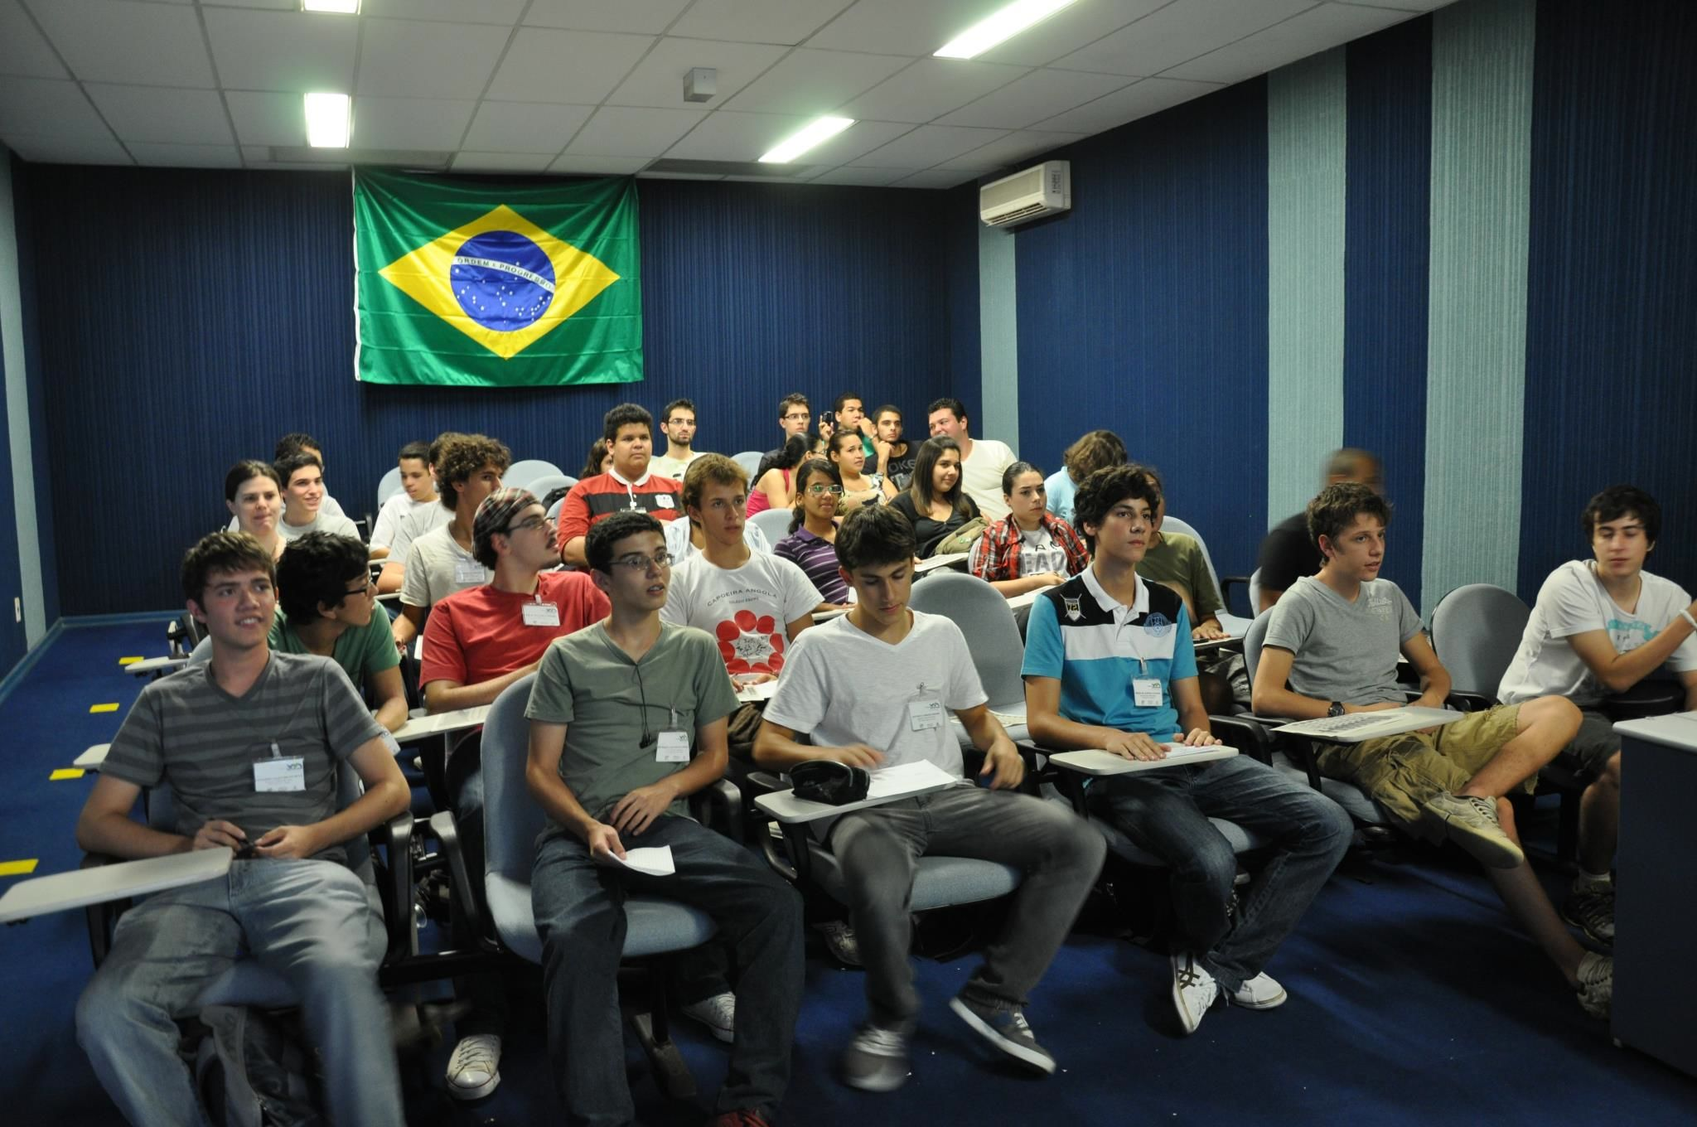
http://www.facebook.com/pages/Os-aceleradores-de-part%C3%ADculas-na-sala-de-aula/100928783362350
Sao Paulo 22.3.2012

Slide 13
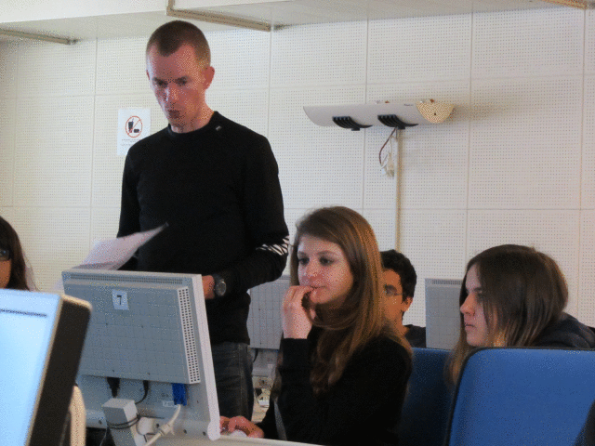
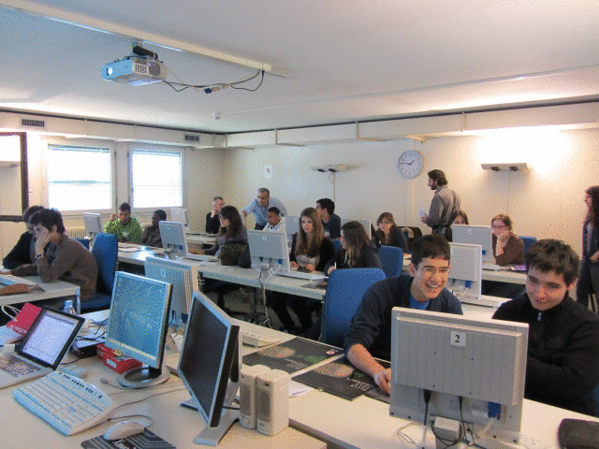
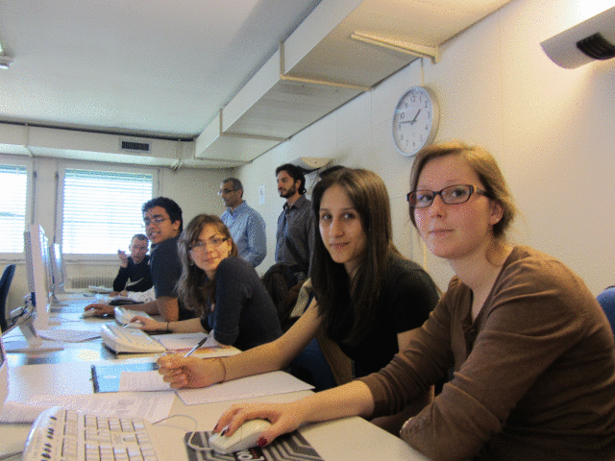
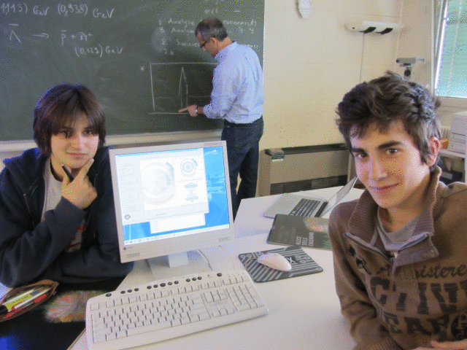
http://cdsweb.cern.ch/record/1438735 CERN 22.3.2012

Slide 14
CERN Masterclass Feedback
The physics teacher (participating for the 3rd time in CERN masterclasses) asked his pupils
to fill in an evaluation sheet (lectures, visit, exercise, video-conference)
19 replies from the 29 pupils who had participated
General impression positive
Enjoyed the day, feel that they learnt a lot
Visit (ALICE exhibition and control room) was too short;
disappointed they could not go underground
Some enthusiastic comments about the CERN cantine!
Concerning the exercise
Some said it was fun, interesting, entertaining, instructive
Many said it was too repetitive
Many found it was too long (spent > 2 hours in the computer rooms)
Some missed the point of the measurement
Marks given : 5/5 (2); 4/5 (10); 2-3.5/5 (7)
Some instructors: it was fun and interesting; they enjoyed the experience

Slide 15
Videoconference
For some (Sao Paulo) it was evident that they were very excited and proud to be participating in the video conference
CERN participants’ comments vary:
not international enough
on that day 3/5 institutes were French: CERN (Ferney), Nantes and Clermont-Ferrand
amusing; interesting; “sympa”; enjoyed the interaction with CERN/other institutes
long, not well organised
expected more analysis of the results
some liked the quiz; others not
Marks given : 5/5 (4); 4/5 (5); 2-3.5/5 (10)
Nantes wanted the quiz answers all at the end so that they can give prizes

Slide 16
Conclusions
Overall experience positive
New institutes participated this year
Generated interest, and new ideas
(new measurement “R_{AA}– nuclear modification factor” developed just before the MCs)
see presentation by Ralf Averbeck
Need to optimise the proposed outline
Share time between visual analysis and long-scale analysis + fitting procedure
Future
Generate more datasets with lead events (in different centrality regions); attempt to “measure strangeness enhancement” by comparing PbPb with pp measurements
Generate smaller datasets for the visual analysis
Ideas to decouple from root – web-based application
advantages and disadvantages - how to deal with histograms and fitting
Will be investigated in the summer

