Slide 1
New ALICE Exercise: Nuclear Modification Factor

Slide 2
Outline
ALICE
goals of the new exercise
physics objective
  geometry of Pb-Pb collisions
  nuclear modification factor: R_{AA} (R_{CP})
new exercise
  step 1: visual analysis of pp and Pb-Pb collisions
  step 2: large scale analysis
experience up to now
summary

Slide 3
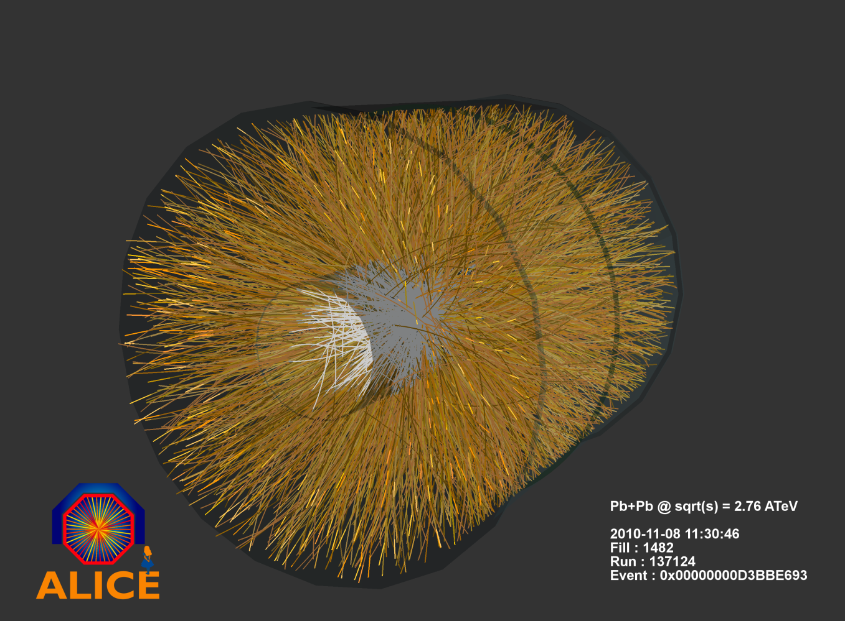
ALICE
heavy-ion experiment at the LHC → investigation of quark-gluon plasma properties

Slide 4
Goals of the new exercise
physics lesson
  Pb-Pb collision ≠ many independent pp collisions
other goals
  reduce number of required physics and analysis concepts to an absolute minimum
  2 step analysis approach
    introduce the idea in a visual, hands-on analysis
    large scale analysis close to what we do in real life → let‘s write some analysis code together!
  emphasize the importance of collaborative work
→ comparison of unidentified charged particle momentum spectra in pp events and Pb-Pb collisions with different collision geometries

Slide 5
Necessary concepts
reconstruction of charged particle trajectories from hits in tracking detectors (ALICE TPC in this case)
  easily explained in visual analysis
momentum measurement via curvature of tracks in a magnetic field
  visual analysis and: centripetal force = Lorentz force
centrality in heavy-ion collisions
nuclear modification factor
not needed: particle identification, particle decays, quantum numbers …

Slide 6
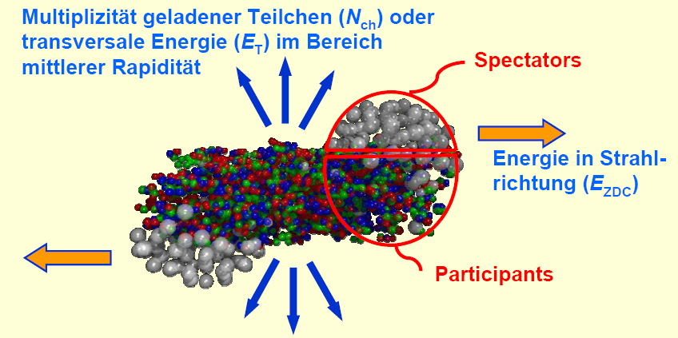
Collision geometry
cartoon of a Pb-Pb collision
  central collision (small impact parameter b) has more participants, more equivalent pp collisions (N_{coll}) and more produced particles than a peripheral collision (large b)
produced particles observed in the experiment
b

Slide 7
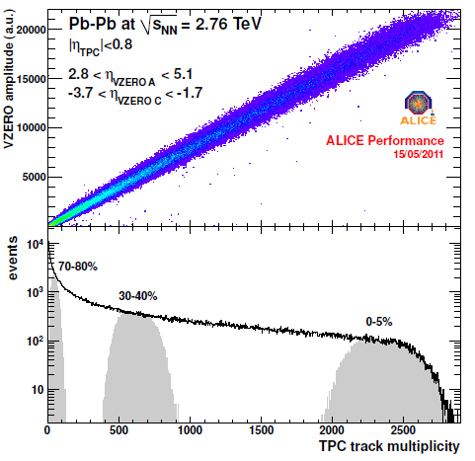
Collision geometry
practical approach
  use ALICE VZERO detec- tor (sensitive to number of produced particles) to sort all collisions into centrality percentiles
  use Glauber MonteCarlo (3D billiard simulation) to determine <N_{part}> and <N_{coll}> for each centrality percentile
  → give the centrality for each collision and <N_{coll}> for a centrality class as input to the students!

Slide 8
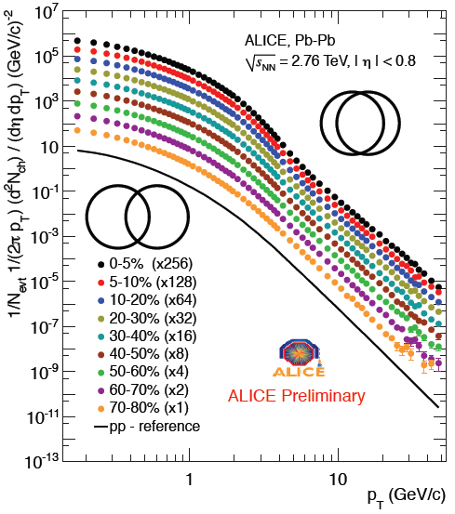
Transverse momentum spectra
transverse momentum spectra of unidentified, primary charged particles
  yield increases from pp to Pb-Pb collisions
  yield increases from peripheral to central Pb-Pb collisions
  spectral shape seems to change as well
how can this be quantified?

Slide 9
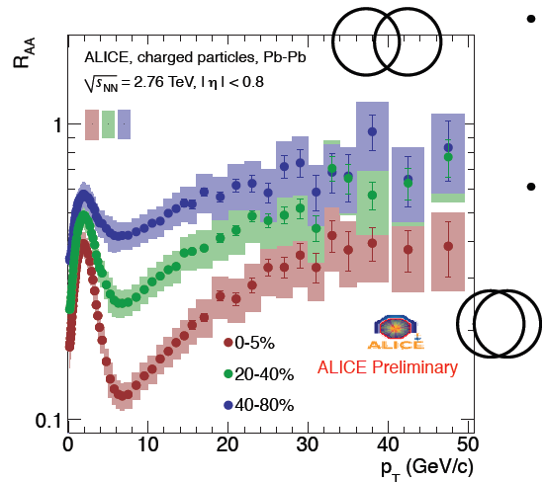
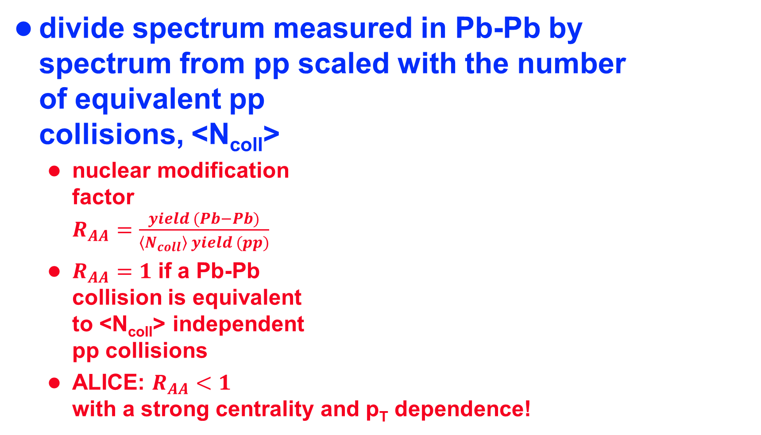
Nuclear modification factor
divide spectrum measured in Pb-Pb by spectrum from pp scaled with the number of equivalent pp collisions, <N_{coll}>
  nuclear modification factor $R_{AA}=\frac{yield (Pb−Pb)}{\left\langle N_{coll}\right\rangle yield (pp)}$
  $R_{AA}=1$ if a Pb-Pb collision is equivalent to <N_{coll}> independent pp collisions
  ALICE: $R_{AA}<1$ with a strong centrality and p_{T} dependence!

Slide 10
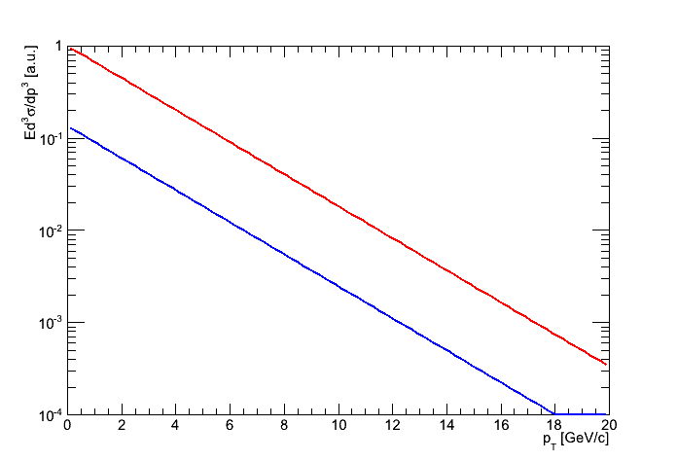
Interpretation of R_{AA} < 1
in (central) Pb-Pb collisions a deconfined form of strongly interacting matter is formed → quark-gluon plasma (QGP)
propagation of particles through QGP → energy loss ΔE
at a given p_{T}, ΔE can not be distin- guished from a reduced yield ΔY, leading to R_{AA} < 1!
ΔE
ΔY

Slide 11
How to teach these concepts to the students in a Masterclass exercise?

Slide 12
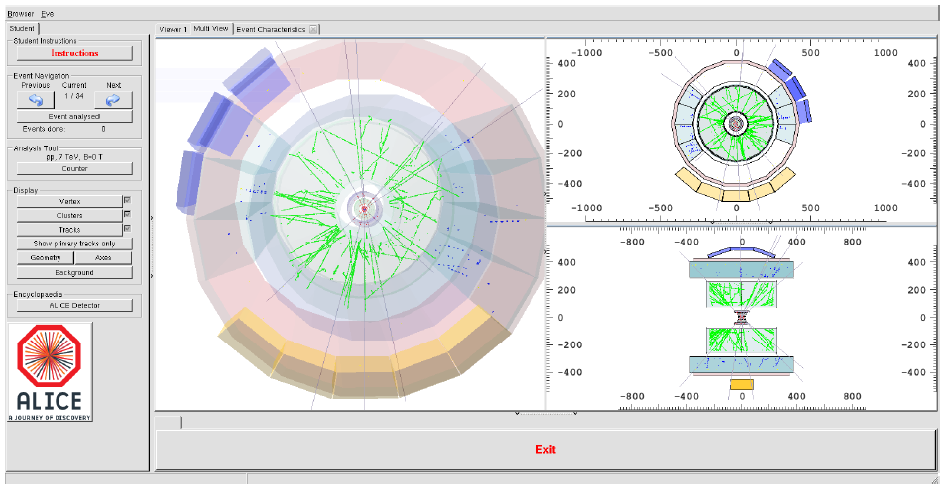
Exercise 1: visual analysis
tool: ALICE event display

Slide 13
Visual analysis: step 1
look at and play with one (!) pp event without magnetic field
understand how tracks are reconstructed from hits/clusters in the individual detectors
understand to distinguish tracks from the primary vertex from pileup and secondary decays

Slide 14
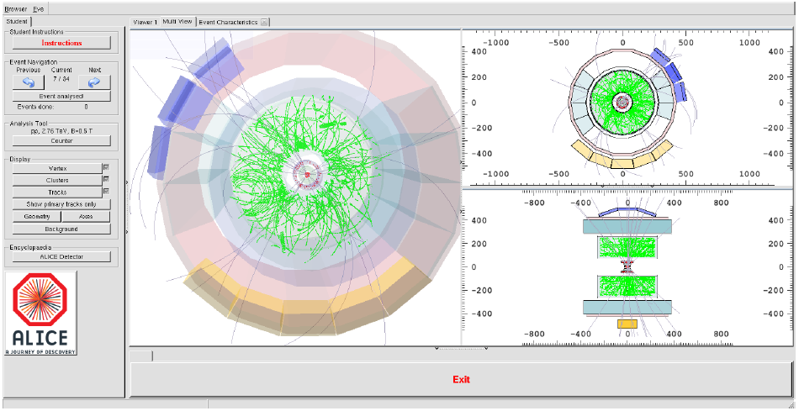
Visual analysis: step 2
analyze unidentified, primary charged particle tracks for 30 pp events with magnetic field → p_{T} measurement
  ‚click‘ on each track in the event display

Slide 15
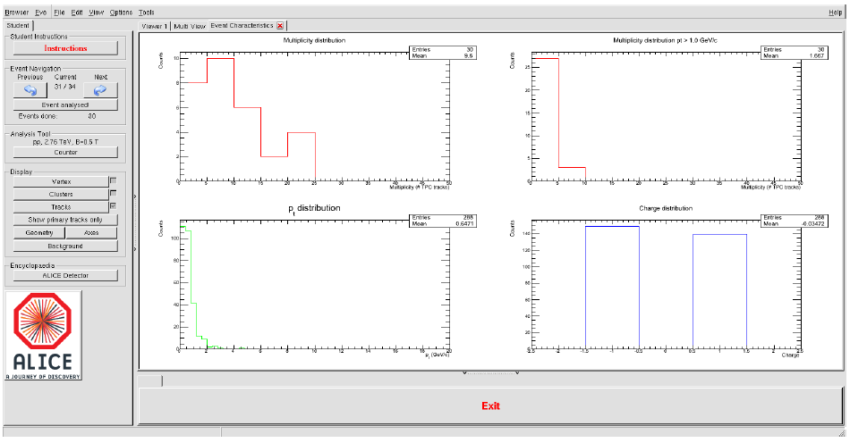
Visual analysis: step 3
accumulate multiplicity, p_{T}, and charge distributions for 30 pp events
mean number of charged particles

Slide 16
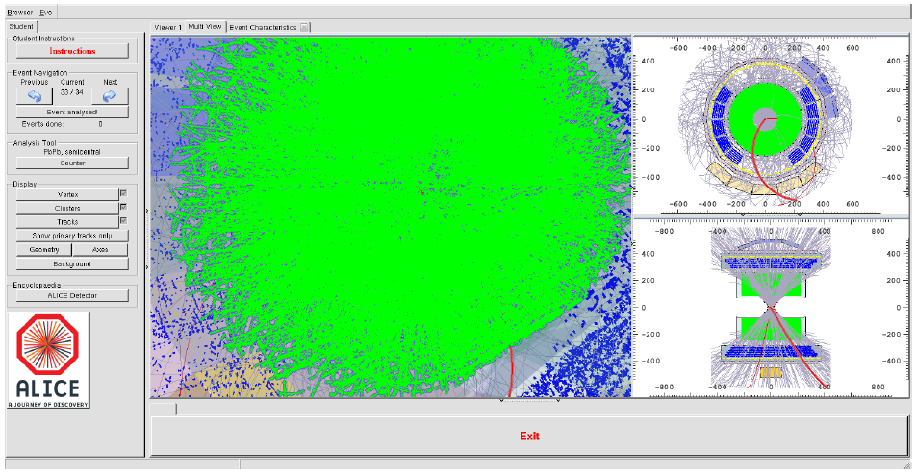
Visual analysis: step 4
look at one peripheral, semicentral, and central Pb-Pb collision and count the tracks (by hand or by pressing a button)

Slide 17
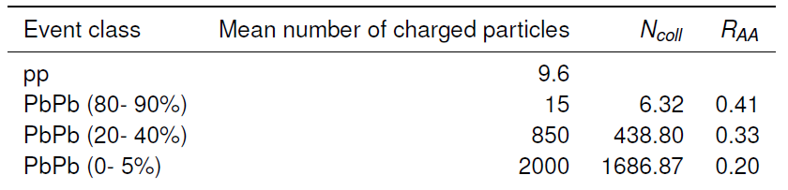
Visual analysis: step 5
calculate R_{AA} for the given peripheral, semicentral, and central Pb-Pb event per hand from
  mean number of tracks in 30 pp events (from students)
  number of tracks in the 3 Pb-Pb events (from students)
  number of equivalent pp collisions <N_{coll}> (provided)
  correction factor of 0.6 to account for efficiency differences in pp and Pb-Pb collisions (provided)
typical results (but large variations between the student groups due to low statistics)

Slide 18
Large scale analysis: concept
student response to visual analysis: “are you really serious that this is how you do analysis?” → of course not!
  introduce the concept of reading data from a file, doing calculations with these data, and filling histograms with the results (analysis based on ROOT package)
  first, students are ‘shocked’ by the idea that they should write code (even though it’s only ‘cut and paste’)
  they recover quickly (~10 minutes) when they realize that this is much more convenient than a visual analysis
  cutting and pasting from an example macro that demonstrates how to create, fill, plot, and save histograms gets them on track quickly!

Slide 19
Large scale analysis: approach
practical, collaborative approach
  split the student group into several teams
  all but one of the teams have the task to produce unidentified charged particle p_{T} spectra in a given Pb-Pb centrality class → numerator for R_{AA}
  one team works on the code to combine the results from the other groups and calculate R_{AA}(p_{T}) from the charged particle spectra. Dummy input is provided such that this group can start working before the output from the Pb-Pb analyzers is available.
  future option: another group could prepare the pp collision reference spectrum. For the moment, this is given to the students. → denominator for R_{AA}

Slide 20
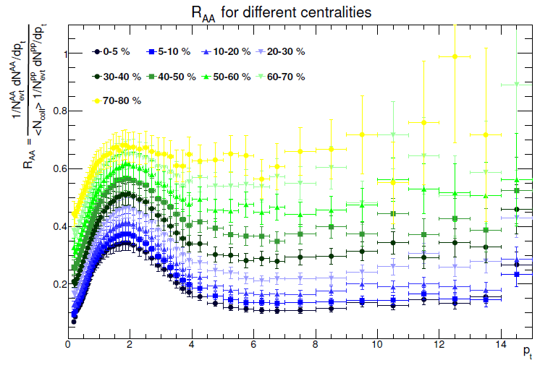
Large scale analysis: result
results produced by the first student group working on this new ALICE exercise:
→ close to the published result!

Slide 21
Video conference
students summarize their results in a presentation during the video conference
  different institutes present results for different centrality classes to avoid repeated presentations of the same result
  (alternative: replace pp reference by peripheral Pb-Pb reference → R_{CP})
  presentation by an ‘expert’ showing students how their results compare with the published results on unidentified charged particle R_{AA} and R_{AA} of other particles

Slide 22
Experience up to now
students realize quickly that visual analysis is not the ‘real deal’
concept of ‘writing analysis code’ is a shock for students in the first moment but they get used to the idea quickly
students understand the idea of collaborative work immediately →a huge success!

Slide 23
Summary
second ALICE exercise is in place, focusing on a genuine heavy-ion physics observable
  based on very few concepts students can convince themselves that heavy-ion collisions are not a simple superposition of pp collisions
student exercise goes beyond ‘click & watch’ concept, approaching what’s really done in data analysis
strong emphasis on collaborative work
similar analysis approaches for other heavy-ion observables are investigated right now

Slide 24
ALICE R_{AA} exercise developed by:
Ralf Averbeck1, Friederike Bock2, Benjamin Doenigus1, Yiota Foka1, Philipp Luettig3, Kilian Schwarz1, Reinhard Simon1, Jochen Thaeder1
1ExtreMe Matter Institute EMMI, GSI Darmstadt, 2Physikalisches Institut, University Heidelberg, 3Institut für Kernphysik, University Frankfurt

