Slide 1

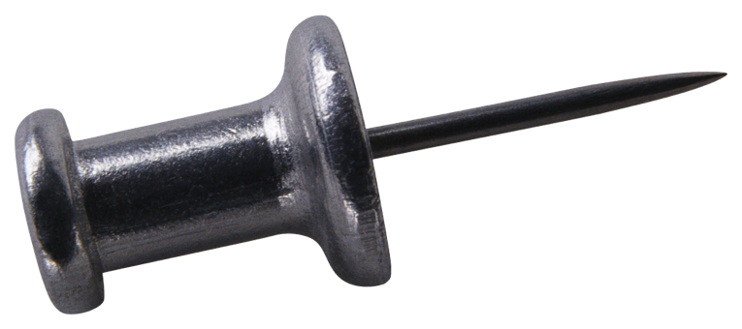



Fluctuating hydrodynamics confronts rapidity dependence
of p_{T}-correlations
Rajendra Pokharel¹, Sean Gavin¹ and George Moschelli²
¹ Wayne State University
² Frankfurt Institute of Advanced Studies
Hot Quark 2012 Oct 14-20 Copamarina, Puerto Rico

Slide 2
Outlines
Motivation
Viscosity and Hydrodynamics of Fluctuations
Diffusion of p_{t} correlations
Results and STAR measurements
Summary

Slide 3
Motivation
Modification of transverse momentum fluctuations by viscosity
Transverse momentum fluctuations have been used as an alternative measure of viscosity
Estimate the impact of viscosity on fluctuations using best information on EOS, transport coefficients, and fluctuating hydrodynamics
Sean Gavin & Mohamed Abdel-Aziz, Phys. Rev. Lett. 97 (2006) 162302
STAR: H. Agakishiev et al, Phys.Lett. B704 (2011) 467

Slide 4
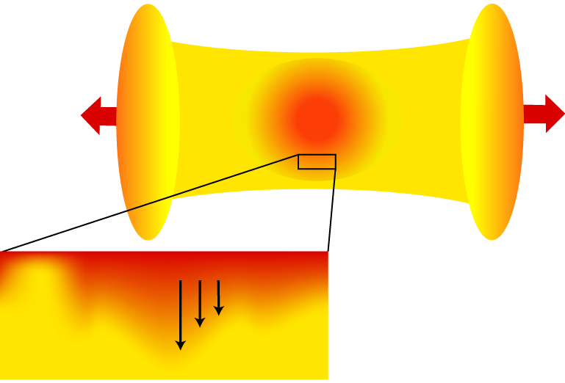
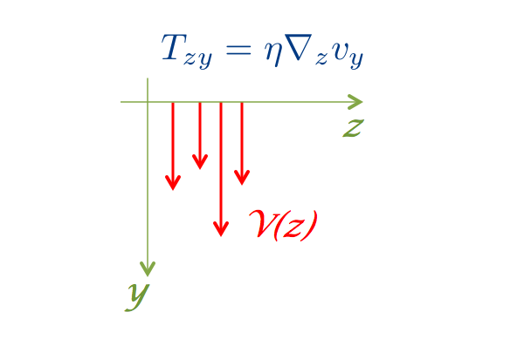
Fluctuations of transverse flow
Small variations of initial transverse flow in each event
Viscosity arises as the fluid elements shear past each other
Shear viscosity drives the flow toward the average
damping of radial flow fluctuations ←→ viscosity
Sean Gavin & Mohamed Abdel-Aziz, Phys. Rev. Lett. 97 (2006) 162302

Slide 5
Transverse momentum fluctuations
Momentum density current
First, from non-relativistic hydro:
Linearized Navier-Stokes →
Helmholtz decomposition:
Transverse modes:
Longitudinal modes:
viscous diffusion
sound waves (damped by viscosity)
It is the transverse modes that we are interested in.
Notes:
(Note: put these points to contrast Kapusta) use the figure to explain transverse modes

Slide 6
Dissipative relativistic hydrodynamics
Conservation of energy-momentum:
ideal
dissipative
→ Equations of relativistic
viscous hydrodynamics
First order (Navier-Stokes) hydro:
Second order (Israel-Stewart) hydro:
A. Muronga, Phys.Rev. C69, 034903 (2004)
Notes:
Get rid the notations/put in back up

Slide 7
Linearized hydro and diffusion of flow fluctuations
Linearized Navier-Stokes for transverse flow fluctuations:
→
g transverse component
First order diffusion violates causality!
Linearized Israel-Stewart for transverse flow fluctuations:
→
This saves causality!

Slide 8
Two-particle transverse momentum correlations and first order diffusion
Two-particle momentum correlation
satisfies the diffusion equation → r satisfies
→
→
first order
Sean Gavin & Mohamed Abdel-Aziz, Phys. Rev. Lett. 97 (2006) 162302

Slide 9
Second order diffusion of transverse momentum correlations
is temp. dependent
T. Hirano and M. Gyulassy, Nucl. Phys. A769, 71(2006), nucl-th/0506049.
Entropy density s(T) depends on equation of state (EOS)
EOS I -> Lattice s95p-v1
EOS II -> Hirano & Gyulassy
P. Huovinen and P. Petreczky, Nucl.Phys. A837, 26(2010), 0912.2541
T. Hirano and M. Gyulassy, Nucl. Phys. A769, 71(2006), nucl-th/0506049.
Notes:
Just put the plots only for Hirano

Slide 10
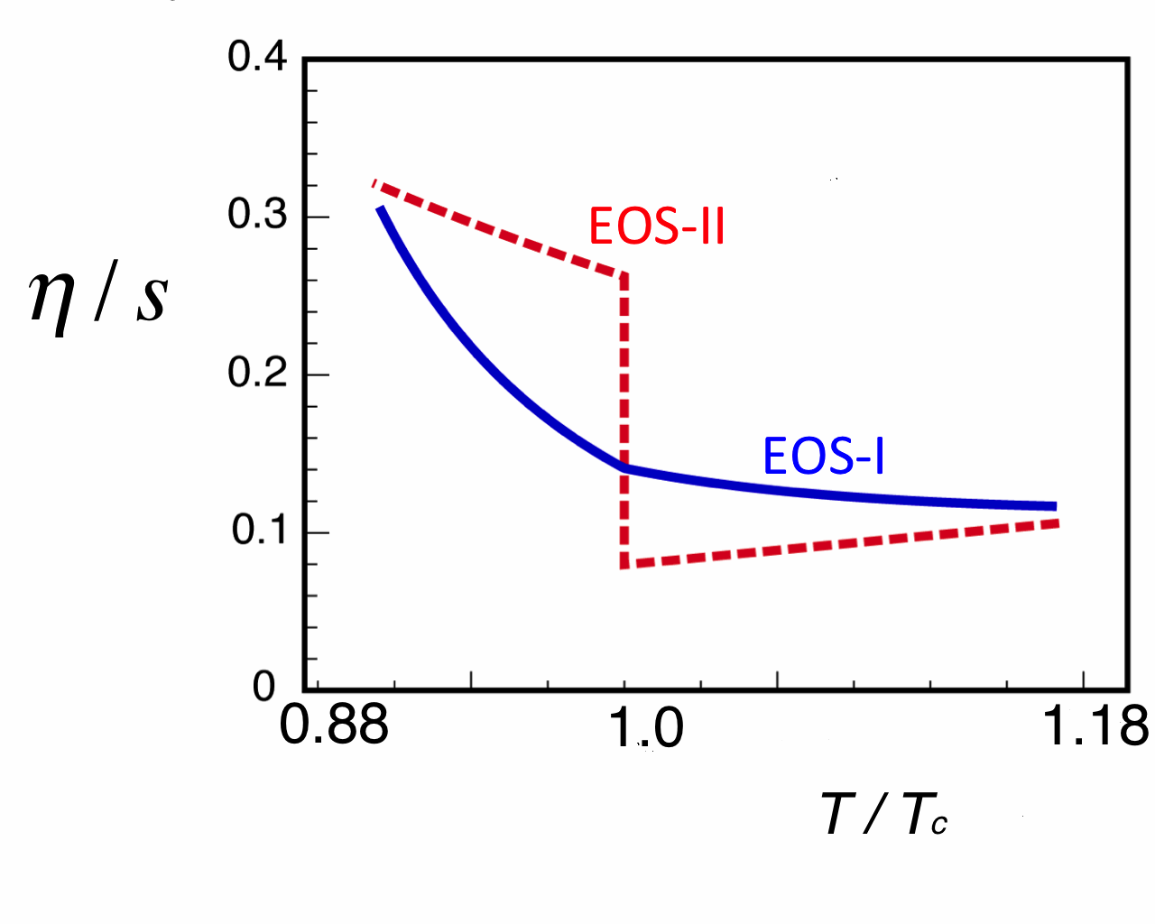
Entropy density and EOS
EOS I and EOS II
T. Hirano and M. Gyulassy, Nucl. Phys. A769, 71(2006), nucl-th/0506049
Lattice: P. Huovinen and P. Petreczky, Nucl.Phys. A837, 26(2010), 0912.2541
Entropy production
ideal: first order:
second order:
We have used used both in our numerical solutions.
A. Muronga, Phys.Rev. C69, 034903 (2004)

Slide 11
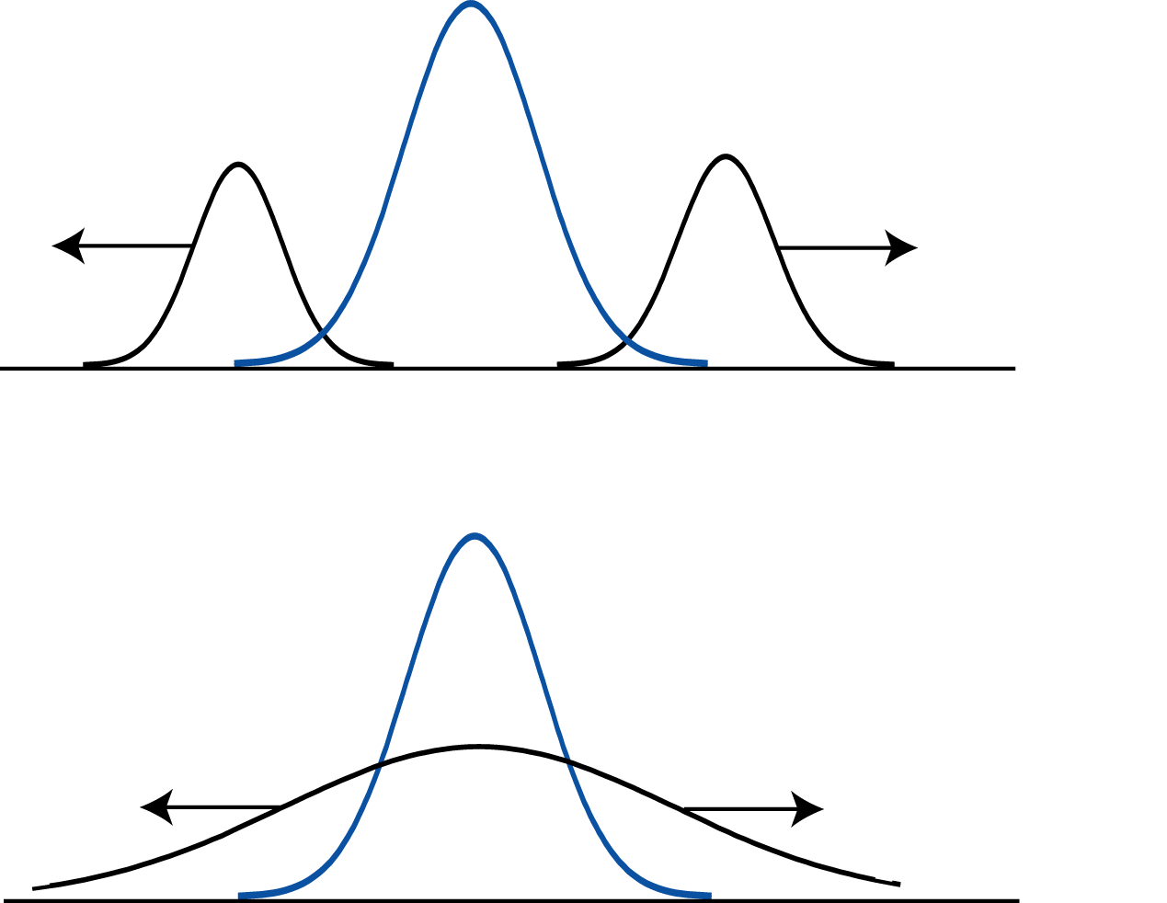
Diffusion vs Waves
Diffusion fills the gap in
between the propagating
Wave
Rapidity separation of the fronts saturates

Slide 12
Choosing different initial widths
Initial correlation is a normalized Gaussian
Smaller initial widths resolves better
Constant diffusion coefficient used in these examples plots
R. Pokharel, S. Gavin, G. Moschelli in preparation
Notes:
Get rid of the gaussian/ did

Slide 13
STAR measured these correlations
Sean Gavin & Mohamed Abdel-Aziz, Phys. Rev. Lett. 97 (2006) 162302
STAR: H. Agakishiev et al, Phys.Lett. B704 (2011) 467
Notes:
Divide this slides in to C and sigma in one. Explain C

Slide 14
STAR measured these correlations
STAR: H. Agakishiev et al, Phys.Lett. B704 (2011) 467
Central vs. peripheral increase consistent with
Measured: rapidity width of near side peak – the ridge
Fit peak + constant offset
Offset is ridge, i.e., long range rapidity correlations
Report rms width of the peak

Slide 15
NeXSPheRIO
Fluctuating ideal hydro, NeXSPheRIO vs Ideal hydro
NeXSPheRIO calculations of width fails match the STAR data
NeXSPheRIO: Sharma et al., Phys.Rev. C84 (2011) 054915
STAR: H. Agakishiev et al, Phys.Lett. B704 (2011) 467

Slide 16
Results
Numerical results vs STAR
Relaxation time:
τ_{π} = 5-6, AMY, Phys. Rev. D79, 054011
(2009), 0811.0729
τ_{π} = 6.3, J. Hong, D. Teaney, and P. M. Chesler (2011), 1110.5292
R. Pokharel, S. Gavin, G. Moschelli in preparation
STAR: H. Agakishiev et al, Phys.Lett. B704 (2011) 467

Slide 17
Results
C : second order vs STAR
Bumps in central to mid-central case in data and second order diffusion calculations
No such bumps in the first order case means bumps are second order diffusion phenomena
First and second order entropy production equations give virtually the same results (plots not shown here).
R. Pokharel, S. Gavin, G. Moschelli in preparation
STAR: H. Agakishiev et al, Phys.Lett. B704 (2011) 467
STAR unpublished data: M. Sharma and C. Pruneau, private communications.

Slide 18
Results
Second order vs first order
Evolution of C for 10-20%
10-20%
R. Pokharel, S. Gavin, G. Moschelli in preparation

Slide 19
Results

Slide 20
Summary
First order hydro calculations do poor job in fitting the experimental (STAR) data.
NeXSPheRIO calculations (ideal hydro + fluctuations) of width show opposite trend in the variation of width with centralities compared to the data.
Widths given by second order diffusion agrees with STAR data.
Second order diffusion calculations show bumps in C for central to mid-central cases and this is also indicated by data.
Theory the bumps is clear: pronounced effect of wave part of the causal diffusion equation.
Notes:
Mitigate the strong word in the first point

Slide 21
Thank You

Slide 22
Backups
Notations & conventions:
R. Baier, P. Romatschke, and U. A. Wiedemann,
Phys.Rev. C73, 064903 (2006), U. W. Heinz, H. Song, and A. K. Chaudhuri, Phys.Rev. C73, 034904 (2006)

Slide 23
