Slide 1
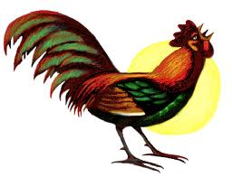
ROOT Tutorial
Simulation and fitting in ROOT
Attilio Andreazza
Università di Milano and INFN
Caterina Doglioni
Université de Genève

Slide 2


Outline
Today is my personal opinion of what should be in the toolbox of every physicist!
Making simulations:
  Random number generation in RooT
  Build the TTree we will use in the hands-on session
Fitting a model to data
...and how to do all of that in a simpler way
using RooFit
  Or more complicated way, it is a matter or taste...
Macros for today exercises in RootTutorial2.zip
in the indico page of the lecture.

Slide 3
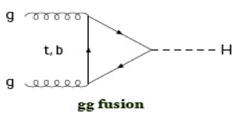
What we want to learn
How the Higgs boson decay in two photons looks like in a LHC detector?
Produced gluon-gluon fusion with gluons,
carring fractions x_{a} and x_{b} of
protons 4-momentum
  It is a narrow resonance: its mass is well defined
  It has rapidity
It decays into two γ’s isotropically distributed
Each photon is observed if:
  With a finite energy resolution
  If it is within the geometrical acceptance (|η|<2.4 for ATLAS)
  If it passes acceptance cuts (p_{T}>40 GeV for leading, p_{T}>30 GeV for sub-leading)

Slide 4
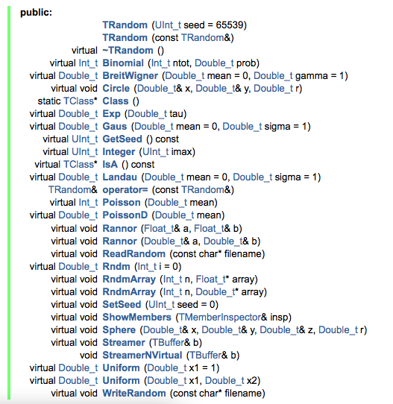
TRandom
Class TRandom is the basic random number generator in ROOT
http://root.cern.ch/root/html/TRandom.html
  More refined generators TRandom2, TRandom3 inherit from TRandom
  ➔ same interface
Constructor: argument is seed.
Seed=0: use system clock [s]
BreitWigner (resonance) distribution
Gaussian distribution
Poisson distribution
Uniformt distribution

Slide 5
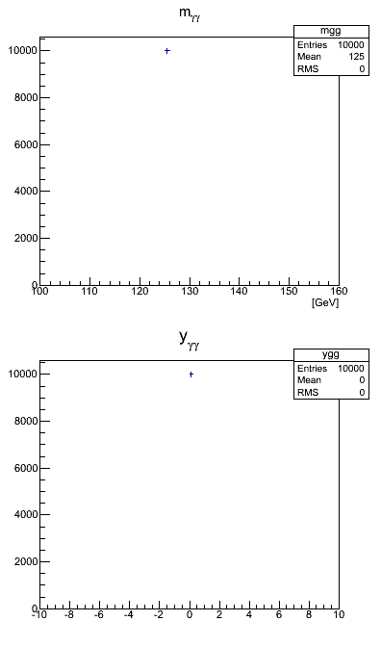
Higgs decay
{Double_t mH = 125.;
TRandom3 gen(0);
TH1F* mgg = new TH1F("mgg" ,"m_{#gamma#gamma}”,60,100.,160.);
TH1F* ygg = new TH1F("ygg" ,"y_{#gamma#gamma}",100,-10.,10.);
for (Int_t i=0; i<events; i++) {
Double_t phis = gen.Uniform(0.,TMath::TwoPi());
Double_t coss = gen.Uniform(-1.,1.);
Double_t sins = sqrt(1-coss*coss);
TLorentzVector g1(cos(phis)*sins,sin(phis)*sins,coss,1.);
g1*=(mH/2.);
TLorentzVector g2(-cos(phis)*sins,-sin(phis)*sins,-coss,1.);
g2*=(mH/2.);
TLorentzVector H=g1+g2;
mgg->Fill( H.M() );
ygg->Fill( H.Rapidity() );
}
TCanvas myCanvas("myCanvas","Higgs properties",400,700);
myCanvas.Divide(1,2);
myCanvas.cd(1); mgg->Draw("e");
myCanvas.cd(2); ygg->Draw("e"); }

Slide 6
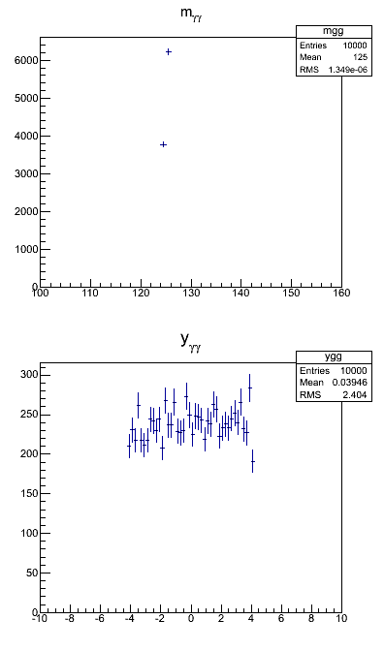
Higgs production
{
...
Double_t sqrts = 8000.; // center of mass energy
Double_t ymax = log (sqrts/mH);
for (Int_t i=0; i<events; i++) {
...
Double_t y = gen.Uniform(-ymax,ymax);
TLorentzVector beta(0.,0.,tanh(y),1.);
g1.Boost(beta.BoostVector());
g2.Boost(beta.BoostVector());
...
}
...
}

Slide 7
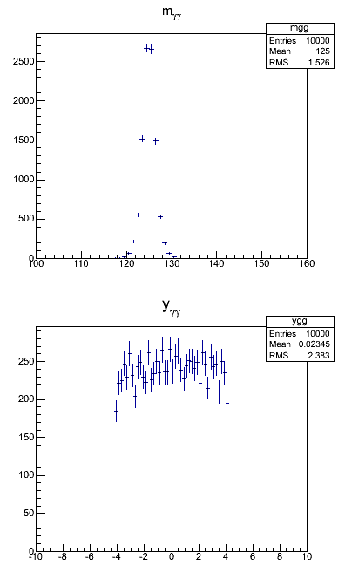
Energy resolution
{
...
Double_t A = 0.01;
Double_t B = 0.15;
for (Int_t i=0; i<events; i++) {
...
g1*=(gen.Gaus(1.,sqrt(A*A+B*B/g1.E())));
g2*=(gen.Gaus(1.,sqrt(A*A+B*B/g2.E())));
...
}
...
}

Slide 8
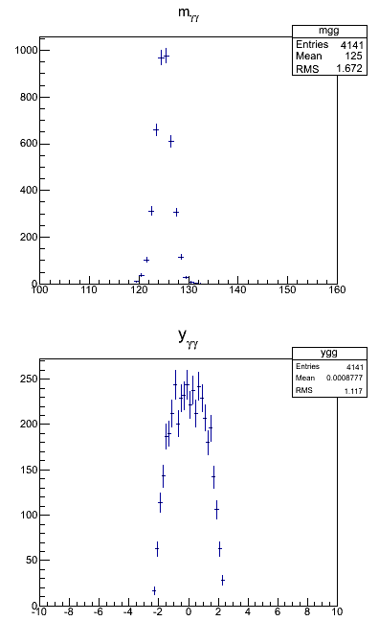
Detector and selection acceptance
{
...
for (Int_t i=0; i<events; i++) {
...
if ( fabs(g1.Eta())>2.4 || fabs(g2.Eta())>2.4 ) continue;
if ( g1.ET()<40. && g2.ET()<40. ) continue;
if ( g1.ET()<30. || g2.ET()<30. ) continue;
...
}
...
}

Slide 9
Putting everything into a TTree
{
...
TFile* myFile = TFile::Open(“myHiggs.root","RECREATE");
TTree *tree = new TTree("tree","Di-photons");
Double_t Et1, eta1, phi1, Et2, eta2, phi2;
tree->Branch("Et1" ,&Et1 ,"Et1/D" );
tree->Branch("eta1",&eta1,"eta1/D");
tree->Branch("phi1",&phi1,"phi1/D");
tree->Branch("Et2" ,&Et2 ,"Et1/D" );
tree->Branch("eta2",&eta2,"eta2/D");
tree->Branch("phi2",&phi2,"phi2/D");
for (...) {
...
}
...
tree->Write();
mgg->Write();
ygg->Write();
myFile->Close()
}
for (...) {
...
Et1 =g1.Et();
eta1=g1.Eta();
phi1=g1.Phi();
Et2 =g2.Et();
eta2=g2.Eta();
phi2=g2.Phi();
tree->Fill();
...
}

Slide 10
Move to a compiled macro
#include "TRandom3.h"
#include "TH1F.h"
#include "TMath.h"
#include "TTree.h"
#include "TFile.h"
#include "TLorentzVector.h"
#include "TCanvas.h"
#include <cmath>
void generator_simple(Int_t events, char* filename) {
...
}
All used classes need their corresponding header file
Define interface to interactively change number of events and output file
Interpreted macro:
root –l
.L generator_simple.C
generator_simple(100000,”file.root”)
Compiled macro:
root –l
.L generator_simple.C+
generator_simple(100000,”file.root”)
Check the execution time difference

Slide 11
For other distributions
The TF1 and the TH* (including multi-dimensional histograms) classes provide a GetRandom method to generate random numbers according to the given distributions.
Example:
use for the photons a forward-peaked distribution, instead of an uniform one:
  TF1* myPDF = new TF1("myPDF","1./sqrt(1-x*x)",-0.99,0.99);
  for (Int_t i=0; i<events; i++) {
  ...
  Double_t coss = myPDF->GetRandom();
  ...

Slide 12
Fitting
Determine a set of parameters of a model that better describe the measurements.
But also:
  Does the model described the data well enough?
  Which are the uncertainties on the best set of parameters?
  Correlations among the parameters
Different techniques and methods:
  Binned vs. unbinned data
  χ² vs. log-Likelihood

Slide 13
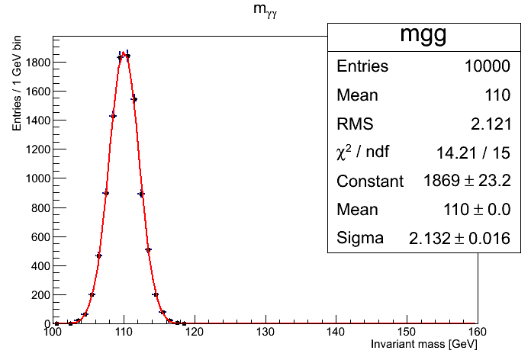
Example: χ² fit
Minimize deviations normalized by their uncertainties.
Binned data
  Compare bin content of an histogram with expectation from model.
  Example: data normally distributed
Unbinned data
  Compare each individual measurement with model
  Example: different measuremens of the same physics quantity α
  Gets back the well known weighted mean:
1σ uncertainty: increase of χ² by 1
Exercise:
figure out the connection between A and number of events in Gaussian
Poisson statistics

Slide 14
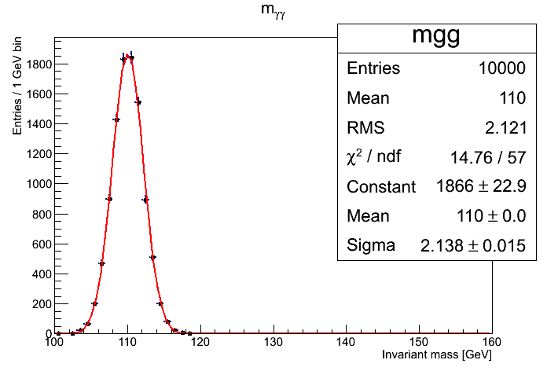
Example: Likelihood fit
Use the pdf of observables and maximize the product of likelihoods.
  In practice: minimize the -2*logarithm of the likelihoods
Binned data
  Use Poisson pdf for bin content
  Example: data normally distributed
Unbinned data
  Example: normally distributed points about α
  It looks familiar, doesn’t it?
1σ uncertainty: increase of -2lnL by 1

Slide 15
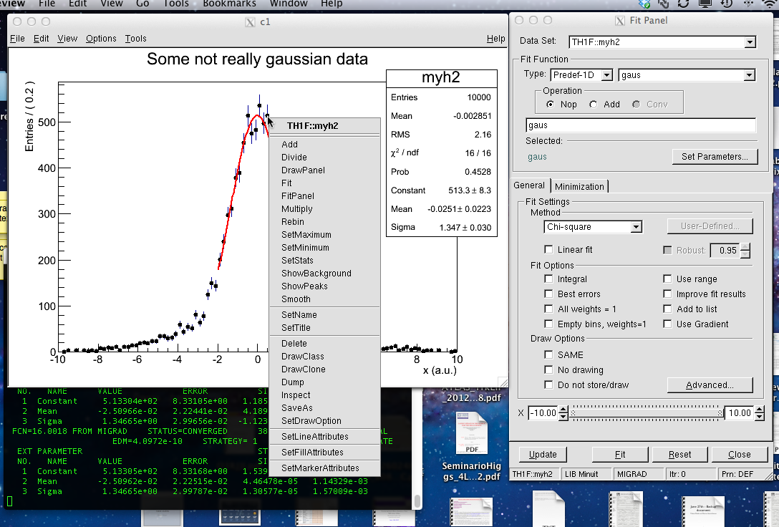
Fitting in the GUI
Fit results on stat. panel.
Right-click and SetOptFit to 1111
Sample histrogram
in myHisto.root:
> root –l myHisto.root
> myh2->Draw();
Function choice
Fit results on terminal window
Range setting

Slide 16
Simple fits
myh2->Fit("gaus","","",-2.,2.);
myh2->GetFunction(”gaus”)->Draw();
TFitResultPtr fitres = myh2->Fit(”gaus”,”S”);
fitres->Parameter(2);
fitres->ParError(2);
fitres->Chi2();
fitres->Ndf();
Some predefined fit functions available:
  Exponential
  Gaussian
  Landau
  Polynomial (up to 9th degree)
Most common options:
  “L” likelihood fit
  “WL” likelihood fit with weighed points
  “Q” quiet mode: do not print info on screen
  “S” save the results in a TFitResultPtr opbect.
Function name
Fit options
Plotting options
Fit range
The ponter can be used to manipulate the function: plotting, changing style, inspecting parameters...
Retrieve a pointer to the fitted TF1

Slide 17
TFitResult
The TFitResultPtr is a class that behaves like a pointer to a TFitResult object.
  The latter inherits from a ROOT::Fit::FitResult
Many accessor methods, full documentation at
http://root.cern.ch/root/html/ROOT__Fit__FitResult.html

Slide 18
TFitResult
root [38] TFitResultPtr fitres = myh2->Fit("gaus","S","",-2.,2.)
FCN=16.5644 FROM MIGRAD STATUS=CONVERGED 71 CALLS 72 TOTAL
EDM=6.18403e-09 STRATEGY= 1 ERROR MATRIX ACCURATE
EXT PARAMETER STEP FIRST
NO. NAME VALUE ERROR SIZE DERIVATIVE
1 Constant 5.12179e+02 8.19111e+00 1.21137e-02 2.10983e-06
2 Mean -1.99953e-02 2.13804e-02 4.36950e-05 -5.06752e-03
3 Sigma 1.35596e+00 2.78382e-02 1.20495e-05 -1.87226e-03
root [39] fitres->Print(cout)
****************************************
Minimizer is Minuit / Migrad
Chi2 = 16.5644
NDf = 17
Edm = 6.18403e-09
NCalls = 72
Constant = 512.179 +/- 8.19111
Mean = -0.0199953 +/- 0.0213804
Sigma = 1.35596 +/- 0.0278382 (limited)

Slide 19
TFitResult
root [40] fitres->PrintCovMatrix(cout)
Covariance Matrix:
Constant Mean Sigma
Constant 67.094 0.0048267 -0.1576
Mean 0.0048267 0.00045712 -2.9505e-05
Sigma -0.1576 -2.9505e-05 0.00077498
Correlation Matrix:
Constant Mean Sigma
Constant 1 0.027561 -0.69116
Mean 0.027561 1 -0.049571
Sigma -0.69116 -0.049571 1
root [41]

Slide 20
Inlined functions
Not always you can find the function
...or the parameterization that you want to use.
In this case we want to try to fit our distribution as the sum of two Gaussians.
So you can define it yourself providing its formula:
TF1* gauss2 = new TF1("gauss2",
"([0]/[2])*exp(-0.5*(x-[1])**2/[2]**2)+([3]/[4])*exp(-0.5*(x-[1])**2/[4]**2)",
-10.,10.);
And use in fitting:
TFitResultPtr fitres = histo->Fit("gauss2","S");
Just remember in between:
gauss2->SetParameter(0,100.);
gauss2->SetParameter(1,0.);
gauss2->SetParameter(2,1.);
gauss2->SetParameter(3,100.);
gauss2->SetParameter(4,2.);

Slide 21
C-functions
Sometimes you cannot put everything on a line...
...use a normal C-function:
Double_t myTwoGauss(Double_t *x, Double_t *p) {
Double_t norm = 1./sqrt(TMath::TwoPi());
Double_t g1 = exp(-0.5*pow((x[0]-p[1])/p[2],2));
g1*=(norm*p[0]/p[2]);
Double_t g2 = exp(-0.5*pow((x[0]-p[1])/p[4],2));
g2*=(norm*p[3]/p[4]);
return g1+g2;
}
So you can define it yourself providing its formula:
TF1* gauss3 = new TF1("gauss3", myTwoGauss, -10., 10., 5);
And use in fitting:
TFitResultPtr fitres2 = histo->Fit("gauss3","S");
Just remember to set the parameters!
Let’s run the FitTwoGaussian.C macro

Slide 22
RooFIT
...and when things starts to become really complicated

Slide 23
Introduction to RooFit
Disclaimer:
I am not a RooFit expert: I learnt it last week because of you!
Only few of the features will be presented here!
So you can get much better material from the official sources:
  RooFit web page: http://roofit.sourceforge.net/
  RooFit tutorials: http://root.cern.ch/root/html/tutorials/roofit/index.html
  RooFit entry in the ROOT reference guide:
  http://root.cern.ch/root/html/ROOFIT_Index.html
In particular I appreciated a lot the tutorial at the Desy 2012 School of Statistics by L. Moneta and S. Kreiss:
https://twiki.cern.ch/twiki/bin/view/RooStats/WebHome#Resources
many slides here by them and W. Werverke

Slide 24
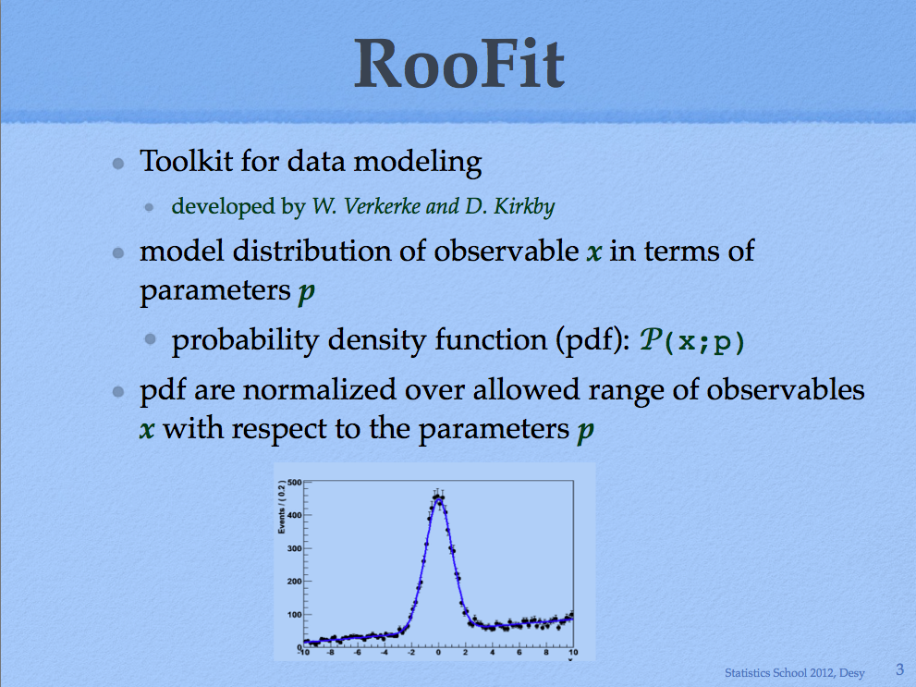

Slide 25
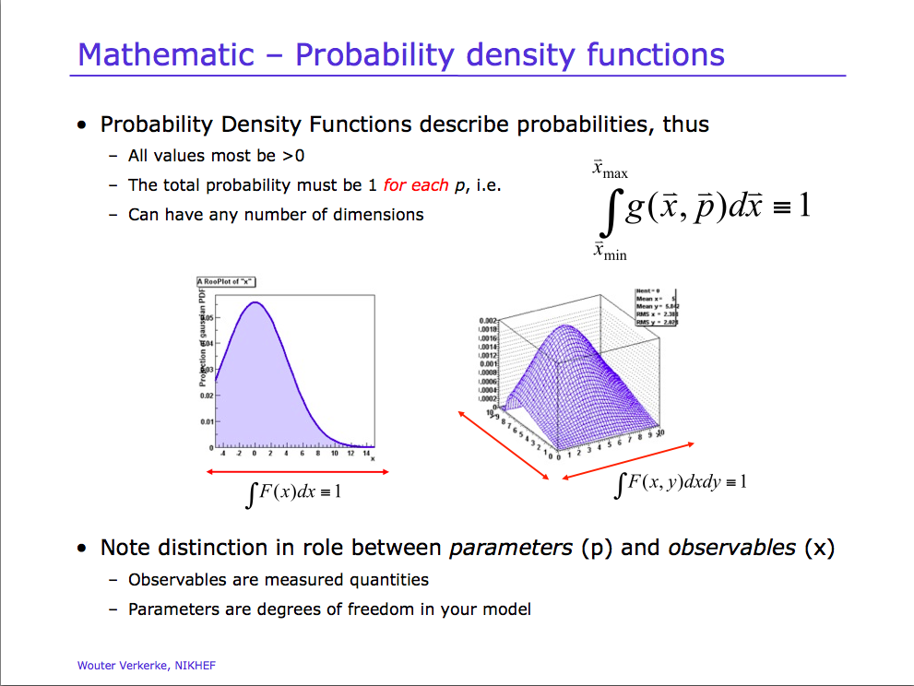

Slide 26
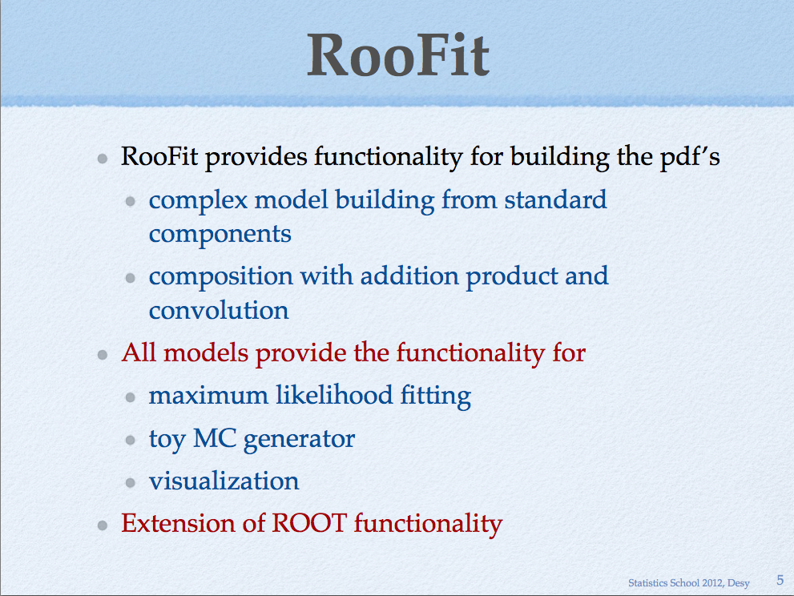

Slide 27
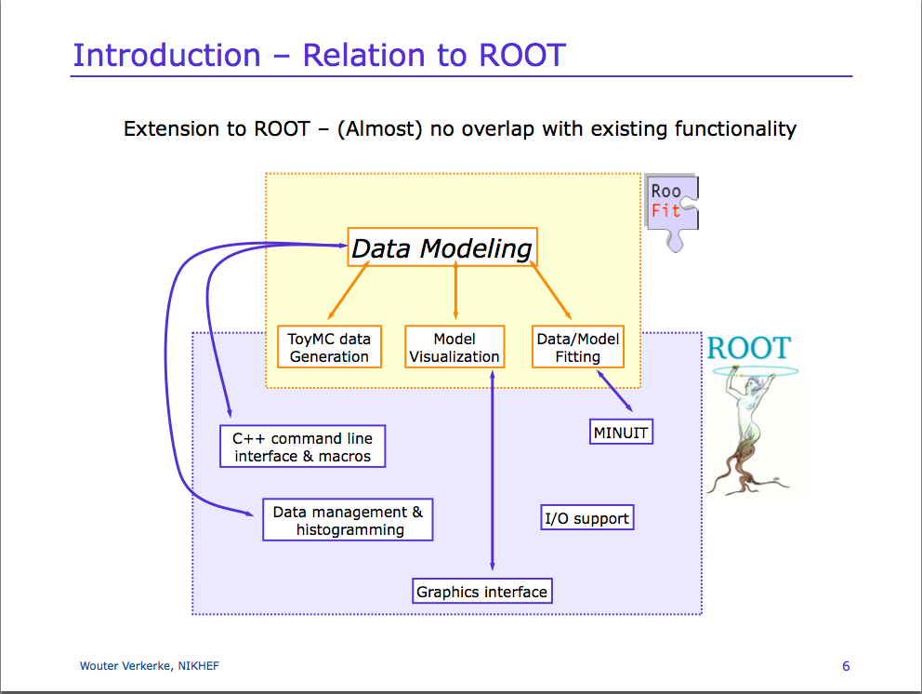

Slide 28
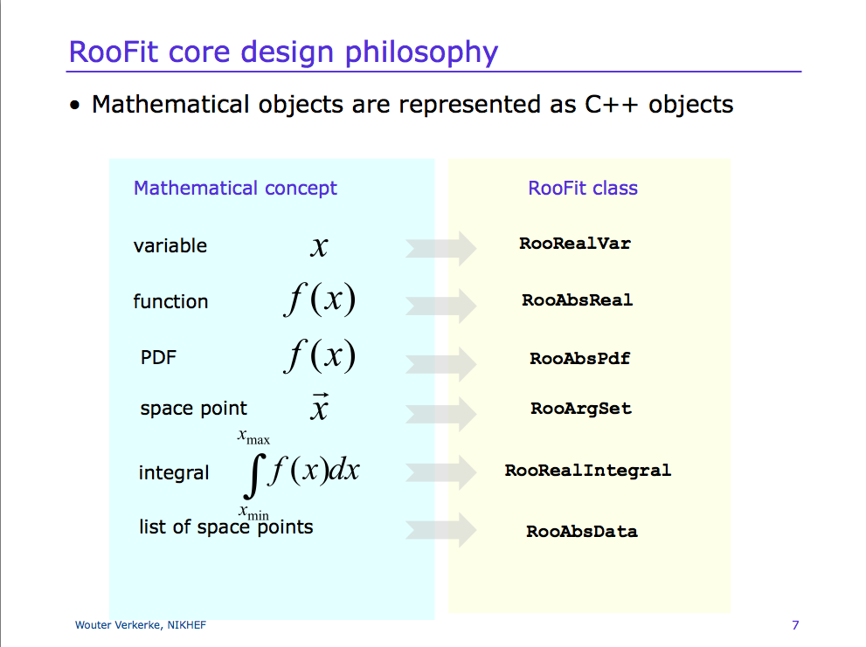

Slide 29
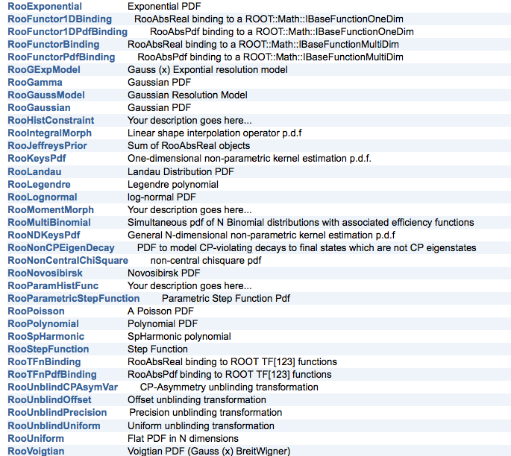
Some of the available pdf

Slide 30
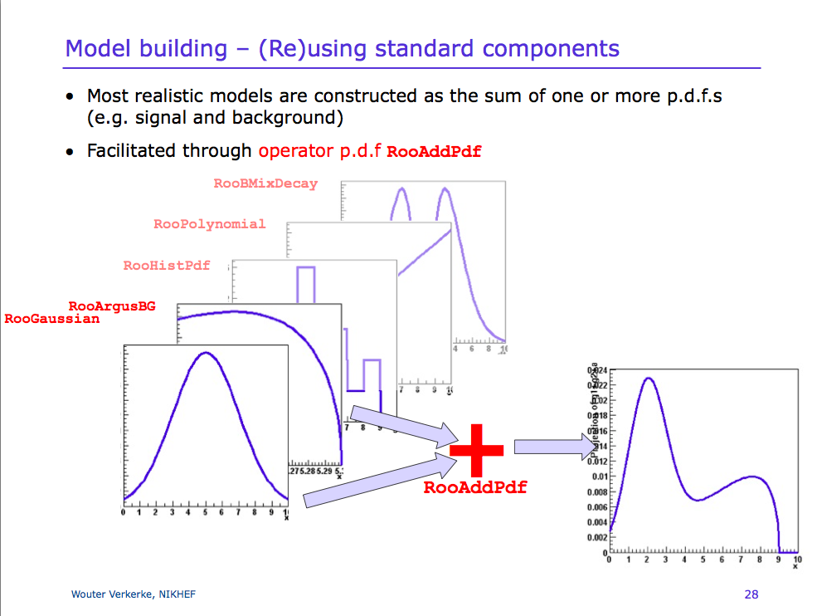

Slide 31
Two Gaussians in RooFit
This is the story behind the histogram used for the fit study:
  RooRealVar x("x","Bad Gaussian",-10.,10.);
  RooRealVar mean("mean","mean of Gaussian",0.,-10.,10.) ;
  RooRealVar sigma1("sigma1","width of narrow Gaussian",1.2,0.1,10.) ;
  RooRealVar sigma2("sigma2","width of wide Gaussian",3.4,2.,10.) ;
  RooRealVar fraction("fraction","fraction of narrow Gaussian",2./3.,0.,1.);
  RooGaussian gauss1("gauss1","Narrow Gaussian",x,mean,sigma1);
  RooGaussian gauss2("gauss2","Wide Gaussian",x,mean,sigma2);
  RooAddPdf twogauss("twogauss","Two Gaussians pdf",
  RooArgList(gauss1,gauss2),fraction);
Now twogaussian is pdf:
what can we do with it?

Slide 32
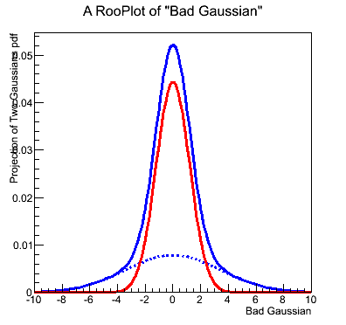
Drawing a pdf
Simply plotting a pdf is a bit more elaborate:
  Create a frame to show a certain variable
  RooPlot* xframe = x.frame();
  Plot the pdf in that frame
  twogauss.plotOn(xframe)
  But also can plot individual components, setting the style on the fly:
  twogauss.plotOn(xframe,Components("gauss2"),LineStyle(kDashed));
  twogauss.plotOn(xframe,Components("gauss1"),LineColor(kRed));
  Finally draw the frame
  xframe.Draw();

Slide 33
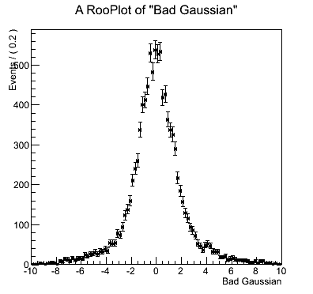
Generate events according to a pdf
From a pdf it is possible to create datasets:
  Create a dataset of 10000 sampling of variable x
  RooDataSet* mydata = twogauss.generate(x,10000);
  Plot the dataset in a frame
  RooPlot* xframe = x.frame();
  mydata->plotOn(xframe)
  Finally draw the frame
  xframe.Draw();

Slide 34
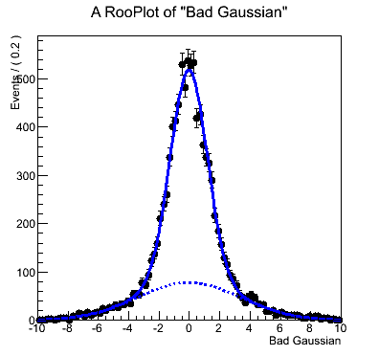
Fitting a dataset
A pdf can be fitted to a dataset:
  This is very simple:
  twogauss.fitTo(*mydata);
  Plot the resulting dataset and pdf in at frame
  mydata->plotOn(xframe);
  twogauss.plotOn(xframe);
  twogauss.plotOn(xframe,Components("gauss2"),LineStyle(kDashed));
  Like for normal fits, it is possible to store results in a RooFitResult:
  RooFitResult* fitres = twogauss.fitTo(*mydata,Save());
  fitres->Print();
  fitres->correlationMatrix()->Print();
To fix a parameter:
mean=0.;
mean.setConstant(true);

Slide 35
Datasets <-> TTree, TH1
It is possible to convert a TTree or a TH1 into a RooDataSet for fitting
RooDataSet mytreedata(“mytreedata”,”imported data”,x,Import(*myTree));
RooDataHist myhistdata(“myhistdata”,”imported data”,x,Import(*myTH1));
And also the other way around (this is how our test histogram was created)
TH1F* myh = x.createHistogram("myh","Entries");
TH1* myh2 = mydata->fillHistogram(myh,x);
TTree* myTree = mydata->tree();

Slide 36
Another way of summing
In many application we are interested to know how many event are in the narrow Gaussian (N1) or in the wide one (N2):
  RooRealVar x("x","Bad Gaussian",-10.,10.);
  RooRealVar mean("mean","mean of Gaussian",0.,-10.,10.) ;
  RooRealVar sigma1("sigma1","width of narrow Gaussian",1.2,0.1,10.) ;
  RooRealVar sigma2("sigma2","width of wide Gaussian",3.4,2.,10.) ;
  RooGaussian gauss1("gauss1","Narrow Gaussian",x,mean,sigma1);
  RooGaussian gauss2("gauss2","Wide Gaussian",x,mean,sigma2);
  RooRealVar N1(”N1",”events in narrow Gaussian”,6000.);
  RooRealVar N2(”N2",”events in wide Gaussian”,3000.);
  RooAddPdf twogauss("twogauss","Two Gaussians pdf",
  RooArgList(gauss1,gauss2),RooArgList(N1,N2));
It will be useful in tomorrow exercises.

Slide 37
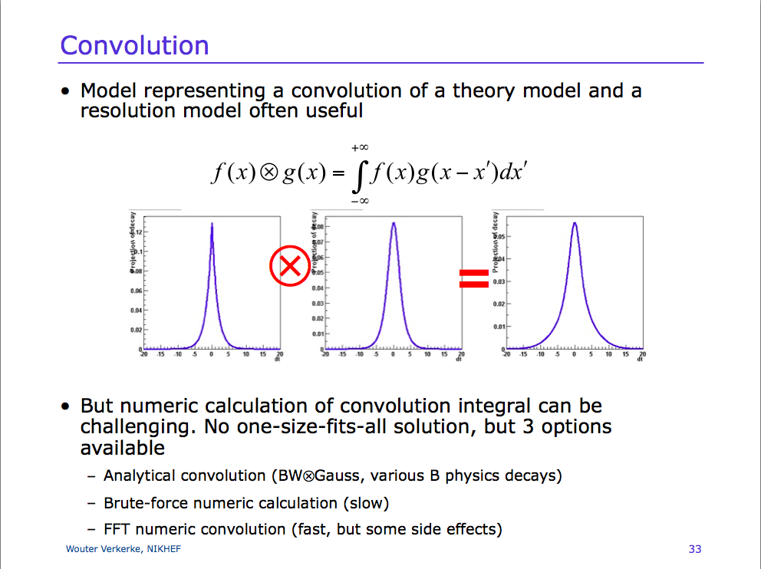

Slide 38
Example of convolution: BW+Gauss
Let’s assume we want to describe the widening of the Z resonance peak (Breit-Wigner shape) due to detector resolutio (Gaussian).
  RooRealVar m("m","mumu invariant mass",91.,66.,116.);
  RooRealVar mZ("mZ","Z mass",91.1876);
  RooRealVar GZ("GZ","Z width",2.4952);
  RooBreitWigner peak("peak","Z peak",m,mZ,GZ);
  RooRealVar mres("mres","auxiliary variable",0.,-20.,20.);
  RooRealVar sigma("sigma","mass resolution",2.,0.,10.);
  RooGaussian gauss("gauss","Resolution function",m,RooConst(0.),sigma);
  RooFFTConvPdf conv("conv","Reconstructed peak",m,peak,gauss);
  RooVoigtian voigt("voigt","Reconstructed peak",m,mZ,GZ,sigma);
Let’s run the Convolution.C macro.

Slide 39
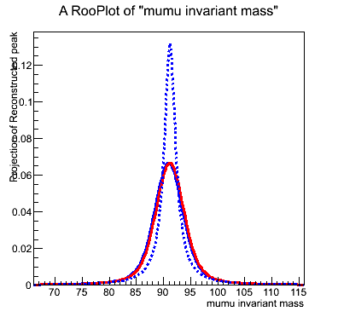
Comparing FFT vs Analytical
TCanvas cfun("cfun","Plot of a function",400,400);
RooPlot* xframe = m.frame(Range(66.,116.));
conv.plotOn(xframe);
voigt.plotOn(xframe,LineColor(kRed));
peak.plotOn(xframe,LineStyle(kDashed));
xframe.Draw();

Slide 40
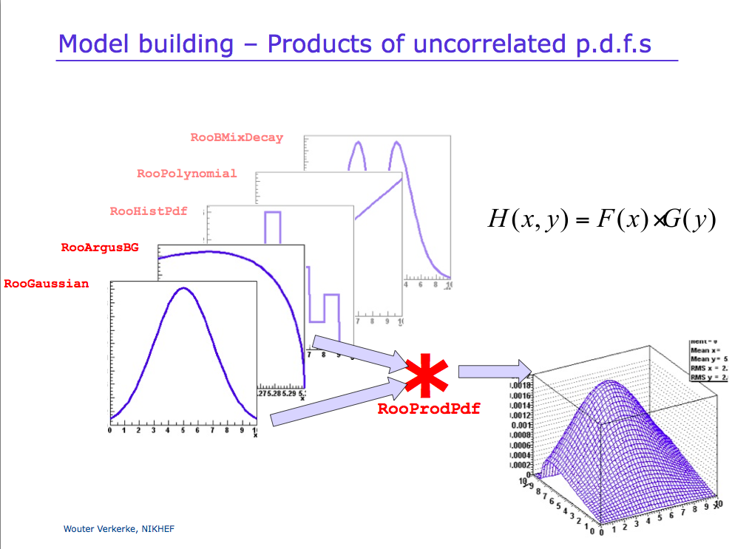

Slide 41
Product of PDF: Poisson with uncertainty on μ
We expect data to be distributed according to a Poisson distribution
...but we have some uncertainty on value of μ.
We can describe the problem in RooFit as product of two probability distribution, one conditional on the other.
  RooRealVar Nobs("Nobs","Observed events",1,0.,14.);
  RooRealVar mu("mu","Expected events",0.,6.);
  RooPoisson observed("observed","Observed events",Nobs,mu);
  RooGaussian mupdf("mupdf","Mu value",mu,RooConst(2.5),RooConst(0.9));
  RooProdPdf modPoisson("modPoisson","Poisson with uncertainty on mu",
  mupdf,Conditional(observed,Nobs));
Let’s run the PoissonComposition.C macro.

Slide 42
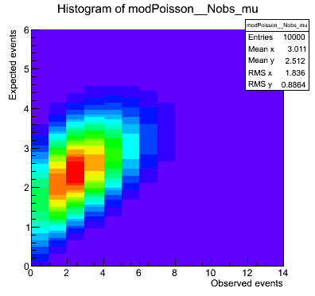
Plotting the 2D pdf
RooDataSet* mydata = modPoisson.generate(RooArgSet(Nobs,mu),10000);
TCanvas c2D("cfun","2D distribution",400,400);
TH2* hh = modPoisson.createHistogram("Nobs,mu");
hh->Draw("COL");
TCanvas cmu("cmu","mu distribution",400,400);
RooPlot* frame1 = mu.frame();
mydata->plotOn(frame1);
frame1.Draw();
TCanvas cN("cN","Nobs distribution",400,400);
RooPlot* frame2 = Nobs.frame();
mydata->plotOn(frame2);
frame2.Draw();

Slide 43
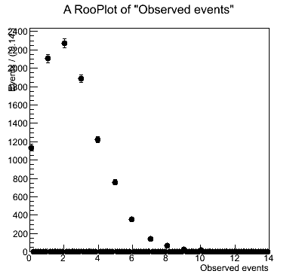
Plotting the N_{obs} pdf
RooDataSet* mydata = modPoisson.generate(RooArgSet(Nobs,mu),10000);
TCanvas c2D("cfun","2D distribution",400,400);
TH2* hh = modPoisson.createHistogram("Nobs,mu");
hh->Draw("COL");
TCanvas cmu("cmu","mu distribution",400,400);
RooPlot* frame1 = mu.frame();
mydata->plotOn(frame1);
frame1.Draw();
TCanvas cN("cN","Nobs distribution",400,400);
RooPlot* frame2 = Nobs.frame();
mydata->plotOn(frame2);
frame2.Draw();

