Slide 1
ROOT and statistics tutorial
Exercise: Discover the Higgs, part 2
Attilio Andreazza
Università di Milano and INFN
Caterina Doglioni
Université de Genève

Slide 2
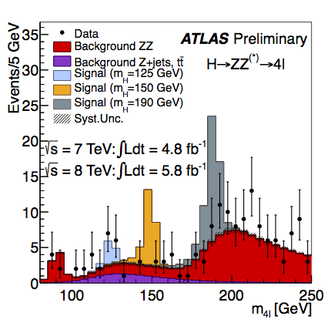
Outline
What will we do today:
  Discover the Higgs boson of course! ...well, check ATLAS is not cheating us ☺
What we will learn!
  Computing confidence levels based on
  Poissonian statistics.
  Compute confidence levels based if the
  expected μ_{(B,S)} is uncertain.
For people running fast:
  Expected 95% level exclusion + error bars
2011+2012 data
In the region 125 ± 5 GeV
Dataset 2011 2012 2011+2012
Expected B only 2±0.3 3±0.4 5.1±0.8
Expected S m_{H}=125 GeV 2±0.3 3±0.5 5.3±0.8
Observed in the data 4 9 13
From F. Gianotti’s Higgs seminar

Slide 3
Confidence level definition
Definition of confidence level
  N.B.: this is the frequentist definition, not the Bayesian one from the lectures, but that allows you to make all computations by yourself and to grasp the main features of the problem.
  A certain criterion rejects an hypothesis with C.L. α if, in case the hypothesis is true, it would be erroneously rejected by that criterion on a fraction 1-α of the cases.
In our exercise:
  We observe a certain number of events
  N_{obs}
  We expect a certain number of background events:
  N_{B}
  Discovery: we reject the hypothesis our sample contains only background events if:
  Exclusion: we reject an hypothesis expecting N_{S} signal events if:

Slide 4
Confidence level computation
At first just assume a Poisson statistics:
  We can compute the probability summing the probabilities of all N up to N_{obs}
  But we want to use a Monte Carlo method!
  Why? It will be easier to extend to the treatment of systematic uncertainties (this is what BAT or RooStats do for example).
What to do:
  Sample the probability distribution M times (say M=10000)
  Count how many cases M’ the value of N exceeds (or is lower than, if appopriated) N_{obs}.
  We can reject the hypothesis if M’/M<1-α.
  Something like:
  Int_t M=0;
  for (Int_t i=0; i<10000; i++) {
  Int_t N = gen.Poisson(NB);
  if ( N>=Nobs ) M++;
  }
  Double_t CL = 1.-M/10000.

Slide 5
Computing confidence levels
  Neglecting uncertainties on N_{B}
With which CL can we reject the background-only hypothesis when using:
  Only 2011 data
  Only 2012 data
  The combined set
If one would have been observed only the expected backgroun (i.e. N_{obs} =2,3 and 5 events respectively for 2011, 2012 and combined dataset), with which confidence level one would have rejected the hypothesis of the Higgs presence?
Repeat adding the uncertainty on the μ value of the Poisson distribution. Assume the uncertainties on N_{B} and N_{S} are fully correlated.
  In such a situation
  and the integral can be performed by sampling N_{B} from a Gaussian distribution and afterward sampling N.

Slide 6
Computing exclusion limit
  Observed exclusion limit:
    after getting N_{obs} events, all N_{S}>N_{0,S} are excluded at confidence level α, where is the N_{0,S} minimum one satisfying the relation:
    Determining this minimum, even in this simple case is quite computationally expensive, and special tools are usually employed.
  Expected exclusion limit:
    Is the one that would obtained if N_{obs} would correspond to the median of
    The ±1σ expected values correspond to the limit that would be obtained if N_{obs} would coincide with the 16% and 84% percentiles of
    The ±1σ expected values correspond to the limit that would be obtained if N_{obs} would coincide with the 2.25% and 97.75% percentiles of
  Compute the expected limits for ATLAS and m_{H}=125 GeV

Slide 7
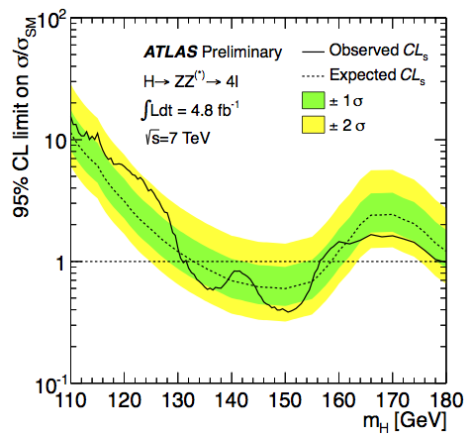
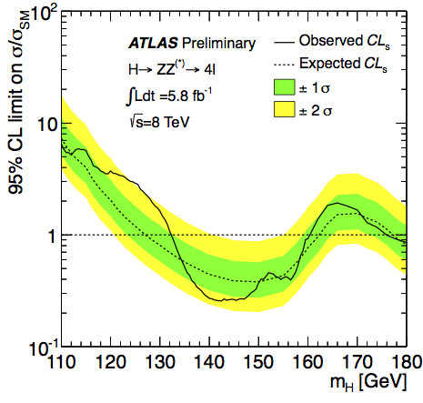
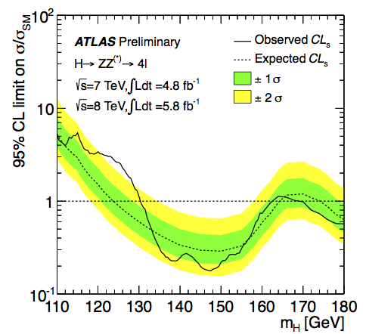
2011 data
2012 data
  Repeating the same calculation for all m_{H} hypothesis is the way the famous band plots are produced.
From F. Gianotti’s Higgs seminar
Excluded (95% CL):
131-162, 170-460 GeV
Expected:
124-164, 176-500 GeV
Excluded (95% CL):
130-170 GeV
Expected: xxxx GeV
2011+2012 data

