Slide 1
WLCG Service Report
September 17 – October 15
Andrea Sciabà
16-OCT-2012 WLCG MB

Slide 2
Introduction
This report covers the period from September 17 to October 15
  3 real ALARMs by ATLAS to CERN
No Service Incident Reports received
  one expected for this week for a LHCb storage outage at CNAF
Highlights from the WLCG operations coordination
  Reminder: next meeting is this Thursday

Slide 3
Highlights from daily ops
Several sites affected by an FTS bug affecting proxy delegation (GGUS:86775)
  A patch exists which does not fully fix the bug but makes the recovery much easier
  Installed at least at RAL, CNAF, IN2P3, TRIUMF, PIC, KIT, ASGC
EOS problems for ALICE
  Crashes due to overload caused by read traffic for conditions data, fixed by new hardware and performance tuning
EOS problems for ATLAS
  EOS upgrade showed some instabilities and was followed by crashes
LHCb storage issue at CNAF (description)
  Routine hardware intervention caused failure of disk arrays which required ~7 days to run the array and GPFS consistency checks
Accidental data deletion at PIC
  200,000 ATLAS files deleted (fortunately data was recoverable elsewhere)
KIT tape staging slowness (GGUS:80794, GGUS:86720, GGUS:87061)
  Only two read pools for tape, a bug in the tape library software and heavy traffic on the few LTO5 drives are the causes
Network problem between BNL (and other OSG sites) and ASGC
  Due to BNL Cyber Security blocking FTS at ASGC due to high rate activity being automatically tagged as “suspicious” (it came from several jobs sending their output to ASGC)

Slide 4
Work in progress in Ops coordination (from Maria’s talk at the GDB)
Most TF’s actively working already. Some highlights from last meeting’s minutes:
  Upgrade to EMI WN (ideas to install in under CVMFS)
  PerfSonar deployment on priority sites to test priority links
  SHA-2 compliance matrix for middleware in EMI and OSG and setup of a validation infrastructure. Testing already ongoing
  Discussion on policies and timing for middleware upgrades
  FTS3 deployment co-locate with FTS3 demos. Focus on integration testing
  LHCb has decommissioned Oracle streaming, the local LFCs and oracle conditions DBs at T1 sites
Several TF mailing lists created and internal meetings organised

Slide 5
GGUS summary (last 4 weeks)
VO | User | Team | Alarm | Total
ALICE | 2 | 1 | 0 | 3
ATLAS | 19 | 116 | 4 | 139
CMS | 8 | 2 | 0 | 10
LHCb | 8 | 33 | 0 | 41
Totals | 37 | 152 | 4 | 193
5
5

Slide 6
Support-related events since last MB
There have been 3 real ALARMs since the 2012/09/18 MB
All were submitted by ATLAS
All concerned the CERN site (LSF & Castor)
A GGUS release took place since the last MB (on 2012/09/26). A problem in SNOW-to-GGUS update propagation was experienced then for CERN tickets, until 2012/10/01. The problem was due to some NULL values sent from SNOW to GGUS for fields that don’t allow NULL

Slide 7
Attached material
Detailed drills
Reliability reports

Slide 8
ATLAS ALARM->CERN SLOW LSF GGUS:86788
What time UTC | What happened
2012/10/05 12:08 | GGUS ALARM ticket opened, automatic email notification to atlas-operator-alarm@cern.ch AND automatic assignment to ROC_CERN. Automatic SNOW ticket creation successful. Type of Problem: Local Batch Systems.
2012/10/05 12:15 | The operator and the service expert, independently, record in the ticket that investigation already started.
2012/10/05 13:09 | Service expert applied a reconfiguration, saw performance improvement and received log extracts from the submitter in 3 comments exchanged.
2012/10/05 14:10 | Ticket set to ‘solved’ by the shifters’ GGUS login.

Slide 9
ATLAS ALARM->CERN SLOW LSF GGUS:86883
What time UTC | What happened
2012/10/05 15:31 | GGUS ALARM ticket opened, automatic email notification to atlas-operator-alarm@cern.ch AND automatic assignment to ROC_CERN. Automatic SNOW ticket creation successful. Type of Problem: Local Batch Systems.
2012/10/05 15:37 | The operator records in the ticket that the service has been informed.
2012/10/05 15:48 | Service expert applied yet another reconfiguration (see previous slide for a similar handling during the same day at noon)..
2012/10/05 17:40 | Ticket set to ‘solved’ with shifters’ agreement after exchange of 4 comments, with net performance improvement observed and acknowledged.

Slide 10
ATLAS ALARM->CERN castor data inaccessible GGUS:87285
What time UTC | What happened
2012/10/11 18:04 | GGUS ALARM ticket opened, automatic email notification to atlas-operator-alarm@cern.ch AND automatic assignment to ROC_CERN. Automatic SNOW ticket creation successful. Type of Problem: Storage Systems.
2012/10/11 18:15 | The operator records in the ticket that the CASTOR piquet was called. The service expert already saw the ticket notification and started investigation.
2012/10/11 18:20 | Service expert found all attempted files to be on a single inaccessible disk server, being down (initially on maintenance for kernel upgrade).
2012/10/15 09:05 | 13 comments were exchanged. Impossible to solve till Friday evening due to a dead RAID controller. Ticket set to ‘on hold’ due to TEAM Child-ticket https://ggus.eu/ws/ticket_info.php?ticket=87279 and finally solved on Monday at noon

Slide 11
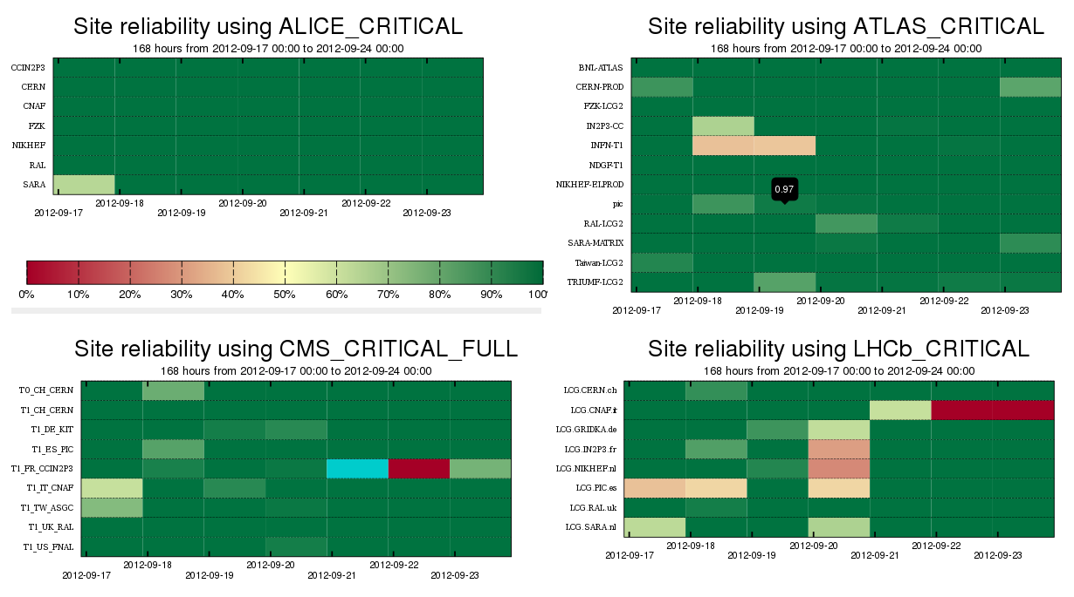
2.1
1.1
4.4
4.3
4.3
3.3
4.3
3.1
4.2
4.3
3.2
4.1
4.3

Slide 12
Analysis of the reliability plots : Week 17/09/2012
Alice :
  1.1 SARA : CREAMCE - JobSubmit test failing because of errors while loading glite libraries
Atlas :
  2.1 INFN : CREAMCE - JobSubmit test failing because of timeouts
CMS :
  3.1 CNAF : failures of SRM-VOPut due to moving of data from disk, see GGUS , also HammerCloud errors, see GGUS
  3.2 ASGC : transfer and SRM failures, see GGUS
  3.3 IN2P3 : org.cms.WN-mc test not run
LHCb :
  4.1 SARA : CREAMCE - JobSubmit test failing because of errors while loading glite libraries
  4.2 PIC : CREAMCE - DirectJobSubmit test failing, jobs are aborted because MSG queue is disabled
  4.3 GRIDKA, IN2P3, NIKHEF, PIC, SARA - test jobs are timing out or tests are not being executed, they are waiting in the queues because the queues are full, LHCb run heavily reprocessing and sites are fully loaded.
  4.4 CNAF - UNSCHEDULED OUTAGE , see GOCDB

Slide 13
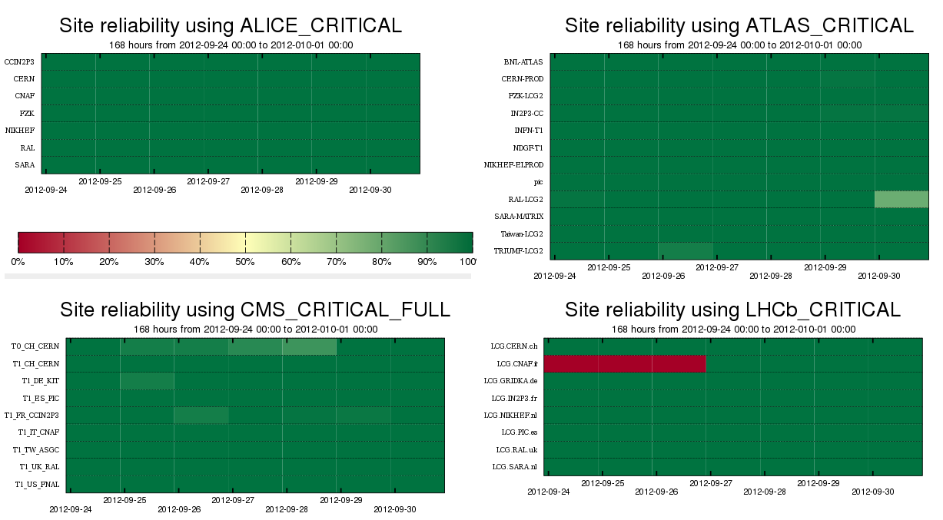
2.1
4.1

Slide 14
Analysis of the reliability plots : Week 24/09/2012
Alice : NTR
Atlas :
  2.1 RAL : SRM database problems, UNSCHEDULED WARNING, see GOCDB
CMS : NTR
LHCb :
  4.1 CNAF : SE incident, 2 consecutive UNSCHEDULED OUTAGES : GOCDB and GOCDB
UNSCHEDULED

Slide 15
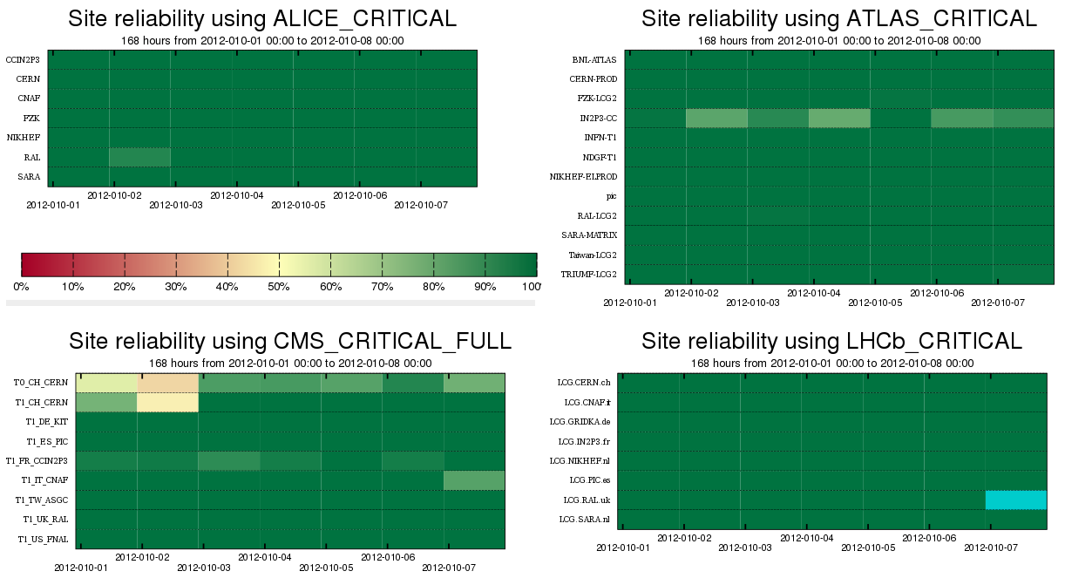
3.1
3.1
4.1

Slide 16
Analysis of the reliability plots : Week 01/10/2012
Alice : NTR
Atlas : NTR
CMS :
  3.1 CERN : CREAMCEs - failures of the org.cms.WN-swinst test, no downtime or GGUS ticket registered
LHCb :
  4.1 RAL : CREAMCEs - no test results from SAM framework, because there were no job slots at RAL. Could be related to the fact that currently LHCb is running very low number of jobs at RAL and don't have the possibility to run more as they were over pledge for the last days.
UNSCHEDULED

Slide 17
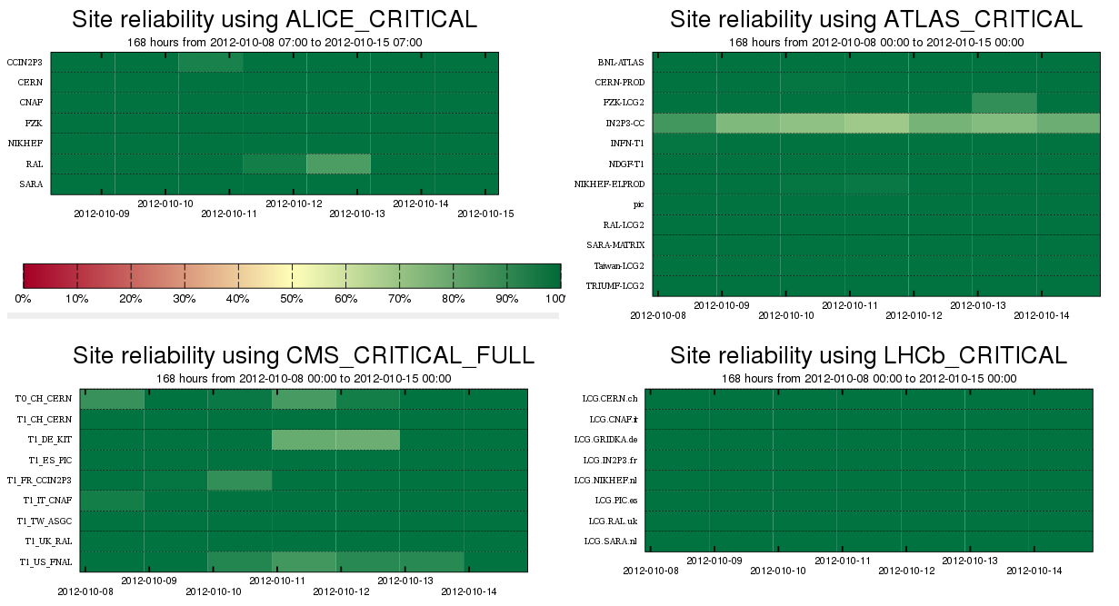
2.1
3.1

Slide 18
Analysis of the reliability plots : Week 08/10/2012
Alice : NTR
Atlas :
  2.1 IN2P3 : CREAMCE – intermittent failures throughout the whole week of the JobSubmit test. Transfer to CREAM failed due to authorization exception.
CMS :
  3.1 KIT : CREAMCE – few time outs of the JobSubmit test
LHCb : NTR
UNSCHEDULED

