Slide 1
Update on Plan for Tier-1 @ KISTI-GSDC
GSDC Tier-1 Team
Sang-Un Ahn, for the GSDC Tier-1 Team
sahn@kisti.re.kr
20/11/2012 WLCG MB

Slide 2
Outline
Current Status
  Resource Summary
  Operation status
  Network
Update on Plan
  Tape: installation & test
  Network upgrade
  Pledges
  SAM & APEL
  Staff
Conclusion

Slide 3
Current Status
Resource Summary
Operation
Network

Slide 4
Resource Summary
CPUs
  Intel Xeon, 24 cores w/ 96GB (3GB/core) x 62 WNs = 1488 cores (~17k HS06)
Disks
  1000 TB disks
Middleware components
  CREAM-CE, site-BDII, VOBOX, XROOTD, WNs, APEL
  Production in gLite3.2 -> EMI migration in progress: EMI-2 on SL6
Tape (being installed)
  1 PB capacity, 275 TB buffer, 2 GB/s throughput
Network
  Dedicated 1Gbps established
Storage Element Status @ MonALISA

Slide 5
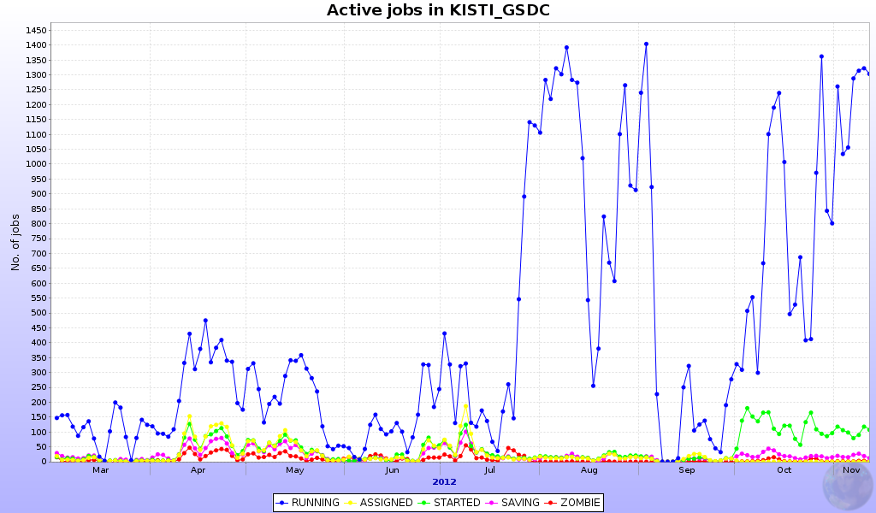
Operation
Job capacity more than 1400 jobs since the end of July
  Internal network issue solved
Quite stable now but instability on PBS requires its restarting in 48/72hrs
Hope to be improved after EMI-2 migration
Stable status
1,400
Active jobs
# of Jobs
Internal network issue solved
March – October in 2012

Slide 6
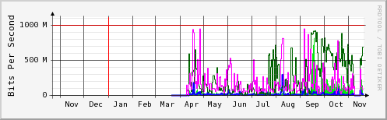
Network Traffic Status
GLORIAD-KR – CERN (dedicated 1Gbps)
  ‘Yearly’ graph (1 Day Average)
  Correlation with # of active jobs
Incoming Traffic in bps
Outgoing Traffic in bps
Dedicated 1Gbps established
Functional test
Maximal 5 minutes Incoming Traffic
Maximal 5 minutes Outgoing Traffic
Internal network issue solved
Start of torrent-based ALICE package distribution service:
Observed large incoming traffic (maximal 5 minutes) after

Slide 7
Update on Plan
TAPE: installation & test
Network upgrade
Pledges
SAM & APEL
Staff

Slide 8
TAPE
IBM TAPE library (TS3500)
TSM and GPFS on SL6.3 is being installed and functioning test will be complete in this week
Disk buffer for cache (allows prompt access to archived data)
  ALICE request: Min. 200 TB; max. 400 TB for pA
  275 TB is now assigned for buffer
Start of data transfer test with ALICE is foreseen by 3 Dec. 2012
Capacity (expendable) | Tape Drive | Throughput | Robotics | Support
1 PB (3PB) | 8 drives: R/W @ 250MB/s | 2 GB/s | Dual | 24/7 recovery for 3 years

Slide 9
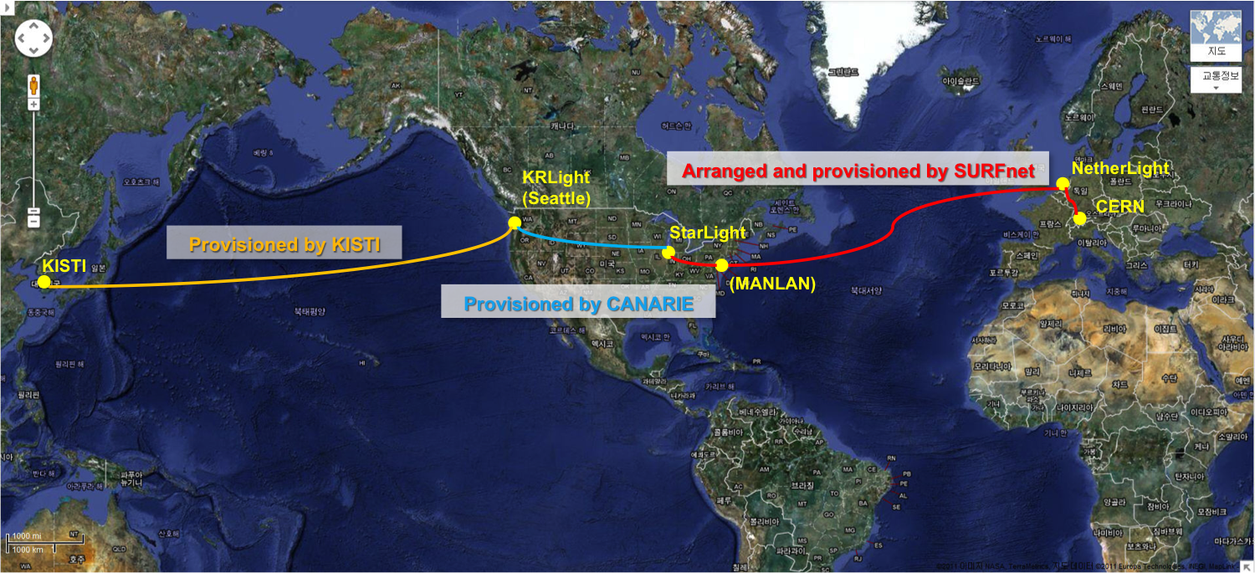
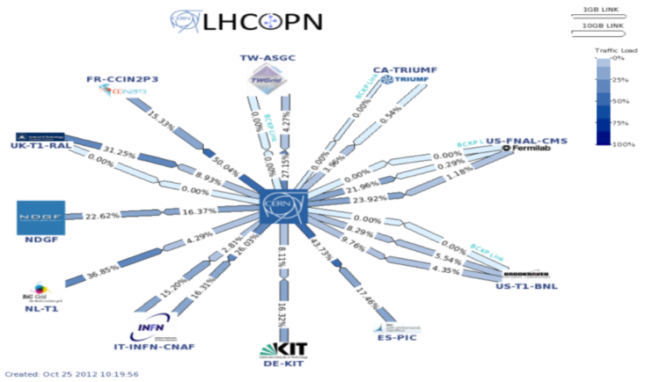
Network to LHCOPN
Currently, 1Gbps (dedicated) connection for CERN-KISTI
10Gbps connection is required to join LHC OPN (Optical Private Network)
In April 2013, dedicated 2Gbps will be established (budget secured)
Plan for upgrading 3Gbps will be presented by May 2013
Dedicated 1Gbps
Shared 10Gbps
Dedicated 1Gbps
Current Network Set-up

Slide 10
Pledged
Pledged resources
  Based on WLCG & ALICE Collaboration MoU
  Provides 2500 cores (~31k HS06) & 2PB for TAPE by 2014
  Meeting ALICE requirement by 2013
 | Current (ALICE Req.) | Pledged
 |  | 2012 | 2013 | 2014
CPUs (HS06) | 16,900 (25,000) | 18,800 | 25,000 | 31,250
Disk (TB) | 1,000 (1,000) | 1,000 | 1,000 | 1,000
Tape (TB) | - (1,500) | 700 | 1,500 | 2,000

Slide 11
SAM & APEL
Job queues available for OPS VO
  KISTI_GSDC included monthly SAM report for OPS VO
  Not monitored by ALICE VO
APEL server is running and properly publishing accounting data
  Recently found APEL was not correctly configured
  Fixed it and should be working now

Slide 12
Staff
ROLE |  | June (7 FTE) | Current (7 FTE)
System Admin | Disk & Server | 3 FTE | 2.5 FTE (2 FTE to be employed)
 | Tape | 1 FTE (to be employed) | 1 FTE
 | Grid Middleware | 1.5 FTE | 1.5 FTE
 | Network | 0.5 FTE + KISTI support | 0.5 FTE + KISTI support
 | Power/Cooling | KISTI support | KISTI support
Physics Analysis | ALICE service | 1 FTE (0.5 FTE to be employed) | 1.5 FTE
Good News
2 new member employed in June: 1 for TAPE; 1 for M/W and ALICE support
Bad News
1 member (Beob Kyun Kim) for M/W left in September and 1 member for S/A would leave soon

Slide 13
Summary
Milestones
T1 Demonstration Plan Roadmap

Slide 14
Milestones
Objective | Target date
 | Original | Revised
Nominate KISTI/GSDC representatives in the WLCG Management Board and the GDB | Jun. 2012 | -
Establishment of a 1Gbps connectivity to CERN | Apr. 2012 | -
Installation of tape system | Nov. 2012 | Dec. 2012
High speed transfer of data from CERN to KISTI at the speed required to receive and archive 10% of the ALICE AA raw data foreseen for 2012 over a continuous period of 2 weeks | Dec. 2012 | Jan. 2012
Provide a precise plan for 3Gbps (or higher) connectivity to CERN | Jan. 2013 | May 2013
Present a plan for providing on-call services/support according to the T1 specifications as laid out in the WLCG MoU | May 2013 | -
85% of the job capacity running for at least 2 months | Jan. 2013 | Feb. 2013
90% Storage Element (DPM and/or XROOTD ?) availability (functional tests) for at least 2 months | Jan. 2013 | Jul. 2013
Running of the reliability tests (both OPS and ALICE-specific) and publishing those to the new SAM infrastructure | Jan. 2013 | -
Integration with the APEL accounting system and publishing accounting data | Jan. 2013 | -
90% of the WLCG T1 service targets for at least 2 months | Feb. 2013 | Sep. 2013
Integration in the WLCG OPN (with 2Gbps) | Jan. 2013 | Jul. 2013
Functional tests of the OPN (with 2Gbps) | Feb. 2013 | Aug. 2013
■ Done
■ Almost done
■ To be done
■ In question
■ Urgent

Slide 15
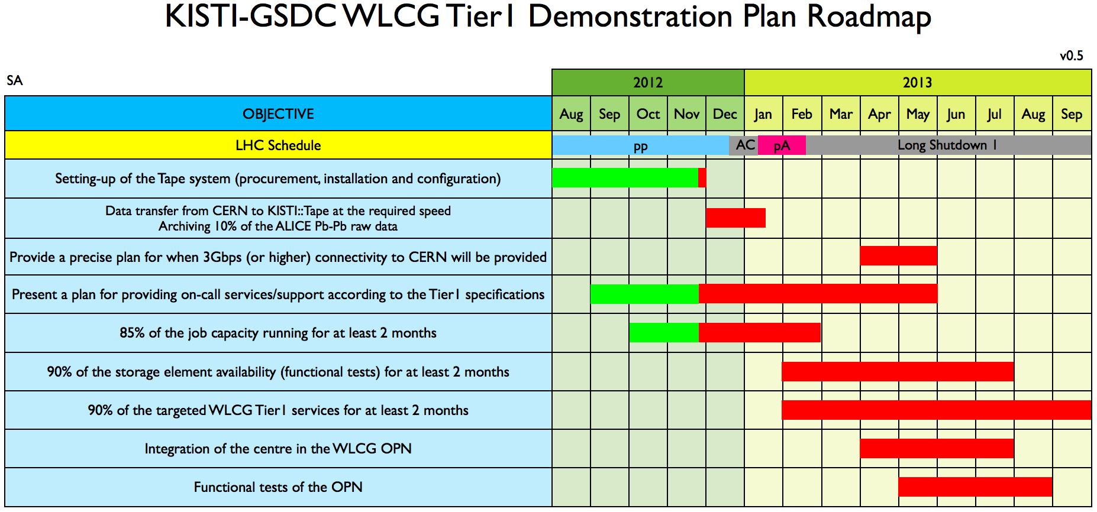
T1 Roadmap
TAPE library set-up and data transfer test: to be ready for pA
Plan for 3Gbps to be provided by May 2013
Internal discussion on 24hr on-call service: monitoring, shift, and documentations …
>85% job capacity can be accomplished
Demonstration of Tier-1 target services (>90%) at least 2 months

Slide 16
Thank you

