Slide 1
Successful Common Projects: Structures and Processes
WLCG Management Board
20th November 2012
Maria Girone, CERN IT

Slide 2
Historical Perspective
The original LCG-EIS model was primarily experiment-specific with the team having a key responsibility within one experiment
  Examples of cross-experiment work existed but they were not the main thrust
From the beginning of EGI-InSPIRE (SA3.3 - Services for HEP), a major transition has taken place: focus on common solutions, shared expertise
  A strong and enthusiastic team
This has led to a number of notable successes, covered later

Slide 3
The process
Identify areas of interest between grid services and the experiment communities which would benefit by
  Common tools and services
  Common procedures
Facilitate their integration in the experiments workflows
Save resources by having a central team with knowledge of both IT and experiments
Key element: regular discussions with computing management; agreement on priorities; review achievements with plans

Slide 4
Structure of a Common Solution
Experiment Specific Elements
Interface layer between common infrastructure elements and the truly experiment specific components
  Higher layer: experiment environments
  Box in between: common solutions
    A lot of effort is spent in these layers
    Significant potential savings of effort in commonality
      not necessarily implementation, but approach & architecture
  Lower layer: common grid interfaces and site service interfaces
IT/ES
Higher Level Services that translate between
Common Infrastructure Components and Interfaces

Slide 5
Data and Workload Management
Service | Description
Data Popularity & Site Cleaning | Within the experiment analysis frameworks, allow to decide when the number of replicas of a sample needs to be adjusted - either up or down - and to suggest obsolete data that can be safely deleted. (ATLAS, CMS and LHCb) (recent campaign in CMS: freed 2PB – 20% total managed space)
xrootd Data Popularity | Complements the above also for direct data access (outside analysis frameworks). Deployed so far to monitor the usage of EOS for ATLAS and CMS. Can be extended to other Vos and to the rest of the storage federations.
Common Analysis Framework | Proof of Concept of a common analysis submission system based on PanDA, for ATLAS and CMS also integrated with GlideinWMS components.

Slide 6
Site Commissioning and Availability
Service | Description
SAM tests | Allows experiments to calculate the site availability based on experiments tests (all 4 VOs)
HammerCloud | Allows sites to stress test and monitor their status and readiness with realistic workflows. Used to validate the effectiveness of changes. (ATLAS, CMS and LHCb). Being adapted to Cloud infrastructure testing.
Agile Infrastructure testing | Testing infrastructure leveraging experiments’ workload management frameworks. Common procedures and image configuration for ATLAS and CMS. Being used also by HLT.
Dashboards | Allows experiments and sites to monitor and track production and analysis activities across the grid.

Slide 7
Summary
  Integration of services using common pools of expertise allows optimization of resources on both sides
    Infrastructure and grid services (FTS, CE, SE, VMs, Clouds, etc)
    Workflow and higher level services (PANDA, Dynamic Data Placement, Site Commissioning and Availability, etc)
  Common solutions result in fewer services, better integration testing, and more stable and consistent operations
    LHC schedule presents a good opportunity for technology changes during LS1
Key process: regular discussions with computing management; agreement on priorities; review achievements with plans
Key benefit: successfully deployed common solutions have immediately saved integration effort, and will save in operations effort

Slide 8
Examples of common projects

Slide 9
Data Popularity & Cleaning
Experiment Booking Systems Mapping Files to Datasets
Experiments want to know which datasets are used, how much, and by whom
  First Idea and implementation by ATLAS, followed by CMS and LHCb
Data popularity uses the fact that all experiments open files and access storage
The monitoring information can be accessed in a common way using generic and common plug-ins
The experiments have systems that identify how those files are mapped onto logical objects like datasets, reprocessing and simulation campaigns
Files accessed, users and CPU used
File Opens and Reads

Slide 10
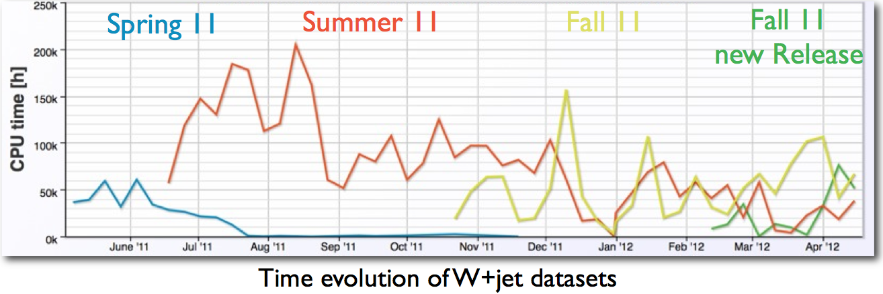
Popularity Service
Used by the experiments to assess the importance of computing processing work
  to decide when the number of replicas of a sample needs to be adjusted - either up or down
  to suggest obsolete data that can be safely deleted without affecting analysis.

Slide 11
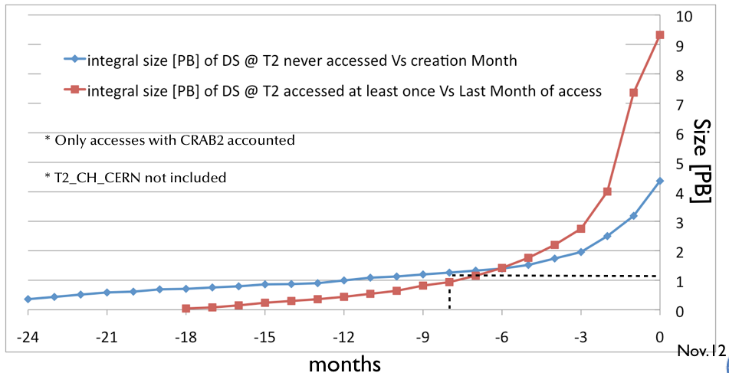
Site Cleaning Service
The Site Cleaning Agent is used to suggest obsolete or unused data that can be safely deleted without affecting analysis.
The information about space usage is taken from the experiment dedicated data management and transfer system
High savings in terms of storage resources: 2PB (20% of total managed space)

Slide 12
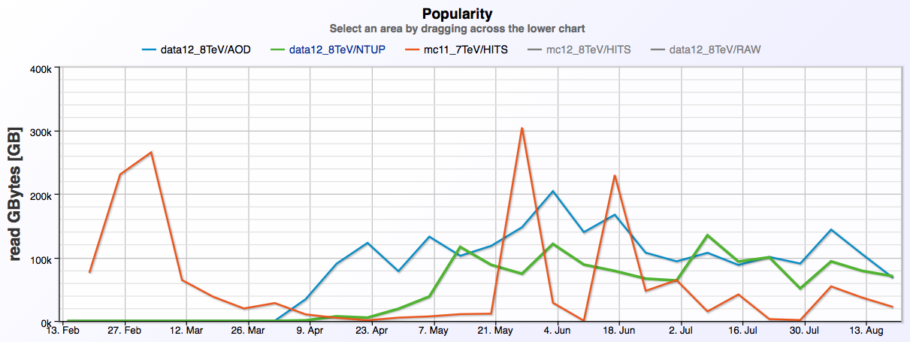
EOS Data Popularity
Allows the experiments to verify that EOS and CPU resources at CERN are used as planned
First deployed use-case: monitor the file usage of Xrootd-based EOS DataSvc @ CERN for ATLAS and CMS
To be extended to the rest of the ATLAS and CMS storage federation
    assess data popularity also for batch/interactive job submissions
    help in managing the user space on a site:
Weekly amount of read data for the ATLAS most popular Projects/Data Type accessed from EOS from Feb. to Aug.

Slide 13
HammerCloud
Distributed analysis Frameworks
HammerCloud is a common testing framework for ATLAS (PanDA), then exported to CMS (CRAB) and LHCb (Dirac)
Common layer (built on Ganga) for functional testing of CEs and SEs from a user perspective
Continuous testing and monitoring of site status and readiness. Automatic Site exclusion based on defined experiment policies
Same development, same interface, same infrastructure → less workforce to maintain it
Testing and Monitoring Framework
Computing & Storage Elements

Slide 14
HammerCloud
Allows sites to make reconfigurations and then test the site with realistic workflows to evaluate the effectiveness of the change
Sufficient granularity in reporting that it can identify which of the site services has gone bad
Adapting it as cloud infrastructure testing and validation tool
  CERN IT Agile Infrastructure testbed, HLT farms

Slide 15
Common Analysis Framework
As of spring IT-ES proposed to look at commonality in the analysis submission systems
  Using PanDA as the common workflow engine
  Investigating elements of GlideinWMS for the pilot
  90% of the code CMS used to submit to the experiment specific workflow engine could be reused submitting to PanDA
Feasibility study presented at CHEP
  Program of work for a Proof-of-Concept (PoC)
Having people familiar in both systems working together was critical
  PoC prototype (due by end 2012) is ahead of schedule
  Dedicated Workshop in December 2012 @FNAL

Slide 16
Dedicated Resources to PoC
IT-ES has invested resources with expertise on both experiments workflows
  2 FTE (CMS) + 1 FTE (ATLAS)
ATLAS: very constructive interaction with PanDA developers (pilot, factory, server and monitoring) for the work on system modularity
CMS: user data handling and GlideinWMS expertise

Slide 17
Analysis Framework Diagram
Client side
Server side
Grid resources
Data Mgmt Services
Job trans
Job trans
(Optional) Client Service
Data Adaptor
PanDA pilot
PanDA pilot
PanDA
Server
…
VO-specific client
glexec
Computing Element
PanDA
Pilot Factories
PanDA monitor and Dashboard Historical views
glideIns
GlideIn
WMS
PanDA components
VO specific, external components
glexec
GlideInWMS components

Slide 18
Status
PanDA services have been integrated in the CMS specific analysis computing framework
  Jobs submitted through CMS specific interface (CRAB3) on a dedicated testbed (4 sites)
  User data transfers managed by CMS specific tools (Asynchronous Stage Out)
GlideInWMS for CMS workflow still to be included
  Will profit of ATLAS experience: “Feasibility of integration of GlideinWMS and PanDA”
Also now working on direct gLExec-PanDA integration

Slide 19
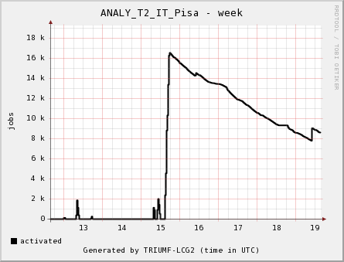
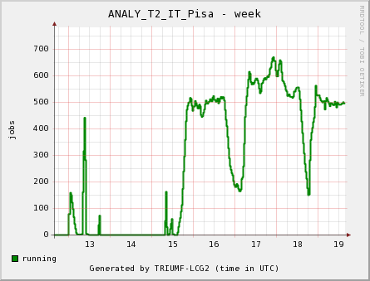
First Results
Prototype phase completed
  Functionality validation, following CMS requirements, in a multi-user environment
Full integration in the CMS workflow during LS1

Slide 20
Agile Infrastructure Testing
CernVM FS
CERN AI Openstack
Software
Experiment workload management framework (ATLAS PanDA,
CMS glidein)
Condor head
jobs
Workers
Head node
Input and output data
CERN EOS Storage Element
CernVM
ganglia
condor
cvmfs
CernVM
ganglia
httpd
condor
cvmfs
Boot up a batch cluster in the CERN Openstack infrastructure
Integrate it with the experiments’ workload management framerworks
Run experiment workload on the cluster
Share procedures and image configuration between ATLAS and CMS

Slide 21
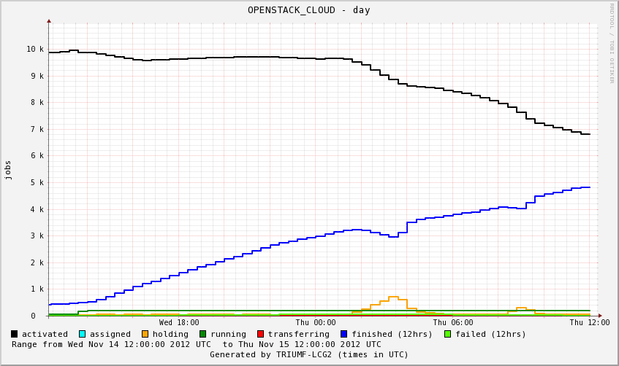
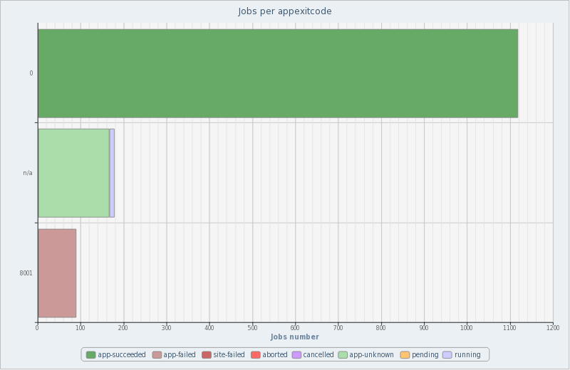
First Results
24 hours 14-15 Nov
Finished: 8630
Failed: 57
7-15 Nov
Finished: 1118
Failed: 89
Nov 15
http://gridinfo.triumf.ca/panglia/sites/day.php?SITE=OPENSTACK_CLOUD&SIZE=large
http://cern.ch/go/GfJ9
Currently ramping up size of clusters
Running HammerCloud and test jobs
Next steps:
  Operate standard production queue on the cloud
  Analyze HammerCloud metrics, compare with production queues and provide feedback

