Slide 1
Review of the experiment critical services
Maria Girone / CERN
MB meeting, 20th November 2012

Slide 2
Impact and Urgency
For each WLCG service, each experiment defines:
  The Impact on operations and people of a complete service failure
    ⇒ the amount of “damage” done if no action is taken
  The time before the full impact is reached
    ⇒ how “urgent” it is to fix the service to prevent such damage from happening
  We will call it “Urgency”
Example: Px → Computer Centre network cut has a very high impact but low urgency as the experiments have buffers

Slide 3
Services
“Functional” service
  A high level service corresponding to a particular function of the computing system
    Example: data export from Tier-0 to Tier-1’s
    Defined in the WLCG MoU, Annex 3
  directly part of LHC computing operations
  also included tools, desktop services and services for application development
“Specific” service
  A service contributing to one or more functional services
    Example: FTS

Slide 4
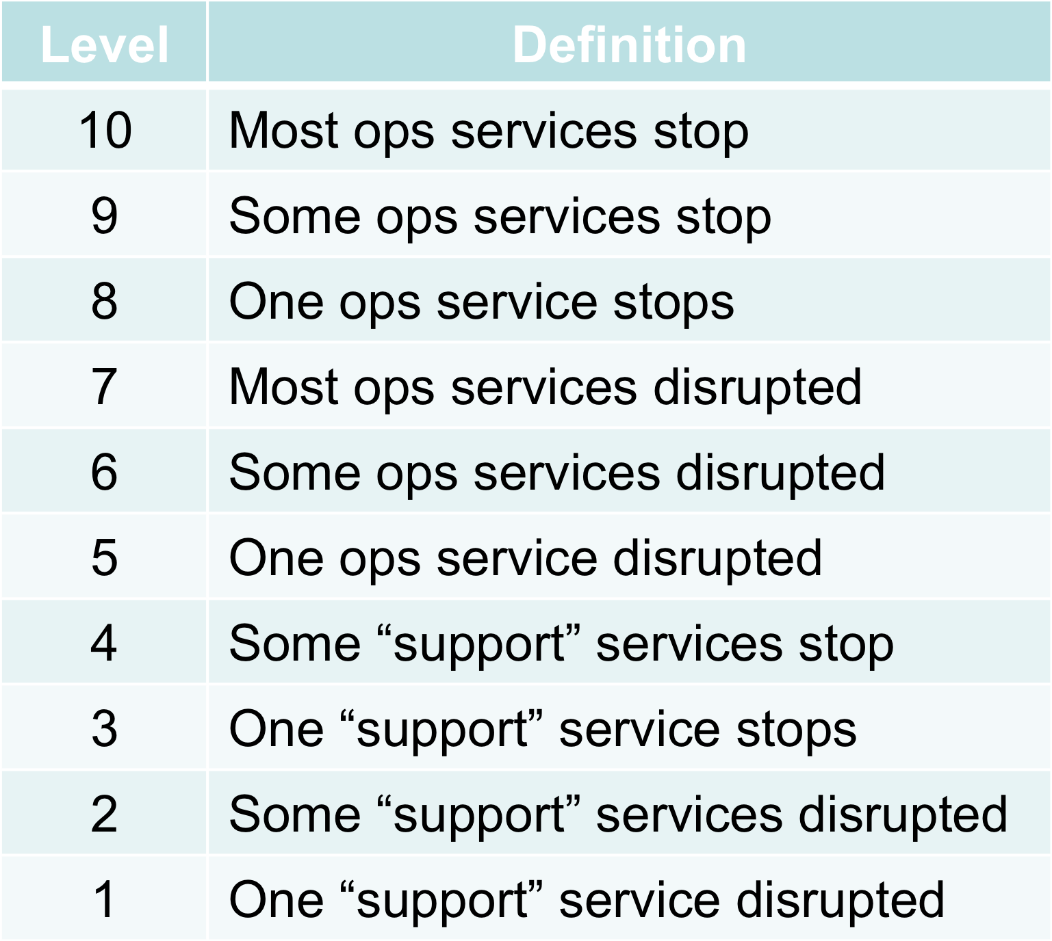
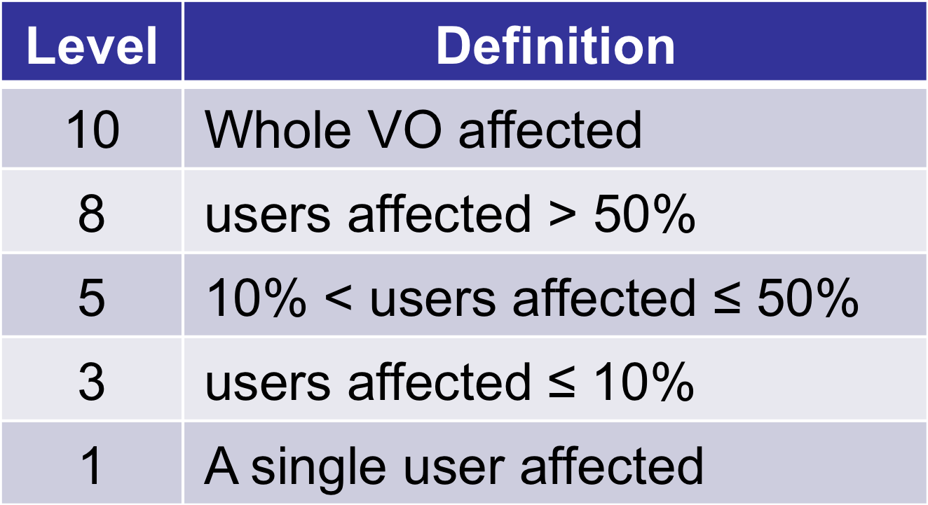
Impact on operations and people
Scale used for Impact

Slide 5
Urgency
Time after the incident when the “full” impact is reached
  Typically correlated to the experiment buffers, i.e. short service interruptions are normally not a problem
Not to be confused with “response time”
Level | Time (hours)
10 | 0
9 | 0.5
8 | 1
7 | 2
6 | 4
5 | 6
4 | 12
3 | 24
2 | 48
1 | 72
Scale used for Urgency

Slide 6
Services with urgency or impact differences larger than 3
Service | ALICE |  | ATLAS |  | CMS |  | LHCb
 | Urgency | Impact | Urgency | Impact | Urgency | Impact | Urgency | Impact
Px→CC | 6 | 10 | 4 | 10 | 3 | 10 | 2 | 10
ORAOFF | 6 | 7 | 8 | 8 | 5 | 10 | 3 | 10
Tape | 4 | 10 | 7 | 8 | 2 | 8 | 2 | 8
CE | 3 | 10 | 6 | 8 | 3 | 3 | 5 | 6
VOMS | 3 | 10 | 4 | 10 | 4 | 10 | 7 | 10
MyProxy | 3 | 10 | 3 | 3 | 4 | 9 | 4 | 10
Dashboard | 1 | 3 | 5 | 8 | 3 | 4 | 1 | 1
VOBOXes | 3 | 10 | 9 | 10 | 8 | 10 | 9 | 10
CAF | 6 | 10 | 8 | 9 | 3 | 8 | 1 | 1
Twiki | 3 | 3 | 7 | 9 | 6 | 6 | 6 | 6
Savannah | 3 | 3 | 4 | 8 | 3 | 5 | 3 | 6
BDII |  |  | 3 | 8 | 3 | 5 | 3 | 1

Slide 7
Tentative explanations
(TBFI=Time before full impact )
px->CC: TBFI ranges from 4h (ALICE) to 48h (LHCb): large differences in buffer sizes?
ORAOFF: TBFI from 1h (ATLAS) to 24h (LHCb)
Tape: TBFI from 2h (ATLAS) to 48h (CMS, LHCb)
CE: Impact ranges from 3 (CMS) to 10 (ALICE) due to differences in the computing systems (CMS uses the CERN CEs for testing and analysis)
VOMS: TBFI ranges from 2h (LHCb) to 24h (ALICE) (impact on interactive work)
MyProxy: impact is very low (3) for ATLAS (not used), very high(9-10) for the rest
Dashboard: impact ranges from null (LHCb) to 8 (ATLAS), depending on how much the experiment relies on it. Coherently, the TBFI ranges from > 72h (ALICE,LHCb) to 6h (ATLAS)
VOBOXes: TBFI ranges from 30' (ATLAS, LHCb) to 24h (ALICE)
CAF: impact ranges from null (LHCb) to 10 (ALICE). TBFI from 1h (ATLAS) to >72h (LHCb) (some run calibration and alignment first pass)
Twiki: impact ranges from 3 (ALICE) to 9 (ATLAS), presumably depending on how much critical documentation is on twiki. TBFI ranges from 2h (ATLAS) to 24h (ALICE)
Savannah: impact ranges from 3 (ALICE) to 8 (ATLAS)
BDII: impact ranges from null (ALICE) to 8 (ATLAS)

Slide 8
Alarms and Critical Services
  Having Introduced the two terms “urgency” and “impact” helps both
    service managers to evaluate how to treat services
    experiments in stating the importance of a service (impact) without mixing up with urgency
  As of today, the drill-down of alarms, performed systematically by ops team/service managers, presented at the MB shows NO misuse of ALARMS
      Issued alarms are justified
      They are solved professionally by the service support teams
  Issuing alarms either for very high urgency or very high impact can be justified, but this has to be dealt with common sense
    the established workflow of GGUS ALARMs is the way to go

Slide 9
          Detailed
Experiments Critical Services Tables

Slide 10
ALICE
Service | Urgency | Impact
Px → Computer Centre network | 6 | 10
WLCG network (LHCOPN, GPN) | 8 | 10
CERN Oracle online | 10 | 10
CERN Oracle Tier-0 (including streaming) | 6 | 7
Frontier front-end and Squid | - | -
CASTOR tape | 4 | 10
CASTOR disk | 5 | 10
EOS | 5 | 10
Batch service | 3 | 10
CE | 3 | 10
LFC | - | -
FTS | - | -
VOM(R)S | 3 | 10
BDII | - | -
Service | Urgency | Impact
Myproxy | 3 | 10
gLite WMS | - | -
CVMFS Stratum0 | - | -
CVMFS Stratum1 | - | -
Dashboard | 1 | 3
SAM | 3 | 3
VOBOXes | 3 | 10
AFS | - | -
CAF | 6 | 10
CVS/SVN | - | -
Twiki | 3 | 3
Mail and Web services | 6 | 10
Hypernews | - | -
Indico | 3 | 3
Savannah/JIRA/TRAC | 3 | 3
Service | Urgency | Impact
SSO | 7 | 10
DNS | 7 | 10
NICE AD servers | 6 | 10

Slide 11
ALICE distribution

Slide 12
ATLAS
Service | Urgency | Impact
Px → Computer Centre network | 4 | 10
WLCG network (LHCOPN, GPN) | 7 | 8
CERN Oracle online | 9 | 10
CERN Oracle Tier-0 (including streaming) | 8 | 8
Frontier front-end and Squid | 6 | 8
CASTOR tape | 7 | 8
CASTOR disk | 8 | 9
EOS | 6 | 8
Batch service | 6 | 8
CE | 6 | 8
LFC | 9 | 10
FTS | 7 | 8
VOM(R)S | 4 | 10
BDII | 3 | 8
Service | Urgency | Impact
Myproxy | 3 | 3
gLite WMS | 3 | 3
CVMFS Stratum0 | 4 | 9
CVMFS Stratum1 | 3 | 5
Dashboard | 5 | 8
SAM | 3 | 3
VOBOXes | 9 | 10
AFS | 5 | 9
CAF | 8 | 9
CVS/SVN | 4 | 8
Twiki | 7 | 9
Mail and Web services | 8 | 10
Hypernews | na | na
Indico | 3 | 8
Savannah/JIRA/TRAC | 4 | 8

Slide 13
ATLAS distribution

Slide 14
CMS
Service | Criticality | Impact
Px → Computer Centre network | 3 | 10
WLCG network (LHCOPN, GPN) | 7 | 9
CERN Oracle online | 10 | 10
CERN Oracle Tier-0 (including streaming) | 6 | 10
Frontier front-end and Squid | 6 | 10
CASTOR tape | 2 | 8
CASTOR disk | 6 | 8
EOS | 6 | 8
Batch service | 5 | 9
CE | 3 | 3
LFC | NA | NA
FTS | 4 | 8
VOM(R)S | 4 | 10
BDII | 3 | 5
Service | Urgency | Impact
Myproxy | 4 | 9
gLite WMS | 3 | 5
CVMFS Stratum0 | 4 | 6
CVMFS Stratum1 | 4 | 6
Dashboards | 3 | 5
SAM | 5 | 3
VOBOXes | 8 | 8
AFS | 6 | 9
CAF | 3 | 8
CVS/SVN | 6 | 6
Twiki | 6 | 6
Mail and Web services | 5 | 10
Hypernews | 4 | 5
Indico | 3 | 5
Savannah/JIRA/TRAC/eLog | 3 | 5

Slide 15
CMS distribution

Slide 16
LHCb
Service | Criticality | Impact
Px → Computer Centre network | 2 | 10
WLCG network (LHCOPN, GPN) | 7 | 10
CERN Oracle online | 10 | 10
CERN Oracle Tier-0 (including streaming) | 3 | 10
Frontier front-end and Squid | NA | NA
CASTOR tape | 2 | 8
CASTOR disk | 6 | 8
EOS | NA | NA
Batch service | 5 | 6
CE | 5 | 6
LFC | 9 | 10
FTS | 5 | 9
VOM(R)S | 7 (was 8) | 10
BDII | 3 | 1
Service | Criticality | Impact
Myproxy | 4 | 10
gLite WMS | 4 | 6
CVMFS Stratum0 | 6 | 6
CVMFS Stratum1 | 1 | 5
Dashboard | 1 | 1
SAM | 4 | 2
VOBOXes | 9 | 10
AFS | 8 | 10
CAF | 1 | 1
CVS/SVN | 6 | 6
Twiki | 6 | 6
Mail and Web services | 8 ( was 9) | 10
Hypernews | NA | NA
Indico | 8 | 9
Savannah/JIRA/TRAC | 3 | 6

Slide 17
LHCb distribution

Slide 18
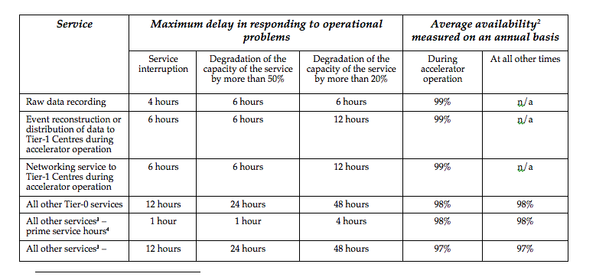
  MoU Annex 3
Assuming 200d LHC operations
Annual Downtime
14h
14h
14h
28h
28h
42h
Written before operations began
Response time referred to the maximum delay before action is taken
Mean time to repair covered indirectly through the availability targets

