Slide 1
RRB Summary
Link to RRB agenda – see report & slides from C-RSG
2013 +2104 requests – report from C-RSG
  Small changes by RSG vs experiment requirements (~5%)
  Requests approved
REBUS: 2013 now reflects these approved requests
  Pledges within about 10% of requirements, except for ALICE (shortfalls up to ~30%), LHCb at T1 (~20%)

Slide 2
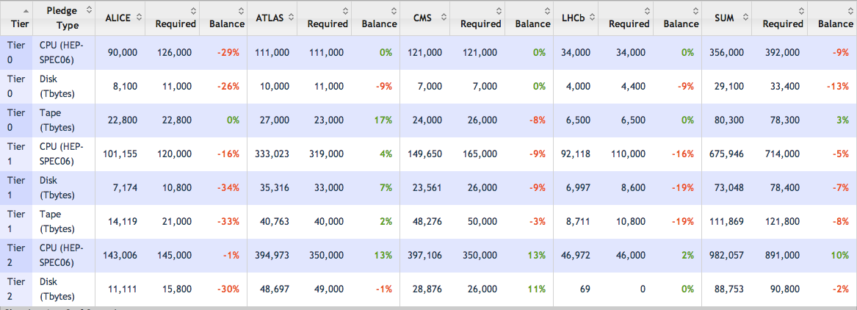
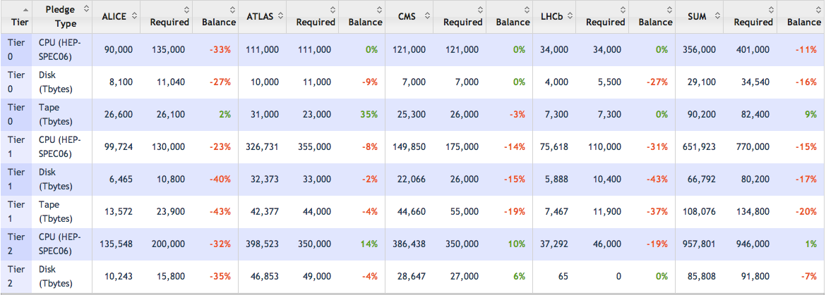

Slide 3
RRB Summary – 2
2015: presented indications of likely needs
  Me: according to what was agreed in OB, but RSG was explicit about possible trigger rates
The key message:
  the funding agencies must ensure that computing (continues to be) fully funded at an appropriate level, and
  that the computing should not be the limiting factor in the future exploitation of the LHC and experiments;
  also stated that the expectation of immediate analysis of data should be relaxed in the future.
Some comments by funding agencies on the need for prioritisation of computing tasks
  experiments clarified the physics needs underlying the likely requests for significant trigger rate increases in 2015

