Slide 1
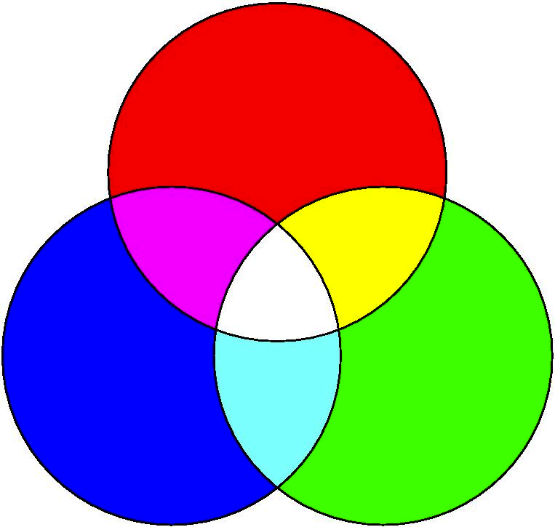


Universality of TMD distribution functions
Maarten Buffing, Asmita Mukherjee & Piet Mulders
DIS 2013, Marseille
April 24, 2013
m.g.a.buffing@vu.nl asmita@phy.iitb.ac.in mulders@few.vu.nl

Slide 2
Content
Overview of TMD correlators
Transverse momentum weightings
  Formalism
  Results for gluons
  Example
Summary and conclusions

Slide 3
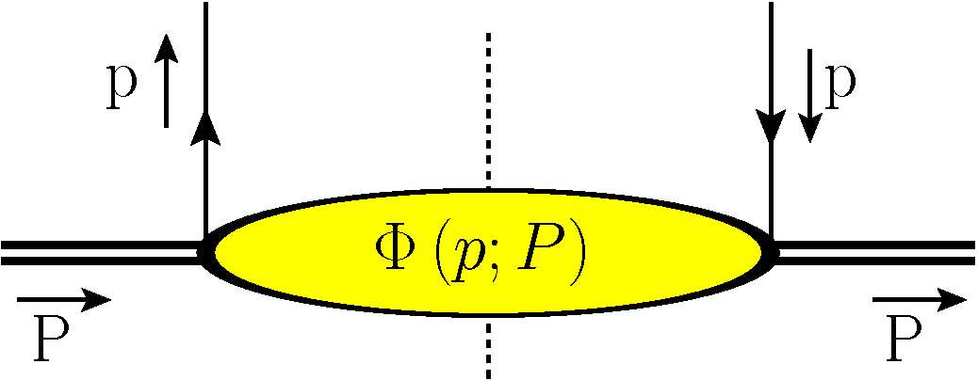
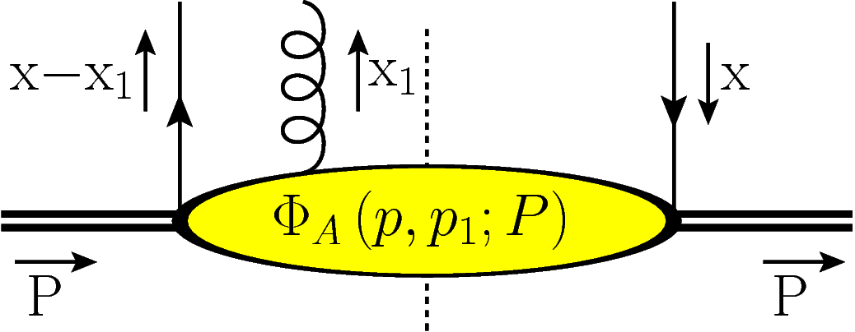
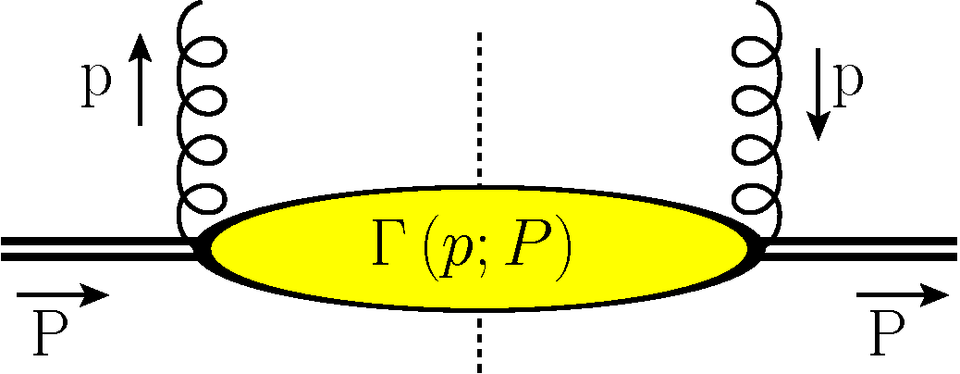
Correlators
Quark correlators can be written as matrix elements
Similarly, the gluon correlator can be
written as a matrix element.

Slide 4
Correlators and TMDs
The gluon TMD correlator can be parametrized as
In which
The parametrization contains three types of contributions
Mulders, Tangerman, Boer
Bacchetta, Diehl, Goeke, Metz, Mulders, Schlegel, JHEP 0702 (2007) 093

Slide 5
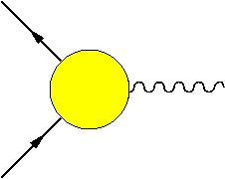
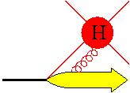
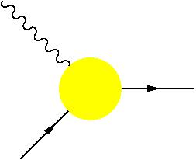
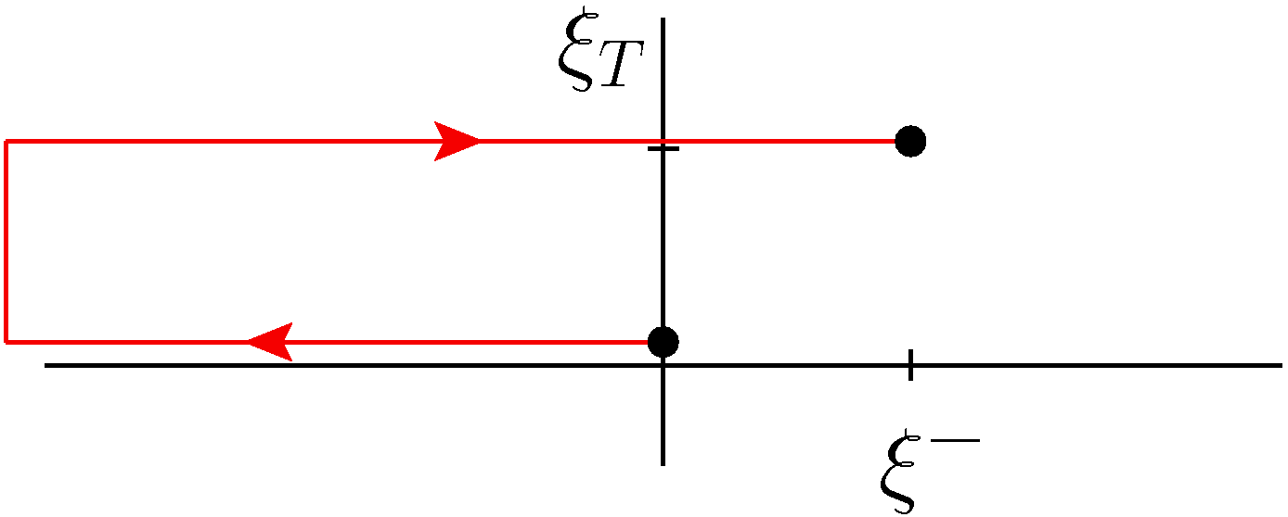
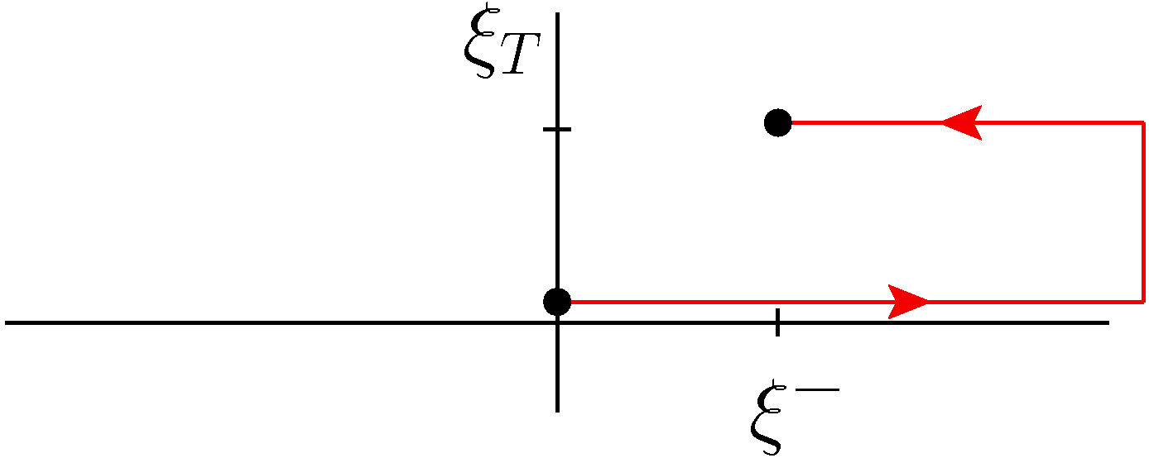
Gauge invariance for quark TMDs
Gauge links are required to make the nonlocal combinations of fields gauge invariant
Introduces a path dependence for correlators
FSI
ISI
Time-reversal couple
A.V. Belitsky, X. Ji, F. Yuan, NP B 656, (2003) 165
D. Boer, P.J. Mulders & F. Pijlman, NP B 667 (2003) 2012

Slide 6
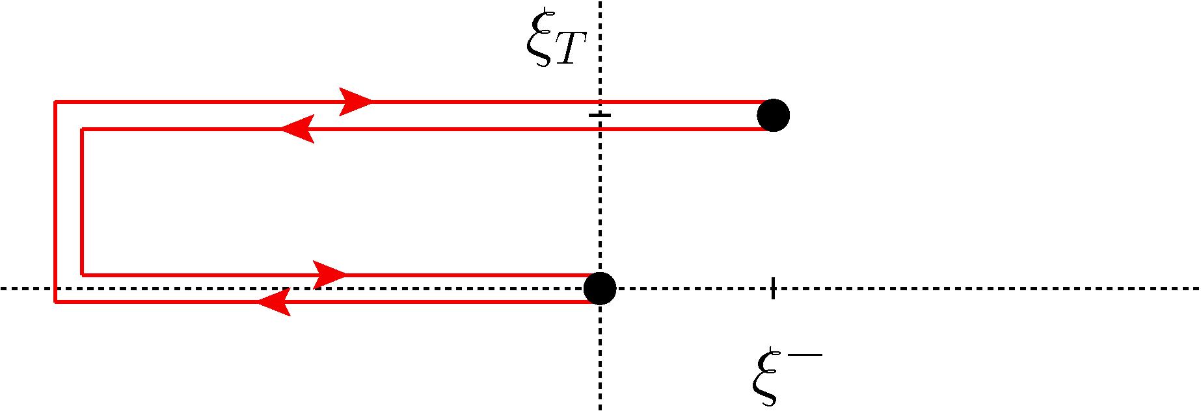
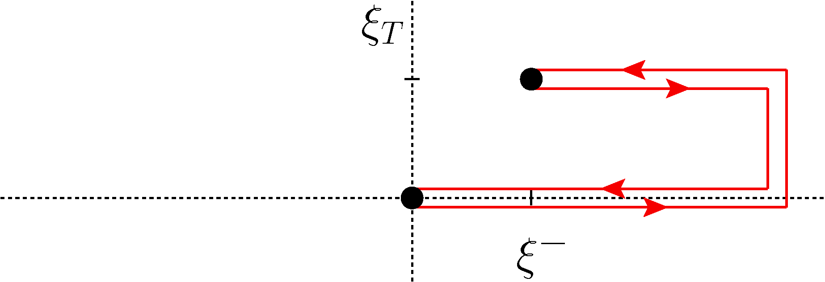
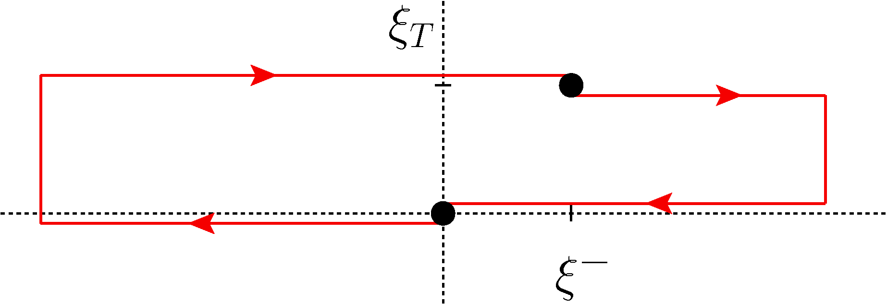
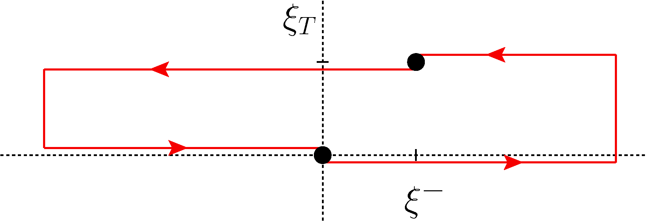
Gauge invariance for gluon TMDs
For gluons more gauge link structures exist.
More complicated structures arise for complicated processes

Slide 7
Mellin moments
Collinear functions
Moments correspond to local matrix elements with calculable anomalous dimensions, that can be Mellin transformed to splitting functions
All operators have same twist since dim(D^{n}) = 0

Slide 8
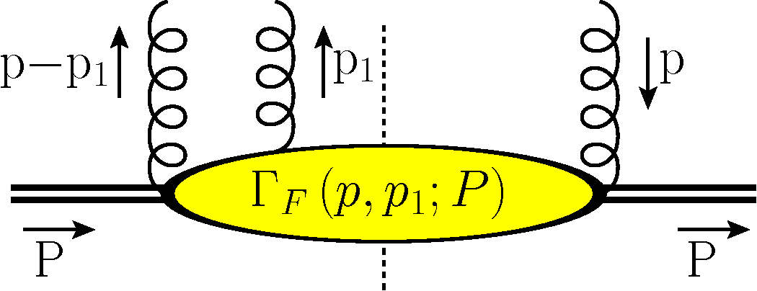
Transverse moments
Transverse moments are considered for transverse weightings
Due to transverse directions, partonic operators show up. For the simplest gauge links one finds
Bomhof, PJM, 2007; Dominguez, Xiao, Yuan (2011); MGAB, A Mukherjee, PJM, in preparation

Slide 9
Color structures
This gives the operator combinations
Bomhof, PJM, 2007; Dominguez, Xiao, Yuan (2011); MGAB, A Mukherjee, PJM, in preparation

Slide 10
Classifying the nonuniversality
All contributing matrix elements can be classified according to their rank and behavior under time reversal symmetry
Behavior of TMDs under time reversal symmetry and rank can be used to identify their corresponding matrix element
E.g.
T-even
T-odd (gluonic pole or ETQS m.e.)
T-odd & rank 1
T-even & rank 2
Efremov & Teryaev 1982; Qiu and Sterman 1991
Boer, Mulders & Pijlman, NP B667 (2003) 201;
Bomhof, Mulders and Pijlman, EPJ C 47 (2006) 147

Slide 11
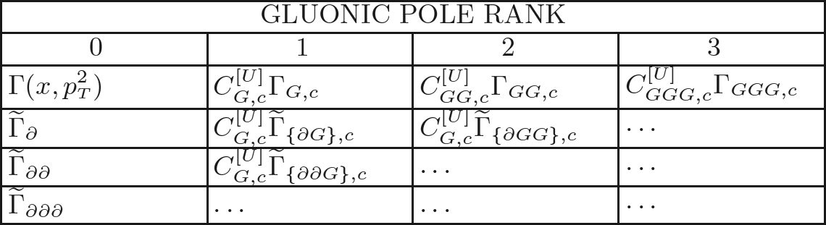
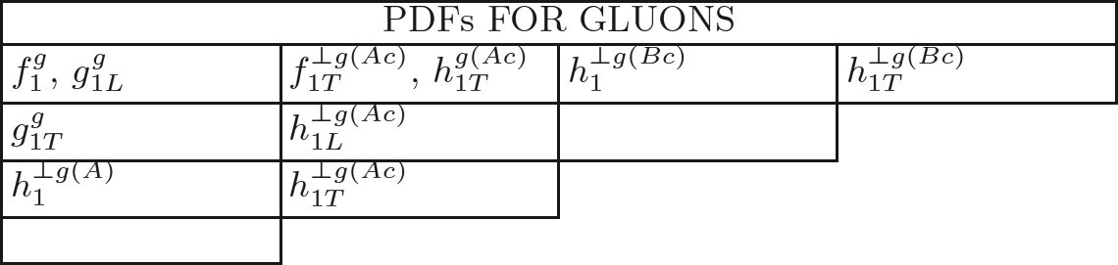
Ranking the contributions
All contributing matrix elements can be classified according to their rank
The identification with the gluon PDFs yields
MGAB, Mukherjee, PJM, PR D86 (2012) 074030; MGAB, Mukherjee, PJM, in preparation

Slide 12
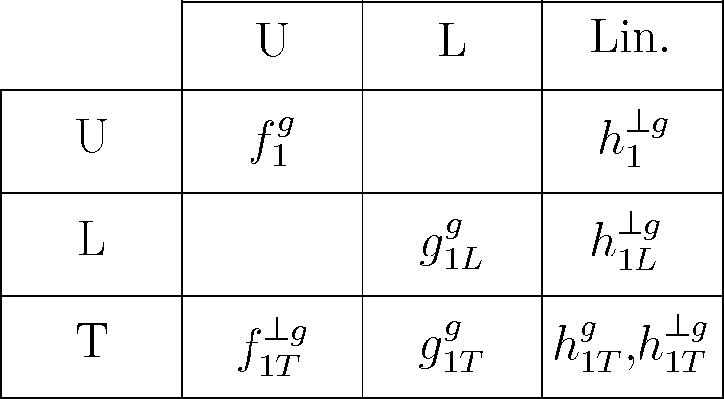
TMD correlators for gluons
Gluon TMD correlator can be expanded as
Depending on polarizations, multiple contributing PDFs
gluon polarization
T-odd
nucleon pol.

Slide 13
TMD correlators for gluons
Gluon TMD correlator can be expanded as
Depending on polarizations, multiple contributing PDFs
gluon polarization
Process dependent
h₁^{⊥g} is T-even and process-dependent
nucleon pol.

Slide 14
Color contributions
Depending on the process, TMDs contain multiple contributions
gluon polarization
nucleon pol.
Bomhof, Mulders, 2007
MGAB, A Mukherjee, PJM, in preparation

Slide 15
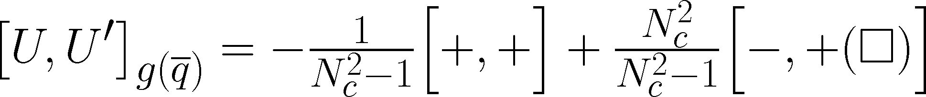
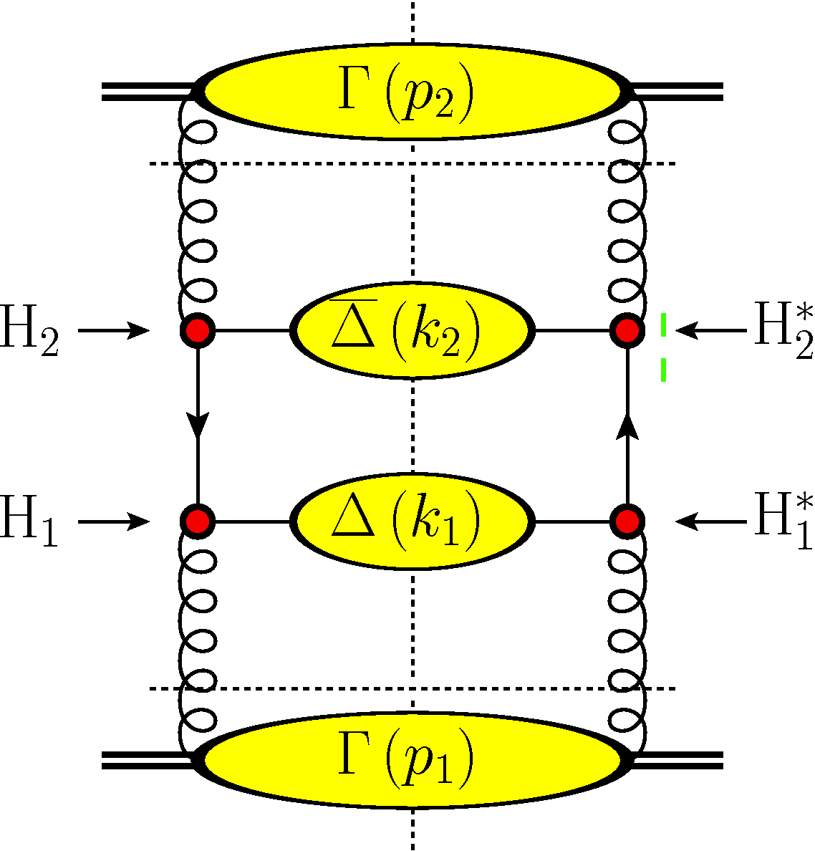
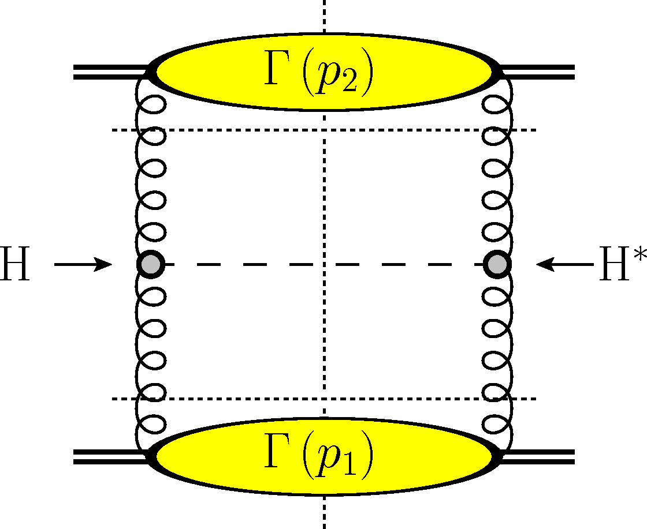
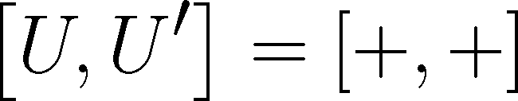
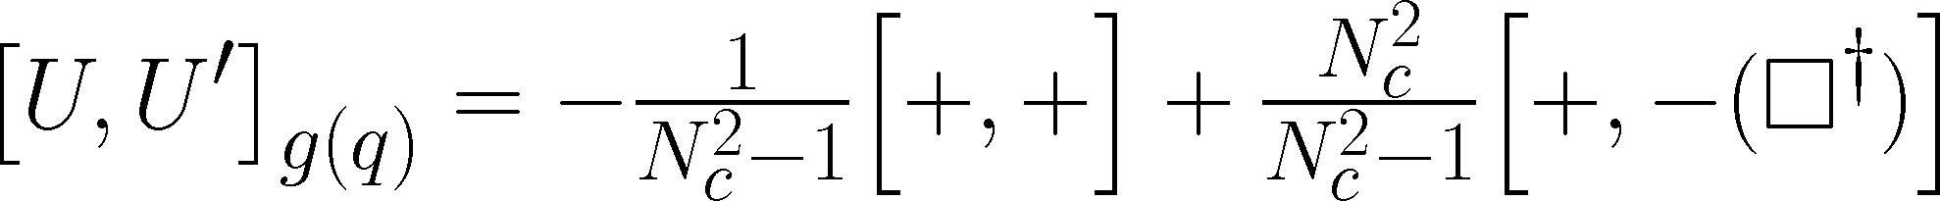
Processes: example for h₁^{⊥g}
gg → H and a specific gg → process have different gauge link structures and different contributions to PDFs
Gauge link contributions:
TMD contributions
MGAB, A Mukherjee, PJM, in preparation

Slide 16

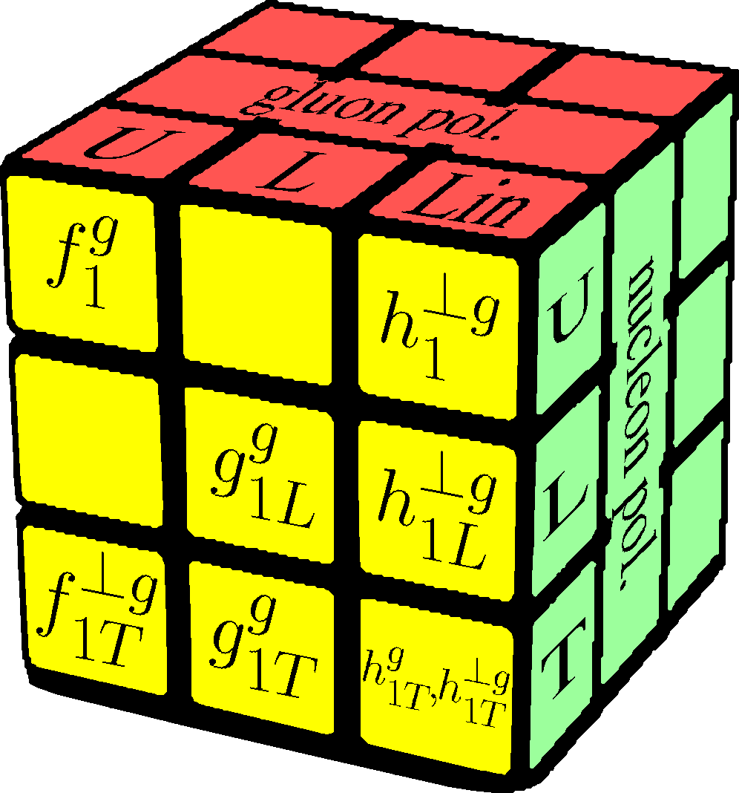
Summary and conclusion
Transverse weightings involve multiple matrix elements.
Separation in T-even and T-odd parts is no longer enough to isolate the process-dependence part.
TMD PDFs can be written down as combinations of universal functions.
There are multiple universal functions for h₁^{⊥g}, h_{1L}^{⊥g}, f_{1T}^{⊥g}, h_{1T}^{g} and h_{1T}^{⊥g}.
Further reading:
Phys.Rev. D86, 074030 (MGAB, Mukherjee, Mulders), 1207.3221 [hep-ph]
Results for gluons: forthcoming

Slide 17
Spare slides

Slide 18
Transverse moments Quarks
For TMD functions one can consider transverse moments
Transverse moments involve collinear twist-3 multi-parton correlators F_{D} and F_{F} built from non-local combination of three parton fields

Slide 19
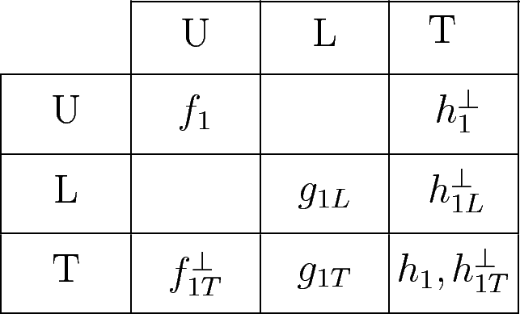
TMD correlators for quarks
Quark TMD correlator can be expanded as
For the T-even Pretzelocity this implies
quark polarization
MGAB, Mukherjee, PJM
PR D86 (2012) 074030
Process dependent
nucleon pol.
T-even

