Slide 1

ePHENIX at eRHIC
Klaus Dehmelt
Dis 2013
April-25-2013
On behalf of the phenix collaboration

Slide 2
The Electron Ion Collider Project
See A. Deshpande (159) WG6/7
Many questions for understanding the role of gluons and sea quarks in QCD are unanswered
US Nuclear Science Community is considering
  High energy
  High luminosity
  Polarized proton–electron
  Ion–electron
Two possible scenarios
  eRHIC: add 5 – 30 GeV electron beam facility to existing RHIC facility
  MEIC: add 20 – 100 GeV proton (up to 40 GeV/u ion) beam facility to existing CEBAF facility
Collider EIC

Slide 3
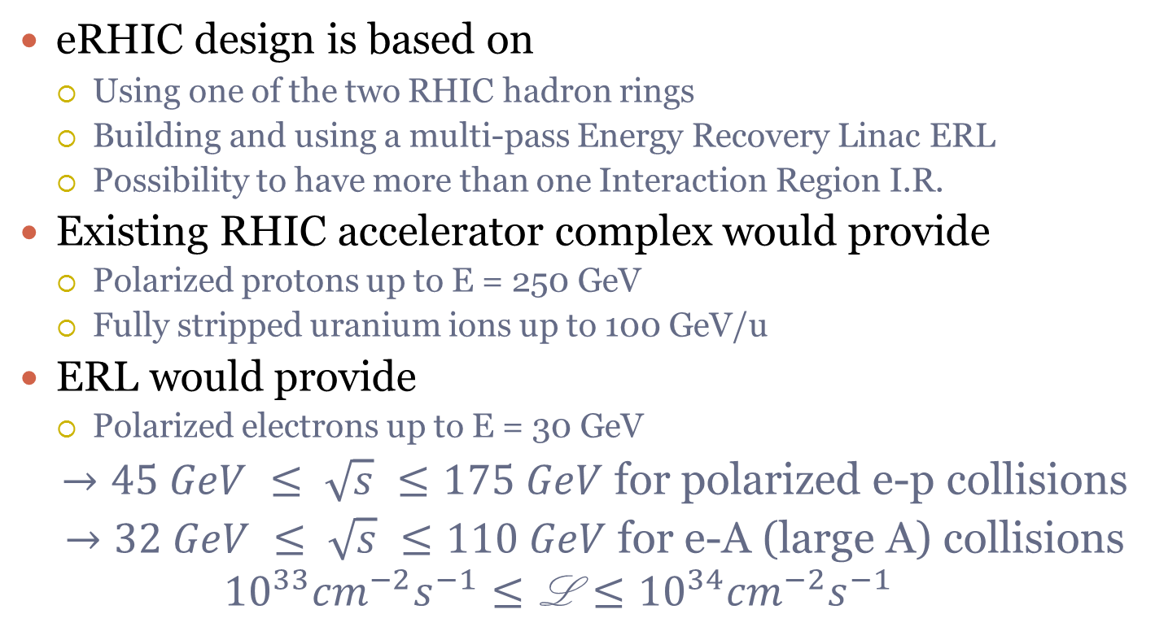
eRHIC
See A. Deshpande (159) WG6/7
E. Aschenauer (331) WG7
eRHIC design is based on
  Using one of the two RHIC hadron rings
  Building and using a multi-pass Energy Recovery Linac ERL
  Possibility to have more than one Interaction Region I.R.
Existing RHIC accelerator complex would provide
  Polarized protons up to E = 250 GeV
  Fully stripped uranium ions up to 100 GeV/u
ERL would provide
  Polarized electrons up to E = 30 GeV
  $→45 GeV ≤ \sqrt{s} ≤175 GeV$ for polarized e-p collisions
  $→32 GeV ≤ \sqrt{s} ≤110 GeV$ for e-A (large A) collisions
  $${10}^{33}{cm}^{−2}s^{−1}≤\text{L} ≤{10}^{34}{cm}^{−2}s^{−1}$$

Slide 4
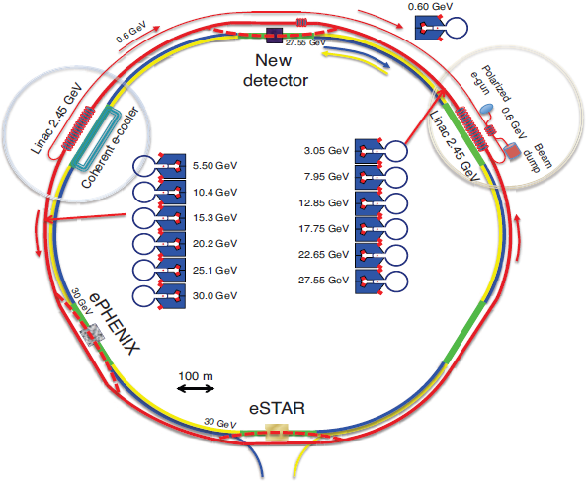
eRHIC
EIC White Paper: arXiv 1212:1701, A.Accardi et al.

Slide 5
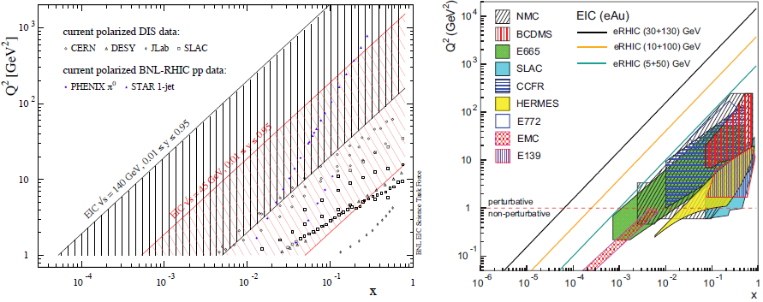

eRHIC Staging
See A. Deshpande (159) WG6/7
Construction proposal for eRHIC is based on staging
  Initial electron-beam with E = 5 … 10 GeV
  Colliding with 100 – 250 GeV polarized protons
  Colliding with d, ³He, Al, Si, Cu, Au, U … d/³He $→$ polarized n
EIC White Paper: arXiv 1212:1701, A.Accardi et al.
T. Ulrich

Slide 6
Physics Goals of EIC
See M. Stratmann (304) Plenary
Investigation of
Nucleon structure
QCD in nuclei
Searches beyond Standard Model BSM
eRHIC Stage 1: ePHENIX will be able to make important measurements in all areas but BSM
  sPHENIX: An Upgrade Concept from the PHENIX Collaboration, arXiv:1207.6378, C. Adare et al.
ePHENIX studies were performed within PHENIX by the "ePHENIX task force"

Slide 7
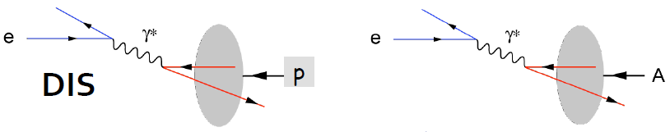

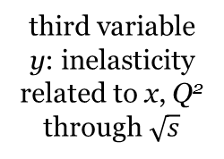
Deep Inelastic Scattering
Measure energy and angle of scattered electron $→$ fully determines two relevant kinematic variables
  Q²: virtuality of exchanged photon
  x: momentum fraction of probed parton
For large Q² $→$ exchange of W, Z bosons contributes
  Need to determine x and Q² from hadronic final state
third variable y: inelasticity
related to x, Q² through $\sqrt{s}$

Slide 8
Physics Goals for ePHENIX
3-D structure of nucleon
  Gluon and sea quark helicity contributions to nucleon helicity
    Inclusive and semi-inclusive measurements
  Quark and gluon Transverse Momentum Distributions TMD
    Semi-inclusive measurements SIDIS
  Spatial gluon and sea quark distribution in nucleon
    Exclusive measurements Deeply Virtual Compton Scattering DVCS

Slide 9
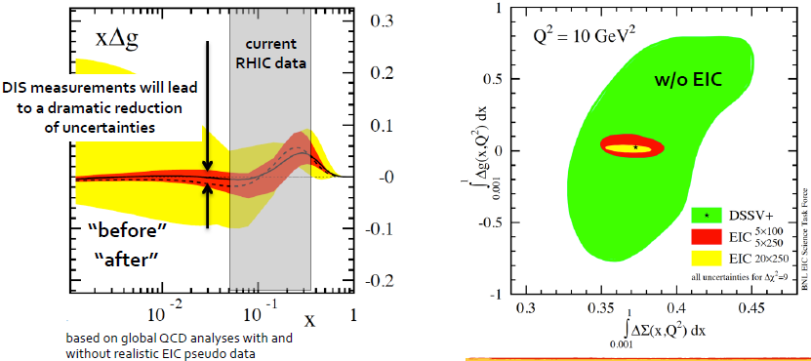
Spin Structure
DIS: Δg(x, Q²) can be determined for x down to 10⁻⁴
EIC White Paper: arXiv 1212:1701, A. Accardi et al.

Slide 10
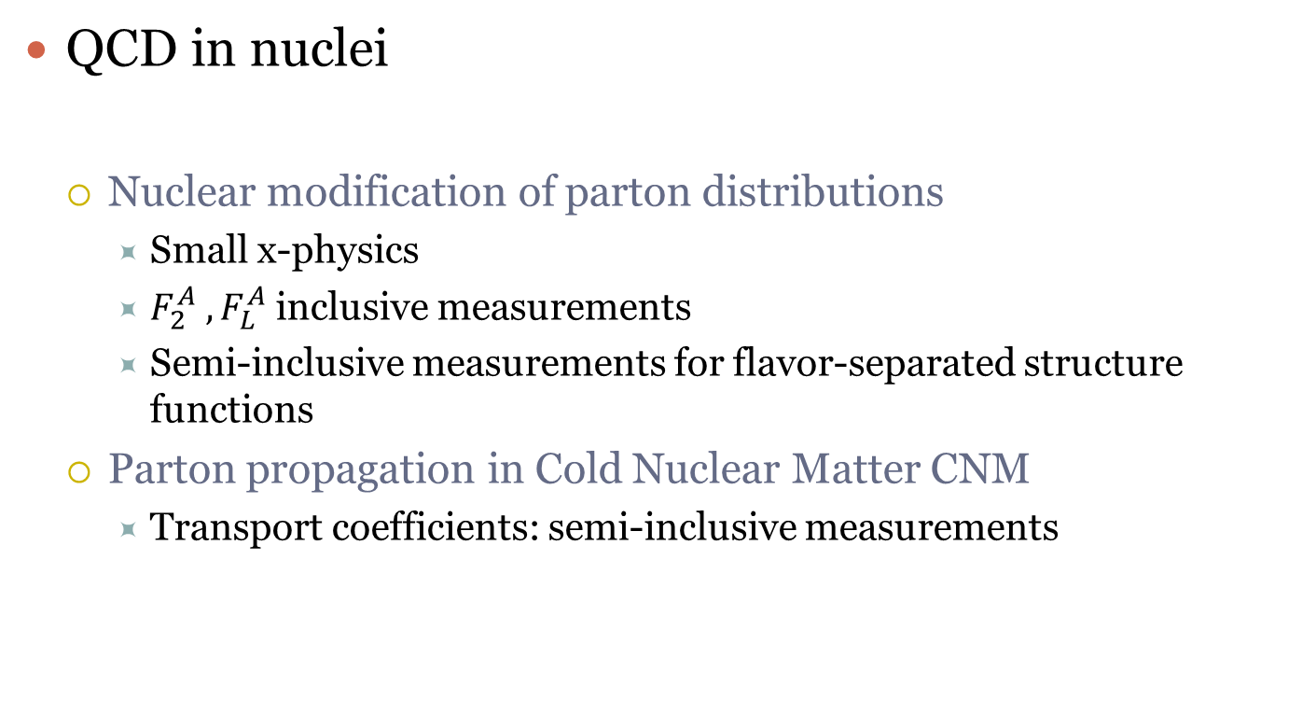
Physics Goals for ePHENIX
QCD in nuclei
  Nuclear modification of parton distributions
    Small x-physics
    $F_{2}^{A} {, F}_{L}^{A}$ inclusive measurements
    Semi-inclusive measurements for flavor-separated structure functions
  Parton propagation in Cold Nuclear Matter CNM
    Transport coefficients: semi-inclusive measurements

Slide 11
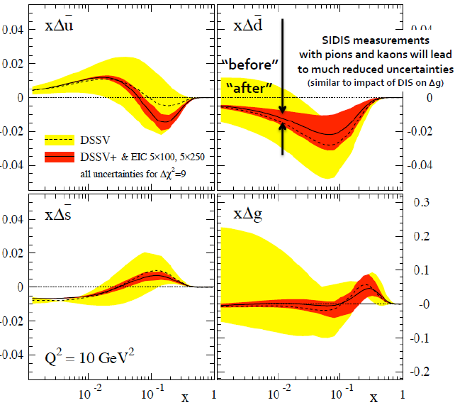
Flavor Separated Structure Functions
EIC White Paper: arXiv 1212:1701, A. Accardi et al.

Slide 12
ePHENIX Detector
Considerations regarding
  Kinematics for various measurements
  Required precision
  lead to determining
Tracking
  Momentum and angular resolution
Measurement of scattered electron
  Energy
  Angular resolution
Particle Identification PID

Slide 13
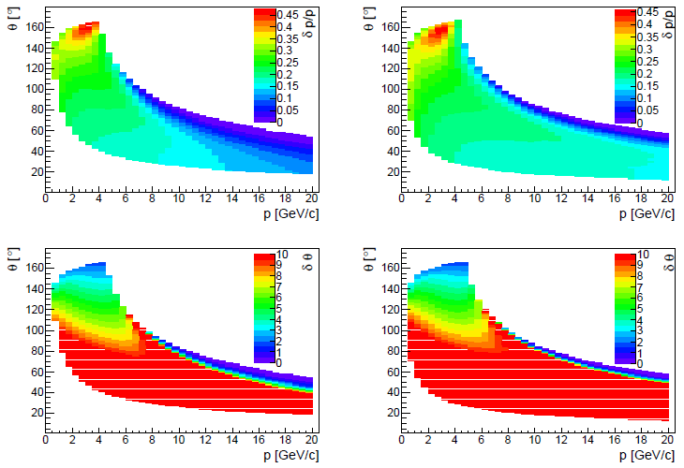
ePHENIX Tracking Requirements
e⁻(5 GeV) on p(100 GeV)
e⁻(5 GeV) on p(250 GeV)
Momentum and
angular resolution
sPHENIX: An Upgrade Concept from the PHENIX Collaboration, arXiv:1207.6378, C. Adare et al.

Slide 14
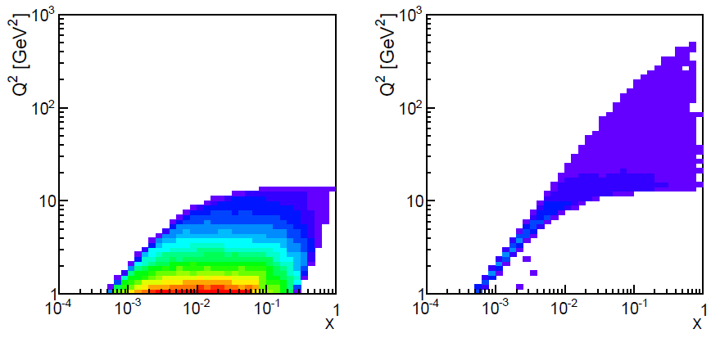
ePHENIX and Scattered Electron
e⁻ (5 GeV) on p(100 GeV) configuration
x-Q² coverage of the scattered electron
Backward rapidity η < -1
Midrapidity |η| < 1
sPHENIX: An Upgrade Concept from the PHENIX Collaboration, arXiv:1207.6378, C. Adare et al.

Slide 15
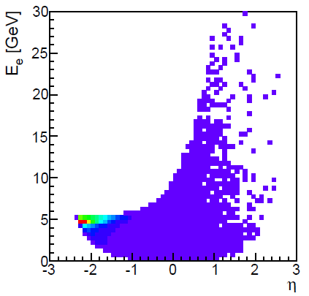
ePHENIX and Scattered Electron
e⁻ (5 GeV) on p(100 GeV) configuration
η-Energy coverage of the scattered electron
sPHENIX: An Upgrade Concept from the PHENIX Collaboration, arXiv:1207.6378, C. Adare et al.

Slide 16
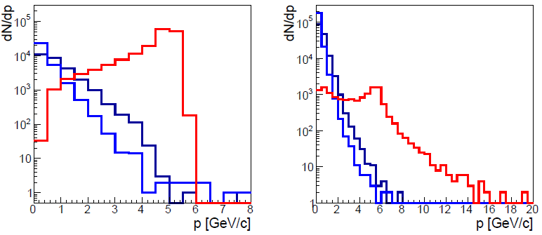
ePHENIX and Scattered Electron
e⁻ (5 GeV) on p(100 GeV) configuration
e - γ - π: E/p matching and shower profile should provide satisfactory rejection
Backward rapidity η < -1
Midrapidity |η| < 1
e⁻
π±
γ
sPHENIX: An Upgrade Concept from the PHENIX Collaboration, arXiv:1207.6378, C. Adare et al.

Slide 17
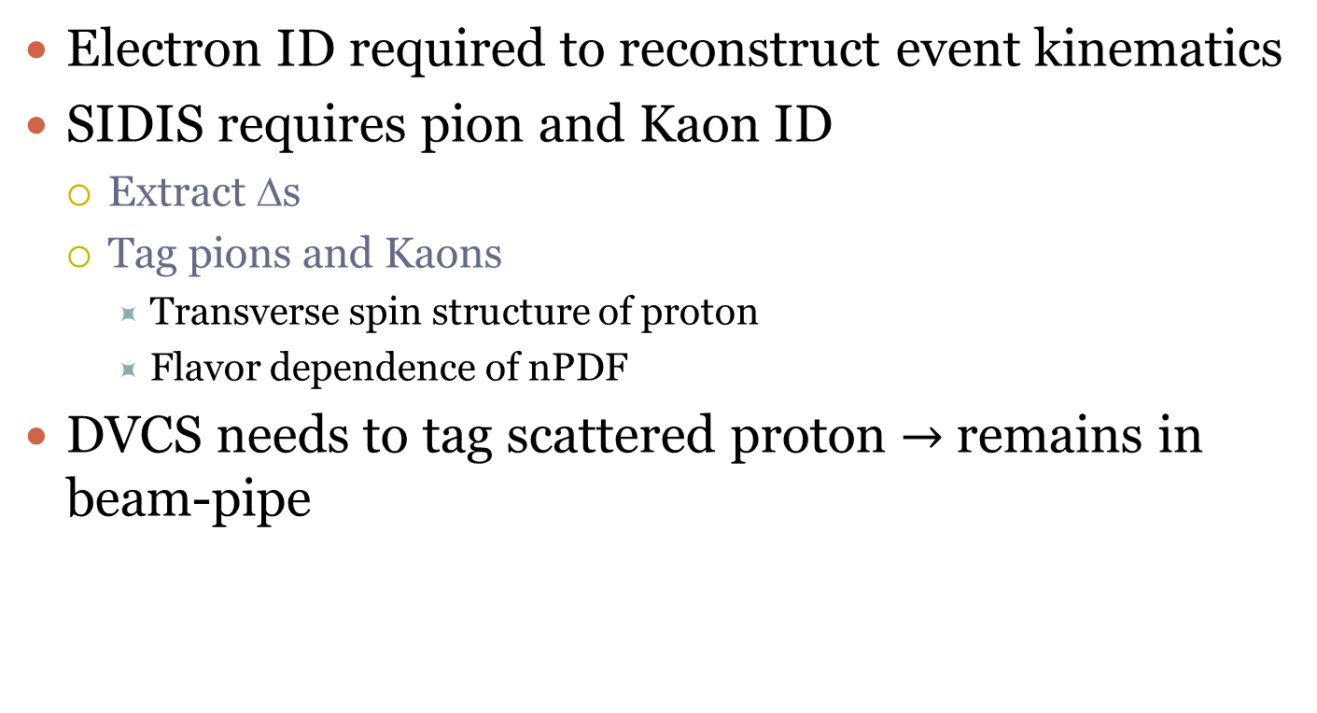
ePHENIX and PID
Electron ID required to reconstruct event kinematics
SIDIS requires pion and Kaon ID
  Extract Δs
  Tag pions and Kaons
    Transverse spin structure of proton
    Flavor dependence of nPDF
DVCS needs to tag scattered proton $→$ remains in beam-pipe

Slide 18
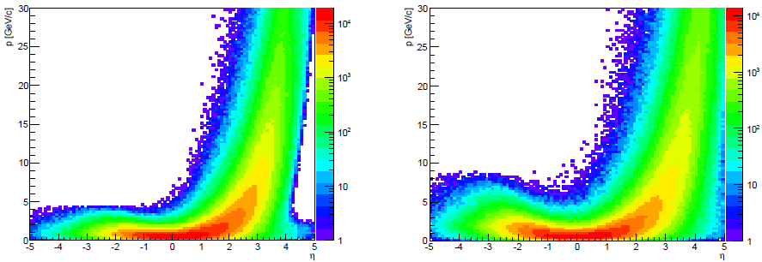
ePHENIX and PID
η-momentum coverage
of π⁺
e⁻ (5 GeV) on p(100 GeV) configuration
e⁻ (10 GeV) on p(250 GeV) configuration
sPHENIX: An Upgrade Concept from the PHENIX Collaboration, arXiv:1207.6378, C. Adare et al.

Slide 19
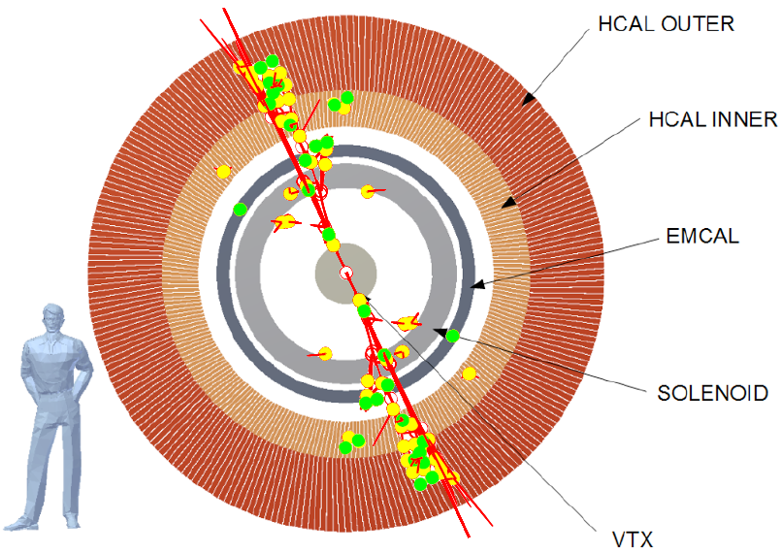
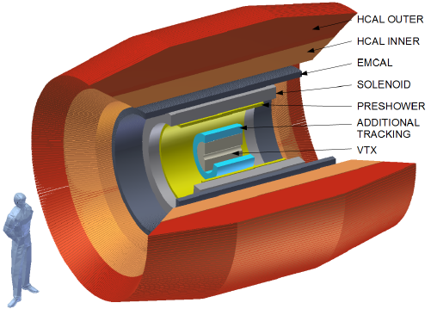
ePHENIX Evolution
See Y. Goto (182) WG7
sPHENIX will evolve in ePHENIX
  Hermetic detector at midrapidity |η| < 1.0
  Barrel solenoidal field (2 T)
  Barrel tracking
  Electromagnetic & Hadronic Calorimetry
  Introduction of barrel PID (e.g. DIRC)
sPHENIX: An Upgrade Concept from the PHENIX Collaboration, arXiv:1207.6378, C. Adare et al.

Slide 20
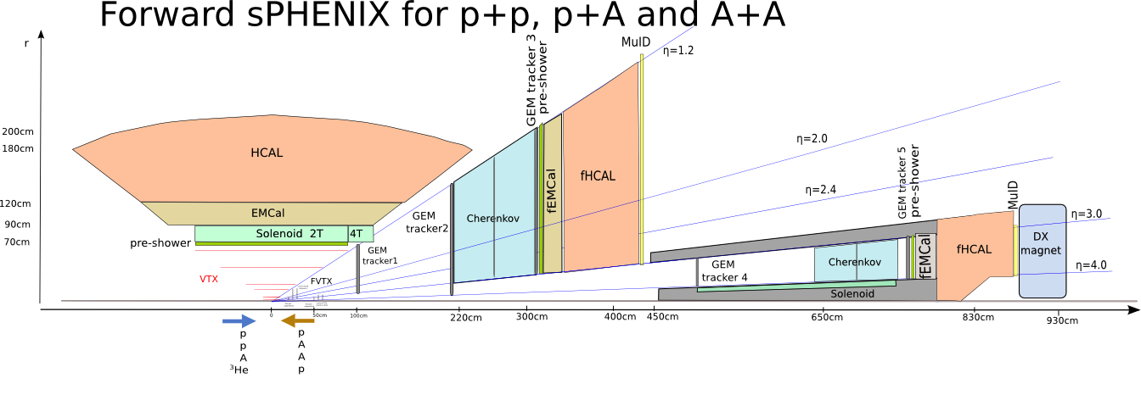
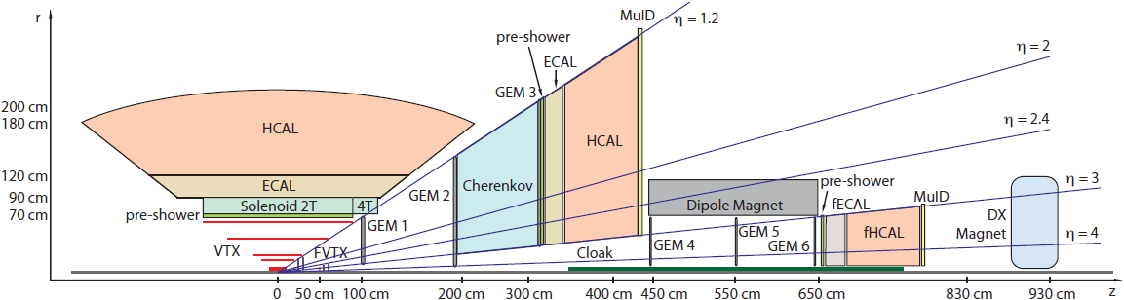
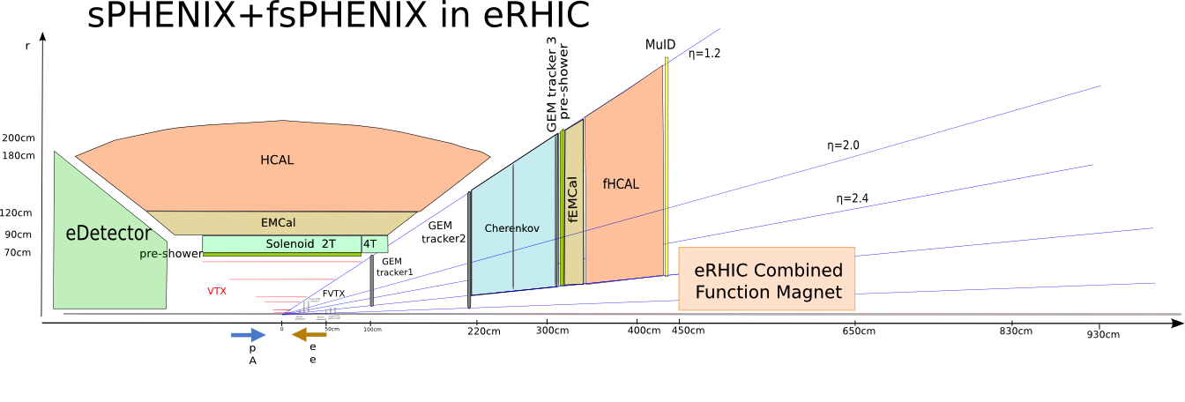
ePHENIX Evolution
sPHENIX + Forward will evolve in ePHENIX
p/A
e⁻
Backward
Forward
Magnetic cloak
fsPHENIX/ePHENIX task force

Slide 21
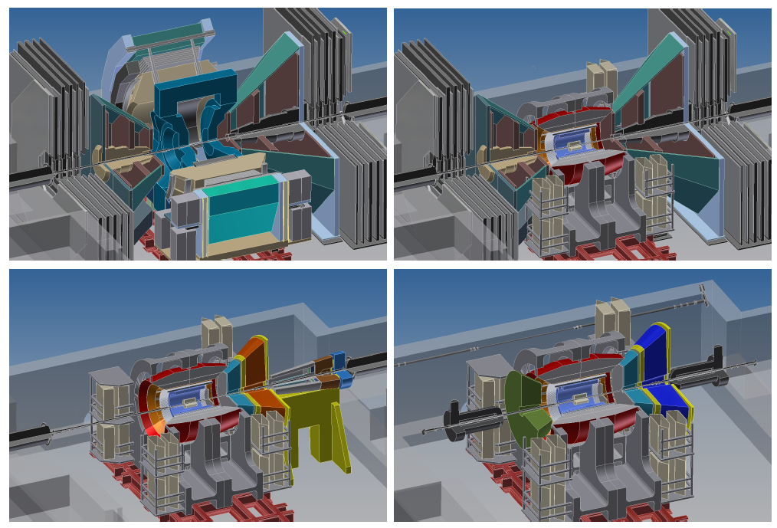
PHENIX – sPHENIX - ePHENIX

Slide 22
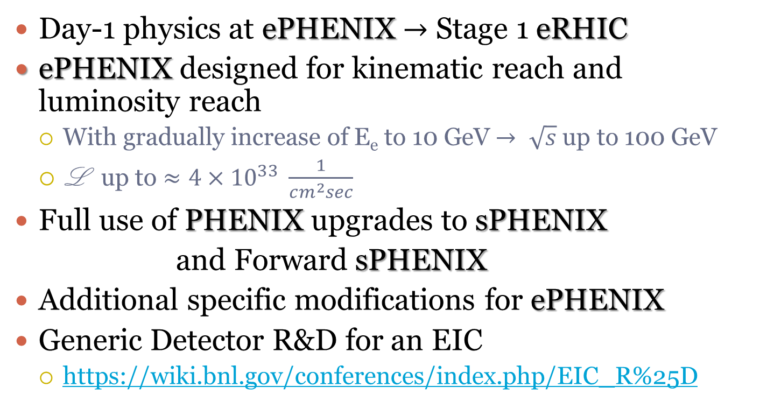
Summary
Day-1 physics at ePHENIX $→$ Stage 1 eRHIC
ePHENIX designed for kinematic reach and luminosity reach
  With gradually increase of E_{e} to 10 GeV $→ \sqrt{s}$ up to 100 GeV
  $\text{L}$ up to $≈4×{10}^{33} \frac{1}{cm^{2}sec}$
Full use of PHENIX upgrades to sPHENIX
and Forward sPHENIX
Additional specific modifications for ePHENIX
Generic Detector R&D for an EIC
  https://wiki.bnl.gov/conferences/index.php/EIC_R%25D

Slide 23
Extra Slides

Slide 24
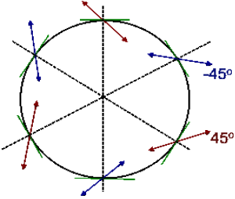
Polarized Neutrons at eRHIC
Polarized ³He beams offer an effective way to provide polarized neutron beams
Similar to polarized protons, accelerating polarized ³He also requires Siberian snakes
Cancelation of spin perturbation on the spin motion requires six snakes (two existing + four new)
MOPPC021 Proceedings of IPAC2012, M. Bai et al.
Notes:
This means that the
snake resonances encountered when accelerating He-3 are
stronger and denser.
due to closed orbit distortion and intrinsic resonances

Slide 25

Polarized Neutrons at eRHIC
Accelerating polarized ³He faces more and stronger spin depolarizing resonances
Overlap of imperfection resonances excites also even order snake resonances
Other sources for even order snake resonance errors in snake settings
Errors of beam parameters for polarized beam acceleration in RHIC

Slide 26
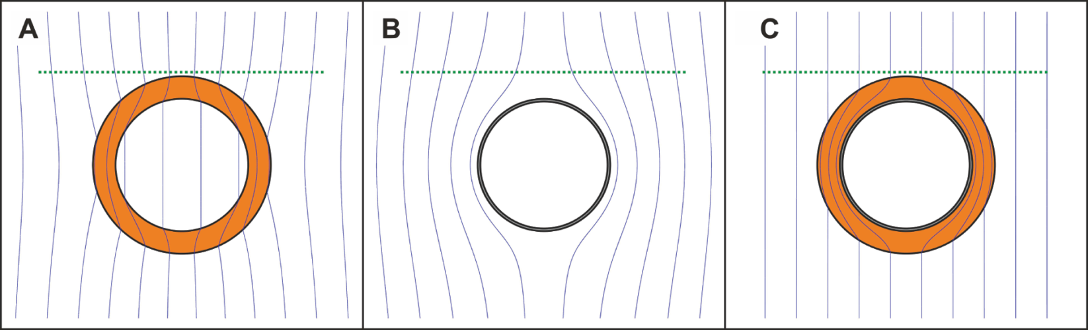
Magnetic Cloak
“Cloak” the beam with a tube
Desired: Null interior field and external field unaffected
Controlling magnetic fields with superconductor-metamaterial hybrids

Slide 27
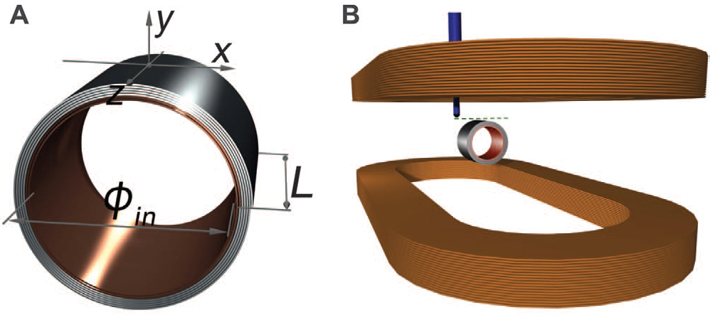
Magnetic Cloak
Alvaro Sanchez
Studies for application in a beam-pipe ongoing

