Slide 1
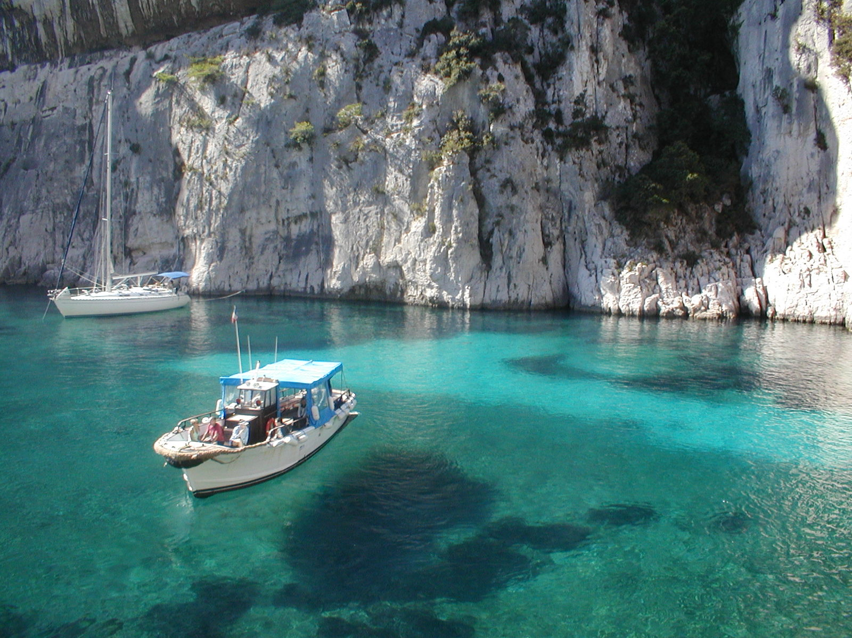


DPHEP: From Study Group to Collaboration.
Data Preservation in High Energy Physics
David South (DESY)
on behalf of the DPHEP Collaboration
arXiv:1205.4667

Slide 2
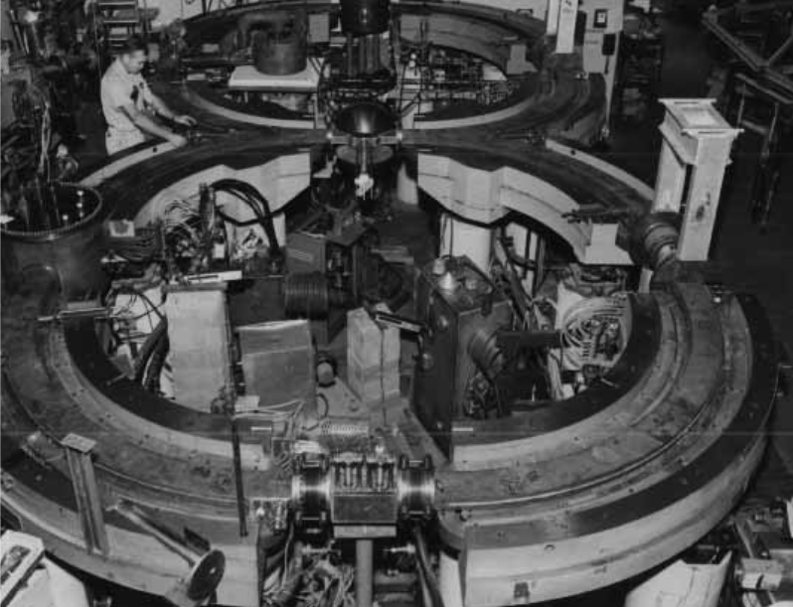
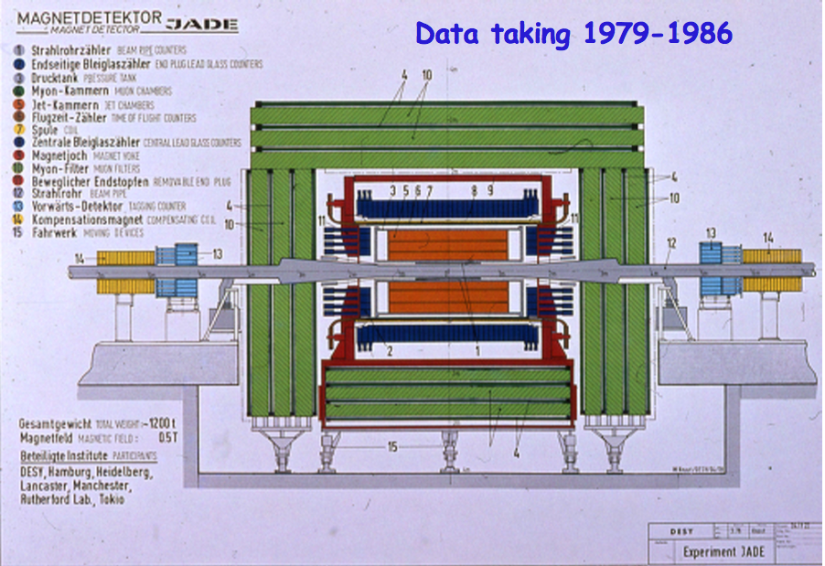

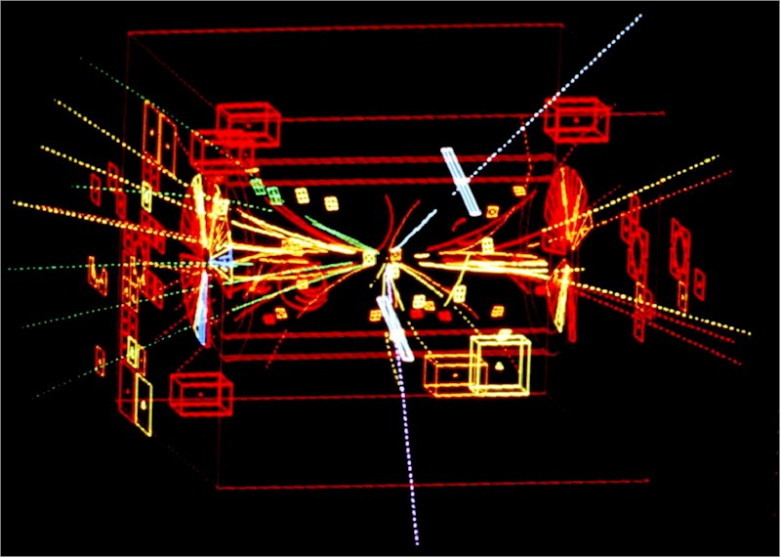
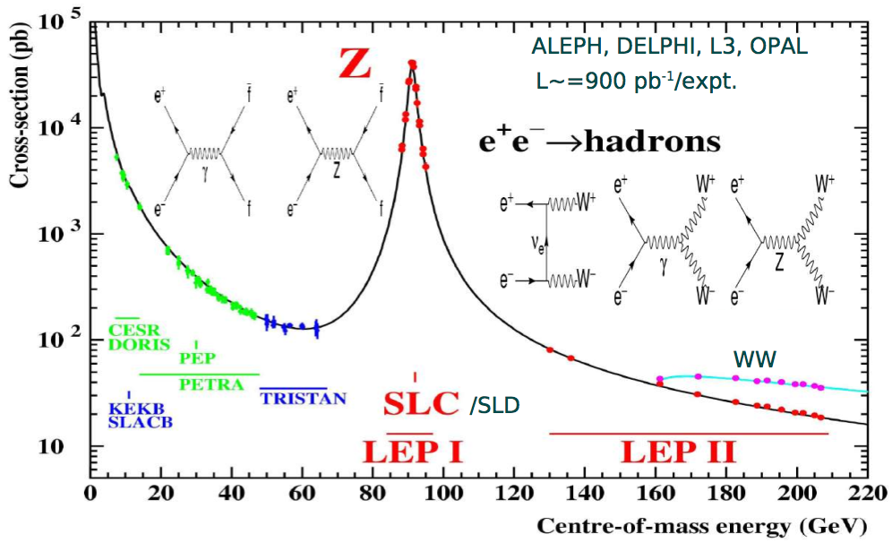
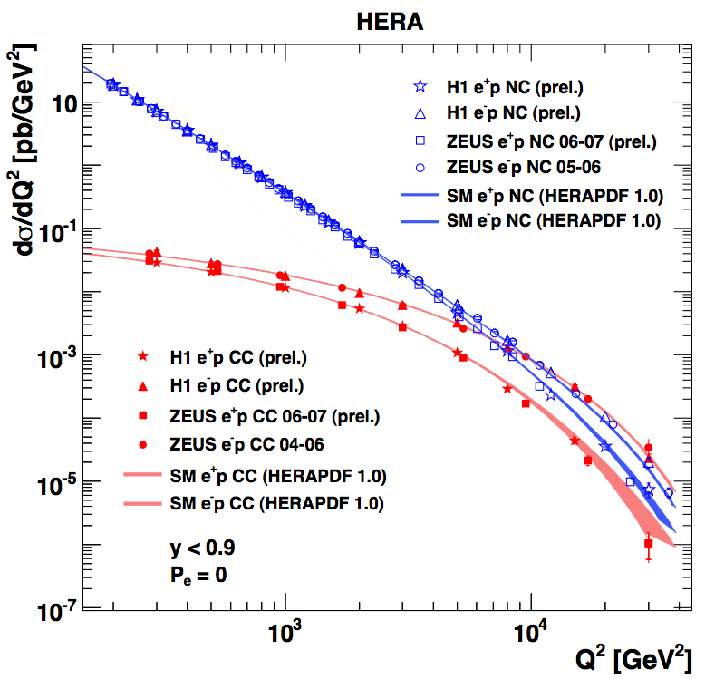
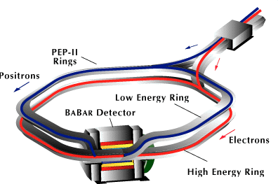
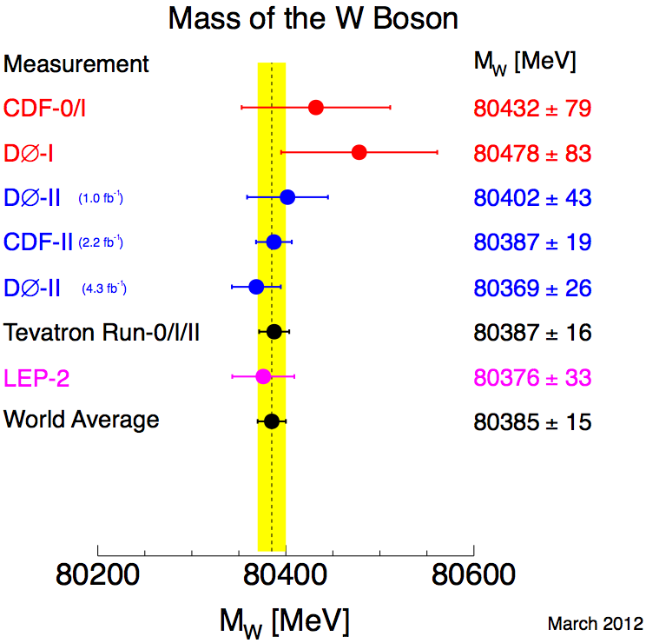
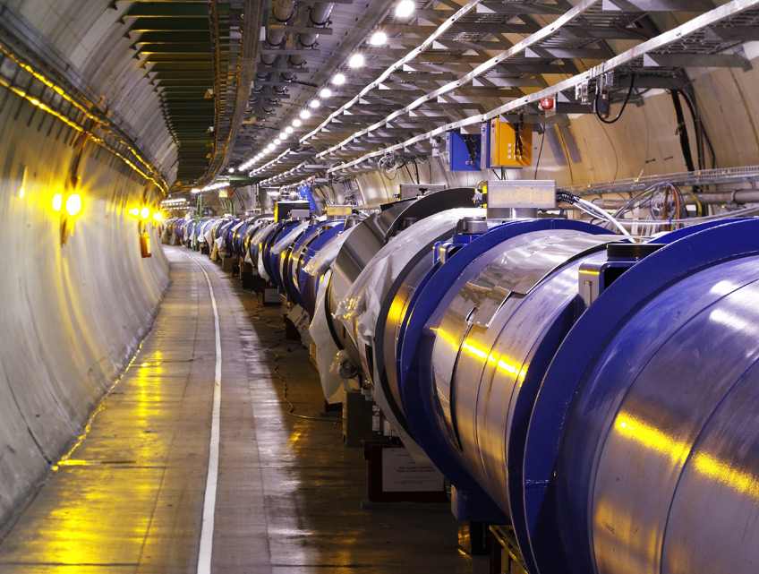
Experimental particle physics in the collider era
A wide variety of physics results from many, often very different experiments
Energy frontier probed with increasingly complex accelerator installations
  New experiments typically supersede previous, similar ones - but not always
Growth in size of the necessary international collaborations, as well as the diversity of the data management
The age of the LHC has truly arrived
  Belle 2, HL-LHC, and other projects such as the ILC or next e-p/A collider are to come

Slide 3
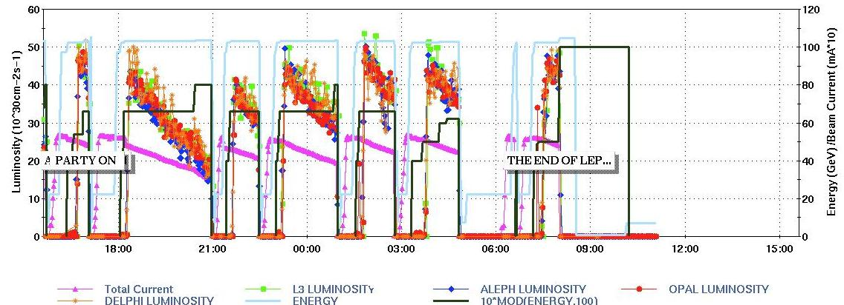
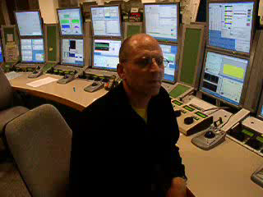
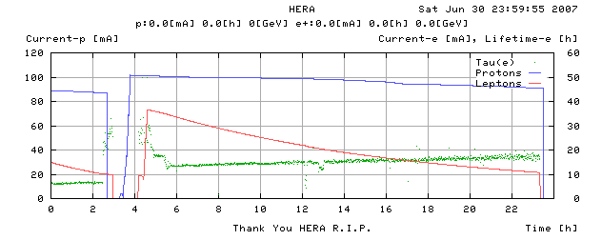
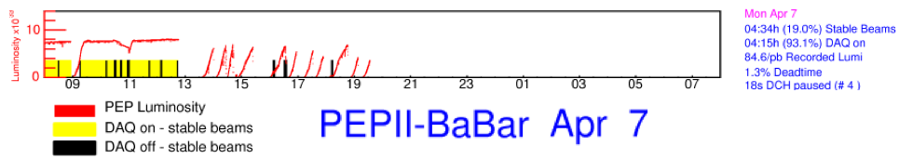
The last years have seen the end of several experiments
LEP, 2 November 2000
HERA, 30 June 2007
PEP-II, 7 April 2008

Slide 4
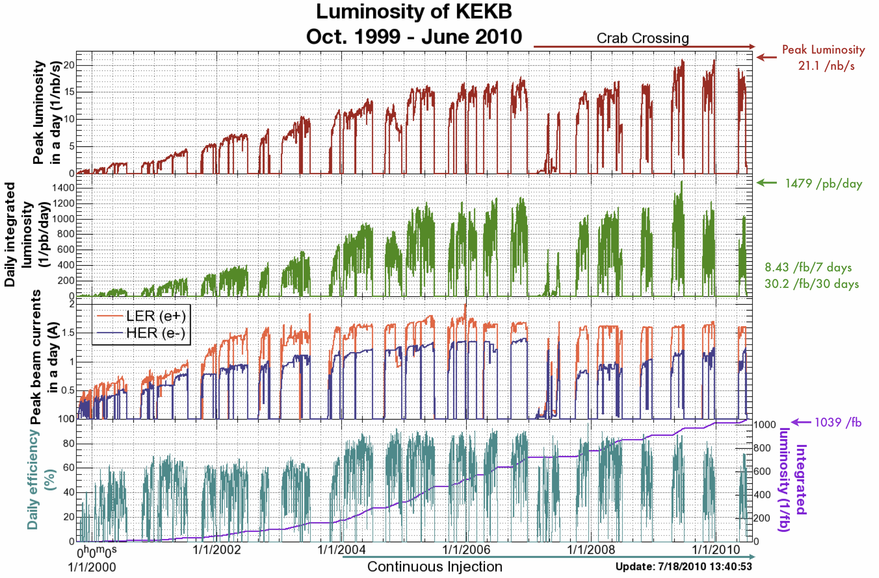
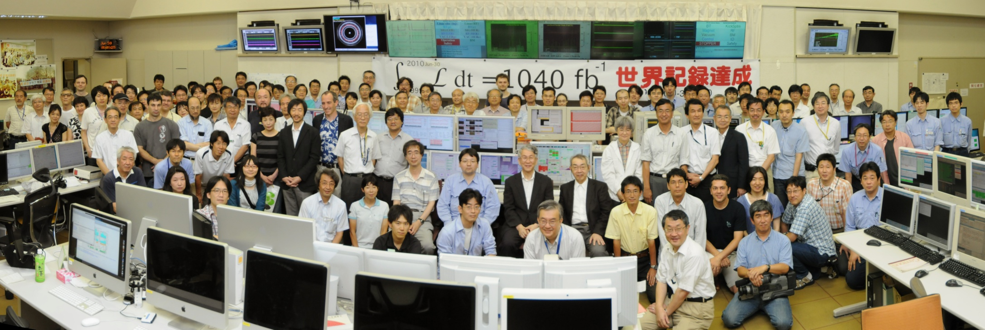
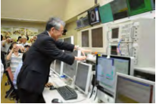
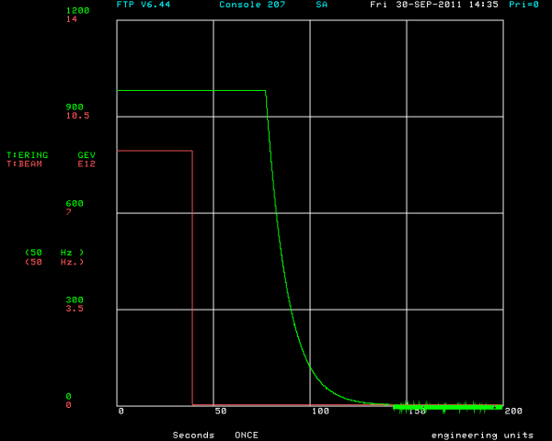
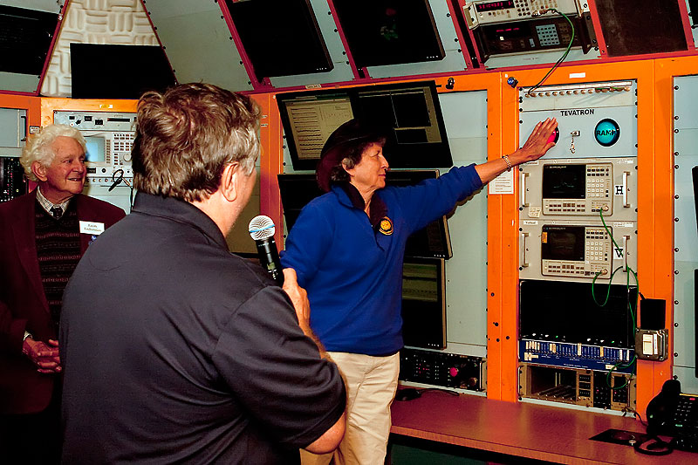
The last years have seen the end of several experiments
KEKB, 30 June 2010
The Tevatron, 30 September 2011

Slide 5
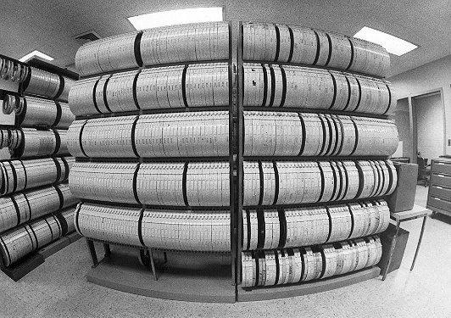
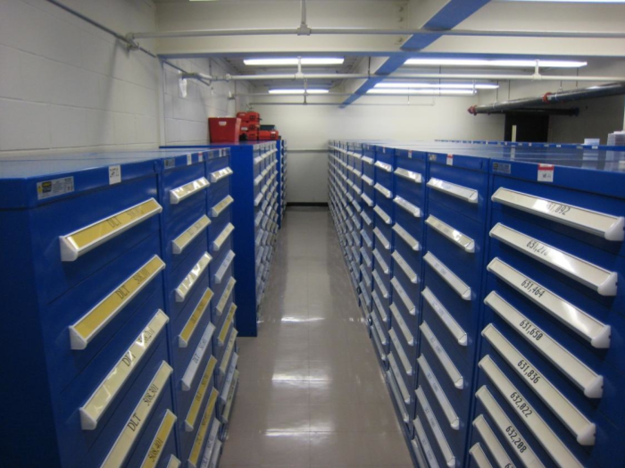
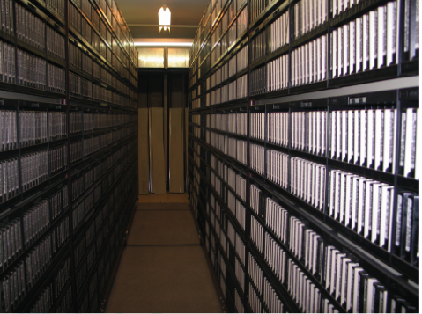
What do you do when the collisions have stopped ?
Finish the analyses! But then what do you do with the data?
  Until recently, there was no clear policy on this in the HEP community
  It’s possible that older HEP experiments have in fact simply lost the data
Data preservation, including long term access, is generally not part of the planning, software design or budget of an experiment
  So far, HEP data preservation initiatives have been in the main not planned by the original collaborations, but rather the effort a few knowledgeable people
The conservation of tapes is not data preservation!
  “We cannot ensure data is stored in file formats appropriate for long term preservation”
  “The software for exploiting the data is under the control of the experiments”
  “We are sure most of the data are not easily accessible!”

Slide 6
The difficulties of data preservation in HEP
Handling HEP data involves large scale traffic, storage and migration
  The increasing scale of the distribution of HEP data can complicate the task
Who is responsible? The experiments? The computing centres?
  Problem of older, unreliable hardware: unreadable tapes after 2-3 years
  The software for accessing the data is usually under the control of the experiments
Key resources, both funding and person-power expertise, tend to decrease once the data taking stops
And a rather key ingredient to all this is: why do it?
  Can the relevant physics cases be made?
  Who says we want to do this anyway?
  Is the benefit of all this really worth the cost and effort?

Slide 7

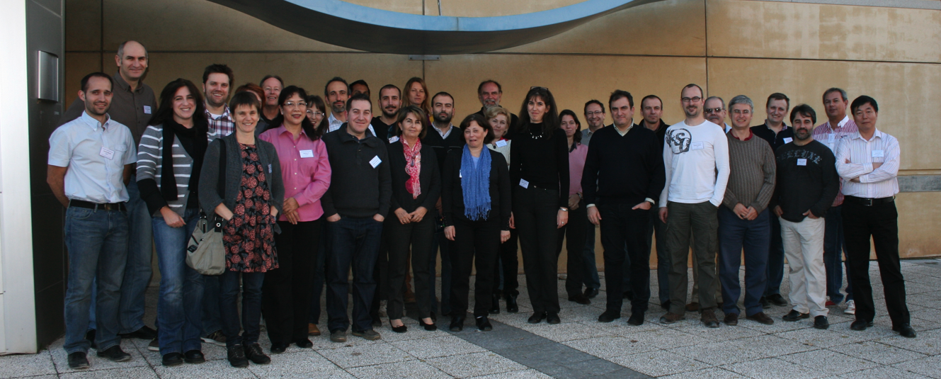
DPHEP: An international study group on data preservation
First contacts established in September 2008
  Group since grown to over 100 contact persons
  Endorsed as an ICFA panel since summer 2009
  Initial make up of the group was driven by the coincidence of the end of data taking at several large colliders – SLAC, HERA, Tevatron - but now has grown to include others including the LHC experiments
Steering Committee with representatives from all members in addition to an International Advisory Committee

Slide 8









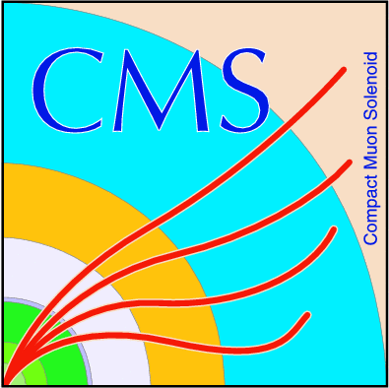












DPHEP: An international study group on data preservation

Slide 9
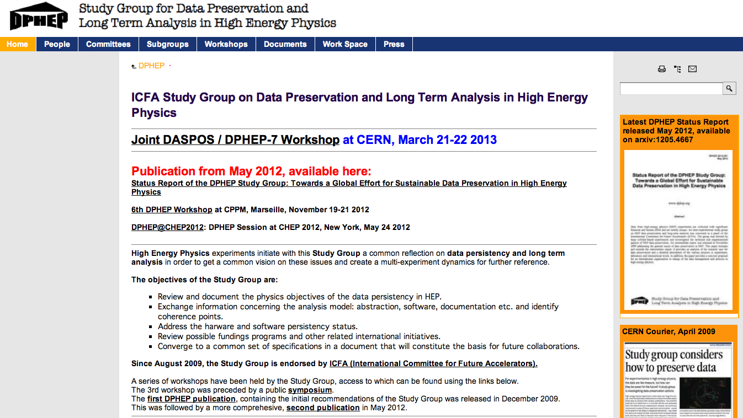
dphep.org

Slide 10
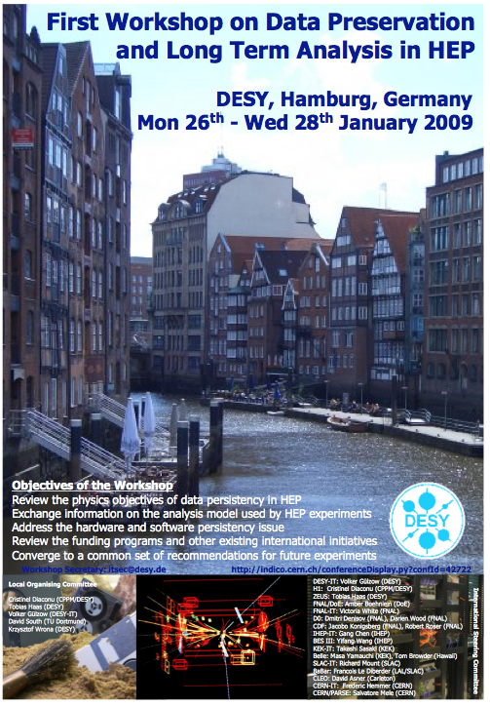
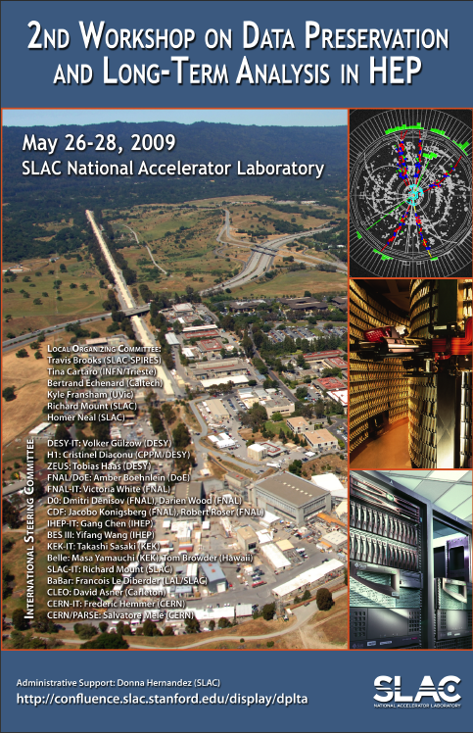
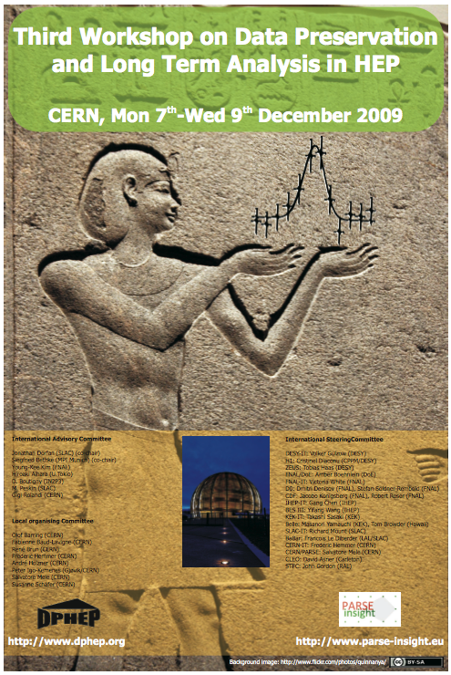
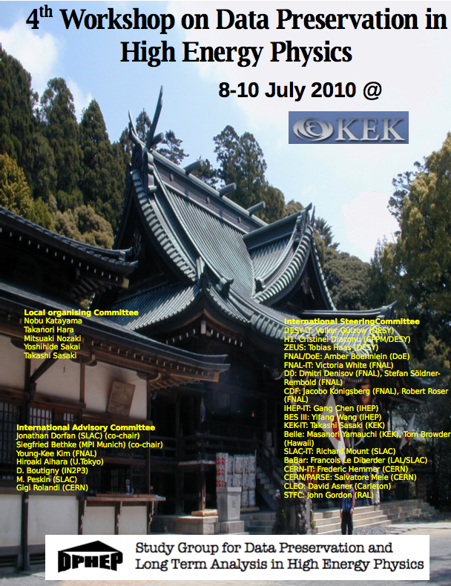
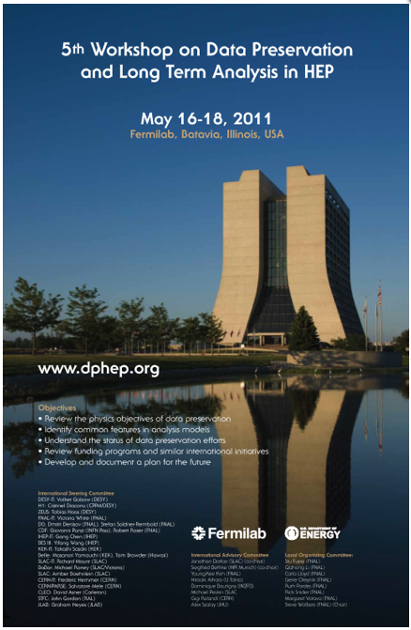
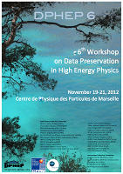
DPHEP: An international study group on data preservation
Series of DPHEP workshops held since 2009
The first task of the group was to establish the working directions
  “To confront data models, clarify the concepts, set a common language, investigate technical aspects, compare with other fields handling large data.”
Initial findings published in an interim report December 2009
  Focus on four key areas of the study group: Physics Case for Data Preservation, Preservation Models, Technologies, Governance
  Jan 2009: DESY May 2009: SLAC Dec 2009: CERN Jul 2010: KEK May 2011: Fermilab Nov 2012: CPPM
arXiv:0912.0255

Slide 11
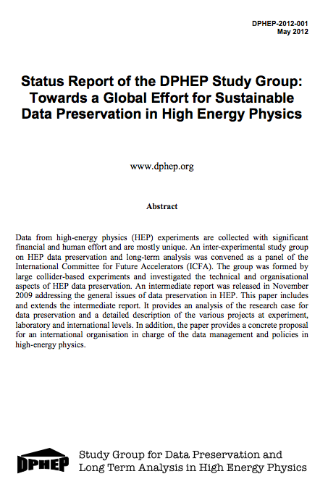
Large scale DPHEP publication
Released May 21st 2012, 93 pages
Full status report of the activities of the DPHEP study group, including:
  Tour of data preservation activities in other fields
  An expanded description of the physics case
  Defining and establishing data preservation principles
  Updates from the experiments and joint projects
  FTE estimates for these and future projects
  Next steps to establish fully DPHEP in the field
arXiv:1205.4667

Slide 12
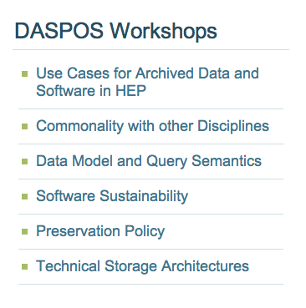
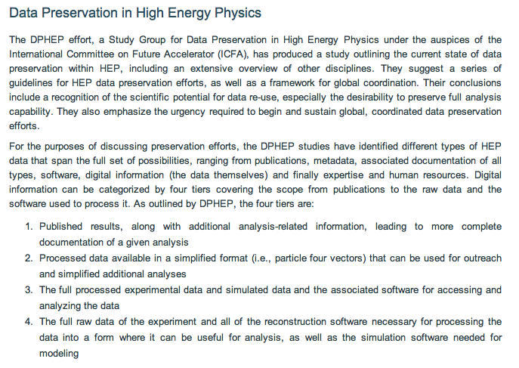
DASPOS
New initiative in the funded in the US by the NSF, “Data and Software Preservation for Open Science” (DASPOS)
  Focussed on high energy physics data from the LHC and the Tevatron
  Complimentary effort to DPHEP, series of workshops focussing on different issues
  Seventh DPHEP workshop held last month at CERN jointly with DASPOS

Slide 13
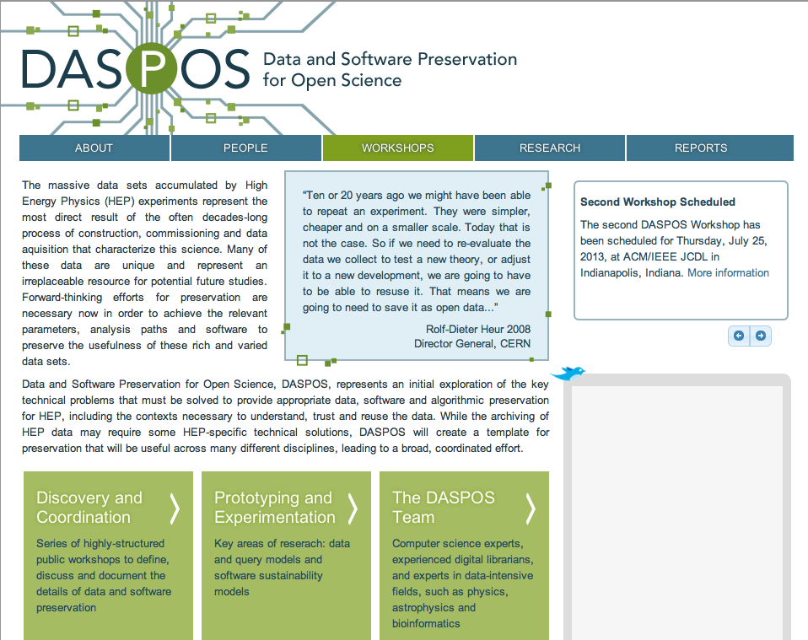
  daspos.crc.nd.edu

Slide 14
Building the physics case: Reasons to preserve HEP data
Long term completion and extension of an existing physics program
  Up to 10% of papers are finalised in the “archival mode”
  Gain in scientific output of the experiments
Cross-collaboration and combinations of physics results
  During the active lifetime of similar experiments at one facility: LEP, HERA, TeVatron
  And later across larger boundaries: Belle/BaBar, TeVatron/LHC
Revisit old measurements or perform new ones
  Access to newly developed techniques, comparisons to new theoretical models
  Unique data sets available in terms of energy, initial states
Use in scientific training, education, outreach
  Simplified formats: associated exercises to perform e.g. composite-particle reconstruction, finding signals in the background, ...

Slide 15
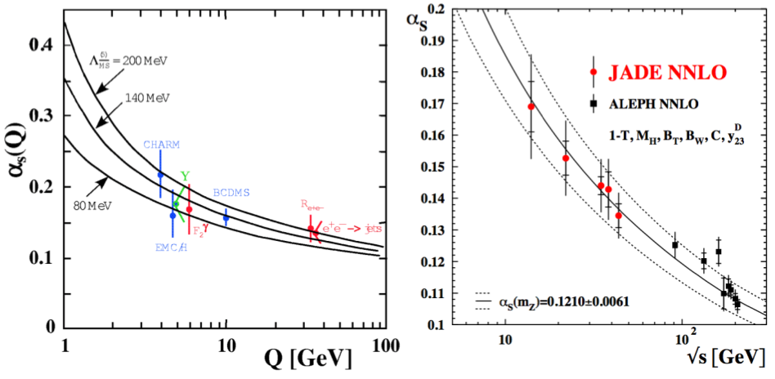
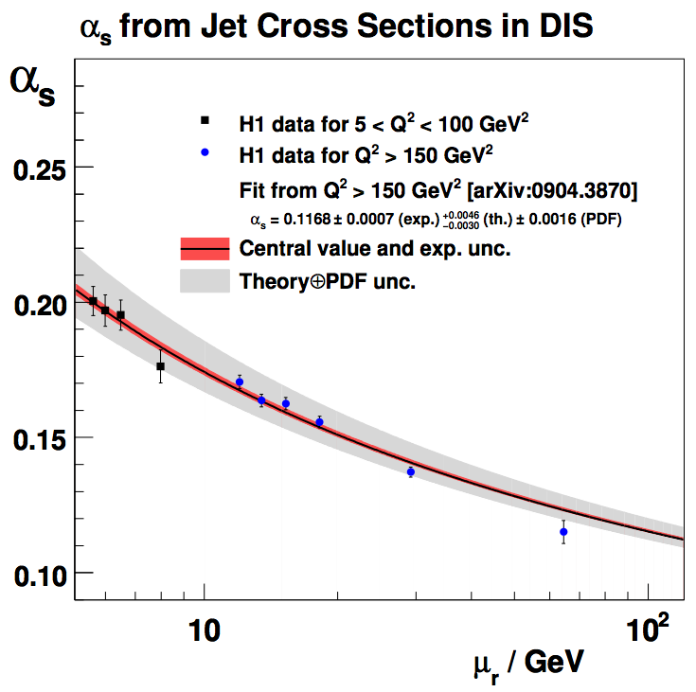
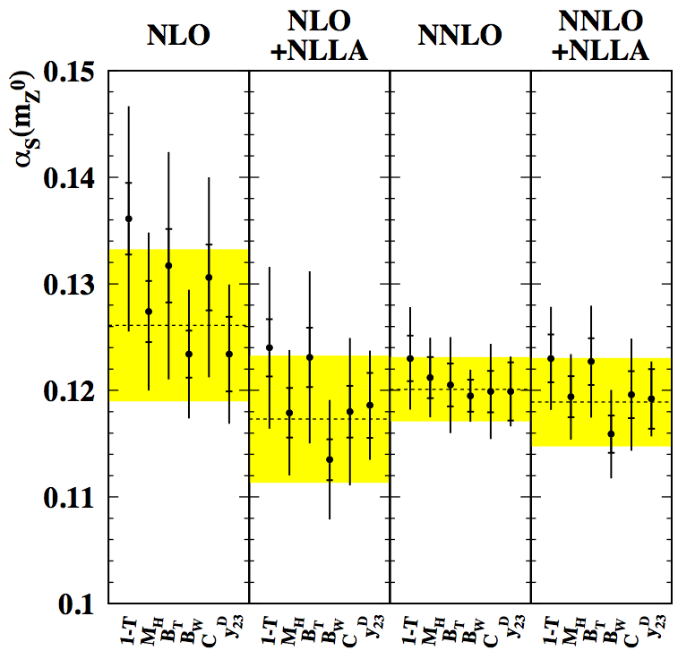

Example: Revisit old measurements or perform new ones
1989
2009
Access to newly developed techniques, comparisons to new theoretical models
  History may be repeated with the HERA α_{s} measurements
Unique data sets are available in terms of initial state particles and energy
  If no LHeC or alternative, all he have are the HERA e±p data
  Tevatron pp are also unique, A_{FB}, high-x jets, ...
  Fixed target experiments, ... others, ...
-

Slide 16
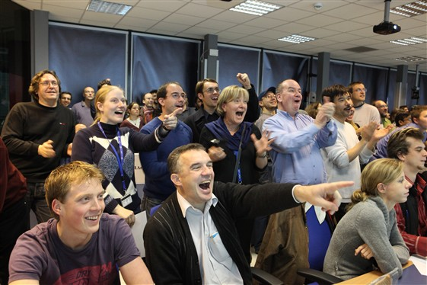
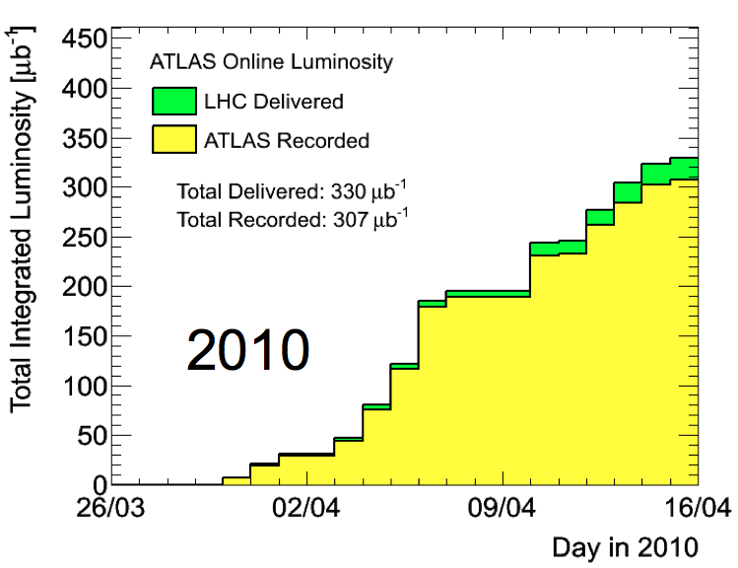
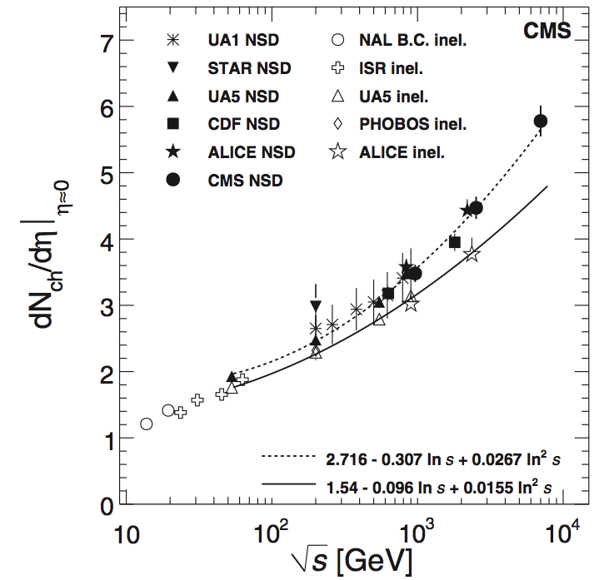
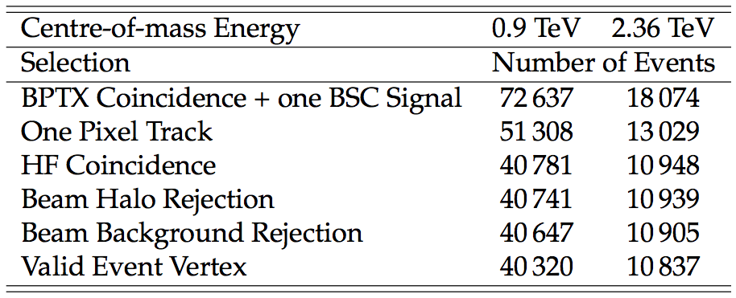
And what about LHC 900 GeV and 2.32 TeV data? 7 TeV data?
Early LHC measurements made using data at a unique centre of masses
Is the 2010 low pile up 7 TeV data “safe”?
What happens to Run 1 data when the 14 TeV collisions come? Something like what happened at the TeVatron?

Slide 17
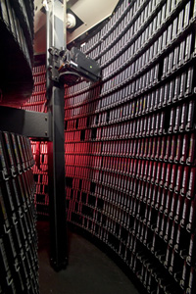
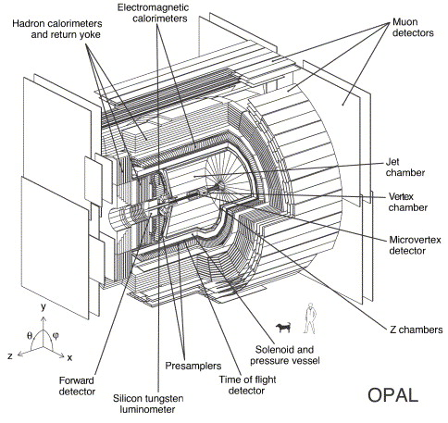
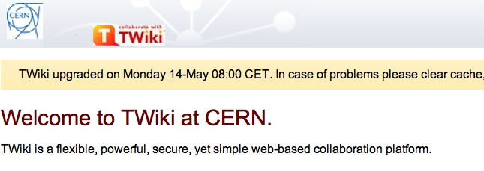



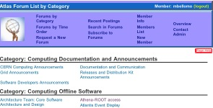
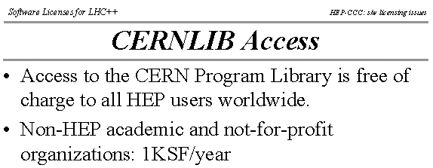

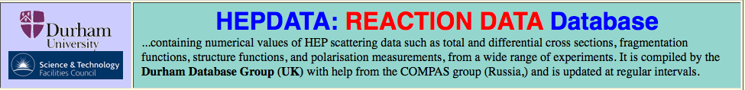

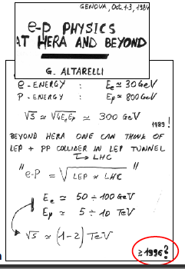
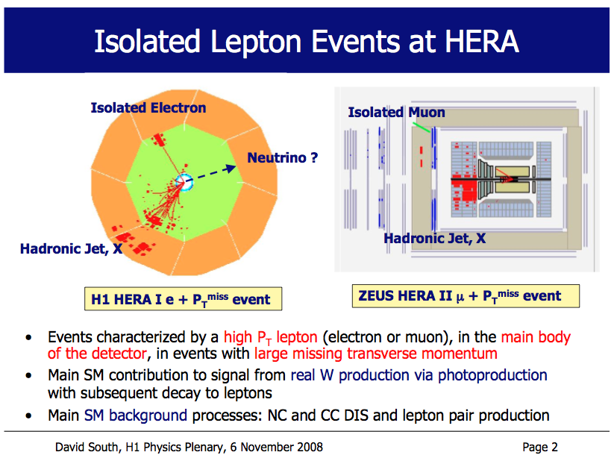
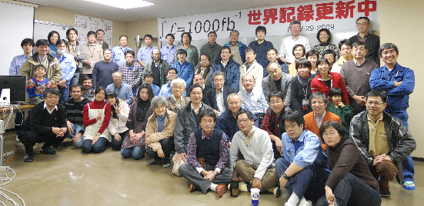



An important question: What is HEP data?
Digital information
The data themselves, volume estimates for preservation data of the
order of a few to 10 PB
Other digital sources such as databases to also be considered
Software
Simulation, reconstruction, analysis, user, in addition to any external dependencies
Meta information
Hyper-news, messages, wikis, user forums..
Publications
Documentation
Internal publications, notes, manuals, slides
Expertise and people

Slide 18
DPHEP models of HEP data preservation
Preservation Model |  | Use Case
1 | Provide additional documentation | Publication related info search | Documentation
2 | Preserve the data in a simplified format | Outreach, simple training analyses | Outreach
3 | Preserve the analysis level software and data format | Full scientific analysis, based on the existing reconstruction | Technical Preservation Projects
4 | Preserve the reconstruction and simulation software as well as the basic level data | Retain the full potential of the experimental data
Increasing cost, complexity and benefits
These are the original definitions of DPHEP preservation levels from the 2009 publication
  Still valid now, although interaction between the levels now better understood
Originally idea was a progression, an inclusive level structure, but now seen as complementary initiatives
Three levels representing three areas:
  Documentation, Outreach and Technical Preservation Projects

Slide 19


Level 1: Documentation
Dedicated documentation task forces set up by many experiments
  Much material from pre-web days, or using all kinds of web applications
Non-digital: Cataloguing, scanning,
photographing older material
  Papers, notes, drawings, pre-web talks,
  detector schematics, blueprints, logbooks...
  New Virtual Archives established
Digital: Securing and consolidating the existing content
  Online shift tools, detector configuration files, electronic logbooks, detailed run info, web content from out-dated servers with dead links, wikis, meetings, talks, ...
  Replacement of old web servers by VMs, hosted by the computer centres
  Replacement of old pages to newer technologies such as wikis
  Use of external services like INSPIRE for hosting collaboration material

Slide 20



Level 2: Simplified formats for outreach
Within DPHEP and the member collaborations there are generic ideas, such as common formats and user interfaces
  In terms formats, much can be learned from other fields such as astrophysics or life sciences
Such outreach formats in HEP are typically based on ROOT, containing particle 4-vectors and simple event information
  Composite-particle reconstruction, finding signals
  Initiatives in place at BaBar, Belle and LHC experiments
Simplified formats also provide an ideal way of transferring data between experiments and theory
  Allowing new models to be tested on HEP data

Slide 21


Technical projects: Levels 3 and 4
This is really the main focus of the data preservation effort
  Access to analysis level data, MC and the analysis level software
  In addition for level 4 this includes the reconstruction and simulation software
It’s not about the data, but about still being able analyse it
  Either keep your current environment alive as long as possible
  Or adapt and validate your code to future changes as they happen
  Two complimentary approaches taken by BaBar at SLAC and the HERA experiments at DESY, both employing virtualisation techniques, but in different ways

Slide 22
Summary and future working directions of DPHEP
The DPHEP Study Group has established itself in the HEP community reached a milestone in the publication of the latest report, which contains a comprehensive appraisal of data preservation in HEP
  Increased participation in the last years, especially from the LHC community
DPHEP will continue to investigate and take action in areas of coordination, preservation standards and technologies
  Also in cooperation with other initiatives such as DASPOS, as well as expanding the experimental reach and inter-disciplinary cooperation
In 2013 DPHEP will make the transition from Study Group to Collaboration
  Final draft of Collaboration Agreement prepared contributors will be asked to sign during 2013
  Target upcoming FP8/Horizon2020 EU funding to realise and fully deploy a variety of projects
  Status Report of the DPHEP Study Group: http://arxiv.org/abs/1205.46677
  Joint DASPOS/DPHEP-7 Workshop, March 2013: https://indico.cern.ch/conferenceDisplay.py?confId=233119
  CHEP 2012 talk: http://indico.cern.ch/contributionDisplay.py?sessionId=0&contribId=607&confId=149557
  Seminar from November 2011: http://www.desy.de/dvsem/WS1112/south_talk.pdf

Slide 23
EXTRAS

Slide 24


Support for data preservation in the HEP community
arXiv:0906.0485

Slide 25

Support for data preservation in the HEP community
arXiv:0906.0485

Slide 26

Transition scenario and resources at the experimental level
Planning the transition to a long term analysis model
R&D phase needed to develop the projects for the transition
Long term custodianship of the physics data
Resources / experiment
  Typically a surge of 2-3 FTEs for 2-3 years, followed by steady 0.5-1.0 FTE per experiment/lab
  This should be compared to 300-500 FTEs for many years per experiment!
Cost estimates represent typically much less than 1% of the original investment
Scientific return: O(10%) in number of publications

Slide 27



Long term completion of the physics programme
Similar publication tails predicted by the BaBar, H1 and ZEUS experiments, taking into consideration the plans for data preservation

Slide 28


Long term completion of the physics programme
The publication tail of LEP is long, with new papers still appearing
Well over 300 papers produced since the end of collisions in 2000
Recent analysis of LEP data gave unique limits on a novel Higgs model
Similar, if not longer publication tails predicted by the BaBar, H1 and ZEUS experiments, after taking into consideration the plans for data preservation

Slide 29




Cross-collaboration combinations of physics results
Combination of data from multiple experiments to produce new scientific results
  Improved precision and increased sensitivity
Comparison of experimental results
  Complimentary information from different physics
  Verification of experimental observations
Both objectives facilitated by data preservation

Slide 30
Level 1: Documentation
The organisation of documentation turns out to be quite a task
  Dedicated task forces set up by many of the experiments
  Much material from pre-web days, or using all kinds of web applications
Non-digital: Cataloguing, organisation, scanning or photographing of appropriate of papers, notes, drawings, talks from pre-web days, detector schematics, blueprints, logbooks, ...
  New Virtual Archives established by the experiments
Digital: Old online shift tools, detector configuration files, electronic logbooks, detailed run information, web content from out-dated servers with dead links, various wikis, meetings, talks, ...
  Replacement of old web servers by VMs, hosted by the computer centres
  Replacement of old pages to newer technologies such as wikis (use of (T)wikis much more prevalent in the LHC era)
  Use of external services for hosting collaboration material

Slide 31

H1 Theses
Since October 2010, 106 H1 theses discovered not previously known to the collaboration; 18 since this summer, latest ones only last week
Scanning and linking these to the official H1 pages is given high priority
Currently, of the 892 known H1 theses 197 are not available in electronic form: ~ 22% not available to the H1 community!

Slide 32

Documentation projects with INSPIRE
Internal notes from all HERA experiments now available on INSPIRE
  Experiments no longer need to provide dedicated hardware for such things
  Password protected now, simple to make publicly available in the future

Slide 33

Documentation projects with INSPIRE
Internal notes from all HERA experiments now available on INSPIRE
  Experiments no longer need to provide dedicated hardware for such things
  Password protected now, simple to make publicly available in the future

Slide 34

Documentation projects with INSPIRE
Internal notes from all HERA experiments now available on INSPIRE
  Experiments no longer need to provide dedicated hardware for such things
  Password protected now, simple to make publicly available in the future

Slide 35

Documentation projects with INSPIRE
Internal notes from all HERA experiments now available on INSPIRE
  Experiments no longer need to provide dedicated hardware for such things
  Password protected now, simple to make publicly available in the future
The ingestion of other documents is under discussion, including theses, preliminary results, conference talks and proceedings, paper drafts, ...
  More experiments working with INSPIRE, including CDF, D0 as well as BaBar

Slide 36

INSPIRE: Paper histories
H1 internal
Envisage an additional link for H1 members only
Provides additional information such as preliminary results, earlier draft versions and documentation from the publication procedure

Slide 37

INSPIRE: Paper histories
H1 internal

Slide 38







Initiatives in other fields
Data preservation and in particular open access and data sharing are present in other fields such as:
  Astrophysics, molecular biology, earth sciences, humanities and social sciences

Slide 39





HEP outreach initiatives
Many initiatives promoting outreach efforts and to improve the public understanding of science in general

Slide 40


Science Hack Day: Increasing the access to LHC data
http://cms.web.cern.ch/news/cms-public-data-activity-scoops-prize-nairobi

Slide 41



Some Outreach activity within DPHEP
BaBar data
H1 data
One nice collaboration was between BaBar and H1, using the NASA Viewpoints application
Common format:
simple text

Slide 42

HERA data for preservation
Final data reprocessing to mDST completed in 2009
Basic preserved data format: ROOT based “Common Ntuples”
Ultimately RAW, MDST data and MC removed from robots, keep only cNuptles
Final production of data/MC cNuptles started, to be completed early 2013
Final reprocessing (DST-7) of HERA II data in 2009, HERA I done in 2012
Final version of common analysis software environment + files, H1OO also done
Preserve RAW data, as well as DST-7 and H1OO 4.0 versions
Large MC production of up 2.10⁹ events / year, preserved MC sets to be decided
Final data and MC production completed in 2012
Main format for analysis is the mDST, this is the one to be preserved
Importantly for HERMES, all data/MC productions now moved to dCache
Dialogue with DESY machine
group concerning their HERA data

Slide 43
HERA data for preservation
Final data reprocessing to mDST completed in 2009
Basic preserved data format: ROOT based “Common Ntuples”
Ultimately RAW, MDST data and MC removed from robots, keep only cNuptles
Final production of data/MC cNuptles started, to be completed early 2013
Final reprocessing (DST-7) of HERA II data in 2009, HERA I done in 2012
Final version of common analysis software environment + files, H1OO also done
Preserve RAW data, as well as DST-7 and H1OO 4.0 versions
Large MC production of up 2.10⁹ events / year, preserved MC sets to be decided
Final data and MC production completed in 2012
Main format for analysis is the mDST, this is the one to be preserved
Importantly for HERMES, all data/MC productions now moved to dCache
Dialogue with DESY machine
group concerning their HERA data
Total for HERA experiments: ~ 1 PB
Data preservation is not about the data!

Slide 44
Long term archival storage for the HERA data
Dedicated system too costly in both hardware and person-power
All collaborations now using dCache for mass storage, and this system will continue at DESY-IT for the LHC, photon-physics, others..
  By using dCache this is completely transparent for user, relying on IT admin work
  Active check for the data consistency on disk level, tape copy only for the case if disk copy is corrupted; corresponding checks also on the tape (checksum)
  For data which have no copy on disk: two copies on tapes (different technology old vs new, but both still readable), regular migration to new media
  Data which should be archived, but not online all the time – re-pack into larger files
System properties also defined by which data needed “always online”
  Initial estimates:
  ~ 1 PB in total
  Different strategies
  visible
 | Online | Not online | Total
H1 | ~ 250 TB | ~ 100 TB | ~ 350 TB
ZEUS | ~ 250 TB |  | ~ 250 TB
HERMES | ~ 40 TB | ~ 350 TB | ~ 390 TB
Total | ~ 540 TB | ~ 450 TB | ~ 990 TB

Slide 45

Isn’t it obvious, virtualisation will solve everything?
Yves Kemp (DESY-IT)

Slide 46



Freezing vs rolling
Yves Kemp (DESY-IT)

Slide 47


Pizza Preservation
Y. Kemp, D. Ozerov, CHEP 2012
Whilst freezing the software and environment is easy to do, long term use and correctness of the results not guaranteed
  Naïve assumption virtualisation solves everything breaks down at the first security hole
Freezing software is OK if the timeline and scope are reduced, but if changes are needed this is more difficult the longer software is frozen
Better to cook the same recipe again and again (and maybe even allow it to be improved), validating the output automatically
  Virtualisation can help!

Slide 48
The Software Preservation System @ DESY
Automated validation system to facilitate future software and OS transitions
  Uses virtualisation techniques to repeatedly run well defined tests
  Perform checks of different and evolving environments (OS, s/ware configuration)
  Stand alone system: No hidden dependencies or /afs access etc: rigorous testing
  Automatically check these results against predefined, default values
  Notify when test results differ from these values
  Separate responsibilities of IT and the experiments

Slide 49
The Software Preservation System @ DESY
This is provided by the experiments
Automated validation system to facilitate future software and OS transitions
  Uses virtualisation techniques to repeatedly run well defined tests
  Perform checks of different and evolving environments (OS, s/ware configuration)
  Stand alone system: No hidden dependencies or /afs access etc: rigorous testing
  Automatically check these results against predefined, default values
  Notify when test results differ from these values
  Separate responsibilities of IT and the experiments

Slide 50
The Software Preservation System @ DESY
This is defined by the experiments and (generally) provided by IT
Automated validation system to facilitate future software and OS transitions
  Uses virtualisation techniques to repeatedly run well defined tests
  Perform checks of different and evolving environments (OS, s/ware configuration)
  Stand alone system: No hidden dependencies or /afs access etc: rigorous testing
  Automatically check these results against predefined, default values
  Notify when test results differ from these values
  Separate responsibilities of IT and the experiments

Slide 51
The Software Preservation System @ DESY
And this is provided by IT
Automated validation system to facilitate future software and OS transitions
  Uses virtualisation techniques to repeatedly run well defined tests
  Perform checks of different and evolving environments (OS, s/ware configuration)
  Stand alone system: No hidden dependencies or /afs access etc: rigorous testing
  Automatically check these results against predefined, default values
  Notify when test results differ from these values
  Separate responsibilities of IT and the experiments

Slide 52
The Software Preservation System @ DESY
And herein lies the majority of the work for the experiments
Automated validation system to facilitate future software and OS transitions
  Uses virtualisation techniques to repeatedly run well defined tests
  Perform checks of different and evolving environments (OS, s/ware configuration)
  Stand alone system: No hidden dependencies or /afs access etc: rigorous testing
  Automatically check these results against predefined, default values
  Notify when test results differ from these values
  Separate responsibilities of IT and the experiments

Slide 53
First test runs in pilot project at CHEP 2010
SL4
SL5
Fedora 13
ROOT
V5.26
no F77 compiler gfortran found
libX11 MUST be installed
Estimated ROOTMARKS: 1534.29
Estimated ROOTMARKS: 1512.76
Compilation
H1Data
analysis
Processed 47243 events with J/Psi candidates Histogram written to jpsi_mods.root
Processed 47243 events with J/Psi candidates Histogram written to jpsi_mods.root
Processed 47243 events with J/Psi candidates Histogram written to jpsi_mods.root
Run pre-compiled tgz using compat libs
ZEUS
MC prod
> ls -lh
ZEUSMC.HFSZ627.E8954.GRAPE.Z01
4.2 MByte
> ls -lh
ZEUSMC.HFSZ627.E8954.GRAPE.Z01
4.2 MByte
> ls -lh
ZEUSMC.HFSZ627.E8954.GRAPE.Z01
4.2 MByte
Run pre-compiled tgz using compat libs
HERA-B
Compilation OK
Compilation OK
Compilation failed – needs code change
Compilation
DB connect fails
DB connect fails

Slide 54

The sp-system: Towards the full implementation
Pilot project in 2010
  Single configuration, simple tests
Full implementation now installed at DESY
Common baseline of SLD5 / 32-bit achieved in 2011 by all experiments
  Sound starting point for validation
Following OS configurations now available in sp-system:
  sl5.6/64(gcc4.4), sl5.7/32(gcc4.4), sl5.7/64(gcc4.1), sl5.7/32(gcc4.1), sl6.2/64(gcc4.4)
In addition, to multiple ROOT versions
  5.26.00d, 5.28.00c, 5.30.05, 5.32.00, 5.34.01
64-bit systems a major step toward migrations to future OS and hardware
  SL6 will only be supported in 64 bit variant at DESY
  NFS4.1 technology, to be used in dCache, native only in SL6.2/64 or higher

Slide 55
Running jobs in the sp-system
Initial step
  Compilation of analysis (level 3) and sim/rec (level 4) software
  Or: use tar-balls with pre-compiled software
  Provide access to software
  Copy tar-balls to persistent storage
  All output kept in directory with unique name

Slide 56
Running jobs in the sp-system
Initial step
  Compilation of analysis (level 3) and sim/rec (level 4) software
  Or: use tar-balls with pre-compiled software
  Provide access to software
  Copy tar-balls to persistent storage
  All output kept in directory with unique name
Run parallel tests
  Set up software environment
  Validate binaries with persistent input
  e.g. event display, database access, ..

Slide 57
Running jobs in the sp-system
Initial step
  Compilation of analysis (level 3) and sim/rec (level 4) software
  Or: use tar-balls with pre-compiled software
  Provide access to software
  Copy tar-balls to persistent storage
  All output kept in directory with unique name
Run parallel tests
  Set up software environment
  Validate binaries with persistent input
  e.g. event display, database access, ..
Run sequential tests
  Set up software environment
  Validate file production
  1. MC generation (produce gen files)
  2. Reconstruction (gen. files → DSTs)
  3. Analysis level (DSTs → ROOT files)
  Tests use output of previous test as input
Results remain accessible or can be reproduced with identical results

Slide 58
Running jobs in the sp-system
Initial step
  Compilation of analysis (level 3) and sim/rec (level 4) software
  Or: use tar-balls with pre-compiled software
  Provide access to software
  Copy tar-balls to persistent storage
  All output kept in directory with unique name
Run parallel tests
  Set up software environment
  Validate binaries with persistent input
  e.g. event display, database access, ..
Run sequential tests
  Set up software environment
  Validate file production
  1. MC generation (produce gen files)
  2. Reconstruction (gen. files → DSTs)
  3. Analysis level (DSTs → ROOT files)
  Tests use output of previous test as input
Results remain accessible or can be reproduced with identical results
➔ It is essential to have robust definition of complete set of experimental tests
The nature and number dependent on desired preservation level

Slide 59

First sketch of H1 tests

Slide 60

First sketch of H1 tests

Slide 61


Example structure of experimental tests: H1 (Level 4)
Compilation
Validation
Including compilation of individual packages: about 250 tests planned by H1

Slide 62
Example structure of experiment tests: ZEUS (Level 3 + MC chain)
ZEUS strategy: use ROOT based analysis level Common Ntuples as data format for preservation – DPHEP level 3
Only external dependence is ROOT
  Validation of new ROOT versions included as analysis level tests in the sp-system
However, the MC production chain pre-compiled executables will also be preserved as a standalone package
  Remaining ZEUS SL3 executables continue to work on the SL6/64 OS
In addition, an interface for new generators is developed, which is also included in the validation system

Slide 63

Putting it all together

Slide 64
Putting it all together
Full chain, including compilation of all H1 software, from MC generation, through to validation of analysis level (e.g. high Q² neutral current) histograms now in place within the sp-system

Slide 65
Putting it all together
Here a much finer granularity needed for displaying the results !

Slide 66
Digesting the validation results
Display the results of the validation in a comprehensible way: web based interface
The test determines the nature of the results
  Could be simple yes/no, plots, ROOT files, text-files with keywords or length, ...

Slide 67


Deployment
The whole point of the sp-system is not to provide a future resource for the experiments, but rather to provide a recipe which can be deployed
  At DESY, this means for example exploring alternative resources such as the local BIRD cluster, the National Analysis Facility (dedicated to LHC, unlikely) or the Grid

Slide 68
The BaBar Long Term Data Access archival system
New BaBar system installed for analysis until at least 2018
  Isolated from SLAC, and uses virtualisation techniques to preserve an existing, stable and validated platform
  Complete data storage and user environment in one system
    Required large scale investment: 54 R510 machines, primarily for data storage, as well as 18 other dedicated servers
  Resources taken into account in experiment’s funding model during analysis phase!
  From the user’s perspective, very similar to existing BaBar infrastructure

Slide 69

The BaBar Long Term Data Access archival system
Crucial part of design is to allow frozen, older platforms to run in a secure computing environment
Naïve virtualisation strategy, not enough
  Cannot support an OS forever
  Security of system under threat using old versions
Achieved by clear network separation via firewalls of part storing the data (more modern OS) and part running analysis (the desired older OS)
Other BaBar infrastructure not included in VMs is taken from common NFS
More than 20 analyses now using the LTDA system as well as simulation

Slide 70







Data analysis models in HEP
Complicated, at first glance different
Familiar descriptions of data analysis chain, from reconstruction to analysis level
  RAW (→ POT )→ DST → ntuple → analysis

Slide 71



Data analysis models in HEP in the LHC era
More skims - yes
More distribution - certainly
More complexity - perhaps..
Data placement is key, but analysis-wise it’s still very similar to what we had before

Slide 72

Summary of information from the (pre-LHC) experiments

Slide 73

A multi-preservation level tool: RECAST
arXiv:1010.2506
Framework developed to extend impact of existing analyses
Complementary approach of analysis archival, encapsulating the full event selection, data, backgrounds, systematics
Idea is to recast existing physics search results to constrain alternate model scenarios
  Complete information from original analysis contained in the data
  Already performed on ALEPH data, LHC experiments investigating
RECAST does not fit directly into the DPHEP preservation levels
  Levels 3 and 4 are in the back-end, containing the complete archived analyses
  However, only the selection in the publication is preserved, it could also be described as additional information, more like level 1

Slide 74

Changing face of the HERA collaborations
H1 moved to a new collaboration management model in July 2012
  Formation of H1 Physics Board, to replace Collaboration Board (institute based)
  Future author list policies also set down in new constitution approved by collaboration
ZEUS (and HERMES) management teams retain same model as before, but similarly to H1 the collaborating institute layer is now removed
  Remaining physics ZEUS working groups are now consolidated to a single physics group

Slide 75

DPHEP person power requirements

Slide 76

LEP Paper Tables

