Slide 1
Electron-Ion Collider at JLab: Conceptual Design, and Accelerator R&D
Yuhong Zhang
for
JLab Electron-Ion Collider Accelerator Design Team
DIS 2013 -- XXI International Workshop on Deep Inelastic Scatterings and Related Subjects, Marseille, France, April 22-28, 2013

Slide 2
Outline
Introduction
Machine Design Baseline
Anticipated Performance
Accelerator R&D Highlights
Summary

Slide 3
Introduction
A Medium energy Electron-Ion Collider (MEIC) at JLab will open new frontiers in nuclear science.
The timing of MEIC construction can be tailored to match available DOE-ONP funding while the 12 GeV physics program continues.
MEIC parameters are chosen to optimize science, technology development, and project cost.
We maintain a well defined path for future upgrade to higher energies and luminosities.
A conceptual machine design has been completed recently, providing a base for performance evaluation, cost estimation, and technical risk assessment.
A design report was released on August, 2012.

Slide 4
MEIC Design Goals
Base EIC Requirements per INT Report & White Paper
Energy (bridging the gap of 12 GeV CEBAF & HERA/LHeC)
  Full coverage of s from a few 100 to a few 1000 GeV²
  Electrons 3-12 GeV, protons 20-100 GeV, ions 12-40 GeV/u
Ion species
  Polarized light ions: p, d, ³He, and possibly Li, and polarized heavier ions
  Un-polarized light to heavy ions up to A above 200 (Au, Pb)
Up to 2 detectors
Luminosity
  Greater than 10³⁴ cm⁻²s⁻¹ per interaction point
  Maximum luminosity should optimally be around √s=45 GeV
Polarization
  At IP: longitudinal for both beams, transverse for ions only
  All polarizations >70% desirable
Upgradeable to higher energies and luminosity
  20 GeV electron, 250 GeV proton, and 100 GeV/u ion

Slide 5
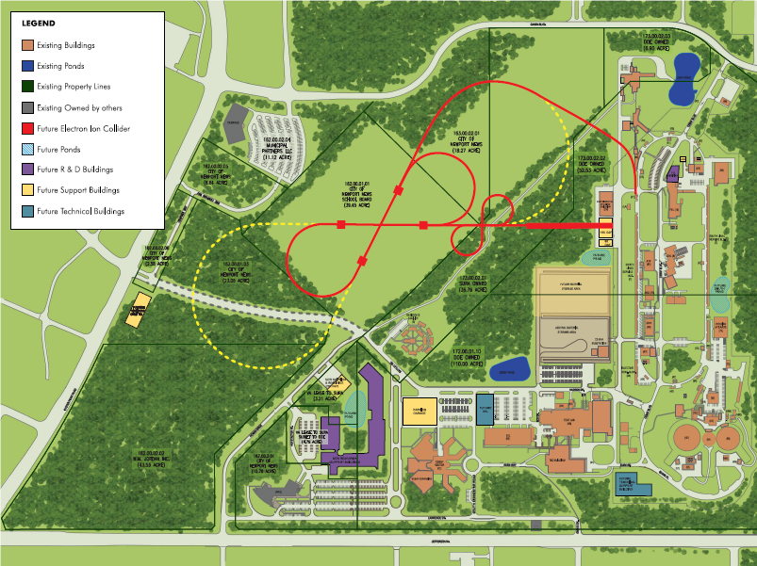
MEIC/EIC Layout
MEIC
(Stage-I EIC)
IP
Ion linac
IP
Pre-booster
CEBAF
Full Energy (Stage-II EIC)

Slide 6
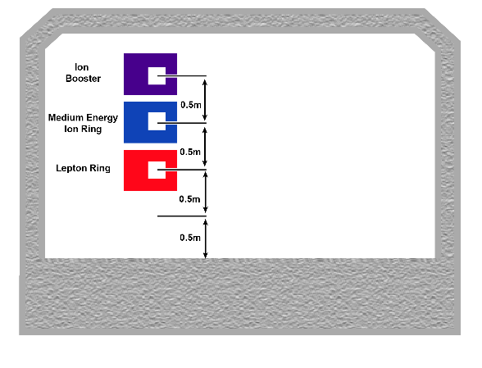
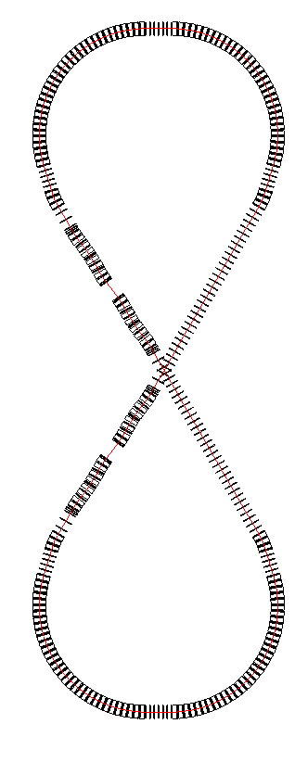
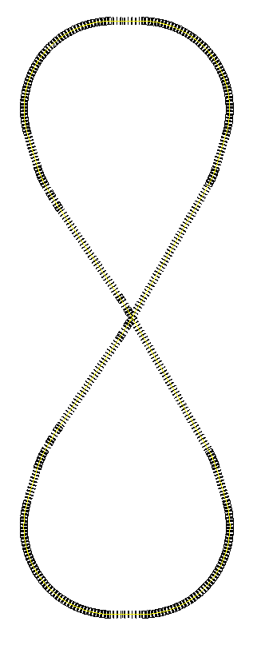
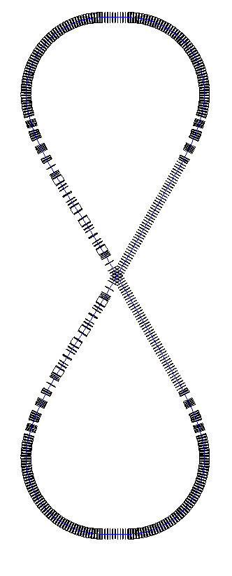
MEIC Layout
Interaction point locations:
Downstream ends of the electron straight sections to reduce synchrotron radiation background
Upstream ends of the ion straight sections to reduce residual gas scattering background
Ion path
Interaction Regions
Electron path
Medium-energy IPs with
horizontal beam crossing
Large Ion Booster
Electron Collider
Ion Collider
12 GeV CEBAF
Vertical stacking of nearly identical rings (max. deviation: 4 m; ring circumferences: 1350 m)
Ion beams execute vertical excursion to the plane of the electron orbit for a horizontal crossing
Horizontal crab crossing (50 mrad) at Ips; Figure-8 crossing angle: 60 deg.

Slide 7
New Ion Complex
  Goals: covering all required ion species & energies, matching phase-space structures
  Challenges: beam formation ⬅ space charge effect at low energy
    maintaining beam phase density ⬅ intra-beam scatterings
  Low energy DC electron cooling for assisting accumulation of heavy ions
  SRF linac and boosters. No transition energy crossing in all rings.
  High energy electron cooling
Low Energy DC electron cooling
ERL electron cooling
Large booster
collider ring
ion sources
SRF Linac
pre-booster
Components | Max. energy (GeV/u) | Electron Cooling | Process
SRF linac | 0.2 (0.08) |  | Stripping
Pre-booster | 3 (1.2) | DC | Accumulating
Large booster | 20 (8) |  | Stacking
collider ring | 100 (40) | Multi-phased/ERL | Coasting/rebunching
* Numbers in parentheses represent energies per nucleon for heavy ions

Slide 8
MEIC Design Point Parameters
Detector type |  | Full acceptance |  | high luminosity & Large Acceptance
 |  | Proton | Electron | Proton | Electron
Beam energy | GeV | 60 | 5 | 60 | 5
Collision frequency | MHz | 750 | 750 | 750 | 750
Particles per bunch | 10¹⁰ | 0.416 | 2.5 | 0.416 | 2.5
Beam Current | A | 0.5 | 3 | 0.5 | 3
Polarization | % | > 70 | ~ 80 | > 70 | ~ 80
Energy spread | 10⁻⁴ | ~ 3 | 7.1 | ~ 3 | 7.1
RMS bunch length | mm | 10 | 7.5 | 10 | 7.5
emittance, normalized | µm rad | 0.35/0.07 | 54/11 | 0.35/0.07 | 54/11
Horizontal and vertical β* | cm | 10 and 2 | 10 and 2 | 4 and 0.8 | 4 and 0.8
Vertical beam-beam tune shift |  | 0.014 | 0.03 | 0.014 | 0.03
Laslett tune shift |  | 0.06 | Very small | 0.06 | Very small
Distance from IP to 1st FF quad | m | 7 | 3.5 | 4.5 | 3.5
Luminosity per IP, 10³³ | cm⁻²s⁻¹ | 5.6 |  | 14.2
Slide 8
Notes:
8

Slide 9
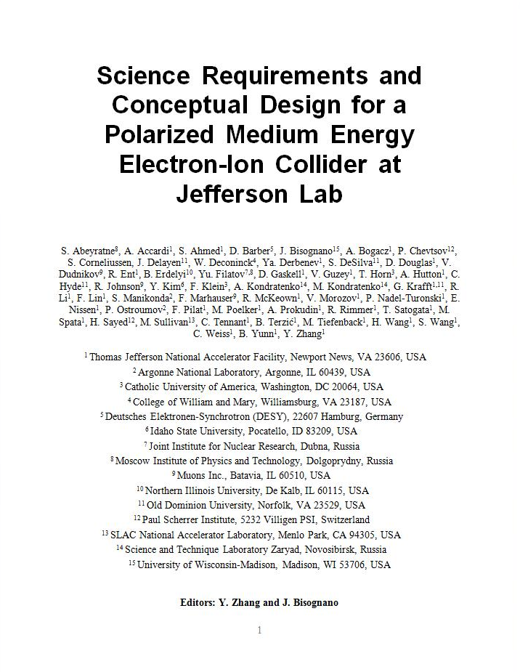
MEIC Design Report
JSA Science Council 08//29/12)
“… was impressed by the outstanding quality of the present MEIC design”
“The report is an excellent integrated discussion of all aspects of the MEIC concept.”
Overall MEIC design features:
High luminosity over broad range
Highly polarized beams (including D)
Full acceptance & high luminosity
Minimized technical risk and R&D
Design concept is stable
arXiv:1209.0757
EPJA article by JLab theory on MEIC science case
(arXiv:1110.1031; EPJ A48 (2012) 92)

Slide 10
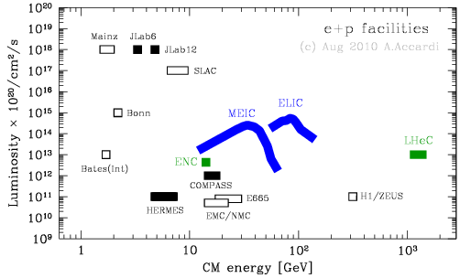
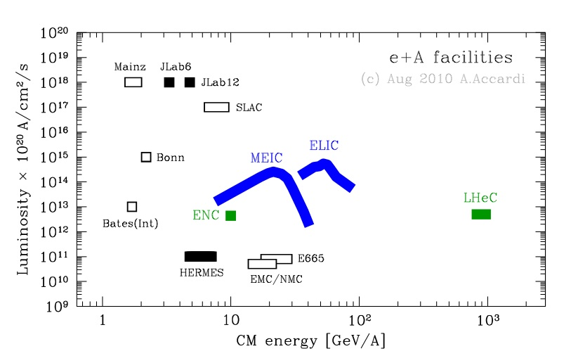
Performance: High Luminosity
e-P collision
  High luminosity over a broad energy range
  MEIC peak luminosity above 10³⁴ cm⁻²s⁻¹
  (A full/high detector acceptance can be achieved simultaneously)
e-A collision
A. Accardi

Slide 11
MEIC High Luminosity Concept
MEIC design concept for high luminosity is based on high bunch repetition rate CW colliding beams
KEK-B has reached >2x10³⁴ /cm²/s
Beam Design
High repetition rate
Low bunch charge
Very short bunch
Very small emittance
JLab is poised to replicate same success in an electron-ion collider:
  A high repetition rate electron beam from CEBAF
  A new ion complex specifically designed to match e-beam
  Multi-phase electron cooling of ion beams
IR Design
Small β*
Crab crossing
Cooling
Multi-phase
During collision
 |  | KEK-B | MEIC
Repetition rate | MHz | 509 | 748.5
Energy (e⁻/e⁺ or p/e⁻) | GeV | 8/3.5 | 60/5
Particles/bunch (e⁻/e⁺ or p/e⁻) | 10¹⁰ | 3.3/1.4 | 0.42 2.5
Beam current | A | 1.2/1.8 | 0.5/3
Bunch length | cm | 0.6 | 1/0.75
Horiz. & vert. β* | cm | 56/0.56 | 10/2~4/0.8
Luminosity/IP, 10³³ | /cm²s | 20 | 5.6 ~ 14
Slide 11

Slide 12
Performance: High Ion Polarization
We are quite confident MEIC could deliver superior ion polarization!
Primary technology innovation: Figure-8 ring
➔All ion rings (two boosters, a collider) have a figure-8 shape
➔ Most simple (in principle)
  Spin precession in the left & right parts of the ring are exactly cancelled
  Special insertions invented to provide energy independent spin tune off 0 at constant orbit
  Ensures an easy means of spin preservation and manipulation
  Avoids energy-dependent spin sensitivity for ion all species
  ➔ Polarized deuterons
  The only practical way to accommodate medium energy polarized deuterons which allows for “clean” neutron measurements
  ➔ No-pain operation
  Offers firm no-pain long term operation runs for all polarized beams at all energies,
  Intrinsic spin resonances stay away
  High order intrinsic effects are diminished with cooled emittance
Slide 12

Slide 13
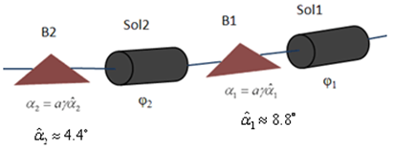
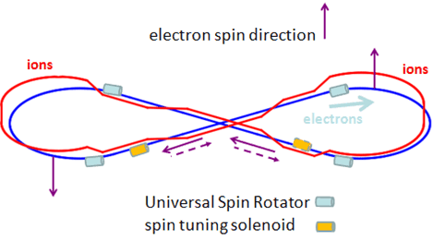
Performance: High Electron Polarization
MEIC Physics program demands
  High polarization (>70%) and long life-time (>10 min.)
  Longitudinal direction at IPs and spin flip
MEIC electron polarization design
  CEBAF polarized electron source (superior, >85%) as a full energy injector
  Beam in the ring can be frequently replaced
  Inject e-beam with vertical spin in arcs
  Using universal spin rotators for longitudinal spin at IP
  Employing spin matching to minimizing depolarization
Universal Spin Rotator
rotating spin from vertical to longitudinal direction
➔ energy independent
➔ orbit (geometry) independent
spin
arc dipole
arc dipole
Solenoid 1
spin
Solenoid 2
φ₁
e beam
α₂≈4.4º
φ₂
α₁≈8.8º

Slide 14
Performance: Low Energy Electron-Ion Collisions
Implementation of low energy electron-ion collisions
Converting large ion booster to a collider ring
Peak luminosity can reach 10³³ cm⁻²s⁻¹
Could be a 3rd IP as an additional capability or the 1st phase of EIC@JLab
Design flexibility, detector interchangeable
No SC ring for large booster ➔ easier to start
Low technology R&D challenges, reduce risk
Low energy ion ring
(large booster)10 to 25 GeV
IP
Electron ring
3 to 12 GeV

Slide 15
Performance: Polarized Positrons
MEIC/LEIC can collide polarized positrons with ions, achieving high luminosity similarly to electron-ion collisions
➔ Only be possible with a ring-ring collider (a lepton storage ring)
Use CEBAF beam to generate unpolarized positrons
(Development of an optimum scheme in process)
Accelerate in CEBAF, inject and stack in the lepton storage ring
Arrange and wait for possibly fastest self-polarization (Sokolov-Ternov effect)
(at 10-12 GeV, and/or by using special wigglers)
Ramp energy down to the target value for experiment
Use spin-resonance SC cavities for spin flip (frequent flip for the whole beam or one-time flip for half beam)

Slide 16
MEIC Accelerator R&D Toward CD1
Electron cooling
  Electron cooling of medium energy ion beam (by simulations)
  ERL circulator cooler design optimization, technology development
  Cooling with bunched electron beams
  ERL-circulator cooler demo (using JLab FEL facility)
Interaction region
  Optimization of detector integration
  Sufficient dynamic aperture with low beta insertions
Beam Synchronization
  A scheme has been developed; SRF cavity frequency tunability study is in progress
Polarization
  Demonstrate superior ion polarization with figure-8 ring
  Electron spin matching
Collective beam effects
  (Long time scale) beam-beam with crab crossing
  Space charge effects in pre-booster
  Electron cloud in the ion rings and mitigation
Ion Injector complex optimization and beam studies
Bold font indicates priority

Slide 17
Cooling: No. 1 R&D Priority
Essential to achieve high luminosity for MEIC
Based on traditional electron cooling
Multi-phase cooling scheme
  Pre-booster: Cooling for assisting accumulation of positive ion beams
  (Using a low energy DC electron beam, existing technology)
  Collider ring: Initial cooling after injection
  Final cooling after boost & re-bunching, reaching design values
  Continuous cooling during collision for suppressing IBS
  (Using new technologies)
Energy (proton / electron) | GeV/MeV | 20 / 10.9 | 100 / 54
Current & Particles/bunch, p/e | A / 10¹⁰ | 0.5/1.5 and 0.417/1.25
Ion bunch length | cm | coasting | ➔1
Electron bunch length | cm | 2
Proton emittance, horiz. /vert. | μm |  | 0.35/0.07
Cooling time | min | 10 | ~ 0.4
Medium energy
Bunched e-beam
ERL
Circulator ring
➔ Cooling of medium energy (up to 100 GeV) hadrons w/ a bunched electron beam (state-of-art: 8 GeV p-bar at Fermilab, DC)
➔ Generating 3 A, 55 MeV cooling electron beam

Slide 18
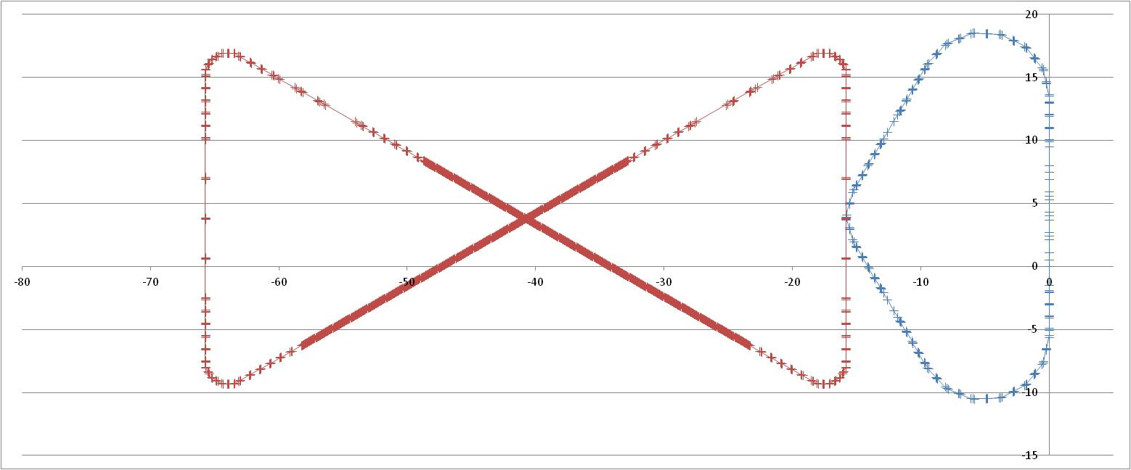
Design Concept: ERL Circulator Cooler
solenoid
Design Choices
Energy Recovery Linac (ERL)
Compact circulator ring
to meet design challenges
Large RF power (up to 81 MW)
Long gun lifetime (average 1.5 A)
Required technologies
High bunch charge magnetized gun
High curr. ERL (55 MeV, 15 to150 mA)
Ultra fast kicker
ion bunch
electron bunch
Cooling section
Fast kicker
circulator ring
Fast kicker
energy recovery
injector
SRF Linac
dump
e-bunches circulates 10+ turns ➔ reduction of current from an ERL by a same factor
recirculation/decompression
Optimization:
Put it at center of the Figure-8 ring, for eliminating the long return path doubles the cooling rate
CCR
dump
cooling solenoids
beam exchange system
dechirper
ERL
rechirper
injector
recovery/recompression
Slide 18
18
Notes:
18

Slide 19

Design Concept Optimization
 |  | Ion energy (GeV/u) | Ready-to-build | Ultimate | Old scheme
Pre-booster | DC electron cooling to assist accumulation of positive ions | 0.1
 | DC electron cooling for emittance reduction | 3
Collider ring | ERL electron cooling at injection energy for emittance reduction | 20
 | ERL electron cooling at top energy for emittance reduction | Up to 100
 | ERL electron cooling during collision to suppress IBS induced emittance growth | Up to 100 | “Weak”
 | Stochastic cooling of heavy ions during collision to suppress IBS induced emittance growth | Up to 100
Luminosity | 10³³ 1/cm²/s |  | 1 ~ 3 | 5.6 ~ 14
The “ready-to-build” version utilizes only (loosely speaking) the existing and proven accelerator technologies.
“Weak” ERL cooling means using much lower electron current

Slide 20
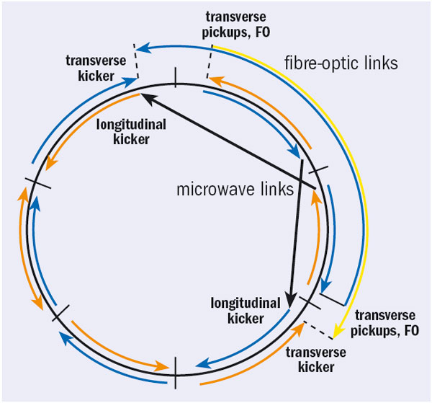
Existing Cooling Technologies
“Weak” ERL Cooler
Bunched Stochastic Cooling
solenoid
ion bunch
electron bunch
Cooling section
Fast kicker
circulator ring
Fast kicker
RHIC
injector
SRF Linac
dump
No circulating ring (no fast kicker)
Electron current: ~100 mA (state-of-art)
Needs ERL (e-beam power: 5.5 MW)
Only for heavy ions
Bandwidth: 4~9 GHz
Lead ions: 5.1x10⁷ per bunch
Cooling time: ~ 14 min
Medium energy
Bunched e-beam
ERL
Circulator ring

Slide 21
MEIC Phased Cooling Scheme
Loosely speaking, based on existing technologies
5.6~14
Add “weak” ERL cooling &stochastic cooling (heavy ions) during collision
Full capacity electron cooling (ERL-circulator cooler)
Luminosity (10³³ 1/cm²/s)
~3.3
Low energy DC cooling only at pre-booster injection
~1.1
Add DC cooling at top energy (3 GeV) of pre-booster
~0.41

Slide 22
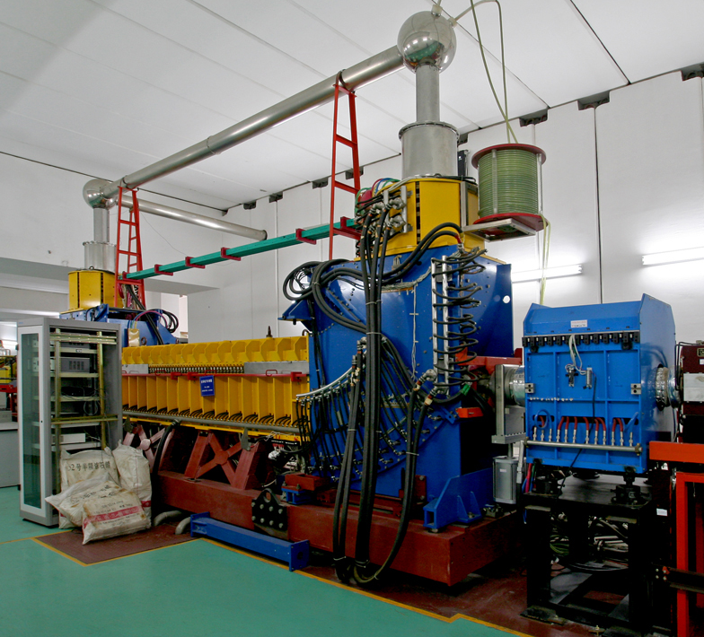
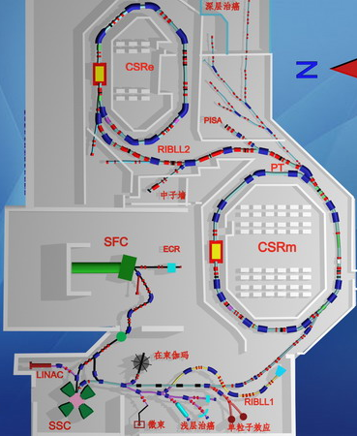
Cooling Experiments at IMP
Institute of Modern Physics, Chinese Academy of Science
Two storage rings with DC coolers for heavy ion coasting beams
DC cooler
Purpose: testing cooling with a bunched electron beam (Andrew Hutton)
➔ Modulated the DC beam into a bunched beam with a high repetition rate by applying a pulsed voltage to the bias-electrode of the electron gun (Hongwei Chao, IMP)
➔ Replacing the existing thermionic gun by a JLab photo-cathode gun (Matt Poelker, JLab)
Low cost, non-invasive experiment, as early as 08/2013
Supporting the “Ready-to-Build” design concept
Phase II: adding an RF cavity for bunching the ion beams)
testing a bunched electron beam to cool a bunched ion beam
Medium energy
Bunched e-beam
ERL
Circulator ring

Slide 23
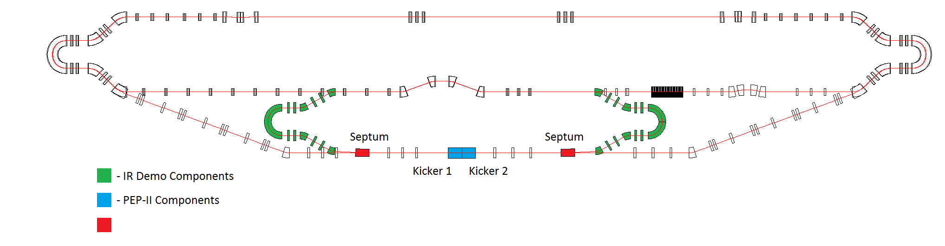
ERL-Circulator Cooler Proof-of-Concept Experiment at JLab FEL-ERL
Dechirper
Rechirper
Cooler Test Facility @ JLab FEL ERL
Purpose
  Demonstrate the design concept
  Develop/test key accelerator technologies (faster beam kickers, etc.)
  Study dynamics of the cooling electron bunches in a circulator ring
Phase 1 scope
  Using the existing ERL without new upgrade except two 180° beam lines (available at JLab)
  Supporting MEIC to deliver the high luminosity (5.6~14 x 10³³ 1/cm²/s), not needed for the “ready-to-build” version
  To be completed (hopefully) before 2016
Medium energy
Bunched e-beam
ERL
Circulator ring

Slide 24
Summary
The MEIC design has been completed and a comprehensive design report has been released.
Low energy electron-ion collisions can be realized either as an add-on or as a first stage, expanding the science reach
We anticipate superior performance of MEIC, particularly in luminosity, lepton and light ion polarization, detection acceptance, etc.
The focus of the MEIC team has shifted to design optimization (low cost and less technical uncertainty) and critical accelerator R&D.
Cooling is considered the most critical R&D
  Optimizing the cooling scheme by using more existing (DC) technology
  “Ready-to-Build” enables luminosity above 10³³ cm⁻²s⁻¹, meets the EIC white paper requirement;
  R&D will bring an order of magnitude booster
  Two low-cost experiments will demonstrate the design concept

Slide 25
Acknowledgement
S. Abeyratne, A. Accardi, S. Ahmed, D. Barber, J. Bisognano, A. Bogacz, A. Castilla, P. Chevtsov, S. Corneliussen, W. Deconinck, P. Degtiarenko, J. Delayen, Ya. Derbenev, S. DeSilva, D. Douglas, V. Dudnikov, R. Ent, B. Erdelyi, P. Evtushenko, Yu. Filatov, D. Gaskell, R. Geng, V. Guzey, T. Horn, A. Hutton, C. Hyde, R. Johnson, Y. Kim, F. Klein, A. Kondratenko, M. Kondratenko, G. Krafft, R. Li, F. Lin, S. Manikonda, F. Marhauser, R. McKeown, V. Morozov, P. Nadel-Turonski, E. Nissen, P. Ostroumov, M. Pivi, F. Pilat, M. Poelker, A. Prokudin, J. Qiang, R. Rimmer, T. Satogata, H. Sayed, M. Spata, M. Sullivan, C. Tennant, B. Terzić, M. Tiefenback, H. Wang, S. Wang, C. Weiss, B. Yunn, Y. Zhang
¹ Jefferson Lab
² Argonne National Laboratory
³ Brookhaven National Laboratory
⁴ Catholic University of America
⁵ College of William and Mary
⁶ DESY
⁷ Hampton University
⁸ Idaho State University
⁹ Joint Institute for Nuclear Research, Dubna
¹⁰ Lawrence Berkeley National Laboratory
¹¹ Moscow Institute of Physics & Technology
¹² Muons Inc.
¹³ Northern Illinois University
¹⁴ Old Dominion University
¹⁵ Paul Scherrer Institute
¹⁶ SLAC National Accelerator Lab
¹⁷ Science and Technique Lab Russia
¹⁸ Universidad de Guanajuato
¹⁹ University of Wisconsin-Madison

