Slide 1
Precision QCD measurements in DIS
DIS 2013, Marseille
22th april 2013
Olaf Behnke (DESY)
1
Notes:
Welcome to this DESY seminar
It is my pleasure to present you a sneak
preview of new H1 results for ICHEP06

Slide 2
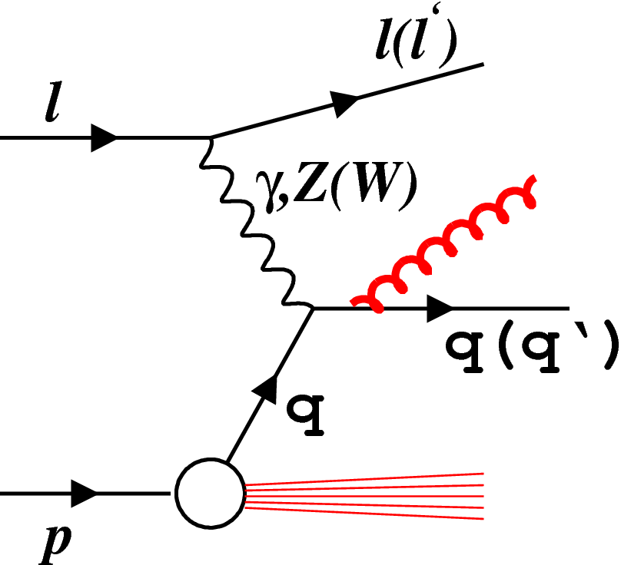
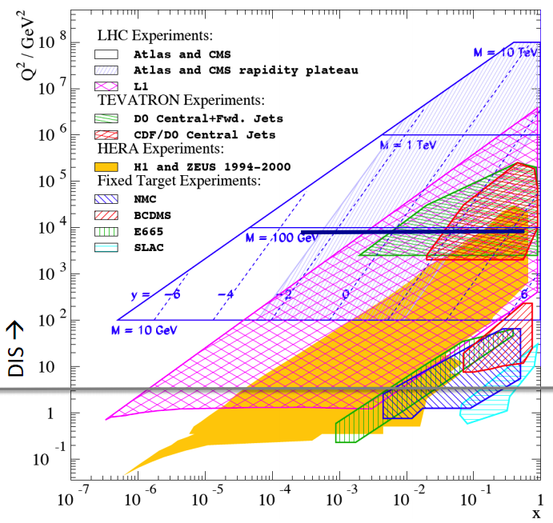
Deep inelastic scattering: nucleon structure and QCD
Boson virtuality
LHC
Q² = -q²
Tevatron
Boson energy
y = E_{γ}/E_{l|p-cms}
LHC
TeV
HERA
Quark momentum
LHeC
xp
Fixed
target
PHP
HERA
Constraint:
Today: Present new HERA QCD results
Q² = sxy
2

Slide 3
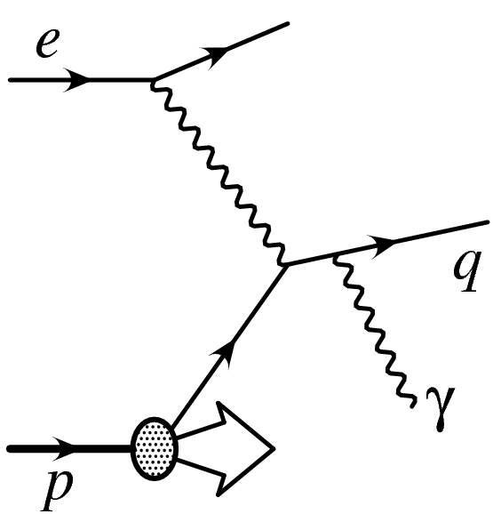
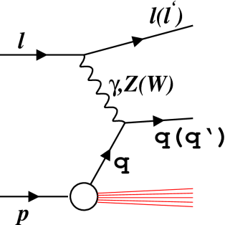
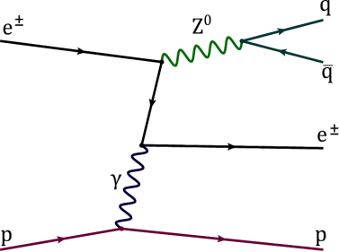
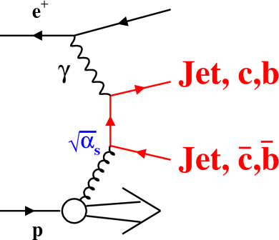

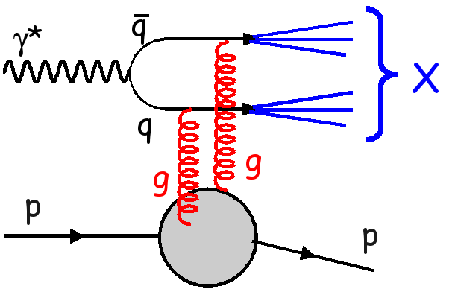
Todays HERA Tour through perturbation series:
α²
α_{w}α²
α³
inclusive DIS
Z0 production
α_{s}⁰
Compare to N(NLO) calculations based on factorisation
Isolated γ
α_{s}¹
Proton PDF
hard scattering kernel
Jets and HFL
α_{s}²
Hard diffraction
Not covered: Charged particle spectra, Very forward neutron/photon production, strangeness production
3

Slide 4
Todays HERA Tour through perturbation series:
α²
α_{w}α²
α³
inclusive DIS
Z0 production
α_{s}⁰
JHEP 1209:061 (2012)
PL B 718 (2013) 915
PRD 87, 052014 (2013)
ZEUS-prel-13-001
Isolated γ
α_{s}¹
EPJ C73 (2013) 2311
DESY-13-054
DESY-13-028
NPB 864 (2012) 1
H1prelim-12-031
JHEP02 (2013) 071
EPJ C72 (2012) 2047
EPJ C72 (2012) 2148
Jets and HFL
α_{s}²
H1prelim-13-011
Hard diffraction
DESY-13-012
H1prelim-13-032
Not covered: Charged particle spectra, Very forward neutron/photon production, strangeness production
H1prelim-12-111, H1prelim-13-012
H1prelim-13-031, H1prelim-13-033
4

Slide 5
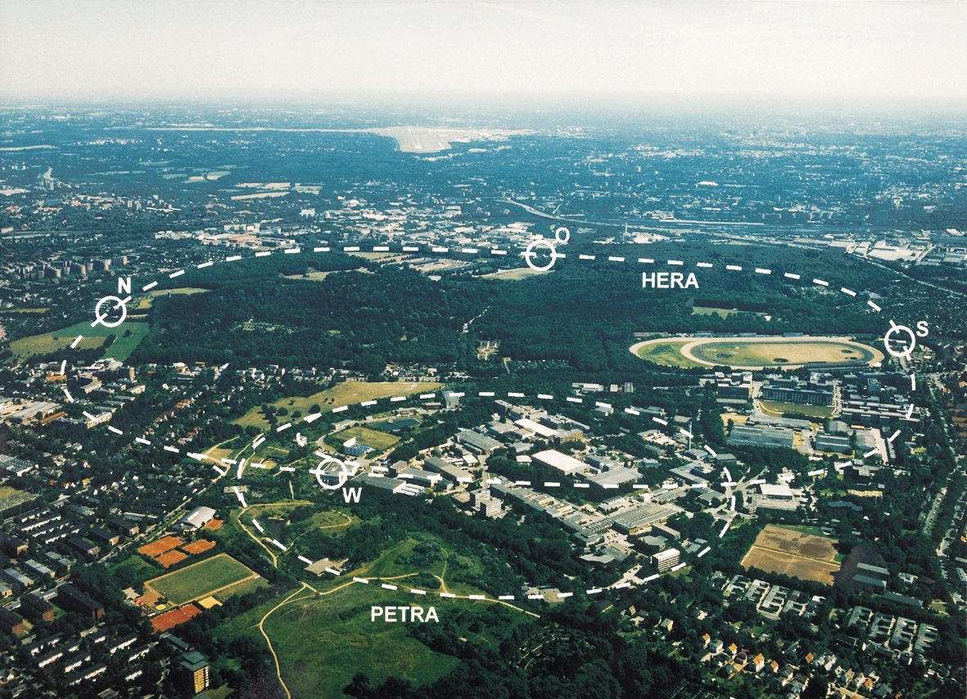
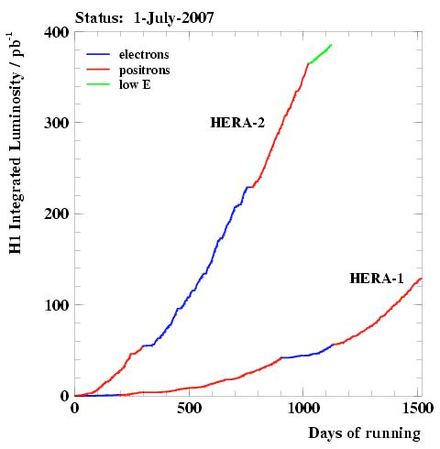


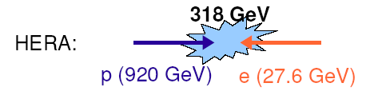
The HERA ep collider (1992-2007)
Longitudinally polarised e
~0.5 fb⁻¹ per experiment
±
5

Slide 6
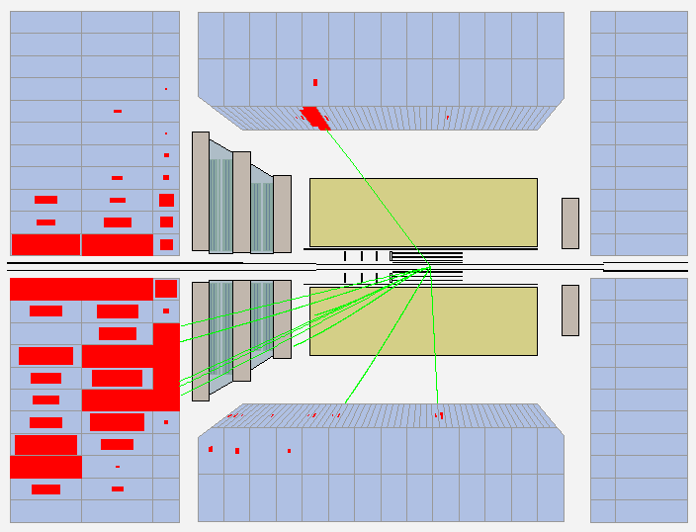
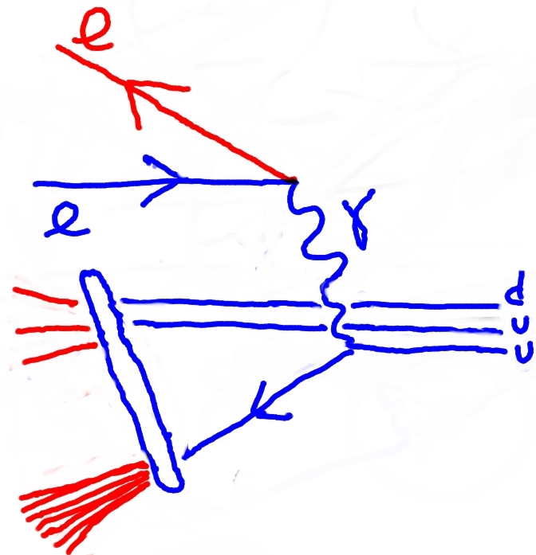
Inclusive DIS at HERA (count every DIS event)
NC Event in ZEUS detector
,Z⁰
Display produced from ROOT ntuple (“ZEUS common ntuple”)
6

Slide 7
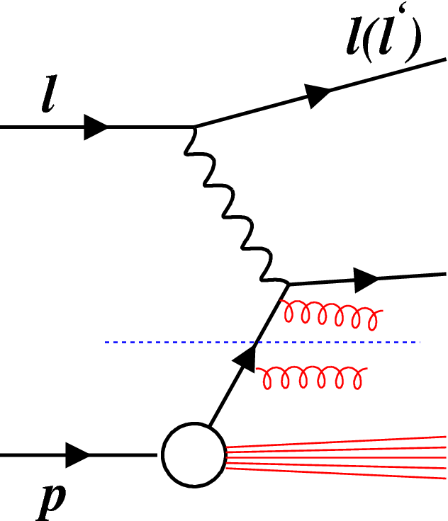
Inclusive DIS at HERA: three pieces
Electroweak
Fix Electroweak & pQCD
Determine PDFs
Voica Radescu talk
Perturbative QCD
Fix Electroweak
Test pQCD ⊗ PDFs
Main talk topic!
Fix pQCD ⊗ PDFs
Test Electroweak
Next two slides
PDFs at Q₀
7

Slide 8
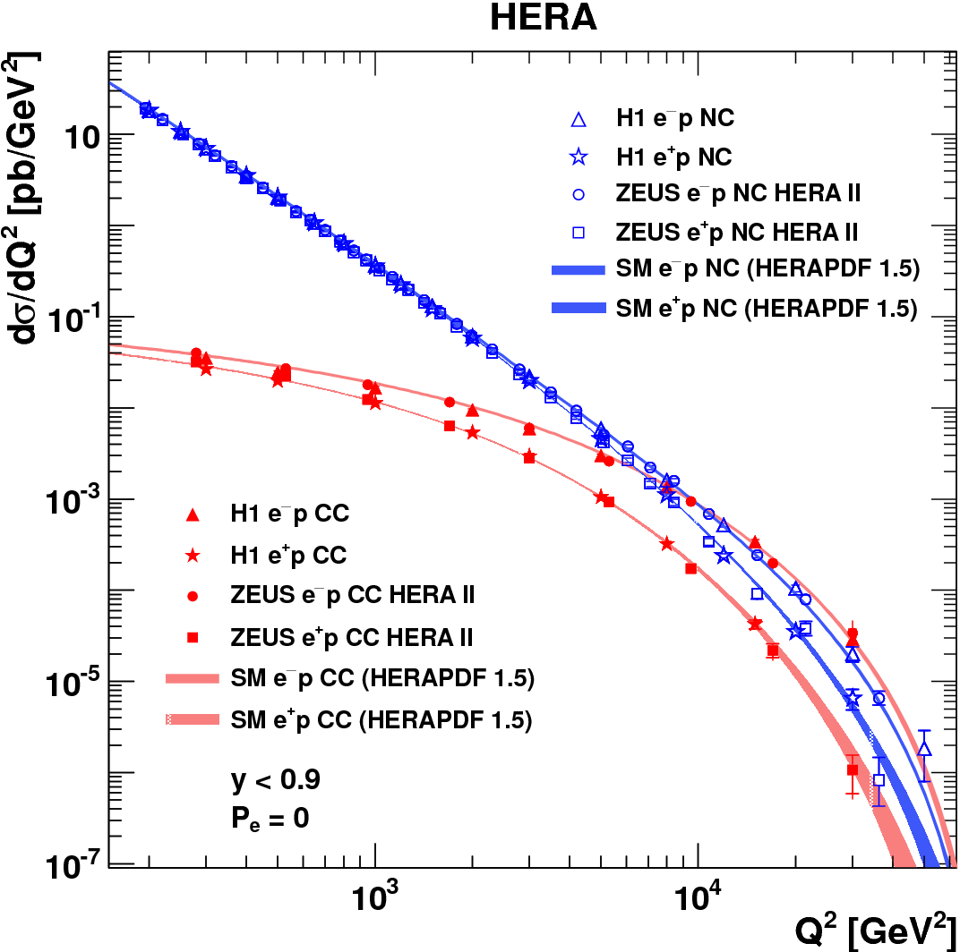
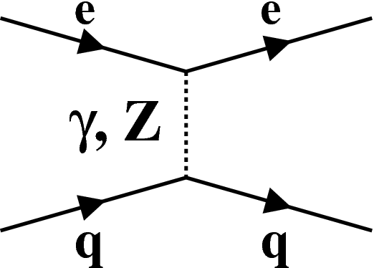
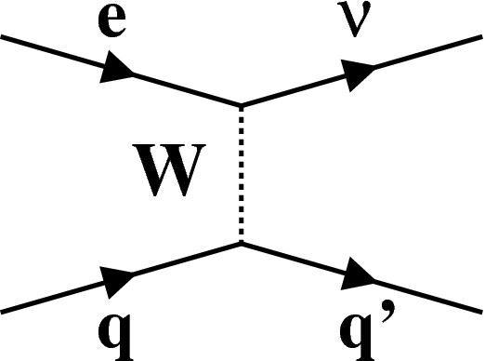

Electroweak unification
Using the full HERA II results completed by
JHEP 1209:061 (2012)
PRD 87, 052014 (2013)
Textbook plot
8

Slide 9
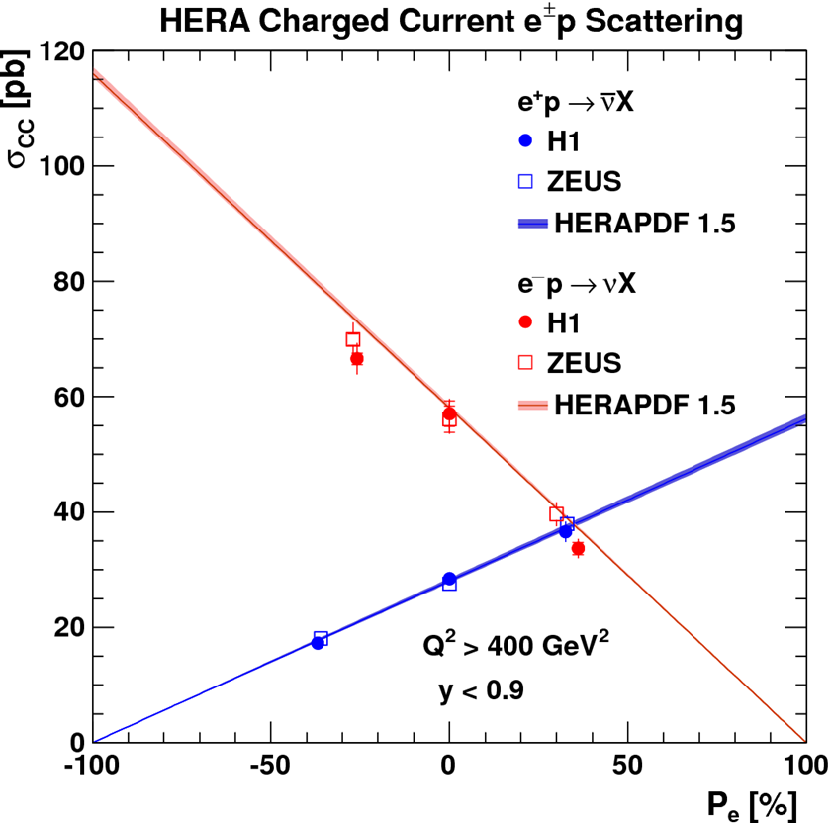
Parity violation in charged current DIS
Using the full HERA II results completed by
JHEP 1209:061 (2012)
SM: zero cross section
for RH e- and LH e+
Data agree with SM
Rules out W_{R} bosons under 200 GeV
9

Slide 10
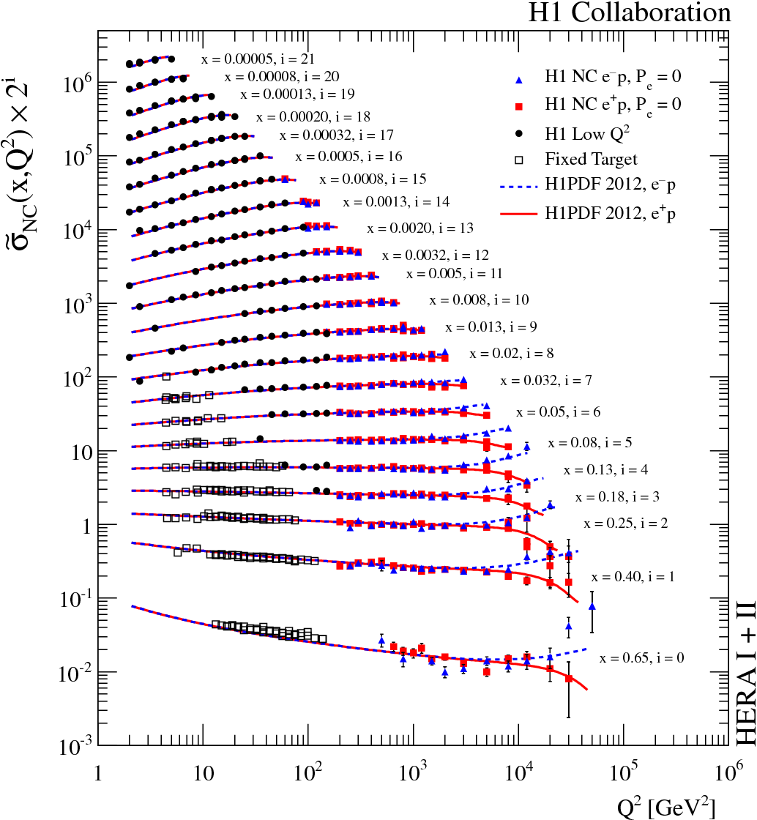
Reduced NC
cross sections
Final H1 results
JHEP 1209:061 (2012)
1.5% precision for Q²<500 GeV²
Data well described by
DGLAP NLO QCD
10

Slide 11
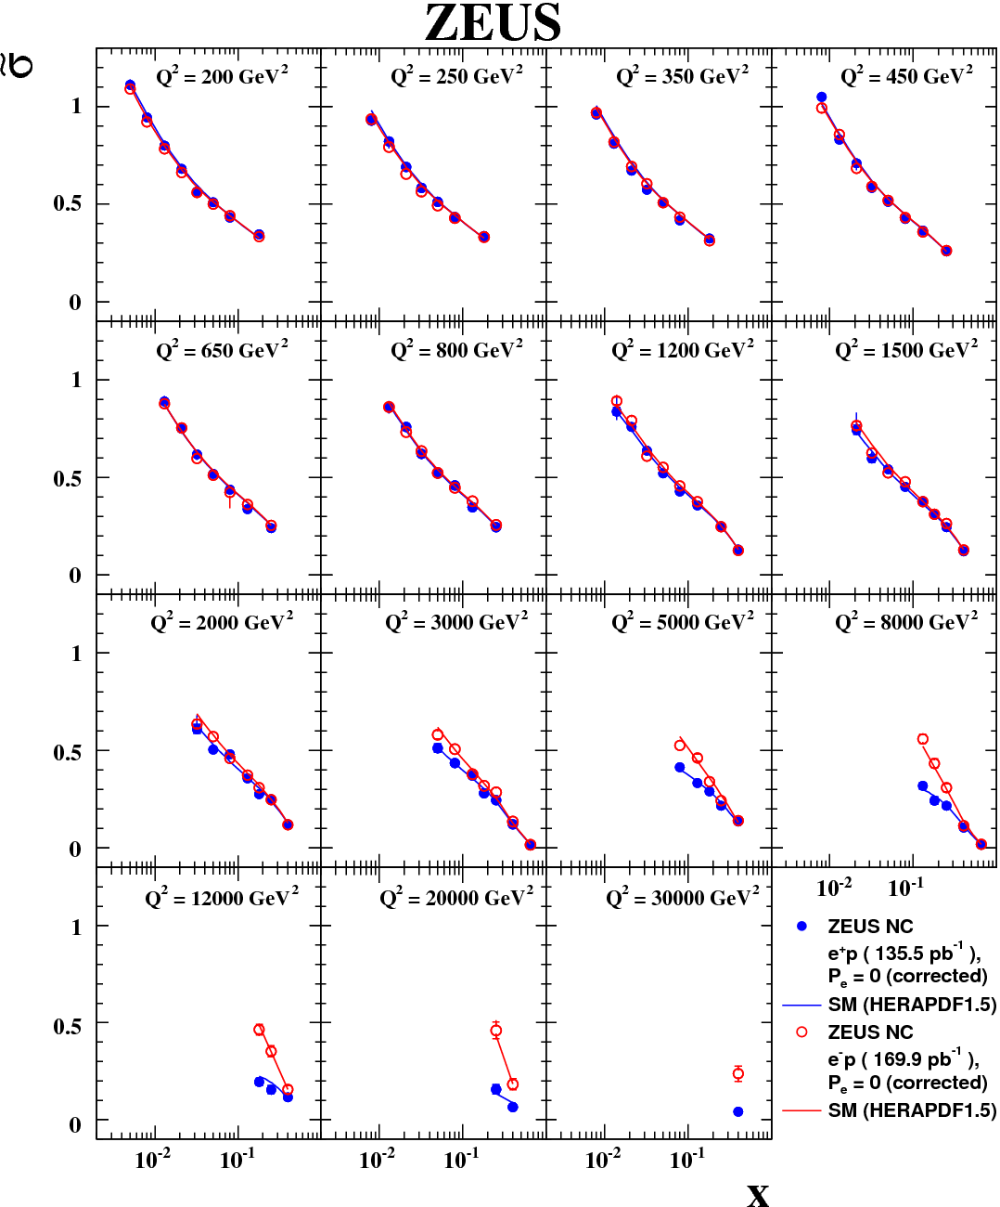
Reduced NC
cross sections
ZEUS final
high Q² HERA II results
completed by e+p NC data
PRD 87, 052014 (2013)
Best precisions of ~1.5%
Data well described by DGLAP NLO QCD
e-p
e+p
11

Slide 12
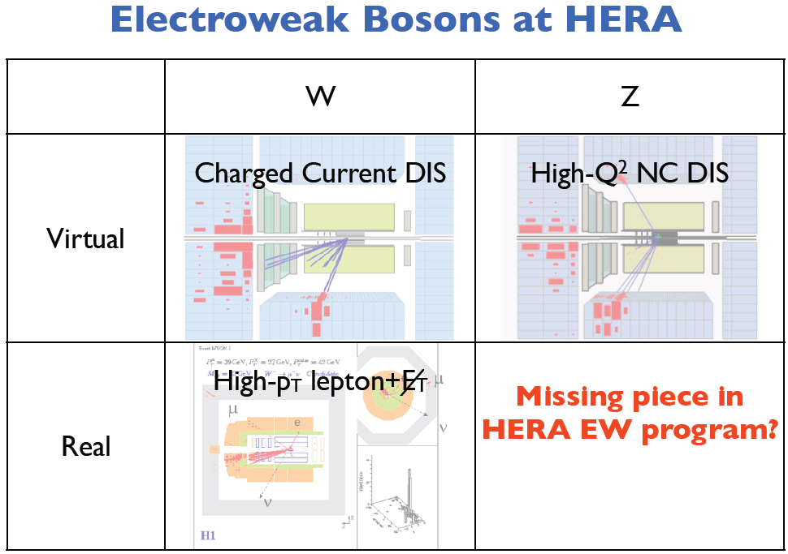
12

Slide 13
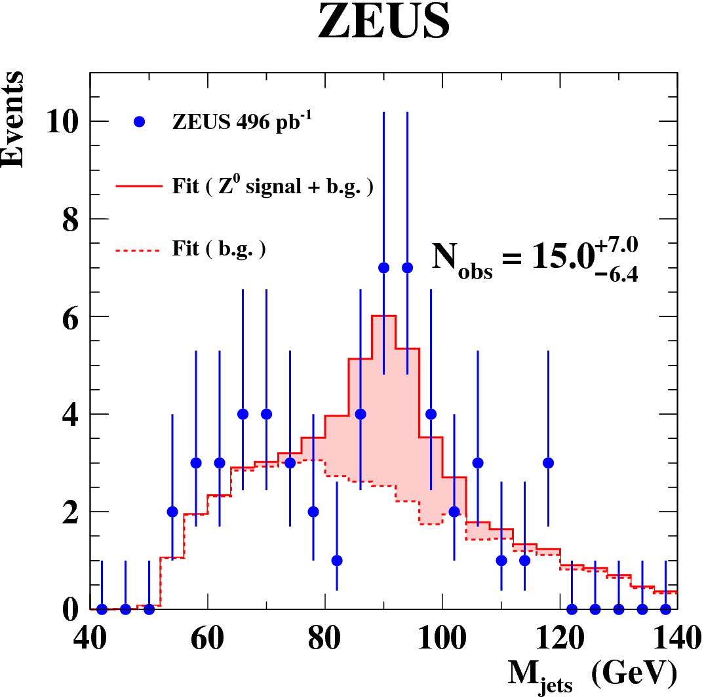
Elastic Z⁰ production
PL B 718 (2013) 915
shows excellent σ_{E}^{hadronic} of
ZEUS Uranium scintillator calorimeter
13

Slide 14
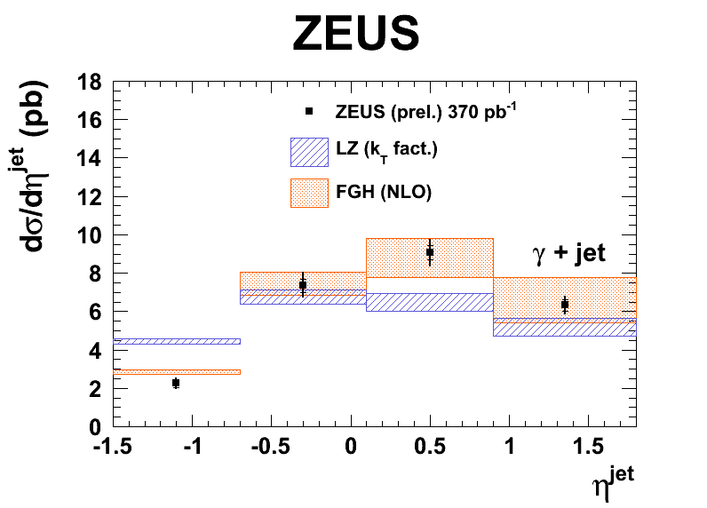
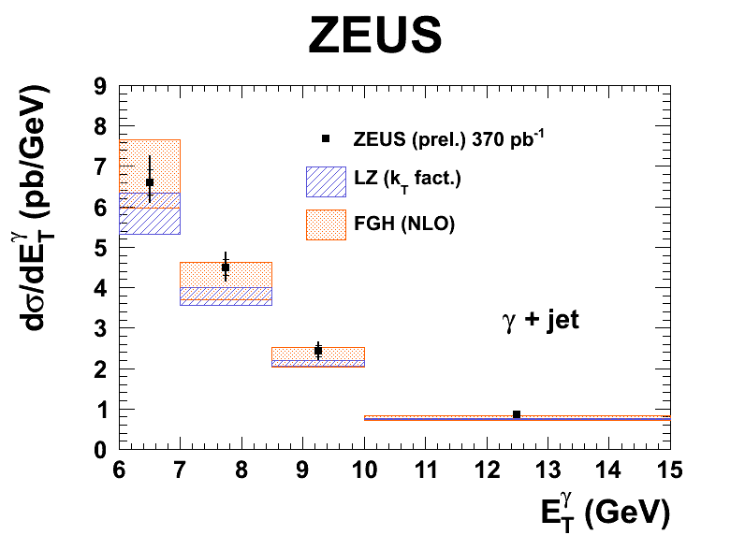
Isolated γ+jets in photoproduction
ZEUS-prel-13-001
γ emissions are not affected by hadronisation => direct probe of the parton dynamics
Both predictions ~reasonable, but room for improvements
14

Slide 15
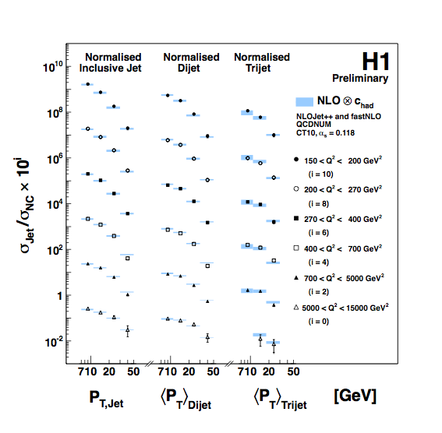
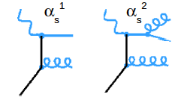
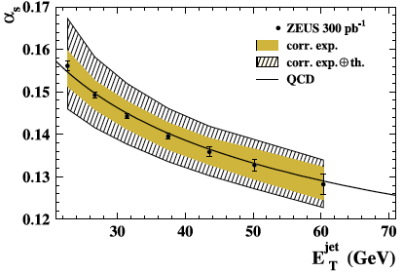
Jets at HERA
DIS, 150 GeV² < Q² < 15000 GeV²
(Multi) jets directly
sensitive to α_{s}
Data well described by
DGLAP NLO QCD
Photoproduction
Q²~0
NPB 864 (2012) 1
H1prelim-12-031
+ 0.0023
- 0.0022
+ 0.0042
- 0.0035
+ 0.0011
- 0.0011
+ 0.0042
- 0.0042
αS(MZ)=0.1206 (exp) (theory)
αS(MZ)=0.1163 (exp) (theory)
Higher order theory uncertainties dominate → need NNLO calculations!
15

Slide 16
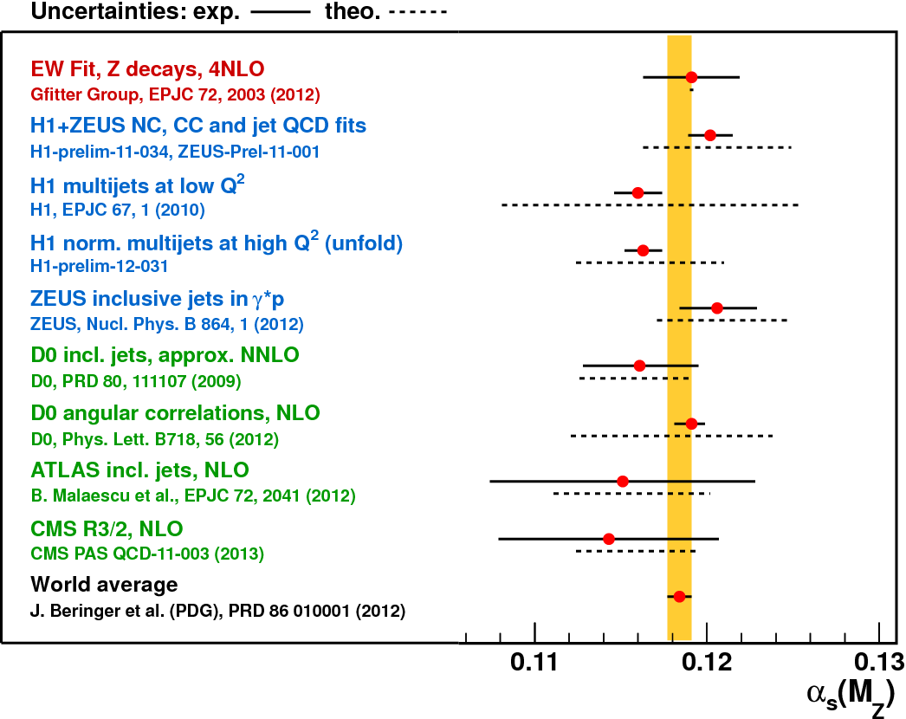
Comparison of recent α_{s}(M_{Z}) values
Compiled by R. Kogler
Using complete o(α_{s}⁴)
P. Baikov et al. PRL 108,222003 (2012)
Theory
uncertainty
dominates,
Need NNLO
16

Slide 17
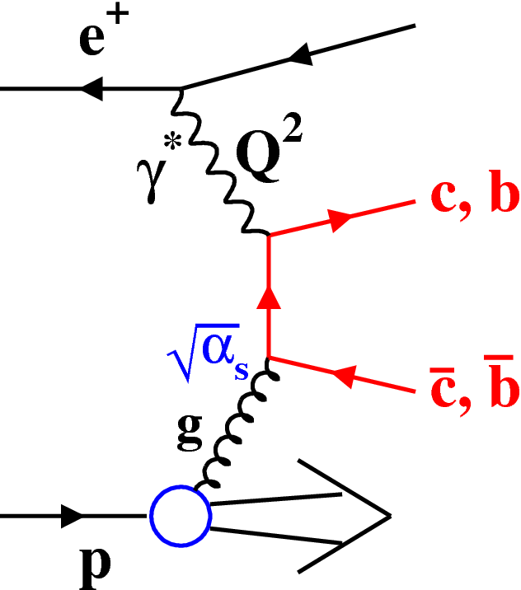
Charm and Beauty production at HERA
Large contributions to incl. DIS
Sensitive to g(x)
17

Slide 18
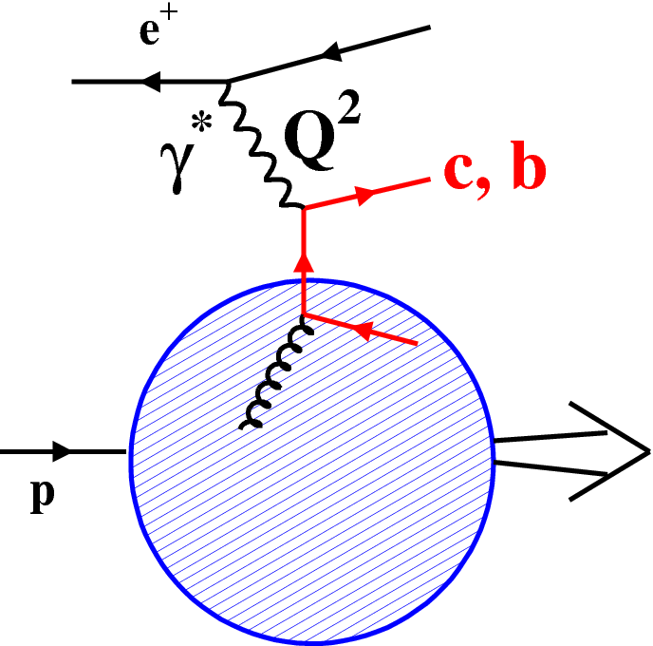
HFL schemes
Massive scheme: Q²~m_{c}²
Massless scheme: Q²>>m_{c}²
ZM-VFNS
FFNS
Mixed schemes: interpolate, but how to do transition? → numerous variants
GM-VFNS
18

Slide 19
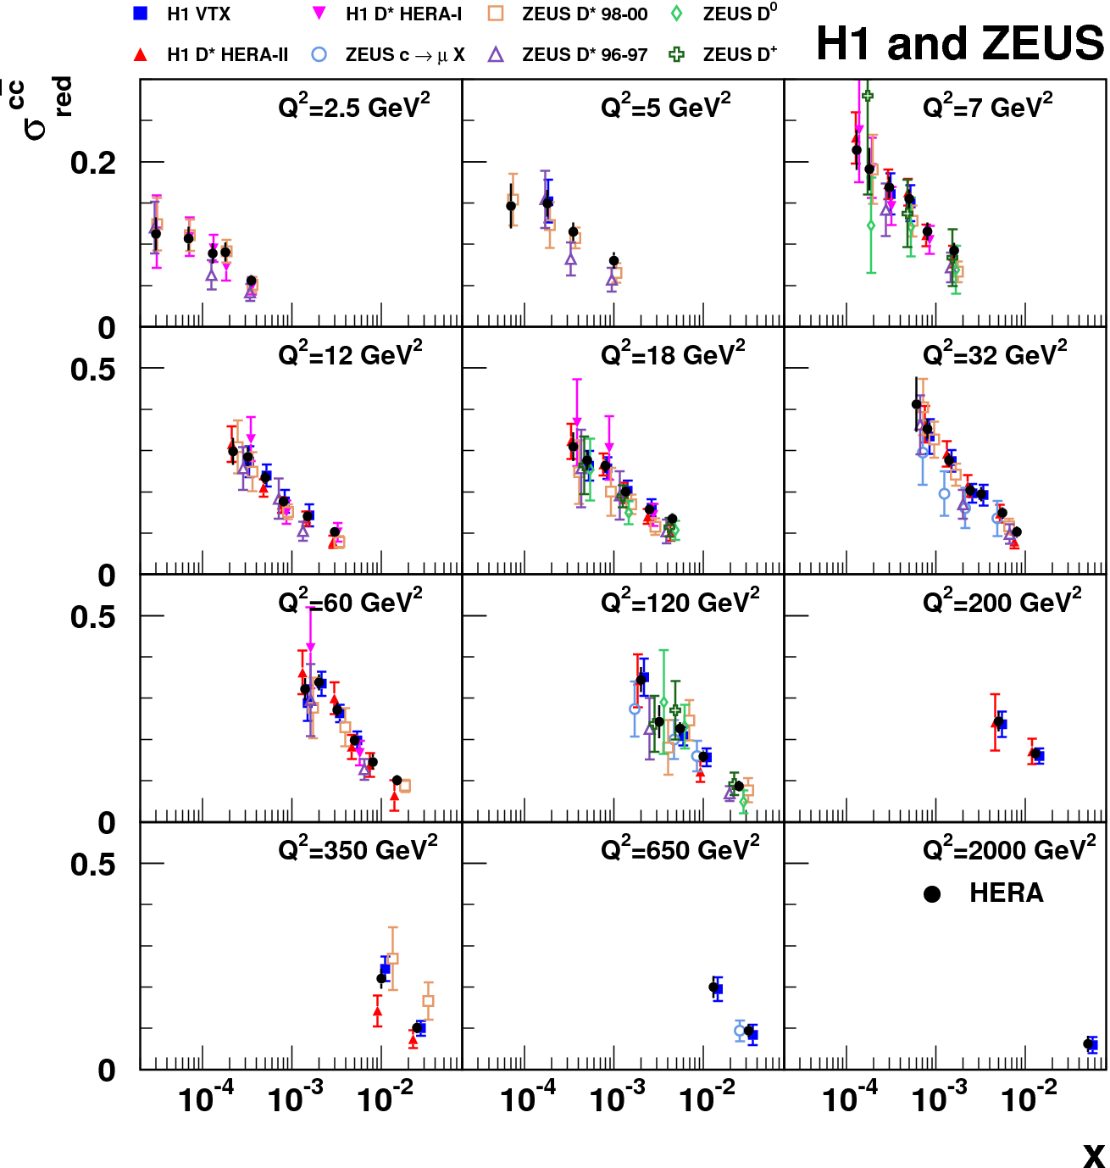
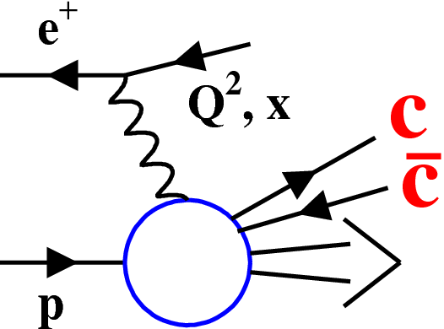
HERA Charm data combination
EPJ C73 (2013) 2311
Combine D*,D⁺,D⁰, μ and lifetime tag data
take correlated syst. fully into account
~σ^{cc}_{red}
19

Slide 20
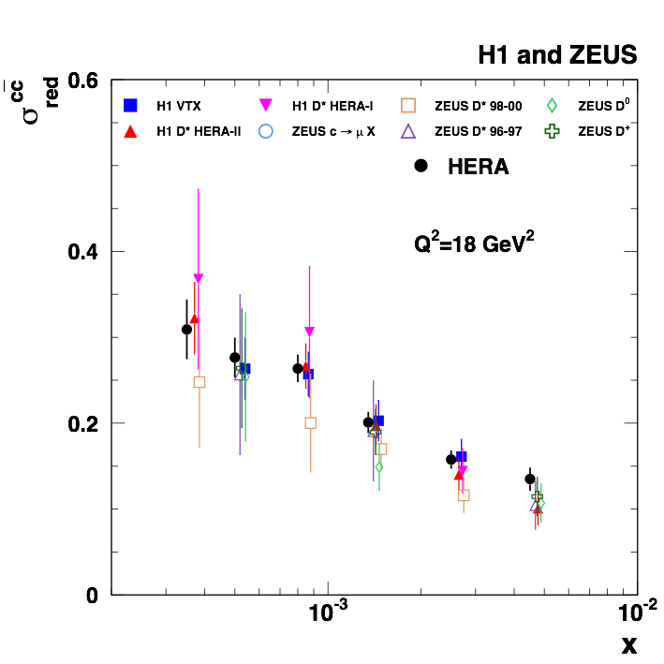
HERA Charm data combination
EPJ C73 (2013) 2311
Combine D*,D⁺,D⁰, μ and lifetime tag data
take correlated syst. fully into account
Best precision
obtained:~5%
~σ^{cc}_{red}
Best precision:~5%
20

Slide 21
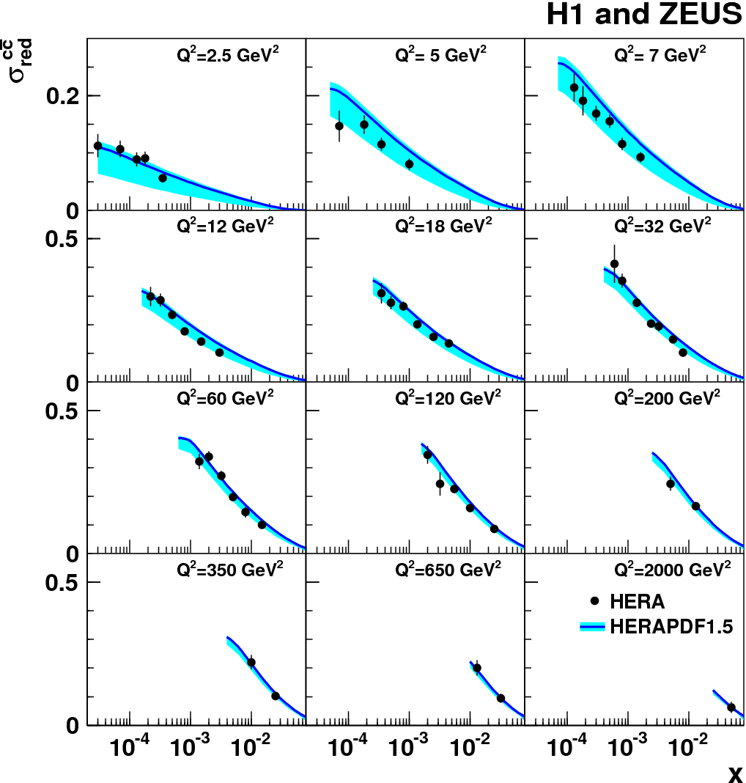
Combined charm data vs NLO GMVFNS
EPJ C73 (2013) 2311
HERAPDF1.5:
only inclusive DIS data
RT standard scheme
NLO GM-VFNS ok
large theory uncertainty dominated by m_{c} variation
21

Slide 22

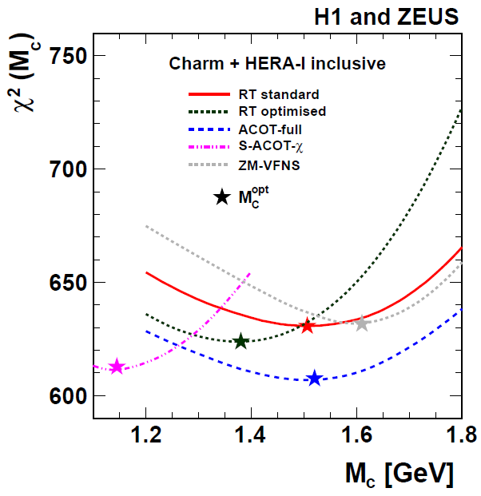

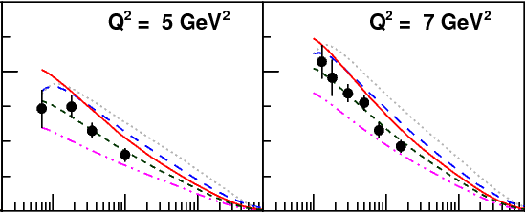
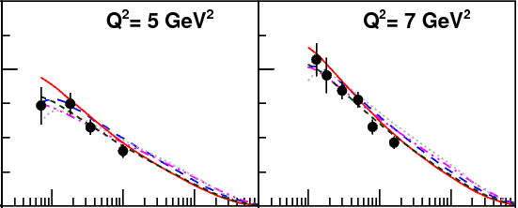

PDF plus charm mass param. fit
EPJ C73 (2013) 2311
Fit combined charm and inclusive DIS data
GMVFN-schemes with charm mass parameter M_{c}
M_{c} = 1.4 GeV
M_{c} = M_{c}^{opt}
Various GM-VFNS: interpolate differently between massive and massless schemes
→ different quality of charm data description for fixed M_{c}→ compensate by M_{c}^{opt} values
→ stabilises flavour mixture in PDF → stabilises LHC predictions (W,Z) (see talk V. Radescu)
22

Slide 23
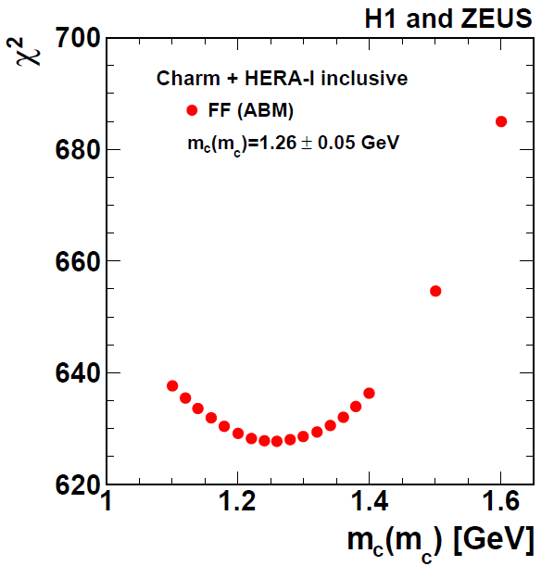
PDF plus running charm mass fit
EPJ C73 (2013) 2311
Fit to the same data
Massive scheme (FF ABM)
Consistent with world average:
m_{c}(m_{c}) = 1.275±0.025 GeV
23

Slide 24
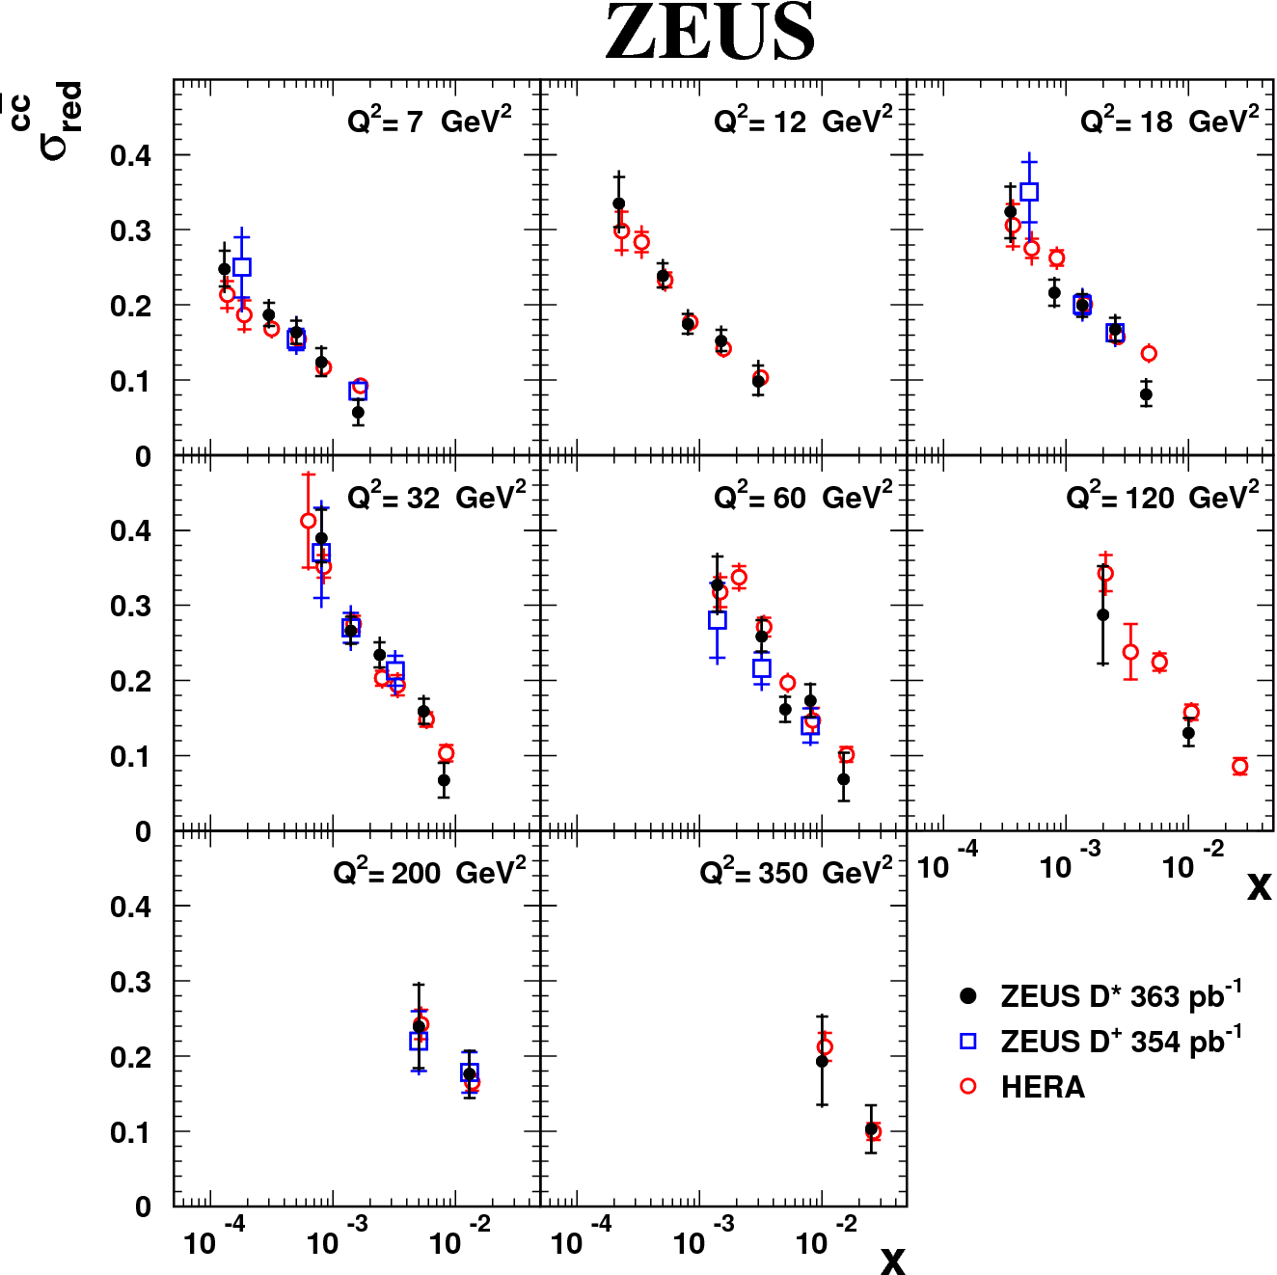
Brand new charm results in DIS: D* and D+
DESY-13-054
DESY-13-028
Consistent findings
New ZEUS results will improve combination, PDF and m_{c} fits
24

Slide 25
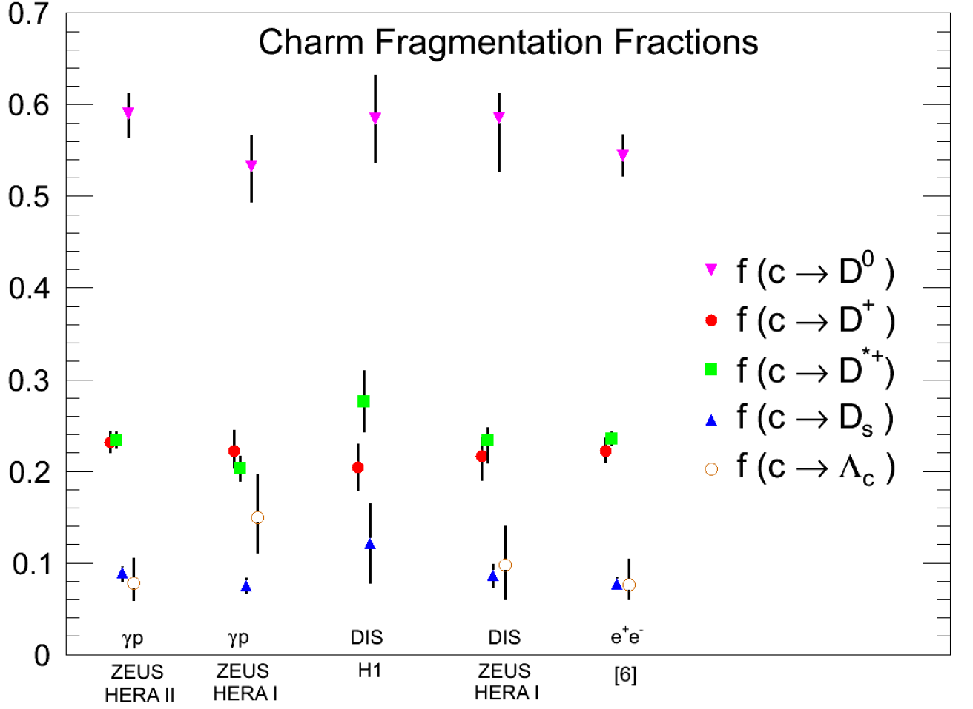
Charm fragmentation fractions in PHP
to be submitted soon for DESY preprint
Probabilities of the charm quark to hadronise into particular hadrons
Competitive precision to e+e- data
Confirm universality of charm fragmentation
25

Slide 26
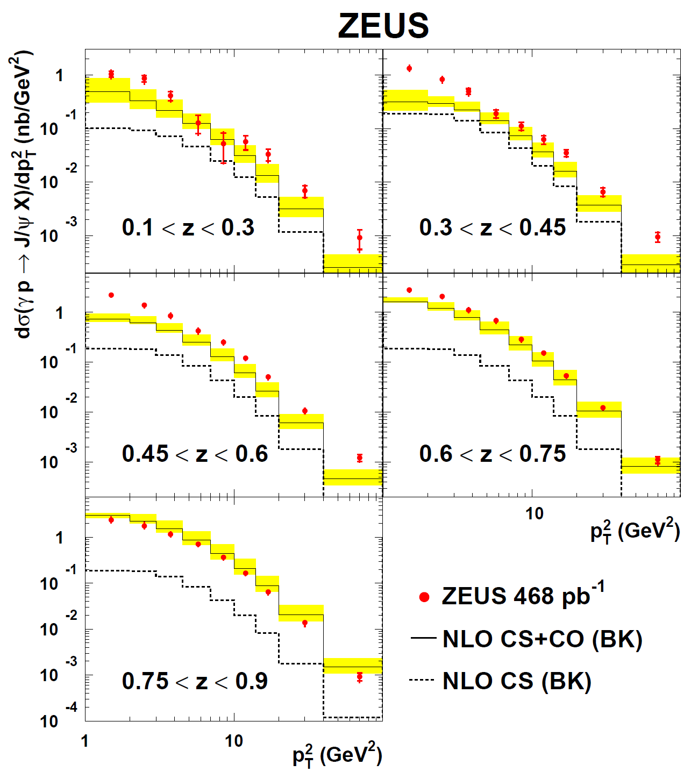
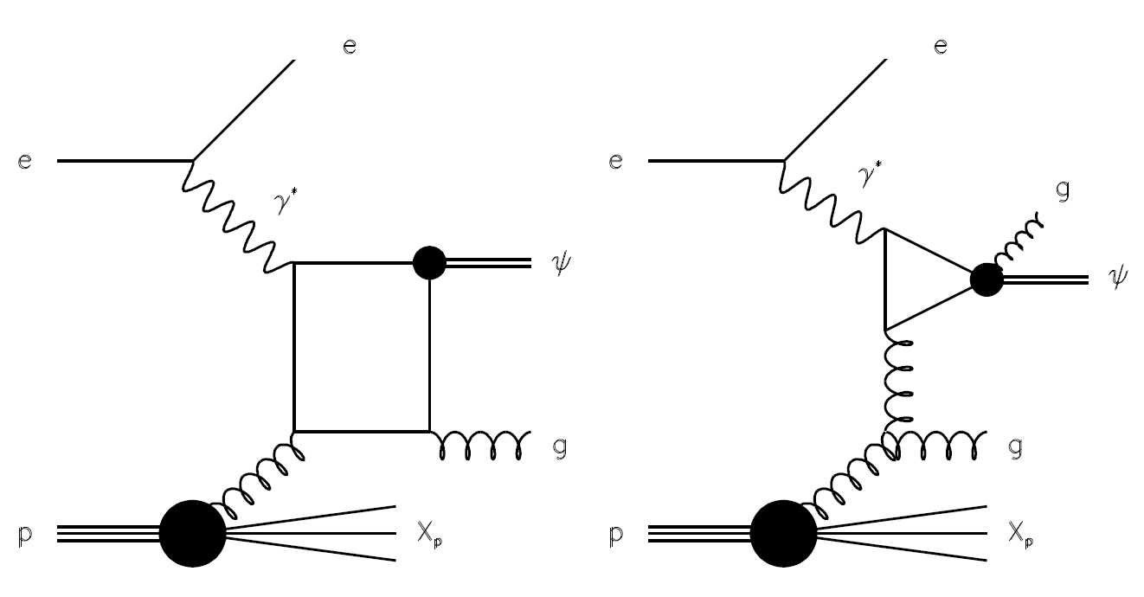
Inelastic J/ψ production in PHP
JHEP02 (2013) 071
Non relativistic QCD
CS
CO
(E-p_{z})_{J/Ψ}
z
=
(E-p_{z})
NLO calculation:
Rough data description
Color octet contribution is essential
26

Slide 27
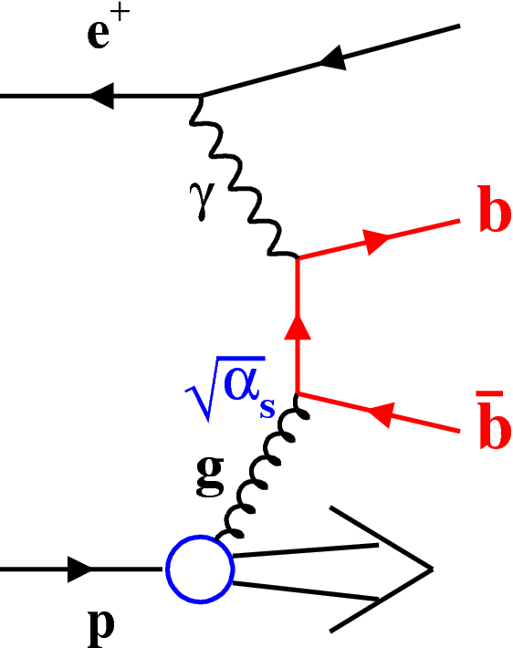
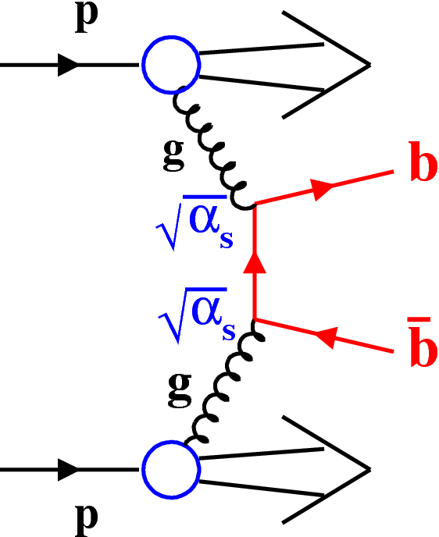
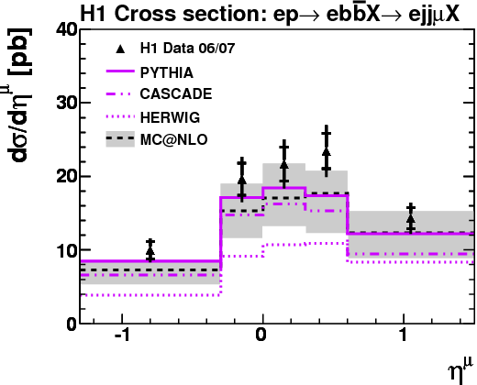
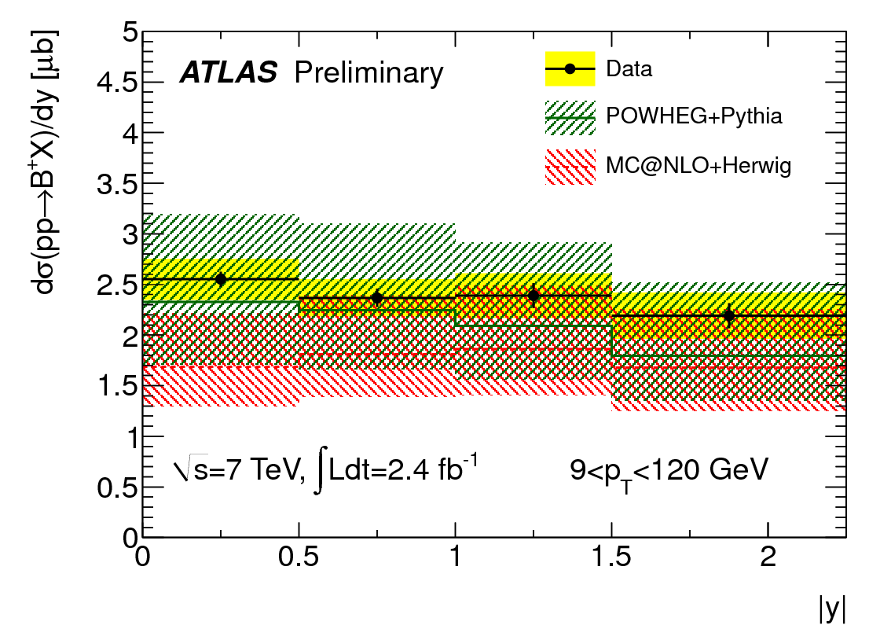
Beauty: HERA photo- vs LHC hadroproduction
Jet+μ
B⁺→ J/ΨΚ⁺
HERA
LHC
EPJ C72 (2012) 2047
Jet
ATLAS-CONF-2013-008
p_{T}^{jet1}>7 GeV
ATLAS-CONF-2013-008
MC@NLO: - describes both data reasonably (however fails ATLAS d²σ/dpt/dy)
- comparable (rather large) theory uncertainties
27

Slide 28
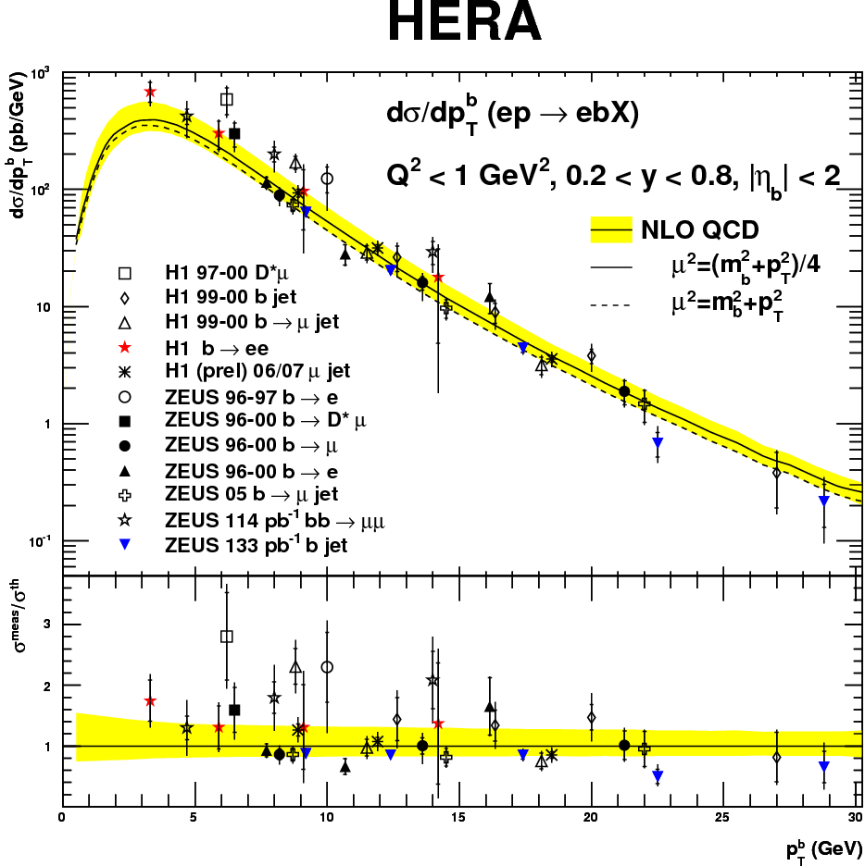
Beauty photoproduction vs p_{T}^{b}
Data vs massive NLO (FMNR)
New results:
EPJ C72 (2012) 2148
EPJ C72 (2012) 2047
Reasonable description from threshold to high momenta
28

Slide 29
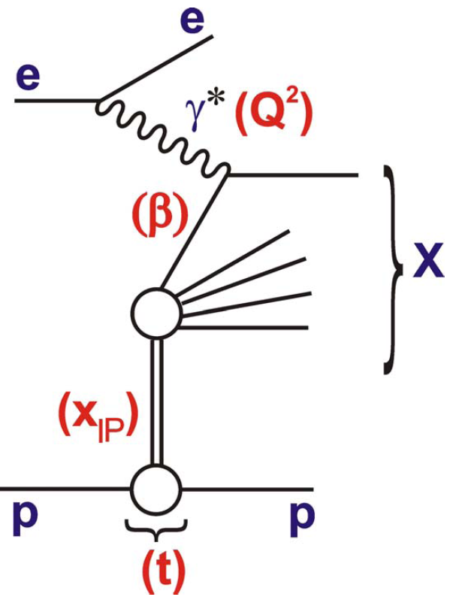

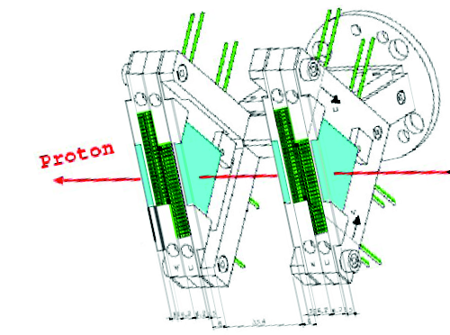
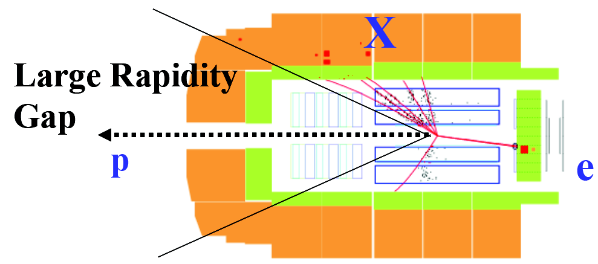
Hard Diffraction
at HERA start: ~10% of DIS events are diffractive!
Momentum fraction of struck q
Fractional p momentum loss
Gap in rapidity
Proton is intact or quasi-intact
Experimental tagging:
Very Forward
Proton Spectrometer
Forward Proton Spectrometer
z = 64 m
p
z = 220 m
Last year: Final H1 HERA II Large Rapidity Gap inclusive data
Today: focus on H1 results with VFPS
EPJ C72 (2012) 2074
29

Slide 30
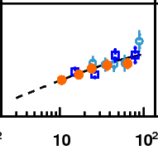







Diffraction: VFPS Results
Inclusive
H1prelim-10-014
agree with LRG data
Q²
Dijets in DIS
H1prelim-11-013
QCD fact.
Confirm QCD factorisation
p
Dijets in PHP
H1prelim-13-011
Hints for suppression = factorisation breaking (but rather large syst. Uncertainties)
p
30

Slide 31

Status report
Factorisation breaking in diffractive dijets
Data/NLO
- TEVATRON: CDF ~0.1
CDF kinematic studies
- LHC: CMS ~0.1
- HERA PHP: H1 ~0.7
  H1 ~0.6
  ZEUS compatible
  with 1
Rescatter with p ?
PRL 84 (2000) 5043
PRD 86 (2012) 032009
PRD 87 (2013) 012006
Rescatter with p ?
H1prelim-13-011
EPJC 70 (2010) 15
EPJC 55 (2008) 177
HERA results not fully conclusive
need future experiments to clarify (LHeC)
31

Slide 32
Conclusions
HERA provides precision measurements in many QCD areas
Best precision
Recent highlight
Inclusive DIS
1%
Complete HERA II high Q²data
Jets
1-2%
α_{s} from inclusive or multijets
c and b
5%
m_{c}(m_{c}) determination
Diffraction
Few %
Dijets with proton tagged data
Plus nice results with final states: Z⁰, γ, charged particles, strange particles, neutrons
Theory: pQCD works great, but almost everywhere large uncertainties due to missing NNLO calculations
32

Slide 33
Outlook
Still numerous precise HERA QCD results (also combined) to come, stay tuned!
Future experiments:
  JLAB@12 GeV (Valence quarks)
  longer term: LHeC and EIC would be ideal/complementary large scale facilities
33

Slide 34



LHeC: collide the LHC protons with electrons
Electrons: LINAC Ring
60 GeV race track with Energy recovery
L = 10³³ cm⁻²s⁻¹ → O(100) fb⁻¹
CC rates
60 GeV
Electroweak
pQCD
PDFs at Q₀
Electroweak part much enhanced at LHeC
helps for all three pieces
7 TeV
34

Slide 35

Physics and Range
LHeC grand
picture
High mass 1-2 TeV
r_{q} few times 10⁻²⁰ m
Large x
High precision
partons in plateau
of the LHC: u,d,s,c,b,t
α_{s} at 1 permille
running sinθ_{w}
Nuclear
Structure
& dynamics
High Density Matter Saturation
A truly worthy HERA successor
35

Slide 36
Backup slides

Slide 37
Reduced NC
cross sections
Final ZEUS
high Q² HERA II results
PRD 87, 052014 (2013)
Best precisions of ~1.5%
Data well described by DGLAP NLO QCD
e⁺p and e-p differ due to
γZ interference → extract xF₃^{γz}
see V. Radescu talk
e-p
e+p
37

Slide 38

Reduced NC cross sections: F₂^{γZ}
JHEP 1209:061 (2012)
Data well described by
DGLAP NLO QCD
38

Slide 39


Reduced CC cross sections
JHEP 1209:061 (2012)
Data well described by
DGLAP NLO QCD
39

Slide 40


Jet production at HERA
Different processes allow to disentangle g(x) and α_{s}
40

Slide 41

Charm contribution to DIS: F₂^{cc}
41

Slide 42

Diffraction: Results
with VFPS
Inclusive
H1prelim-10-014
agree with LRG data
QCD fact.
Dijets in DIS
H1prelim-11-013
Confirm QCD factorisation
Dijets in PHP
H1prelim-13-011
Hints for suppression = factorisation breaking (but rather large syst. Uncertainties)
42

