Slide 1
eRHIC:
New Technology Frontiers in Machine,
IR and Detector Design

Slide 2
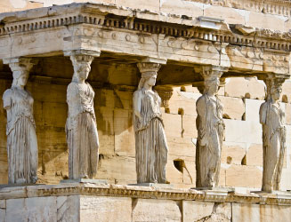
The Pillars of the eRHIC Physics program
Requirements from Physics:
High Luminosity ~ 10³³ cm⁻²s⁻¹ and bigger
Flexible center of mass energy
Electrons and protons/light nuclei (p, He³ or D) polarised
Wide range of nuclear beams (d to U)
a wide acceptance detector with good PID (e/h and π, K, p)
wide acceptance for protons from elastic reactions and
neutrons from nuclear breakup
Electro Weak
physics of
strong color
fields
spin Physics
2D+1 Imiging
Hadronisation
Wide physics program with high requirements on detector and machine performance

Slide 3
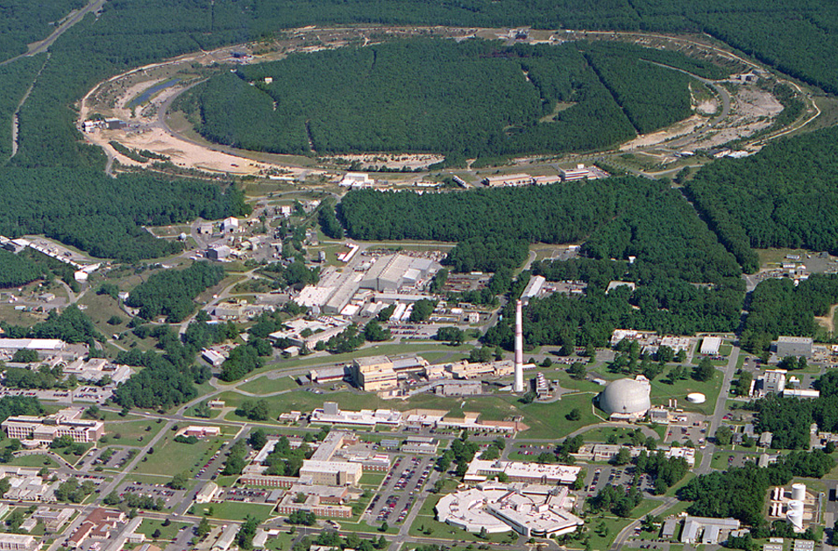
From RHIC to eRHIC
eLenses
10:00 o’clock
Jet/C-Polarimeters
12:00 o’clock
eRHIC-Detector
& Polarimeters
12:00 o’clock
CeC
2:00 o’clock
RHIC
eRHIC
e
PHENIX
8:00 o’clock
RF
4:00 o’clock
e
STAR
6:00 o’clock
LINAC
NSRL
EBIS
Booster
ERL Test Facility
AGS
Tandems

Slide 4

What is eRHIC
RHIC
Existing = $2B
Electron accelerator
to be build
p
Polarized protons
50-250 GeV
Unpolarized and
polarized leptons
5-20 (30) GeV
e⁻
Light ions (d,Si,Cu)
Heavy ions (Au,U)
50-100 GeV/u
e⁻
e⁺
70% e⁻ beam polarization goal
polarized positrons?
Polarized light ions He³ 166 GeV/u
Center mass energy range: √s=30-200 GeV; L~100-1000xHera
longitudinal and transverse polarization for p/He³
protons
electrons

Slide 5
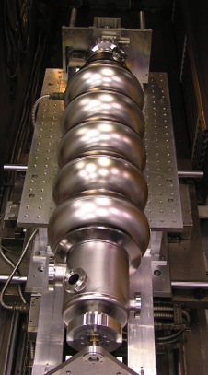

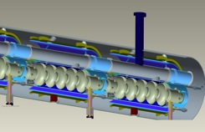

Electron beam evolution in eRHIC’s ERL
0.60 GeV
All energies scale proportionally by adding SRF cavities to the injector
0.6 GeV
Polarized
e-gun
0.6 GeV
Beam
dump
27.55 GeV
E/Eo
0.0200
0.1017
0.1833
0.2650
0.3467
0.4283
0.5100
0.5917
0.6733
0.7550
0.8367
0.9183
1.0000
New
detector
Linac 2.45 GeV
Coherent e-cooler
0.1017 GeV E₀
Linac 2.45 GeV
0.1833 GeV Eo
0.2650 GeV E₀
0.3467 GeV E₀
0.4283 GeV E₀
0.5100 GeV E₀
0.5917 GeV E₀
0.6733 GeV E₀
0.7550 GeV E₀
0.8367 GeV E₀
0.9183 GeV E₀
30 GeV
1.0000 GeV E₀
ePHENIX
All magnets would be installed from the day one and we would be cranking power supplies up as energy is increasing
100 m
ERL:
energy recovery linac
eSTAR
30 GeV
Animation is by N. Tsoupas

Slide 6
Main elements of the eRHIC concept
  We chose ERL for electrons to reach high luminosity at high energy
  We assumed that we can cool hadron beam 10-fold in both longitudinal and transverse directions using coherent electron cooling
  We take advantage of small beam size in ERL and plan to use small magnets with gaps of 5 mm (and 10 mm at two lowest orbits)
  We had found a solution unique for Linac-ring colliders which would allow us to change energy of colliding hadrons from 50 GeV to 250 GeV
  We took advantage of recent advances in super-conducting quadrupole technology to design interaction region with β* of 5 cm
  Following success of KEK-B with crab-crossing we accommodated this approach into new IR layout
  We assumed that we can generate up to 50 mA of polarized electrons
  These assumptions bring eRHIC top luminosity above 10³⁴ cm⁻² sec⁻¹
    If polarized positrons are needed for the program, we suggest to build positron ring and use ERL for generating and accelerating positrons. Luminosity of this collisions will be much lower, i.e. at 10³² cm⁻² sec⁻¹ level and not all energies of hadrons could be used in the collisions

Slide 7
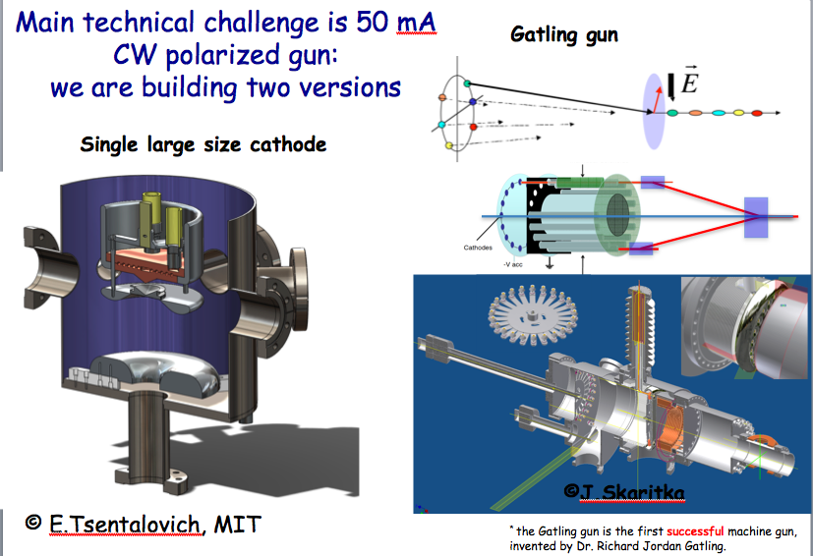
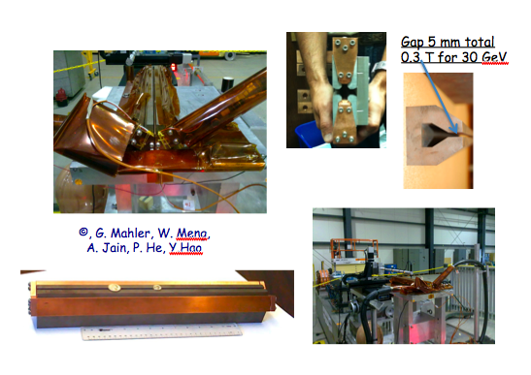
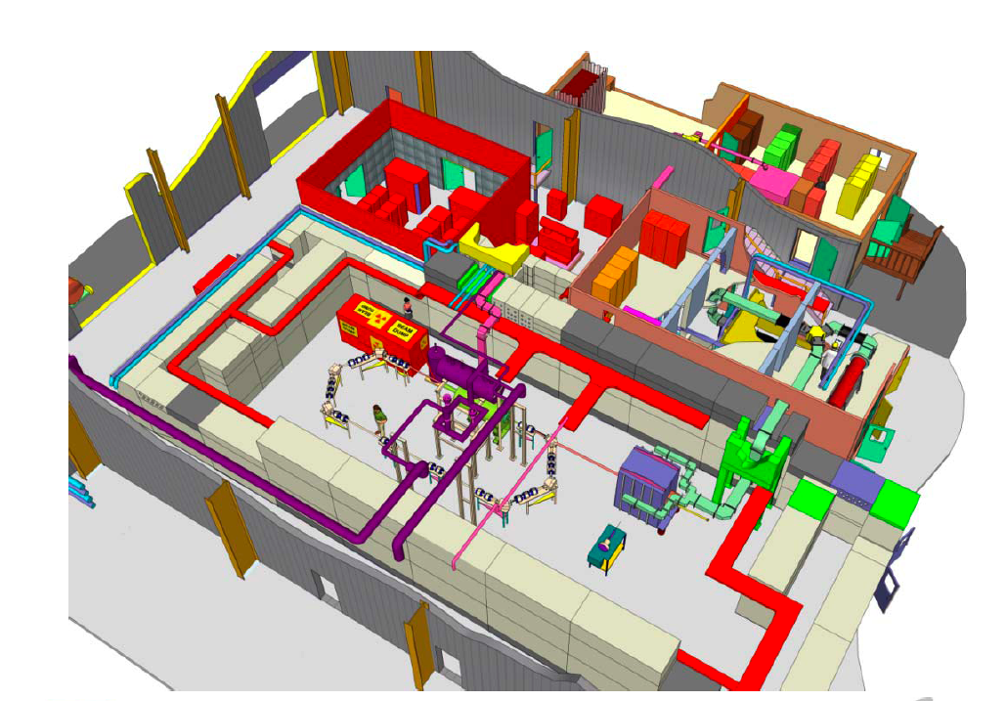
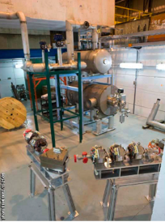
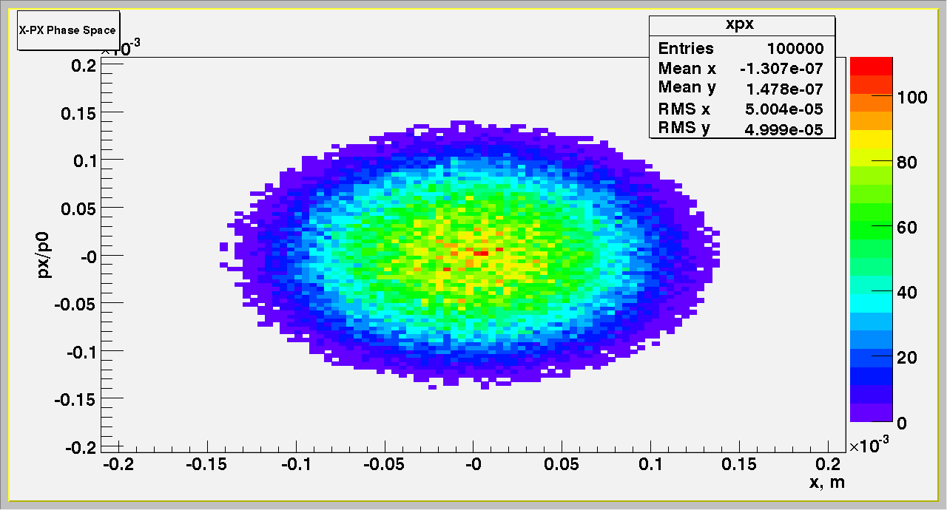
eRHIC R&D highlights
Polarized gun for e-p program – LDRD at BNL + MIT
→ prototype under construction
Development of compact magnets - LDRD at BNL → first prototyes
SRF R&D ERL – TF ongoing
Beam-beam effects, beam disruption, kink instability suppression, etc.
Polarized He³ source - Workshop: https://indico.bnl.gov/conferenceDisplay.py?confId=405
Coherent Electron Cooling: TF for PoP by ~2016
Challenge | Increase/reduction beyond the state of the art
Polarized electron gun | 10 x increase
Coherent Electron Cooling | New concept
Multi-pass SRF ERL | 5 x increase in current 30 x increase in energy
Crab crossing | New for hadron colliders
Understanding beam-beam effects | New type of collider
β*=5 cm | 5x reduction
Multi-pass SRF ERL | 2-3 x in # of passes
Feedback for kink instability suppression | Novel concept
Space charge effect compensation | Novel concept

Slide 8
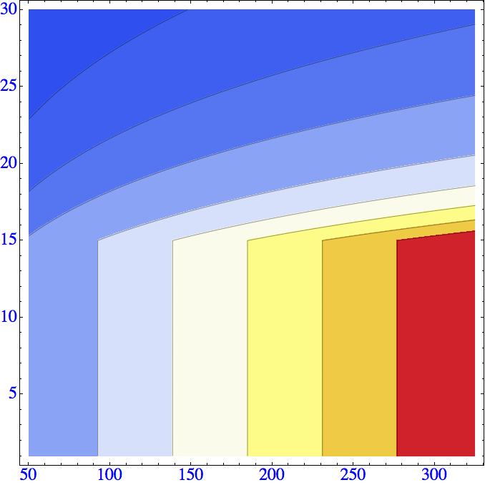

eRHIC: design luminosity
 | e | p | ²He³ | ⁷⁹Au¹⁹⁷ | ⁹²U²³⁸
Energy, GeV | 20 | 250 | 167 | 100 | 100
CM energy, GeV |  | 100 | 82 | 63 | 63
Number of bunches/distance between bunches | 107 nsec | 111 | 111 | 111 | 111
Bunch intensity (nucleons) ,10¹¹ | 0.36 | 4 | 6 | 6 | 6
Bunch charge, nC | 5.8 | 64 | 60 | 39 | 40
Beam current, mA | 50 | 556 | 556 | 335 | 338
Normalized emittance of hadrons , 95% , mm mrad |  | 1.2 | 1.2 | 1.2 | 1.2
Normalized emittance of electrons, rms, mm mrad |  | 16 | 24 | 40 | 40
Polarization, % | 80 | 70 | 70 | none | none
rms bunch length, cm | 0.2 | 5 | 5 | 5 | 5
β*, cm | 5 | 5 | 5 | 5 | 5
Luminosity per nucleon, x 10³⁴ cm⁻²s⁻¹ |  | 2.7 | 2.7 | 1.6 | 1.7
E_{e}, GeV
L., cm⁻² sec⁻¹
>3.10³⁴
0.1.10³⁴
3.10³⁴
0.25.10³⁴
2.5.10³⁴
0.5.10³⁴
2.10³⁴
1.5.10³⁴
1.10³⁴
1.10³⁴
1.5.10³⁴
2.10³⁴
2.5.10³⁴
3.10³⁴
0.5.10³⁴
0.25.10³⁴
0.1.10³⁴
Hourglass the pinch effects are included. Space charge effects are compensated.
Energy of electrons can be selected at any desirable value at or below 30 GeV
The luminosity does not depend on the electron beam energy below or at 20 GeV
The luminosity falls as E_{e}⁻⁴ at energies above 20 GeV
The luminosity is proportional to the hadron beam energy: L ~ E_{h}/E_{top}
E_{p}, GeV

Slide 9
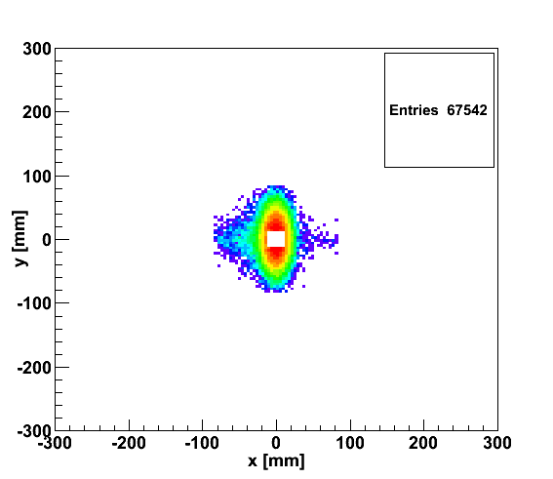
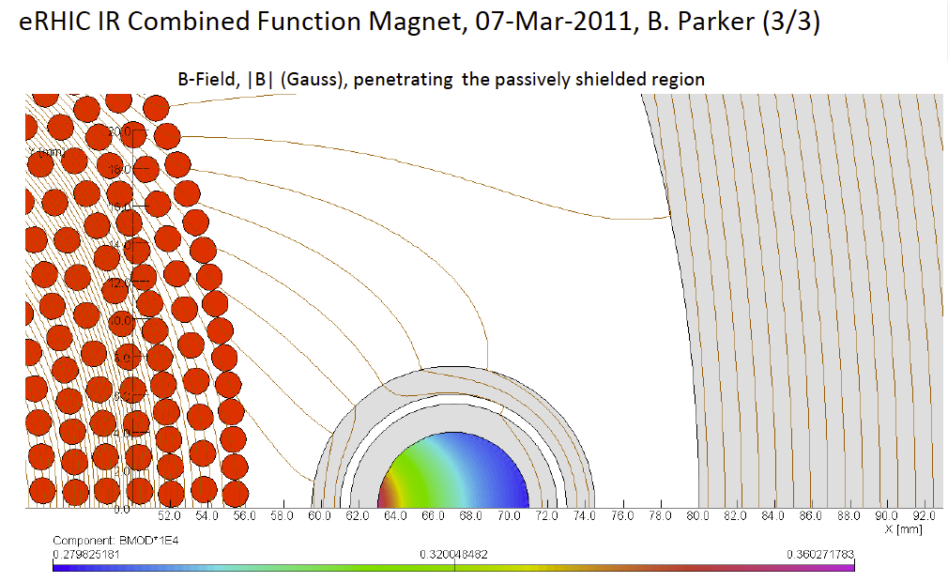
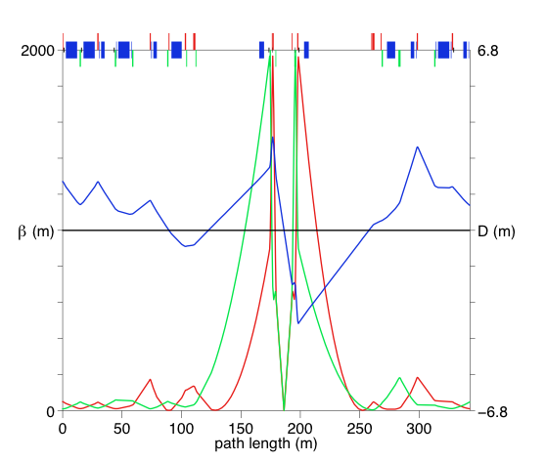
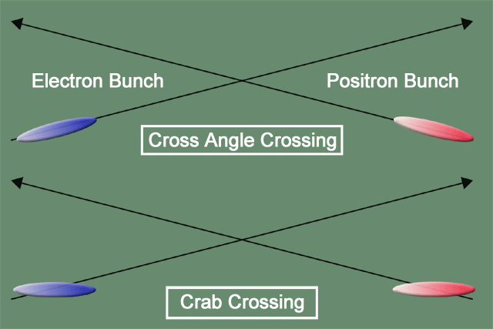
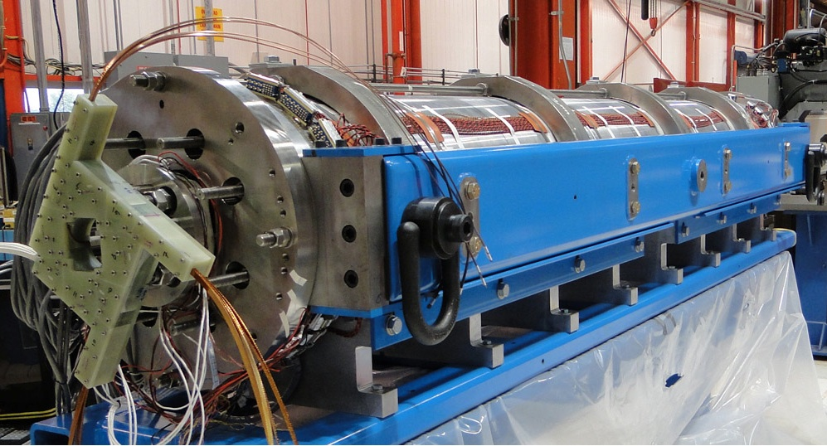
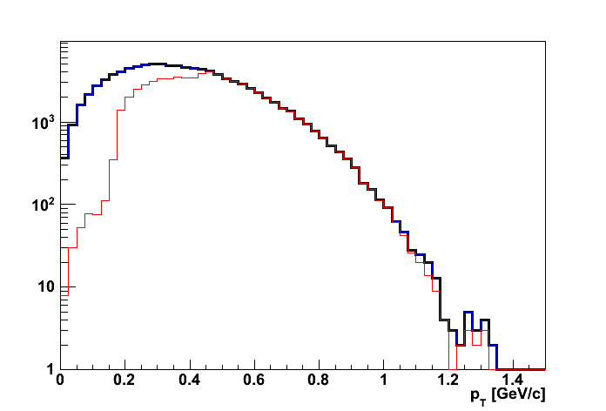
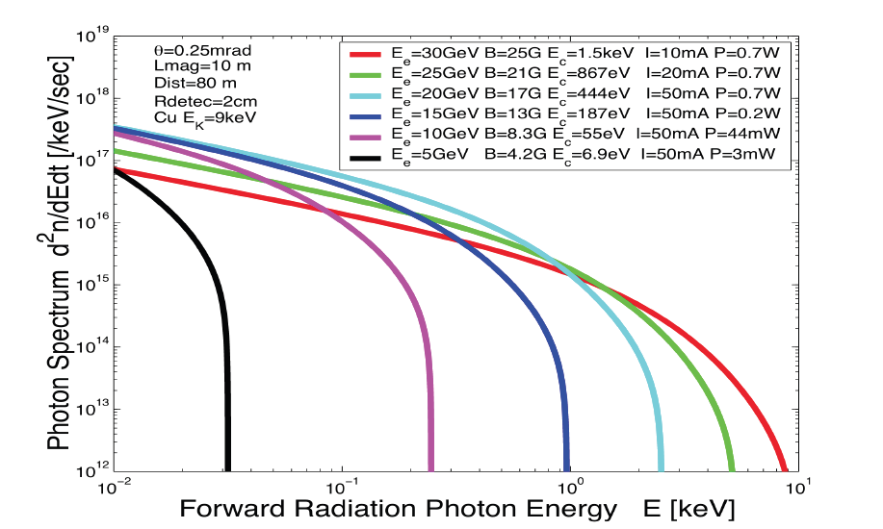
eRHIC: high-luminosity IR
20x250
p
Proton beam lattice
G.Ambrosio et al., IPAC’10
e
Nb₃Sn
20x250
200 T/m
eRHIC - Geometry high-lumi IR with β*=5 cm, l*=4.5 m
and 10 mrad crossing angle → 10³⁴ cm⁻² s⁻¹
Generated
Quad aperture limited
RP (at 20m) accepted
10 mrad crossing angle and crab-crossing
High gradient (200 T/m) large aperture Nb₃Sn focusing magnets
Arranged free-field electron pass through the hadron triplet magnets
Integration with the detector: efficient separation and registration of low angle collision products
Gentle bending of the electrons to avoid SR impact in the detector
© D.Trbojevic, B.Parker, S. Tepikian, J. Beebe-Wang

Slide 10
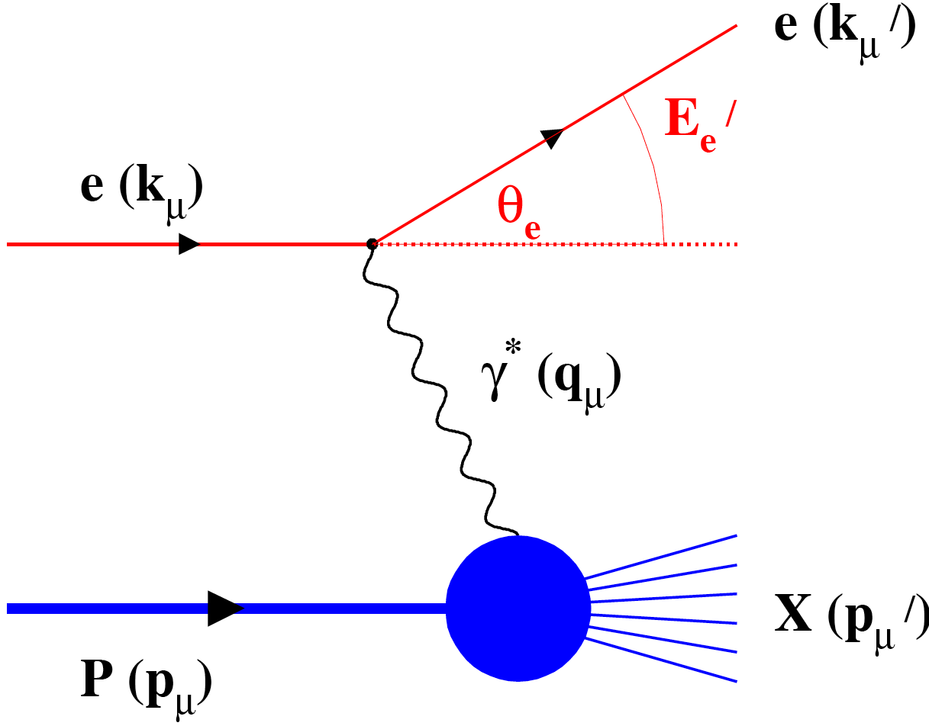
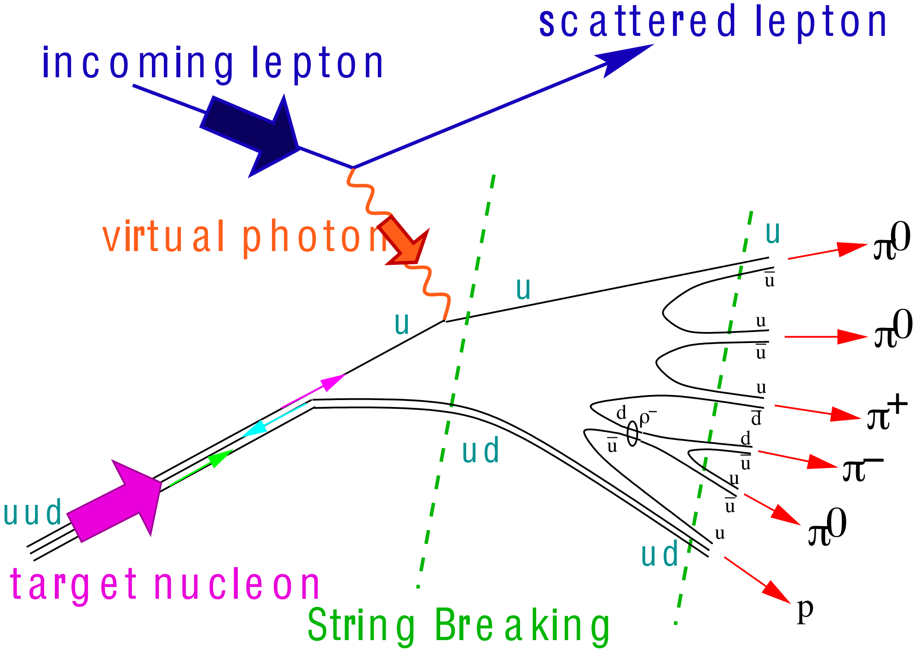
What needs to be covered BY THE DETECTOR
e’
γ, π,J/Ψ
e
γ_{L}*
(Q²)
x+ξ
x-ξ
~
~
H, H, E, E (x,ξ,t)
p
p’
Inclusive Reactions in ep/eA:
Physics: Structure Fcts.: g₁, F₂, F_{L}
Very good electron id → find scattered lepton
Momentum/energy and angular resolution of e’ critical
scattered lepton → kinematics
t
Semi-inclusive Reactions in ep/eA:
Physics: TMDs, Helicity PDFs → flavor separation, dihadron-corr.,…
→ Kaon asymmetries, cross sections
Excellent particle ID: π±,K±,p± separation over a wide range in η
full Φ-coverage around γ*
Excellent vertex resolution → Charm, Bottom identification
Exclusive Reactions in ep/eA:
Physics: GPDs, proton/nucleus imaging, DVCS, excl. VM/PS prod.
Exclusivity → large rapidity coverage → rapidity gap events
↘ reconstruction of all particles in event
high resolution in t → Roman pots

Slide 11
DIS Kinematics
Possible limitations in kinematic coverage:
HERA:
y>0.005
high y limited by
radiative corrections
can be suppressed by
requiring hadronic
activity
Even for colliders:
  Strong x-Q² correlation
    high x → high Q²
    low x → low Q²
low y-coverage:
limited by E’_{e} resolution
hadron method
or change energy

Slide 12
Lepton Kinematics
Increasing Lepton Beam Energy:
5 GeV: Q² ~ 1 GeV → η ~ -2
10 GeV: Q² ~ 1 GeV → η ~ -4
highest E’_{e} at most negative rapidities
independent of E_{h}
low Q² coverage
critical for
saturation physics
√s

Slide 13
Pion Kinematics
Cuts: Q²>1 GeV, 0.01<y<0.95, z>0.1
√s
Increasing Hadron Beam Energy: influences max. hadron energy at fixed η
Increasing 30 GeV < √s < 170 GeV
hadrons are boosted from forward rapidities to negative rapidities
no difference between π±, K±, p±

Slide 14
Hadron, lepton, Photon Separation
5 GeVx50 GeV
hadron
photon
electron
no cuts applied
hadron/photon suppression factor
needed for p_{e’}>1GeV:
-3<η<-2: ~10
-2<η<-1: > 100
-1<η<0: ~1000
p_{max} hadron for PID:
-5<η<-1: < 10 GeV
-1<η<-1: < 5 GeV
1<η<5: < 50 GeV

Slide 15
Lepton Identification
20 GeVx250 GeV
hadron
photon
electron
no cuts applied
hadron/photon suppression factor
needed for p_{e’}>1GeV:
-4<η<-3: >100
-3<η<-2: ~1000
-2<η<-1: > 10⁴
p_{max} hadron for PID:
-5<η<-1: < 30 GeV
-1<η<-1: < 10 GeV
1<η<5: < 100 GeV

Slide 16
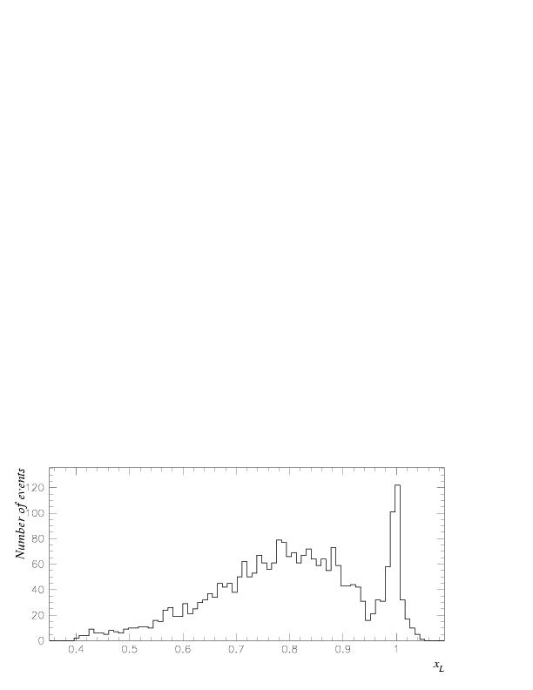
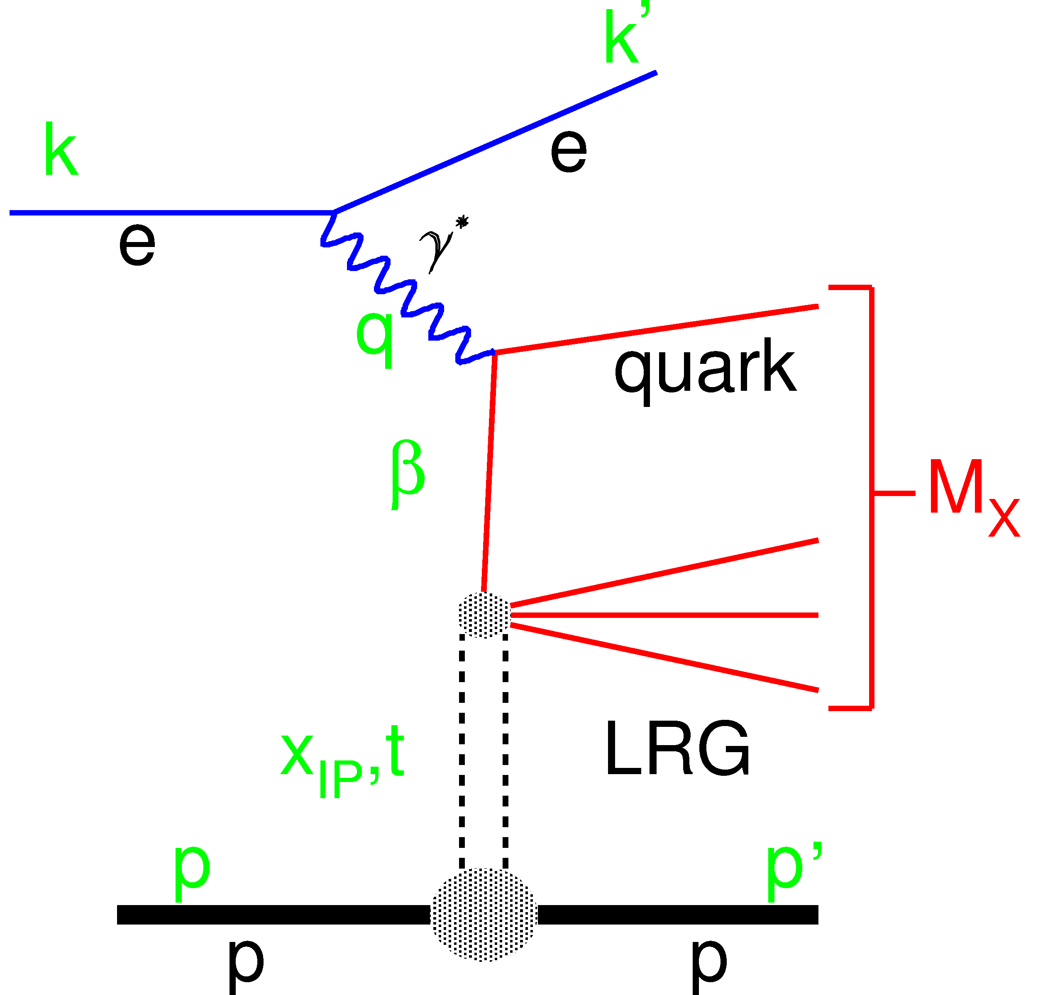
Exclusive Reactions: Event Selection
How can we select events: two methods
proton/neutron tag method
Measurement of t
Free of p-diss background
Higher M_{X} range
to have high acceptance for
Roman Pots / ZDC challenging
→ IR design
Diffractive peak
Need for
roman pot spectrometer
AND
ZDC
Q²
Large Rapidiy Gap method
X system and e’ measured
Proton dissociation background
High acceptance
Need for
Hcal in the forward region
W
M_{Y}

Slide 17
DVCS Kinematics
leading protons are never
in the main detector acceptance at
EIC (stage 1 and 2)
e’
γ
e
γ_{L}*
(Q²)
x+ξ
x-ξ
~
~
p
H, H, E, E (x,ξ,t)
p’
eRHIC detector acceptance
t
DVCS - photon
Cuts: Q²>1 GeV, 0.01<y<0.95, E_{γ}>1 GeV
Increasing Hadron Beam Energy:
influences max. photon energy at fixed η
Increasing 30 GeV < √s < 170 GeV
photons are boosted from symmetric
to negative rapidities

Slide 18
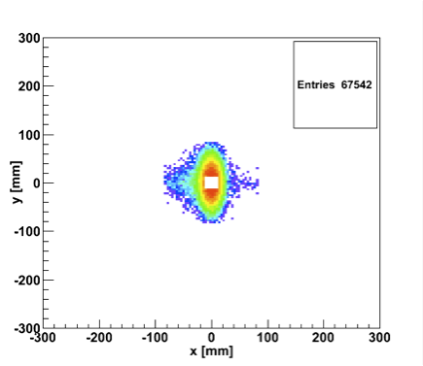
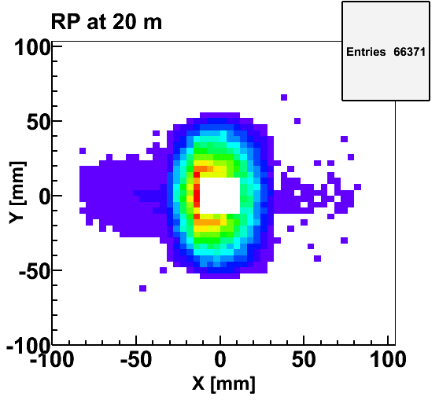
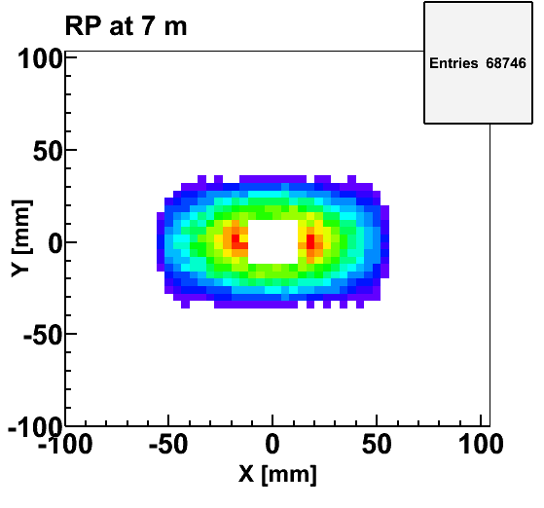
t-Measurement using RP
Accepted in“Roman Pot” at 20m
20x250 GeV
Quadrupoles acceptance
5x100 GeV
5x100 GeV
Simulation based on eRHIC-IR
10s from the beam-pipe
20x250
• high‐|t| acceptance mainly limited by magnet aperture
• low‐|t| acceptance limited by beam envelop (~10σ)
• |t|‐resolution limited by
  – beam angular divergence ~100μrad for small |t|
  – uncertainties in vertex (x,y,z) and transport
  – ~<5-10% resolution in t (follow
  RP at STAR)
Generated
Quad aperture limited
RP (at 20m) accepted

Slide 19
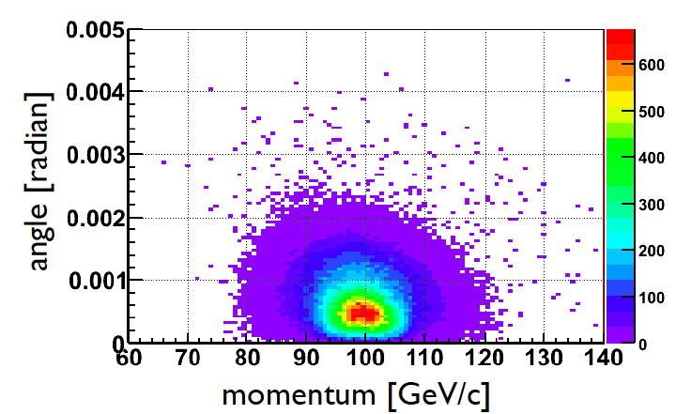
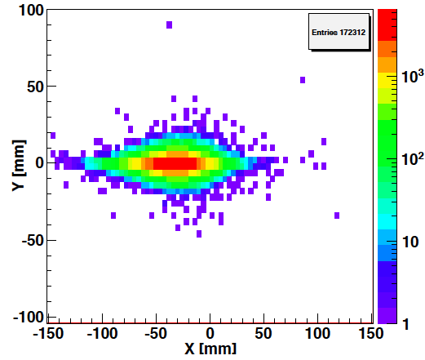
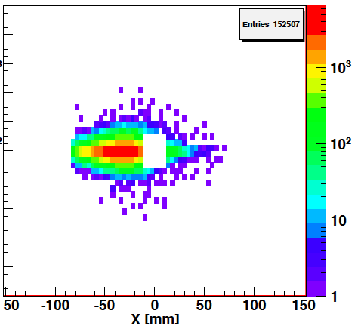
Spectator proton tagging for He-3
Momentum smearing mainly
due to Fermi motion + Lorentz boost
Angle <~3mrad (>99.9%)
after IR magnets
at 20m
at 20m
after IR magnets
RP acceptance
+10σ beam clearance
→ 90% tagging efficency

Slide 20
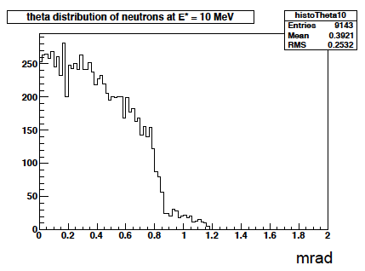
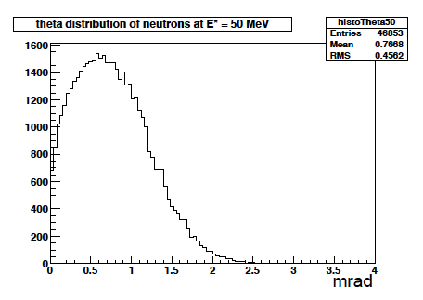
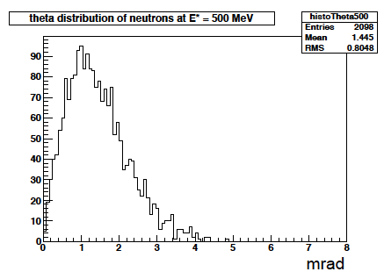
Kinematics of Breakup Neutrons
Results from GEMINI++ for 50 GeV Au
Results:
With an aperture of ±5 mrad we are in good shape
• enough “detection” power for t > 0.025 GeV²
• below t ~ 0.02 GeV² photon detection in very forward direction
→ all accounted in IR design
Question:
For some physics needed rejection power for incoherent: ~10⁴
→ Critical: ZDC efficiency
+/-5mrad acceptance totally sufficient

Slide 21
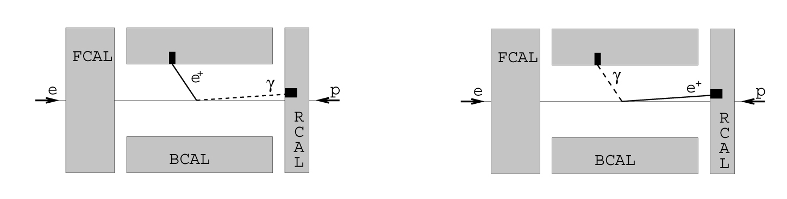
DVCS: Photon-Lepton Kinematics
γ
Δθ
e
BH electron has very low energy
(often below 1 GeV)
Photon for BH (ISR) goes mostly forward
(into the beam pipe)
ECal must discriminate clusters above
noise down to 1 GeV
In DVCS most of the photons are less “rear” than the electrons: (θ_{el}-θ_{g}) > 0 → rejects most of BH
Need for a ECal with a granularity
to distinguish clusters down to Δθ=1 deg
This is also important for Δφ calculation in asymmetries measurement an for BH rejection in the xsec measurement
BH dominated
BH and DVCS

Slide 22
BNL: 1st Detector Design Concept
ECAL W-Scintillator
Upstream
low Q²
tagger
ECAL PWO
ECAL WScin
To
Roman Pots
HCAL
RICH
RICH
HCAL
DIRC/proximity RICH
−η
η
PID:
-1<η<1: DIRC or proximity focusing Aerogel-RICH
1<|η|<3: RICH
Lepton-ID:
-3 <η< 3: e/p
1<|η|<3: in addition Hcal response & γ suppression via tracking
|η|>3: ECal+Hcal response & γ suppression via tracking
-5<η<5: Tracking (TPC+GEM+MAPS)

Slide 23
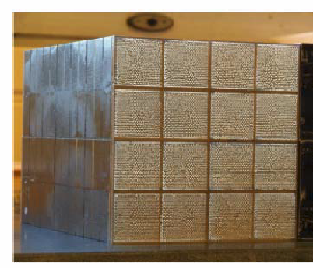
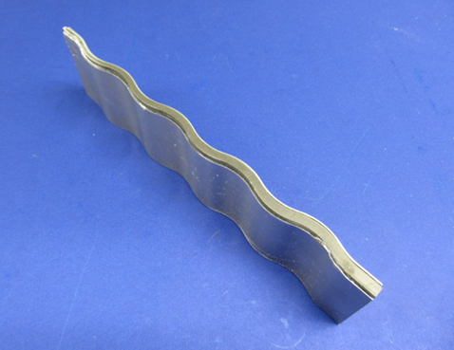
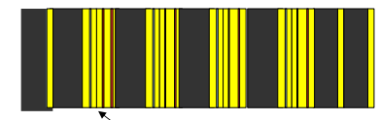
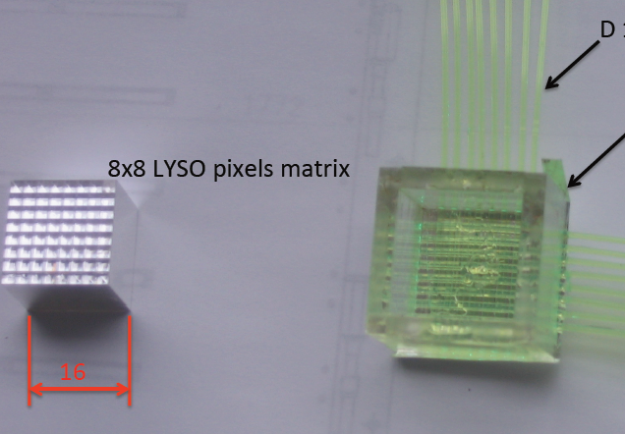
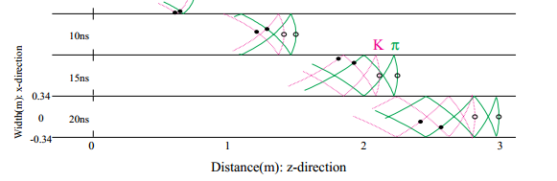
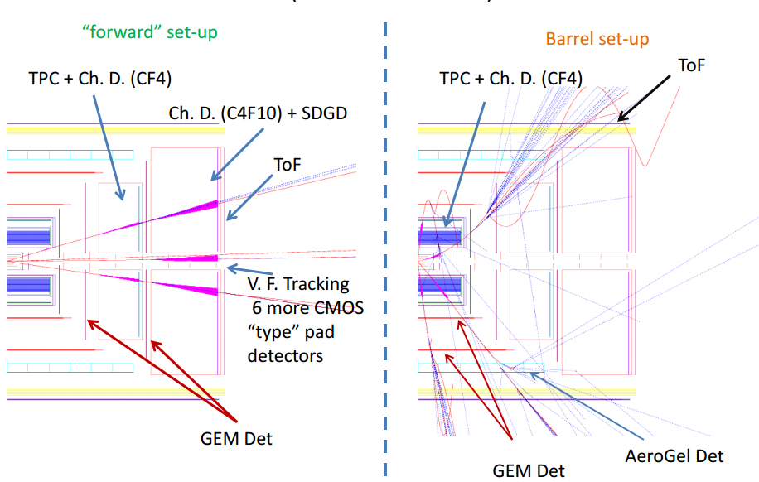
Vibrant Detector R&D Program
Calorimetry
  W-Scintillator & W-Si
    compact and high resolution
  Crystal calorimeters PbW & BGO
BNL, Indiana University, Penn State Univ., UCLA, USTC, TAMU
Pre-Shower
  W-Si
  LYSO pixel array with
  readout via X-Y WLS fibers
Univ. Tecnica Valparaiso
More Info on EIC-Detector R&D:
https://wiki.bnl.gov/conferences/index.php/EIC_R%25D
“Cartesian PreShower”
PID via Cerenkov
  DIRC and timing info
  Catholic Univ. of America, Old Dominion, South Carolina, JLab, GSI
  RICH based on GEM readout
  e-PID: GEM based TRD → eSTAR
BNL, Indiana Univ., USTC, VECC, ANL
Tracking
BNL, Florida Inst. Of Technology, Iowa State, LBNL, MIT, Stony Brook, Temple, Jlab, Virginia, Yale
  μ-Vertex: central and forward based on MAPS
  Central: TPC/HBD provides low mass,
  good momentum, dE/dx, eID
  Fast Layer: μ-Megas or PImMS
  Forward: Planar GEM detectors

Slide 24
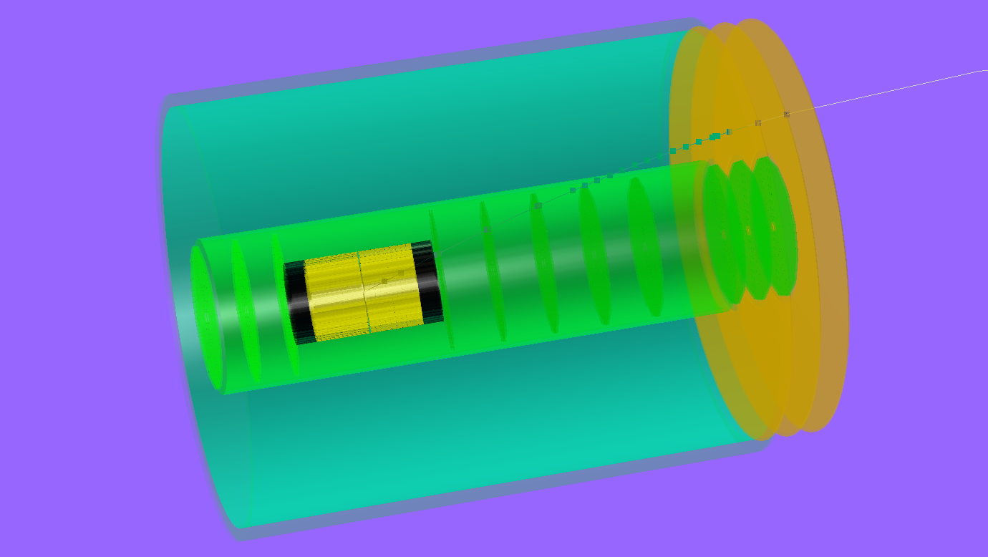
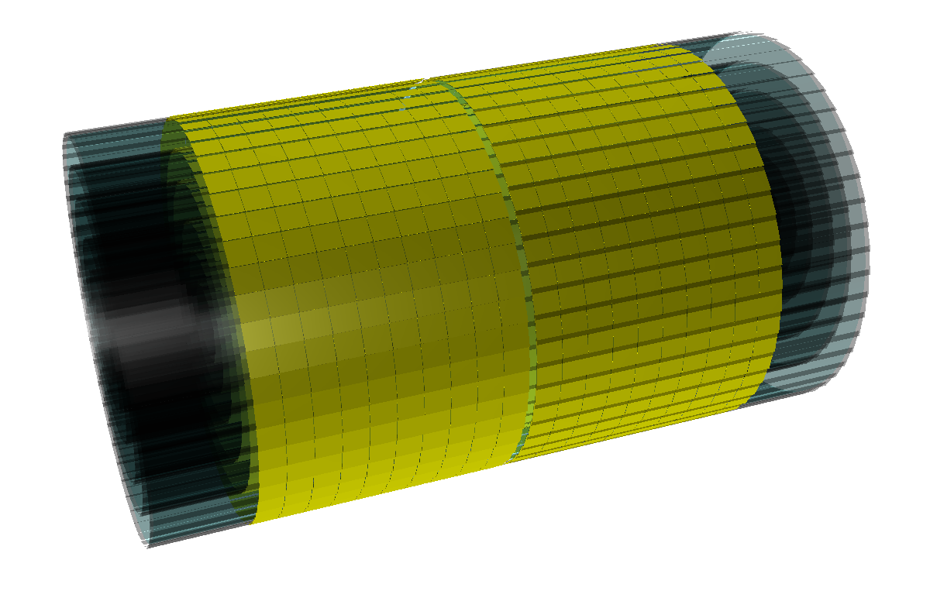
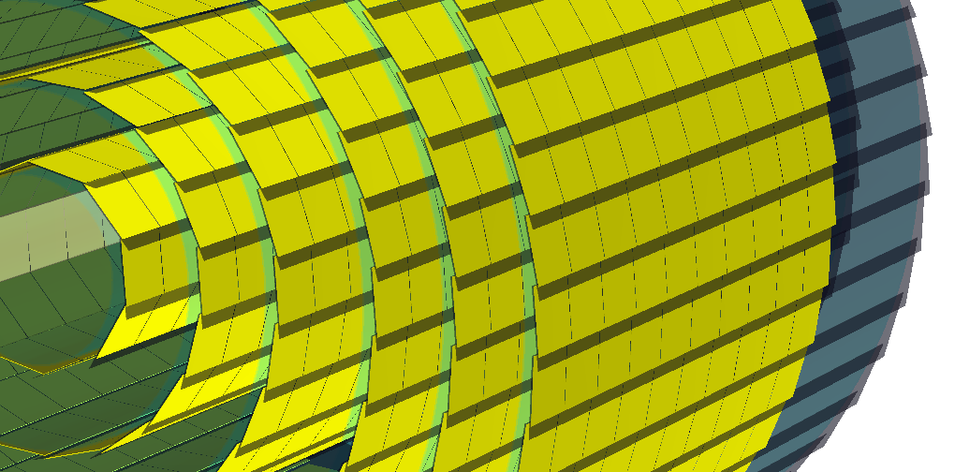
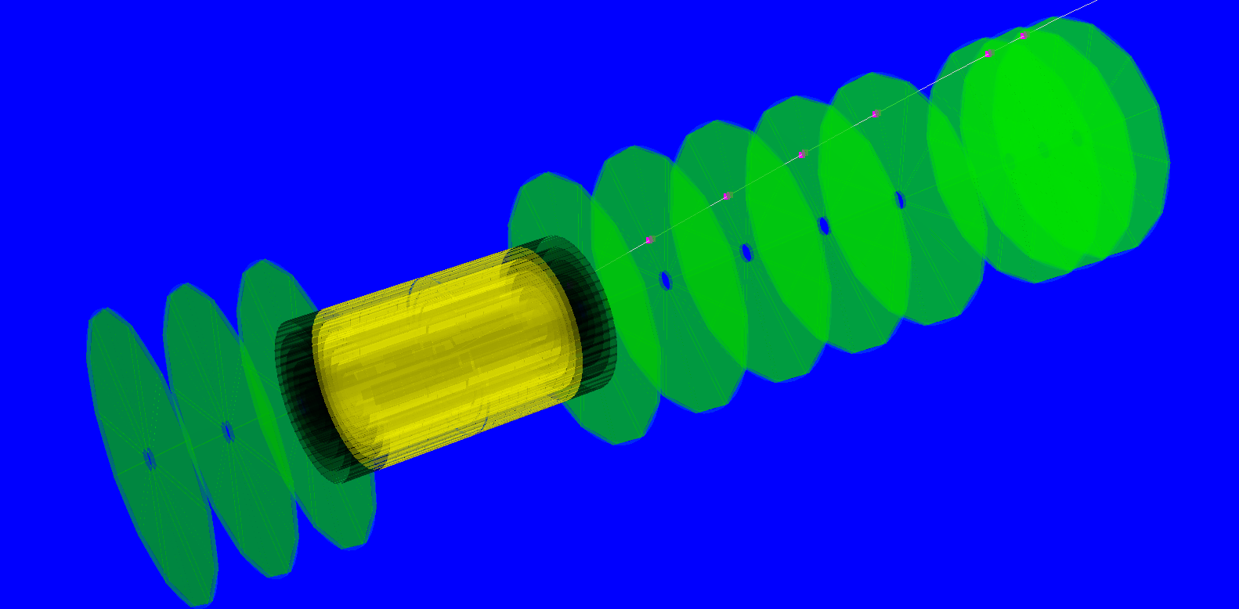
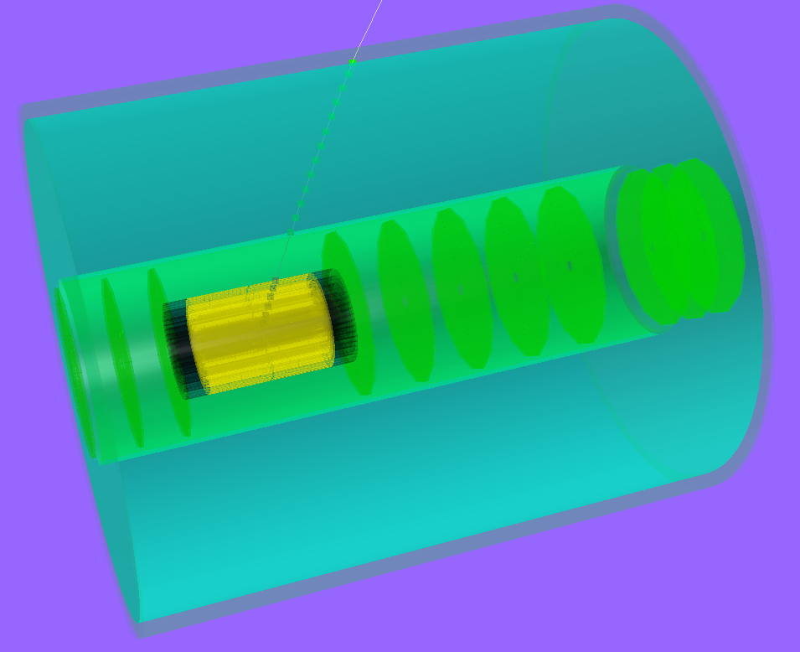
Modeling the Detector in Geant
μ-vertex detector:
6 layers with [30..160] mm radius
0.37% X₀ in acceptance per layer simulated precisely;
digitization: single discrete pixels, one-to-one from MC points
Forward/backward μ-vertex detector:
3+5+3 silicon disks with up to 280 mm radius
N sectors per disk; 200 μm silicon-equivalent thickness
digitization: discrete ~20x20 μm² pixels
TPC
~2m long; gas volume radius [300..800] mm
1.2% X₀ IFC, 4.0% X₀ OFC; 15.0% X₀ aluminum endcap
digitization: assume known (gaussian) resolutions in “rφ” and “Z” and 1x5 mm GEM pads (up to 100 points per track)
Forward tracking:
3 disks behind the TPC endcap
rather precise START FGT design implemented
digitization: 100 μm resolution in X&Y; gaussian smearing

Slide 25
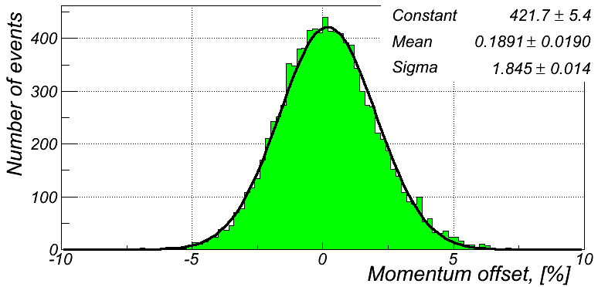
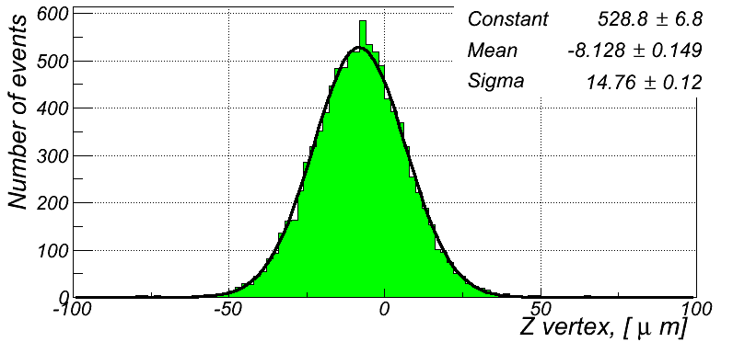
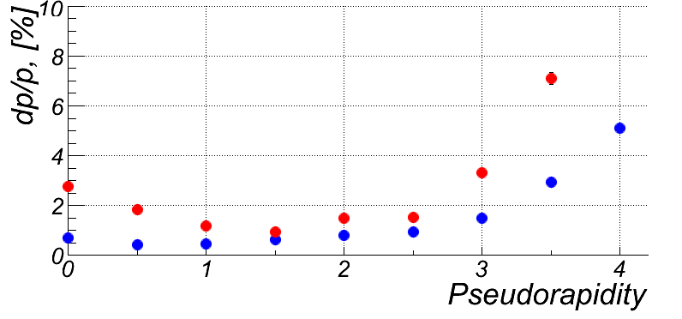
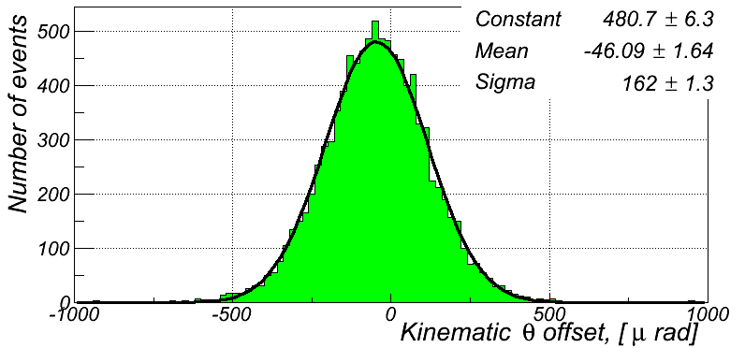
MC: First Results
Simulate and reconstruct 10k π⁺ tracks with 10GeV/c and η=0.5:
δp/p<2%
δz ~15 μm
    To improve momentum resolution for η>3
    need to look in Magnet design
    increase radial field
    current studies involve
      Dipole field on top of solenoidal field
      Solenoid made out of different coils with
      increasing field and radius
10 GeV/c
1 GeV/c

Slide 26
Hadron Coverage
Cuts: Q²>1 GeV², 0.01<y<0.95, p>1GeV
-3<η<3 covers entire p_{t} & z-region important for physics

Slide 27
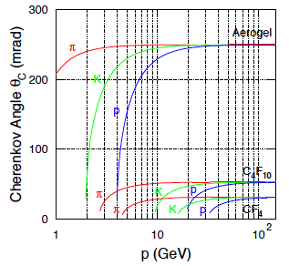
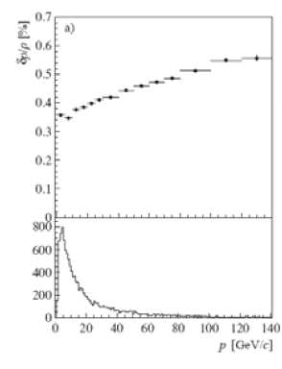
LHC-b: possible RICH design concepts
RICH-1 (modern HERMES RICH) RICH-2
2<p<60 GeV 17<p<100 GeV
25-300 mrad 10-120 mrad
5cm Aerogel (n=1.030) ~200 cm CF₄ (n=1.0005)
85 cm C₄F₁₀ (n=1.0014)
LHC-b
momentum resolution

Slide 28
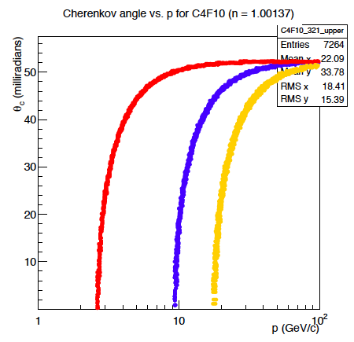
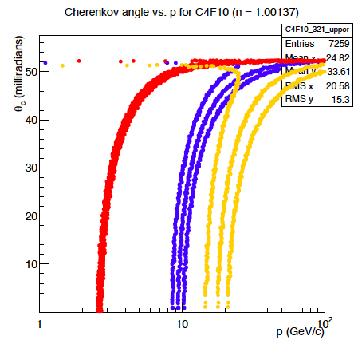

Cerenkov and momentum resolution
δp/p<0.1%
δp/p< 1.0%
δp/p< 3.0%
π
Κ
p
resolution due to photon detector is not included in this simulation
momentum resolution absolutely critical for good π, K, p separation at |η| > 1

Slide 29


Magnet Design
Philosophy:
Increase radial bending to get more momentum resolution at η > 2.5
one design investigated
radial magnetic field in y-z
Bending of a 10 GeV particle at 1.2m
θ=2º in x-z plane: 2.3mm in y-z plane
θ=10º in x-z plane: 11.6mm in y-z plane
Std. solenoid of 3T
θ=2º in x-z plane: 1.8 mm in y-z plane
θ=10º in x-z plane: 8 mm in y-z plane
Fig. 1 – The MRS design is comprised of five solenoid pairs. The inner pair (red colored, along y-axis) is labeled as P1, with the last pair, P5, at z=± 1200 mm.
Total Length – 2.4 m Inner Radius – 1.0 m Outer Radius – 1.1 m
Central B field:
MRS-B – 2.224038 T
Peak Radial B:
MRS-B – 5.545705 T

Slide 30
An Extremely Critical Topic
SYSTEMATICS:
Examples:
Luminosity Measurement → Relative Luminosity
Polarization measurements

Slide 31

The Helicity Distributions in the Proton
EIC: DIS scaling violations mainly determine Δg at small x
Q² = 10 GeV²
arXiv: 1206.6014
Need systematics ≤ 2%

Slide 32
RHIC Polarimetry
Polarized hydrogen Jet Polarimeter (HJet)
  Source of absolute polarization (normalization of other polarimeters)
  Slow (low rates ⇒ needs looong time to get precise measurements)
Proton-Carbon Polarimeter (pC) @ RHIC and AGS
  Very fast ⇒ main polarization monitoring tool
  Measures polarization profile (polarization is higher in beam center) and lifetime
  Needs to be normalized to HJet
Local Polarimeters (in PHENIX and STAR experiments)
  Defines spin direction in experimental area
  Needs to be normalized to HJet
All of these systems are necessary for the proton beam polarization measurements and monitoring

Slide 33


Hadron Polarisation
Account for
beam polarization decay through fill → P(t)=P₀exp(-t/τ_{p})
growth of beam polarization profile R through fill
pCarbon
polarimeter
Collider
Experiments
x=x₀
Result:
Have achieved 6.5% uncertainty for DSA and 3.4 for SSA
correlation of
dP/dt to dR/dt
for all 2012 fills
at 250 GeV
Polarization lifetime has consequences for physics analysis
different physics triggers mix over fill
  → different <P>

Slide 34


Lepton Polarization
Method: Compton backscattering
Questions, which need still answers
  how much does the polarization vary from bunch to bunch
    yes: need a concept to measure bunch by bunch polarisation in an ERL
    no: measure the mean of all bunches → what is done now at JLab
  is there the possibility for a polarization profile
    yes: how can we measure it ?
    no: makes things much easier
Result:
Have achieved 1.4% uncertainty at HERA
572 nm pulsed laser
laser transport system: ~80m
laser light polarisation measured
continuously in box #2

Slide 35
Luminosity Measurement
Concept:
Use Bremsstrahlung ep → epγ as reference cross section
  normally only γ is measured
  Hera: reached 1-2% systematic uncertainty
BUT:
coupling between polarization measurement uncertainty and uncertainty achievable for lumi-measurement
have started to estimate a with the help of Dieter Mueller
  hopefully a is small

Slide 36
Summary
A lot of work was done, but far from complete for a CDR
Machine and IR design very well understood and many details studied
Basic Detector Performance Requirements determined
All tools in place to optimize overall detector performance
  optimize tracking performance vs. ECal /Hcal performance
    lepton hadron separation
    scattered lepton kinematics
    → first studies in the backup
  study momentum resolution impact on π,K,p separation
  perform full analysis of golden bench mark physics channels
Study on relative luminosity requirements and polarization measurements underway
  impact on systematic uncertainties
having huge luminosity means there is the need to control the systematic uncertainties to very low levels.
Big Thanks to my colleagues of the
BNL-EIC-TF and CAD eRHIC group
We welcome everybody to collaborate with us to realize the machine and detector

Slide 37
BACKUP

Slide 38
BH rejection: Calo coverage
BH dominated
BH and DVCS
In DVCS most of the photons are less
“rear” than the electrons:
(θ_{el}-θ_{γ}) > 0 → rejects most of the BH

Slide 39
BH Rejection: Calo Requirements
BH
DVCS
BH electron has very low energy (often below 1 GeV)
Photon for BH (ISR) goes mostly forward
(into the beam pipe)
Important: ECal must discriminate clusters above noise down to 1 GeV

Slide 40
Scattered Lepton Kinematics
CUTS: Q²>0.1GeV² && 0.01<y<0.95
higher √s:
scattered lepton has
small scattering angle
→ negative rapidities

Slide 41

Possible Schedule To Realize eRHIC

Slide 42
Backgrounds at IR
Large amplitude protons/ions scattered on the collimator and ring apertures in RHIC
  Should be essentially eliminated by cooling. Only particles from the IR triplet remain – solution is a large aperture final focusing quadrupoles for hadrons
Hard-X-rays and γ-rays from Synchrotron Radiation in IR
  Using crab-crossing
  Smooth curving electrons into IR
  Keep control of the SR from final triplet
Neutrons
  From synchrotron radiation (negligible)
  From bremsstrahlung
  From debris of hadron beam scattering on residual gas
Scattered electrons
Bremsstrahlung

Slide 43
Backgrounds at IR
Neutrons
  From synchrotron radiation (negligible)
  From bremsstrahlung
  From debris of hadron beam scattering on residual gas
The later should be similar to that currently at RHIC, and most likely is not a major problem:
  We plan to have a dedicated studies of this back-ground during next RHIC run
Electron beam bremsstrahlung is most likely contributor to the background
  Depending on transverse aperture, beam loss due to elastic collision varies from 0.3 to 5.7 p/A
  E.g. 2x10⁶ to 3x10⁷ electrons per second will be lost around eRHIC 3.8 km circumference.
  While most of the electrons will be intercepted elsewhere by collimators,~1% of scatterings would occur in the IR

Slide 44
Inclusive DIS
Measure of resolution power
Measure of inelasticity
Note:
to measure x, y, and Q² at low Q² ~ 1 GeV²
  Electron method
    precise energy and angular resolution for θ’_{e} → 180º and high y
  At low y use hadron method
e-
p/A
Measure of momentum fraction of struck quark
0º / +η 180º / -η
electron method:
Hadron method:
diverges for
y_{e}→0
depends on E’_{e}
diverges for
θ’_{e}→180º
depends on
E’_{e} and θ’_{e}

Slide 45


Fast Simulator: Check
Used fast smearing simulator
  multiple scattering and momentum smearing included according to PDG
  check against STAR results at central region → looks okay
  for details: https://wiki.bnl.gov/conferences/images/d/d1/R%26DOctoberSmearing.pdf
-1< η <1
assumed 0.05 radiation lengths

Slide 46
Fast Simulator: What was modeled
Magnetic field: Solenoid with 3.0 Tesla
Tracking:
  “Central” +/-1: TPC-like:
    45 fit points; 0.03 radiation length, position resolution: 80 μ
  “Forward/Backward” 1-3: GEM-like:
    6 planes; 0.03 radiation length, position resolution: 80 μ
  “Far Forward/Backward” 3-4.5: Si-Pixel-like:
    12 planes; 0.03 radiation length, position resolution: 20 μ
  radiation length needs to be checked
  no bremsstrahlung for electrons yet
Ecal
  “Central” +/-1:
    10%√E+1.5% hadron: MIP + 0.4E_{h} with σ=0.2E_{h} (50:50)
  “Forward” 1-5:
    10%√E+1.5% hadron: MIP + 0.4 with σ=0.2E_{h} (50:50)
  “Backward” -1 to -5: PWO crystal calorimeter
    2.5%/√E + 0.9% + 1%/E hadron: MIP + 0.4E_{h} with σ=0.2E_{h} (50:50)
“Hcal:
  “Forward/Backward” 1<|η|<5: assumed current STAR forward R&D project
    38%√E+3%

Slide 47




Momentum resolutions
0.5<η<1.5
1.5<η<2.5
    To improve momentum resolution for η>3
    need to look in Magnet design
    increase radial field
    current studies involve
      Dipole field on top of solenoidal field
      Solenoid made out of different coils with
      increasing field and radius
2.5<η<3.5
3.5<η<4.5

Slide 48




Resolution for E/p
E_{e}: 5 GeV Q²>1 GeV -1<η<1
E_{e}: 20 GeV Q²>1 GeV -1<η<1
1<p<2
Hadron
electron
1<p<3
lepton-hadron
separation at
-1<η<1 seems
to be okay
4<p<5
7<p<9

Slide 49






Resolution for E/p
E_{e}: 5 GeV Q²>1 GeV
-2.2<η<-1
E_{e}: 20 GeV Q²>1 GeV
-2<η<-1 -3.7<η<-2
1<p<2
1<p<3
1<p<3
For η > 3 e/p not good enough
need to use ECal and HCal to separate
leptons and hadrons
4<p<5
7<p<9
7<p<9

Slide 50

Challenge: Gatling Gun
  How to generate 50 mA of polarized electron beam? Polarized cathodes are notorious for dying fast even at mA beam currents
  One possibility is using my old idea of a “Gatling” electron gun with a combiner?
Notes:
The entire idea of the Gatling gun approach assumes that capabilities of individual cathodes are not affected by the physical presence of other cathodes. This assumption has to be proven experimentally.

Slide 51

Real “Gatling” polarized electron gun
Courtesy of J. Skaritka
Sectioned View of the gun
Green indicate Laser beams, Blue- indicate electron beam paths.
Near center is the cathode shroud and anode.To the right is the cathode magazine. The cathode preparation chamber can be seen on upper left.
Notes:
But it takes ingenuity of talented team of scientists and engineers to turn such simple idea into a really fantastic creation. It is under construction and soon we will test how it works.

Slide 52

Why crab-crossing?
We have to separate colliding beams.
To avoid synchrotron radiation by 30 GeV electrons in the IR – one of serious backgrounds at HERA, we can not use separating dipoles.
To separate beams without applying magnetic field, we need a crossing angle
This also allows bringing the hadron triplet closer to the IR – hence lower β*
Crossing angle reduces luminosity ~100-fold
The crabbing (tail up, nose up) is needed to restore luminosity
Idea Introduced by R. B. Palmer SLAC PUB 4832
M _{left}
M _{right}
B
F/B
F/B
D
D
D
F
B
325 GeV p or 130 GeV/u Au
Courtesy of
I. Ben-Zvi, S. Belomestnykh, D. Trbojevic and Q. Wu
Original BNL crab-cavity
design (I. Ben-Zvi)

Slide 53



Some thought about rates
low multiplicity
4-6 √s = 40-65 GeV
N_{ch} (ep) ~ N_{ch} (eA) < N_{ch}(pA)
→ no occupancy problem
Cross section:
Pythia σ_{ep}: 0.030 – 0.060 mb
Luminosity: 10³⁴ cm⁻¹ s⁻¹ ⁼ 10⁷ mb⁻¹ s⁻¹
Interaction rate:
300 -600 kHz

Slide 54



CHIPAS
Chiapas does semi-analytical calculation of detector resolution
and coverage necessary to achieve physics goals.
  Simple extensions to Chiapas will allow for material budget calculations as well
T. Hemmick: https://wiki.bnl.gov/conferences/images/0/09/Chiapas-Sim.pdf

Slide 55



CHIPAS-Results
5 GeV x 100 GeV
ε=0.20
5 GeV x 100 GeV
ε=0.05

Slide 56



Measuring FL with the EIC (II)
In order to extract F_{L} one needs at least two measurements of the inclusive cross section with “wide” span in inelasticity parameter y (Q² = sxy)
F_{L} requires runs at various √s ⇒ longer program
Need sufficient lever arm in y²/Y⁺
Limits on y²/Y⁺:
At small y:
detector resolution for e’
At large y:
radiative corrections and charge symmetric background
EIC studies:
Statistical error is negligible
in essentially whole range
Systematical Error
Calibration
Normalization
Experiment
Radiative Corrections
Need to combine bins according to the detector resolution
Final y-range needs full MC study
Notes:
Lowest value of x and Q2 :
y y2/Y+ proton p
0.7 0.44 100
0.54 0.24 130
0.28 0.28 250

Slide 57

HERA: σ_{r} and F_{L}
H1

Slide 58

Measuring FL with the EIC
In practice use reduced cross-section:
How to extract F_{L}:
Measure σ_{r} at different √s → vary y
  → F_{L} slope of σ_{r} vs y
  F₂ intercept of σ_{r} vs y with y-axis
Issues:
Lever arm in y
Value of y
  At low y: detector resolution for e’
  At high y: radiative corrections and
  charge symmetric background
  σr
  y²/Y⁺
0
Notes:
\begin{eqnarray*}\sigma_r = \left( \frac{d^2 \sigma}{dx dQ^2}\right)\ \frac{x Q^4}{2 \pi \alpha^2 [1 + (1-y)^2]}
&=& F_2(x, Q^2) - \frac{y^2}{\color{red}{1+(1-y)^2}} F_L(x, Q^2) \\
{} &=& F_2(x, Q^2) - \frac{y^2}{{\color{red}Y^+}} \ F_L(x, Q^2) \\\end{eqnarray*}

Slide 59
lepton kinematics

Slide 60
Simulation Example
Cuts: Q²>1 GeV, 0.01<y<0.95, z>0.1

Slide 61

Integration into Machine: IR-Design
Outgoing electron direction currently under detailed design
detect low Q² scattered leptons
want to use the vertical bend to separate very low-Θ e’ from beam-electrons
can make bend faster for outgoing beam → faster separation
for 0.1º<Θ<1º will add calorimetry after the main detector
space for
low-Θ e-tagger

Slide 62




proton distribution in y vs x at s=20 m
without quadrupole aperture limit
20x250
5x50
with quadrupole aperture limit
20x250
5x50

Slide 63


Accepted in“Roman Pot”(example) at s=20m
20x250
5x50
Summary:
Still a lot of work to be done
  But we have started to address all the important issues
    integration of detector and forward particle reconstruction into
    machine design
    Synchrotron radiation
    ………
20x250
5x50
Generated
Quad aperture limited
RP (at 20m) accepted

Slide 64


Detection efficiency of Breakup Neutrons
Results:
With an aperture of ±3 mrad we are in relative good
shape even for 50 GeV Au beams
• enough “detection” power for t > 0.025 GeV²
• below t ~ 0.02 GeV² we have to look into photon detection
‣ Is it needed?
Assumptions:
• Gemini++ is correct, was verified by SMM
• E* ~ -t/2mN
• Can we make a ZDC 100% (>99.9999%) efficient
‣ do we understand neutron detection on the 10⁻⁴ level?

