Slide 1

Re-evaluation of the Parton Distributions of Strange Quarks in the Nucleon
Uses the final HERMES kaon Multiplicities from SIDIS
[A. Airapetian et al.,Phys. Rev. D (in press)]
H. E. Jackson – DIS 2013

Slide 2
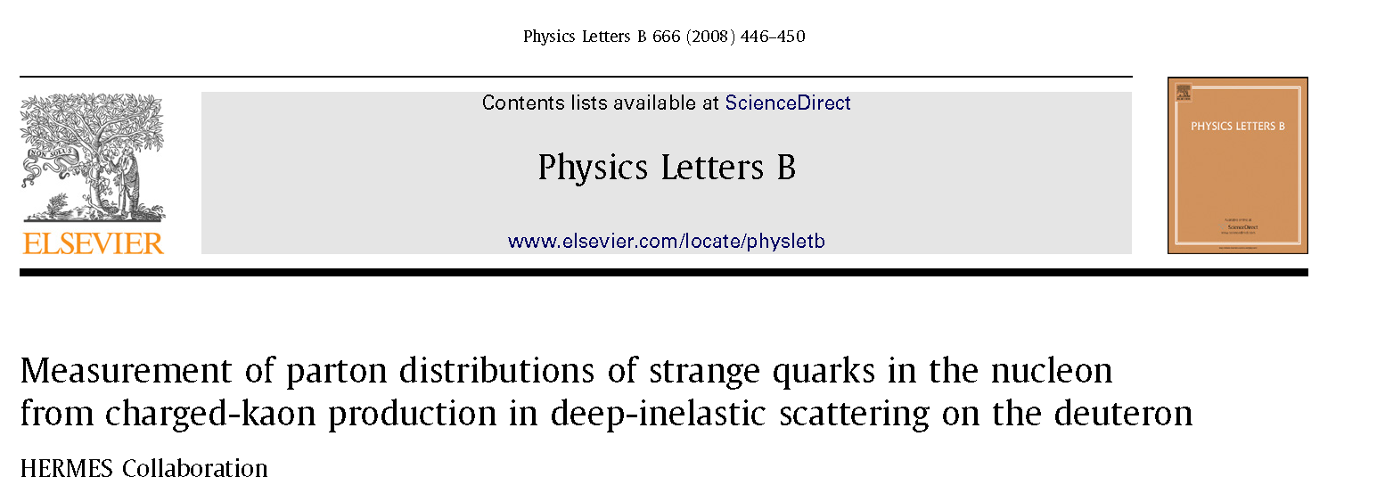
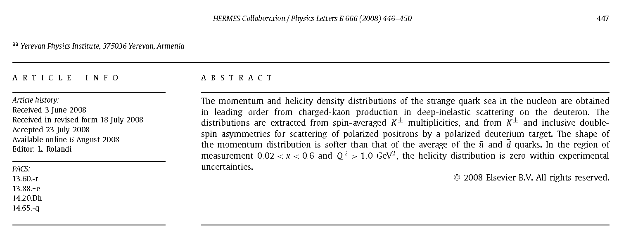

Slide 3
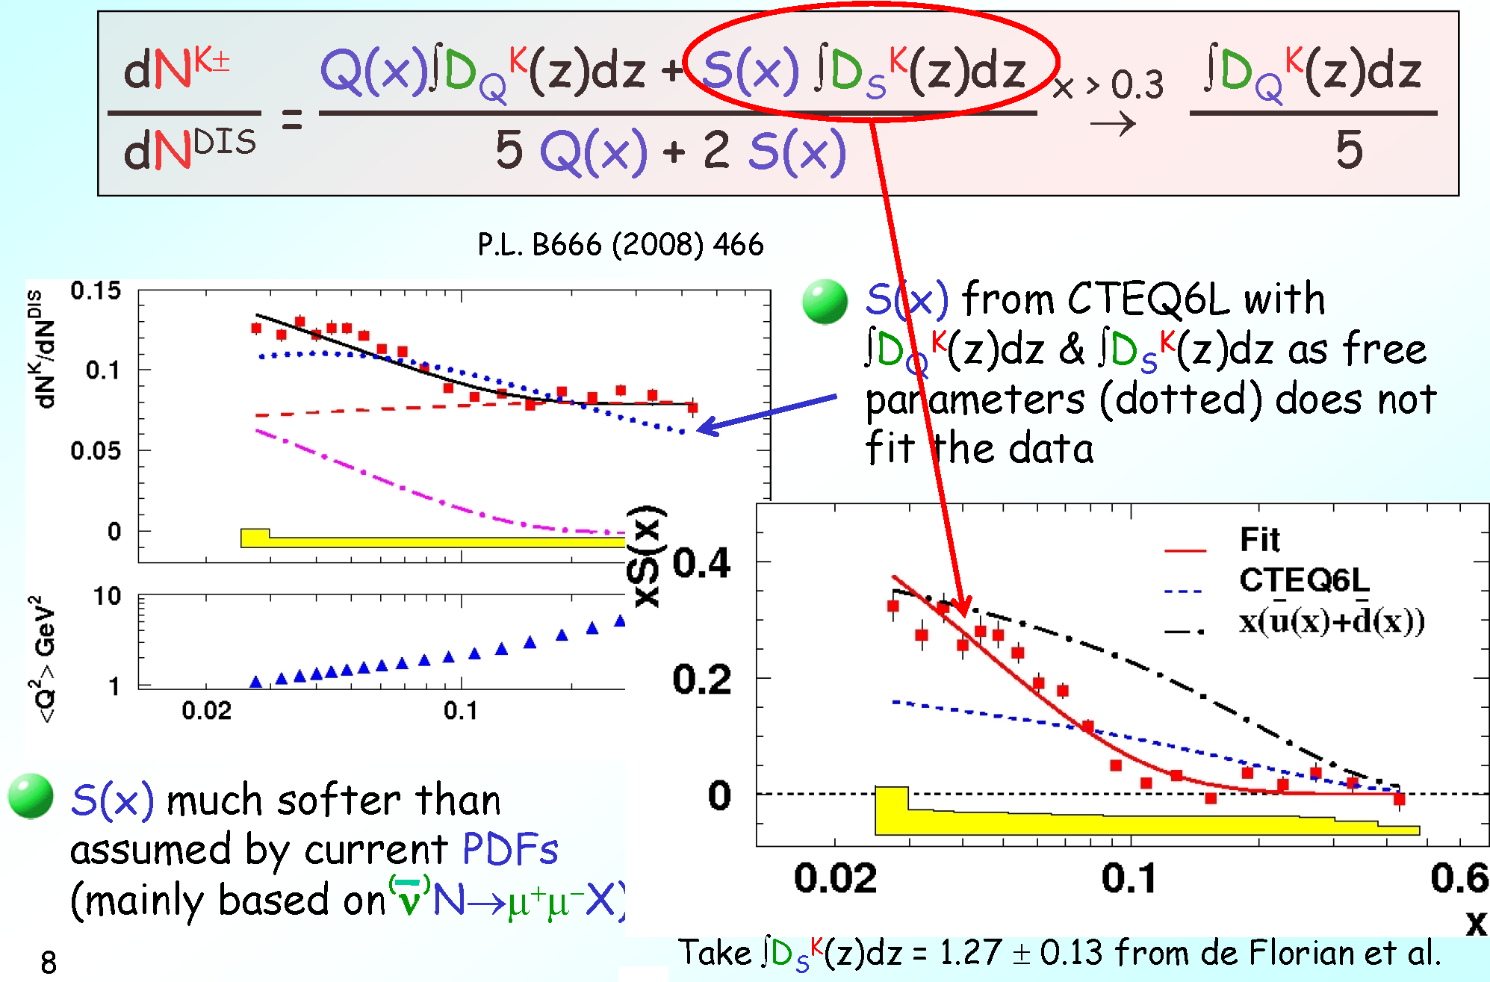
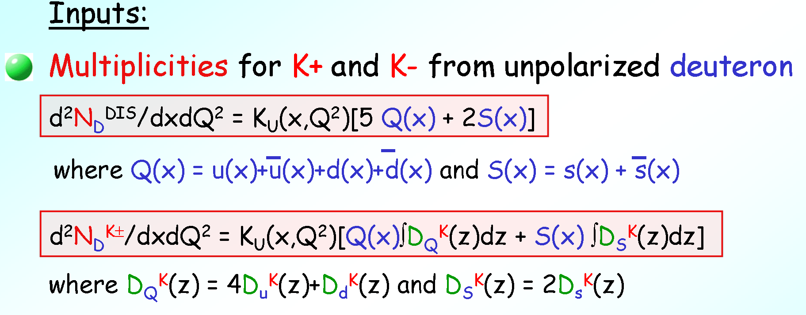
The strange sea: S(x) from K± multiplicities
For the isoscalar deuteron:

Slide 4
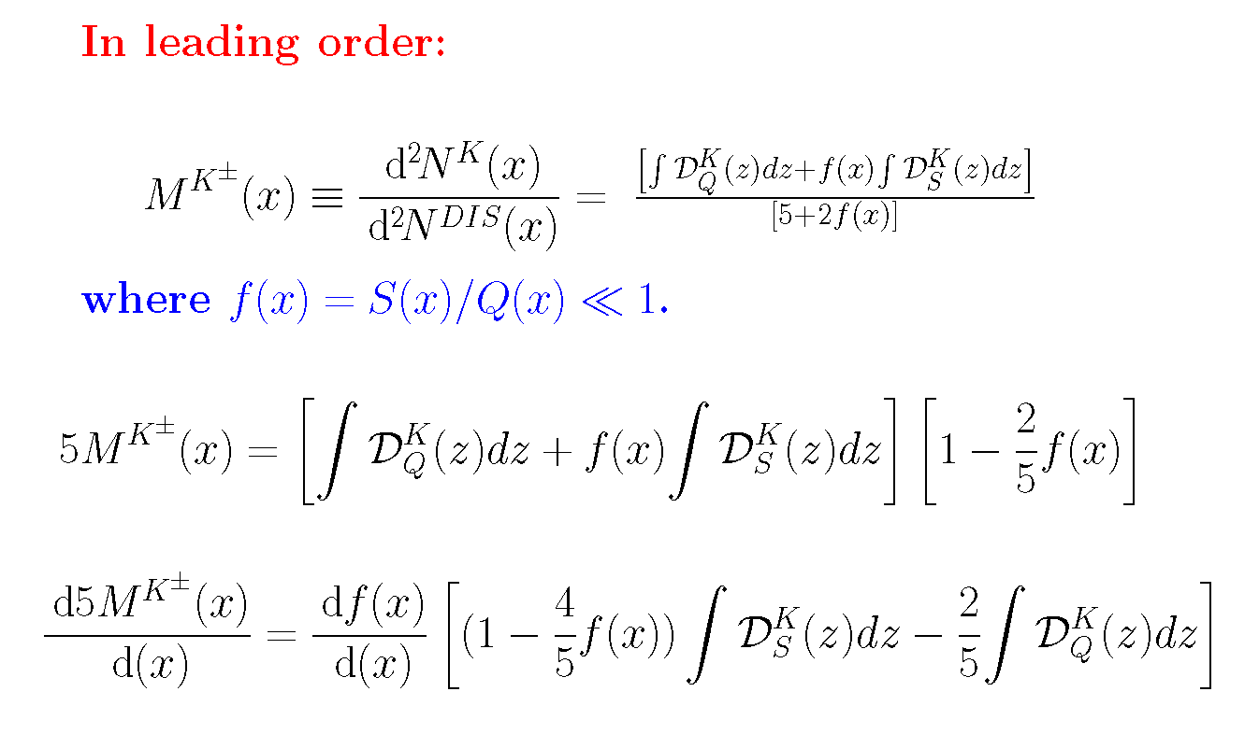
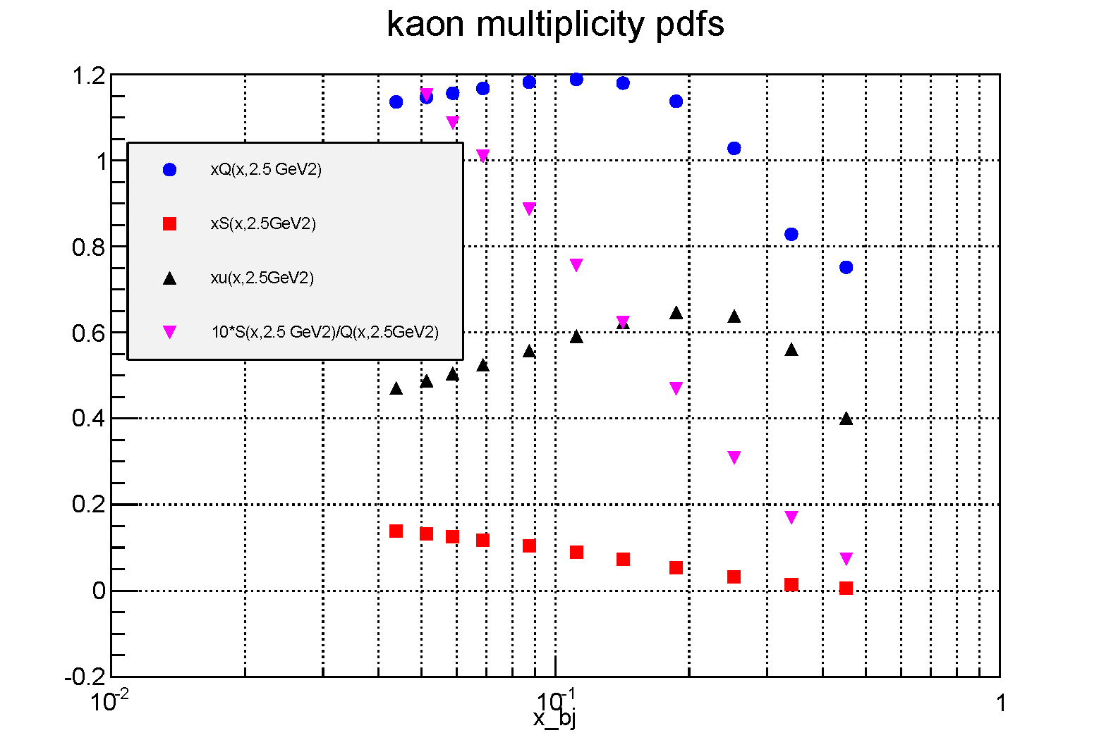
Signal for S(x)=0 at LO
dM(x)/dx < 0 if S(x)≠ 0
Signature for S(x)=0 → dM(x)/dx≥0

Slide 5
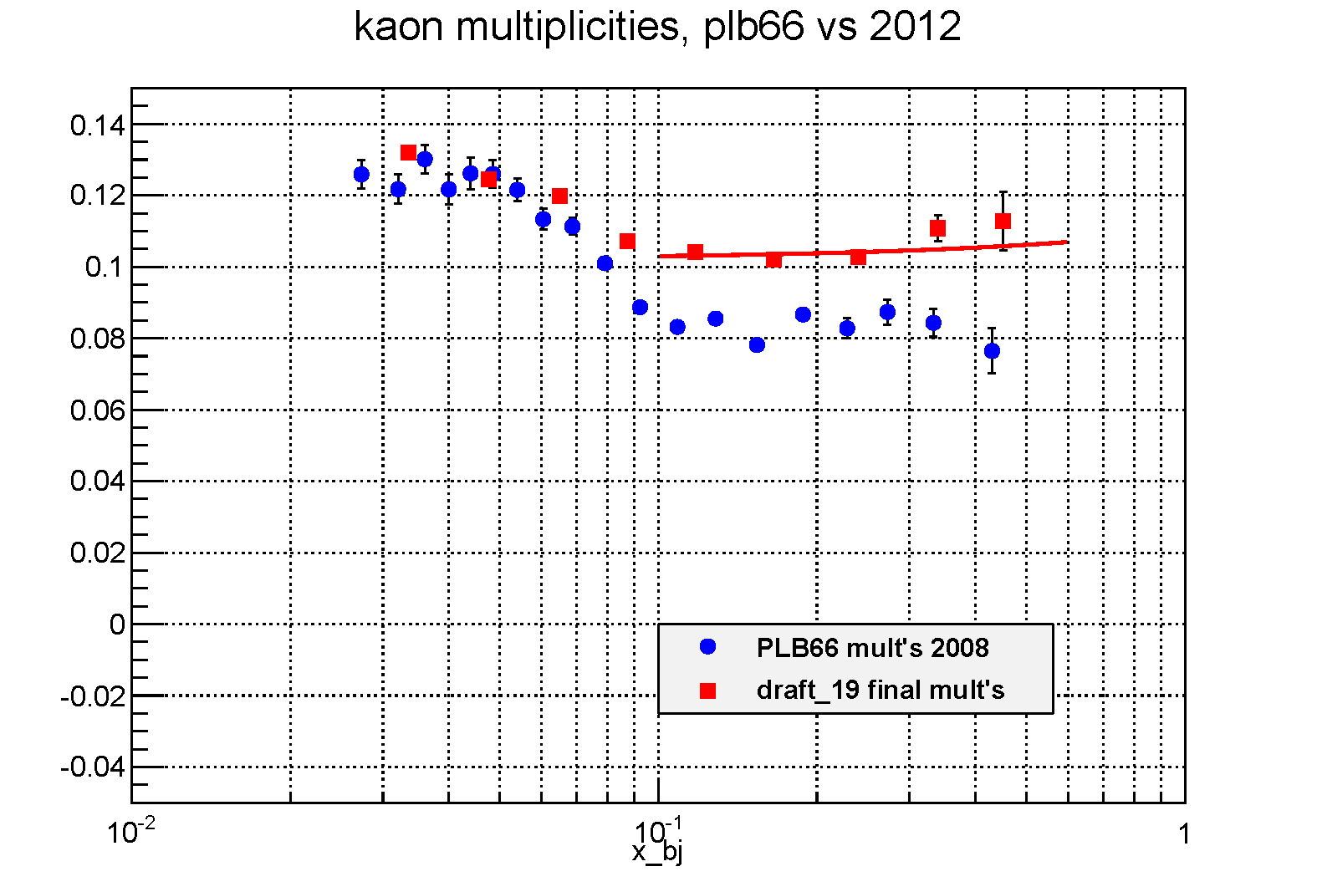
Fit of Q(x) component to M(x)=p[0]+p[1]*x_bj
M(x)=(0.102±0.002) +(0.013±0.010)x

Slide 6
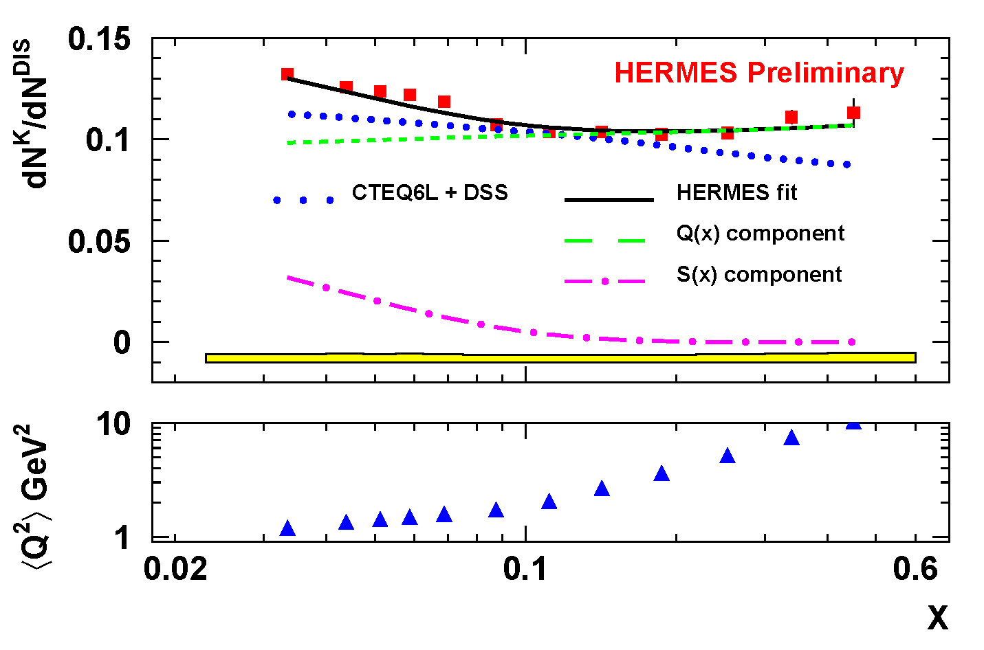
Revised fit to kaon charged multiplicity

Slide 7
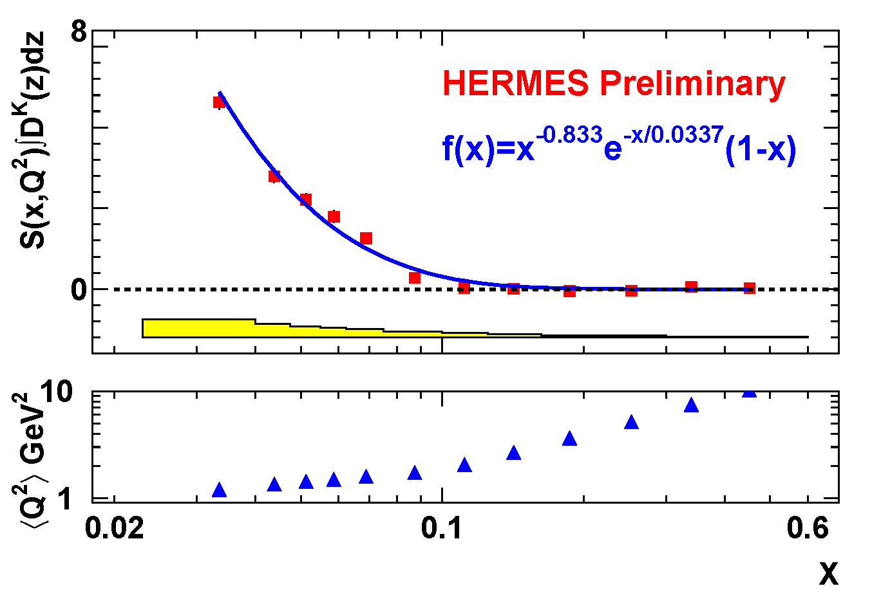
Fit to Component arising from
S(x)∫D^{K}(z)dz=x^{-a} e^{-x/b}(1-x)

Slide 8
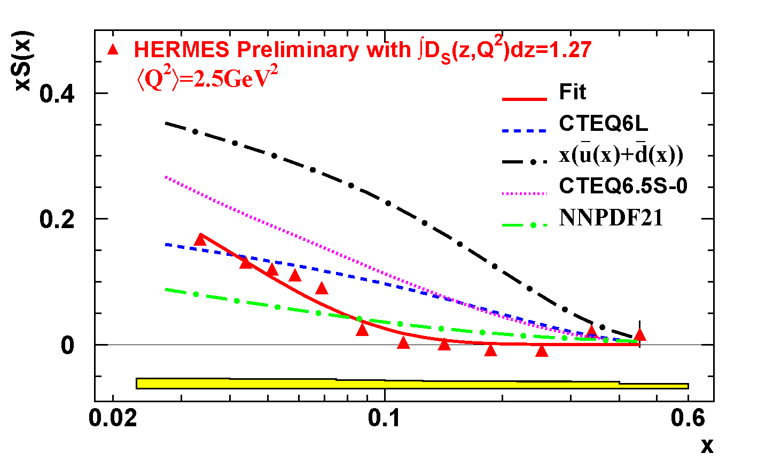
Strange parton distribution S(x) - revised
Fit(x) = x^{-0.867±0.019}e^{-0.331±0.014}(1-x)

Slide 9
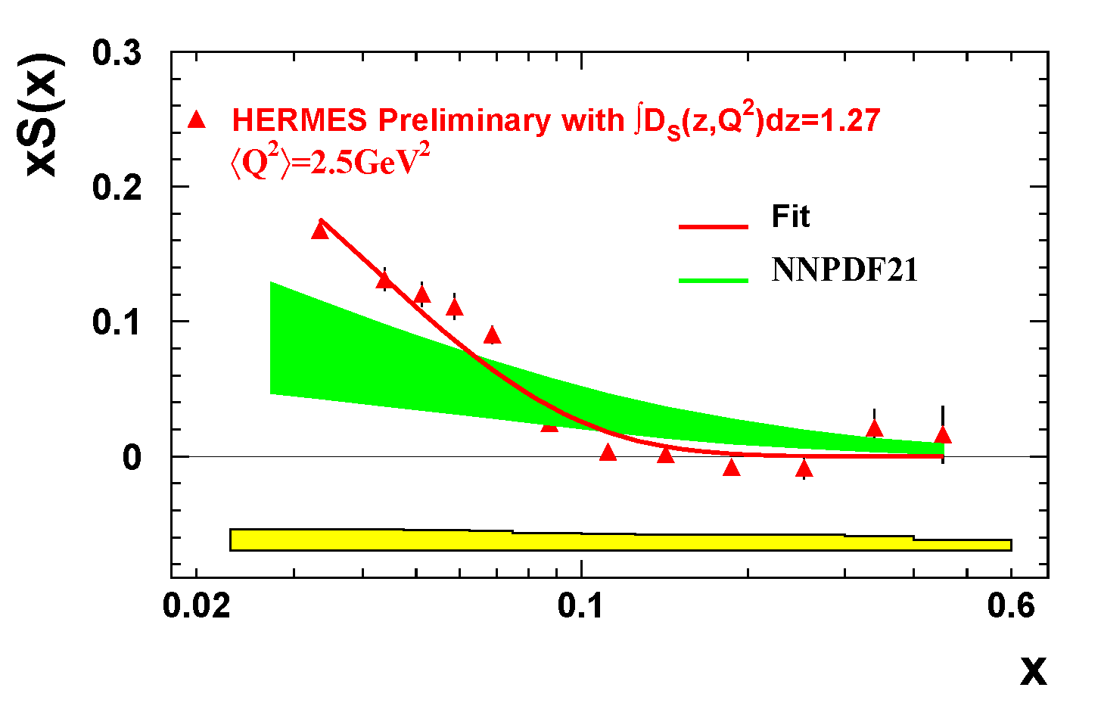
Comparison with prediction of the NNPDF Collaboration

Slide 10
Summary
S(x) ≈ 0 with the measurement error for x ≥ 0.15, as reported in PLB666, 446 (2008).
S(x) is similar in shape but ≈ 0.6 in magnitude of the data reported in 2008.
In magnitude, but not detailed shape , S(x) as extracted here is close to the recent predictions of the NNPDF collaboration (NPB 855, 153 (2012).
The shape of S(x) suggests the possibility that the strange quark pdf may be a surrogate for a sea dominated by the gluon splitting component (see Chang & Peng, PLB 704, 197 (2011).

Slide 11
Extra’s

Slide 12
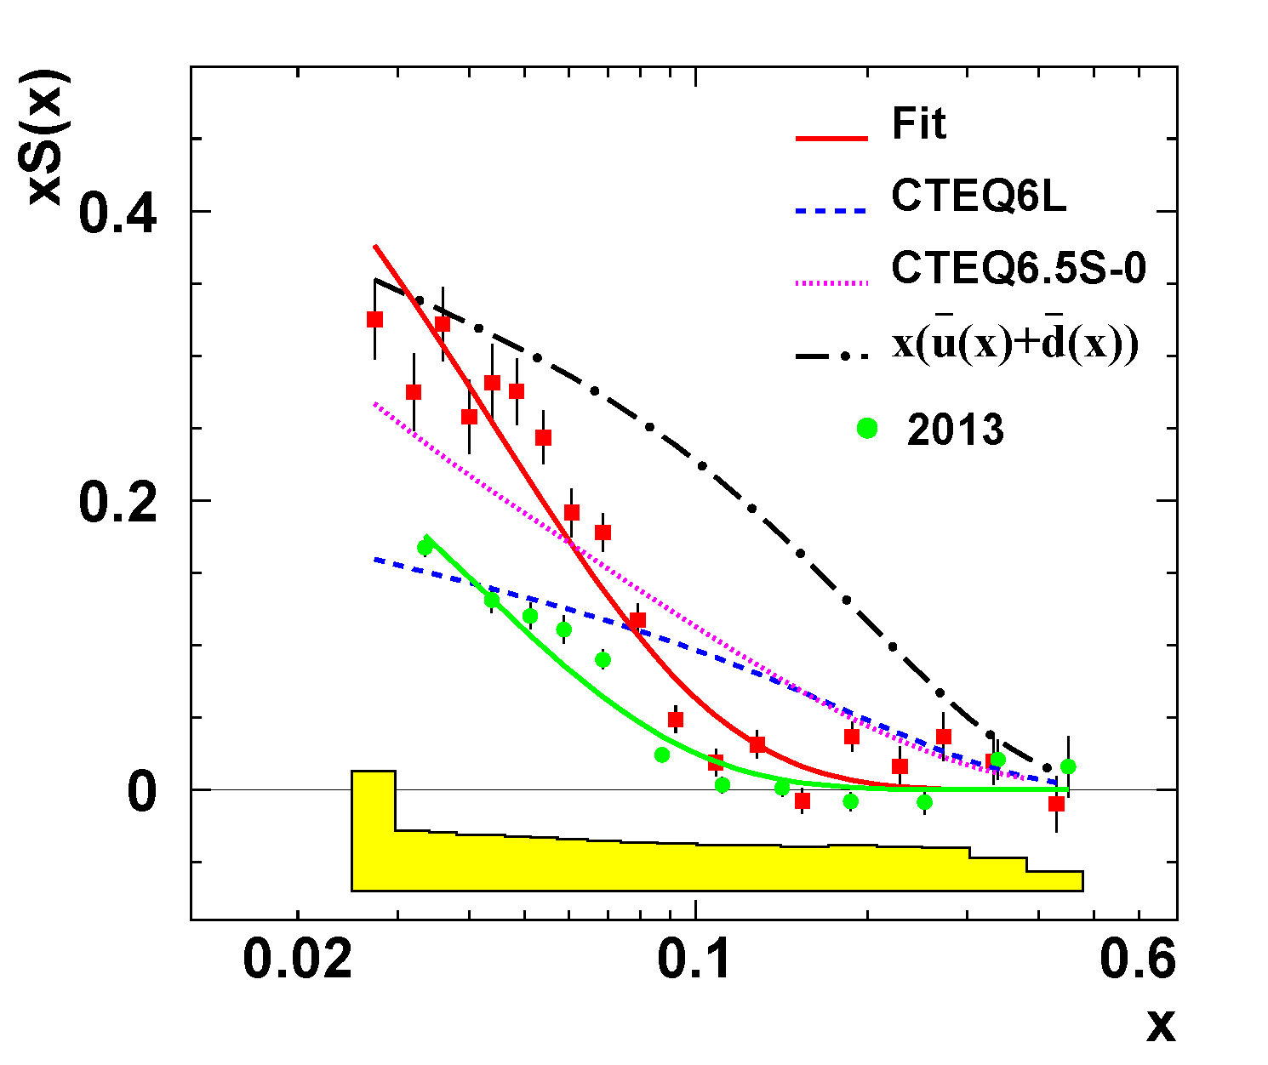
Comparison PLB666 with HERMES (2013)

