Slide 1
The LHCb upgrade
U. Marconi, INFN Bologna
On behalf of the LHCb Collaboration
DIS2013, Marseille April 2013.

Slide 2
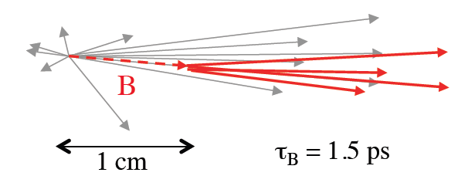
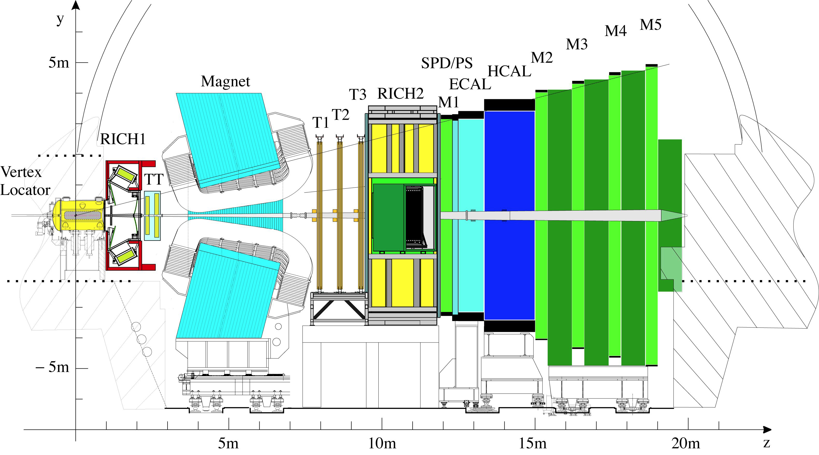
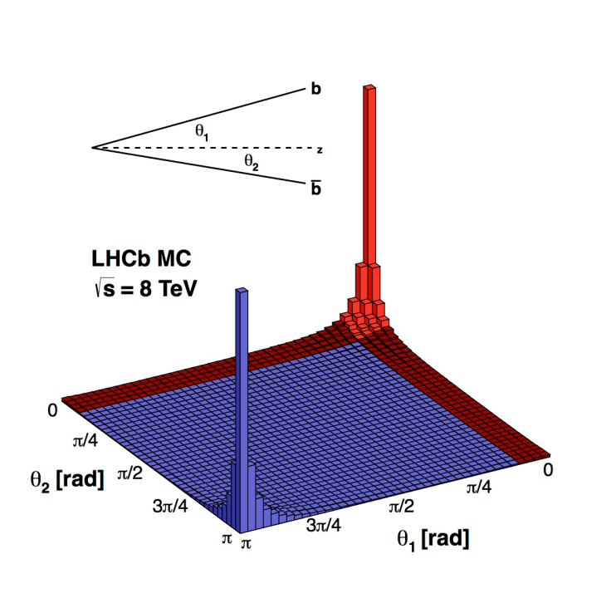
The LHCb detector
Experiment optimized for beauty physics:
– efficient trigger for hadronic and leptonic modes
– precision tracking and vertexing (mass, proper time)
– excellent particle identification
Decay time resolution Δt: 30-50 fs
Δp/p = 0.4-0.6%
Δm = 10-20 MeV/c²
Muon ID: ε(μ/μ) = 95%, mis-ID ε(π/μ) ~ 1%
RICH ID π/K: ε(K/K) = 95%, mis-ID ε(K/π) ~ 5%
CALO ID: : ε(e/e)=90%, mis-ID ~ 5%
B field polarity can be reversed
“The LHCb Detector at CERN”; The LHCb Collaboration, JINST 3, S08005 (2008)

Slide 3

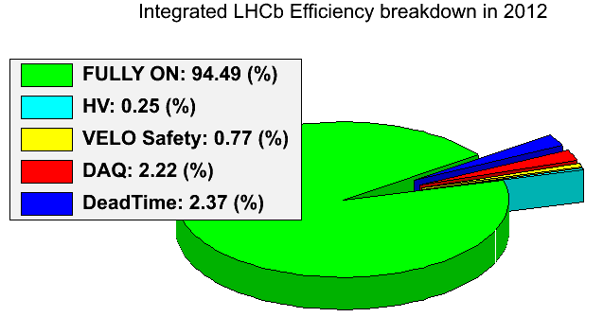
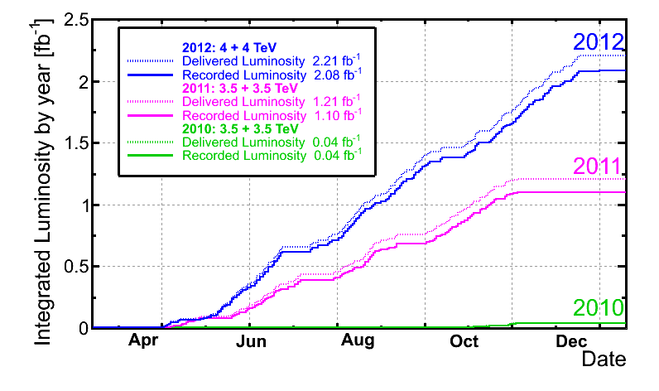
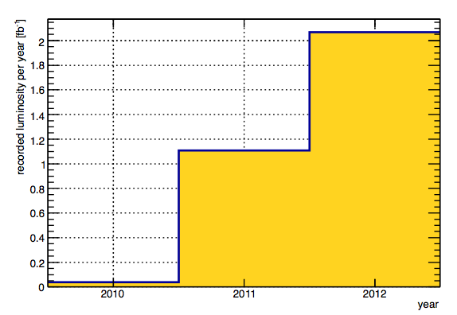
Data taking performance
LHCb has been taking data quite efficiently: 3.2 fb⁻¹ up to now.
The plan is to record 10 fb⁻¹ by 2018.
LHCb data taking efficiency 2012
Integrated luminosity
per year of data taking

Slide 4
Instantaneous Luminosity
LHCb was designed to operate with a single collision per bunch crossing, running at a instantaneous luminosity of
2. × 10 ³² cm⁻² s⁻¹ (assuming about 2700 circulating bunches).
  At the time of design there were worries about possible ambiguities in assigning the B decay vertex to the proper primary vertex among many.
Soon LHCb realized that running at higher multiplicities would have been possible.
  In 2012 we run at 4. × 10³² cm⁻² s⁻¹ with only 1262 colliding bunches.
    50 ns separation between bunches while the nominal 25 ns (will available by 2015).
  4 times more collisions per crossing than planned in the design.
    The average number of visible collisions per crossing in 2012 raised up to µ > 2.5
The luminosity is kept constant at the LHCb interaction point by “luminosity levelling”: beam separation is adjusted few times per hour to maintain the luminosity constant.
  It is a routine operation since 2011.

Slide 5
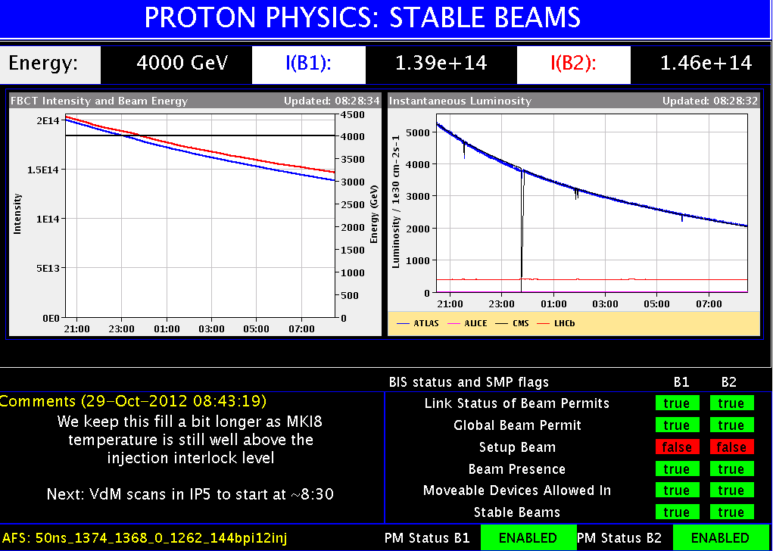
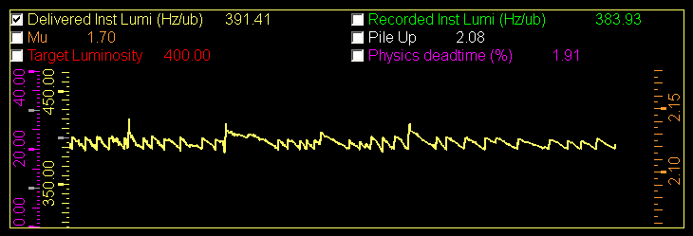
Instantaneous Luminosity (II)
LHCb
luminosity
LHCb luminosity adjustment: ±3% around the target value

Slide 6
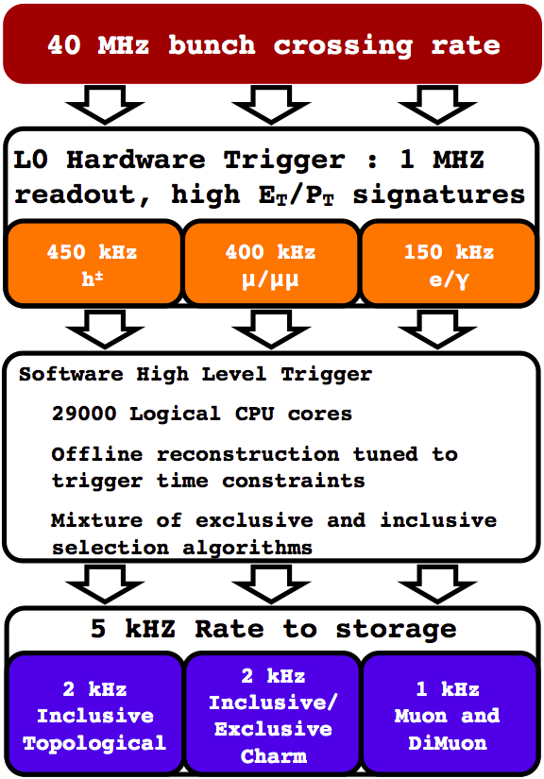
LHCb Trigger
The Level-0 trigger based on the signals from ECAL,
HCAL and MUON detectors read at 40 MHz, operates
on custom electronics, with a maximum output rate
limited to 1.1 MHz.
  Fully pipelined, constant latency of about 4 µs.
  Bandwidth to the HLT ~ 4 Tb/s, GOL serdes, optical links.
  High p_{T} muon (1.4 GeV) or di-muon.
  High p_{T} local cluster in HCAL (3.5 GeV) or ECAL (2.5 GeV)
HLT1 is a software trigger
  Reconstruct VELO tracks and primary vertices
  Select events with at least one track matching
  p, p_{T} , impact parameter and track quality cuts.
  Accept around 50 kHz.
HLT2 performs inclusive or exclusive selections of
the events.
  Full track reconstruction, without particle-id.
  25% of the events are deferred: temporarily stored on
  disk and processed during the inter-fills.
  Total accept rate to disk for offline analysis is around 5 kHz.

Slide 7
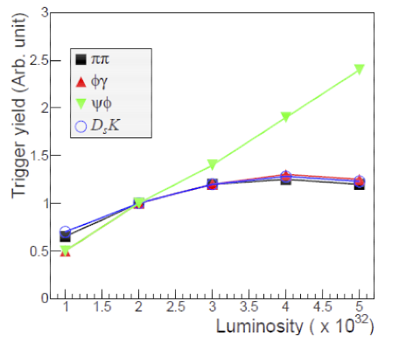
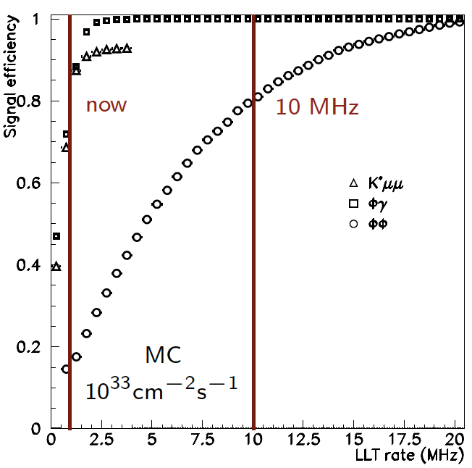
The 1MHz L0 rate limitation
“Framework TDR for the LHCb Upgrade: Technical Design Report”; The LHCb Collaboration,CERN/LHCC-2012-007, LHCb-TDR-12 - 2012
Due to the available bandwidth and discrimination power of the hadronic L0 trigger LHCb experiences the saturation of the trigger yield on the hadronic channels.
Increasing the first level trigger rate would considerably increase the efficiency on the hadronic channels.
Notes:
The fixed layout of the Level-0 trigger does not allow for efficient triggering on decays which
only have hadronic content. It turns out that as the luminosity increases so does the inefficiency
in the hadronic triggers and the net yield of hadronic events levels off, while the yield of events
with leptonic content scales with the luminosity increase.

Slide 8
The LHCb upgrade
Readout the whole detector at 40 MHz.
Use a Low Level Trigger (hardware first level trigger) as a throttle mechanism, while progressively increasing the power of the event filter farm to run the HLT up to 40 MHz.
Run the experiment at a luminosity of at least
10. × 10³² cm⁻² s⁻¹ , i.e. 2.5 times the 2012 running value. We have foreseen to reach 20. × 10³² cm⁻² s⁻¹ and therefore to prepare the sub-detectors on this purpose.
  At 10. × 10³² cm⁻² s⁻¹ pile up µ ≅ 2 (25 ns time spacing).
  Increase the yield in the decays with muons by a factor five and the yield of the hadronic channels by a factor ten.
The upgrade shall take place during the Long Shutdown 2 (LS2) in 2018.
Collect 50 fb⁻¹ of data over ten years.

Slide 9
LHCb upgrade: consequences
The detector front-end electronics has to be entirely rebuilt because of the output rate requirements.
  No more buffering in the front-end electronics boards.
  A lot more optical links to get the required bandwidth needed to transfer data from the front-end to the read-out boars at 40 MHz.
New HLT farm and network to be built by exploiting new LAN technologies and powerful many-core processors.
Rebuild the current sub-detectors equipped with embedded front-end chips.
  Silicon strip detectors: VELO, TT, IT
  RICH photo-detectors: front-end chip inside the HPD.
Consolidate sub-detectors to let them stand the higher foreseen luminosity of 20. × 10³² cm⁻² s⁻¹

Slide 10
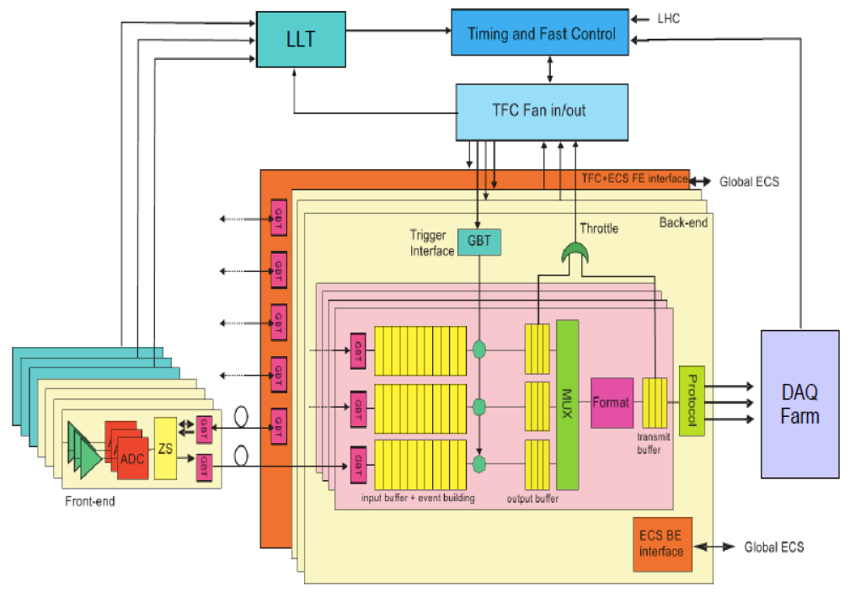
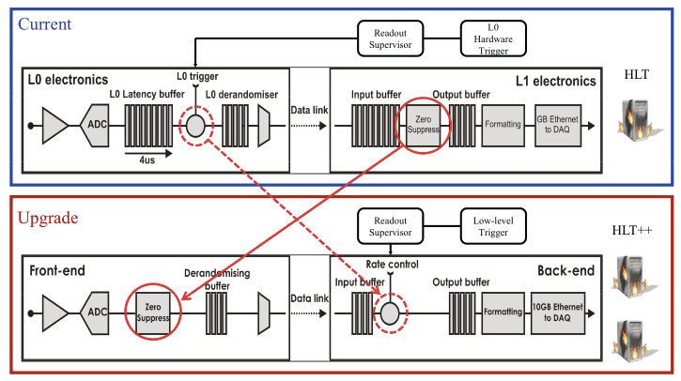
Electronics
The LHCb readout board
AMC40
24 × 3.2 Gb/s
12 × 10 Gb/s
Data transfer from the frontend boards
to the read-out boards at 40 MHz: ~ 40 Tb/s,12000 optical links, using 3.2 Gb/s GBT serializers.
  Zero suppression performed at the frontend board
Readout boards for buffering and data format
conversion, from custom to industrial standard (LAN protocol).
AMC40
AMC40
24 input
12 output
ATCA
Carrier
Board
AMC40
data throughput
~100 Gb/s
AMC40
~500 AMC40
In total

Slide 11
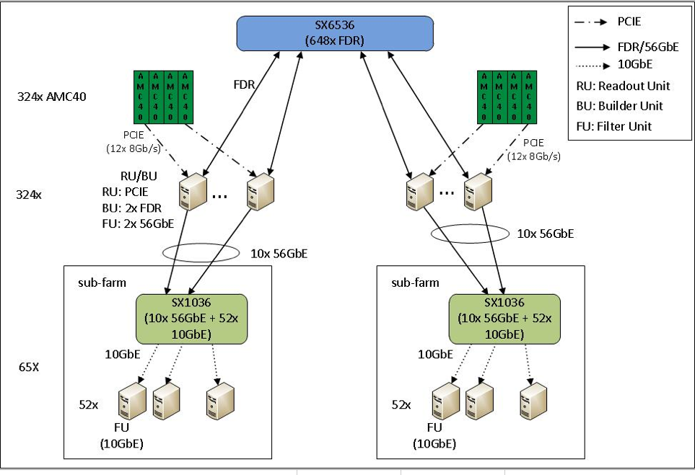
HLT farm and network
Event builder
High speed network
Event filter
http://lbonupgrade.cern.ch/wiki/index.php/Network-arch
DIS2013 : LHCb upgrade

Slide 12
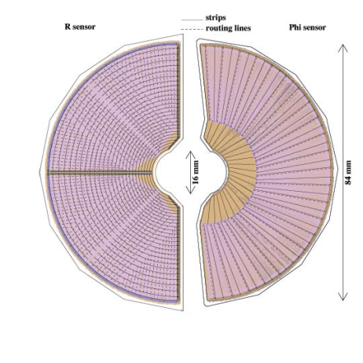
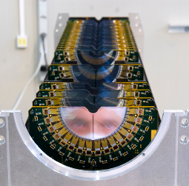
The current VELO
21 stations of silicon micro-strip
sensors, located nearby the
interaction region.
  R and ϕ geometry modules
  44 mm external radius
  Left and right halves of the modules can be moved inward/outward the beam lines: modules open and close at each fill. Distance from the beam line 5.5 mm
  Position centred around the current beam
  position. Modules do not move during a fill.
  Positions reproducible within
  5 µm: measured as the average
  distance between right-side PV
  and left-side PV.
Primary (beam) and secondary
vacuum are separated by a thin
Al box (“RF foil”).
±5 µm

Slide 13
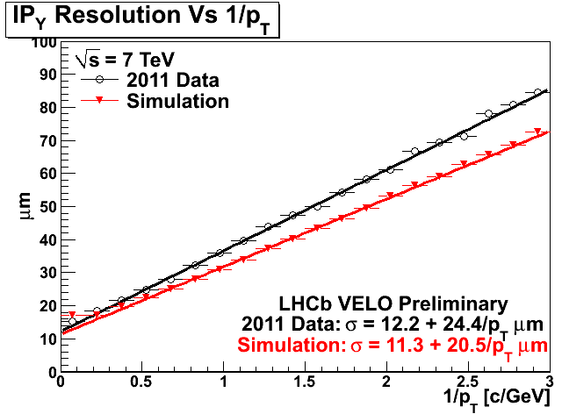
The current VELO (II)
Impact parameter resolution, essential for heavy flavour physics, is quite good: ~ 20 µm at high p_{T} (≤ 10 GeV/c in the LHCb acceptance).
Primary vertex resolution excellent as well:
~ 15 µm in the x,y transverse plane.
~ 75 µm along the longitudinal z axis (typically with 20 tracks).

Slide 14
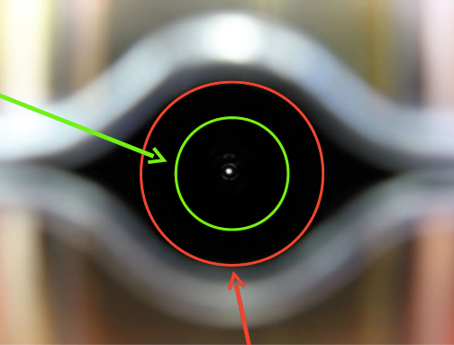
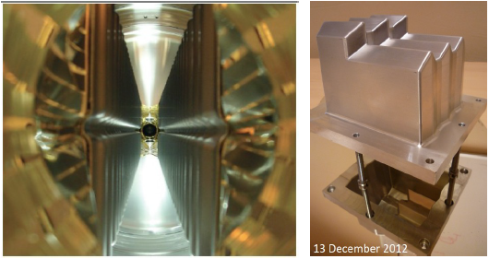
The VELO upgrade
The VELO upgrade has to maintain or improve
the performance of the current detector.
Inner radius r₁ of RF foil will be reduced from 5.5 mm to 3.5 mm.
The RF foil currently contributes
with 80% of the material budget before r₁ and r₂ points: good results in thinning the thickness achieved with 1.5 mm instead of the present
4 mm.

Slide 15
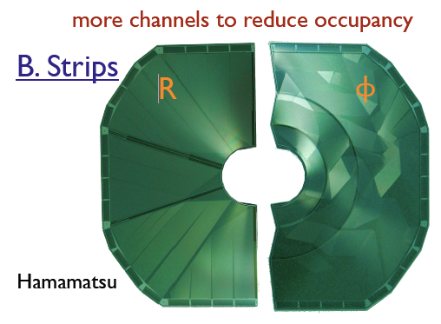
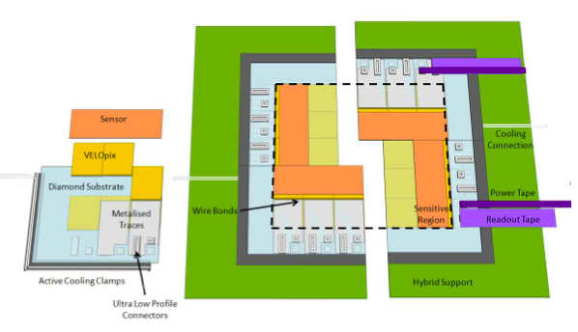
The VELO upgrade (II)
Strip sensor prototype
Electronics will have to withstand 50 fb⁻¹ ,
equivalent to radiation up to 0.3×10¹⁶ n_{eq}cm⁻².
Thickness of the modules has to be reduced
to 200 μm to limit the number of produced
secondary particles.
Two options still considered:
Microstrip sensors:
  Similar to the existing VELO R and ϕ layout.
  Finer pitch and segmentation to reduce occupancy,
  reduced thickness and inner radius.
  SALT readout ASIC, the same for the IT project.
Pixel sensors:
  High granularity eases pattern recognition.
  R&D is focusing on planar silicon sensors
  55 μm ×55 μm (256×256).
  ASIC derived from Timepix/Medipix family.
Projects review for decision scheduled next May.
Pixel module layout

Slide 16
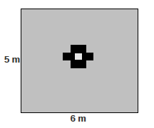
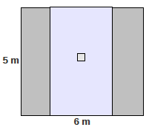
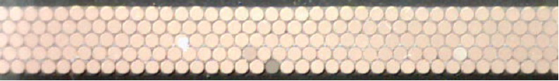
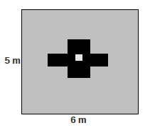
Tracking system upgrade
Replacing the inner tracker of the downstream tracking stations
Scintillating Fibers detector
Replacing the straw tubes of the central regions by Scintillating Fibers with
Silicon Photo-Multiplier (SiPM) for
light collection.
Five layers of 2.5 m long scintillating
fibres of 250 μm diameter.
Expected performance: 60 – 100 μm
spatial resolution.
Silicon strip detector
New silicon strip detector with larger
coverage, reducing geometry of
OT in central region: with shorter straw
tubes in central region.

Slide 17
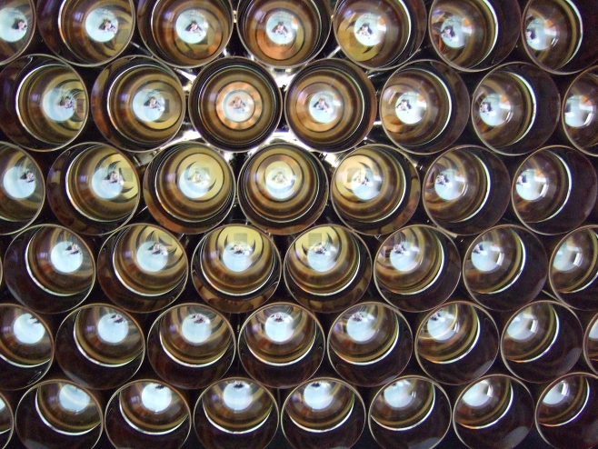
RICH
Particle identification in the range 2 to ~100 GeV
  Two RICH, three radiators
  Readout by HPD
    ~500, 1024 channels
    High efficiency
    Very low noise
Particle ID performance
  ~95% efficiency for 5% contamination
    Averaged over B daughter tracks
  Well described by simulation

Slide 18
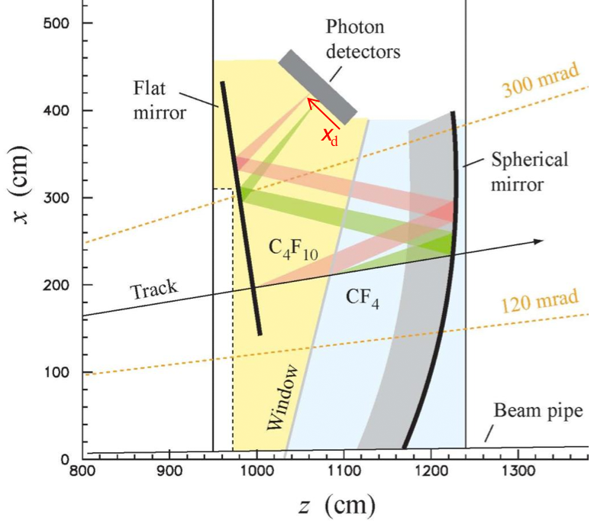
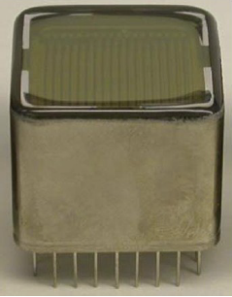
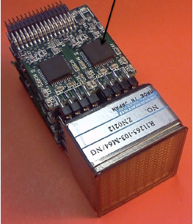
RICH upgrade
HPD to be removed due to embedded front-end electronics.
R&D focused on MaPMT: possible candidate is the Hamamatsu R11265.
Custom readout ASIC being developed.
Aerogel will be removed, but occupancy still seems an issue.
RICH1 upgrade optics with increased mirror radius to spread out the rings.
Twin-Ring-Identication system (TRIDENT)
TRIDENT
merge both RICHs including complex lens system

Slide 19
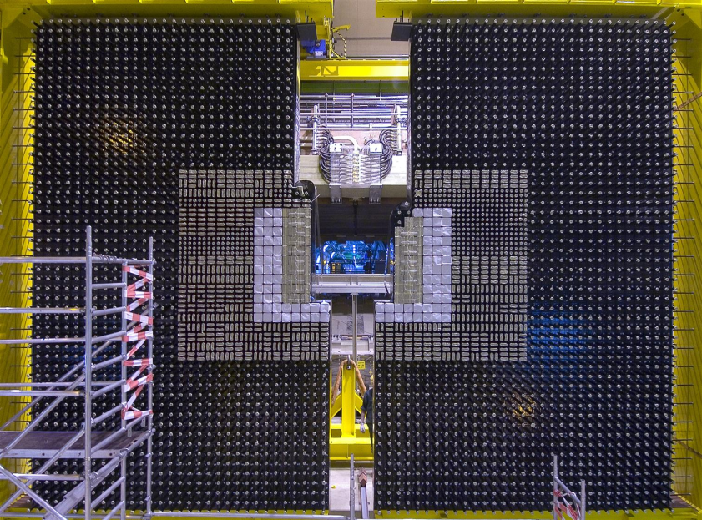
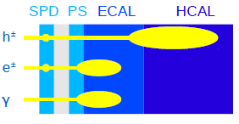
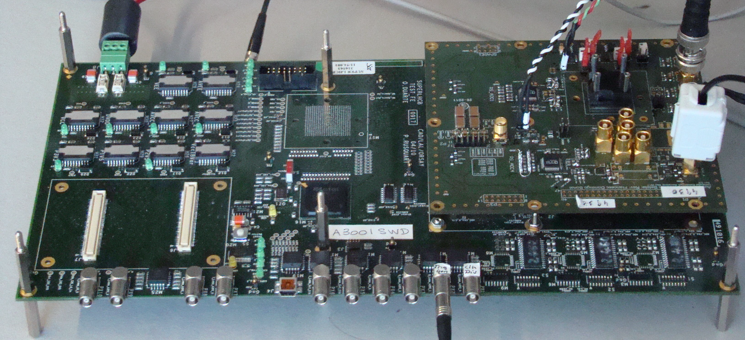
Calorimeters
ECAL made of shashlik blocks
  Lead - scintillator stack
  ~6000 channels, readout by PMT
  ΔE/E ~ 10% / √E + 1%
HCAL: scintillating tiles in iron
  ~1500 channels, same readout and electronics as ECAL
  ΔE/E ~ 70% / √E + 9%
  Mainly used for trigger
PreShower and SPD
  same geometry as ECAL
  Scintillator tiles readout by MAPMT
  Identify electron/photon, used in L0 trigger
  UPGRADE
Removal of SPD and PS due to the high
occupancy
New front-end electronics.
Some ECAL modules in the inner region
might have to be replaced
Notes:
The main challenge of the calorimeter upgrade is to replace the current front-end electronics
by a new system able to send data to the DAQ at 40 MHz. Moreover, the new
electronics must have a gain ve times higher than the present system, in order to compensate
for a gain reduction that will be imposed on the photomultipliers so that the
mean anode current remains at an acceptable level during high-luminosity running. This
requirement has implications for the maximal acceptable noise level for the analogue
components. Two analogue implementations based either on the ICECAL[31] ASIC or on
discrete components are already at an advanced stage of design. The digital front-end is
being developed in parallel and is based on the ACTEL A3PE
ash-based FPGA and on
the GBT[30] ASIC from CERN.

Slide 20
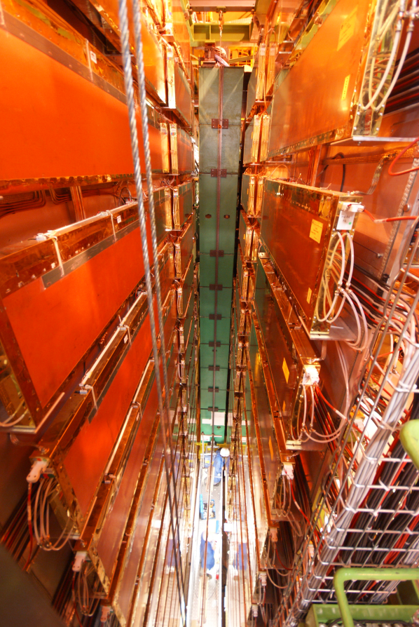
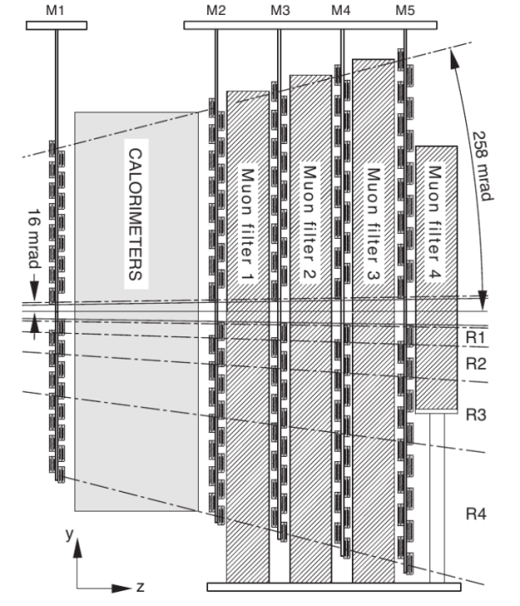
Muon system
5 stations (segmented in four regions) of detectors interleaved with iron walls.
  1368 MWPC and 24 GEMs: 435 m²
  First station M1 located before the calorimeters.
  Projective geometry
    Allows it to be used in the L0 trigger
  Muon identification performance
    ~97% efficiency for 3% miss-ID.
    UPGRADE
M1 will not be needed since of the high occupancy at the higher luminosities.
Due to the higher rates MWPC may not be adequate anymore in the internal regions close the beam pipe: replaceMWPC internal chambers with triple-GEM.

Slide 21
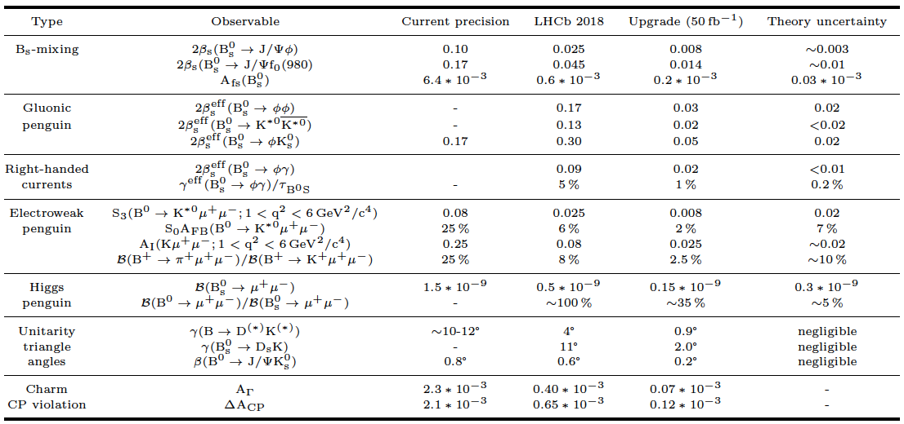
Performance benchmarks
FTDR CERN/LHCC‐2012‐007
May 2012

Slide 22
Performance benchmarks (II)
LHCb is unique for NP searches in B_{S} system and extremely competitive for B_{d} too.
LHCb can collect unprecedented charm yields.
LHCb is also a general purpose experiment with forward geometry.
  W and Z precision measurements
  W→μν & Z→μμ (2010) differential cross sections and asymmetry in arXiv:1204.1620
  Z→ee (2011) differential cross section arXiv:1212.4620
  LHCb Z boson measurements, EPJ C71 1600 (2011), LHCb-CONF-2013-007

Slide 23


More information
CERN/LHCC‐2011‐001
CERN/LHCC‐2012‐007
LHCb Upgrade fully endorsed by LHCC and approved by CERN Research Board

Slide 24
Summary
Concept of LHCb definitely proved.
  Dedicated experiment for heavy flavour physics exploiting a forward spectrometer at a hadron collider.
Many world leading results and many more to come with the 3.2 fb⁻¹ full data set.
Standard Model still survives.
  Now on probing regions where new physics effects might appear.
LHCb plan the upgrade to be installed in 2018: Essential next step forward for flavour physics.

Slide 25
Reconstruction performance
Momentum resolution excellent
  From 0.4% at 5 GeV to 0.6 % at 100 GeV/c
  Important ingredient to study narrow states
  Momentum scale OK, checked by comparing the mass of B mesons to the PDG values.
J/Ψ → μμ : σ ≈ 15 MeV/c²
Υ(1S) → μμ : σ ≈ 54 MeV/c²
B_{S}→J/ΨΦ : σ ≈ 8 MeV/c²

Slide 26

PID is working nicely
  Important to disentangle various decays
B0 → Kπ
B0 → ππ
Λb → pπ
Λb → pK
BS → KK

