Slide 1



Studying hot QCD matter
at the CERN-LHC
with heavy quarks
Thanks to the ALICE, ATLAS and CMS Collaborations and the LHC accelerator team
André Mischke
XXI. Int. Workshop on Deep-Inelastic Scattering and Related Subjects
Marseilles, France – 22-26 April 2013

Slide 2
Outline
Strongly interacting matter in extremes
Heavy quarks (charm and beauty) and
the Quark Gluon Plasma
Measurements
  pp interactions: important baseline; test pQCD models
  p-Pb collisions: study cold nuclear matter effects
  Pb-Pb collisions: study hot QCD matter;
  determine medium properties
Probes
  Open HF (prompt D mesons and HF decay leptons): Energy loss mechanism(s) and degree of thermalization
  Hidden HF (J/ψ and Y states):
  Deconfinement (dissociation in hot QCD matter) and degree of thermalization
Summary
Plenary talk by
Barbara Erazmus
Parallel talk by
Diego Stocco

Slide 3
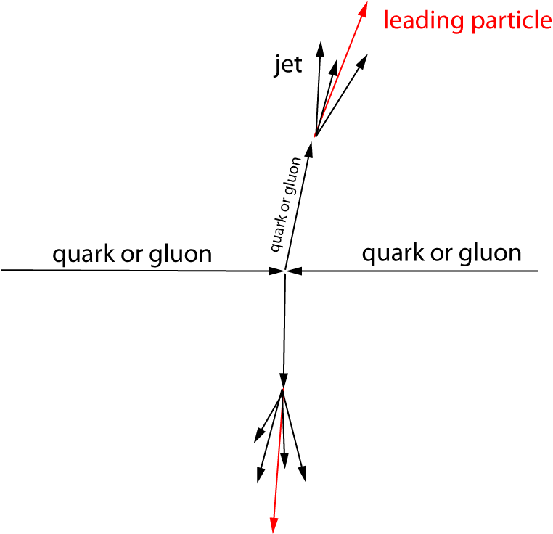
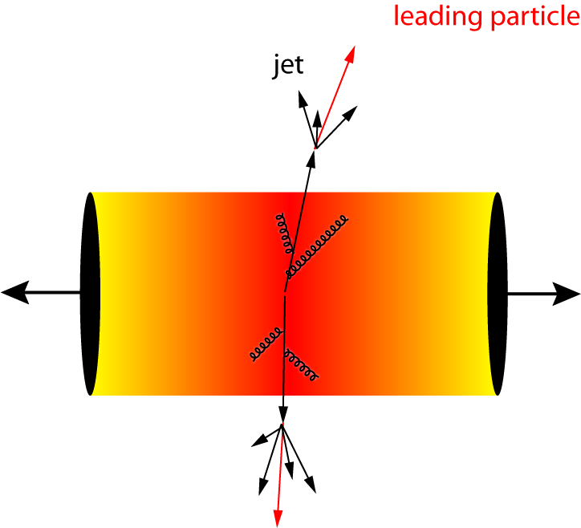
Probing hot and dense QCD matter
“Simplest way” to establish
the properties of a system
  calibrated probe
  calibrated interaction
  suppression pattern tells about density profile
Heavy-ion collision
  hard processes serve as calibrated probe (pQCD)
  traversing through the medium and interacting strongly
  suppression provides density measurement
  General picture: parton energy loss through medium-induced gluon radiation and collisions with medium
Quark-Gluon
Plasma
pp collision
Pb-Pb collision
after the collision
Quantify medium effects with
nuclear modification factor
3

Slide 4
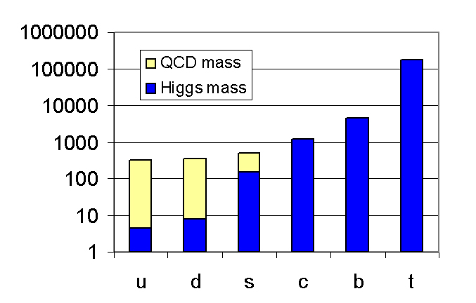
Heavy quarks are ideal probes
B. Müller, Nucl. Phys. A750, 84 (2005)
Symmetry breaking
  Higgs mass: electro-weak symmetry breaking → current quark mass
  QCD mass: chiral symmetry breaking → constituent quark mass
Charm and beauty quark masses are not affected by QCD vacuum → ideal probes to study QGP
Test QCD at transition from perturbative to non-perturbative regime: charm and beauty quarks provide hard scale for QCD calculations
Charm and beauty quarks are 250-450 times heavier than light quarks
They are abundantly produced at the LHC, predominantly in the early phase of the collisions
Production rates calculable in pQCD

Slide 5
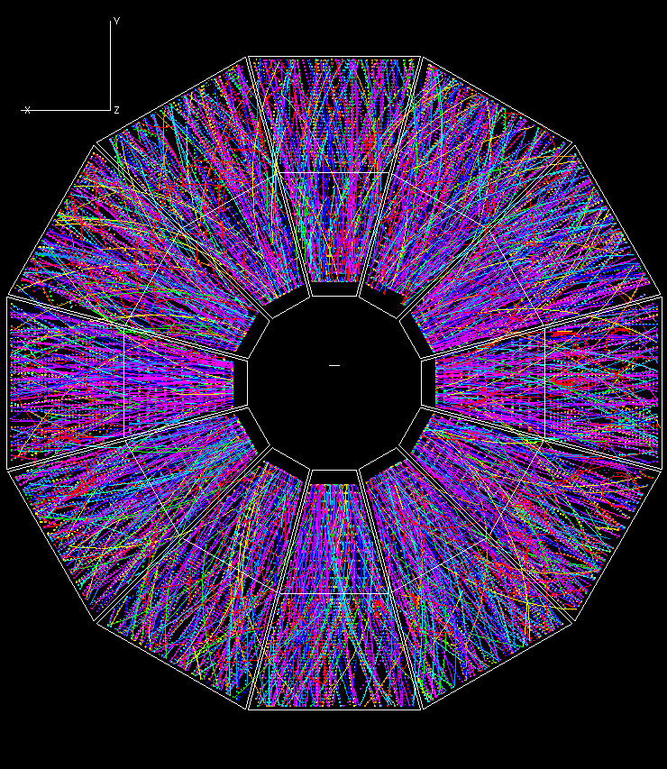
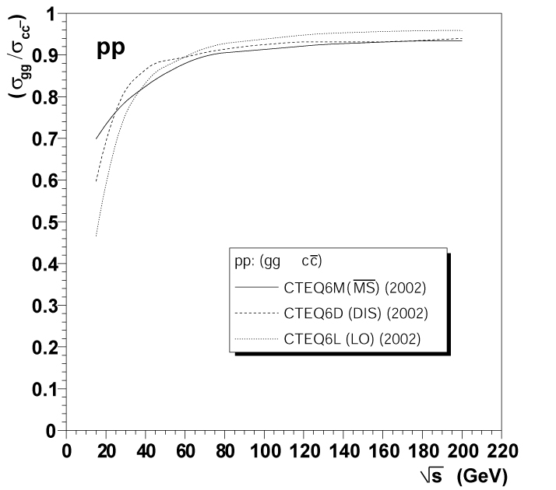
Time evolution of a heavy-ion collision
Thermalization
of QGP
Hadronisation:
QGP lifetime?
Quarkonia melts
and flow develops
~0.1
~1
~10
10¹⁵
time scale (fm/c)
Parton energy loss
Charm production
τ ~ h/2m_{Q}
Gluon fusion dominates → sensitivity to initial state gluon distribution M. Gyulassy and Z. Lin, Phys. Rev. C51, 2177 (1995)
Heavy quarks transverse through the QCD medium and interact strongly with it → energy loss
Due to their mass (m_{Q} >> T_{c}, Λ_{QCD}) → higher penetrating power
Charm,
PYTHIA 6.208

Slide 6
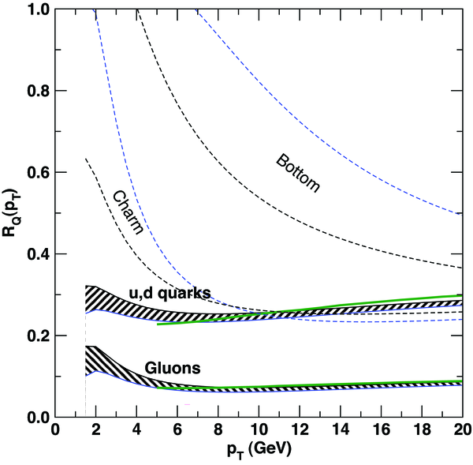
Energy loss of heavy quarks
(1) Radiative parton energy loss is colour charge dependent (Casimir coupling factor C_{R})
R.Baier et al., Nucl. Phys. B483, 291 (1997) (“BDMPS”)
(2) Dead-cone effect: gluon radiation suppressed at small angles (θ < m_{Q}/E_{Q})
Y. Dokshitzer, D. Kharzeev, PLB 519, 199 (2001), hep-ph/0106202
ΔE_{g} > ΔE_{u,d,s} > ΔE_{c} > ΔE_{b}
R_{AA}(π) < R_{AA}(D) < R_{AA}(B)
hot and dense QCD matter
parton
S. Wicks et al., Nucl. Phys. A784, 426 (2007)
beauty
charm
6

Slide 7
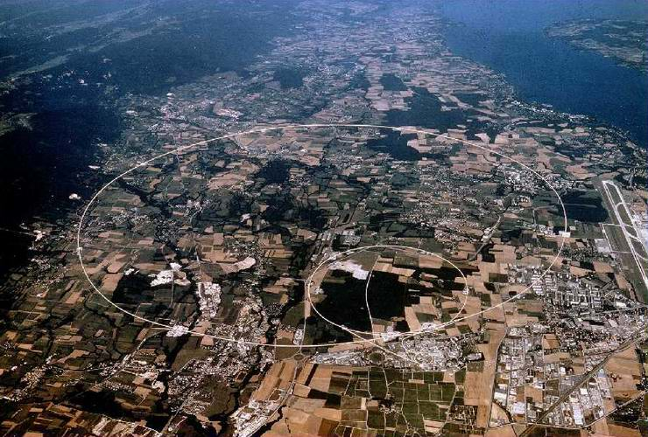
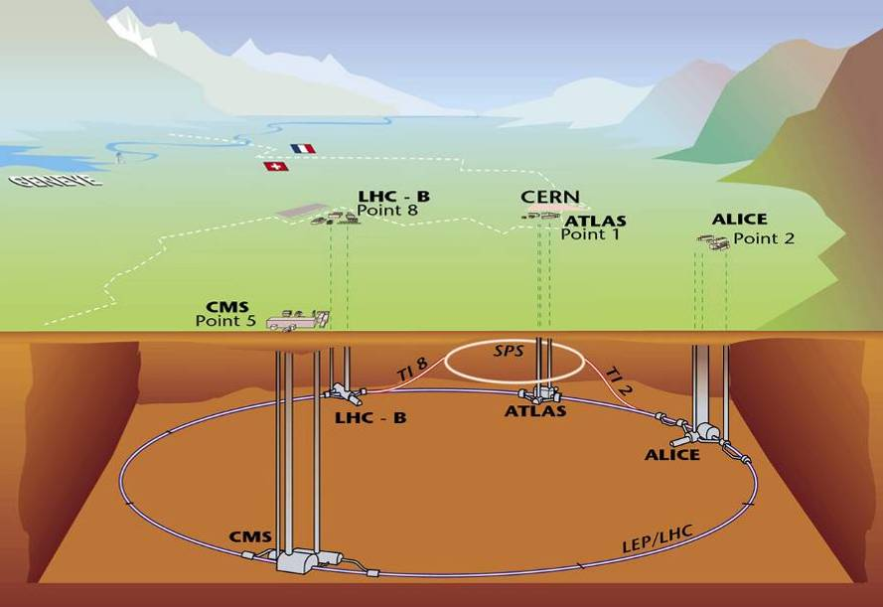

Large Hadron Collider at CERN
1232 dipole magnets
Two counter-rotating beams
Operation with super-fluid helium at 1.9K (~120 tons)
8 Tesla bending field
100 m
Data taking since November 2010
Ion species and energies
- Pb-Pb, √s_{NN} = 2.76 TeV
- pp, √s = 0.9, 2.36, 2.76,
7 and 8 TeV
- p-Pb, √s_{NN} = 5.02 TeV
8.5 km

Slide 8
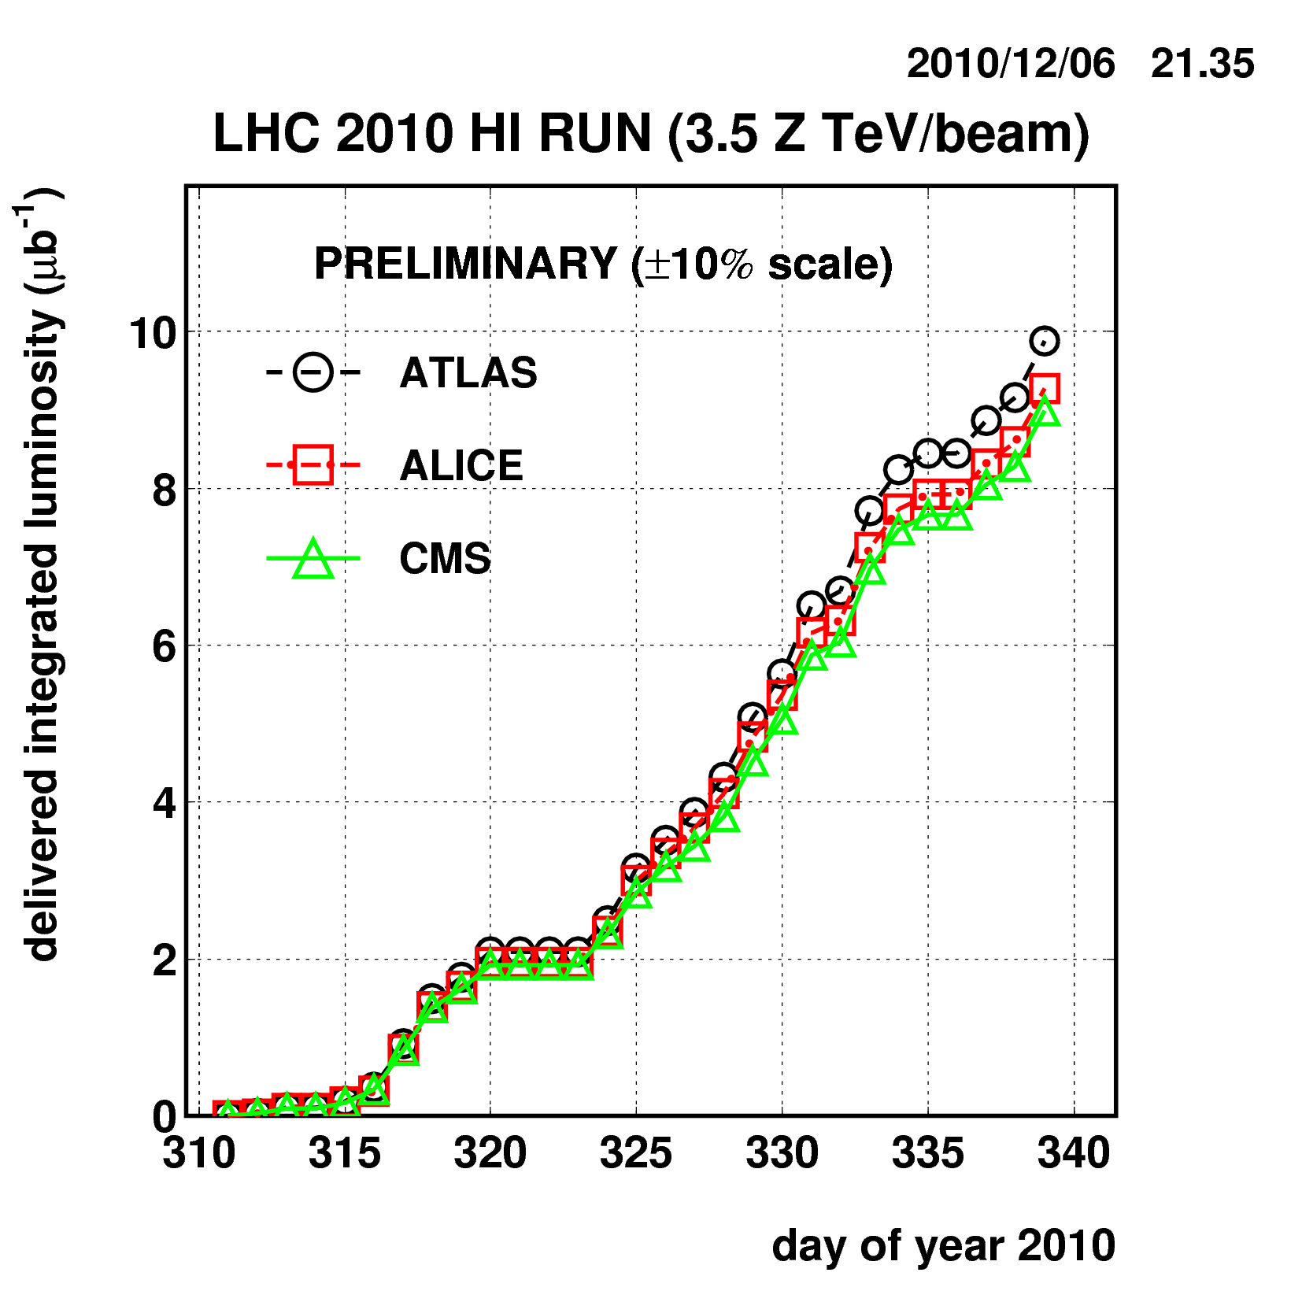
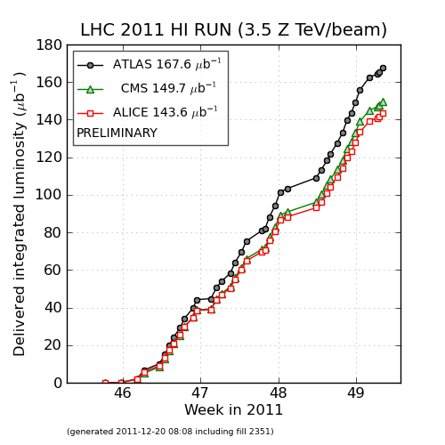
Data: integrated luminosity
year | integrated luminosity
2010 | ~ 10 μb⁻¹
2011 | ~ 0.16 nb⁻¹
Pb- Pb at √s_{NN} = 2.76 TeV
208
82
208
82
2010 → 2011: factor 16 improvement

Slide 9
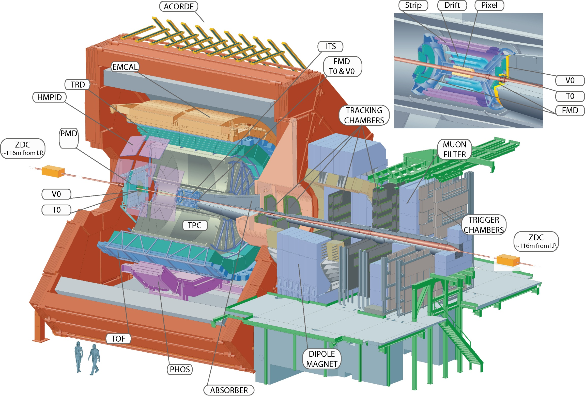
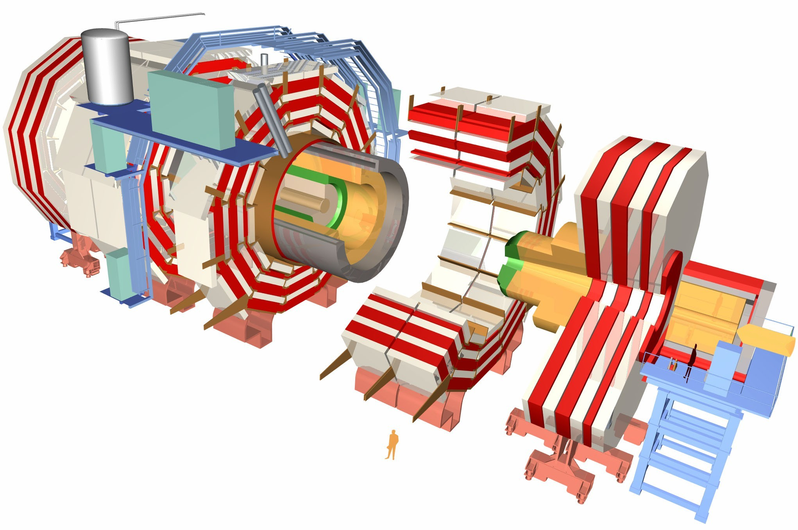




Detectors
Tracking (p_{T} resolution: 1-2%
up to p_{T} ~ 100 GeV/c) and calorimetry
Trigger selectivity over a large range in rapidity and full azimuth
PID over a very broad momentum range (>100 MeV/c)
Large acceptance in azimuth
Mid-rapidity coverage |η| < 0.9 and -4 < η < -2.5 in forward region
Impact parameter resolution better than 65 μm for p_{T} > 1 GeV/c
Three main subsystems with a full coverage in azimuth:
Inner Detector: tracking |η| < 2.5
Calorimetry |η| < 4.9
Muon Spectrometer |η| < 2.7

Slide 10
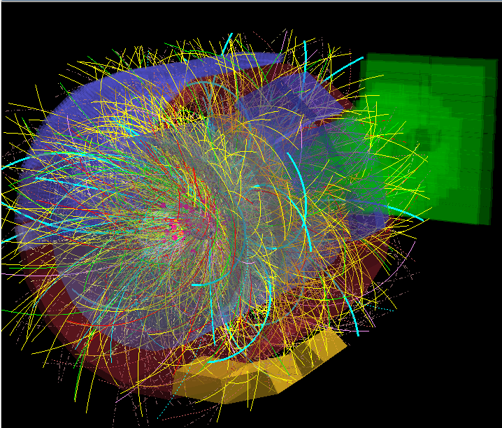
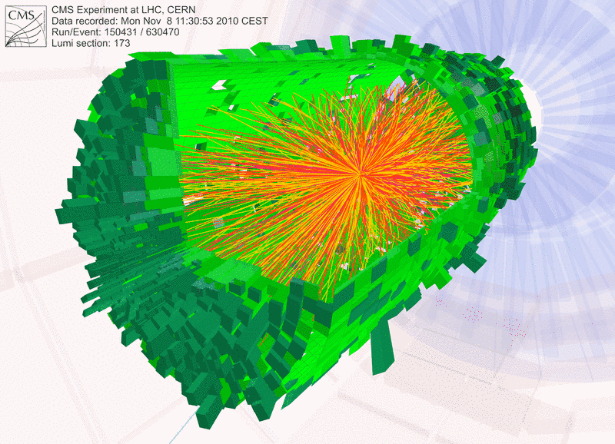
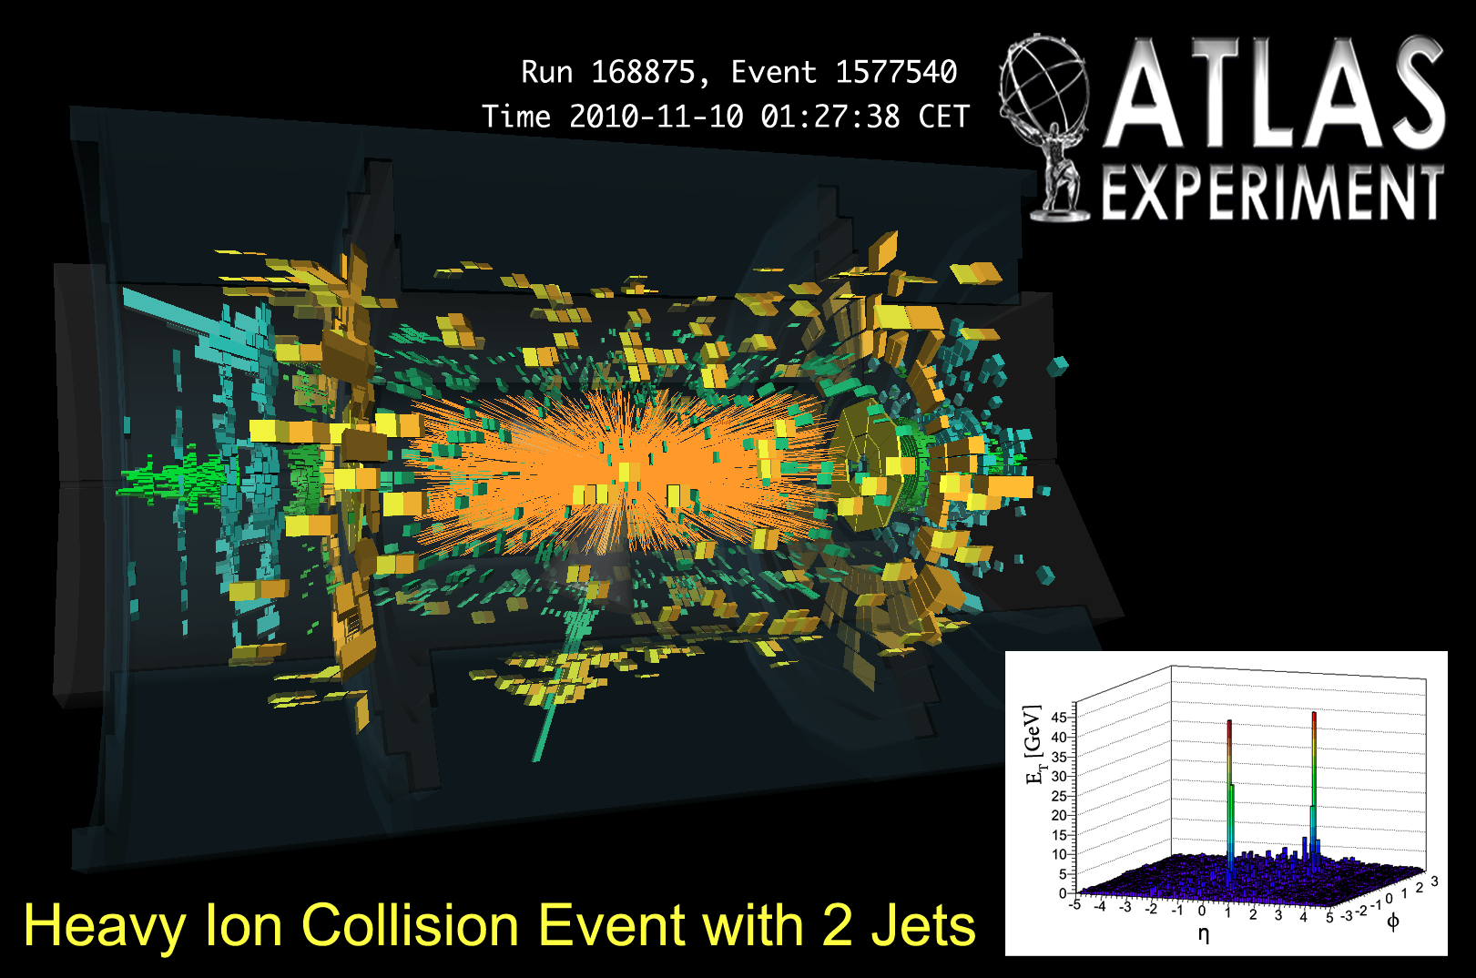
Typical event displays
Pb-Pb at √s = 2.76 TeV per nucleon-nucleon pair

Slide 11
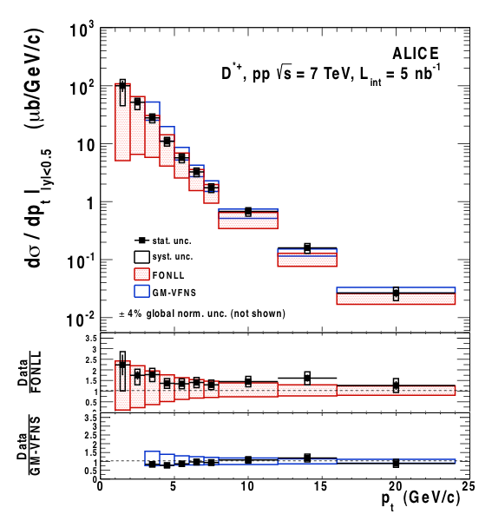
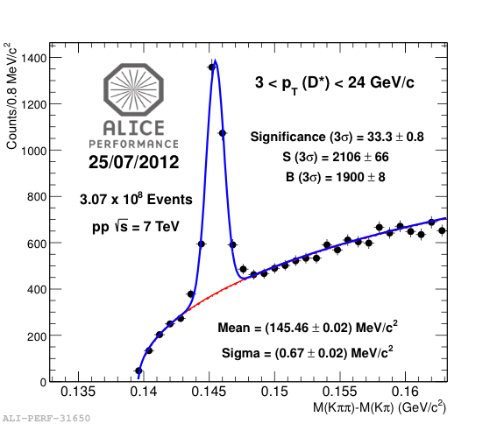
Total charm production cross section in pp
D^{*+}
First collider measurements at TeV scale
Very good agreement between LHC experiments
Consistency with NLO pQCD calculations, although at the upper limit
Baseline for Quarkonia measurements in Pb-Pb
Parton spectra from pQCD input for energy loss models
D^{*+}
ALICE, JHEP 07, 191 (2012)
and JHEP 01, 128 (2012)
NLO: Mangano, Nason, Ridolfi, Nucl. Phys. B 373, 295 (1992)

Slide 12
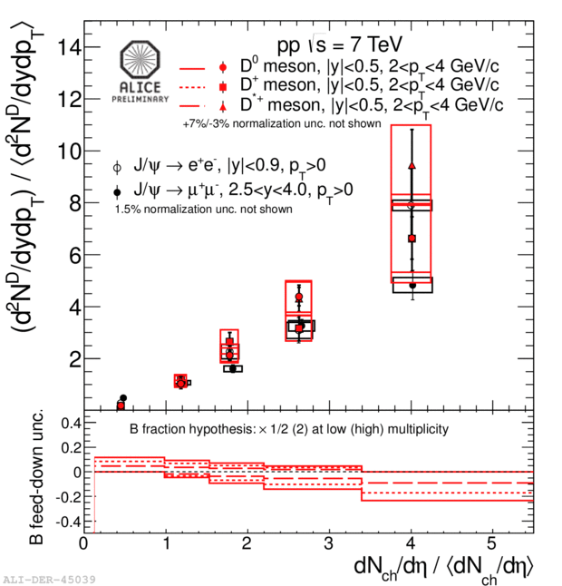
Multiplicity dependence of D and J/ yields in pp
The ~linear increase of the yields with charged multiplicities and the similar behaviour for D and J/ (PLB 712, 165 (2012)) are remarkable
Due to multi-parton interactions?
Particle multiplicity

Slide 13
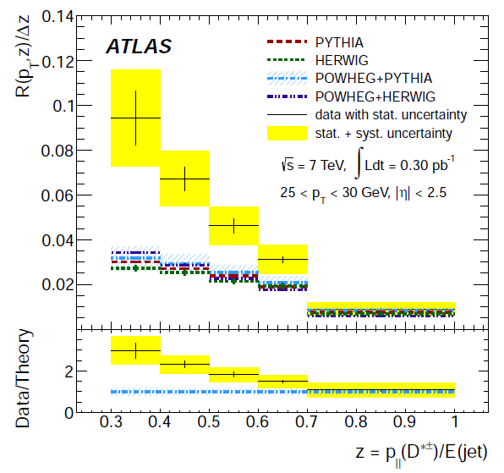
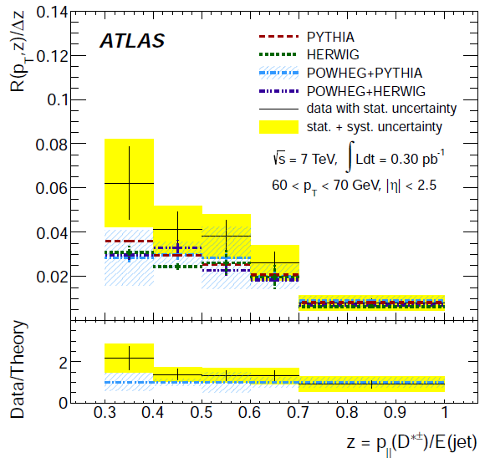
D*± production in jets in 7 TeV pp
Phys. Rev. D85, 052005 (2012)
Monte Carlo calculations fail to describe data at small z
Strongest at low jet transverse momentum

Slide 14
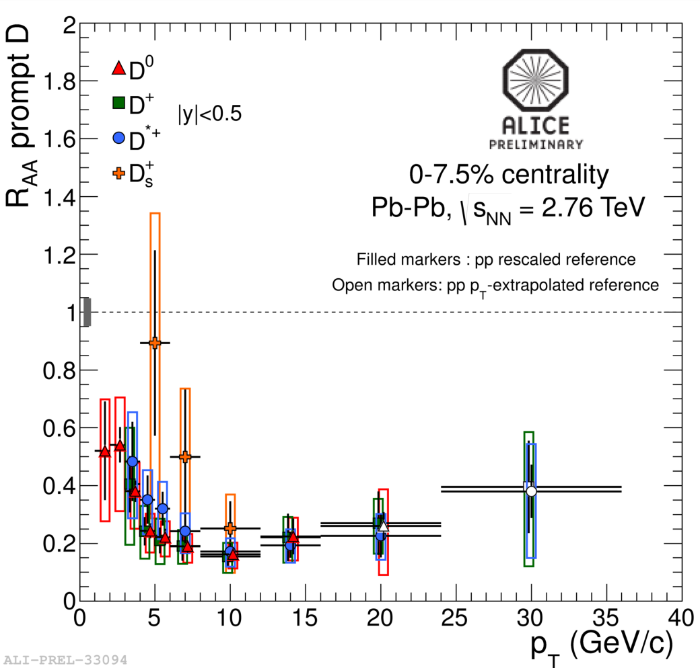
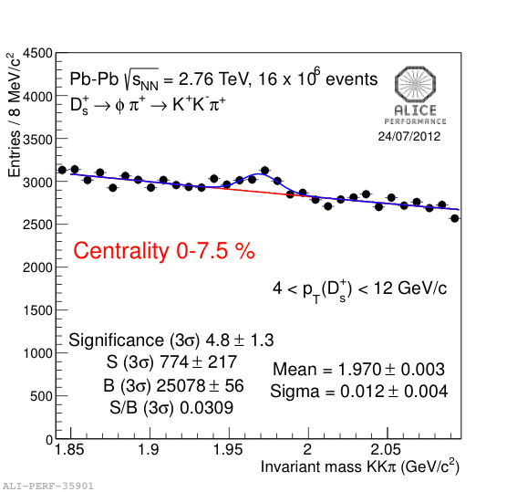
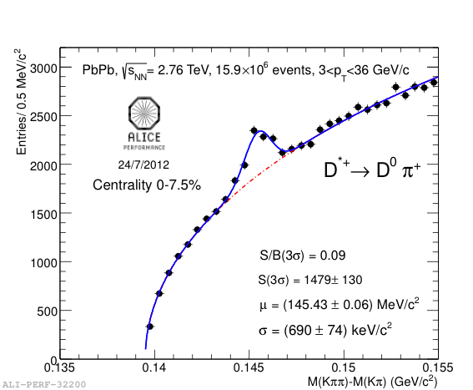
Prompt D meson R_{AA} in Pb-Pb collisions
D^{*+} D_{s}⁺
Strong suppression (factor 4-5) above 5 GeV/c in 7.5% most central Pb-Pb, compared to binary scaling from pp
First D_{s}⁺(cs) measurement in heavy ion collisions
Expectation: enhancement of strange D meson yield at intermediate p_{T} if charm hadronizes via recombination in the medium
14
Notes:
General-Mass Variable Flavour Number Schemes, Kramer et al.

Slide 15
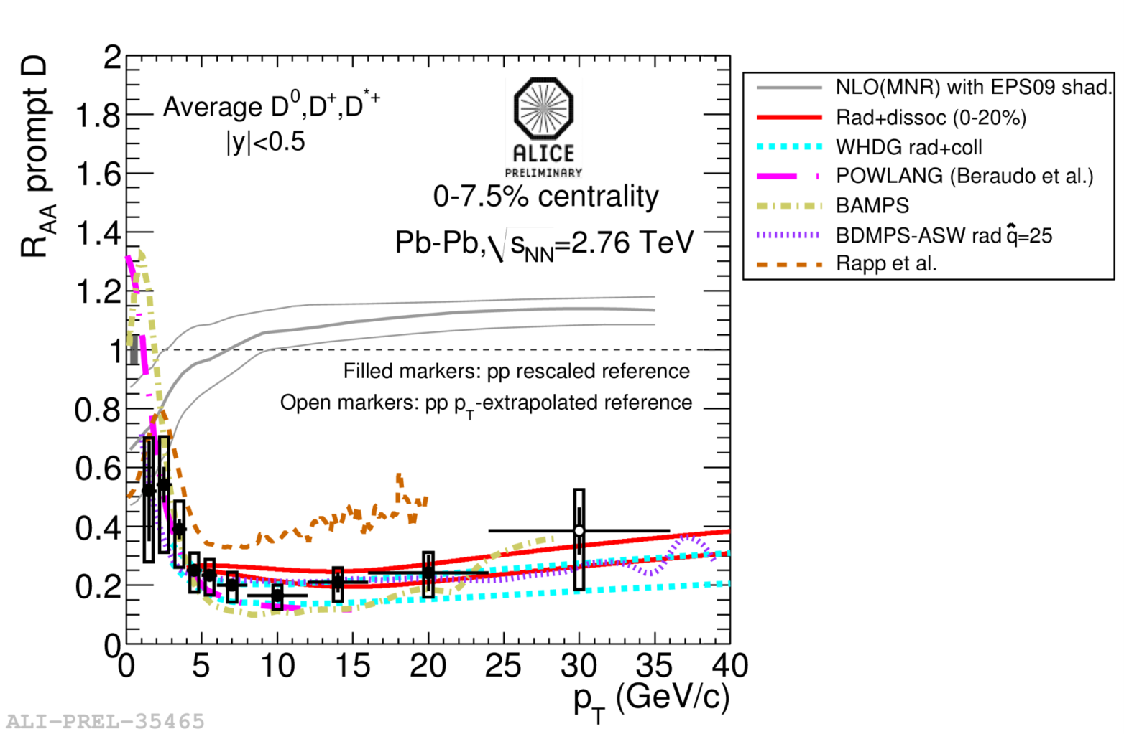
Comparison with model calculations
No/little shadowing (initial-state effect) is expected in this p_{T} range → suppression is a final-state effect; due to hot medium
Indication for rising R_{AA}?
Rad.+dissoc.: R. Sharma, I. Vitev and B.W. Zhang, Phys. Rev. C80 (2009) 054902, Y. He, I. Vitev and B.W. Zhang, arXiv: 1105.2566 (2011)
WHDG (coll.+rad. Eloss in anisotropic medium): W.A. Horowitz and M. Gyulassy, J. Phys. G38 (2011) 124114
POWLANG (coll. Eloss using Langevin approach): W.M. Alberico, et al., Eur. Phyis J. C71,1666 (2011)
BAMPS (coll. Eloss in expanding medium): O. Fochler, J. Uphoff, Z. Xu and C. Greiner, J. Phys. G38 (2011) 124152
Coll. + LPM rad. energy loss: J. Aichelin et al., Phys. Rev. C79 (2009) 044906
BDMPS-ASW: N. Armesto, A. Dainese, C.A. Salgado and U.A. Wiedemann, Phys. Rev. D71 (2005) 054027
Coll. Eloss via D mesons resonances excitation + Hydro evolution: M. He, R.J. Fries and R. Rapp, arXiv:1204.4442

Slide 16
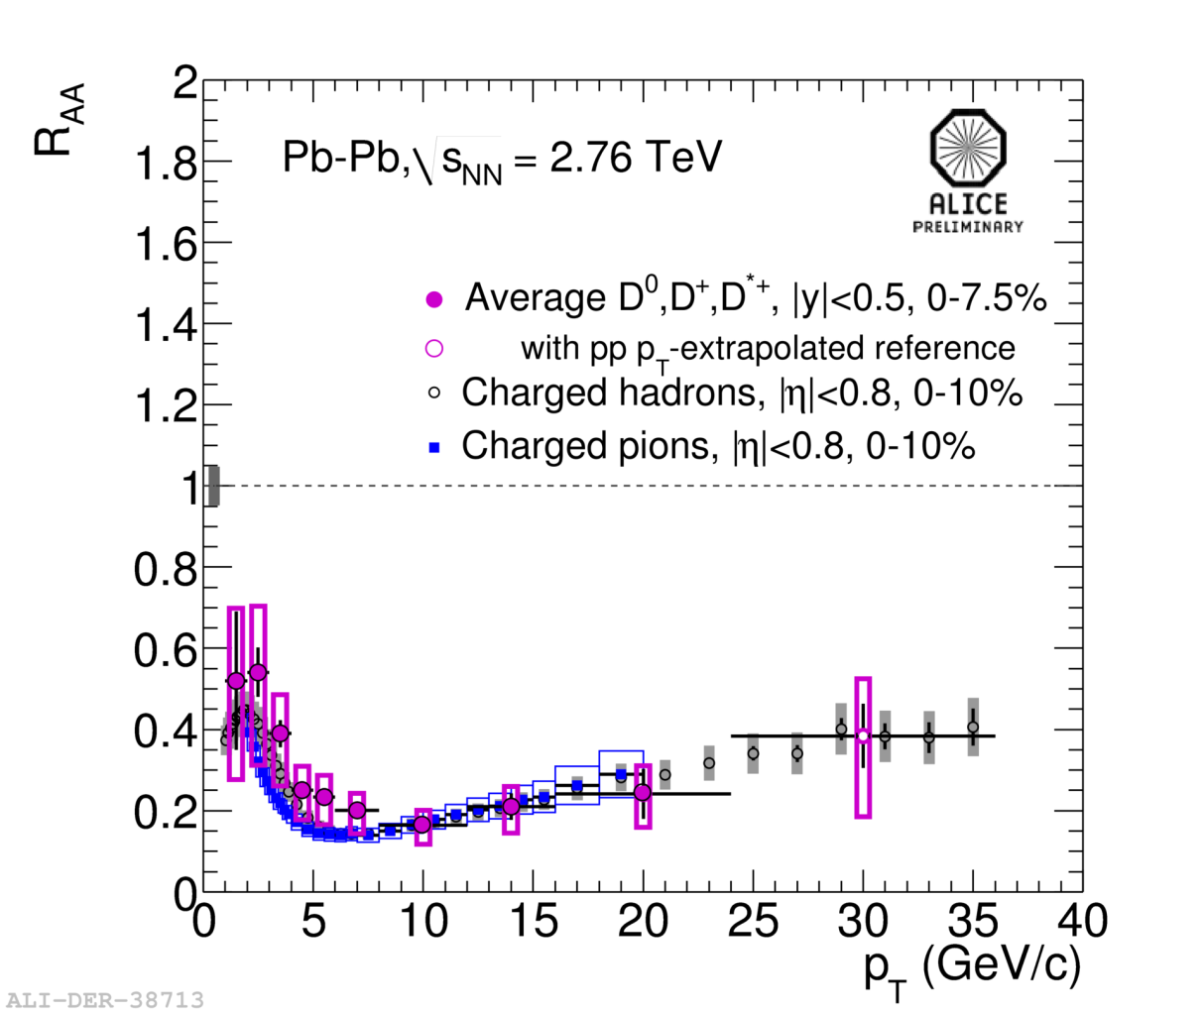
R_{AA}: light versus heavy quark hadrons
ALICE, A. Grelli, Quark Matter 2012
R_{AA}(D meson) > R_{AA}(pions) at low p_{T} ?
→ More data needed for final conclusion
16
Notes:
General-Mass Variable Flavour Number Schemes, Kramer et al.

Slide 17
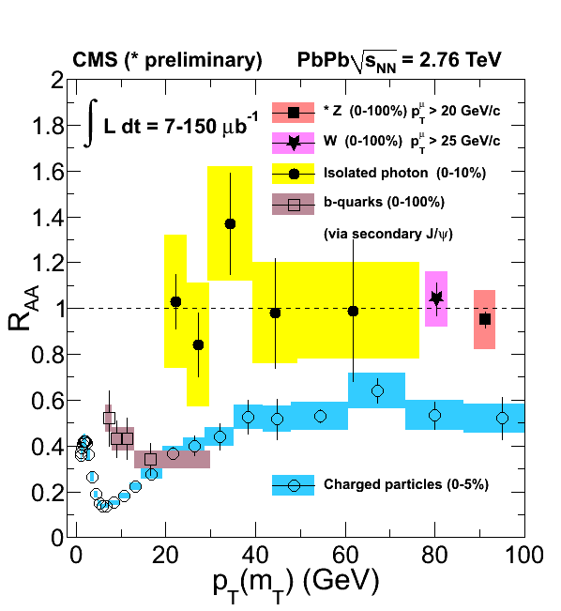
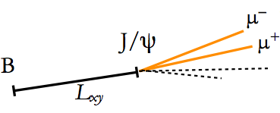
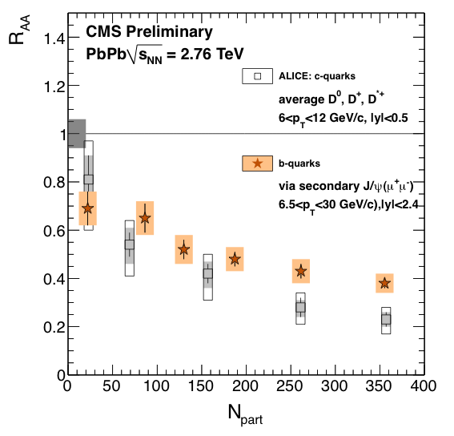
Beauty R_{AA} via non-prompt J/ψ
CMS, Z boson: CMS PAS HIN-12-008
Non-prompt J/ψ in the most central collision
(0-10%) is suppressed by a factor of 2.5
CMS non-prompt J/ψ consistent with ALICE single μ R_{AA} (not shown)
R_{AA}(charm) < R_{AA}(beauty)

Slide 18
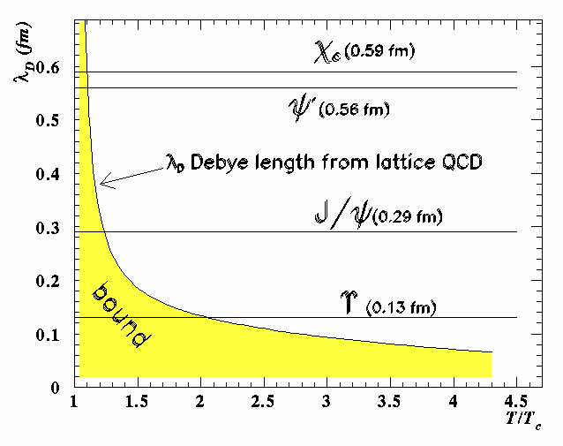
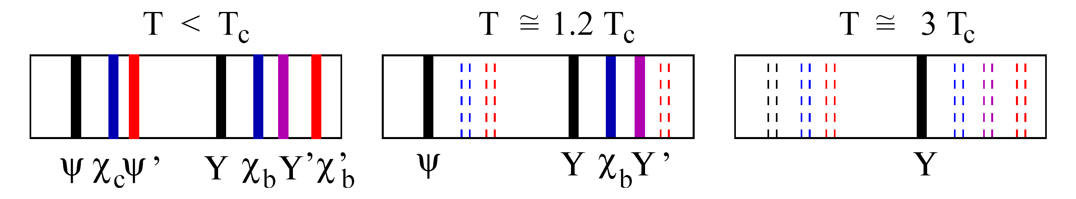
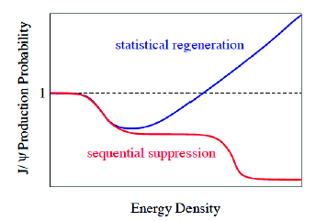
Quarkonia production in hot QCD matter
Colour screening length λ_{D} in the deconfined medium decreases with temperature
Quarkonia “melt” when their binding distance becomes bigger than screening length → yields suppressed (one of the first QGP signatures)
T. Matsui and H. Satz, Phys. Lett. B 178 (1986) 416
Screening at different temperature for different states (binding energy) → sequential suppression of the quarkonium states → QCD thermometer
S. Digal, P. Petreczky and H. Satz, Phys. Rev. D 64 (2001) 0940150
Enhancement via (re-)generation of quarkonium states due to large heavy quark multiplicity
A. Andronic, P. Braun-Munzinger, K. Redlich and J. Stachel, Phys. Lett. B 571(2003) 36
LHC
18

Slide 19
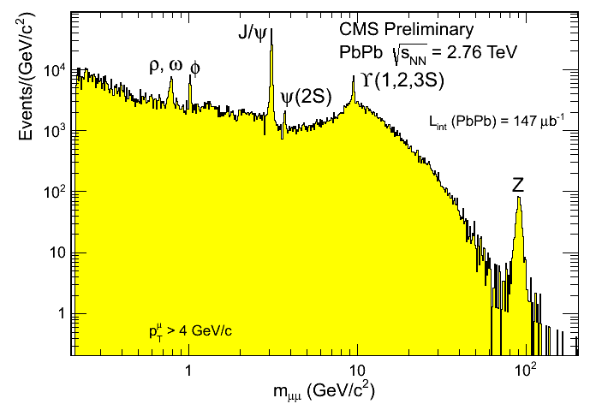
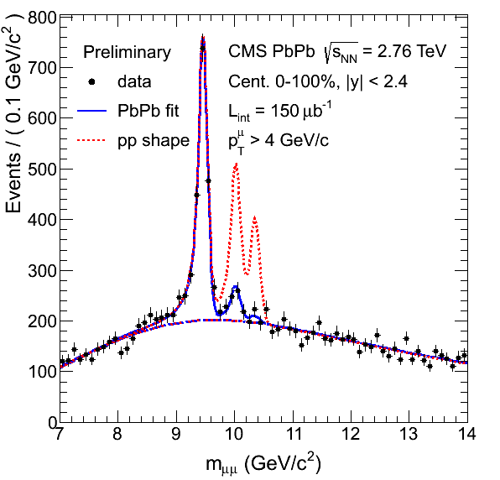
Di-muon invariant mass distribution in Pb-Pb

Slide 20
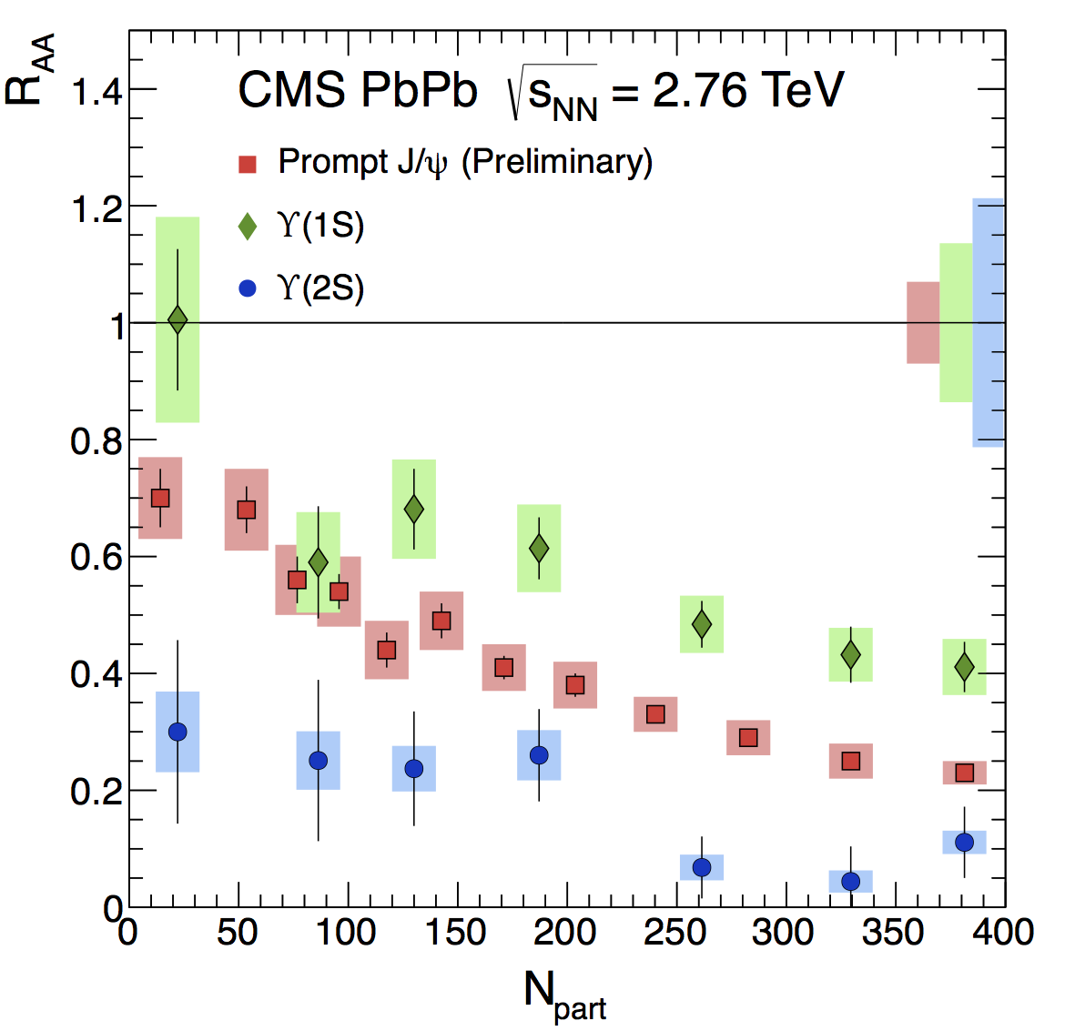
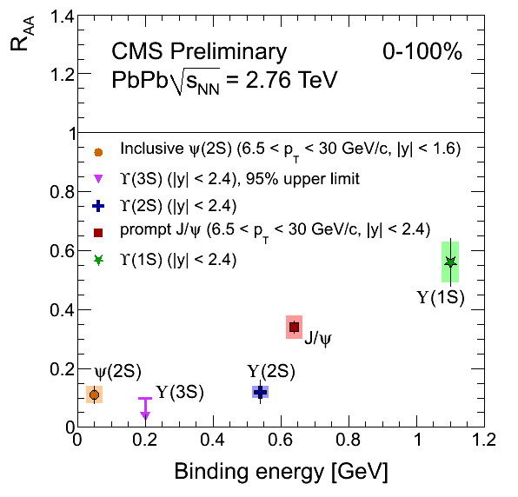



R_{AA} of Quarkonia states in Pb-Pb
Phys. Rev. Lett. 109, 222301 (2012))
Note: 6.5<p_{T}<30 GeV for J/ψ and ψ(2s)
CMS-PAS HIN-12-014, HIN-12-007
N_{part}
Clear hierarchy in R_{AA} of different quarkonium states
Expected in terms of binding energy

Slide 21
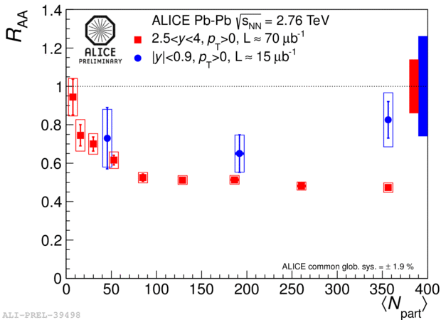
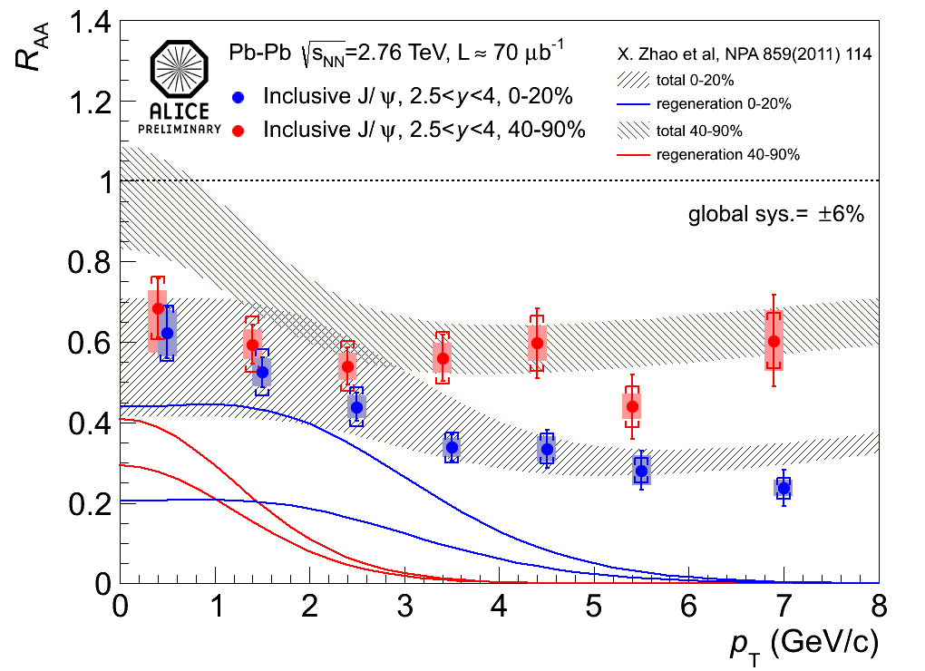
R_{AA} of inclusive J/ψ
J/ψ→e⁺e⁻
Enhanced production at low p_{T}
Comparison with transport model calculations: sizeable QGP regeneration component needed
Hint for enhanced J/ψ production from forward to mid-rapidity

Slide 22
Summary
Heavy quarks
  particularly good probes to study the properties of hot quark matter; especially its transport properties (e.g. drag diffusion coefficient)
  abundantly produced at LHC energies → allow precision measurements
  Lots of new data from Pb-Pb collisions at √s_{NN} = 2.76 TeV
  ALICE: R_{AA} of prompt D mesons, single electrons and muons
  strong suppression at high p_{T} observed in most central collisions
  → more insight on energy loss mechanism(s)
  CMS: b-quark quenching via B→J/ψ
  → R_{AA}(π) ~ R_{AA}(D, single leptons) ≤ R_{AA}(B→J/ψ)
  Quarkonia data
    observation of sequential melting of Y family
    sizeable regeneration needed to describe J/ψ data
Many more exciting results with
  2013 p-Pb data: important baseline measurement of cold nuclear matter effects (Cronin effect, nuclear shadowing, gluon saturation)
  2015 5.5 TeV Pb-Pb run
22

Slide 23
Thank you
23

Slide 24
Backup
24

Slide 25
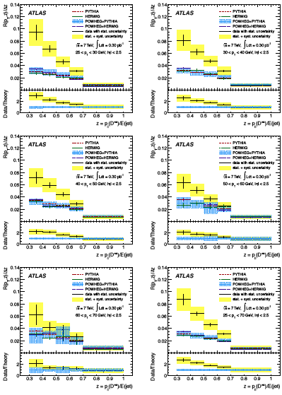

Slide 26
Cold nuclear matter effects: p-Pb
Important baseline measurement of cold nuclear matter effects (Cronin effect, nuclear shadowing, gluon saturation)
p-Pb run at √s_{NN} = 5.02 TeV in February 2013
~130M minimum bias events (30 nb⁻¹)
First publications
-
-
-
…

Slide 27

Upgrade of the ALICE Inner Tracker
New Inner Tracking System based on 7 silicon layers
Factor 3 improvement in impact parameter resolution
Low material budget
(X/X₀ ≤ 0.3% for first 3 inner silicon layers possible)

Slide 28
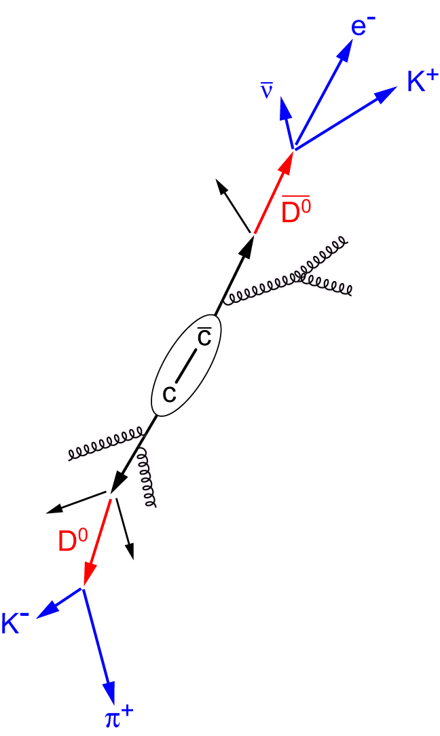
Detection of open heavy-flavor particles
Full reconstruction of open charmed mesons
    D⁰ → K⁻ + π⁺ (BR = 3.89%), cτ = 123 μm
    direct clean probe: signal in invariant mass
    distribution
    difficulty: large combinatorial background
    especially in a high multiplicity environment
    mixed-event subtraction and/or vertex tracker needed
Semi-leptonic decay of D and B mesons
    c → lepton + X (BR = 9.6%)
      D⁰ → e⁺ + X (BR = 6.87%)
      D⁰ → μ⁺ + X (BR = 6.5%)
    b → lepton + X (BR = 10.9%)
    robust electron trigger
    needs handle on photonic electron background
Beauty via non-prompt J/ψ

Slide 29
Tentative LHC schedule
2010/11: long run with pp collisions at 7 TeV
1 month of Pb-Pb collisions each year
2012: long run with pp at 8 TeV
2012/13: p-Pb control measurement
2013/14: machine consolidation and training
2014: pp and Pb-Pb at full energy
2017/18: long shutdown, luminosity and detector
upgrades
2019: pp and Pb-Pb at high luminosity

Slide 30
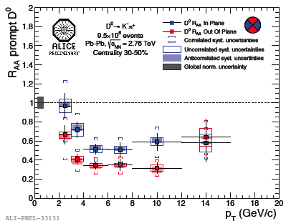
Prompt D⁰ meson R_{AA} versus event plane
z
x
30-50% centrality
y
out-of-plane
in-plane
More suppression at high p_{T} out-of-plane with respect to in-plane due to different path length

Slide 31
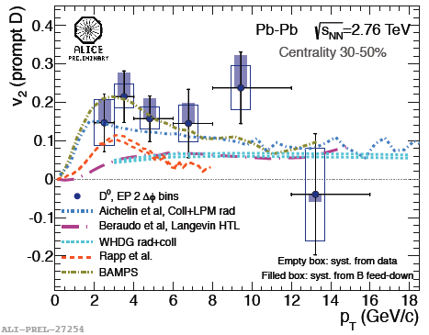
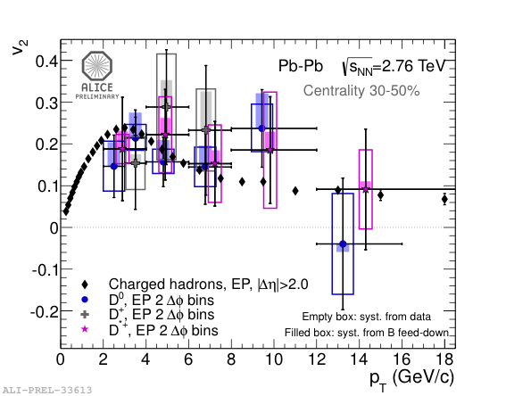
Azimuthal anisotropy of prompt open charm
Pressure gradient generates collective flow → anisotropy in momentum space; Fourier decomposition
Indication (3σ) for non-zero charm elliptic flow at low p_{T}
Models needs to simultaneously describe v₂ and R_{AA}; stringent constraint, gets tougher with more precision/data

Slide 32
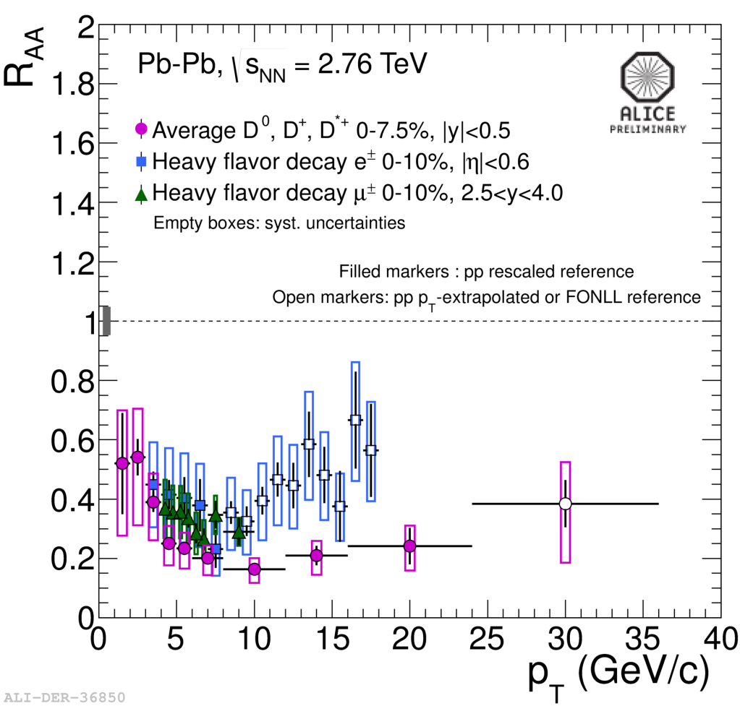
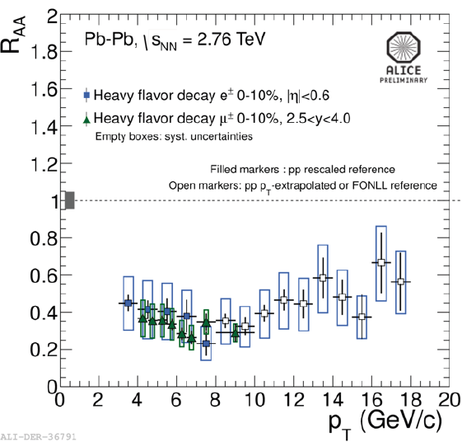
Single muons at forward rapidity
Strong suppression of high-p_{T} muons from heavy flavour decays
No significant dependence on p_{T} in 4 < p_{T} < 10 GeV/c
Similar to single electron and D meson R_{AA} at central rapidity
R_{AA}(single e) > R_{AA}(D) at p_{T} > 8 GeV/c due to beauty contribution

Slide 33
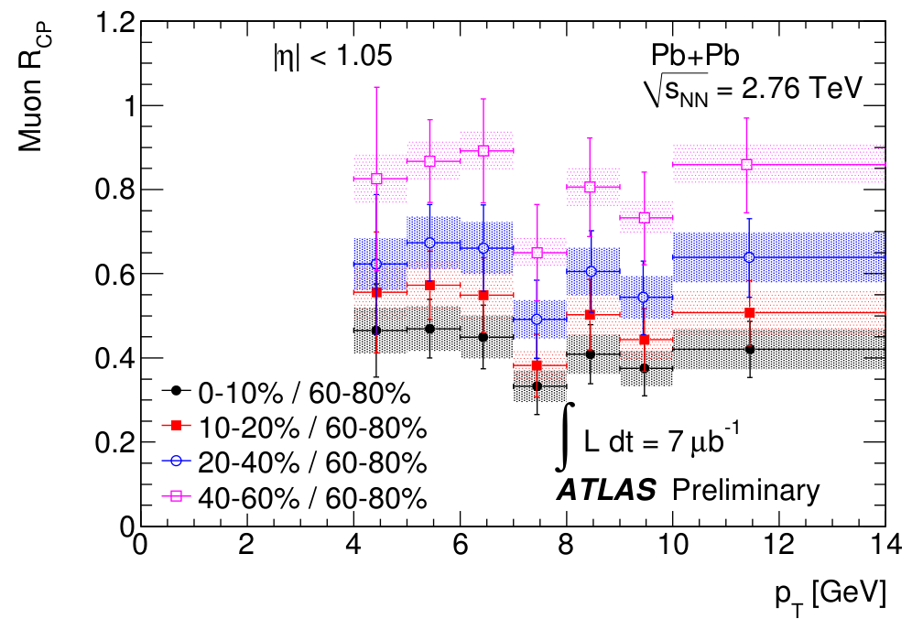
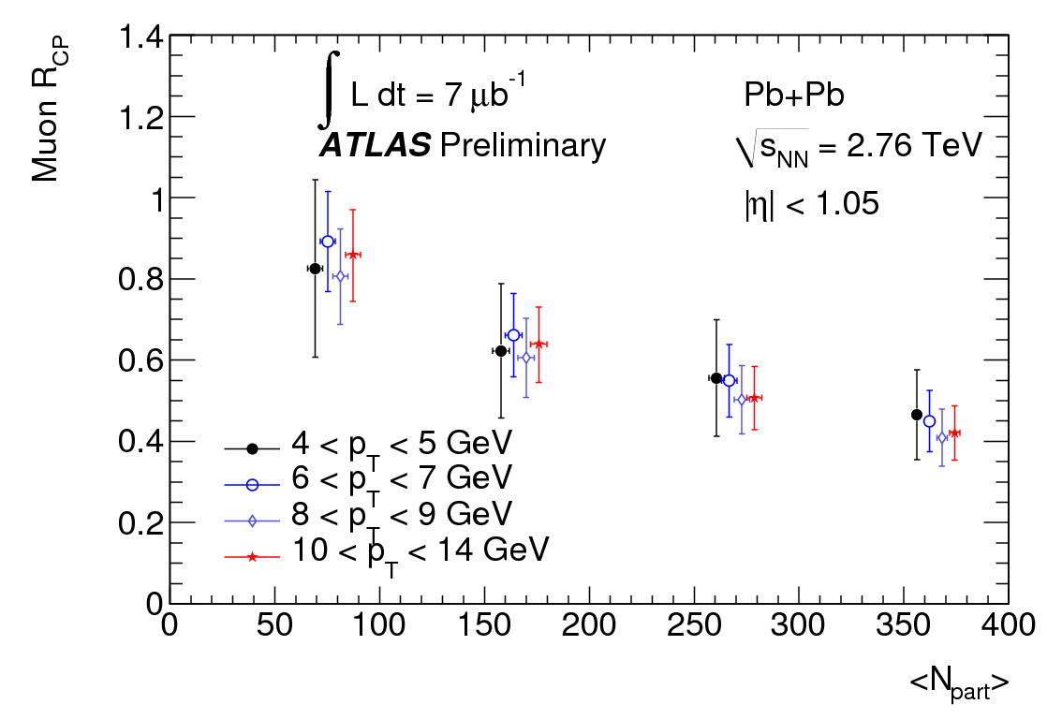
ATLAS: Single muon R_{CP}
A factor of 2 suppression 0-10%/60-80%, independent of p_{T}
Indications for weaker suppression than for charged hadrons and as compared to RHIC electron results

Slide 34
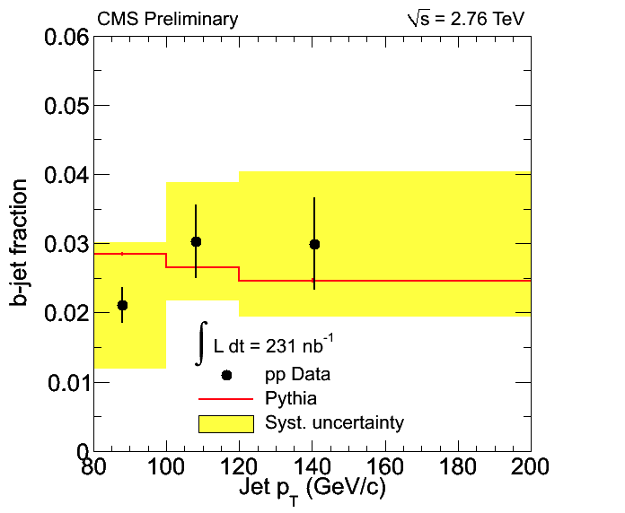
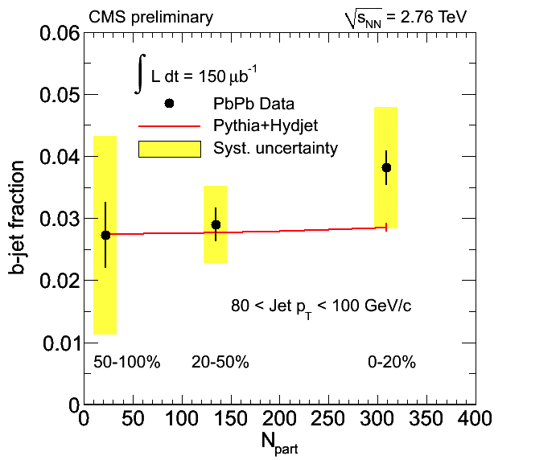
b-tagged jets
CMS-PAS HIN-12-003
Jets from b-quark fragmentation are identified for the first time in heavy ion collisions
  Jets are tagged by their secondary vertices
  b-quark contribution is extracted using template fits to their secondary vertex mass distributions

Slide 35
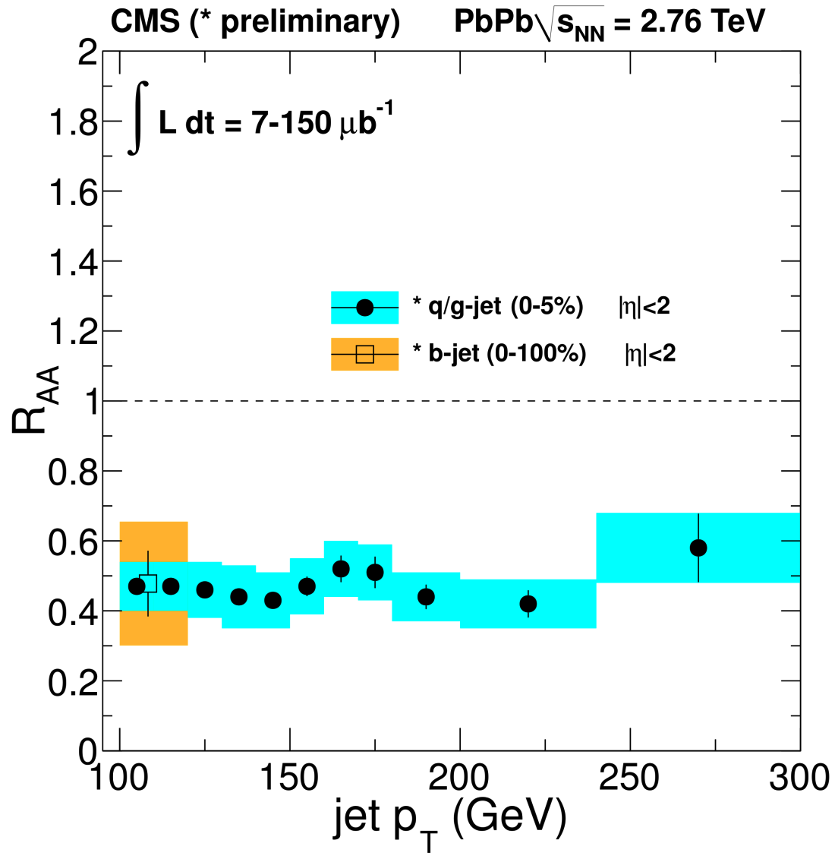
Inclusive and b-jets
Distinct b-quark suppression pattern at low p_{T}
First observation of b-jet suppression at high p_{T}

Slide 36
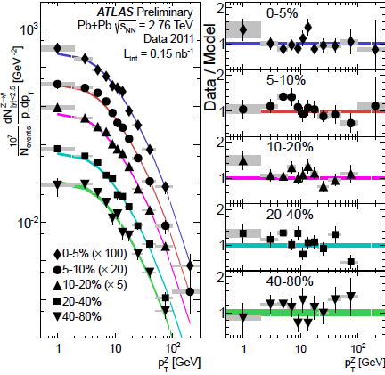
Centrality dependence of Z boson p_{T} spectra
Z→e⁺e⁻ and Z→μ⁺μ⁻
p_{T} and y (not shown) distributions consistent with Pythia simulations for pp with NNLO cross section times <T_{AA}>
Yields consistent with N_{coll} scaling

Slide 37


Particle Identification
Specific ionisation energy loss; PID based on comparison with Bethe-Bloch curves
TPC dE/dx
σ ≈ 5-6%
PID based on comparison of time of flight with particle mass hypothesis
TOF (150k channels)
σ ≈ 90 ps
37

Slide 38



Explore energy loss mechanisms in more detail
MC simulations
Colour charge dependence
Mass dependence (dead cone effect)
C_{R} is 4/3 for quarks
and 3 for gluons
R^{c}_{AA}/R^{b}_{AA} ratio different for pQCD and AdS/CFT

Slide 39


Open heavy-flavour reconstruction
Impact parameter resolution
SSD
SDD
SPD
87.2 cm
Radius inner
pixel layer: 3.9 cm
≈1 cm from the vacuum
Inner Tracking System (ITS)
6 layers of silicon detectors
- aligned using cosmics
and first pp data
- current resolution for pixels:
14 μm (nominal ≈11 μm)
- X/X₀ = 7.7% for radial tracks
Capabilities to measure open charm down to p_{T}=0 in pp and p-Pb (1 GeV/c in Pb-Pb)
High precision tracking, better than 65 μm for p_{T} > 1 GeV/c
39

Slide 40

Reconstruction of D mesons
  D⁰ → K⁻π⁺ BR: 3.89%
  D⁰ → K⁻π⁺π⁺π⁻ BR: 8.09%
  D*⁺ → D⁰(→Kπ)π⁺_{s} BR: 67.7%
  D⁺ → K⁻π⁺π⁺ BR: 9.22%
  D_{s}⁺ → K⁺K⁻π⁺ BR: 5.5%
  Λ_{c}⁺ → pK⁻π⁺ BR: 5.%
D⁰ → K⁻π⁺
Analysis based on decay topology and invariant mass technique
Essential selection cuts
  impact parameter
  distance of closest approach
  pointing angle
High precision tracking (ITS+TPC)
K and π identification (TPC+TOF) → reducing background at low p_{T}

Slide 41





Open charm signals in 7 TeV pp collisions
41

Slide 42


D meson cross sections in 7 TeV pp
|η| < 0.5
D⁰ D*⁺ D⁺
Paper accepted by JHEP,
arXiv:1111.1553
p_{T} range: 1-24 GeV/c with 5 nb⁻¹
Data well described within uncertainties by NLO pQCD calculations: - FONLL, M. Cacciari et al., JHEP 0103 (2001) 006
        - GM-VFNS, B.A. Kniehl et al., PRL 96 (2006) 012001
Notes:
general-mass variable flavor-number scheme (GM-VFNS)

Slide 43



p_{T} spectra and R_{AA} for prompt D*⁺
Strong suppression observed in central (0-20%) Pb-Pb
Less suppression in 40-80% Pb-Pb
suppression
43

Slide 44


Comparison of D meson R_{AA}
First Prompt Open Charm R_{AA} in heavy-ion collisions
Results of different D mesons in agreement within stat. error
Large suppression for charm (factor 4-5) above 5 GeV/c in central (0-20%) Pb-Pb collisions
44

Slide 45


Comparison with charged pion R_{AA}
D meson R_{AA} compatible, within errors, with charged pions for p_{T} > 5 GeV/c
Possible hints that R_{AA} (D) > R_{AA}(π) at lower p_{T};
more data needed for final conclusion
45

Slide 46


Comparison with model calculations
No/little shadowing is expected in this p_{T} range → suppression is a final state effect; due to hot medium
Next: extend p_{T} range; study centrality dependence
46

Slide 47


Single electrons at mid-rapidity
High quality tracks in TPC and ITS
  - hit in innermost pixel layer to reduce γ conversions
Electron identification using TPC and TOF
  TOF to reject Kaons (<1.5 GeV/c) and protons (<3 GeV/c)
  TPC: asymmetric cut around the electron Bethe-Bloch curve
Background is subtracted using the cocktail method

Slide 48


Single muons: analysis procedure
charm, beauty
π, K primaries
π, K secondaries
punch-through
Muon
sources
Remove hadrons and low-p_{T} muons (secondary π, K) by requiring muon tracking-trigger
Remove decay muons (primary π, K) by subtracting MC dN/dp_{T} normalized to data at low p_{T} (< 2 GeV/c)
Remaining contribution are muons from charm and beauty
Corrections on acceptance x efficiency (~80% for p_{T} > 2 GeV/c)

Slide 49

Azimuthal anisotropy: Elliptic flow
z
p_{y}
pressure and
multiple collisions
p_{x}
x
y
coordinate space: momentum space:
initial anisotropy final anisotropy
Multiple interactions lead to thermalisation → hydrodynamic behavior of the system
Pressure gradient generates collective
flow → anisotropy in momentum space
Fourier decomposition:
STAR
Andre Mischke
49

Slide 50

The Quark-Gluon Plasma (QGP)
Heat and pressure
Phase transition to QGP
T ≈ 10¹² K ≈ 10⁵x sun’s core
Novel state of matter: quarks and gluons are liberated
Evolution of the early universe
Produce and study QGP in the laboratory
  - sufficient large reaction volume
  - high density and temperature
Collisions of heavy atomic nuclei (lead or gold)
(deconfinement)

