Slide 1

COMPASS results on
the Collins and Sivers asymmetries
Anna Martin
Trieste University & INFN
on behalf of the
COMPASS Collaboration

Slide 2

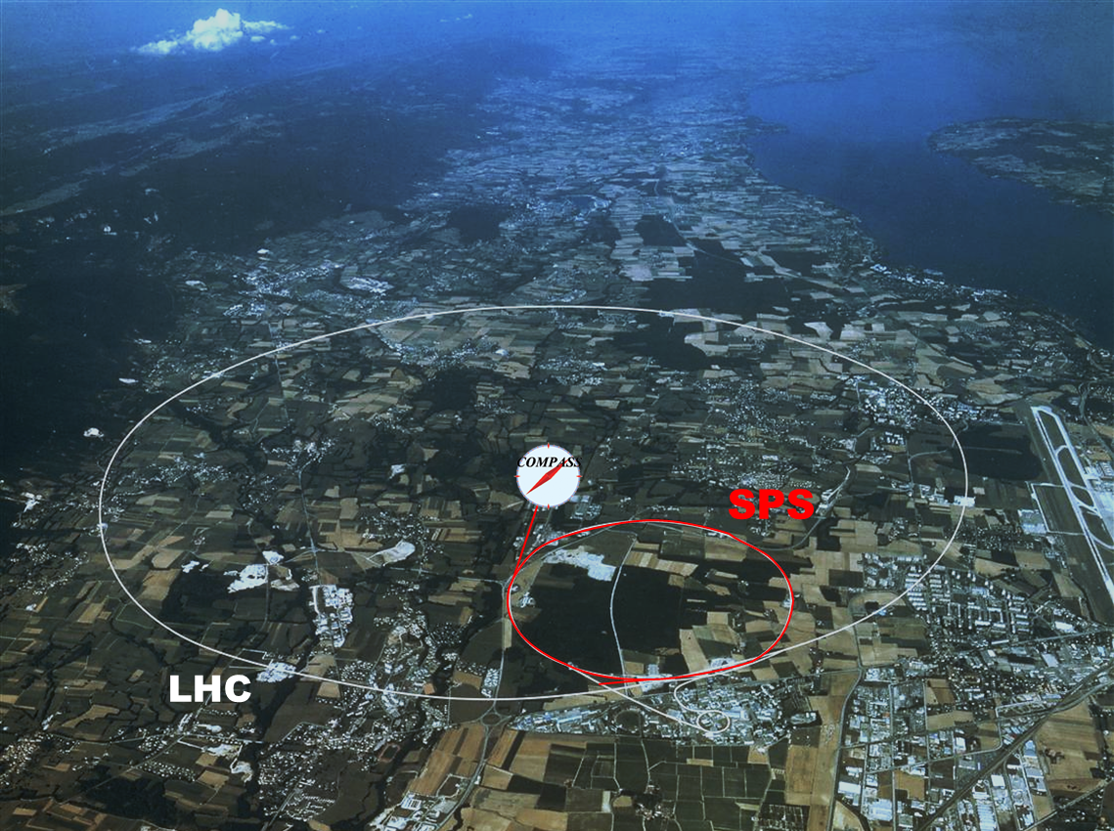
COmmon
Muon and
Proton
Apparatus for
Structure and
Spectroscopy
Collaboration
~ 250 physicists
from 25 Institutions
of 11 Countries
fixed target
experiment
at the CERN SPS
data taking: since 2002

Slide 3
COmmon
Muon and
Proton
Apparatus for
Structure and
Spectroscopy
Collaboration
~ 250 physicists
from 28 Institutions
of 11 Countries
fixed target
experiment
at the CERN SPS
physics programme:
  hadron spectroscopy (p, π, K beams)
  nucleon structure (with μ beam)
  longitudinal spin structure
  transverse momentum and
  transverse spin structure
data taking: since 2002

Slide 4
COmmon
Muon and
Proton
Apparatus for
Structure and
Spectroscopy
Collaboration
~ 250 physicists
from 25 Institutions
of 11 Countries
fixed target
experiment
at the CERN SPS
physics programme:
  hadron spectroscopy (p, π, K beams)
  nucleon structure (with μ beam)
  longitudinal spin structure
  transverse momentum and
  transverse spin structure
data taking: since 2002
results on the
Collins and Sivers
transverse spin asymmetries in SIDIS

Slide 5
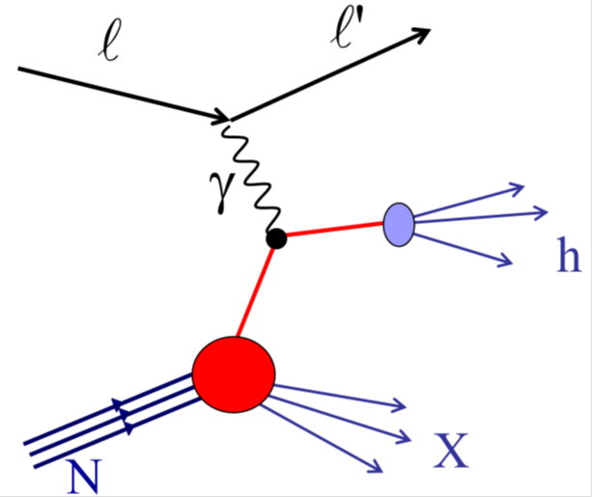
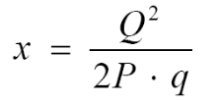

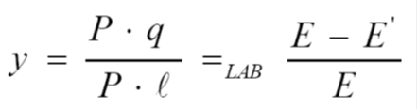

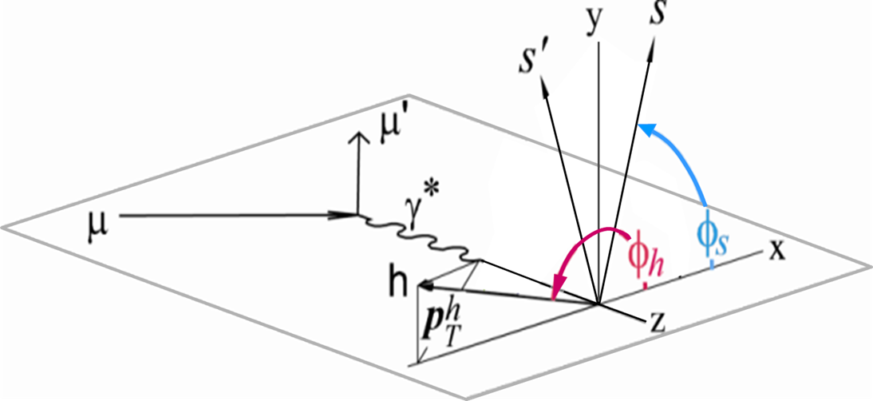
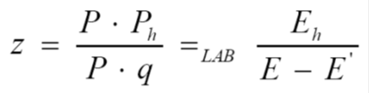



Semi-Inclusive Deep Inelastic Scattering
$$p{}_{T}^{h}$$
$$φ_{h}$$
$$φ_{S}$$

Slide 6
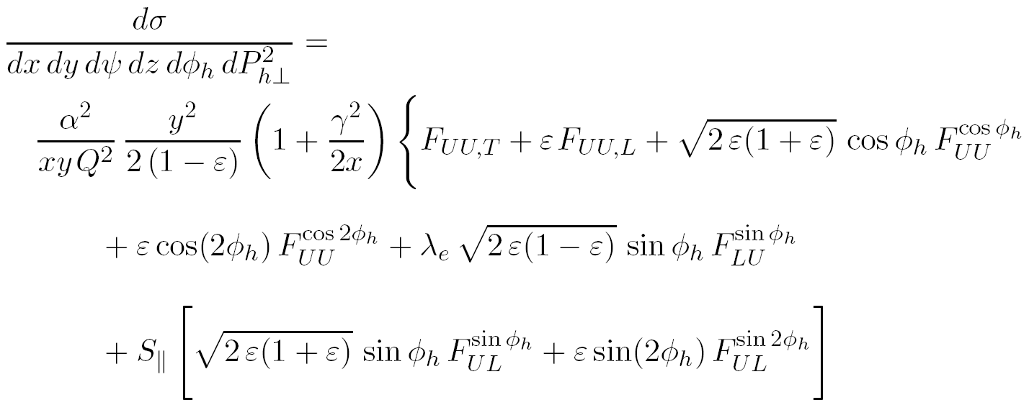
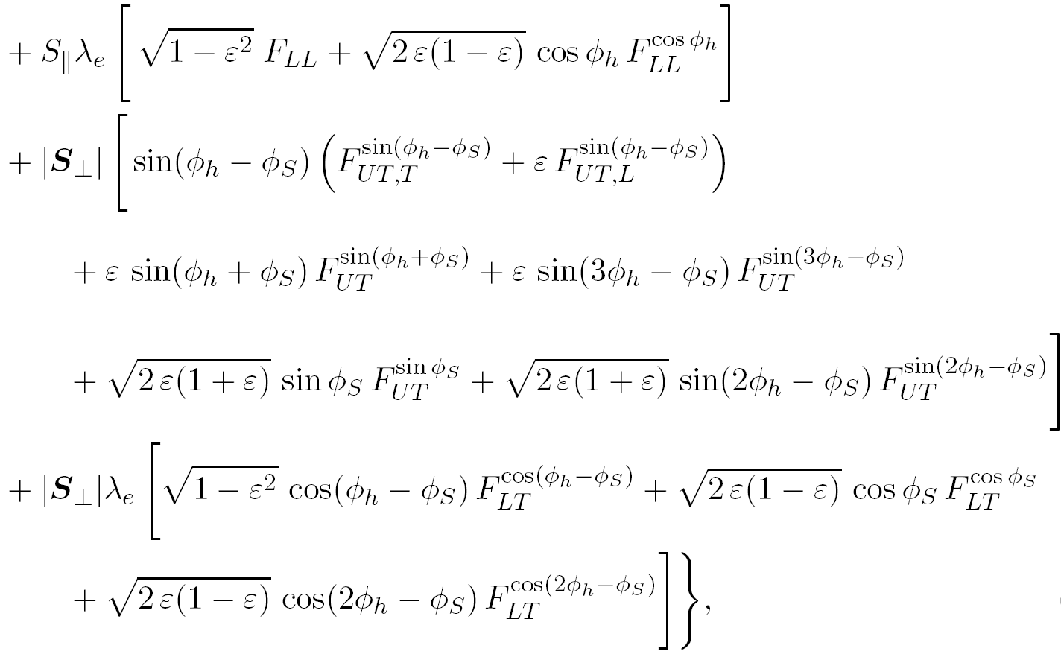
Semi-Inclusive Deep Inelastic Scattering
18 structure functions
14 independent
azimuthal modulations
all the 14 amplitudes are been measured
in COMPASS

Slide 7
Semi-Inclusive Deep Inelastic Scattering
Sivers asymmetry
18 structure functions
14 independent
azimuthal modulations
Collins asymmetry
all the 14 amplitudes are been measured
in COMPASS

Slide 8

SIDIS off transversely polarised nucleons
azimuthal distribution of the inclusively produced hadrons
polarisation direction
nucleon transverse polarisation
Collins angle
Sivers angle
spin transfer coefficient
and and the other 6 transverse spin asymmetries
are measured by fitting the distributions
in the different x, z, p_{T}^{h} bins

Slide 9
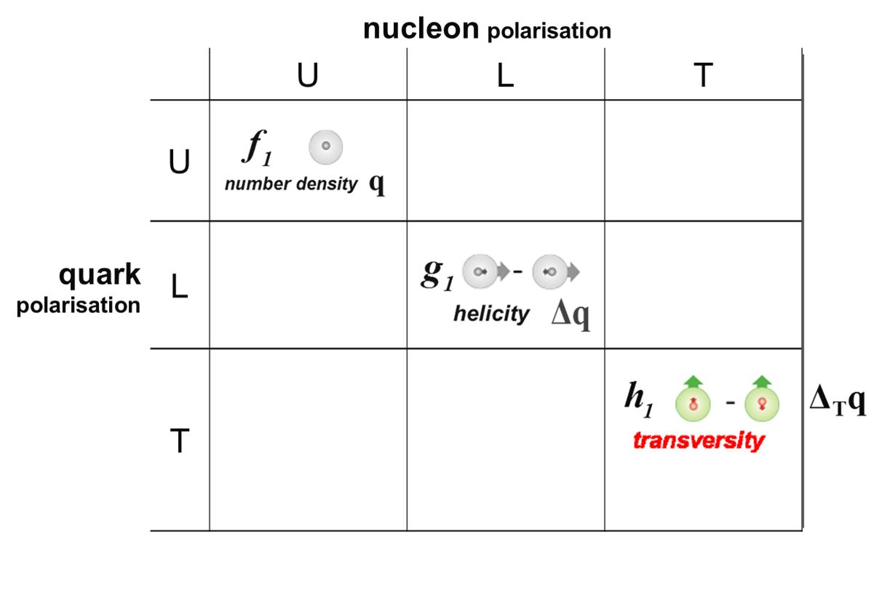
SIDIS off transversely polarised nucleons
azimuthal distribution of the inclusively produced hadrons
Collins FF
BELLE, BaBar
transversity PDF
correlation between the transverse polarisation of the nucleon and the transverse polarisation of the quark
quark structure of the nucleon
in the collinear case
it is chiral odd
it can not be measured in
inclusive DIS,
and it is still poorly know

Slide 10
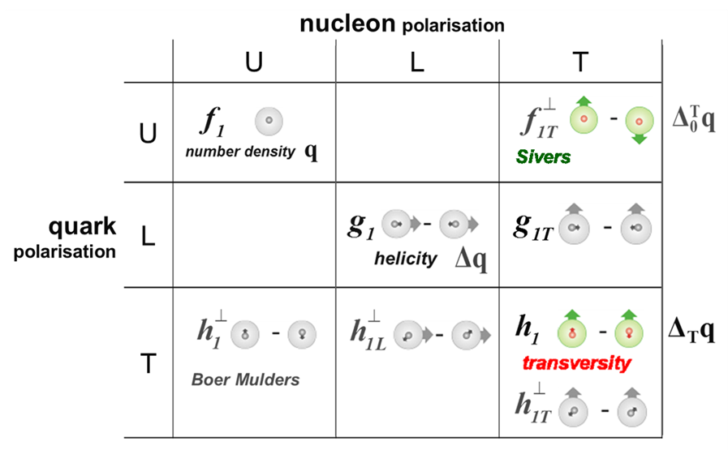
SIDIS off transversely polarised nucleons
azimuthal distribution of the inclusively produced hadrons
Sivers PDF
correlation between the transverse spin of the nucleon and the transverse momentum of the quark
sensitive to orbital angular momentum
the quark structure of the nucleon
at LO with quark intrinsic transverse momentum k_{T}
T-odd, poorly known

Slide 11
SIDIS off transversely polarised nucleons
azimuthal distribution of the inclusively produced hadrons
transversity PDF
and 2h transverse spin asymmetry
the most promising way
to access the
transversity PDFs
and the
Sivers PDFs
different targets and PID
→ flavor separation
Sivers PDF

Slide 12
the COMPASS spectrometer
designed to
use high energy beams
have large angular acceptance
cover a broad kinematical range
Notes:
12

Slide 13
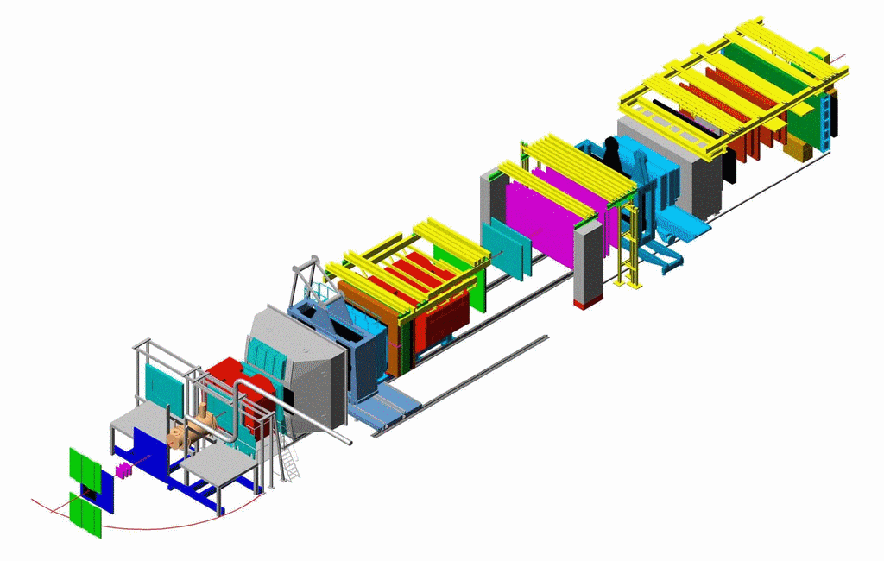
the COMPASS spectrometer
designed to
use high energy beams
have large angular acceptance
cover a broad kinematical range
two stages spectrometer
Large Angle Spectrometer (SM1)
Small Angle Spectrometer (SM2)
SM2
SM1
~ 50 m
Polarised Target
μ beam
Notes:
13

Slide 14
the COMPASS spectrometer
designed to
use high energy beams
have large angular acceptance
cover a broad kinematical range
two stages spectrometer
Large Angle Spectrometer (SM1)
Small Angle Spectrometer (SM2)
variety of tracking detectors
to cope with different particle flux from θ = 0 to θ ≈ 200 mrad with a good azimuthal acceptance
MuonWall
SM2
E/HCAL
E/HCAL
SM1
~ 50 m
Polarised Target
MuonWall
calorimetry, μID
μ beam
Notes:
14

Slide 15
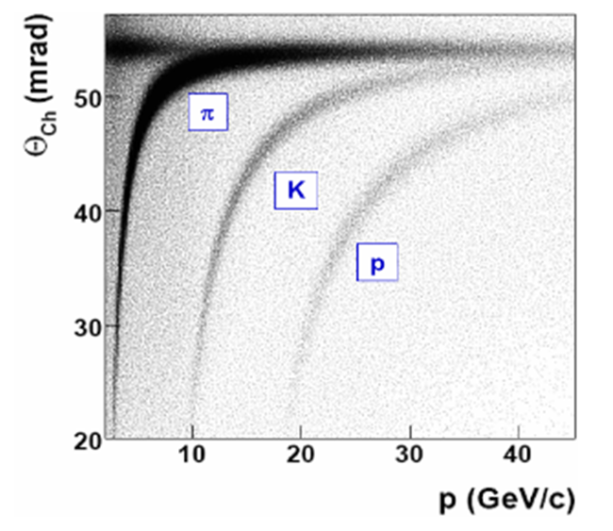
the COMPASS spectrometer
designed to
use high energy beams
have large angular acceptance
cover a broad kinematical range
two stages spectrometer
Large Angle Spectrometer (SM1)
Small Angle Spectrometer (SM2)
variety of tracking detectors
to cope with different particle flux from θ = 0 to θ ≈ 200 mrad with a good azimuthal acceptance
MuonWall
SM2
E/HCAL
E/HCAL
SM1
~ 50 m
Polarised Target
MuonWall
RICH
calorimetry, μID
RICH detector
μ beam
Notes:
15

Slide 16
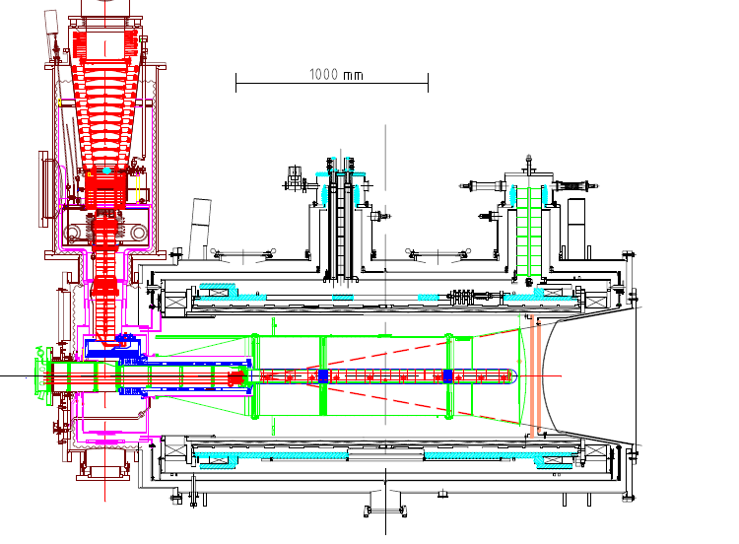
the polarized target system (>2005)
³He – ⁴He dilution refrigerator (T~50mK)
solenoid 2.5T
dipole magnet 0.6T
acceptance > ± 180 mrad
3 target cells
30, 60, and 30 cm long
μ
opposite polarisation
d (⁶LiD) p (NH₃)
polarization 50% 90%
dilution factor 40% 16%
no evidence for relevant
nuclear effects (160 GeV)

Slide 17
SIDIS event and hadron selection
Notes:
17

Slide 18
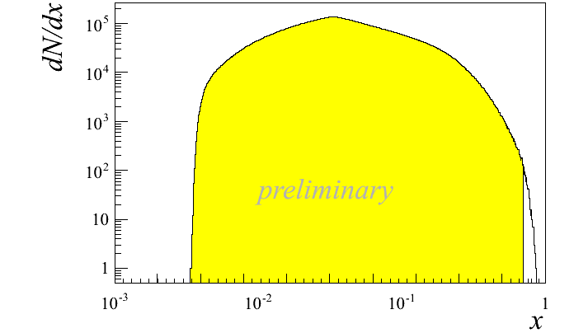
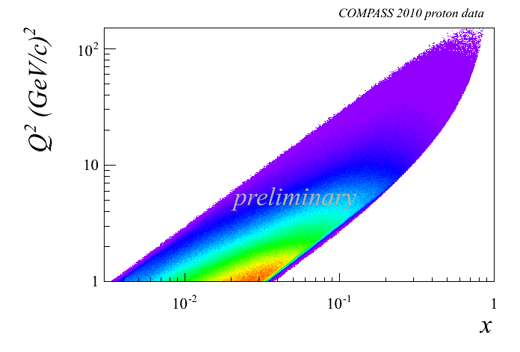
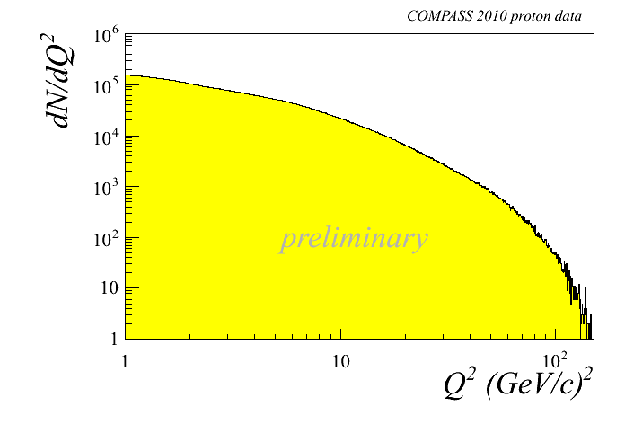
SIDIS event selection
p_{μ} = 160 GeV/c
DIS cuts: Q² > 1 (GeV/c)²
0.1 < y < 0.9
W > 5 GeV/c²
h± selection: p_{t}^{h} > 0.1 GeV/c
z > 0.2
Notes:
18

Slide 19
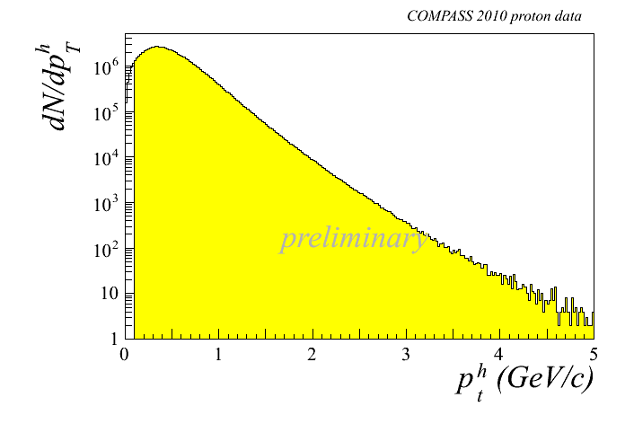
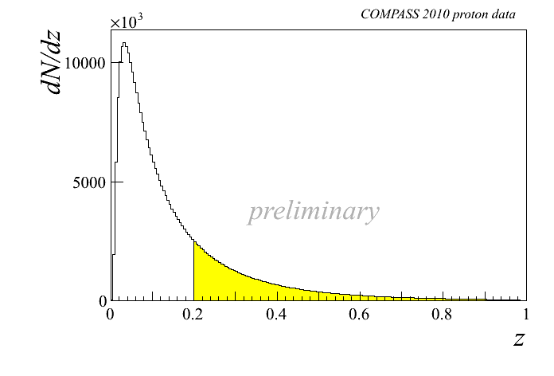
SIDIS event selection
p_{μ} = 160 GeV/c
DIS cuts: Q² > 1 (GeV/c)²
0.1 < y < 0.9
W > 5 GeV/c²
h± selection: p_{t}^{h} > 0.1 GeV/c
z > 0.2
Notes:
19

Slide 20
SIDIS event selection
p_{μ} = 160 GeV/c
DIS cuts: Q² > 1 (GeV/c)²
0.1 < y < 0.9
W > 5 GeV/c²
h± selection: p_{t}^{h} > 0.1 GeV/c
z > 0.2
PID: π± 1.5 < p^{π} < 50 GeV/c
K± 9.5 < p^{K} < 50 GeV/c
Notes:
20

Slide 21
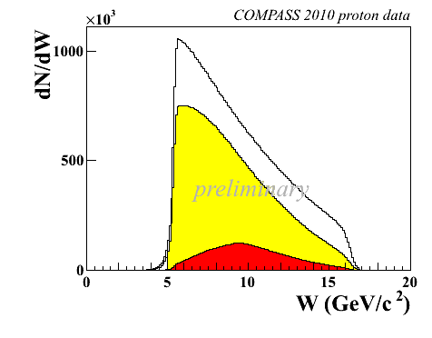
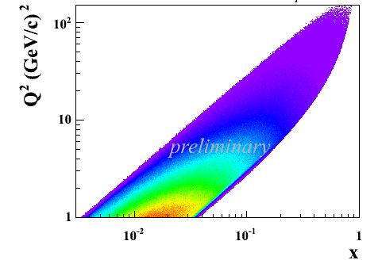
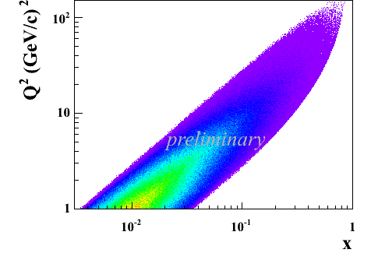
SIDIS event selection
p_{μ} = 160 GeV/c
DIS cuts: Q² > 1 (GeV/c)²
0.1 < y < 0.9
W > 5 GeV/c²
h± selection: p_{t}^{h} > 0.1 GeV/c
z > 0.2
π±
PID: π± 1.5 < p^{π} < 50 GeV/c
K± 9.5 < p^{K} < 50 GeV/c
K±
π±
K±
K±
Notes:
21

Slide 22
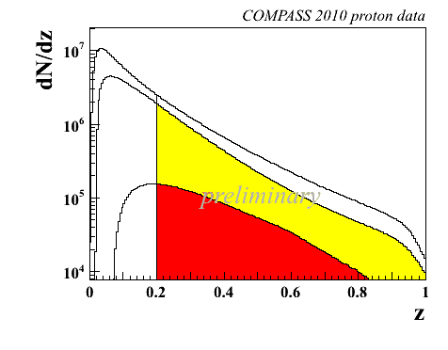
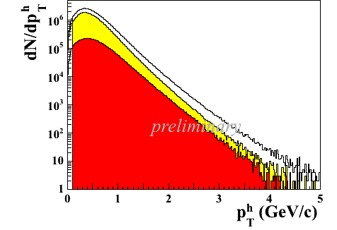
SIDIS event selection
p_{μ} = 160 GeV/c
DIS cuts: Q² > 1 (GeV/c)²
0.1 < y < 0.9
W > 5 GeV/c²
h± selection: p_{t}^{h} > 0.1 GeV/c
z > 0.2
PID: π± 1.5 < p^{π} < 50 GeV/c
K± 9.5 < p^{π} < 50 GeV/c
π±
K±
π±
K±
Notes:
22

Slide 23
results
Collins asymmetry

Slide 24
Collins asymmetry
data taken with transversely polarised targets
deuteron (⁶LiD) target, 160 GeV μ beam
2002, 2003, 2004
proton (NH₃) target, 160 GeV μ beam
2007, 2010

Slide 25
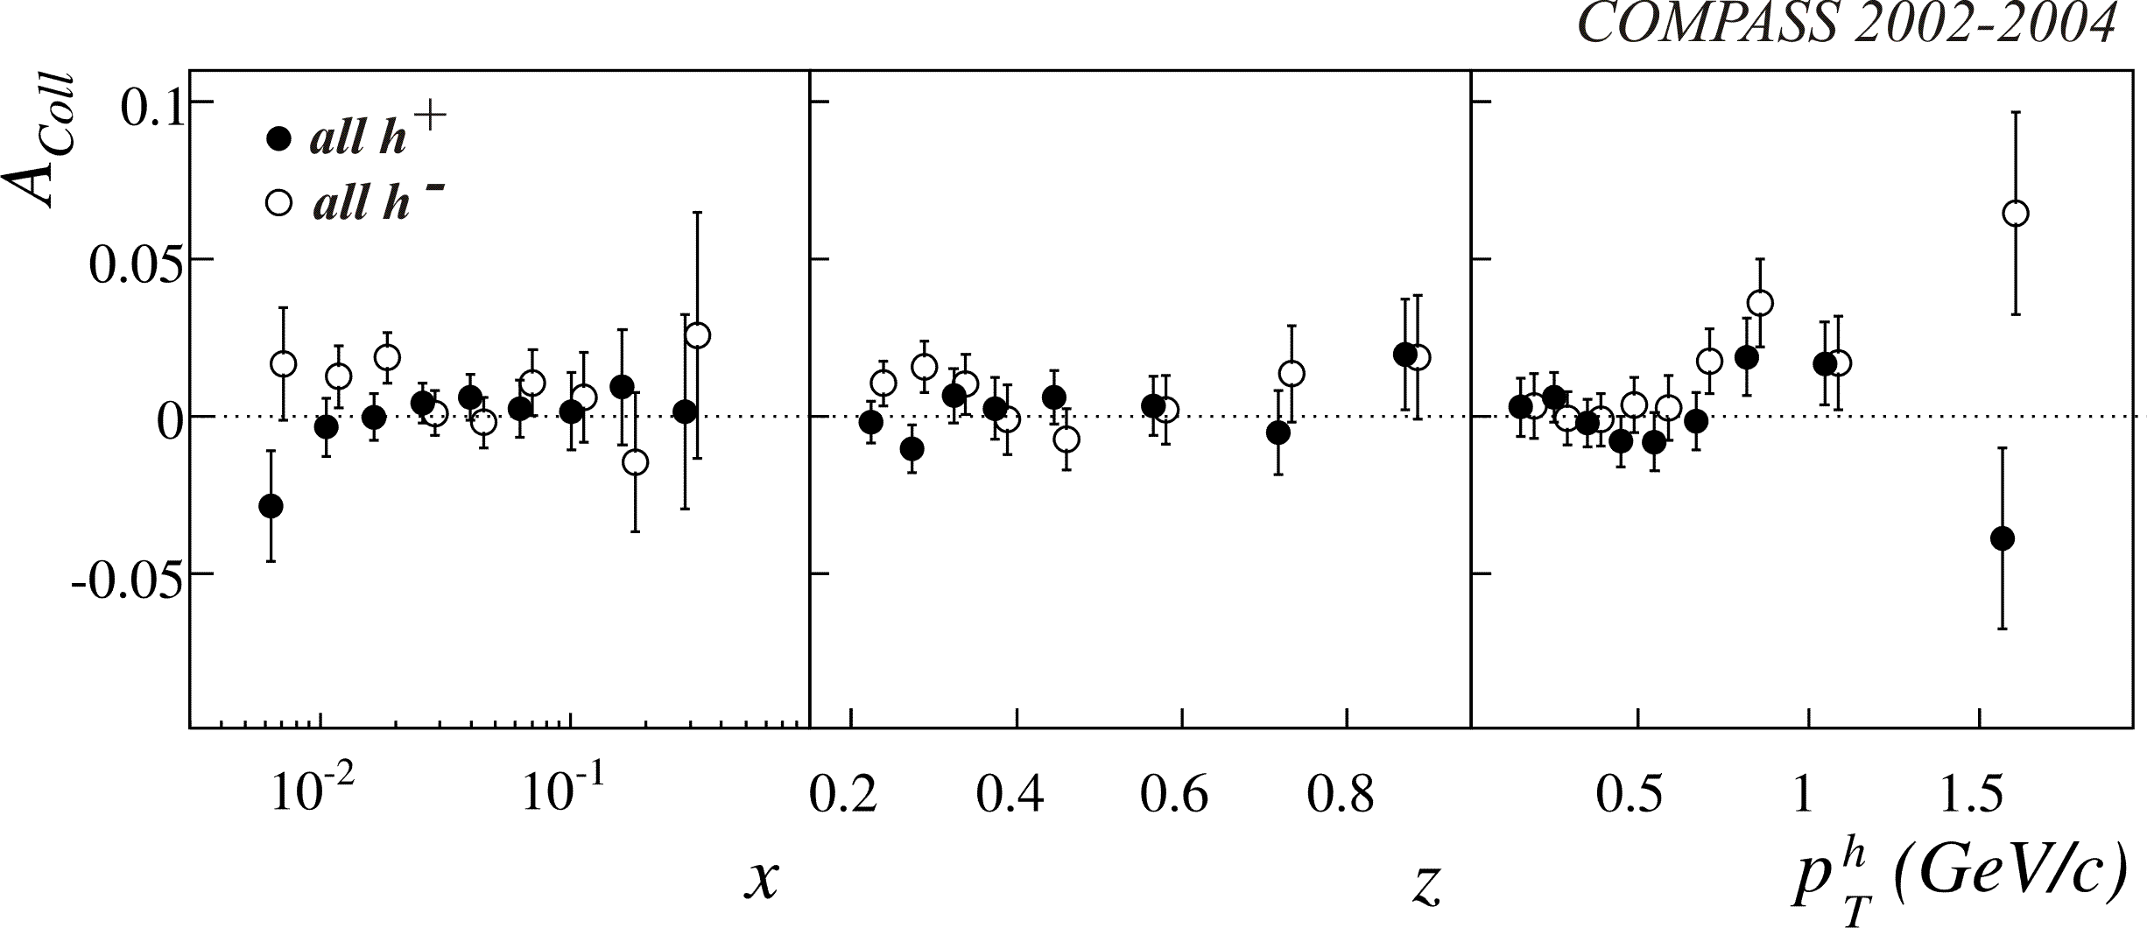
Collins asymmetry on deuteron
final results 2002-2004 data
PRL 94 (2005) 202002, NPB 765 (2007) 31, PLB 673 (2009) 127

Slide 26
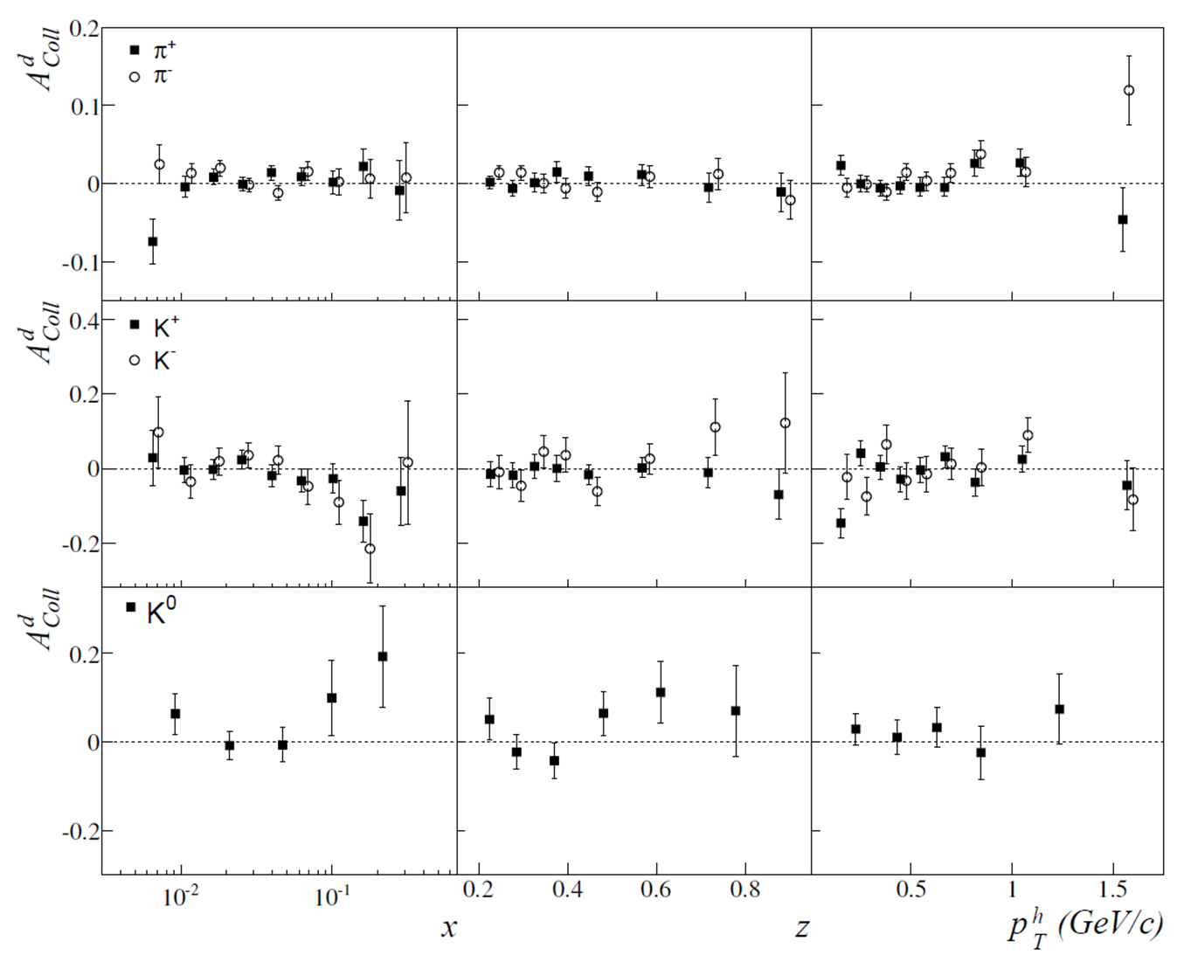
Collins asymmetry on deuteron
final results 2003-2004 data
PLB 673 (2009) 127
π-
π+
understood as
u – d cancellation
favored/unfavored Collins FF
K-
K+
K⁰

Slide 27
Collins asymmetry on proton
Notes:
27

Slide 28
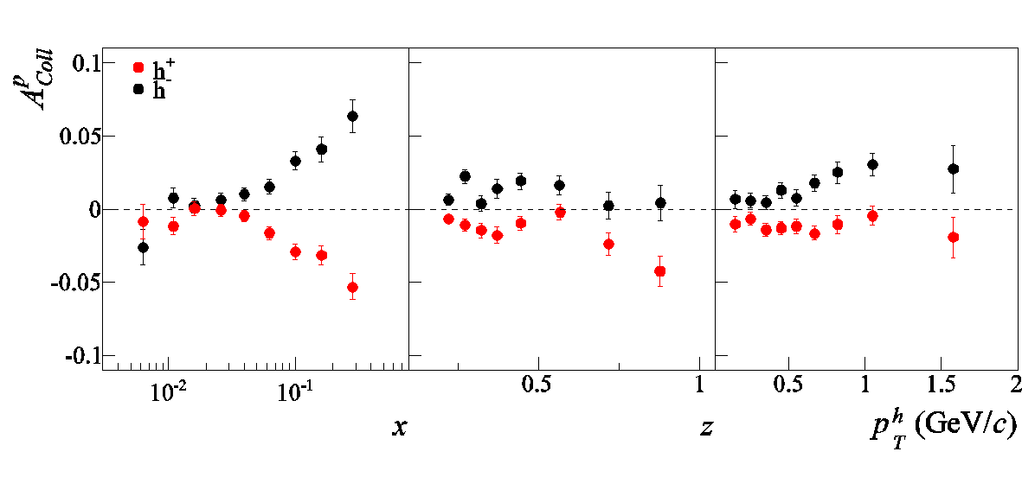
Collins asymmetry on proton
charged hadrons - published 2007 & 2010 data results
PLB 692 (2010) 240 PLB 717 (2012) 376
very good agreement between the two independent data sets
combined 2007 – 2010 results
σ_{syst}~ 0.5 σ_{stat}
precise measurements
clear signal at x > 0.3, with opposite sign for h+ and h-
Notes:
28

Slide 29
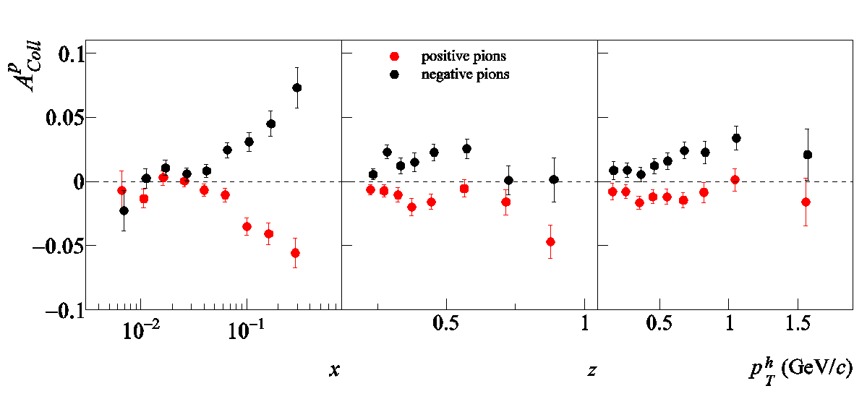
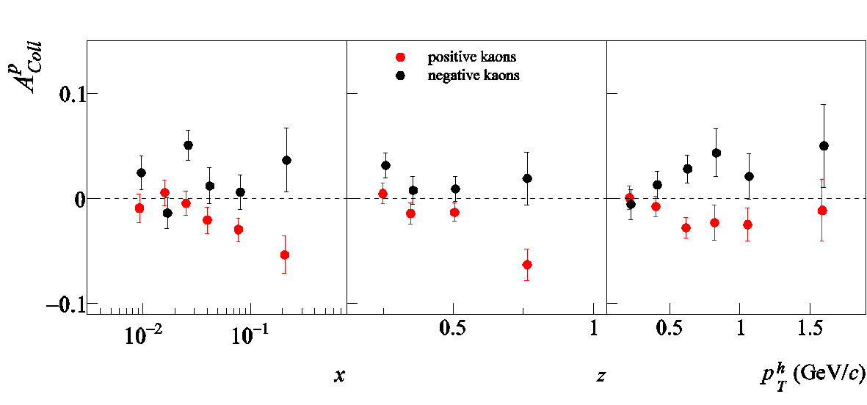
Collins asymmetry on proton
charged pions and kaons
results from 2007 (SPIN2010) and 2010 (SPIN2012) data
combined 2007 – 2010 results
π-
~ h+ / h-
π+
preliminary
K-
compatible
with π+ / π-
K+
preliminary
Notes:
29

Slide 30
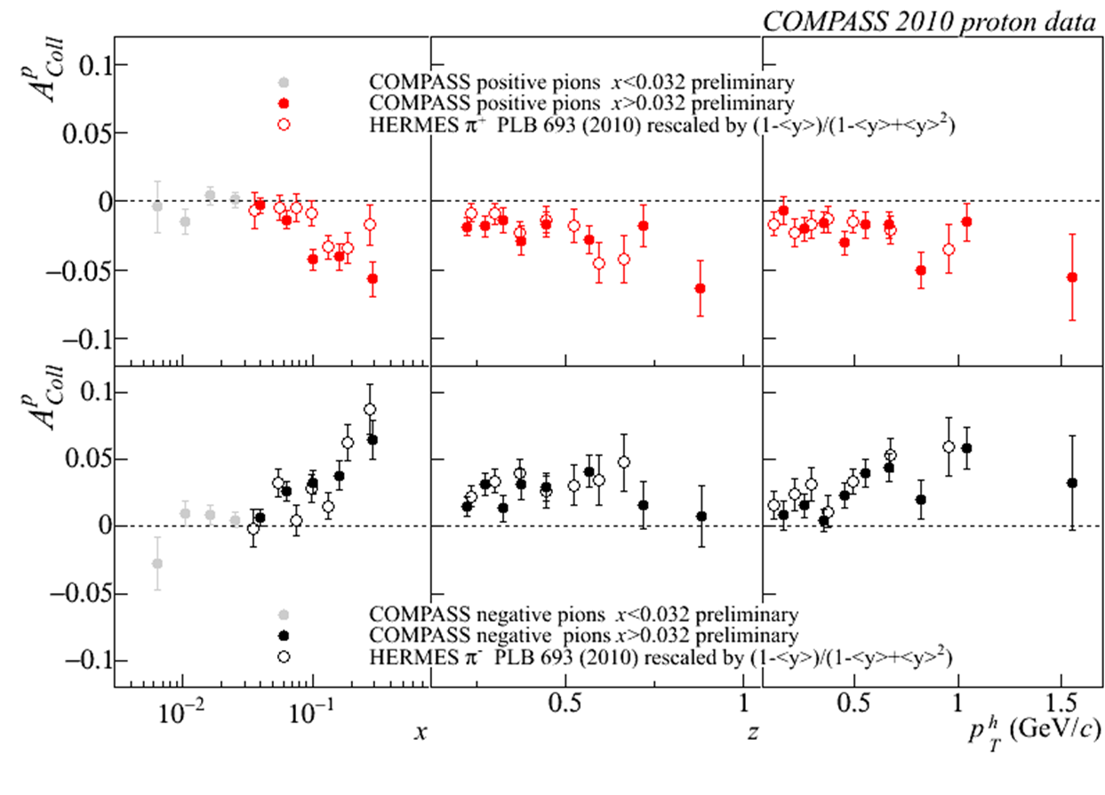
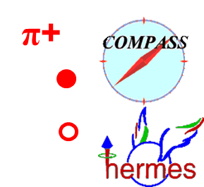
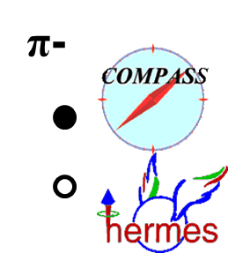
Collins asymmetry on proton
x > 0.032 region
charged pions (and kaons), 2010 data
comparison with HERMES results
Notes:
30

Slide 31
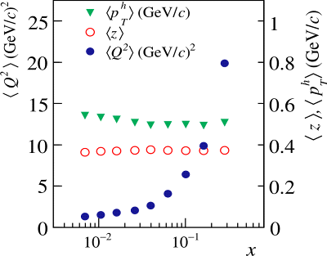


Collins asymmetry on proton
x > 0.032 region
same strength:
a very important, not obvious result!
~12
~ 4
no strong Q² dependence
Notes:
31
\

Slide 32
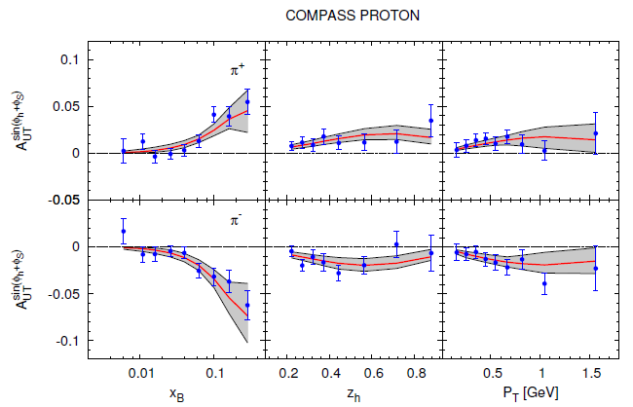
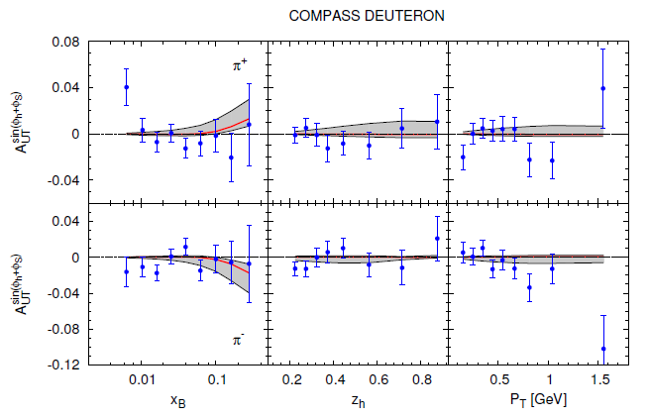
Collins asymmetry on proton
M. Anselmino et al., arXiv:1303.3822
fit to HERMES p, COMPASS p and d, Belle e+e- data
2010 p data
d data
Notes:
32

Slide 33
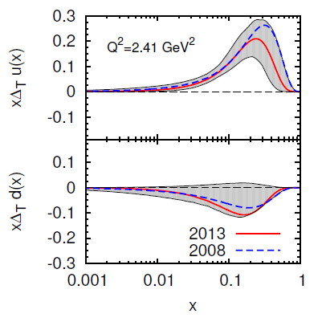
Collins asymmetry on proton
M. Anselmino et al., arXiv:1303.3822
fit to HERMES p, COMPASS d & p, Belle e+e- data
2010 p data
obtained assuming independent measurements in x, z, p_{T}^{h}
Notes:
33

Slide 34
statistical correlations 2010 data
Collins (Sivers, …) asymmetries measured vs x, z, p_{T}^{h}

Slide 35
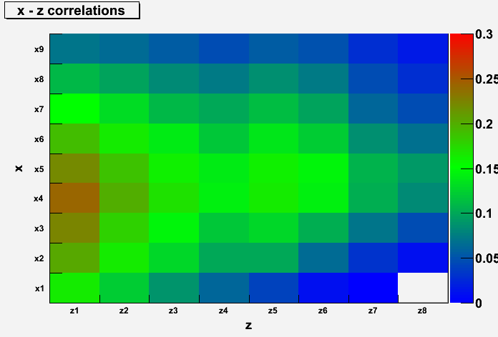
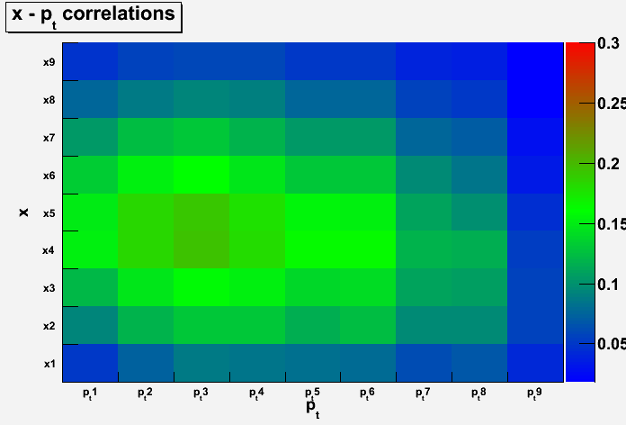
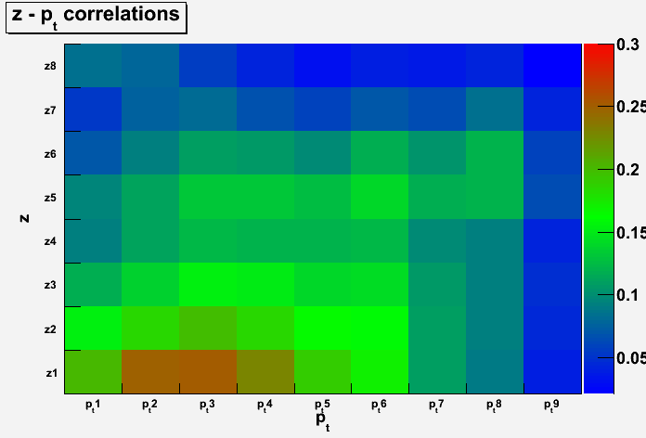
statistical correlations 2010 data
Collins (Sivers, …) asymmetries measured vs x, z, p_{T}^{h}
correlation coefficients
correlation coefficients
x
x
z
p_{T}^{h}
correlation coefficients
new
charged pions
also available for
charged hadrons (HEPDATA)
charged kaons
for all data selection
have to be taken into account
new
z
p_{T}^{h}

Slide 36
results
Sivers asymmetry

Slide 37
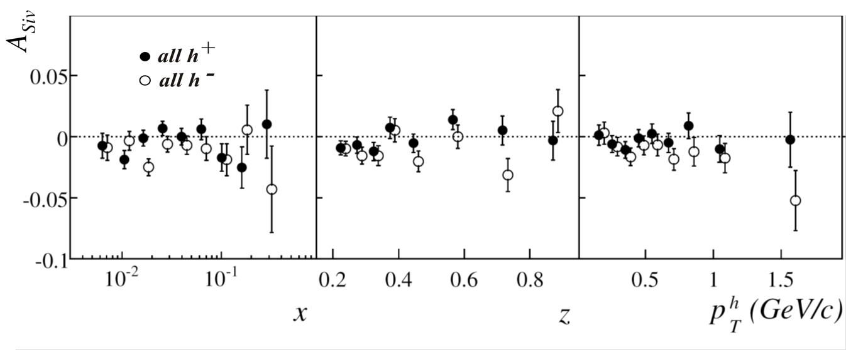
Sivers asymmetry on deuteron
final results 2002-2004 data
PRL 94 (2005) 202002, NPB 765 (2007) 31, PLB 673 (2009) 127

Slide 38
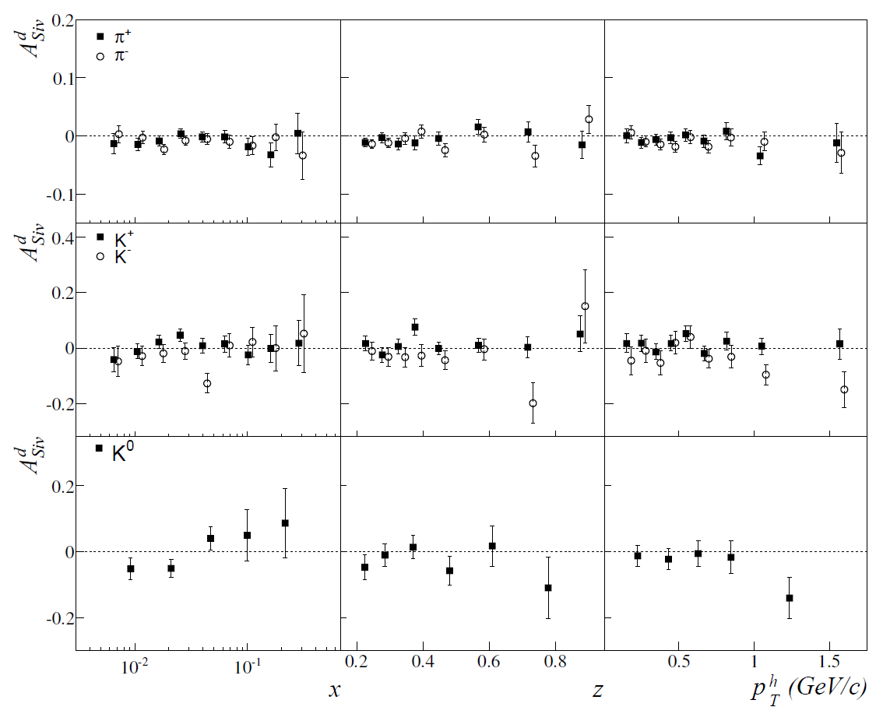
Sivers asymmetry on deuteron
final results 2003-2004 data
PLB 673 (2009) 127
π-
π+
understood as
u – d cancellation
K-
K+
K⁰

Slide 39
Sivers asymmetry on proton

Slide 40
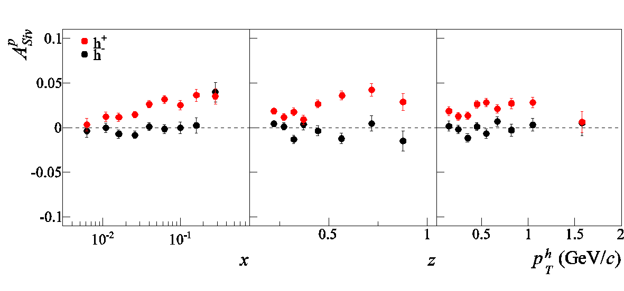
Sivers asymmetry on proton
charged hadrons - published 2007 & 2010 data results
PLB 692 (2010) 240 PLB 717 (2012) 383
good agreement between the two independent data sets !
combined results in HEPDATA
combined 2007 – 2010 results:
h+ : clear signal down to low x, in the previously unmeasured region
in the overlap x range, agreement with HERMES, but
clear indication that the strength decreases

Slide 41
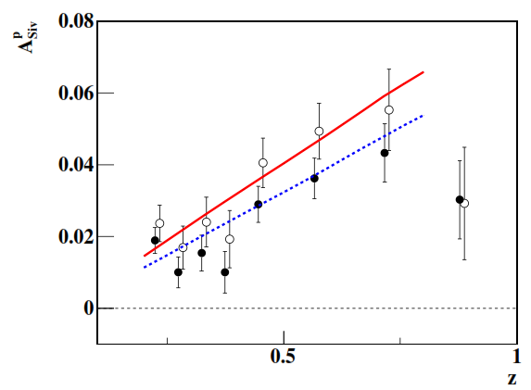
Sivers asymmetry on proton
charged hadrons, 2010 data - Q² evolution
comparison with
S. M. Aybat, A. Prokudin and T. C. Rogers calculations PRL 108 (2012) 242003
x > 0.032
<Q²> = 8.7 GeV/c²
all x
<Q²> = 3.8 GeV/c²
Notes:
41

Slide 42
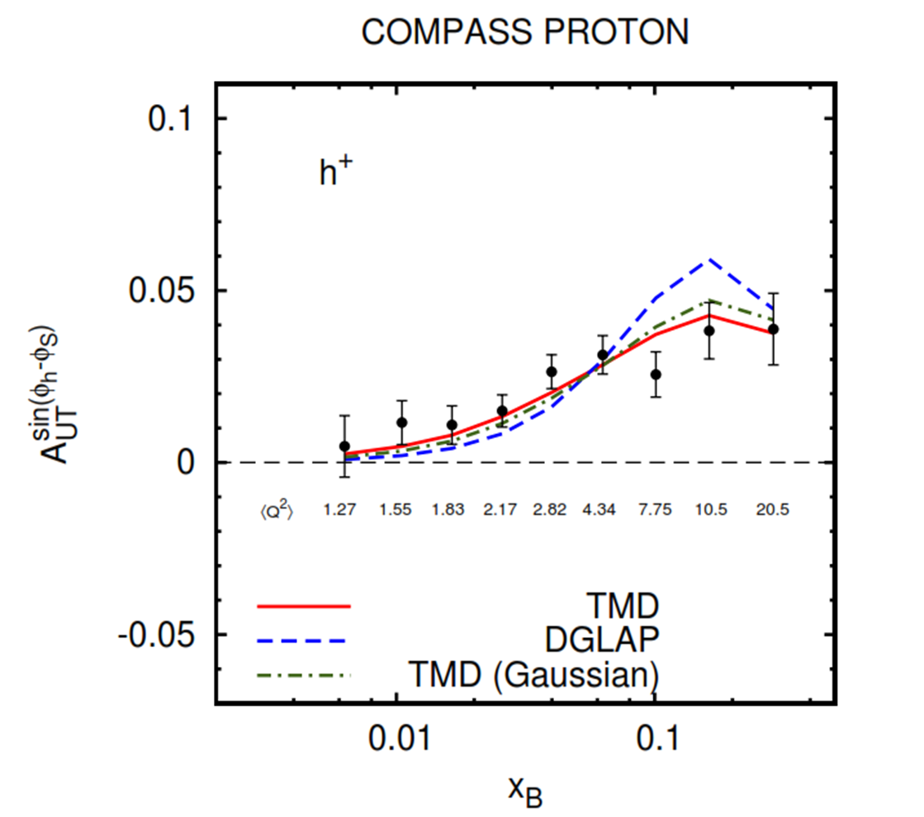
Sivers asymmetry on proton
charged hadrons, 2010 data - Q² evolution
M. Anselmino, M. Boglione, S. Melis arXiv:1204.1239
Notes:
42

Slide 43
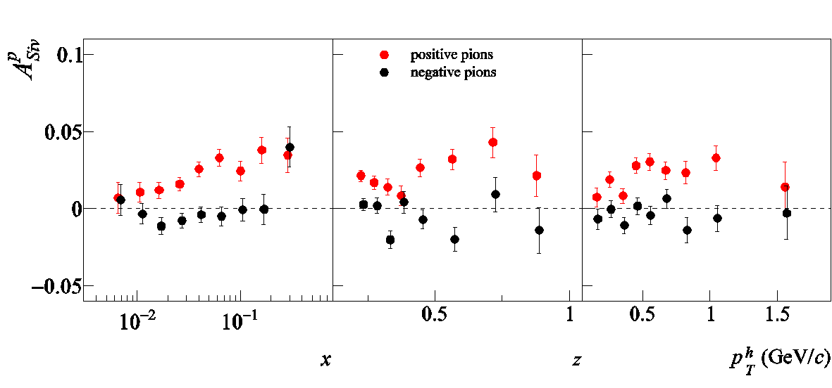
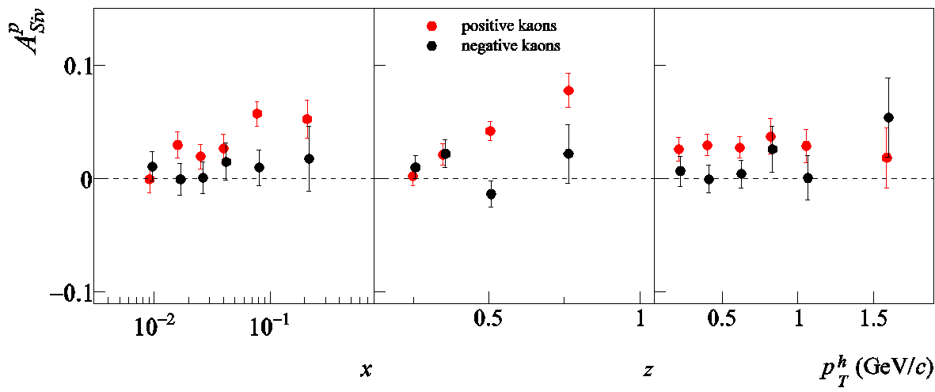
Sivers asymmetry on proton
charged pions and kaons
results from 2007 (SPIN2010) and 2010 (SPIN2012) data
combined 2007 – 2010 results
π+
~ h+ / h-
π-
preliminary
K+
larger than
for π+
K-
preliminary

Slide 44
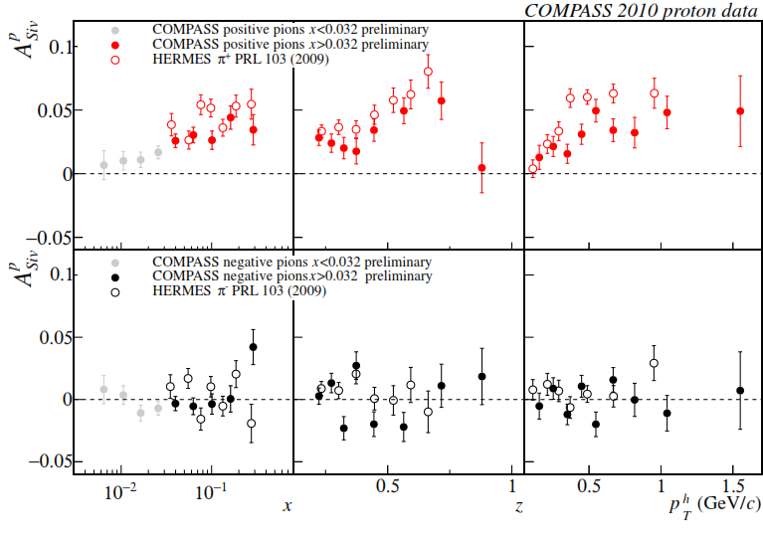
Sivers asymmetry on proton x > 0.032
charged pions (and kaons), 2010 data
comparison with HERMES results
as for h+, smaller values measured by COMPASS;
same indication for K+

Slide 45
more on Collins and Sivers asymmetries
thanks to the high beam momentum,
we have enlarged the usual COMPASS
phase space
still remaining in the DIS CF region
  low z → (0.1,0.2) (0.2,0.3) (0.3,1.0)
  low y → (0.05,0.1) (0.1,0.2) (0.2,0.9)
  for charged and identified hadrons

Slide 46
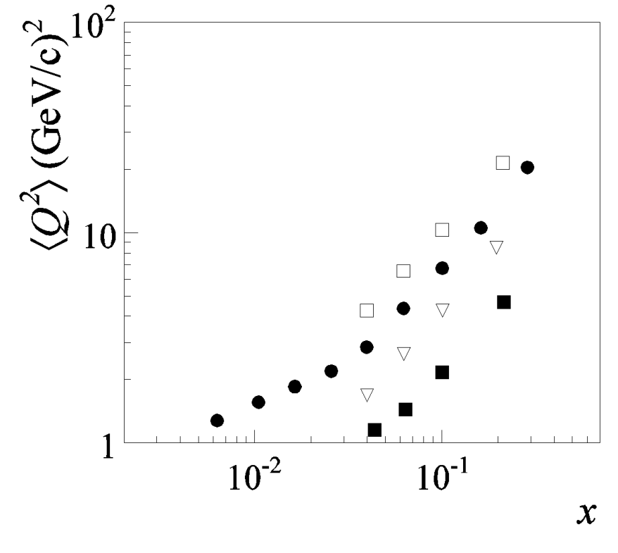
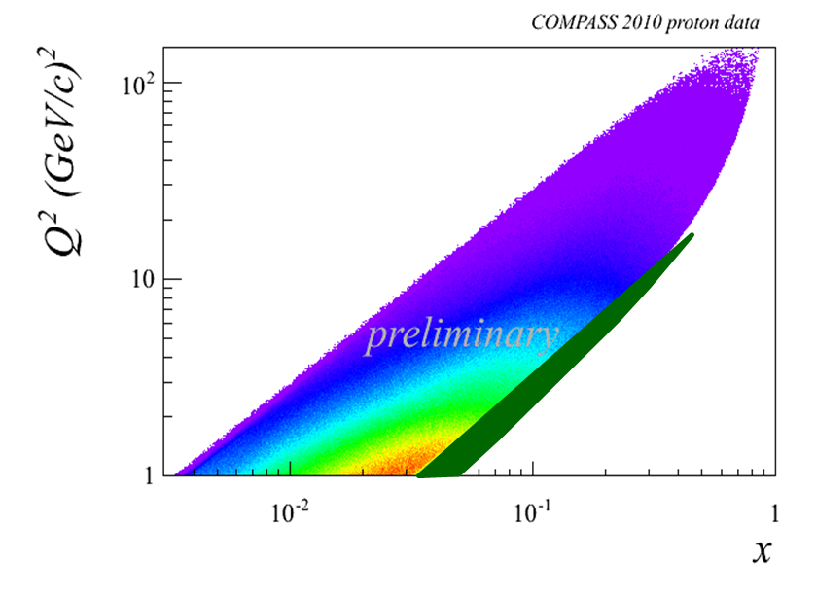
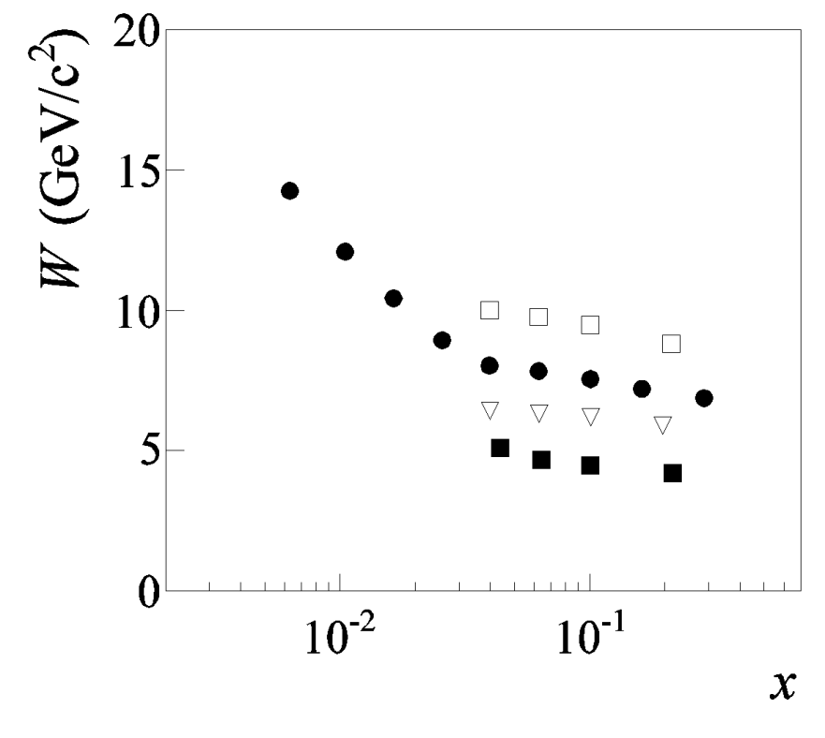
more on Collins and Sivers asymmetries
thanks to the high beam momentum,
we have enlarged the usual COMPASS
phase space
still remaining in the DIS CF region
y (0.2,0.9)
  low z → (0.1,0.2) (0.2,0.3) (0.3,1.0)
  low y → (0.05,0.1) (0.1,0.2) (0.2,0.9)
  for charged and identified hadrons
(0.1,0.2)
(0.05,0.1)
(0.1,0.9)
(0.2,0.9)
(0.1,0.2)
(0.05,0.1)
(0.05,0.1)

Slide 47

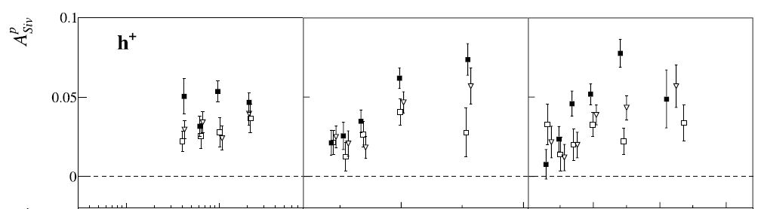
more on Collins and Sivers asymmetries
  charged hadrons, proton data
complete multidimensional analysis: starting

Slide 48
conclusions
COMPASS
has measured the Collins and Sivers asymmetries
on d and on p using a 160 GeV muon beam
for charged and identified hadrons
clear signals on p have been measured,
with interesting kinematical dependences
to be done soon:
multidimensional analysis (x, Q², z, p_{t}) of the p data
on a longer time scale: possible measurements with
- transversely polarised p and 100 GeV muon beam
- transversely polarised d and 160 GeV muon beam

Slide 49


combined 2007 and 2010 p data
preliminary
thank you !

Slide 51

statistical correlations 2010 data
between Collins and Sivers asymmetries
corr.
coeff.

Slide 52



statistical correlations 2010 data
Collins (Sivers, …) asymmetries measured vs x, z, p_{T}^{h}
x
x
z
p_{T}^{h}
charged pions
also available for
charged hadrons (HEPDATA)
charged kaons
all data selection
have to be taken into account
z
p_{T}^{h}

Slide 53


Sivers asymmetry on proton
charged pion and kaons – 2010 data results
SPIN2012
π+
π-
K+
K-

Slide 54



Sivers asymmetry on proton
charged hadrons, pions and kaons - 2010 data

Slide 55

Collins asymmetry on proton
2010 data
Notes:
55

Slide 56

Sivers asymmetry on proton
charged hadrons - published 2007 & 2010 results
PLB 692 (2010) 240 PLB 717 (2012) 376
h+
2010
2007
2010
2007
h-
good agreement between the two independent sets of data
combined results in HEPDATA

Slide 57



Collins asymmetry on proton
x > 0.032 region
K+
2010
K-
2010
Notes:
57

Slide 58

Sivers asymmetry on proton x > 0.032
charged K, 2010 data
- comparison with HERMES results
K+
K-

