Slide 1
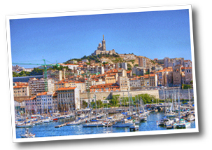
Higgs boson and Top quark masses as test of Electroweak Vacuum Stability
Isabella Masina
University of Ferrara and CP3-Origins Denmark
International Workshop on
Deep-Inelastic Scattering
and Related Subjects
DIS 2013
22-26 April 2013
Marseille, France

Slide 2
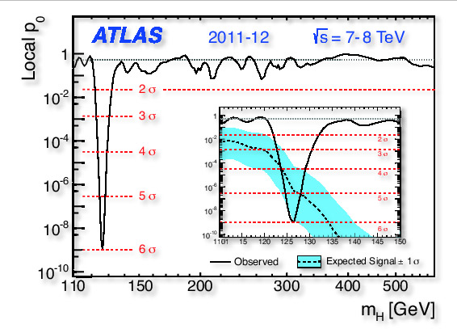
SO WHAT?

Slide 3
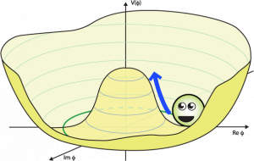

Consider the Higgs doublet
and the SM Higgs potential:
V(φ_{H})
and now… how shall I continue?
φ_{H}

Slide 4
Consider the Higgs doublet
and the SM Higgs potential:
V(φ_{H})
unstable? No, we wouldn’t be there
φ_{H}
Tunneling
with τ < τ_{Universe}

Slide 5
Consider the Higgs doublet
and the SM Higgs potential:
V(φ_{H})
metastable?
φ_{H}
Tunneling
with τ > τ_{Universe}

Slide 6
Consider the Higgs doublet
and the SM Higgs potential:
n.1
n.2
n.3
V(φ_{H})
stable? but which kind?
φ_{H}

Slide 7
Consider the Higgs doublet
and the SM Higgs potential:
1) DO WE LIVE IN A STABLE OR METASTABLE VACUUM ?
V(φ_{H})
φ_{H}

Slide 8
Consider the Higgs doublet
and the SM Higgs potential:
1) DO WE LIVE IN A STABLE OR METASTABLE VACUUM ?
V(φ_{H})
2) IF STABLE, CAN THE HIGH POTENTIAL ENERGY OF THE HIGGS HAVE BEEN RESPONSIBLE FOR INFLATION?
φ_{H}

Slide 9
Consider the Higgs doublet
and the SM Higgs potential:
1) DO WE LIVE IN A STABLE OR METASTABLE VACUUM ?
V(φ_{H})
2) IF STABLE, CAN THE HIGH POTENTIAL ENERGY OF THE HIGGS HAVE BEEN RESPONSIBLE FOR INFLATION?
3) DO NEUTRINOS HAVE SOME IMPACT IN ALL THIS?
φ_{H}

Slide 10
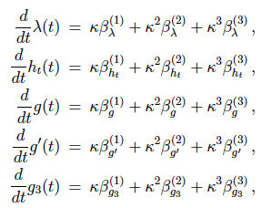
1) DO WE LIVE IN A STABLE OR METASTABLE VACUUM?
[Hung, Cabibbo et al ‘79, Lindner, Sher, Casas, Espinosa, Quiros, Giudice, Riotto, Isidori, Strumia, etc]
(Assuming desert) extrapolate the SM Higgs potential at renormalization scale μ via RGE.
This can now be done at NNLO!!
3-loop running for: g(μ), g’ (μ), g₃(μ), λ(μ), y_{t}(μ)
[Mihaila Salomon Steinhauser, arXiv:1201.5868]
[Chetyrkin Zoller, arXiv:1205.2892]

Slide 11
1) DO WE LIVE IN A STABLE OR METASTABLE VACUUM?
[Hung, Cabibbo et al ‘79, Lindner, Sher, Casas, Espinosa, Quiros, Giudice, Riotto, Isidori, Strumia, etc]
(Assuming desert) extrapolate the SM Higgs potential at renormalization scale μ via RGE.
This can now be done at NNLO!!
3-loop running for: g(μ), g’ (μ), g₃(μ), λ(μ), y_{t}(μ)
matched directly at m_{Z} (larger exp error in α₃)

Slide 12
1) DO WE LIVE IN A STABLE OR METASTABLE VACUUM?
[Hung, Cabibbo et al ‘79, Lindner, Sher, Casas, Espinosa, Quiros, Giudice, Riotto, Isidori, Strumia, etc]
(Assuming desert) extrapolate the SM Higgs potential at renormalization scale μ via RGE.
This can now be done at NNLO!!
3-loop running for: g(μ), g’ (μ), g₃(μ), λ(μ), y_{t}(μ)
matched at 2-loop via m_{H} (unavoidable theor error)
[Bezrukov Kalmykov Kniehl Shaposhnikov, arXiv:1205.2893]
[Degrassi Di Vita Elias-Miro Espinosa Giudice Isidori Strumia, arXiv:1205.6497]

Slide 13
1) DO WE LIVE IN A STABLE OR METASTABLE VACUUM?
[Hung, Cabibbo et al ‘79, Lindner, Sher, Casas, Espinosa, Quiros, Giudice, Riotto, Isidori, Strumia, etc]
(Assuming desert) extrapolate the SM Higgs potential at renormalization scale μ via RGE.
This can now be done at NNLO!!
3-loop running for: g(μ), g’ (μ), g₃(μ), λ(μ), y_{t}(μ)
matched at 2-loop via ”Tevatron” m_{t} pole mass (unavoidable theor error)

Slide 14
1) DO WE LIVE IN A STABLE OR METASTABLE VACUUM?
[Hung, Cabibbo et al ‘79, Lindner, Sher, Casas, Espinosa, Quiros, Giudice, Riotto, Isidori, Strumia, etc]
(Assuming desert) extrapolate the SM Higgs potential at renormalization scale μ via RGE.
This can now be done at NNLO!!
3-loop running for: g(μ), g’ (μ), g₃(μ), λ(μ), y_{t}(μ)
matched at 2-loop via ”Tevatron” m_{t} pole mass (unavoidable theor error)
[Alekhin Djouadi Moch, arXiv:1207.0980]
It is inconsistent to use Tevatron measure
BETTER to match directly with MSbar running m_{t}
as done in [IM, arXiv:1209.0393]

Slide 15
POSSIBLE SHAPES FOR THE HIGGS POTENTIAL CLOSE TO THE PLANCK SCALE
stable
stable
stable with flex
Higgs potential
deg. with EW vacuum
metastable
renormalization scale
[IM, arXiv:1209.0393]

Slide 16
RESULTS
METASTABILITY
STABILITY
Top mass
[IM, arXiv:1209.0393]

Slide 17

RESULTS
METASTABILITY
STABILITY
Top mass
Higgs mass
[IM, arXiv:1209.0393]

Slide 18
[IM, arXiv:1209.0393]

Slide 19
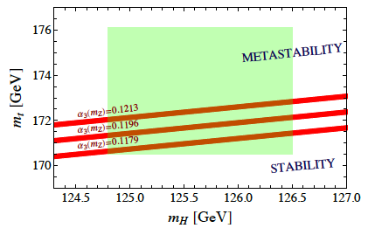
STABILITY BOUND
[IM, arXiv:1209.0393]

Slide 20
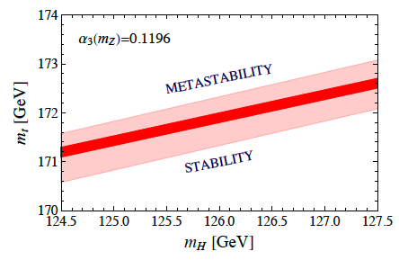
Comparison with previous analysis by Degrassi Di Vita Elias-Miro Espinosa Giudice Isidori Strumia, JHEP 1208 (2012) 098 [arXiv:1205.6497]
IM arXiv:1209.0393
Theoretical uncertainty in the determination of the transition line between stability and metastability according to our analysis (thinner: only μ_{λ} ) and eq. (10) of DDEEGIS(thicker: also error due to y_{t} matching from m_{t} pole).

Slide 21
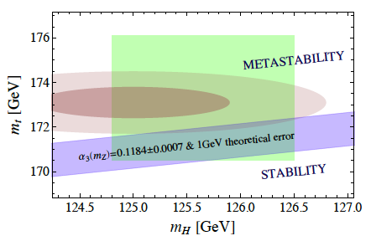
Comparison with previous analysis by Degrassi Di Vita Elias-Miro Espinosa Giudice Isidori Strumia, JHEP 1208 (2012) 098 [arXiv:1205.6497]
IM arXiv:1209.0393
Transition line (blue) between stability and metastability according to Degrassi et al.
The (brown) shaded disks is the 1 and 2 combined ranges for mt and mH used in Degrassi et al. The (green) rectangle allows for the comparison with the ranges of mt and mH used here.

Slide 22
PROSPECTS
NEED MORE PRECISE MEASURE
[IM, arXiv:1209.0393]

Slide 23
PROSPECTS
NEED MORE PRECISE MEASURE
EXPECTED LHC SENSITIVITY
ILC
[IM, arXiv:1209.0393]

Slide 24
2) IF STABLE, CAN THE HIGH POTENTIAL ENERGY OF THE HIGGS HAVE BEEN RESPONSIBLE FOR INFLATION?

Slide 25
2) IF STABLE, CAN THE HIGH POTENTIAL ENERGY OF THE HIGGS HAVE BEEN RESPONSIBLE FOR INFLATION?
YES! If, for some reason, there has been a period in which the Hubble rate was dominated by a nearly constant V
V acts as cosmological constant term
EXPONENTIAL EXPANSION

Slide 26
EXAMPLE 1
V(φ_{H})
A stable configuration like a shallow false minimum with the Higgs trapped in it during inflation, which ends because of some other mechanism
shallow false minimum
M_{Pl}
φ_{H}
A model in scalar-tensor gravity
& a model with hybrid inflation
IM Notari, arXiv:1112.2659,
1204.4155
n_{s} is quite model dependent but tensor-to-scalar-ratio r is not
→ these models can be tested
IM Notari, arXiv:1112.5430

Slide 27
EXAMPLE 2
V(φ_{H})
A configuration more
(or as stable as)
an inflection point is necessary for Higgs inflation via
non-minimal gravitation couplings
plateau for slow-roll
M_{Pl}
φ_{H}
Model discussed in
Bezrukov Shaposhnikov, arXiv:0710.3755, …, 1205.2893

Slide 28
3) DO NEUTRINOS HAVE SOME IMPACT IN ALL THIS?
[Casas Ibarra Quiros, Okada Shafi, Giudice Strumia Riotto, Rodejohann Zhang, etc ]
Type I seesaw Dirac Yukawa interactions neutrinos could destabilize V…

Slide 29
3) DO NEUTRINOS HAVE SOME IMPACT IN ALL THIS?
[Casas Ibarra Quiros, Okada Shafi, Giudice Strumia Riotto, Rodejohann Zhang, etc ]
Type I seesaw Dirac Yukawa interactions neutrinos could destabilize V…
Assume one generation giving m_{ν}=0.06 eV
(conservative) upper bound on M_{ν}
IM arXiv:1209.0393

Slide 30
3) DO NEUTRINOS HAVE SOME IMPACT IN ALL THIS?
[Casas Ibarra Quiros, Okada Shafi, Giudice Strumia Riotto, Rodejohann Zhang, etc ]
Type I seesaw Dirac Yukawa interactions neutrinos could destabilize V…
Assume one generation giving m_{ν}=0.06 eV
(conservative) upper bound on M_{ν}
More stringent if one starts from an inflection point configuration
IM arXiv:1209.0393

Slide 31
CONCLUSIONS
METASTABILITY
STABILITY
Top mass

Slide 32
CONCLUSIONS
1) Intriguing that m_{H} was found right at the transition between stability and metastabilty
2) Some stable SM configurations very close to transition line (like e.g. shallow false minimum) might have been relevant for primordial inflation
METASTABILITY
precision measurements of the top and Higgs masses and α₃(m_{Z}) are deserved
STABILITY
Top mass
Higgs mass

