Slide 1


Highlights of Transverse Spin Physics in PHENIX
XXI. Workshop on Deep Inelastic Scattering
and Related Subjects
K. Oleg Eyser
for the PHENIX collaboration

Slide 2
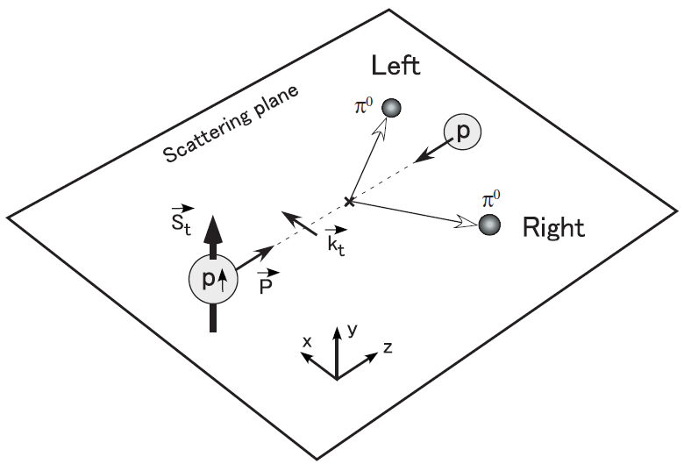
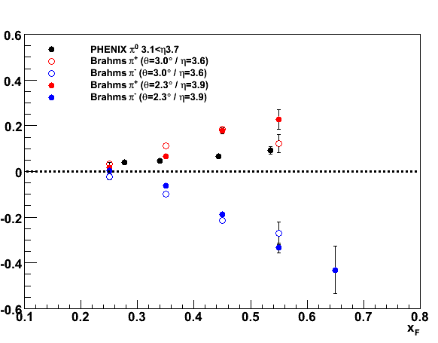
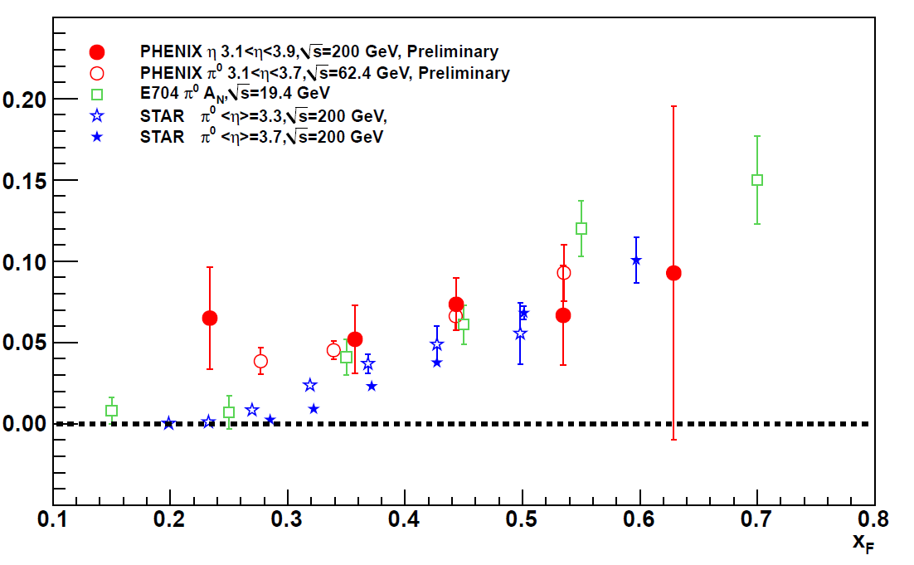
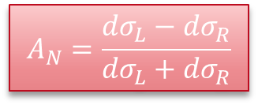



Transverse Spin Asymmetries
The transverse structure of the nucleon is largely unknown
Transversity is chiral odd
Large transverse asymmetries carry potential information about QCD dynamics beyond 1-d picture
Reaction plane
$$A_{N}=\frac{{dσ}_{L}−{dσ}_{R}}{{dσ}_{L}+{dσ}_{R}}$$
$$π^{0} 19.4, 62.4, 200 \text{GeV}$$
$$π^{+}{,π}^{0},π^{−} 62.4 \text{GeV}$$
$$x_{F}=2p_{l}/\sqrt{s}$$

Slide 3
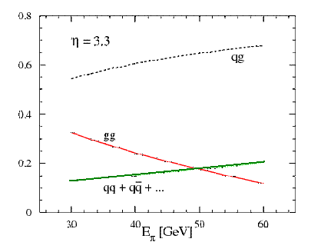
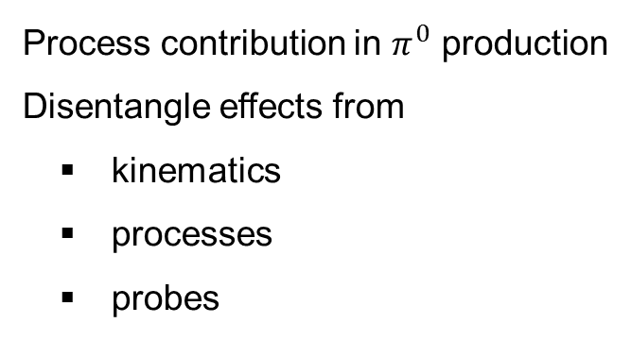
Proton-Proton Collisions
Initial State
pQCD
Final State
f_{a}
FF_{q}
σ
f_{b}
Process contribution in $π^{0}$ production
Disentangle effects from
kinematics
processes
probes

Slide 4
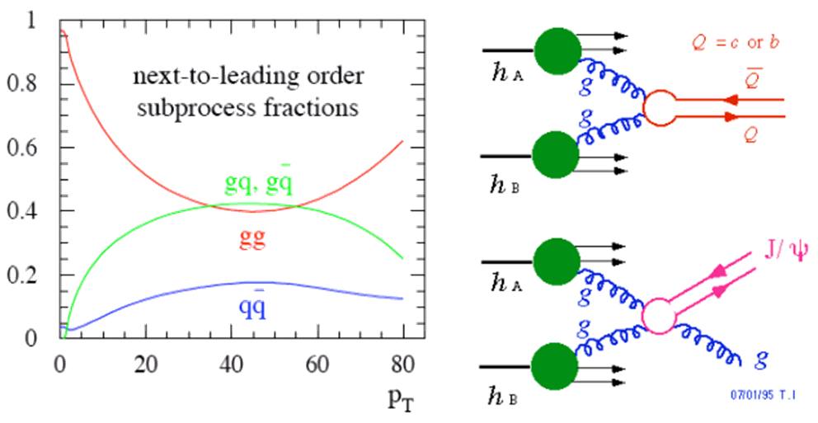
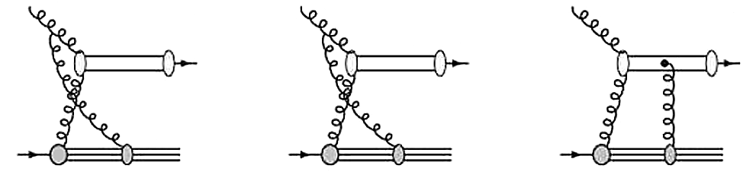


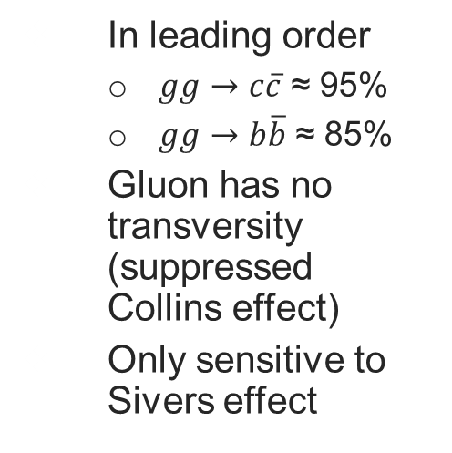








Heavy Flavor
In leading order
  $gg→c\overline{c}$ ≈ 95%
  $gg→b\overline{b}$ ≈ 85%
  Gluon has no transversity (suppressed Collins effect)
  Only sensitive to Sivers effect
  Cancellation of initial and final state interactions [PRD78, 014024, 2008]
  No color-octet
  in asymmetry
$$d$$
$${\left[Q\overline{Q}\right]}_{}^{(1)}$$
$$d$$
$${\left[Q\overline{Q}\right]}_{c}^{(8)}$$
$$d$$
$${\left[Q\overline{Q}\right]}_{c}^{(8)}$$
$$a$$
$$k_{1},b$$
$$a$$
$$k_{1},b$$
$$a$$
$$k_{1},b$$

Slide 5
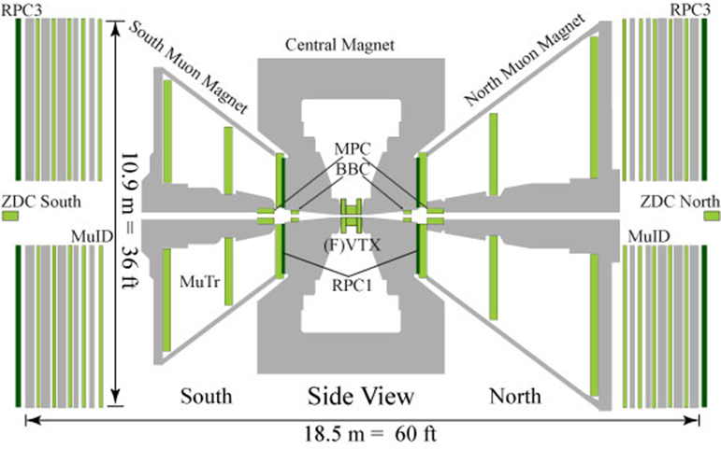
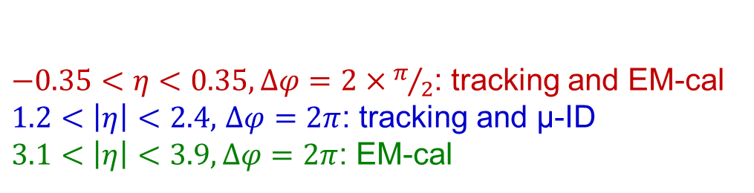
The PHENIX Detector
$−0.35<η<0.35, Δφ=2×π/2$: tracking and EM-cal
$1.2<\left|η\right|<2.4,$ $Δφ=2π$: tracking and μ-ID
$3.1<\left|η\right|<3.9,Δφ=2π$: EM-cal

Slide 6
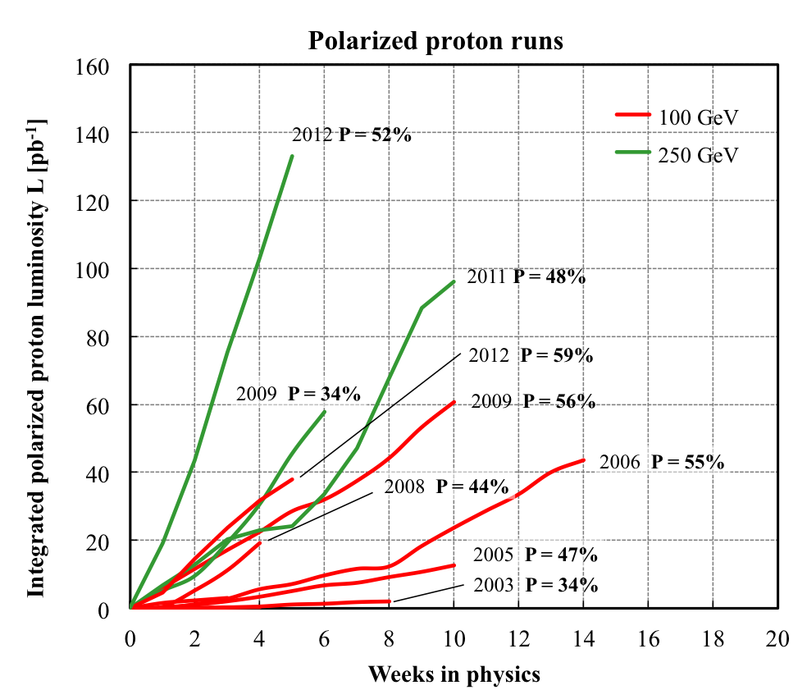
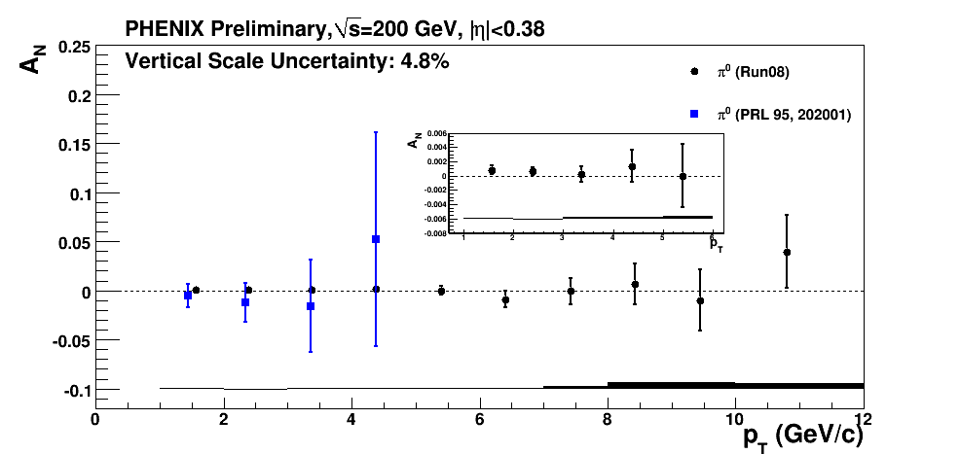
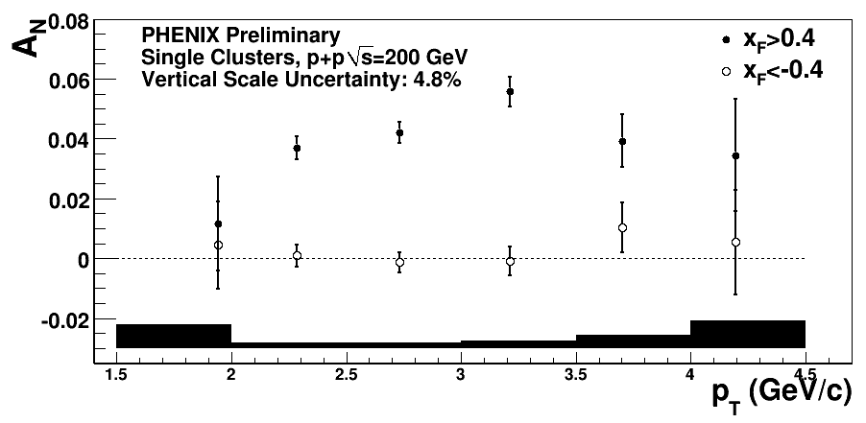
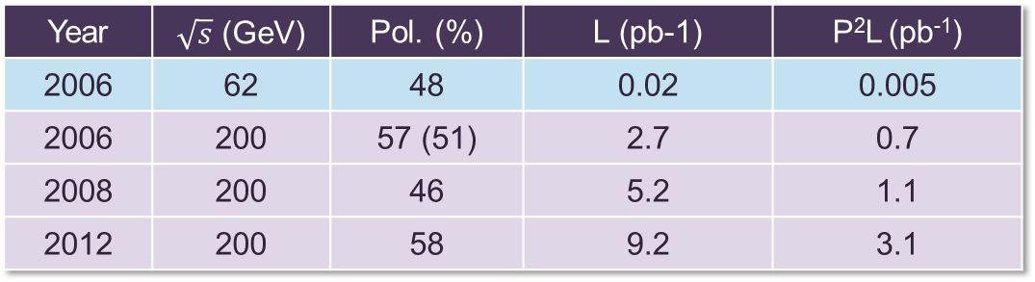
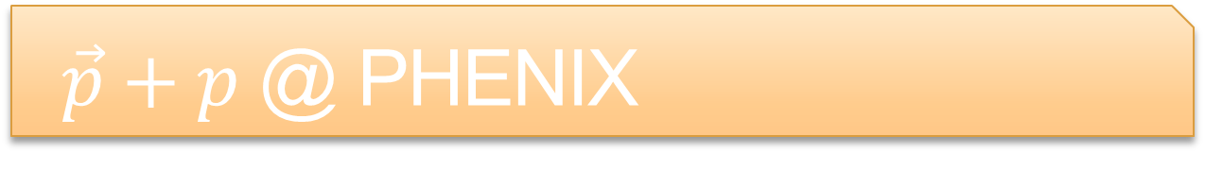
$\vec{p}+p$ @ PHENIX
Year | $\sqrt{s}$ (GeV) | Pol. (%) | L (pb-1) | P²L (pb⁻¹)
2006 | 62 | 48 | 0.02 | 0.005
2006 | 200 | 57 (51) | 2.7 | 0.7
2008 | 200 | 46 | 5.2 | 1.1
2012 | 200 | 58 | 9.2 | 3.1

Slide 7
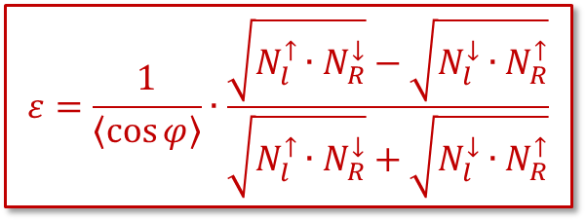
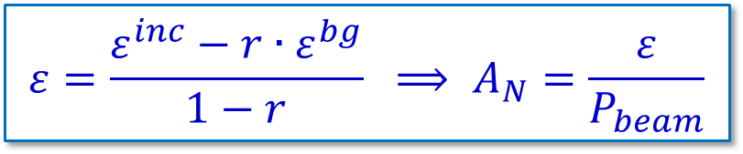
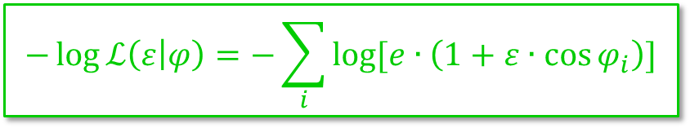
Asymmetry Determination
Conventional square-root method
  Needs assumptions for
  integration of cross section
Unbinned maximum likelihood method
  Sensitive to differences in luminosity of polarization states
Background correction
$$ε=\frac{1}{\left\langle \cos{φ}\right\rangle }∙\frac{\sqrt{N_{l}^{↑}∙N_{R}^{↓}}−\sqrt{N_{l}^{↓}∙N_{R}^{↑}}}{\sqrt{N_{l}^{↑}∙N_{R}^{↓}}+\sqrt{N_{l}^{↓}∙N_{R}^{↑}}}$$
$$−\log{ℒ\left(ε | φ\right)}=−\sum_{i}{\log{[e∙\left(1+ε∙\cos{φ_{i}}\right)]}}$$
$$ε=\frac{ε_{}^{inc}−r∙ε_{}^{bg}}{1−r} ⟹ A_{N}=\frac{ε}{P_{beam}}$$

Slide 8
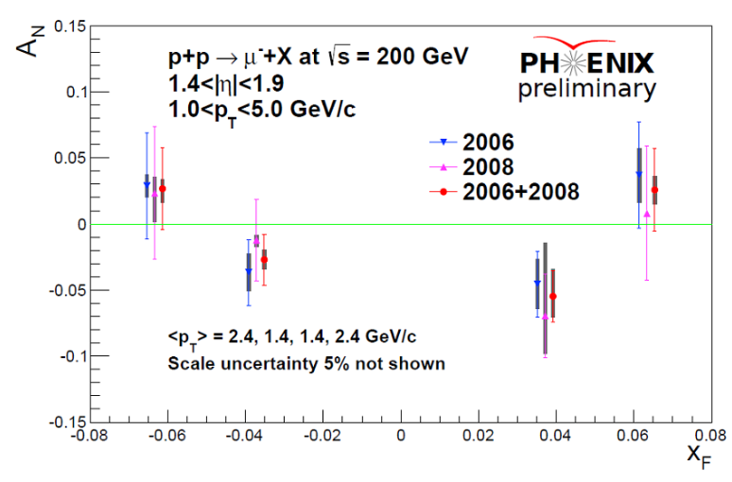
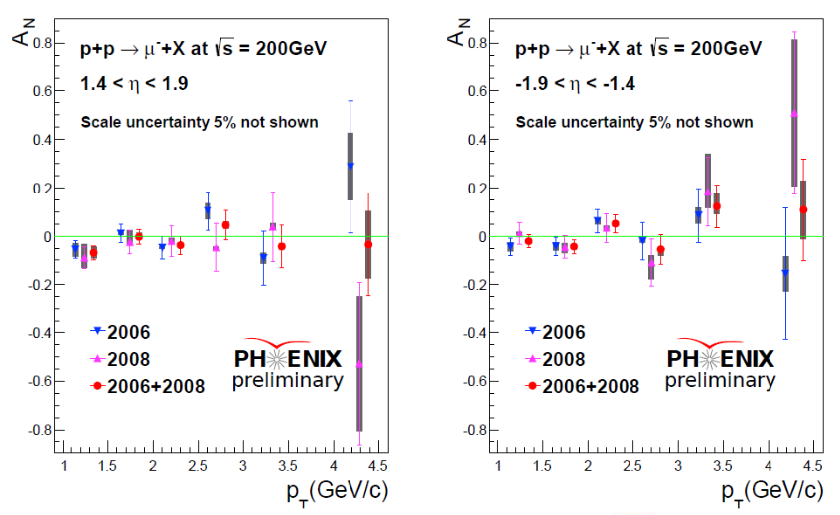
Single Muons
Background from hadrons
Monte-Carlo studies for hadron decays and punch through hadrons
Compare with stopped hadrons
Correct asymmetry
p_{T} dependence
Observed A_{N} are consistent with zero
2012 data will increase sensitivity
FVTX for background rejection in future data

Slide 9
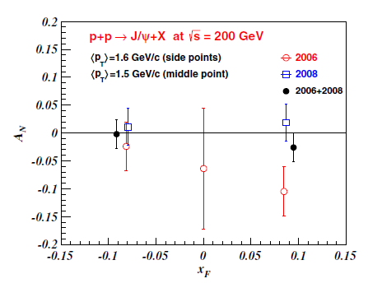
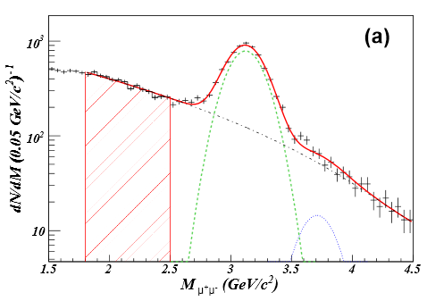

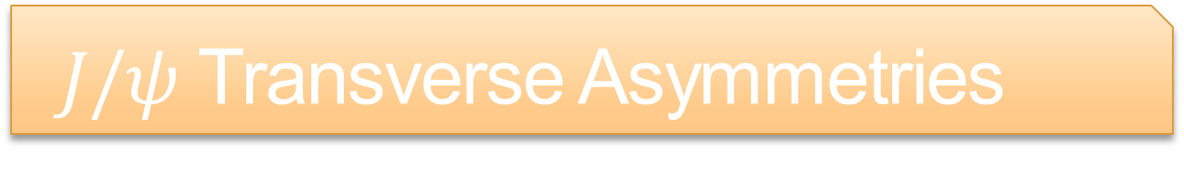
$J/ψ$ Transverse Asymmetries
PRD 86, 099904 (E), 2012
2006 vs. 2008 results at $x_{F}>0$problematic?

Slide 10
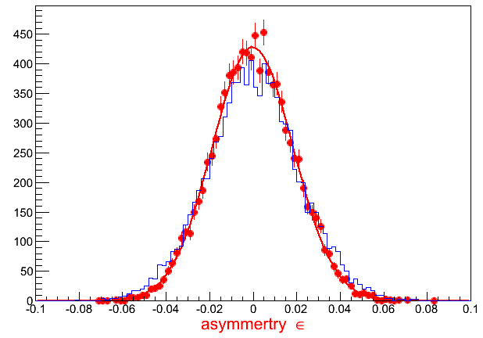
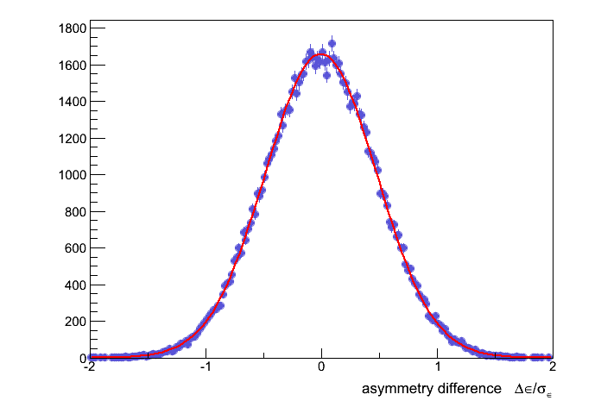
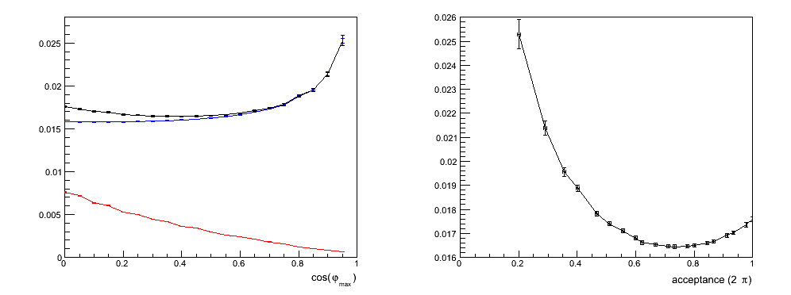
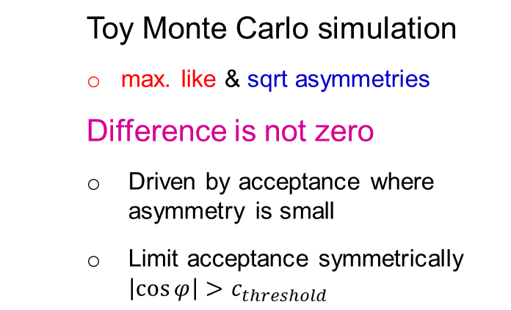


Asymmetry Reproducibility
Toy Monte Carlo simulation
  max. like & sqrt asymmetries
Difference is not zero
  Driven by acceptance where
  asymmetry is small
  Limit acceptance symmetrically $\left|\cos{φ}\right|>c_{threshold}$
$$σ≈0.48$$
$$σ_{tot}$$
$$σ_{mle}$$
$$σ_{Δ}$$
figure of merit

Slide 11
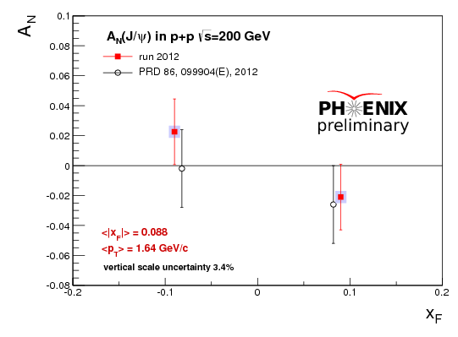
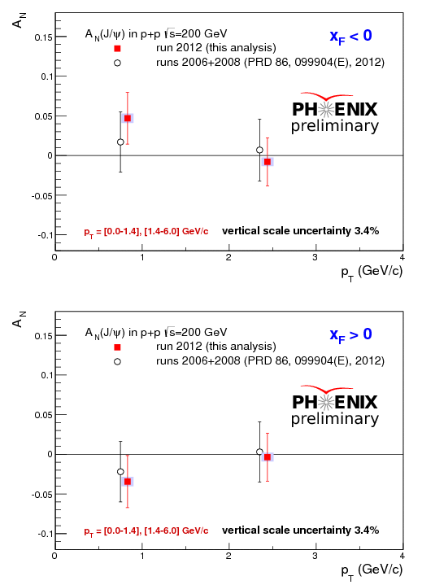
Comparison of Results
p_{T} dependence
Observed A_{N} are consistent with zero
  Higher moments consistent with zero
Measured asymmetries are consistent between data sets

Slide 12
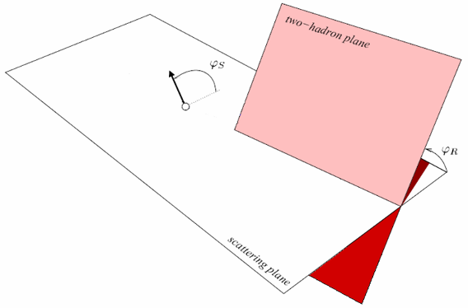

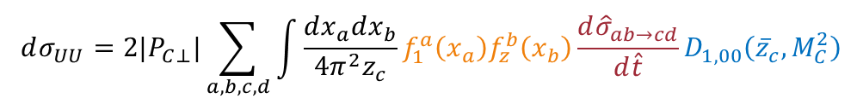









Interference Fragmentation
$$dσ_{UT}=2\left|P_{C⊥}\right||S_{BT}|\sin{(φ_{S}−φ_{R})}\sum_{a,b,c,d}{\int{\frac{dx_{a}dx_{b}}{16πz_{c}}f_{1}^{a}\left(x_{a}\right)h_{1}^{b}\left(x_{b}\right)\frac{dΔ{\hat{σ}}_{ab^{↑}→c^{↑}d}}{d\hat{t}}H_{1,ot}^{∢c}\left({\overline{z}}_{c},M_{C}^{2}\right)}}$$
$$A_{UT}=\frac{σ_{UT}}{σ_{UU}}$$
$$dσ_{UU}=2|P_{C⊥}|\sum_{a,b,c,d}{\int{\frac{dx_{a}dx_{b}}{4π^{2}z_{c}}f_{1}^{a}\left(x_{a}\right)f_{z}^{b}\left(x_{b}\right)\frac{d{\hat{σ}}_{ab→cd}}{d\hat{t}}D_{1,00}\left({\overline{z}}_{c},M_{C}^{2}\right)}}$$
$$A_{UT}∝\sin\left(φ_{S}−φ_{R}\right)$$
A. Bacchetta, M. Radici, PRD 70, 094032 (2004)
$$\vec{P_{h1}}$$
$$\vec{S_{B}}$$
$$\vec{P_{B}}$$
from polarization vector to scattering plane
$$\cos{φ_{S}=\frac{\left(P_{B}×P_{C}\right)}{\left|P_{B}×P_{C}\right|}∙\frac{\left(P_{B}×S_{B}\right)}{\left|P_{B}×S_{B}\right|}}$$
from scattering plane to hadron plane
$$\cos{φ_{R}=\frac{\left(P_{C}×P_{A}\right)}{\left|P_{C}×P_{A}\right|}∙\frac{\left(P_{C}×R_{C}\right)}{\left|P_{C}×R_{C}\right|}}$$
$$\vec{P_{C}}$$
$$\vec{P_{h2}}$$
$$\vec{P_{A}}$$
$$2∙\vec{R_{C}}$$

Slide 13
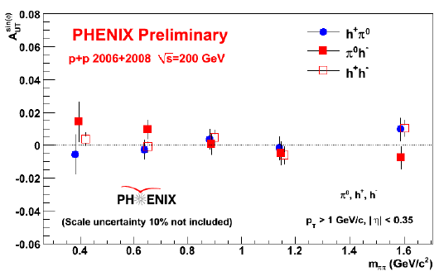
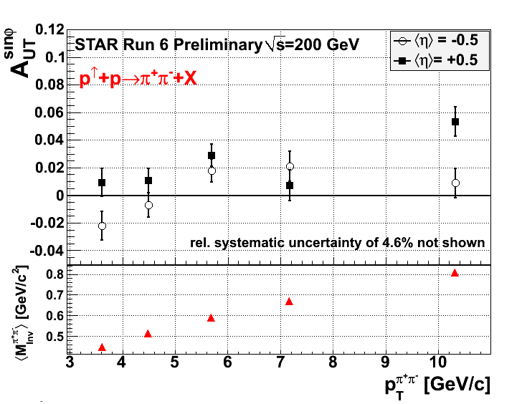
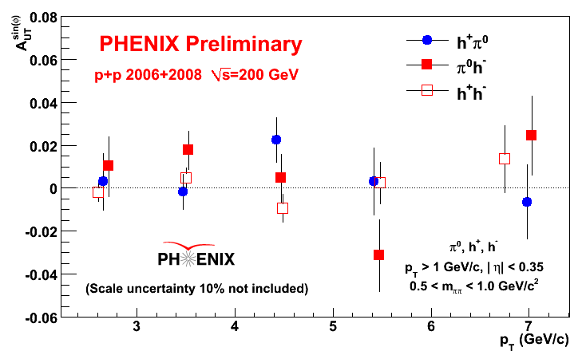
IFF @ RHIC
PHENIX data 2006/2008
A_{UT} ≈ 0
STAR sees significant A_{UT}
Analysis of 2012 is on-going

Slide 14
Sivers Asymmetries
Projected asymmetries with current setup / moderate upgrades in 500 pb⁻¹
Test scale dependence / evolution
Map out functional form / high-x
The RHIC Spin Program: Achievements and Future Opportunities (arXiv: 1304.0079)

Slide 15
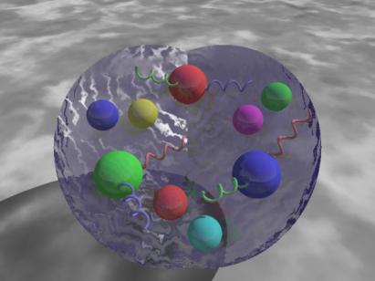
What to take home…
Non-vanishing transverse single spin asymmetries have been measured over a wide range of energies
  Previous A_{N} at mid- and forward rapidities being prepared for publication
Need to disentangle and quantify contributions from different effects
PHENIX has measured A_{N} in heavy flavor production
  Statistics of single μ still limited, 2012 data not included yet
  Previous A_{N}(J/ψ) have been published, consistent with 2012 data
Expect updated results of interference fragmentation functions soon
  Can extract transversity in combination with IFF from Belle
Future measurements of transverse asymmetries at
RHIC can provide essential input to our understanding
of (p)QCD

Slide 16
…

Slide 17
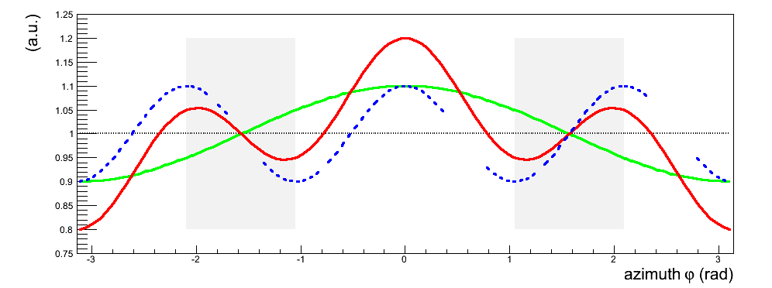
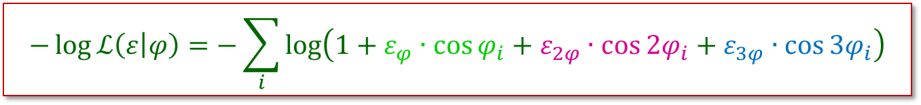
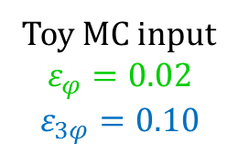
Higher Moments in Asymmetry
$$−\log{ℒ\left(ε | φ\right)}=−\sum_{i}{\log\left(1+ε_{φ}∙\cos{φ_{i}}+ε_{2φ}∙\cos{2φ_{i}}+ε_{3φ}∙\cos{{3φ}_{i}}\right)}$$
unpolarized
Toy MC input
$$ε_{φ}=0.02$$
$$ε_{3φ}=0.10$$
mle sqrt
cos(φ) moment
cos(3φ) moment
total asymmetry

Slide 18
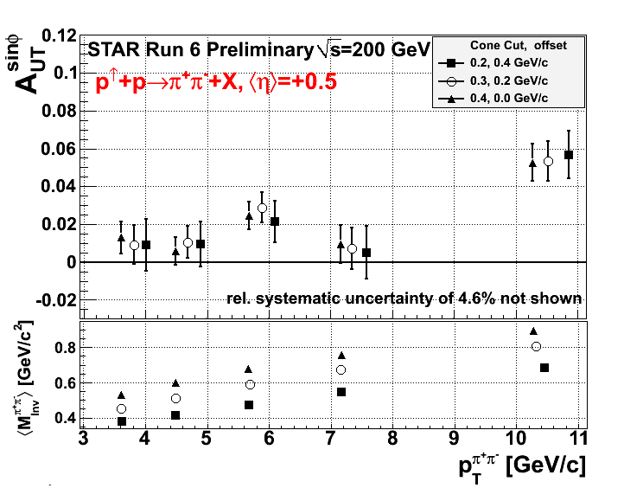
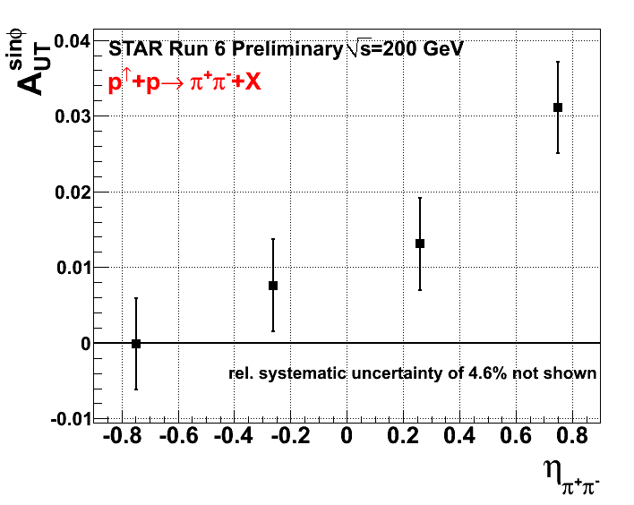
IFF @ STAR
Current PHENIX range/acceptance

