Slide 1
Status of Radiation Protection studies in support of ELENA
R. Froeschl and J. Vollaire
DGS-RP-AS

Slide 2
List of RP studies for ELENA / AD
Shielding of the ELENA ring
Construction of Building 193 extension (on top of TT2)
Shielding reinforcement in the ATP area
New chicane for AD ring access point (Installation of new access system on the PS complex in LS1)

Slide 3
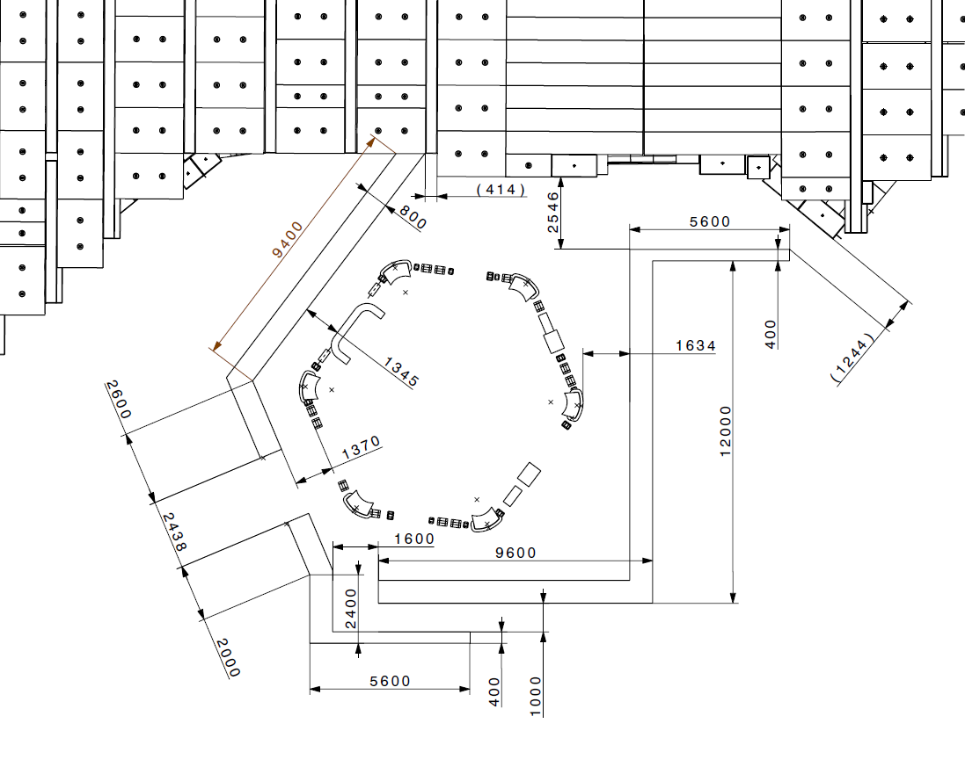
Shielding for ELENA ring (R. Froeschl)
Detailed layout of the ELENA shielding wall implemented in FLUKA
Thx to O. Choisnet for layout

Slide 4
Beam losses I
Considering beam losses at worst locations (close to walls or chicane openings)
3
2b
2a
closed
1

Slide 5
Beam losses II
Energy 5.3 MeV (injection)
Beam intensity
  Injected: 3E7 antiprotons/cycle
  Ejected: 1.6E7 antiprotons/cycle
Normal Loss
  1.4E7 protons/cycle
  1 cycle every 60s (now 100s)
Loss rate
  2.33E5 antiprotons/s (1.4E7/60s)
  47% of full loss rate

Slide 6
Loss point 1
Beam line level
Platform level

Slide 7
Loss point 1 – Side view

Slide 8
Loss point 2a (smallest distance 2b)
Beam line level
Platform level

Slide 9
Loss point 2a (smallest distance 2b) Side view

Slide 10
Loss point 3
Beam line level
Platform level

Slide 11
Preliminary conclusions ELENA shielding
Shielding thickness compatible with AD hall classification
Location of the platform (visitors) to be properly chosen to ensure minimum exposure (it has to be moved away from the shielding enclosure)
Concrete blocks implementation must ensure 80 cm of shielding (connection of slanted walls….)

Slide 12
Building Extension on top of TT2
Similar strategy than for the new barracks (Build. 93)
6 m of earth vertically from TT2
Trench along Build. 193 to be covered with 80 cm of concrete (included in Building design)
Radiation monitor will be installed inside the building extension (included in monitoring budget)
Excavation and work in trench to be conducted in LS1 (no beam in TT2)
Possible PSNF would be 23 m away
Official RP approval to be communicated by memo very shortly

Slide 13
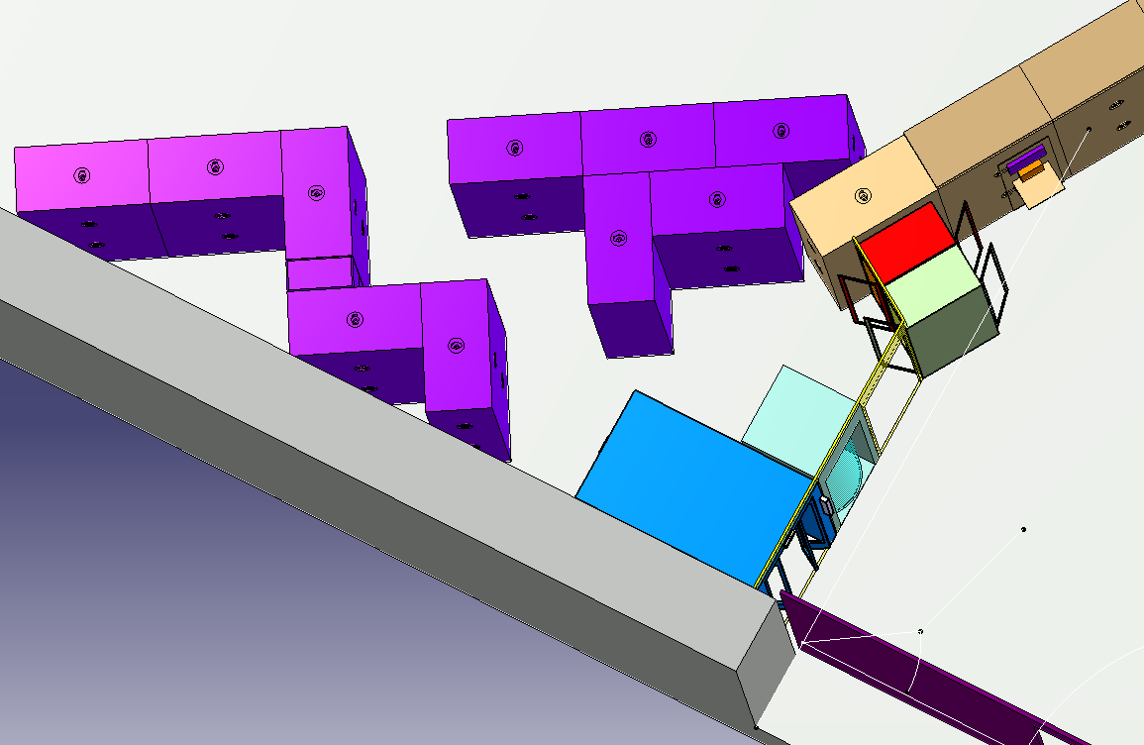
Chicane for the AD access point
Part of the integration studies for the PS Access System Renovation project (installation of PAD/MAD)
Current access point allows direct line of sight with the beam line, opportunity to improve the situation….
Latest proposal does not provide a sufficient shielding overlap….

Slide 14
Shielding improvement the ATP area
Door D321 bis to be relocated and shielded to be added
Existing FLUKA geometry of TT2/ATP does not include details of the area
Layout of the area needed to update the FLUKA model and identify additional shielding requirements (scan performed lately)

