Slide 1
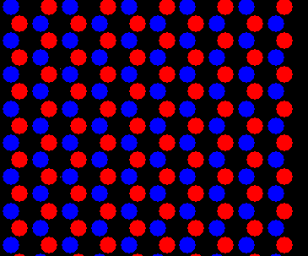
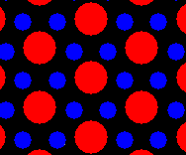
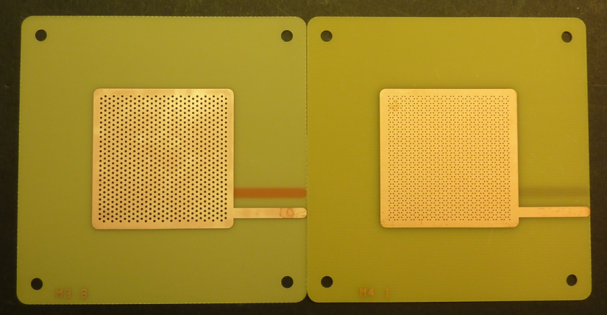
IBF in aligned, misaligned and FLOWER THGEMs
Fulvio Tessarotto
( I.N.F.N. – Trieste )
The IBF problem
Standard THGEM configuration
COBRA and extra electrode
Misaligned holes
FLOWER THGEM solution
THGEM + Micromega
Conclusions

Slide 2
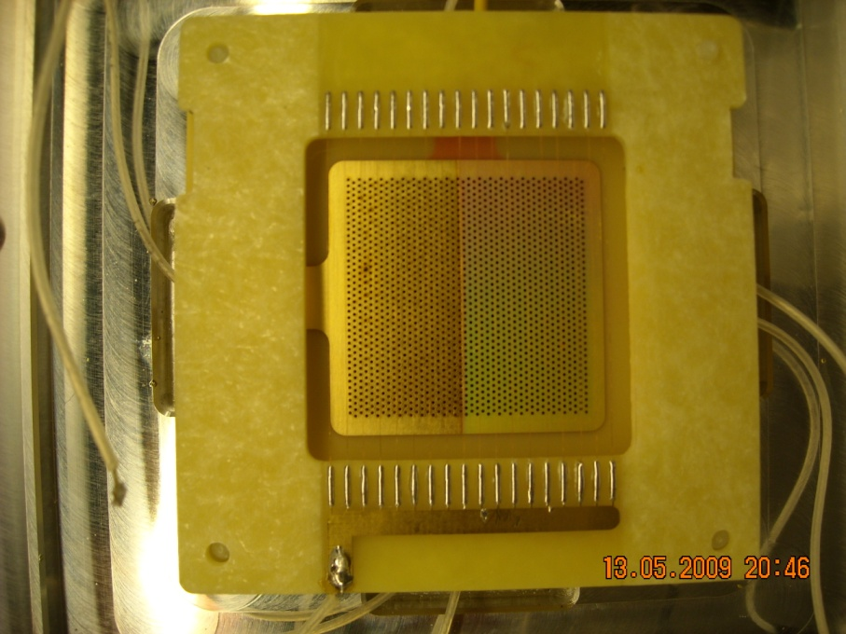
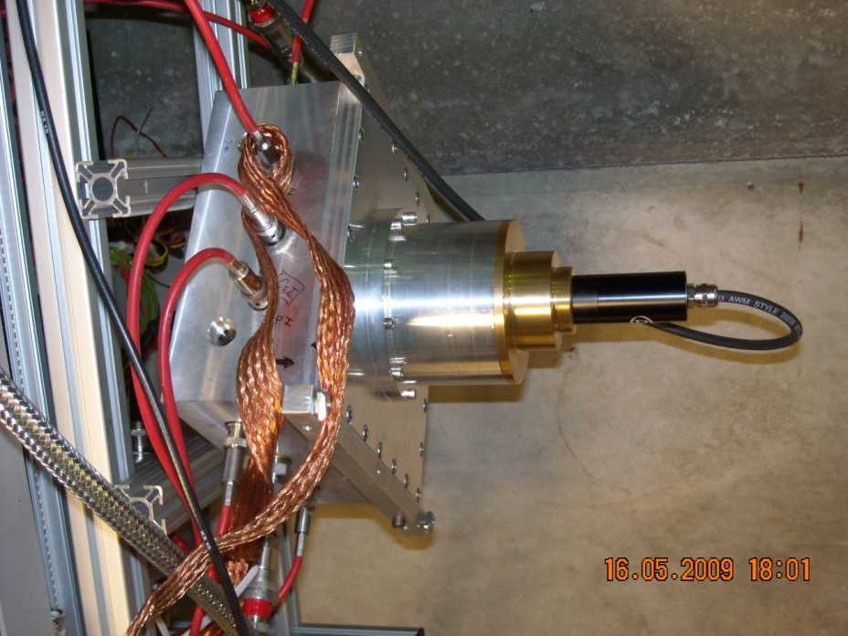
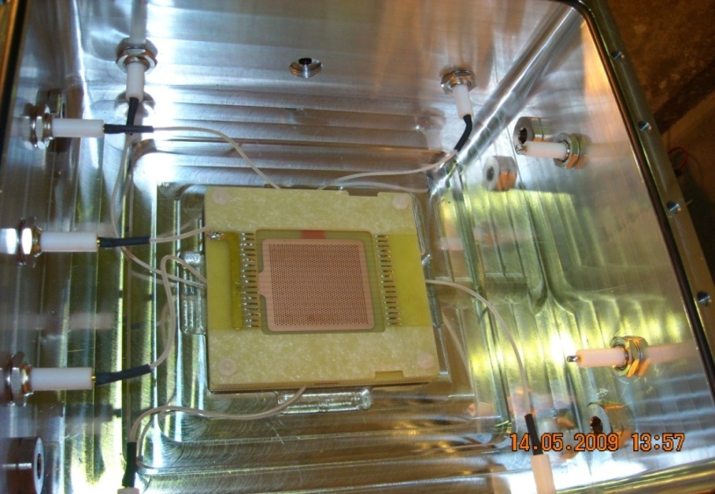
OUR FIRST THGEM-BASED PDs
Triple THGEM (CsI) Ar/CH₄
Pulsed Diode Laser
Active area = 30 mm x 30 mm
CsI coating
Diam=0.4 mm, pitch =0.8,
Thick=0.4, rim ≤10 μm

Slide 3
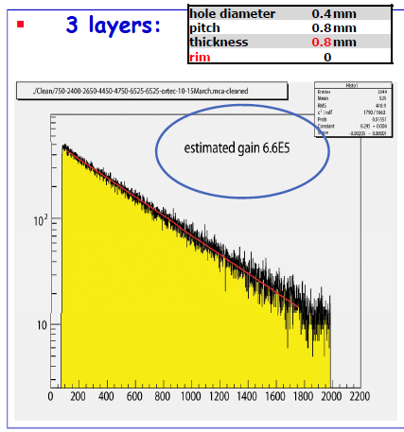
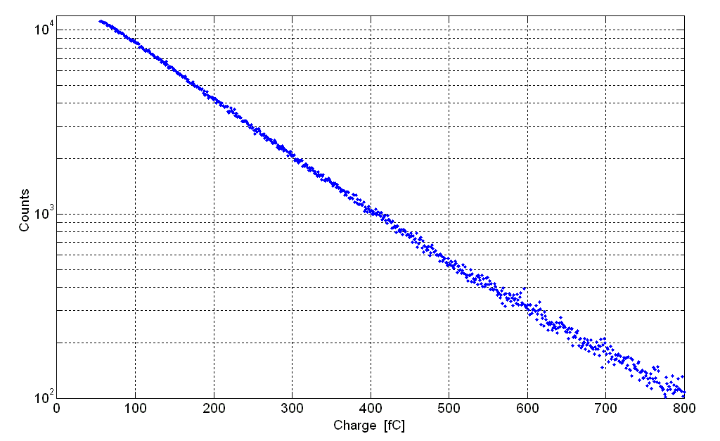
Gain around 1 M
Triple THGEM
Effective gain = 0.91 · 10⁶
Ar/CH₄: 50/50
PARAMETERS:
Diam. = 0.4 mm
Pitch = 0.8 mm
Thickn. = 0.4 mm
Rim = 10 μm

Slide 4
typical charge sharing, no optimization
drift
0%
Drift
26%
THGEM 1
1%
Transfer 1
5%
Transfer 1
THGEM 2
4%
Transfer 2
Transfer 2
68%
THGEM 3
49%
Induction
Induction
47%
anode
field values optimization could reduce IBF by a factor 2 at most

Slide 5
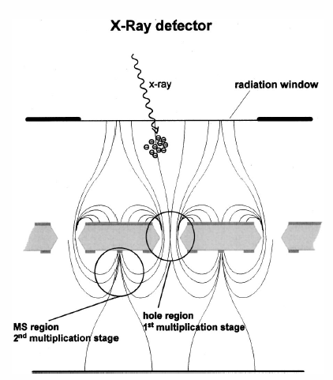
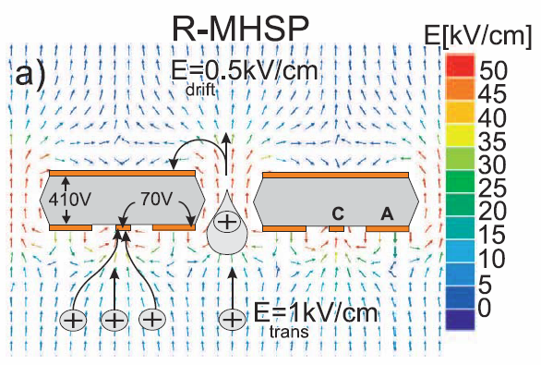
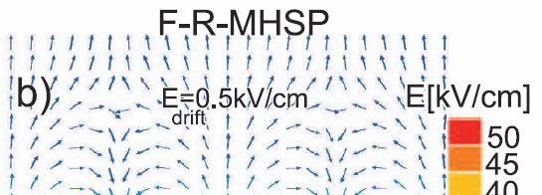
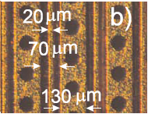
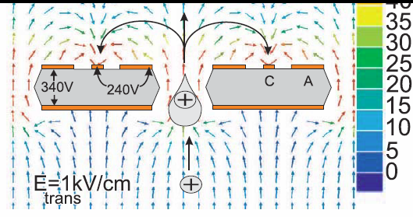
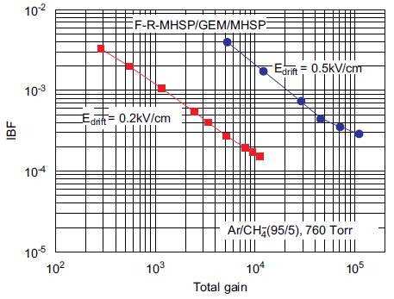
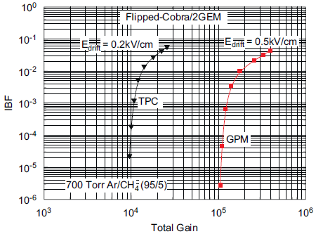
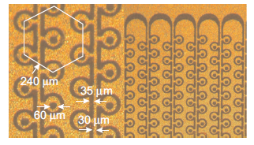
Reducing the ion backflow is possible
with more complex geometries: Micro-Hole & Strip Plate (MHSP), COBRA
MHSP
J.F.C.A. Veloso et al.,
Rev.Sc. Instr. 71 (2000) 2371
A.V. Lyashenko et al., JINST 2 (2007) P08004
COBRA
A.V. Lyashenko et al., NIMA 598 (2009) 116
A.V. Lyashenko et al., NIMA 598 (2009) 116

Slide 6
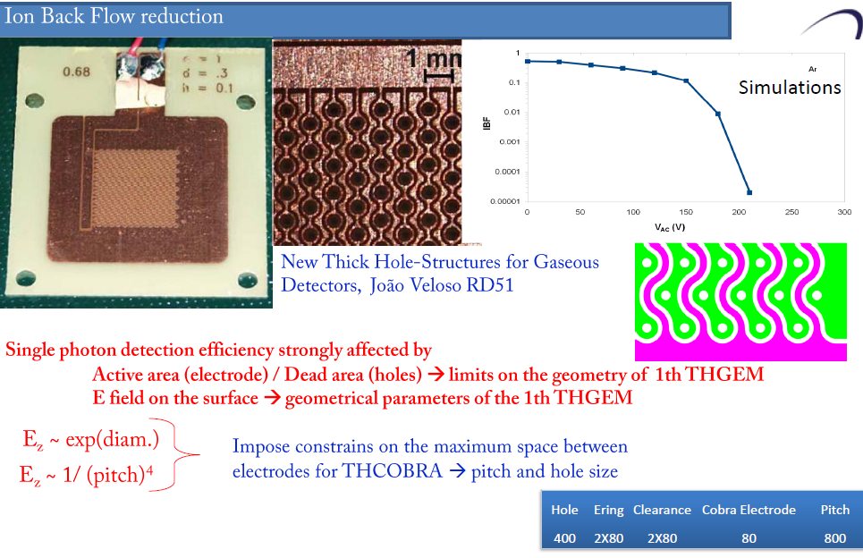
The COBRA way
Loosing robustness and constraining too much the geometry

Slide 7
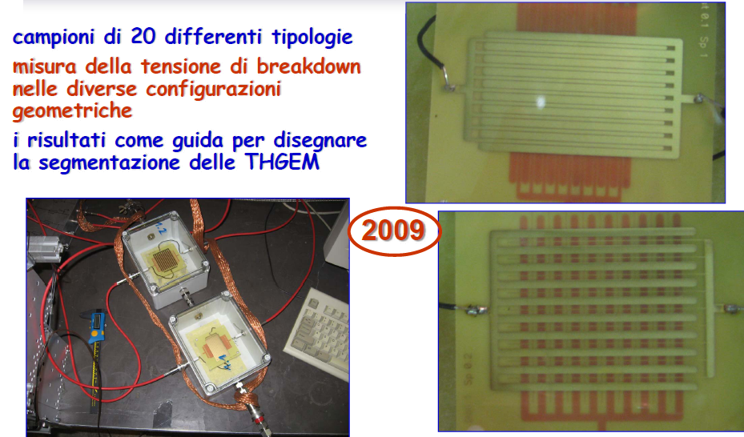
Sparks may damage tiny pists
Samples of 20 different types
Determine the breakdown voltage
Use this information to properly design the THGEM segmentation
spark

Slide 8
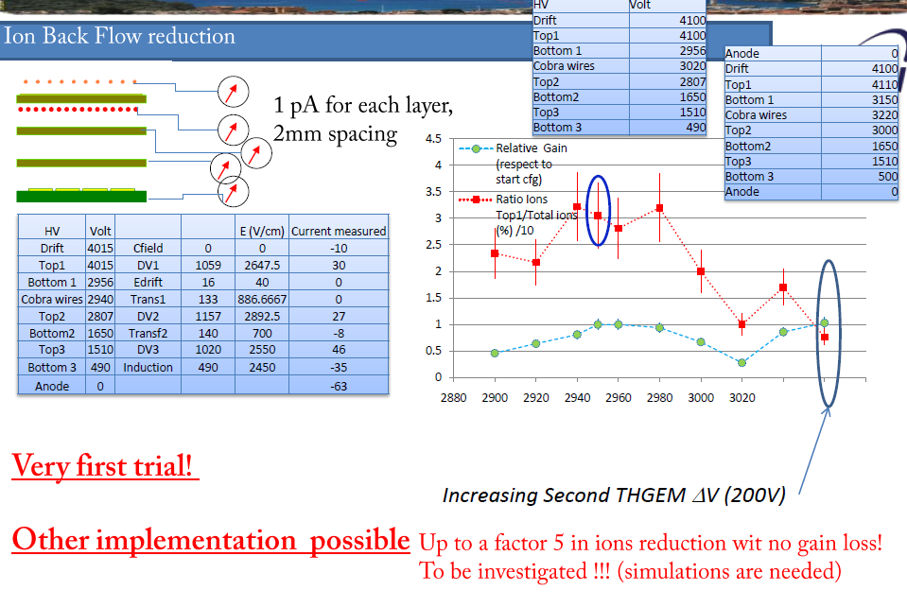
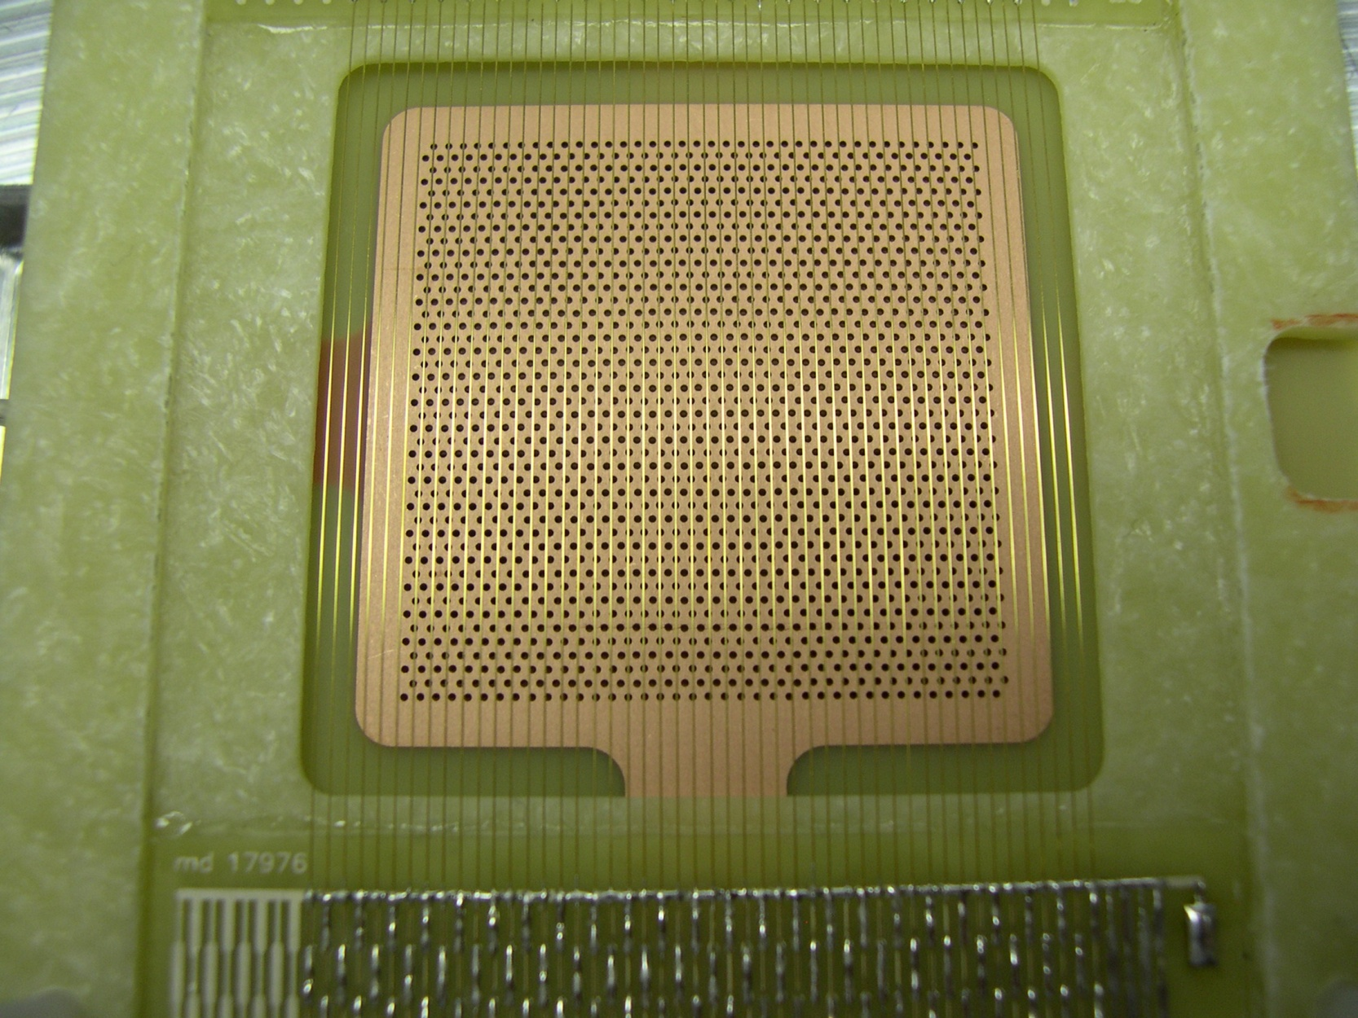
Inserting a dedicated electrode
Reduces by a factor 4 the ion feed-back without gain losses

Slide 9
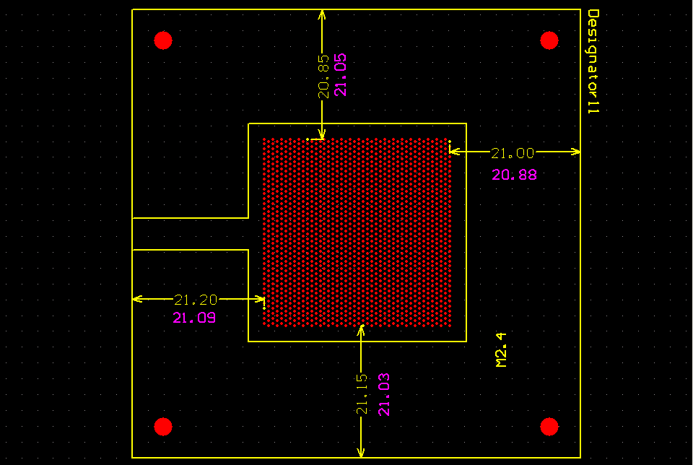
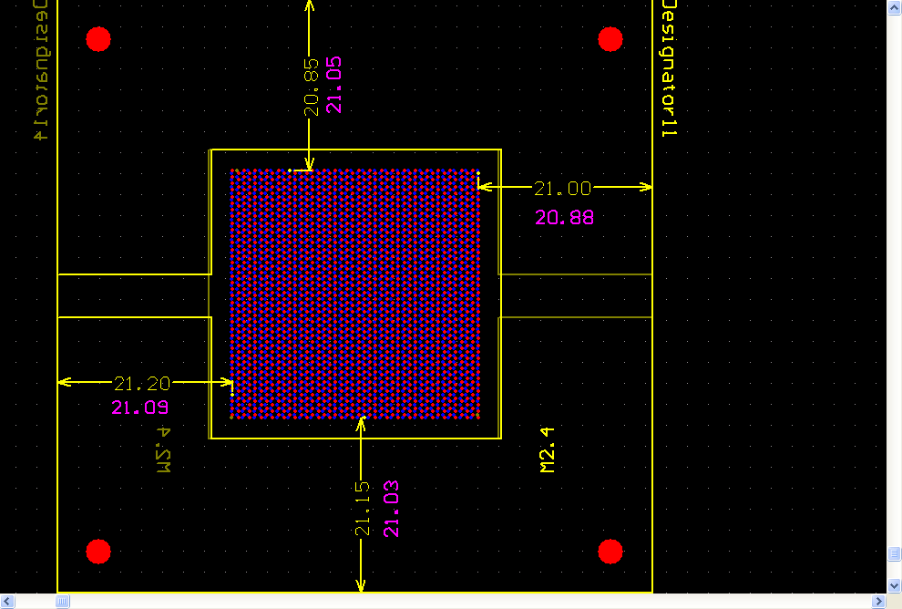
Hole alignment
Inspired by the study of F. Sauli, L. Ropelewski, P. Everaerts on GEM IBF:
NIM A 260 (2006) 269, we decided to study the effect of THGEM hole alignment on IBF.
we produced (ELTOS) THGEMs with a special symmetry:
the holes of the flipped THGEM are displaced by p·√3/3
with respect to the holes before flipping

Slide 10
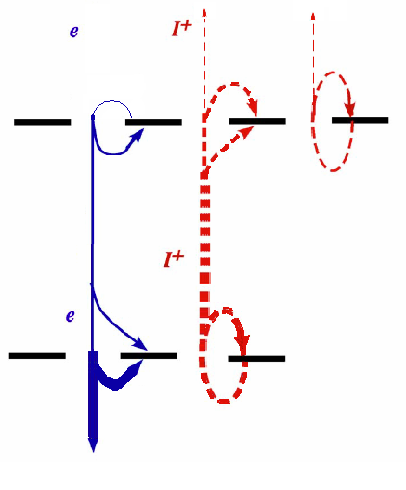
IBF of Aligned DoubleTHGEM
a case study:
low gain on
the first
THGEM,
high gain on
the second
THGEM
T1 IBF = 32 %
D
0 kV/cm
0
0%
1398
32.3%
78
T1
1.7%
B1
221
5.1%
0
-38
0%
0.87%
1.2kV/cm
2588
-34
59.7%
T2
0.78%
B2
-2709
62.5%
0
0%
1.2kV/cm
-1553
A
35.8%

Slide 11
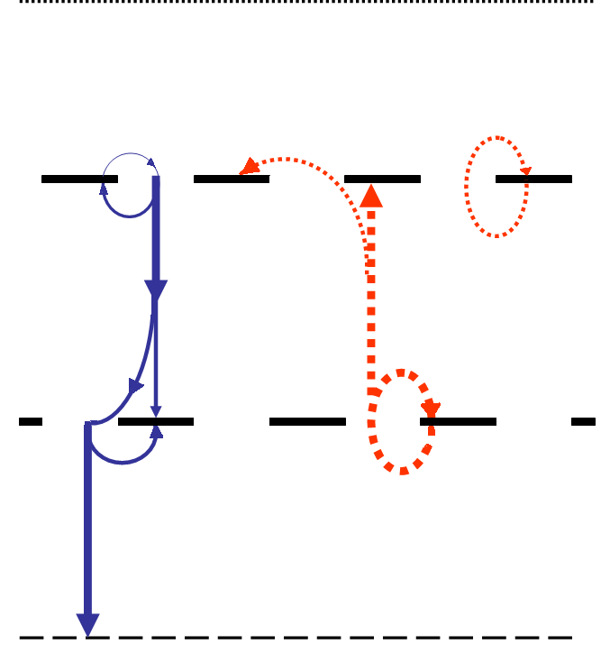
IBF of Misaligned DTHGEM
Staggered holes provide lower IBF
for 1.2 kV/cm
T1 IBF = 14 %
0 kV/cm
0%
14.2%
~0%
~0%
9.8%
0%
1.2kV/cm
~0%
76.2%
77.3%
0%
1.2kV/cm
22.7%

Slide 12
IBF of Misaligned DTHGEM study
Doubling the transfer field, the ions will hit B1 instead of drifting to T1.
for 2.4 kV/cm
T1 IBF = 3 %
0 kV/cm
0%
3.1%
~0%
~0%
27.5%
0%
2.4kV/cm
~0%
68.5%
79.2%
0%
1.2kV/cm
20.7%

Slide 13
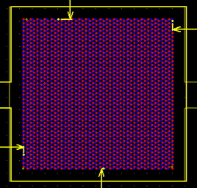
Triple THGEM configuration
D
7.6 mm
1
700 V
2.5 mm
2
1575 V
2.5 mm
3
1575 V
2.0 mm
400 V
A
Flipping the central THGEM provides the maximally misaligned configuration
Flipping the central M2.4 provides the maximally misaligned configuration
tests performed in aligned and misaligned configuration
all parameters have been varied, all currents + signal amplitudes measured

Slide 14
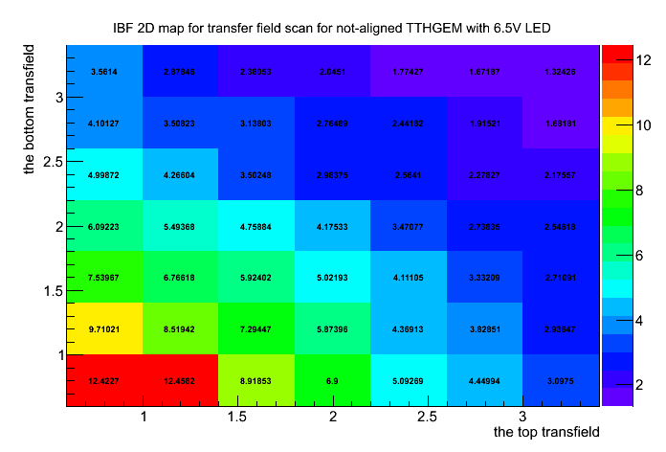
IBF for misaligned THGEMs
Numbers are IBF%

Slide 15
“FLOWER” THGEM
10.6mm
M3.9
2.5
M4.1
2.5
M3.9: T=0.4mm,R=0.6mm,P=1.2mm
M4.1: T=0.8mm,R=0.3mm,P=0.6mm
Drift dis. 10.6mm
Transfer dis. 2.5mm
Induction dis. 2.5mm

Slide 16
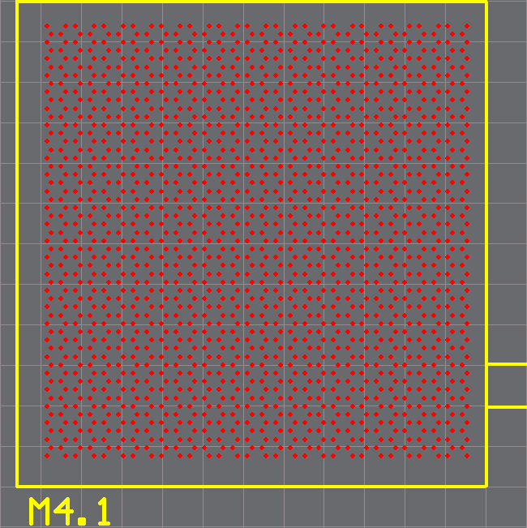
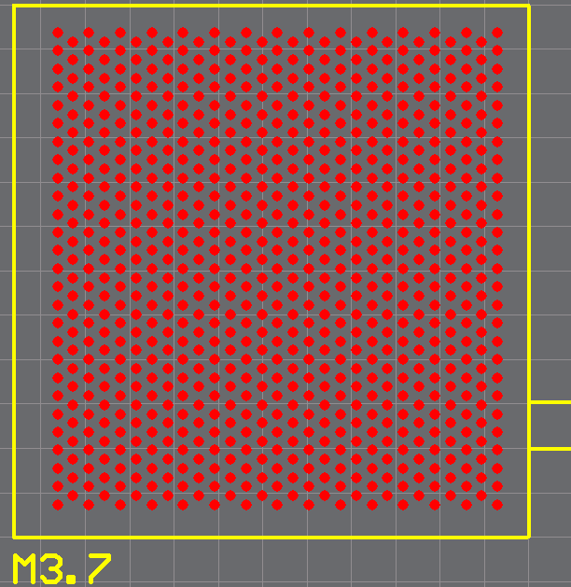
FLOWER” THGEM
4. Check the IBF effect using M4.1 / M3.7 configuration.

Slide 17
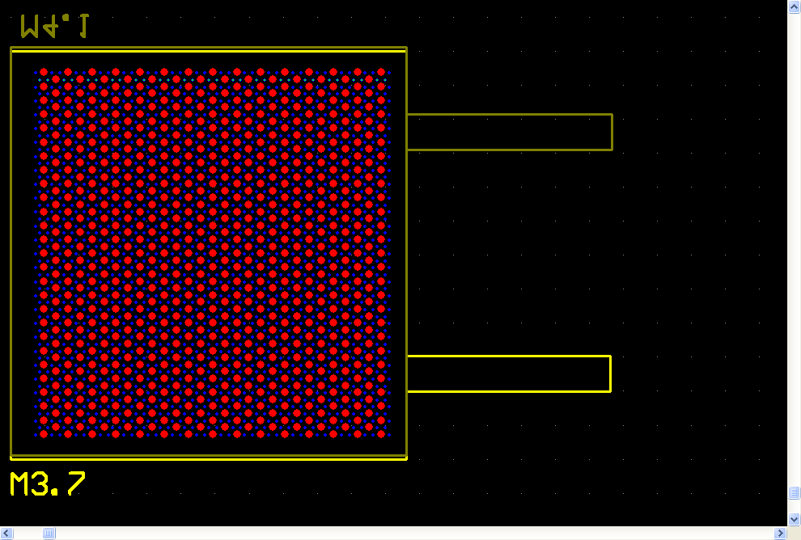
“FLOWER” THGEM

Slide 18
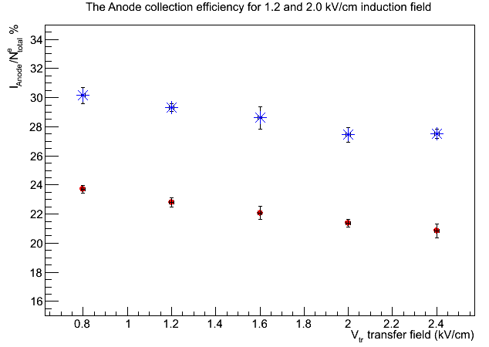
Anodic current (A/Tot)
1.2 kV/cm induction field
2.0 kV/cm induction field
I anode / I total (%)
Anode current is almost not affected by the transfer field value

Slide 19
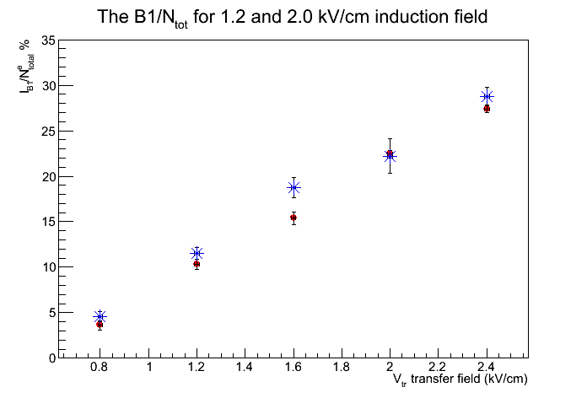
The ions collected at B1 (B1/Tot)
1.2 kV/cm induction field
2.0 kV/cm induction field
I bottom1 / I total (%)
More ions are collected at B1 when transfer field increases

Slide 20
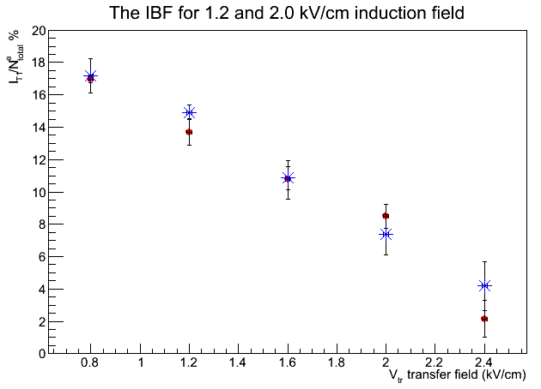
IBF measurement (T1/Tot)
1.2 kV/cm induction field
2.0 kV/cm induction field
I top1 / I total (%)
The IBF decreases dramatically when the transfer field increases.

Slide 21
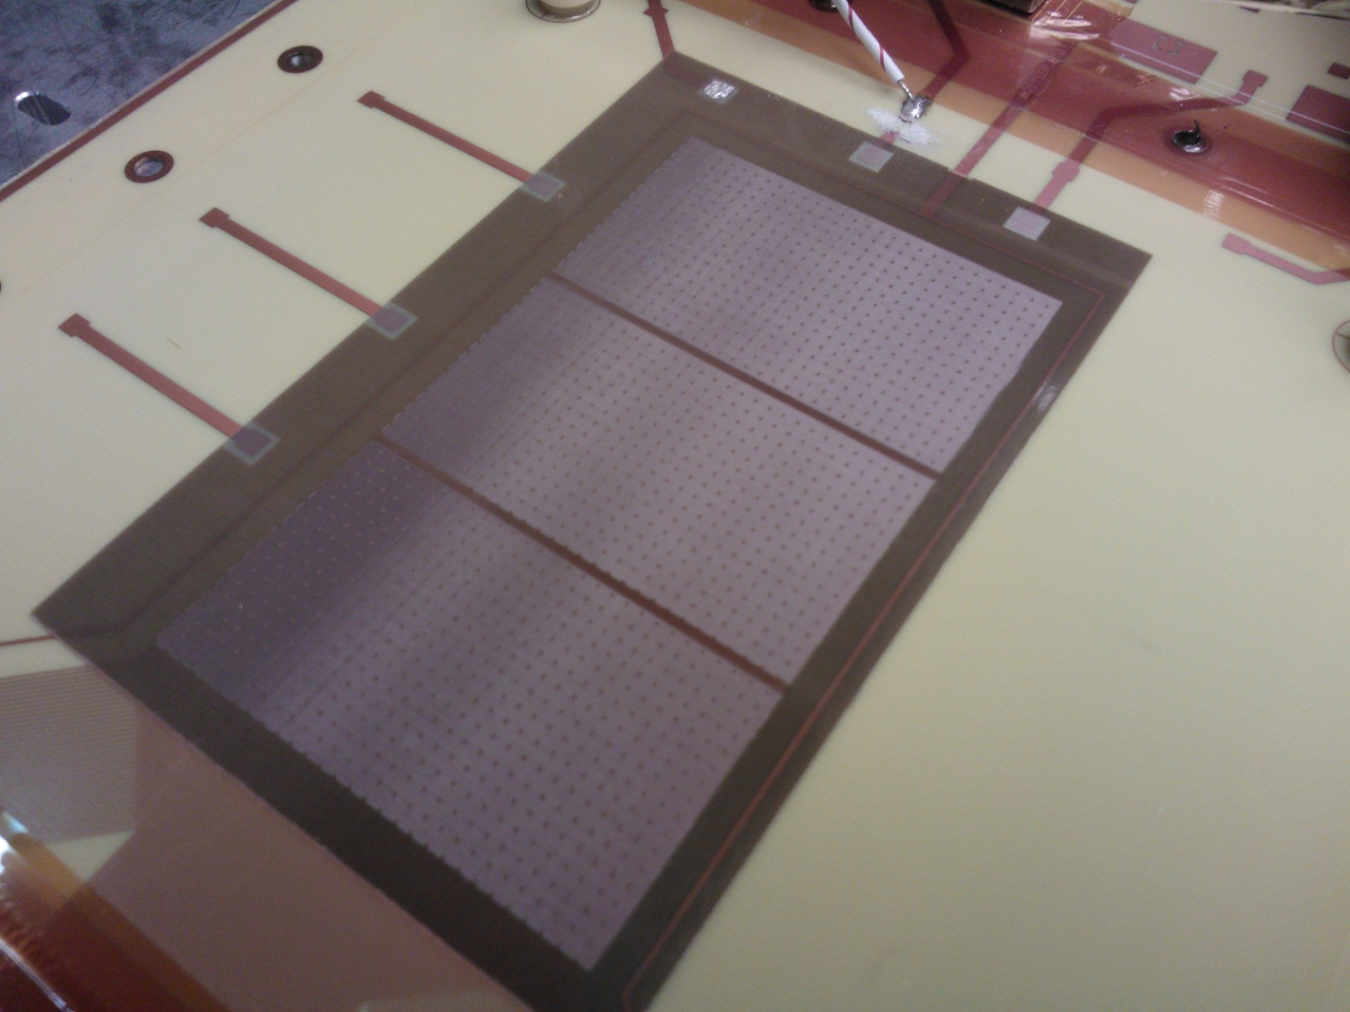
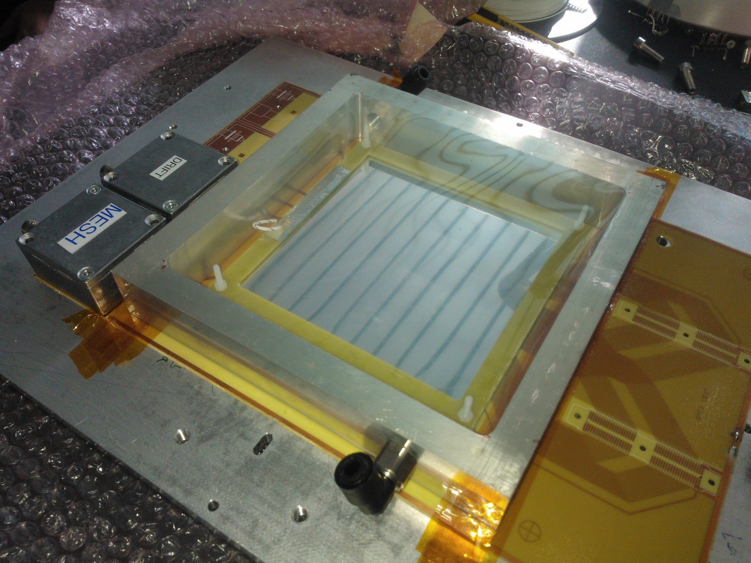
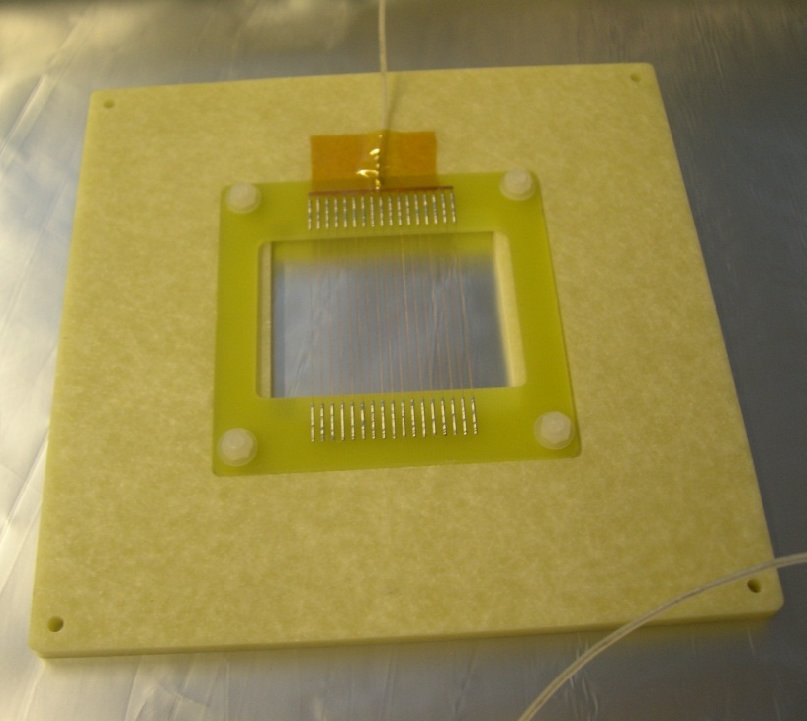
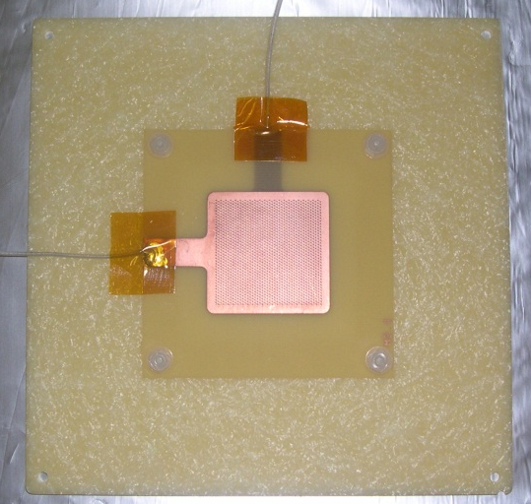
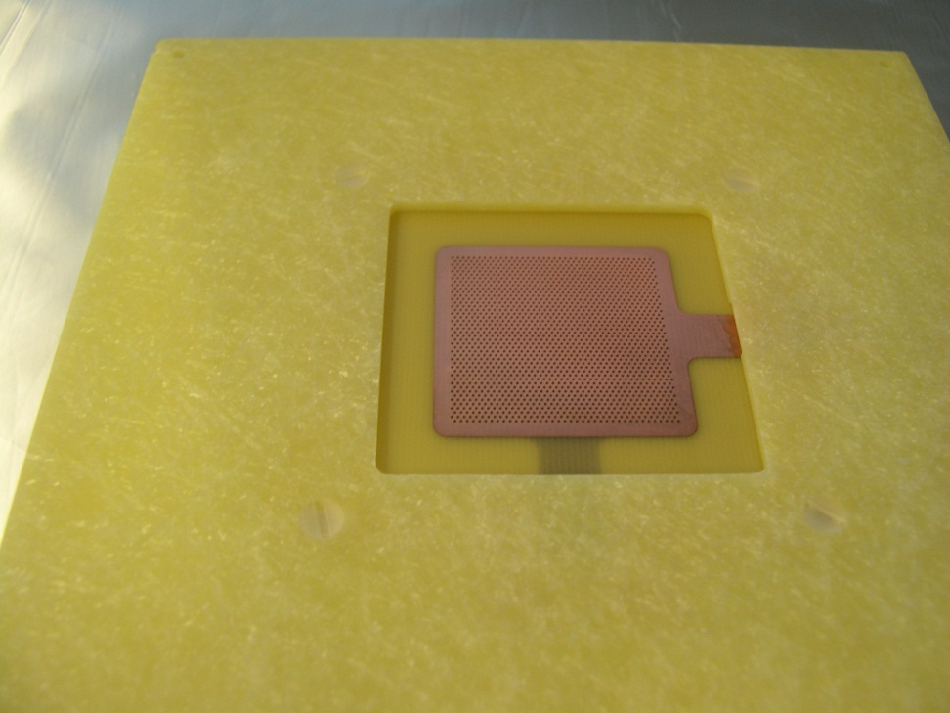
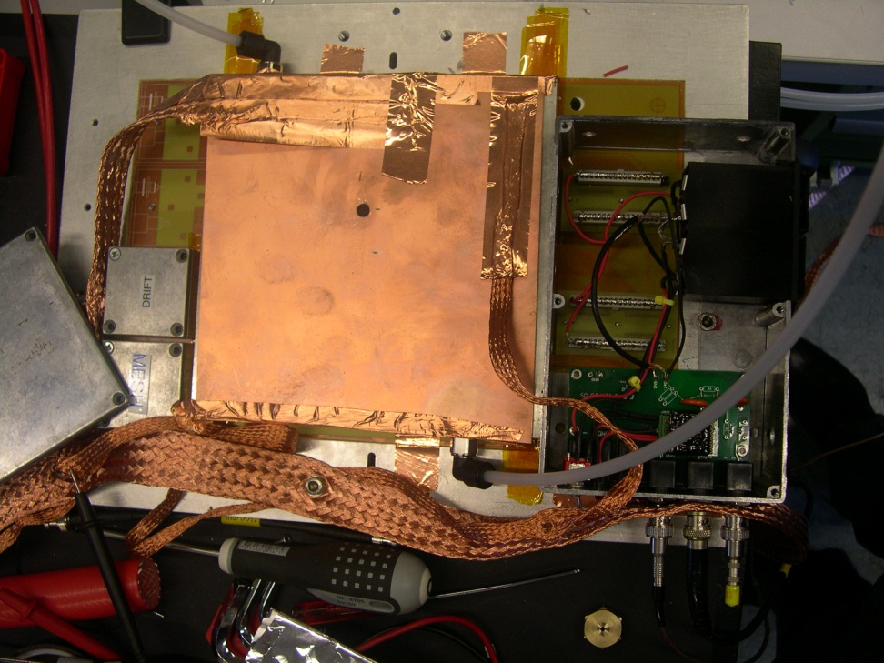
Courtesy of COMPASS CEA-Saclay colleagues:
(many thanks to Damien Neyret)
we could mount one THGEM on top of their Micromega
Saclay
bulk μΩ
Drift wires
THGEM

Slide 22
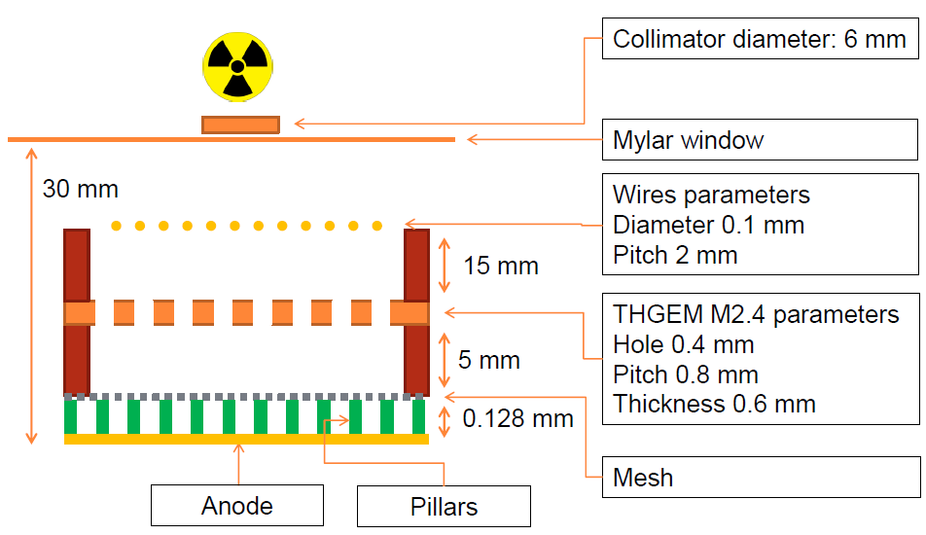
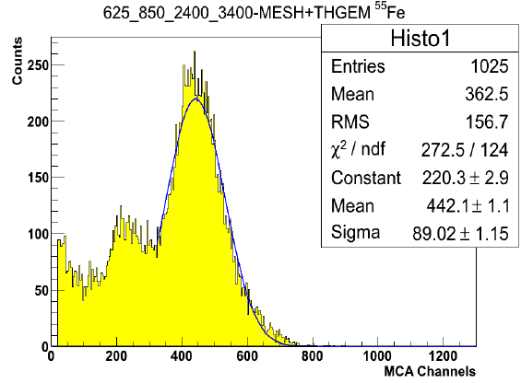
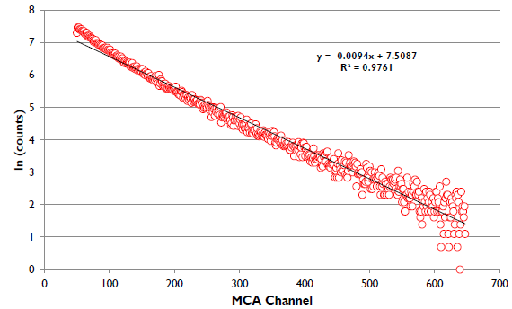
IBF: Very promising preliminary results from
hybrid detector: THGEM + Micromega
⁵⁵Fe source, G ~ 250000
UV light
amplitude
spectrum
gas: Ar/CO2 70/30, source: 55Fe or UV LED (245 nm)
r/o Cremat CR100 + spark protection
Signal amplified (ORTEC) and read by MCA
Electrode: | drift | THGEM top | THGEM bottom | mesh | anode
charge: | 0 % | 4 % | 0% | 96% | -100%
G ~ 10⁶

Slide 23
SUMMARY OF THGEM IBF STUDY
IBF reduction is of utmost importance for large gain, large rate THGEM – based PDs operation
Field optimization in standard geometry allows to go from 30% to 15%
Complex geometries (“COBRA” like) are very effective but compromise the basic simplicity, robustness, low cost characteristics
Adding a dedicated electrode for ion intercept provides IBF ~ 7% but adds engineering complications
Misaligned holes configurations (staggered holes or “FLOWER”) may reduce IBF by one order of magnitude
Very promising results from THGEM + Micromega structure : IBF ~ 4%

