Slide 1
Measurement of the noise of irradiated sensors
CMS Preshower
D. Barney, A. Honma, A. Peisert,
Y-M. (Jacky) Tzeng
Preshower sensors
Noise of non-irradiated sensors
Noise of irradiated sensors
Model
Radiation field
Conclusions

Slide 2
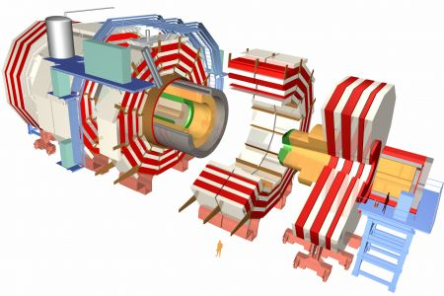
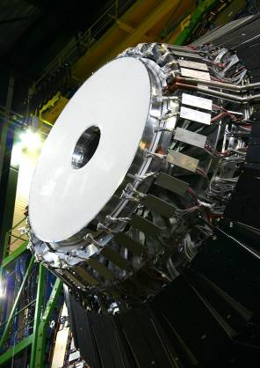
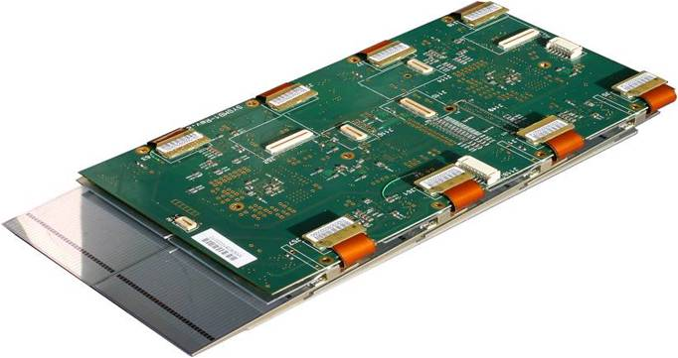
The CMS Preshower: part of the end cap el. calorimeter
Preshower + ECAL
2 layers of lead absorbers
each followed by Si sensors
and digital electronics
Z = ± 304, ± 309 cm
45 cm < R <121 cm
Si sensors, p-on-n , DC coupled, 63×63×0.32 mm³
32 strips 1.8 mm wide at a pitch of 1.9 mm
4288 total, 1072/absorber
Sensors mounted on Al tiles and
assembled into “ladders” of 6 to 10 tiles
Load capacitance dominated by the back plane:
C_{backplane} ~ 40 pF
C_{int} ~ 6 pF
ladder
digital electronics

Slide 3
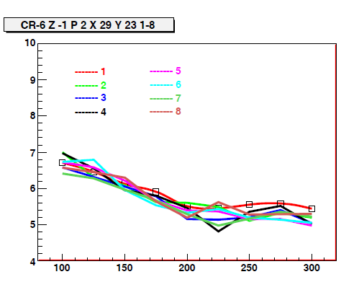
Noise of non-irradiated sensors
Noise ~ C_{detector} ~ 1/√V
Can be used to:
Verify that the sensor is biased
Estimate the full depletion voltage
Single strips noise vs. voltage
V_{noise} – V_{capa} (V)

Slide 4
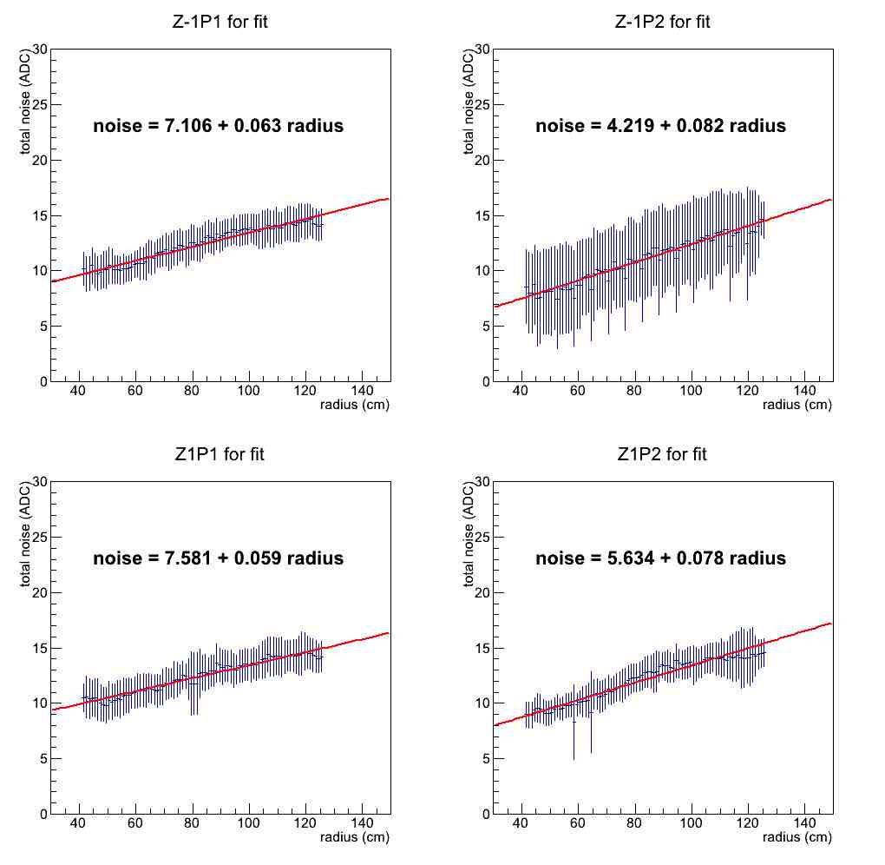
Noise vs. radius at 5.86 fb⁻¹, no bias voltage
Average noise
of fully depleted
sensors

Slide 5
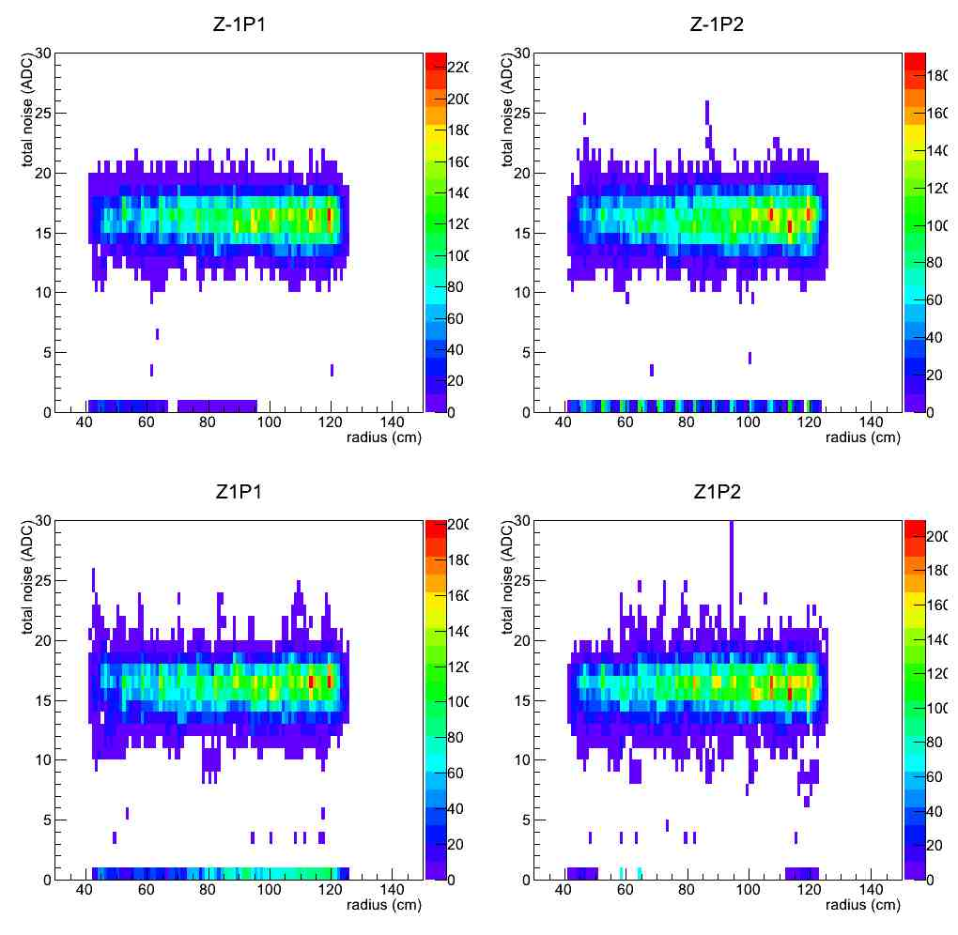
Noise vs. radius, no bias voltage
5.86 fb⁻¹, March 2012
0.066 fb⁻¹, April 2011

Slide 6
Model
Developed by Zheng Li and H.W. Kraner* (1990):
“Studies of Frequency Dependent C-V Characteristics of Neutron Irradiated
P⁺-n Silicon Detectors”
Observed that for φ ≥ 10¹² n/cm² the junction capacitance assumes the value of the detector geometry capacitance at f > 10⁵ Hz, independent of voltage
Frequency dependence of the deviation of the C-V characteristics is strongly dependent on the ratio of the defect density, N_{t}, to the effective doping concentration, N_{d}
Developed a two-trap-level model which predicts this effect as N_{t}/ N_{d} → 1
Fluence vs. distance from beam at 5.85 fb-1
* http://ieeexplore.ieee.org/ielx4/531/3487/00693473.pdf?tp=&arnumber=693473&isnumber=3487&tag=1

Slide 7
Conclusion
Preshower sensors capacitance dominated by the backplane capacitance
Independent of bias voltage at frequencies ~ 10⁵ Hz after irradiation to φ ≥ 10¹² n/cm²
Noise, measured at 40 MHz, can not be used to evaluate the full depletion
V_{fd} can only be measured from the signal

