Slide 1
ARDENT
Advanced Radiation Dosimetry European Network Training initiative
WP1: Gas Detectors
S. Rollet

Slide 2
WP1: Gas Detectors
Content
  Short overview and present status
  Next steps
  Topics for discussions

Slide 3
WP1: Gas Detectors
Collaboration between
  AIT – Austrian Institute of Technology, Austria (Sofia Rollet)
  CERN – Switzerland (Marco Silari)
  POLIMI – Politecnico of Milano, Italy (Marco Caresana)
  UOIT - University of Ontario Institute of Technology, Canada (Tony Waker)

Slide 4
WP1: Gas Detectors
Objectives
Development and performance test of instrumentation based on gas detectors for measuring energy distributions and dosimetric quantities in complex radiation fields and in monoenergetic particle beams used in cancer therapy.
e.g.:
gas electron multipliers (GEM),
tissue equivalent proportional counters (TEPC)

Slide 5
WP1: Gas Detectors
Milestones
M5 Comparison of Detectors technologies (AIT, month 18)
WP1/WP2
M6 Choice of detector technologies (CERN, month 18)

Slide 6
schedule

Slide 7
WP1: Gas Detectors
Next steps
4(5) Early Stage Researchers (ESR) to be recruited
  2 at CERN, Switzerland (ESR3)
  1 at AIT, Austria (ESR5)
  1(2) at the POLIMI, Italy (ESR13 and ESR15)
  Up to 1/3 of time can be spent on secondments
  Work performed within the project to be used for PhD

Slide 8
WP1: Gas Detectors
Discussions
Consider other detectors for comparison:
  CR39/PADC and Medipix?
He-3 and BF₃ for pulsed fields
Are there GEM already available ?
Development of (common) miniaturised electronics?
Secondements

Slide 9
Following slides to be used if necessary for discussion

Slide 10
WP1: Gas Detectors
Aim:
disentangle the various components of the radiation field and determine the dosimetric quantities due to each component
measure the radiation quality of the radiation field
obtain information on the energy distribution of the various components of the radiation field

Slide 11
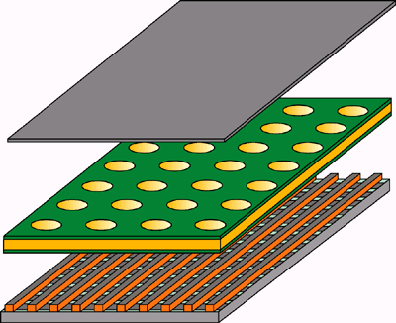
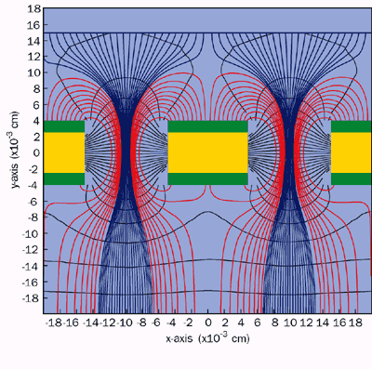
WP1: Gas Detectors
GEM
A thin sheet of plastic coated with metal on both sides and chemically pierced by a regular array of holes a fraction of a millimetre across and apart. Applying a voltage (about 500 V on 50 microns) across the GEM conducting layers, the resulting high electric field in the holes makes an avalanche of ions and electrons pour through each. The electrons are collected by a suitable device, such as a microstrip gas chamber.

Slide 12
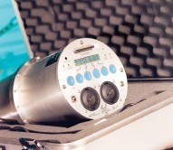
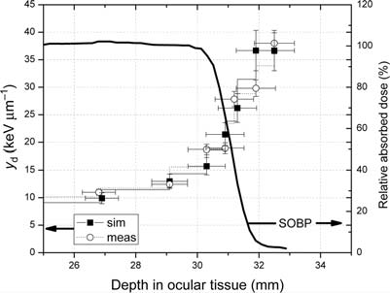
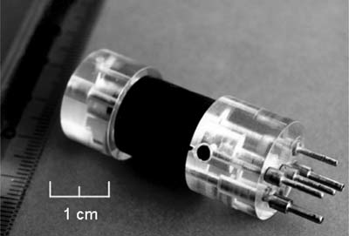
WP1: Gas Detectors
TEPC
Capability to distinguish between various components of the radiation field
→ Space applications, air crew dosimetry or
ambient dose equivalent around high energy proton accelerators or measurements of therapeutic
beam quality

Slide 13
WP1: ESR1 (CERN)
Mainly on neutron detection
The work focuses on the development of a detector sensitive to neutrons over an extended energy range, to be operated as neutron spectrometer. The basic concept is to couple one or more detectors (a GEM, one or more Medipix2 or Timepix, or a stack of scintillator detectors) to a (n,p) converter, and couple them with an ad-hoc moderator of appropriate thickness and composition. You will work on the design of the device via Monte Carlo simulations, and on the development and test of the prototype. The instrument should find applications at intermediate- and high-energy accelerators, as well as for measurements of cosmic radiation on board aircrafts and in space. The possibility of its use in mixed or pulsed radiation fields is of particular interest. You will work in collaboration with some of the ARDENT partners, in particular POLIMI (Politecnico di Milano) and CTU (Czech Technical University in Prague), and you will spend a fraction of your time on secondments.

Slide 14
WP1: ESR3 (CERN)
Mainly on radiation dosimetry and microdosimetry
The work focuses on the application of technologies based on gas detectors (Gas Electron Multiplier, GEM and Tissue Equivalent Proportional Counter, TEPC) for dosimetry and microdosimetry in mixed radiation fields at particle accelerators, in space and in the environment. The project will first require extensive Monte Carlo simulation to study the detector response. The feasibility to employ a GEM detector as x-y plane detector to monitor a clinical scanned ion beam will also be studied. You will work in collaboration with some of the ARDENT partners, in particular POLIMI (Politecnico of Milano), AIT (Austrian Institute of Technology) and UOIT (University of Ontario Institute of Technology), and you will spend a fraction of your time on secondments.

Slide 15
WP1: ESR5 (AIT)
Mainly on TEPC for space and medical application
The researcher will work on dosimetry of complex radiation fields present in space and in hadron therapy. The work focuses on the characterization and calibration of a TEPC currently being developed to determine the absorbed dose and dose equivalent on board of the International Space Station (ISS). Measurements in heavy ion radiation field in different laboratories are planned. Later on, the study of a miniaturized version of a TEPC for hadron therapy will be carried out testing the prototype. The detector characterisation in medical environment with measurements in tissue will be optimized via Monte Carlo simulations. The work is in collaboration with external and, as well, with some of the other ARDENT partners.

Slide 16
WP1: ESR13 (MI.AM-POLIMI)
Mainly on neutron dosimetry and spectrometry with track detectors (mainly PADC).
The researcher will work on the design of the instruments embedding the track detectors via Monte Carlo simulations and via analytical codes. You will also work on the track detector reader, studying innovative algorithms of image analysis of the tracks. As for the personal dosimetry the basic concept is to develop techniques of absolute dose measurement. As for the area dosimetry you will characterize existing prototypes The instruments can find their natural application for neutrons measurement around particle accelerators as well as for measurements of cosmic radiation on board aircrafts and in space. A great attention will be devoted to the characterization of the instrumentation through experimental campaigns at particle accelerator facilities. You will work in collaboration with some of the ARDENT partners, in particular POLIMI (Politecnico di Milano), CERN and AIT (Austrian Institute of Technology).

Slide 17
WP1: ESR15 (POLIMI)
Mainly on neutron detection
The work focuses on the development of a detector sensitive to neutrons in pulsed fields. The basic concept is to develop instrumentations to be used in mixed radiation fields, characterized by a complex time structure. You will investigate both passive and active detectors. As for the active ones you will work with gas detectors (He-3 and BF₃) and/or solid state detectors, coupled with an innovative front end electronic. As for the passive ones you will work in close partnership with the Mi.am’s ESR. The instruments will find their natural application in neutron measurement around particle accelerators. You will work on the design via Monte Carlo simulations. A great attention will be devoted to the characterization of the instrumentation through experimental campaigns at particle accelerator facilities. You will work in collaboration with some of the ARDENT partners, in particular Mi.am and CERN.

