Slide 1
FINANCIAL MANAGEMENT
AND BUDGET
Grégory CAVALLO
CERN – EU Projects Financial Management

Slide 2
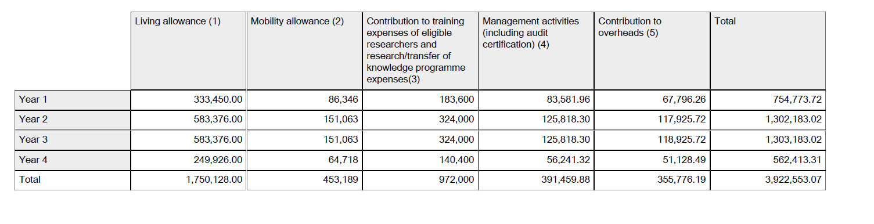
Cost Categories
GPF budget
ARDENT Kick-off meeting – 08.05.2012

Slide 3
Cost Categories
The EC contribution is distributed in 5 categories of costs:
  Living allowance
  Mobility allowance
  Contribution to training expenses of the eligible researchers and research/transfer of knowledge programme expenses
  Management activities
  Contribution to overheads
Major changes in 2011 Work Programme (formerly 2 groups of expenses divided into 7 categories)
ARDENT Kick-off meeting – 08.05.2012

Slide 4
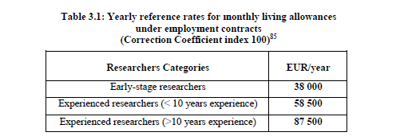
Monthly living and Mobility allowance
Monthly living allowance (col. 1)
Monthly mobility allowance (col. 2)
  700 € / month or 1000 € for researchers with family
  Average used on official budget: 820 €
Paid directly to the researchers (gross salary)
Determined at recruitment date – will not change during the contract
Apply correction factor on both monthly living and mobility allowance (See work programme 2011)
Minimum value (mandatory): must pay at least these amounts !
ARDENT Kick-off meeting – 08.05.2012
Notes:
WP may change

Slide 5
  Contribution to training expenses of the eligible researchers and research/transfer of knowledge programme expenses
  Fixed contribution: 1800 EUR per researcher-month
  Keep in mind that auditors would request for evidence that the activities supported by this fixed contribution have actually taken place
“Contribution managed by the host organisations to contribute for expenses related to the participation of researchers to training activities; expenses related to research costs; execution of the training/partnership project and contribution to the expenses related to the co-ordination between participants.”
ARDENT Kick-off meeting – 08.05.2012
Notes:
300 EUR for non-lab based
Only ESR/ER (Exclude VS)

Slide 6
  Contribution to training expenses of the eligible researchers and research/transfer of knowledge programme expenses
    Example: what we do at Cern
The 1,800 EUR contribution is split between:
expenses related to the participation of researchers to training activities: 600 EUR per researcher/month
expenses related to research costs, execution of the training/partnership project and contribution to the expenses related to the co-ordination between participants: 1,200 EUR
ARDENT Kick-off meeting – 08.05.2012
Notes:
Include col. I if relevant
E/F can be 1 column depending on the year

Slide 7
Management activities and overheads
    Management activities (col. 4)
  Maximum 10% of total Contribution
  Real costs (not a flat rate)
  Used to cover costs for managing the project (coordinator)
  3000 EUR granted per Certificate on the Financial Statement (all beneficiaries)
Overheads (col. 5)
  10% of the direct eligible costs (except subcontracting)
  Can be used by each beneficiary according to its policy
  No justification requested by auditors
ARDENT Kick-off meeting – 08.05.2012
Notes:
Management can change depending on the project

Slide 8
Financial reporting to EC
When ?
  February 2014 and February 2016 (deadline will be communicated by CERN).
Where ?
  Log-in on
  http://ec.europa.eu/research/participants/portal/appmanager/participants/portal
  Use existing ECAS account to log-in or
  Create account by clicking on « sign up to ECAS » (do not forget to change the domain for « external »)
  Create a form C, save and submit to the coordinator
  A Certificate on the Financial Statement (Audit certificate) is required only for beneficiaries claiming for more than 375,000 EUR
ARDENT Kick-off meeting – 08.05.2012
Notes:
Nb project to chage
Deadline to change

Slide 9
Financial reporting to EC
How ?
  Use EC’s flat rates !
    Column 1 & 2: flat rate x correction factor x nb of man/month
      Higher amounts are allowed; lower are disallowed (unless duly justified and paid on subsequent period – inform coordinator !)
      Reminder: paid to the researchers (minus salary charges)
    Column 3 : 1,800 EUR x nb of man/month ONLY
    Column 4:
      Normally 0 EUR on 1st reporting period for all beneficiaries except coordinator
      Cost for Audit Certificate will be claimed on Period 2
    Column 5: 10% of the above, except subcontracting (if any)
  More information on http://cordis.europa.eu/fp7/mariecurieactions/itn-manage_en.html
ARDENT Kick-off meeting – 08.05.2012
Notes:
Exclude VS if relevant
Rules for column G may change

Slide 10
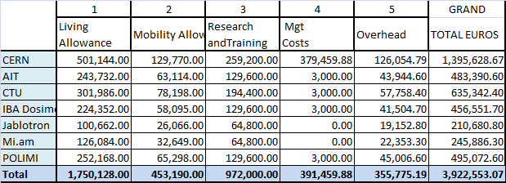
Consortium’s budget
ARDENT Kick-off meeting – 08.05.2012

Slide 11
Prefinancing
2,353,531.85 EUR paid by the Commission to CERN within 45 days after signature of the GA
Distribution from CERN to all beneficiaries when accession forms (Annex IV - form A) and bank coordinates received
ARDENT Kick-off meeting – 08.05.2012

Slide 12
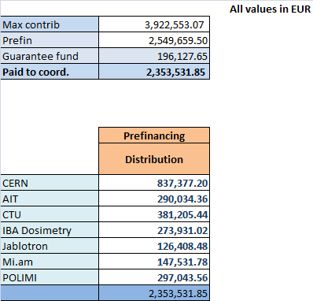
Prefinancing
ARDENT Kick-off meeting – 08.05.2012

Slide 13
Question on Finance
Cordis
  Find a document:
    http://cordis.europa.eu/fp7/find-doc_en.html
  Marie Curie 2011 Work Programme:
    ftp://ftp.cordis.europa.eu/pub/fp7/docs/wp/people/revised-m-wp-201101_en.pdf
Marie Curie Actions website:
    http://ec.europa.eu/research/mariecurieactions/manage.htm
CERN:
  EU projects financial management:
    liz.mullett@cern.ch
  Disclaimer: CERN provides information based on their understanding of current EC’s rules and own experience. Each beneficiary remains responsible for its own cost statement.
ARDENT Kick-off meeting – 08.05.2012
Notes:
WP + URL to change

