Slide 1
ARDENT
Advanced Radiation Dosimetry European Network Training initiative
WP2: Solid state detectors
Zdenek Vykydal

Slide 2
Objectives
Advanced characterization of general mixed radiation fields for:
  Particle accelerators
  Homeland security
  Aircrafts and space
  Medical applications
  Radiation safety
Development and improvement of instrumentation and methodology for measurement of the mixed field particle composition and spectral characteristics
Combining the information from different detectors

Slide 3
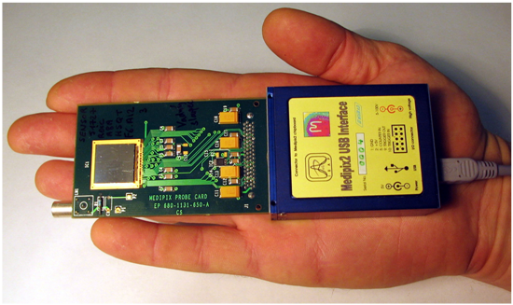
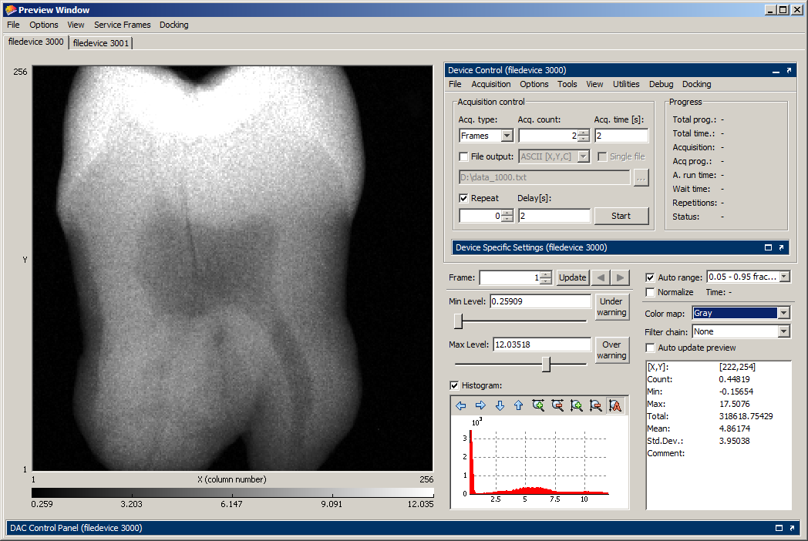
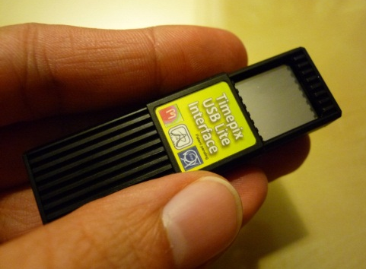
Present status
Medipix / Timepix technology (patent issued on the quantum dosimetry with pixel detectors)
Several readout interfaces and dedicated software (Pixelman) available
Experience from measurements and calibrations
  ATLAS experiment field
  Hadron beam therapy (Heidelberg)
  Neutron and photon fields
First dosimetric calibrations of Medipix detectors in photon fields

Slide 4
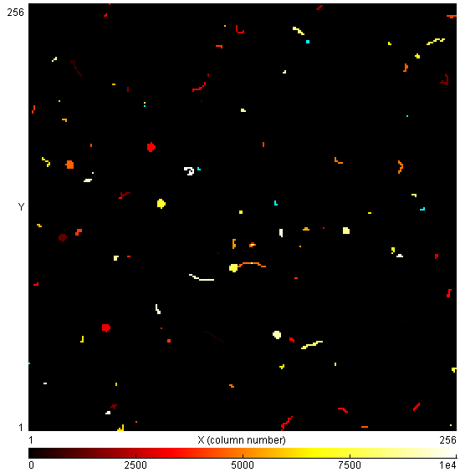
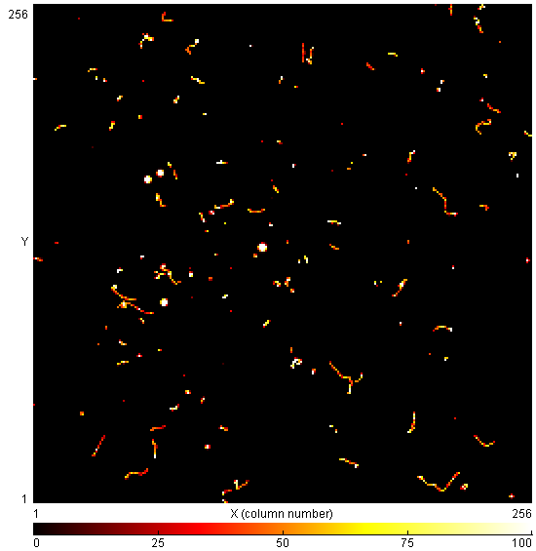
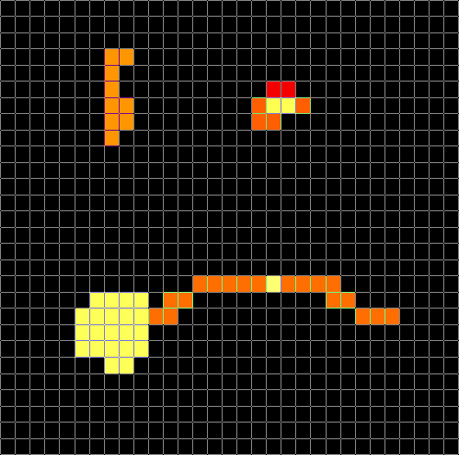
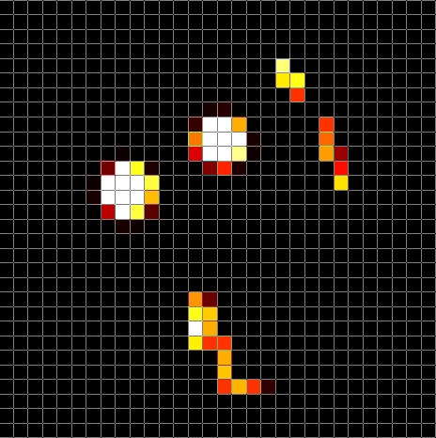
Energy and time information
Timepix in tracking mode in response to ²²⁶Ra source
Time of Arrival mode ~ TIME
Time over Threshold mode ~ ENERGY

Slide 5
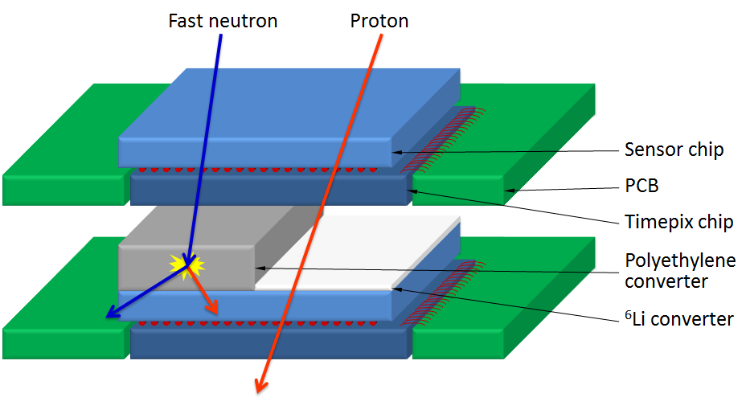
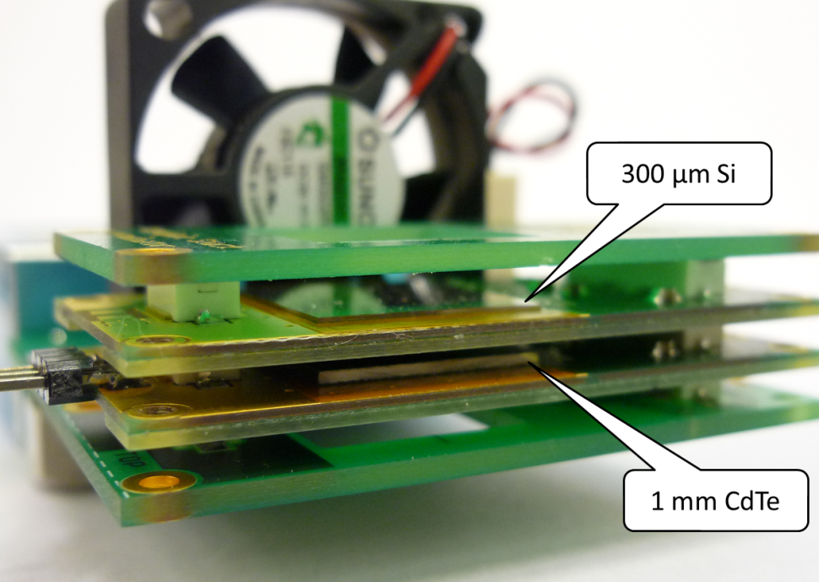
Coincidence information
Timepix telescope
Several sensitive layers to measure angular dependence of the radiation field
Converter/filter materials in between for noncharged particles identification
Possibility to combine different:
  Sensor materials
  Sensor thicknesess
  Bias voltages

Slide 6
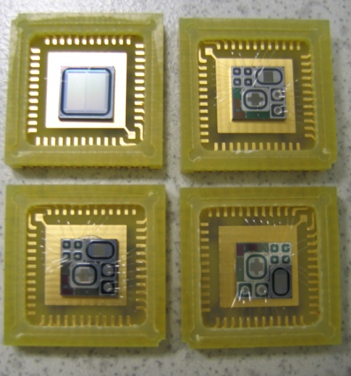
Silicon microdosimeter
(designed in collaboration with ST-Microelectronics)
Segmented silicon telescope:
a thin ∆E stage (1.9 μm thick) coupled to a residual energy stage E (500 μm thick) on the same silicon wafer.
∆E stage : matrix of cylindrical diodes (h = 2 µm , d = 9 μm)
More than 7000 pixels are connected in parallel to give an effective detection area of the ∆E stage of about 0.5 mm²

Slide 7
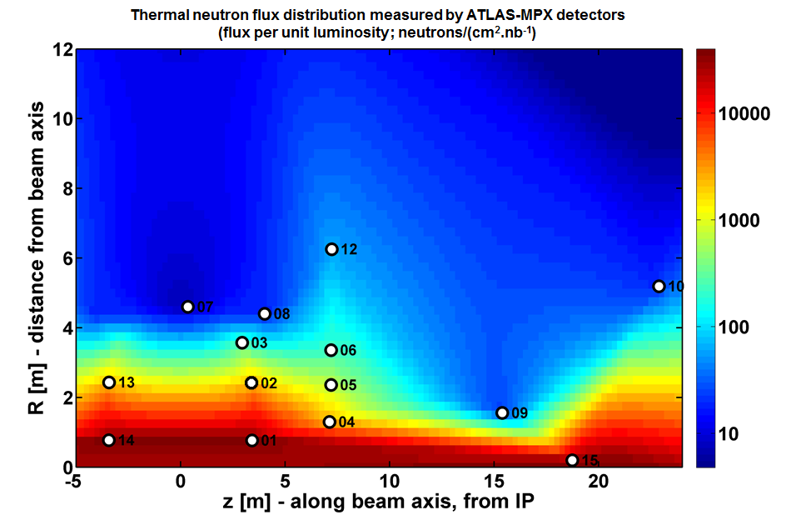
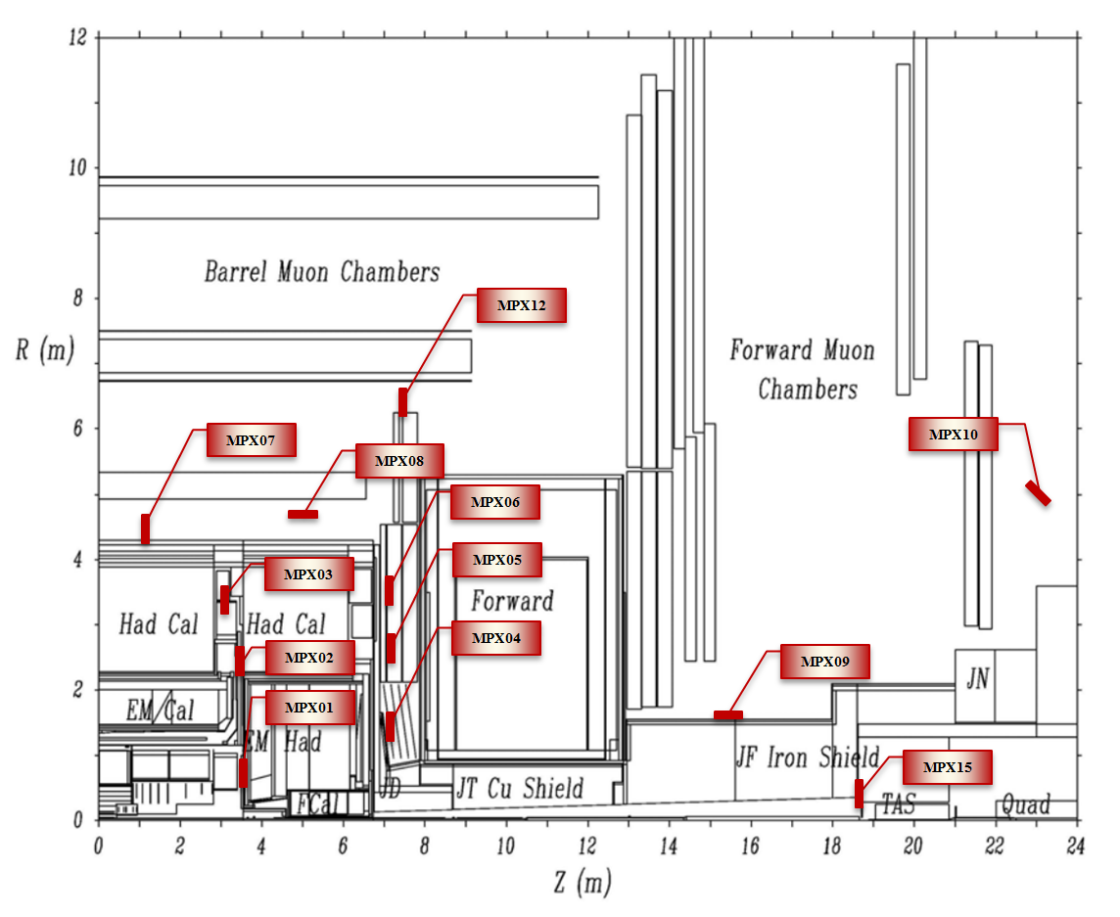
ATLAS-MPX - combined information from distributed network of Medipix detectors

Slide 8
Next steps
Upgrade of the current Timepix readout interface to radiation hard environments
Dosimetric calibrations for highly ionizing particles and other radiation of interest
Optimization of the coincidence information from the telescope
Improvements in the pattern recognition system using the information from TOT, TOA and/or from neighboring detectors
Software for combination of the results from several distributed external units (of the same or different type).

Slide 9
Collaborations
CERN
CTU
POLIMI
Jablotron
University of Houston
University of Wollongong
…

Slide 10
Backup slides

Slide 11
Comparison of microdosimetric spectra measured by the silicon device with those obtained with a reference cylindrical TEPC: 62 MeV clinical proton beam @ CATANA facility (LNS-INFN)

