Slide 1
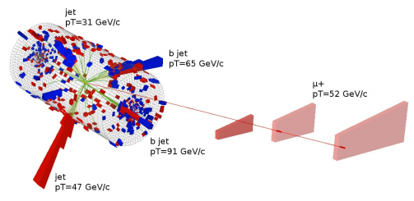


Roberto Chierici (CNRS+CERN)
Recent results on top physics in CMS
CERN PH – LHC Seminar
16th April 2012

Slide 2
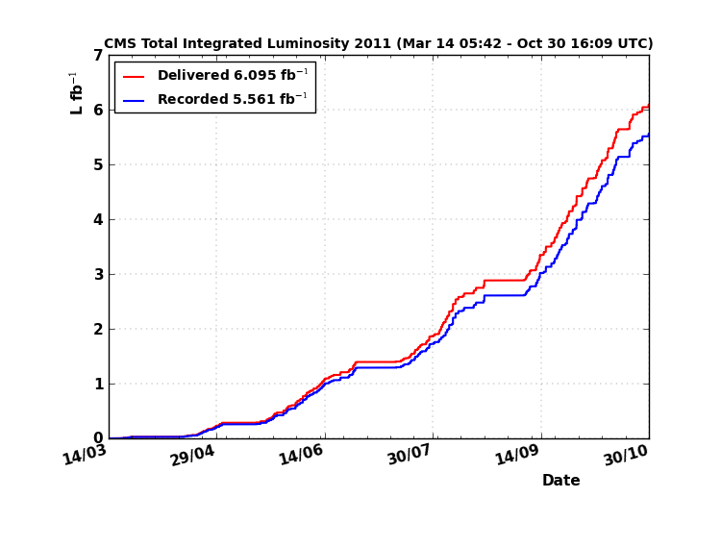
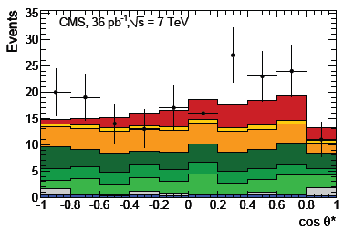
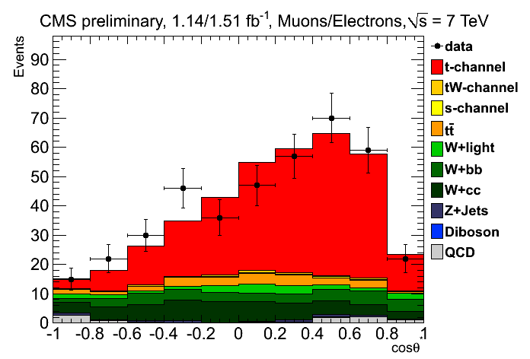
Contents
Introduction
Production cross section
Differential cross section
Top intrinsic properties
  Mass, spin, couplings
Single top production
Top as a window to new physics
  Selected topics
While the overview aims to be complete, more emphasis will be put on recent/new results
All CMS public results available from:
  https://twiki.cern.ch/twiki/bin/view/CMSPublic/PhysicsResults

Slide 3
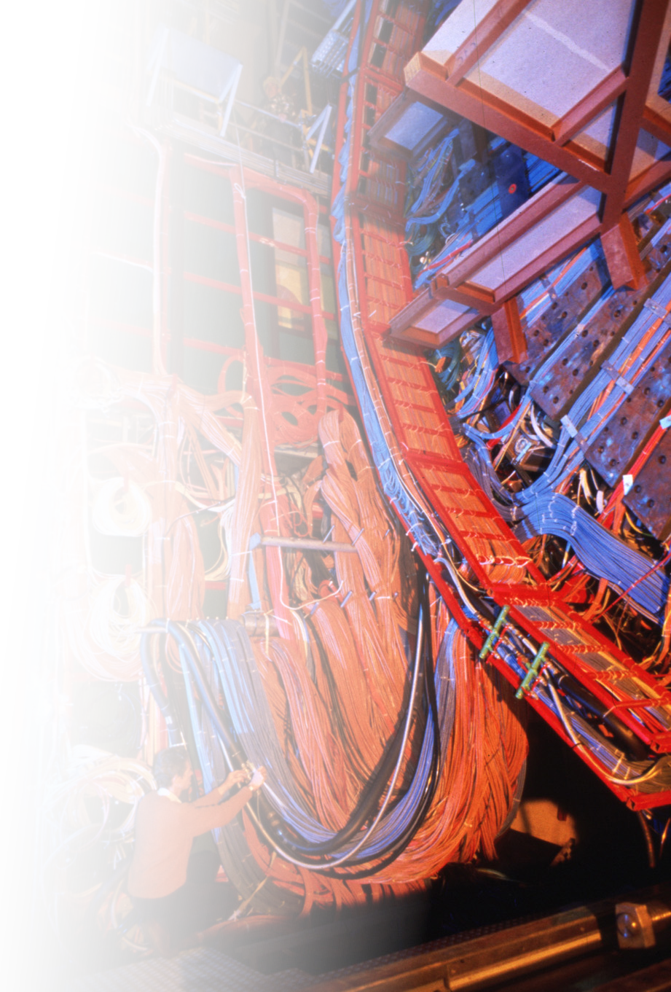
Introduction

Slide 4
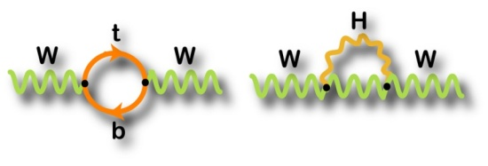
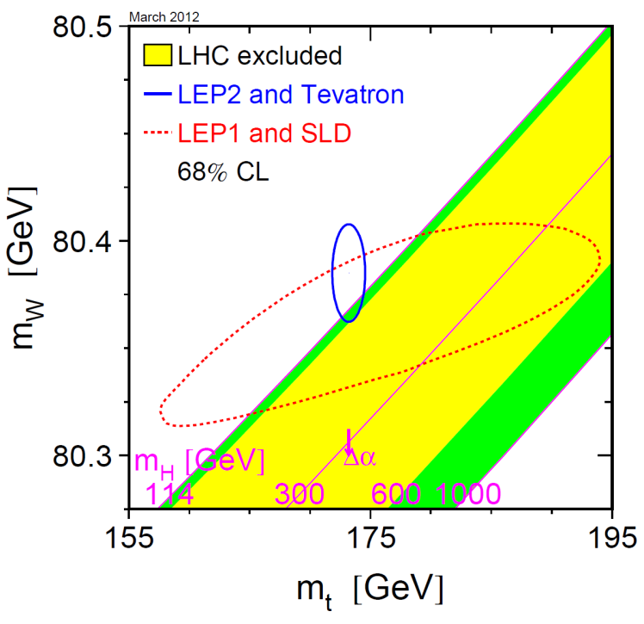
Top physics
Top physics is one of the main pillars of the physics program at the LHC
  Direct access to fundamental parameter of the SM (m_{t}, V_{tb})
  Direct probe of the EWSB sector (y_{t}~1!)
  Other stringent tests of SM (QCD predictions
  in dσ/dX, constraints on couplings, CPT invariance,…)
  Privileged sector for the direct manifestation of new physics
    In production (pp→X→tt)
    In association (pp→tt+X)
    In decay (H⁺, FCNC,…)
  Indirect probe for the presence of new physics
    charge asymmetries, spin structure, couplings
  “The jackknife” for physics at the LHC
    All sub-detectors are involved in top reconstruction
    Helps understand (b)jet scale
    Helps understand b-tagging
    Constraints on PDFs
    Top physics may be an important background for
    searches
∝ m_{t}²
∝ ln(m_{H})

Slide 5
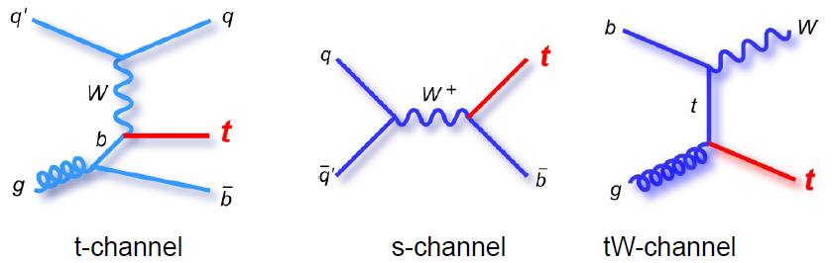
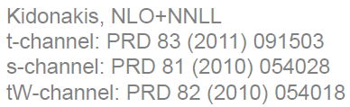
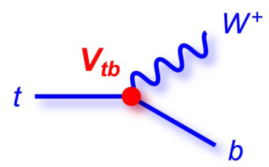
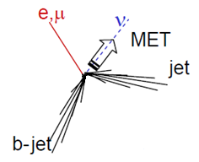
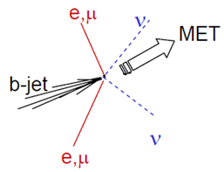
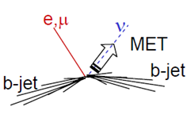
Top production at the LHC
Top is produced in pairs (QCD) or singly (EWK)
Single top EWK production happens via three main contributions
σ(7 TeV)~64 pb
σ(7 TeV)~4.6 pb
σ(7 TeV)~15.6 pb
,τ
,τ
,τ
V_{tb}~1
,τ
Backgrounds
  Top pair
  W+(HF)jets
  QCD
Backgrounds
  Top pair
  W+(HF)jets
  QCD
Backgrounds
  Top pair
  Z+(HF)jets
  QCD

Slide 6

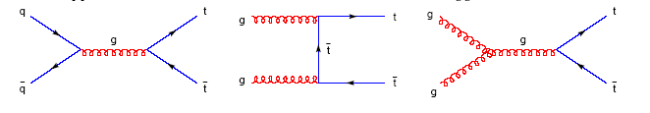

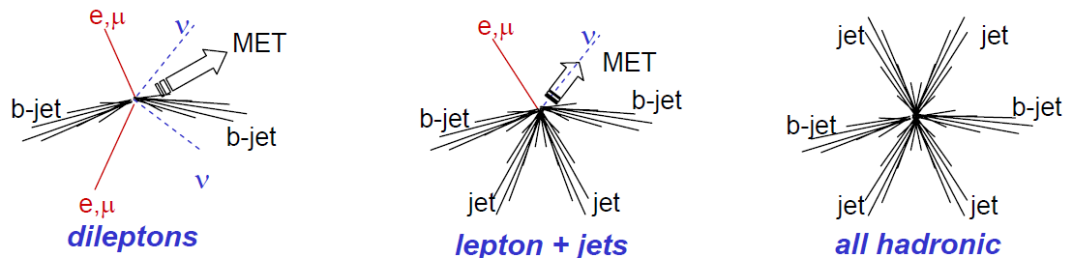
Top production at the LHC
Top pair QCD production happens mainly via gluon fusion
NLO (MCFM):
approx. NNLO:
Kidonakis, PRD 82 (2010) 114030
Langenfeld, Moch, Uwer, PRD80 (2009) 054009
,τ
,τ
,τ
BR~10%
Backgrounds
  Z+jets
  Single top (tW)
  QCD
BR~44%
Backgrounds
  W+jets
  QCD
  Single top
BR~46%
Backgrounds
  QCD

Slide 7
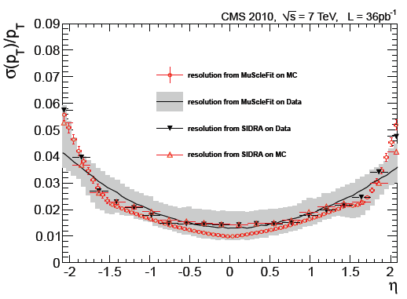
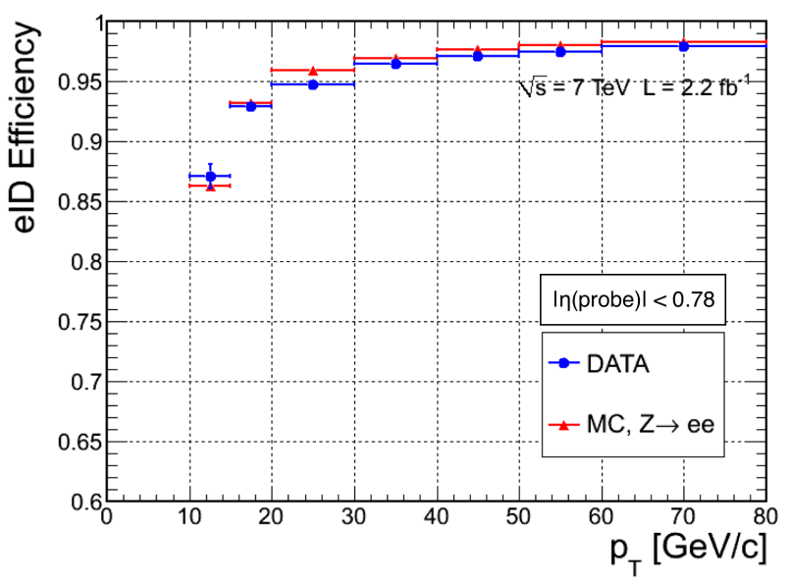

Detector objects: leptons
All physics objects are essential for top physics: leptons, (b)-jets, MET
Particle Flow reconstruction in CMS
  Optimally combine all sub-detector information to reconstruct and identify particles
Leptons (e,μ,τ) with p_{T} >20 |η|<2.5
  Muon p_{T} resolution for top is 1-2%
  ECAL resolution ~1% for top
    Track matching to recover for brehmsstrahlung
Excellent ID capabilities
  Use redundancy of sub-detectors for muons
  Shower shapes, H/E, conversion vetoes for electrons
Isolation in tracker and calorimeters
  Cut on relative isolation in a cone with ΔR=0.3
Trigger largely based on leptons
  Single/double (isolated) lepton
  Lepton+jets at HLT are used for high PU conditions

Slide 8
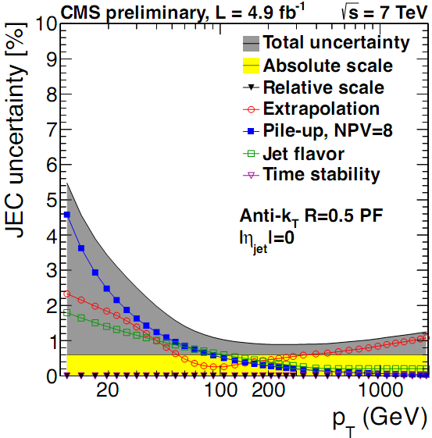
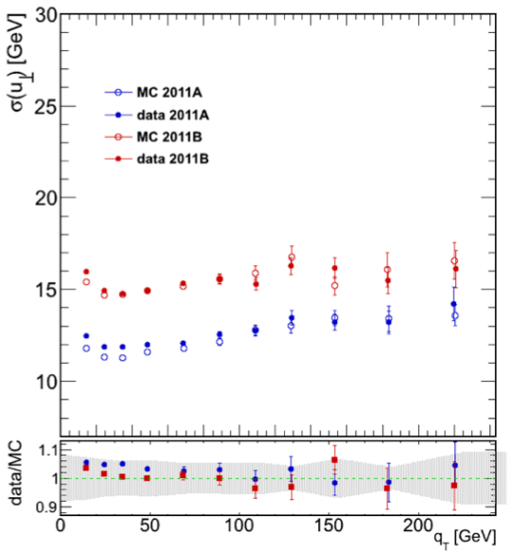
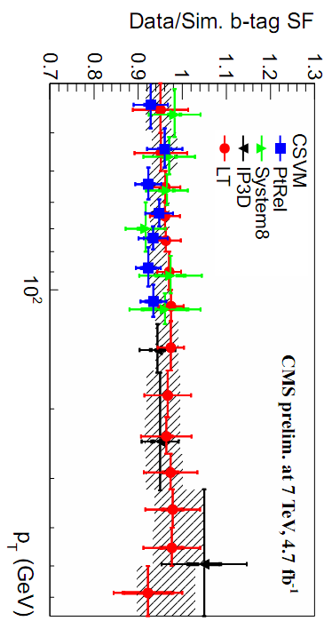
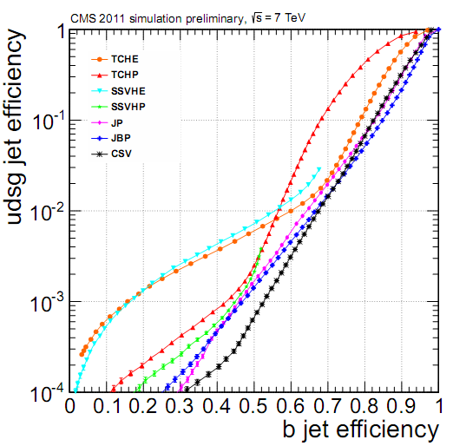
Detector objects: jets, MET, b-tagging
Jets defined with anti-k_{T} algorithm with R=0.5
  p_{T}>30 GeV |η|<2.5 (analysis dependent)
  JES uncertainty via γ/Z+jets, ≤2% for most of the p_{T} range
  JER about 10%
b-tagging is optionally applied
  Uses secondary vertices and/or IP information
  Efficiencies and fake rates are calibrated by using data
  Crosschecked in situ with top pair events
Missing transverse energy
  Requirement depends on analysis, from 20 to 60 GeV
  Resolution vastly improved by the Particle Flow treatment
From Z→μμ
MET resolution
BTV-12-004

Slide 9
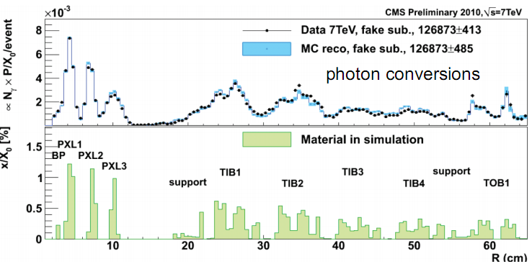
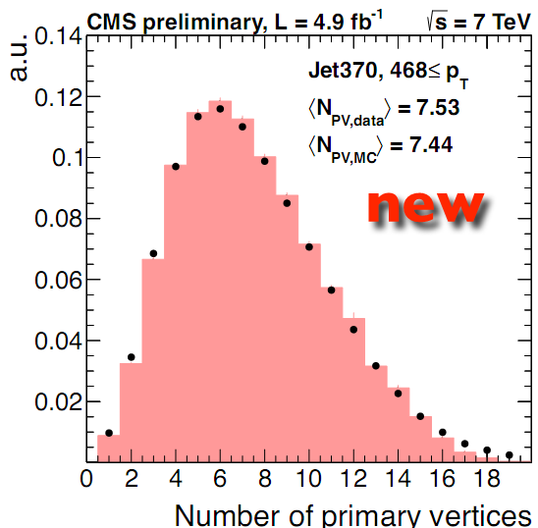
Simulation and Monte Carlo
The reference generator for multi-leg final states is MadGraph_{+PYTHIA}
  W/Z+Njets, N=0,…4, tt+Njets, N=0,…3, ME-PS matching with MLM
  Flexibility for inclusion of new physics scenarios
  Typically crosschecked vs NLO generators
Other reference generators include NLO via POWHEG_{+PYTHIA} and MC@NLO_{+HERWIG}
  For both single top and top-pair description
Systematic sources due to theory/modelling
  Q² choice in the ME description
    also affects PS parameters
  Choice of the ME-PS matching scale
  PDFs, UE tunings
Detector simulation via Geant4
  Impressive accuracy of CMS simulation
  In time and out of time pileup are added
  before the simulation of the electronics
reweight to match the PV distribution in data

Slide 10
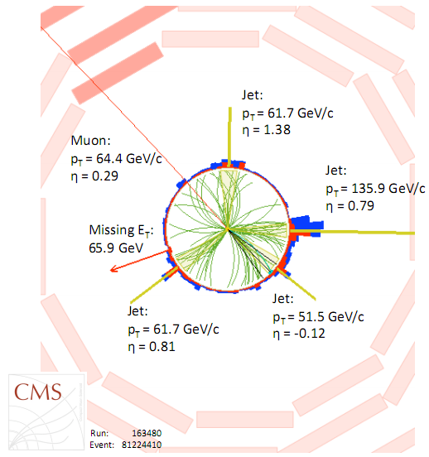
Top pair (differential) cross sections

Slide 11
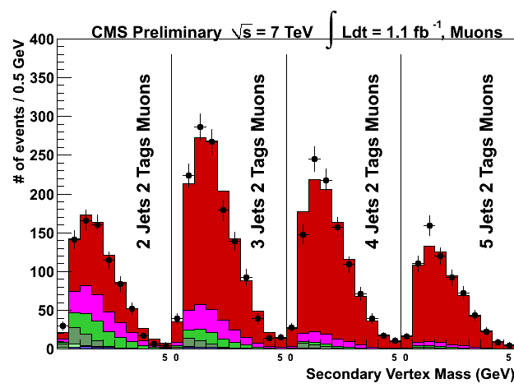
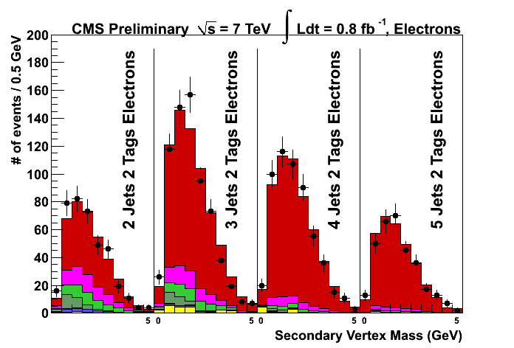
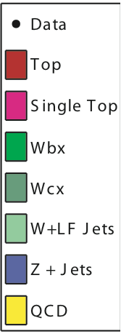
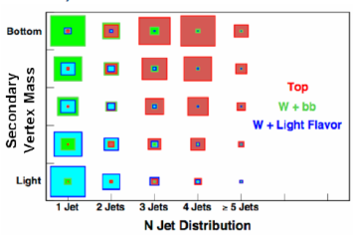
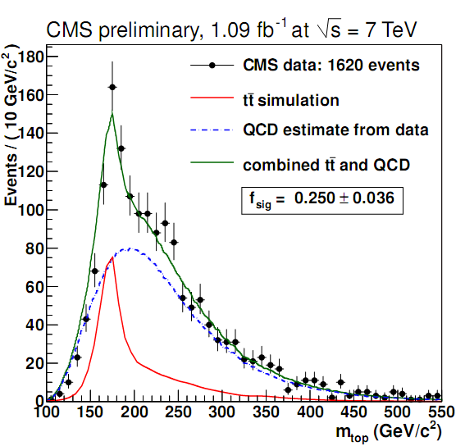
Cross section: hadronic channels
ℓ+jets final states represent a good compromise between statistics and purity
  3D binned maximum likelihood fit: use secondary vertex mass, Njets, Nbtag
    W+HF normalization included in fit
    Systematic errors are treated as nuisance parameters (radiation parameters, JES, b-tag eff,…)
TOP-11-003
Fully hadronic channel fully dominated by QCD
  In situ determination of the QCD component
  Template fit to m_{t} to extract the cross-section
TOP-11-007

Slide 12
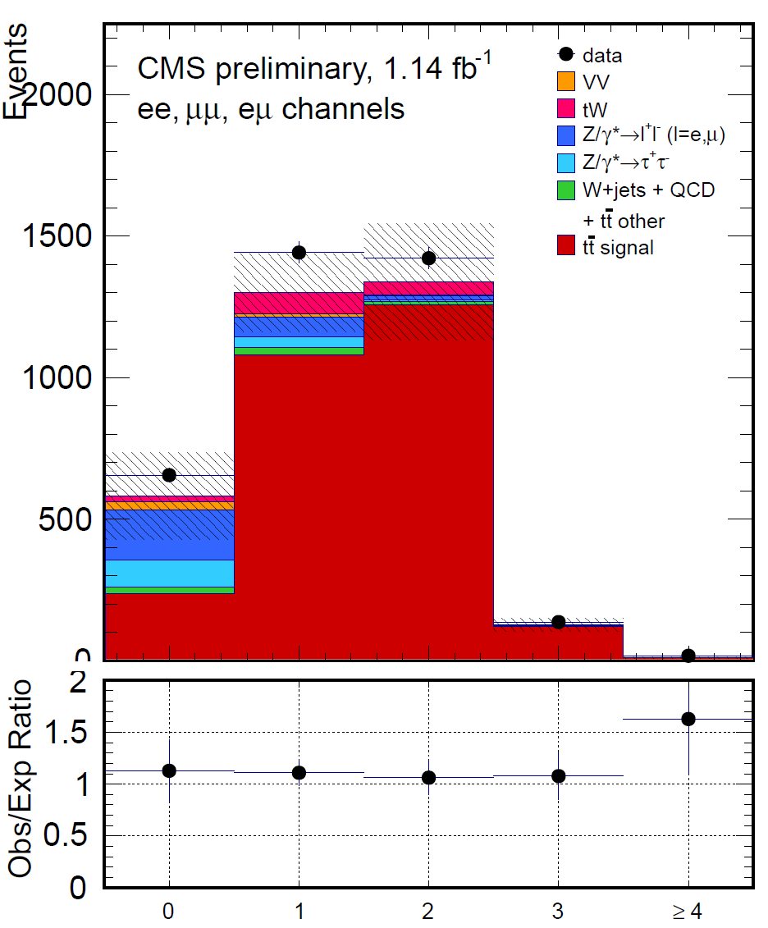
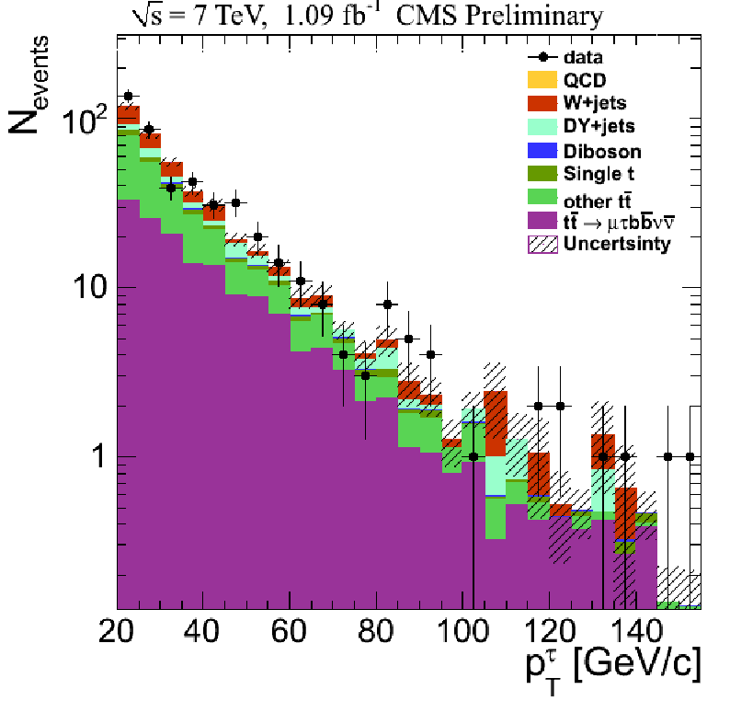

Cross section: leptonic channels
Di-lepton (e, μ) are particularly background free
  Counting experiment performed in three categories of number of jets and number of b-tags
    (2j,>=0 btags; 2j,>=1btags; 1j, >=2 btags)
  DY background completely data-driven
  Cross section extraction driven by the very clean e+μ channel
TOP-11-005
Di-lepton with τ
  Tau-fake leptons determined from data by using QCD events
  First top pair cross section measurement at the LHC involving τ
arXiv:1203.6810

Slide 13
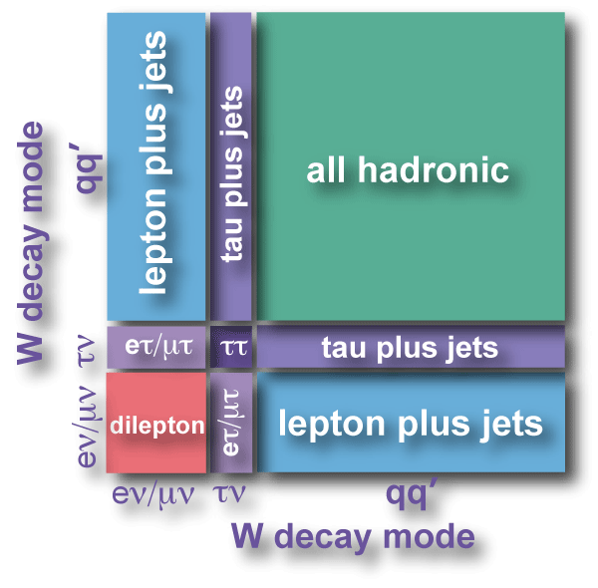
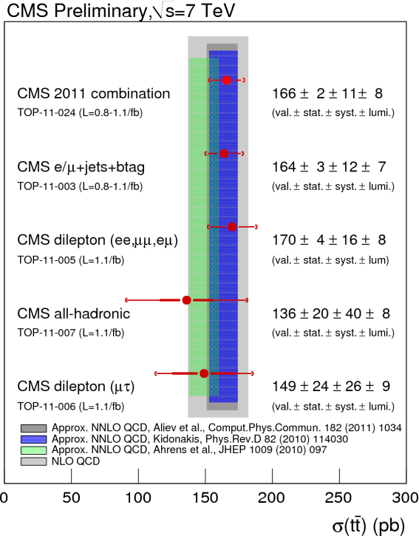
Cross section combination
All top pair final states are (being) investigated
  ℓ(e,μ)+jets, ℓℓ(all but ττ)+jets and fully hadronic final states in the combination.
  τ+jets in the works…
TOP-11-024
The combination is performed via a likelihood formulation
  Counting experiment are expressed as individual bins
  Experimental uncertainty close to 8%
  Challenging approximate NNLO computations !
  Even more stringent in perspective with more precise estimation of the luminosity
    Error on luminosity down to 2.2%

Slide 14
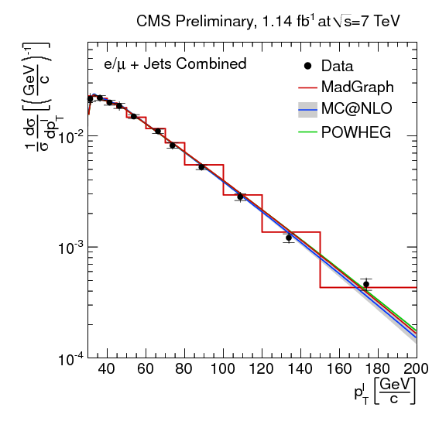

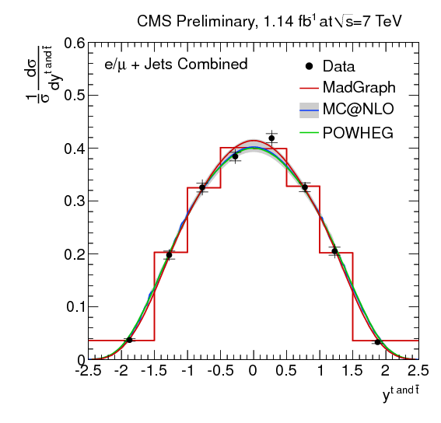
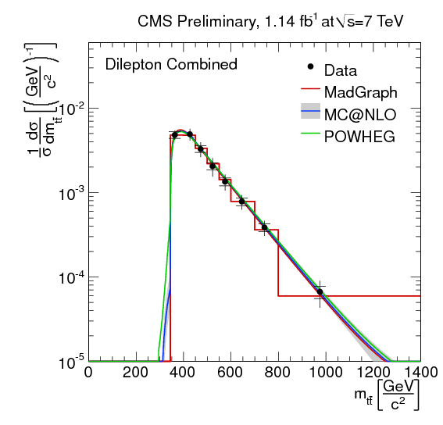
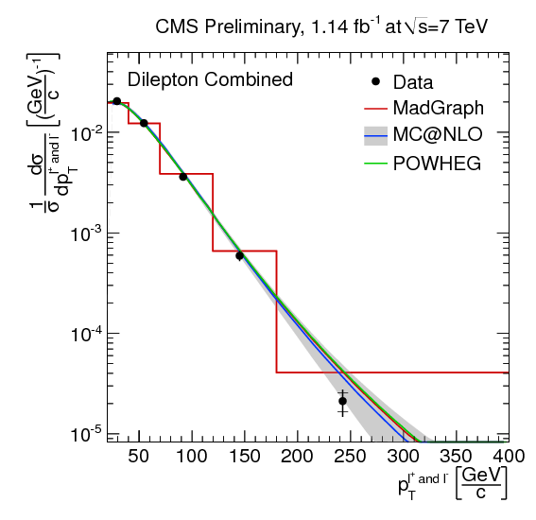
Top pair differential cross sections
First measurement of normalized differential cross-sections in top pair production at 7TeV
  Important test of pQCD
  Sensitive to new physics
  Event selections similar to the total cross section analyses
Full kinematics reconstructed via kinematic fit (ℓ+jets) or a probabilistic reconstruction of neutrinos (di-leptons)
Unfolding to parton level
  Via bin-by-bin correction or full unfolding (SVD)
  Look at variables involving leptons, tops, top pairs
p_{T}(ℓ), ℓ+jets
TOP-11-013
m(tt), di-lepton
y(t), l+jets
p_{T}(ℓ), di-lepton

Slide 15
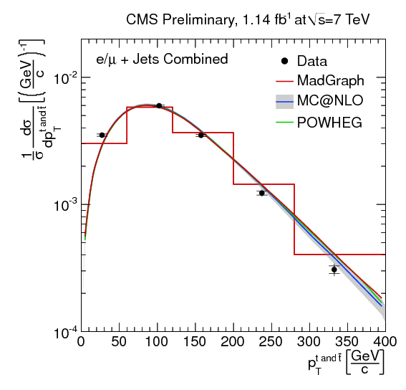
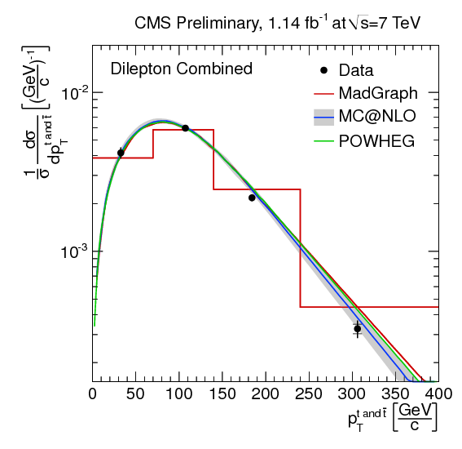
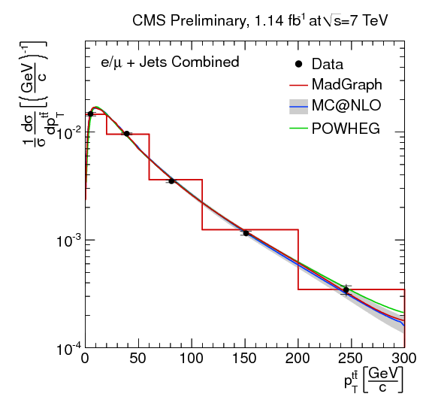
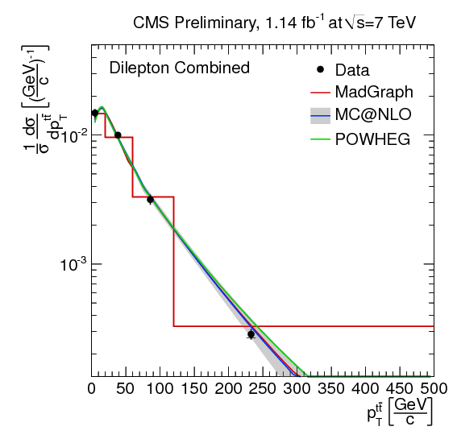
Top pair differential cross sections
Binning optimized for purity (migration in bin i) and stability (migration out of bin i)
Top quark distributions essential for e.g. studies on radiation
Systematic errors (only shape uncertainties important)
  Most important are background knowledge, radiation and hadronisation uncertainties
Excellent agreement with predictions
  Compare with both ME-PS matched and NLO codes
p_{T}(t), ℓ+jets
p_{T}(t), di-lepton
TOP-11-013
p_{T}(tt), di-lepton
p_{T}(tt), ℓ+jets
Horizontal bin center correction for showing the data
Lafferty, Wyatt, NIM A 355 541-547

Slide 16
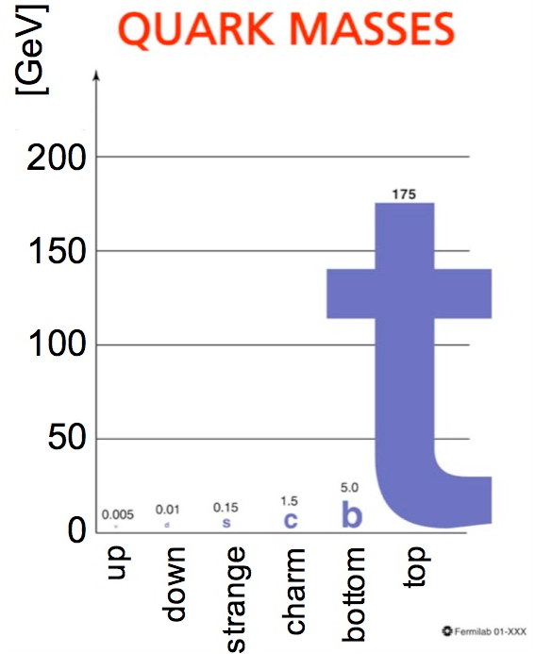
op properties

Slide 17
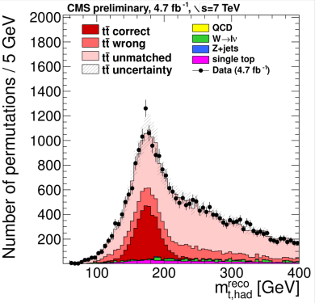

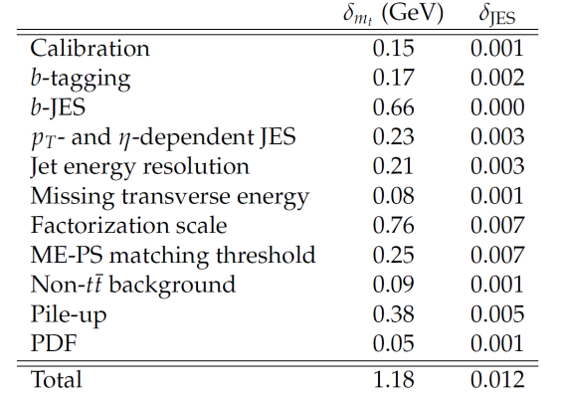
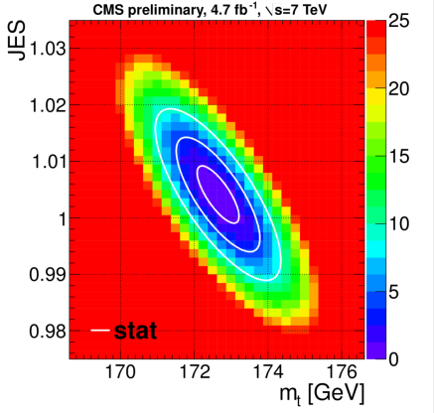
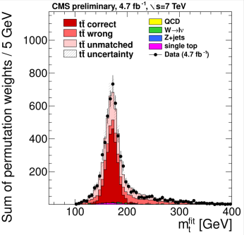
Top mass in ℓ+jets
Top mass reconstructed via kinematic fits using the event kinematics
  Likelihood method considering all jets permutations and b-tagging information
  Need of PDFs per permutation as a function of m_{t} and JES. Calibration on MC.
Measurement dominated by systematic uncertainties
  JES –also fit in situ– and (conservative) theory errors
TOP-11-015
After fit and
χ² cut
CR error not included

Slide 18
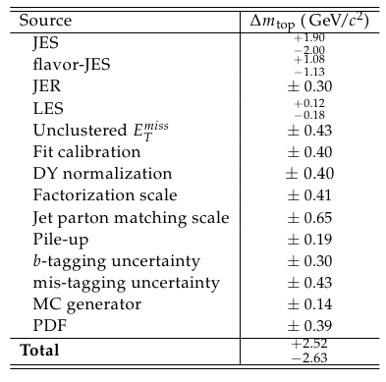
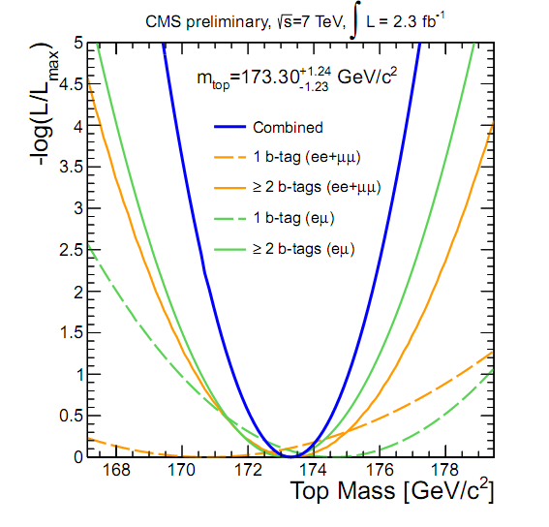
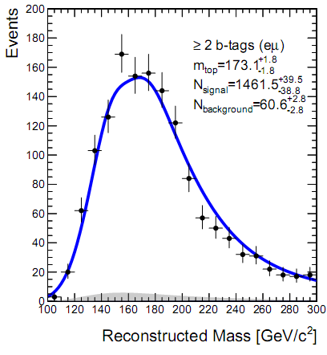
Top mass in di-leptons
Selection similar to the cross section measurement, plus additional MET cut for ee, μμ.
  DY shapes taken from data in the low MET region
Reconstruct the event kinematics by using the KINb method
  Numerically solve the equations for kinematics. Count number of solutions compatible within resolution with the event kinematics. The most likely value for m is the estimator for m_{t}
  Maximum likelihood fit of the resulting distribution for ee, μμ, eμ, 1 and 2 b-tags in the event
  Method linear in m_{t} and unbiased after calibration
Measurement dominated by JES uncertainty
  Most precise to date in the dilepton channel
TOP-11-016
CR error not included

Slide 19
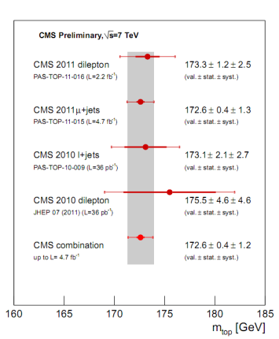

Top mass combination
In both di-lepton and ℓ+jets channel, the CMS m_{t} measurements are competitive with the corresponding ones at the Tevatron
Use BLUE for the CMS combination, with detailed categorization of systematic errors according to their correlations
  Combination dominated by the ℓ+jets channel
  Results very robust against changes in correlation
  values/categories
Towards LHC and world combination
  Work ongoing in
  the TOPLHCWG
  In contact with the
  TEVEWWG
TOP-11-018

Slide 20



Top-antitop mass difference
Test CPT invariance in the top sector
  Reconstruction of the hadronic side: compare ℓ⁺+jets and ℓ⁻+jets events
  Use kinematic fit, and an event-per-event likelihood for ℓ⁻ and ℓ⁺ separately
    Same method of the top mass extraction
Most systematic effects cancel out
  Measurement is statistically limited
  World's best so far, and consistent with the SM
  Consistency also between e and μ channel
arXiv:1204.2807

Slide 21


Top mass from cross section
Use the dependence of σ_{tt} on m_{t} to infer the latter from the σ_{tt} measurement
  Need full dependence of the acceptance of the analysis on m_{t}.
  First extraction realized for the measurement in the di-lepton channel
Theory errors include scales, PDFs, α_{S}(m_{Z})
Extract both pole mass and MS mass
  Pole mass directly related to what measured in direct reconstruction (~1 GeV uncertainty)
Moderate dependence on the used PDFs
  1-2 GeV: the used value of α_{S} is crucial
Extracted top mass not competitive with the direct determination
TOP-11-008

Slide 22





W helicity and top couplings
Measure θ*_{ℓ}, the angle between the lepton and the b direction (in the W rest frame)
  dσ/dcosθ*_{ℓ} reflects 3 possible polarizations of the W. Sensitive to anomalous tWb couplings
The polarization fractions can be extracted by a fit to data
  Fit performed with and without the assumption of F_{R}=0
  Main systematic errors represented by JES and theory uncertainties/W+jets normalisation
Helicity fractions can be translated to constrain anomalous couplings and NP operators
0 in the SM
L=2.2/fb
TOP-11-020
μ+jets

Slide 23






Constraints on the top charge
Assign charge from semi-leptonic b decays
  Minimize wrong charge assignment (e.g. B→D) by using p_{Trel} to optimize efficiency and purity
  Performance measured in QCD b-bbar events
Reconstruct hadronic top by using the knowledge of m_{t}
Limit exotic scenario from asymmetry in charge categories
  N_{SM} and N_{XM} are described by PDFs using signal/bckg
TOP-11-031
N_{SM}
N_{XM}

Slide 24




R=BR(t→Wb)/Σ_{k}BR(t→Wq_{k})
Use di-lepton events with standard selection
  DY background entirely data driven
Estimate Wq contribution from wrong assignments by using data driven approach which uses sidebands in m(qℓ)
b-tagging multiplicity is then parameterized as a function of R, ε_{b}, ε_{q}, (combinatorial) backgrounds
  Also dividing in ee, μμ, eμ and 2, 3 jets events
  Fit R assuming ε_{b} from b production in di-jets
  Determine F-C frequentist interval after profiling of all nuisances
TOP-11-029

Slide 25

Single top

Slide 26


Single top - t-channel
Select events with one isolated lepton, one b-tagged jet, one forward jet
  1 isolated e (p_{T}>30 GeV) or μ (p_{T}>20 GeV)
  2 jets, E_{T}>30 GeV, |η|<5.0
  One “tight” b-tag
  Transverse W mass > 40(50) GeV
Cross section is extracted from a fit to the angular variable η_{ℓ}
  All background rates and shapes are taken from control regions in data
    QCD from fits to low m_{T}, MET
    Top pair from the 3 jets, 2 b-tag sample
    W+light jets from 2 jets and anti b-tag
    W+HF via fit of sidebands in m(ℓbν)
Main systematic errors
  JES
  Background knowledge from data-driven
  methods
TOP-11-021

Slide 27





Single top - t-channel
Excellent agreement in differential distributions after the fit:
  Charge ratio: N(ℓ⁺)~1.9N(ℓ⁻)
  Angular and mass distributions
TOP-11-021
|V_{tb}| can be derived by assuming

Slide 28






Single top – tW production
Same as top pair at NLO
  Subtraction schemes needed to properly define the observable
Signature similar to di-lepton top pair (one b-jet less)
  2nd b-jet veto is applied for signal region
  Add conditions on the p_{T} of the system
  Categorize events to constrain the tt component and ε_{b}
Use maximum likelihood fit for σ(tW):
  Observed significance is 2.7σ (expected 1.8+/-0.9 σ)
TOP-11-022

Slide 29

Looking for something beyond the SM

Slide 30








Charge asymmetries
Tevatron observes anomalous charge asymmetries
Different definition is possible at the LHC, but asymmetry diluted
Need a full event reconstruction
  Use ℓ+jets events, the top charge is correlated to
  that of the lepton
  Use W mass constraint for the neutrino
  Use top kinematics to solve combinatorial
Results are unfolded
  Via regularized matrix inversion
  Method tested to be linear and unbiased
arXiv:1101.0034, arXiv:0712.0851
TOP-11-030

Slide 31



Differential asymmetries
In many new physics scenarios the charge asymmetry depends on phase space
  High mass/p_{T} regimes enhance the quark annihilation part of the initial state
Measure A_{c} differentially as a function of p_{T}, y or invariant mass of the top pair system
Full 2D regularized unfolding after background subtraction
  Method tested to be linear in distortion function of the second unfolded variable
Good agreement found between data and SM expectations within uncertainties
  Main systematics errors are given by the unfolding itself and lepton ID efficiency
  Results also compared with EFT predictions
    Anomalous axial coupling of gluons to quarks: capable to explain the Tevatron anomaly
TOP-11-030
EFT: PRD84:054017,2011
NLO: Rodrigo, Kuehn

Slide 32





New physics in production: resonances
Several models of new physics predict resonances decaying into top pairs
ℓ+jets events: full event reconstruction
  Jet pairing by χ² association (correct in ~70%)
  Multi-jet and W+jets background from data control regions
  Fit together different Njets, b-tag categories
Di-leptons: use a NN approach to best separate S and B
  Uses information from jets, leptons, MET
Systematic errors include shape (JES, b-tag, theory modelling)
and rate (efficiencies, background yields) changing ones
  Topcolor/Technicolor Z’
  Higgses
  KK excitations
TOP-11-009
m_{tt}, μ+jets, ≥2b-tags
ℓ+jets
di-leptons
TOP-11-010
CL_{S} criterion, LR=

Slide 33




New physics in production: high boosts
Advanced techniques for top tagging in case of jet merging
  Essential for hadronic channels at high mass/boosts
  C-A modified algorithm finding jet substructures compatible with top kinematics
  Entirely calibrated by using QCD data
Also alternative ℓ+jets analyses which increase sensitivity at very high masses
  No lepton isolation conditions, at least two jets
  No direct reconstruction if more jets, top constructed favoring back to back configurations
m_{tt}, hadronics
arXiv:1204.2488
m_{tt}, e+jets
EXO-11-092
e+jets
hadronics

Slide 34






New physics in decays: FCNC
At LO FCNC is highly suppressed: BR SM(t → qZ)_{NLO}~10⁻¹⁴
  NLO corrections from BSM can enhance the BR by a factor of 10¹⁰
Search in top decays: t→qZ→ qℓ⁺ℓ⁻
  Tri-lepton events (two from Z), very clean signature, but small BR
Selection also requires two jets, MET>30GeV, veto on 4th lepton.
  Full kinematics specified from χ² fit
  or using m_{W} and MET constraints
  Either HT_{S} or b-tagging are used to
  further reduce the background
  No excess observed
TOP-11-028
=
(world best)

Slide 35





Other new physics compatible with top pairs
Berger et al., PRL106(2011), 201801
Z’ model could explain the Tevatron A_{FB} asymmetry
  Search for two same sign leptons and at least two b-tagged jets with MET
Heavy top like quark decays
  Look beyond the m(ℓb) endpoint in di-lepton events
SUS-11-020
EXO-11-050
Other searches involving fourth generation are investigated in CMS
  Examples are and
  May lead to spectacular signatures with tt+multilepton final states
EXO-11-036
arXiv:1109.4985

Slide 36

Roadmap ahead and conclusive remarks

Slide 37
Top in the year of the Scalar Boson
Consolidate the top sector at 8 TeV
  Total and differential cross sections.
    Double ratios tt/Z(8TeV)/tt/Z(7TeV)
  Monitor distributions sensitive to new physics
New ideas in the high statistics/precision regime
  Alternative methods for determining the top mass
    Favour methods presenting systematic errors uncorrelated with standard reconstruction
  Constraining systematic errors by using data
    Study Colour Reconnection effects, constrain theory uncertainties on radiation by using data
  Let us go doubly differential (e.g. m_{t}(X); A_{C}(Y))
    Select phase space regions where the sensitivity to the main systematic errors is reduced
  “Environmental” studies of top-pair: tt+X !
    Study couplings to bosons, and test signatures of new physics in association
Other ongoing work in CMS/top
  Top spin correlations, top finite width effects
  Single top s-channel and differential distribution
  Global fit to the Wtb vertex (top pair and single top measurements)
  Contribute to the combination efforts ongoing in the TOPLHCWG
Process | σ(8 TeV)/σ(7 TeV)
Top pair | ~1.5
Single top t-ch | ~1.3
Single top tW | ~1.5
Single top s-ch | ~1.2

Slide 38
Conclusions
Last year has been crucial for top physics
  From a handful of events to a deep testing of the top sector
  The realm of differential distributions
CMS has been doing great…
  Very competitive analyses in the top sector
  We start to challenge theory predictions
…and the Standard Model looks healthier than ever
  No hints of new physics yet
This year will be even more crucial for top physics
  Doubly differential distributions
  In situ constraints of theory systematic uncertainties
  Study the environment in association to top pair events
  Find hints of physics beyond the Standard Model ?
Inclusive
quantities
Differential
cross sections
Top-pair
“environment”

