Slide 1
MP7 – An Avago MiniPOD Application
Jim Brooke, , Geoff Hall, Simon Fayer, Rob Frazier, Sarah Greenwood, Mark Grimes, Greg Iles, John Jones, Robyn Lucas, Chris Lucas, Dave Newbold, Michele Pioppi, Andy Rose, Alex Tapper

Slide 2
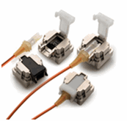
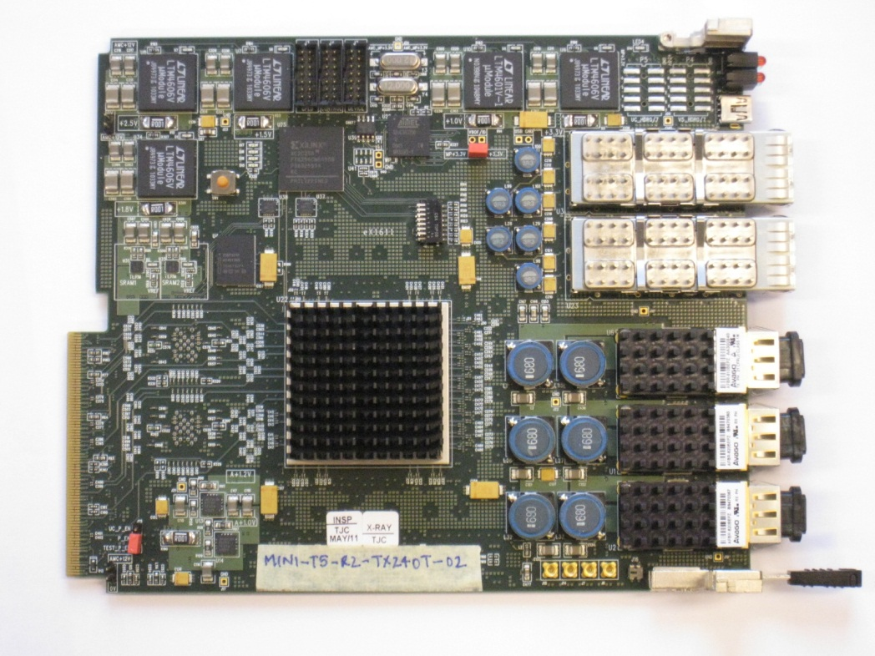
MP7
Andy Rose, Imperial
Full-height, double-width AMC card
Xilinx Virtex 7 – 1.6Tb/s of SerDes links
6× 12-channel, >10 Gb/s
72 bidirectional channels Rx & Tx = 720 Gb/s
Mini-T5-R2
AMC Card, but with Avago PPODs
Rx = 160 Gb/s
Tx = 100 Gb/s

Slide 3
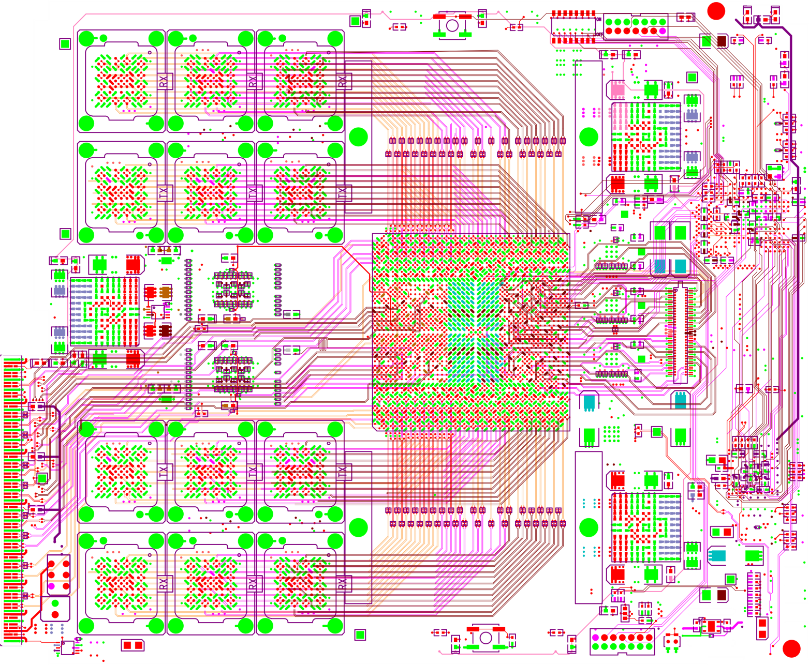
Receivers
2v5
3v3
Andy Rose, Imperial
Transmitters
1v5
1v8
FPGA
Header
Transmitters
1v0
Receivers

Slide 4
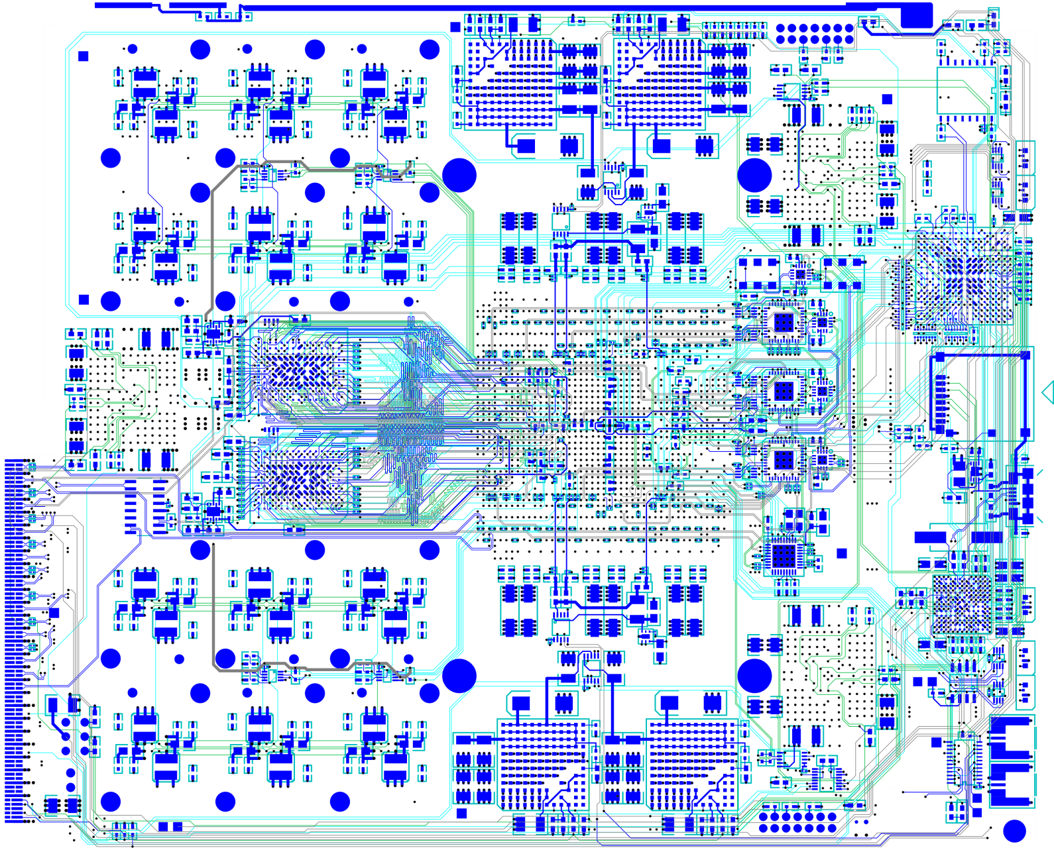
A1v2
A1v0
Andy Rose, Imperial
CPLD
QDR
μSD
QDR
Clocking
USB
μC
A1v0
A1v2
Clk

Slide 5
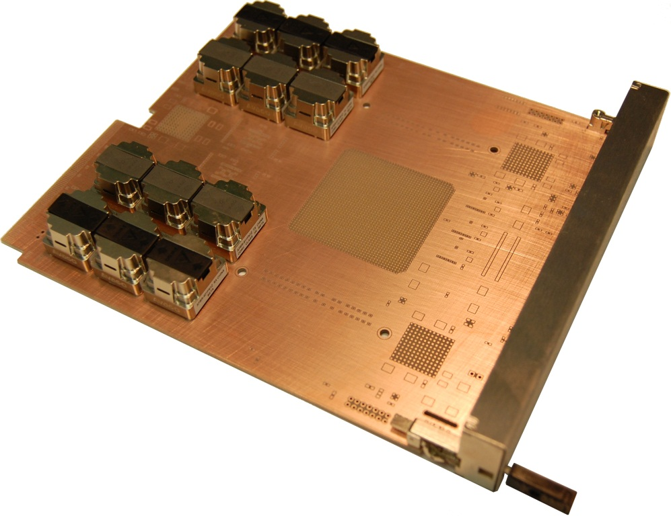
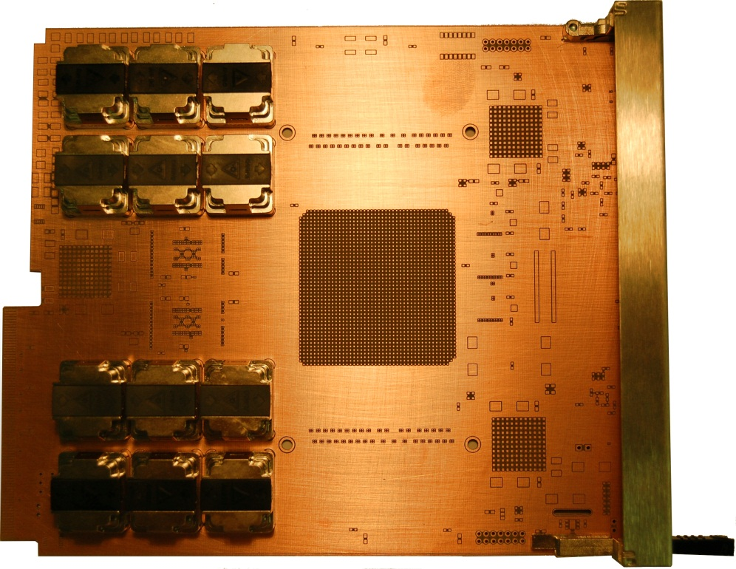
Mechanical Prototype
Andy Rose, Imperial
No electrical connections, just surfaces and mounting-holes

Slide 6
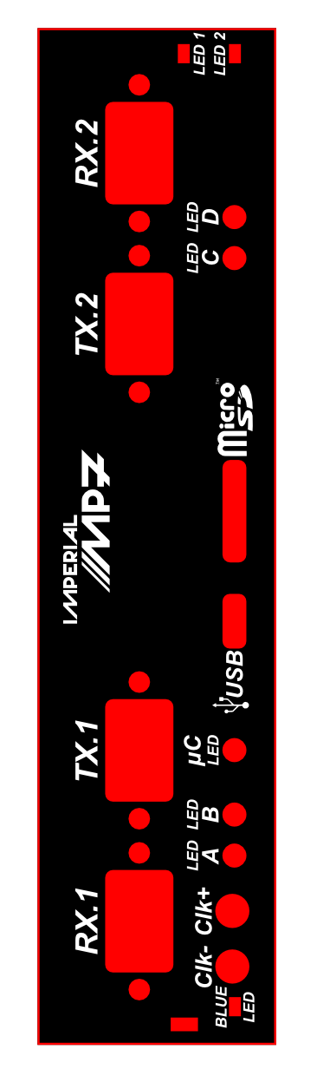
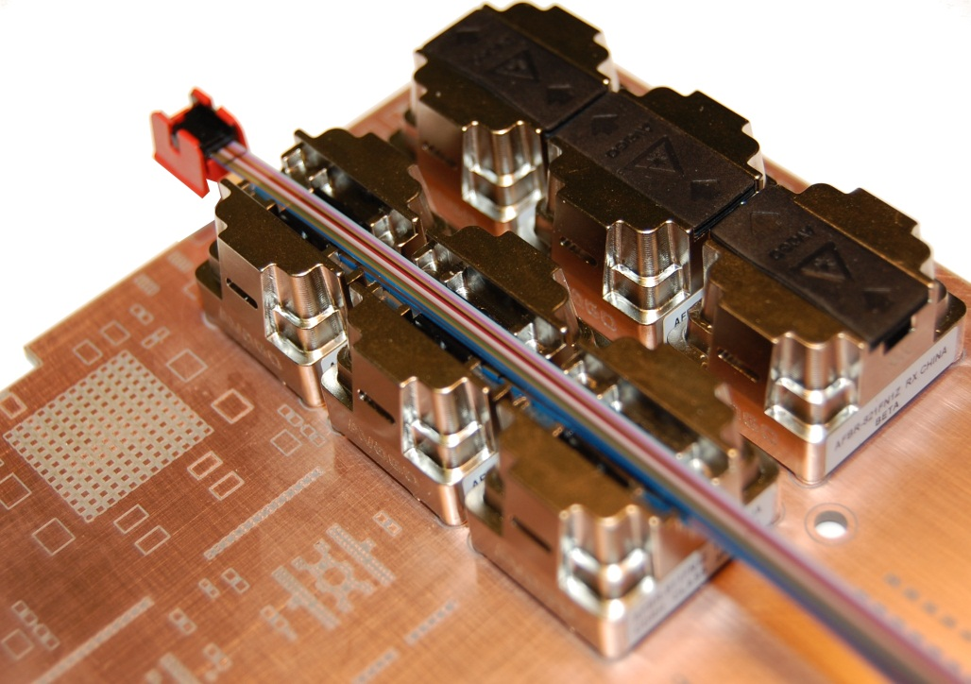
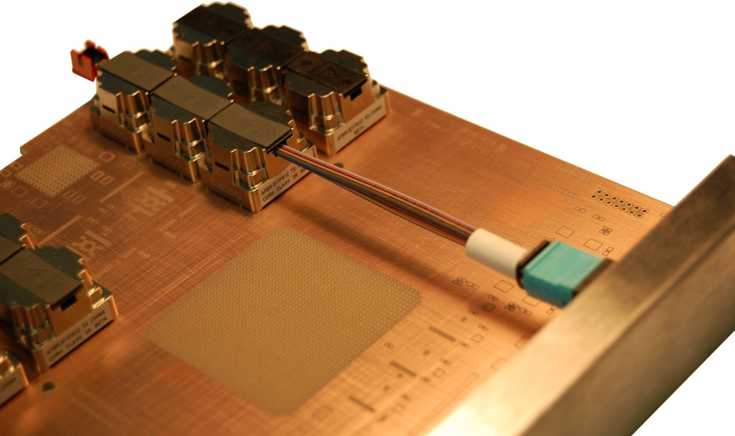
Mechanical Prototype
Andy Rose, Imperial

Slide 7
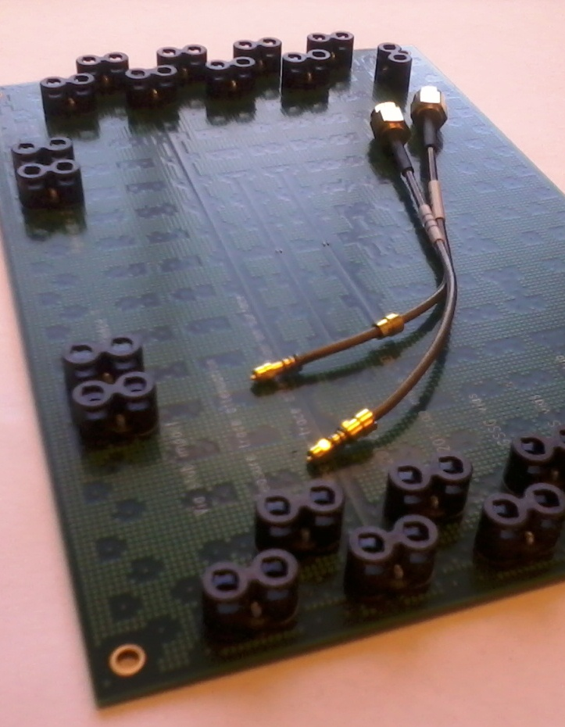
Test Cards
Many different test structures:
Bend tracks with 45 degrees or curves
Track to weave angle
Capacitor void impact
Via impact
Immunity to switching power supply noise
Ground-Signal-Signal-Ground
Material impact

Slide 8
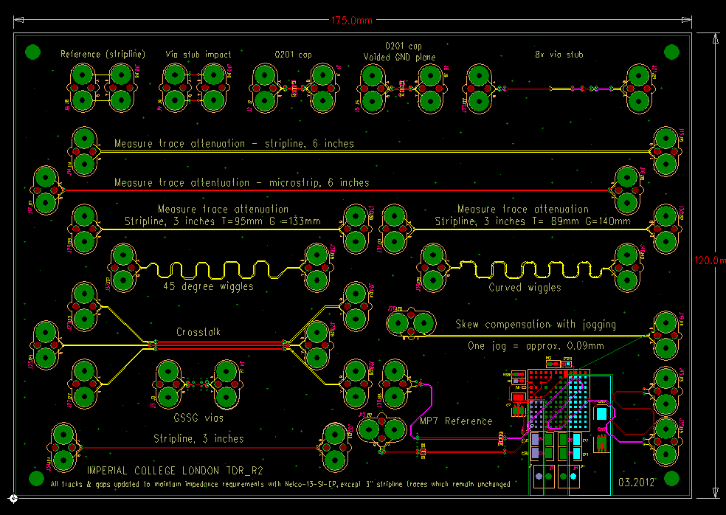
Test Card

Slide 9
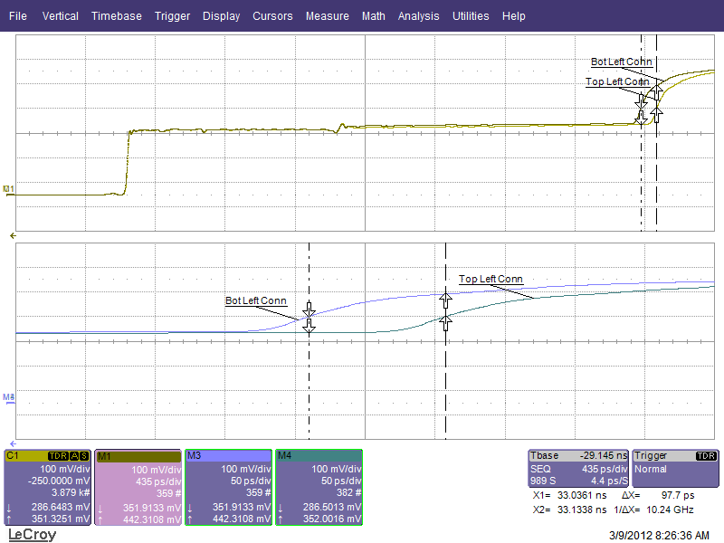
Skew: Test Card 0
Same scope channel for both traces – No calibration error
0 degrees, 153mm stripline, Ventec VT461, 89um track, 140um gap

Slide 10
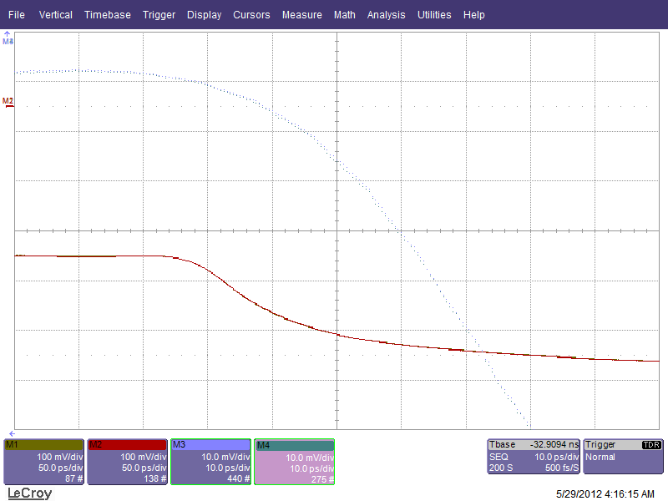
Skew: Test Card 2
22 degrees, 153mm stripline, Nelco N4000-SI, 89um track, 140um gap

Slide 11
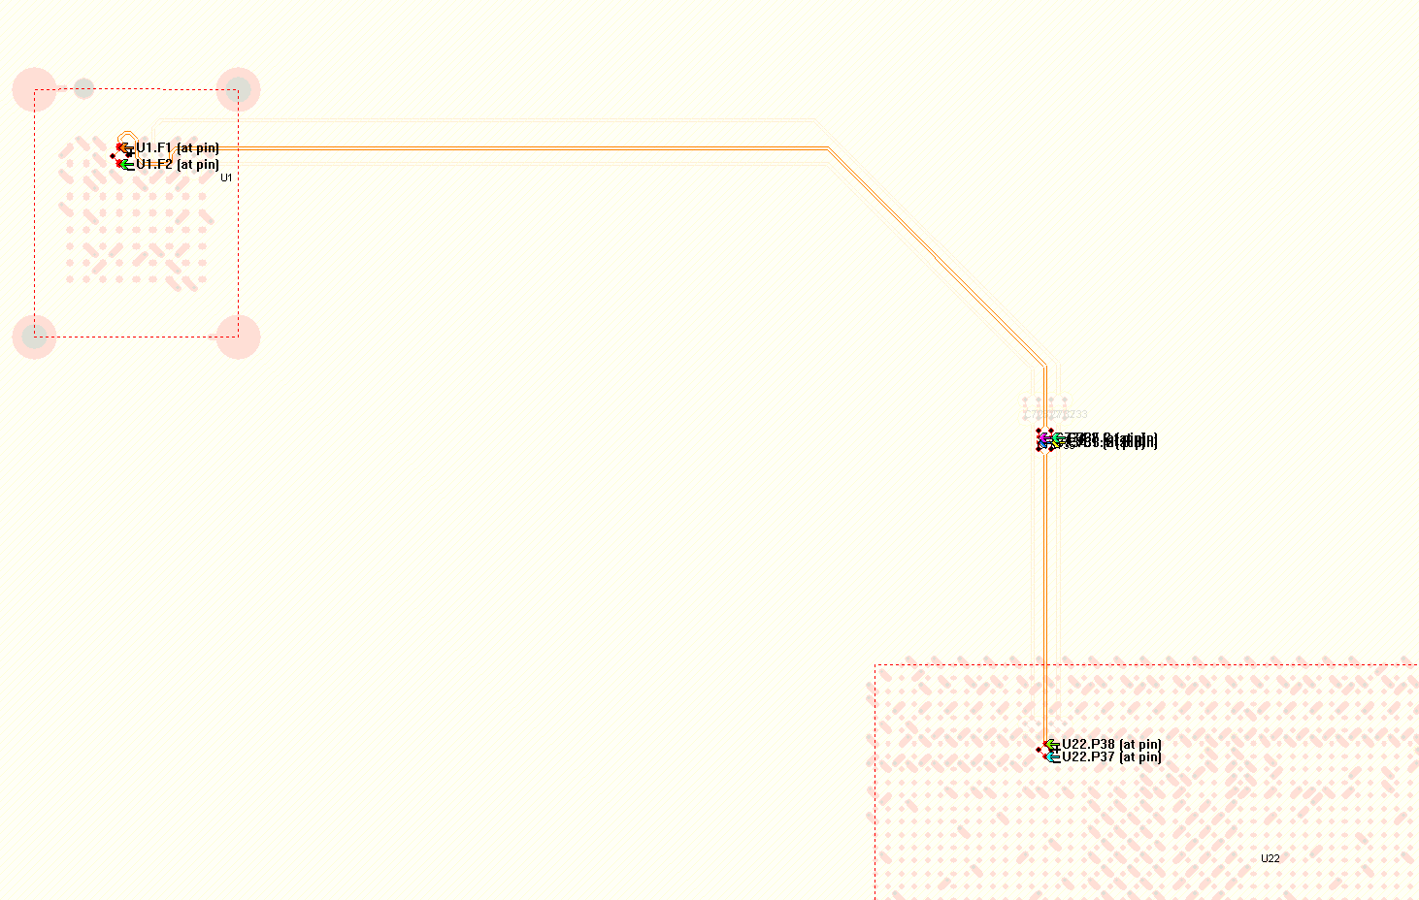
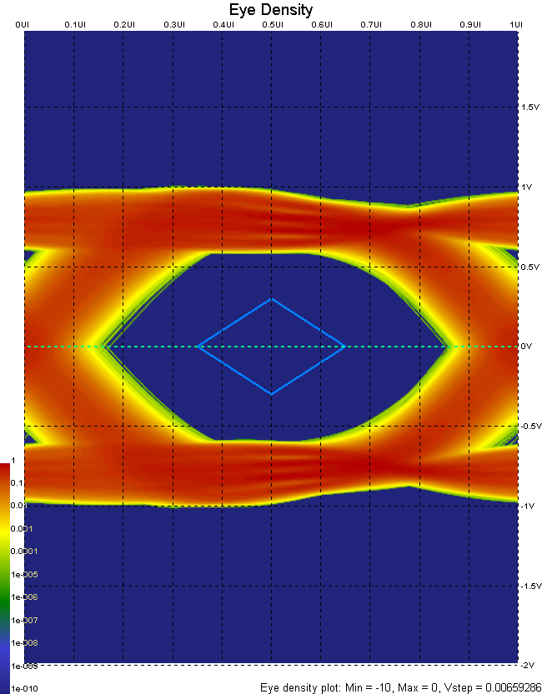
Simulations
Stressed Eye – Based on SFP+ Spec
128 bit per UI
1 million UI
8B/10B
PreEmp = 5 (100)
AMI-Dj-min = 5ps
AMI-Dj-max = 15ps
AMI-Sigma = 2.3ps rms

Slide 12
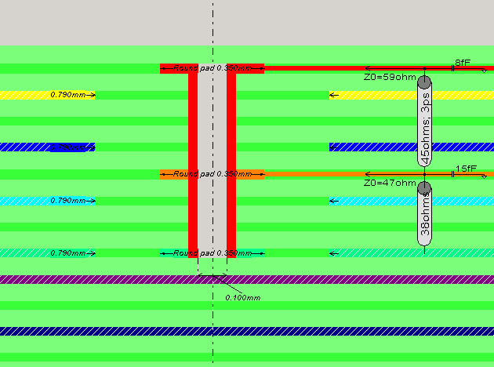
Via impedance..
Via length, excluding stub < 0.4mm
Signal takes < 3ps to traverse via

Slide 13
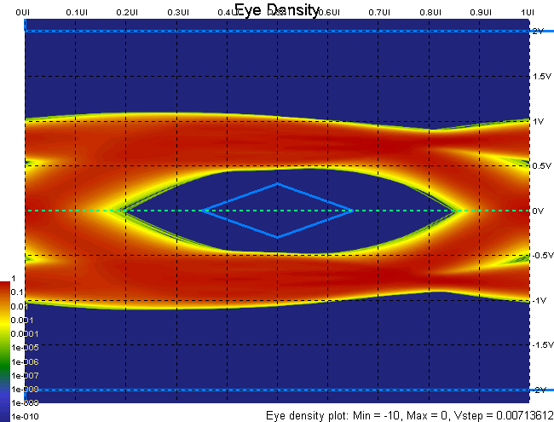
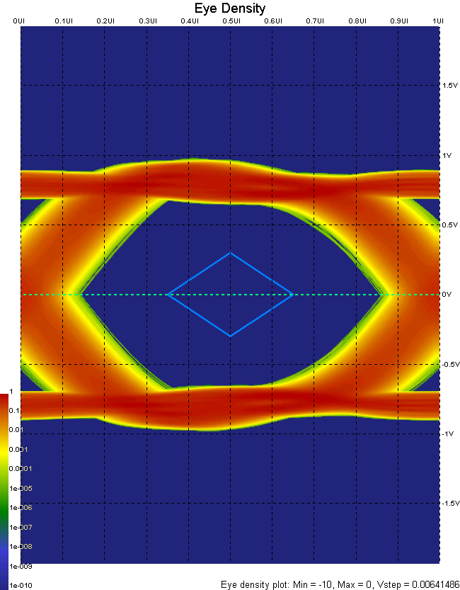
Stressed Eye & Via Inductance
AMI-Dj-min = 5ps
AMI-Dj-max = 15ps
AMI-Sigma =2.3ps
128 bit per UI
1 million UI
8B/10B
PreEmp = 5 (100)
0.35mm pad,
0.15mm real drill
Diff Imp = 77
0.20mm pad,
0.11mm real drill
Diff Imp = 104
Diff Imp = 62
Not buildable!

Slide 14
End

