Slide 1






Korea CMS team Report
Apr. 23, 2012
The 11th CERN-Korea Committee
Inkyu PARK
Dept. of Physics, University of Seoul
Notes:
1

Slide 2
An introduction
for our new
CKC members

Slide 3
Brief history of Koreans at CERN
1980-1990: Prehistoric age (individual based)
  individual participations
1990-1998: LEP age (research group based)
  e+ e- collisions at Z0, W pair production energies
    ALEPH : KU, KWNU et al.
    L3: KNU, KAIST et al.
  Neutrino oscillation
    CHORUS : KSNU et al.
1998-2006: LHC preparation age (university based)
  MOST (Former MEST) funded “Korea-CMS” (~$2M)
    12 universities
      Superconducting magnet platform (815kCHF)
      Forward RPC production (500kCHF)
      Online DAQ hardware (500kCHF)

Slide 4
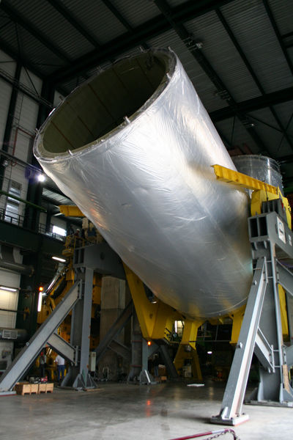
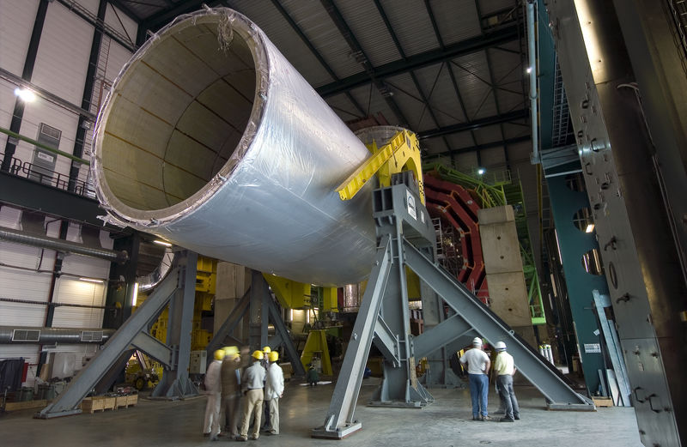
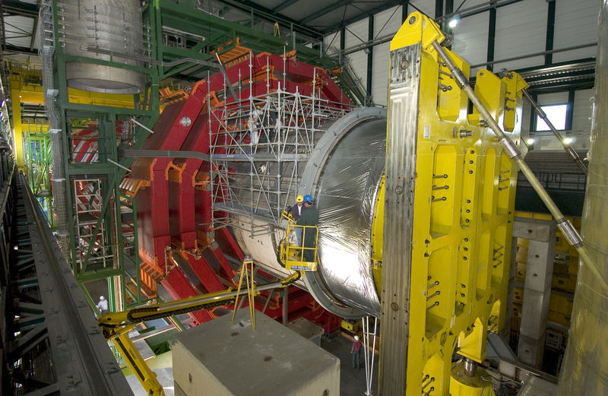
1998-2006 : Swiveling table

Slide 5
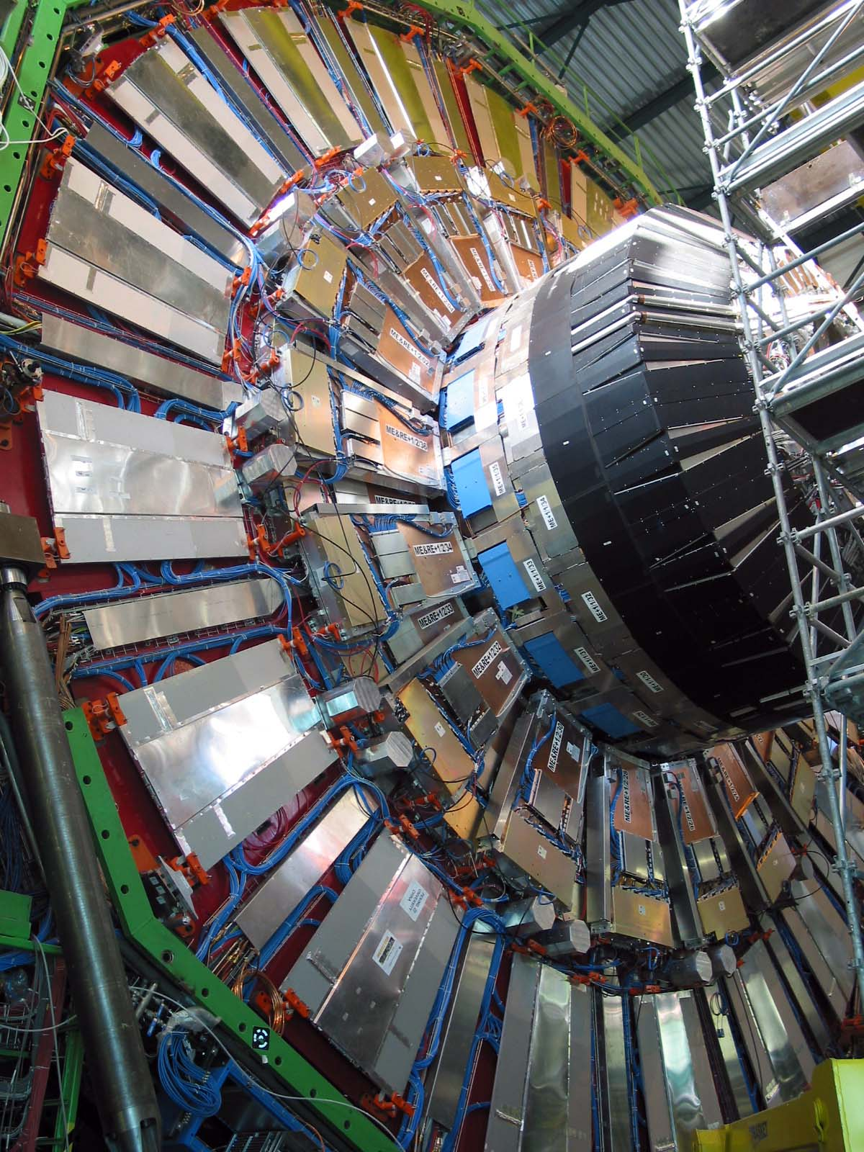
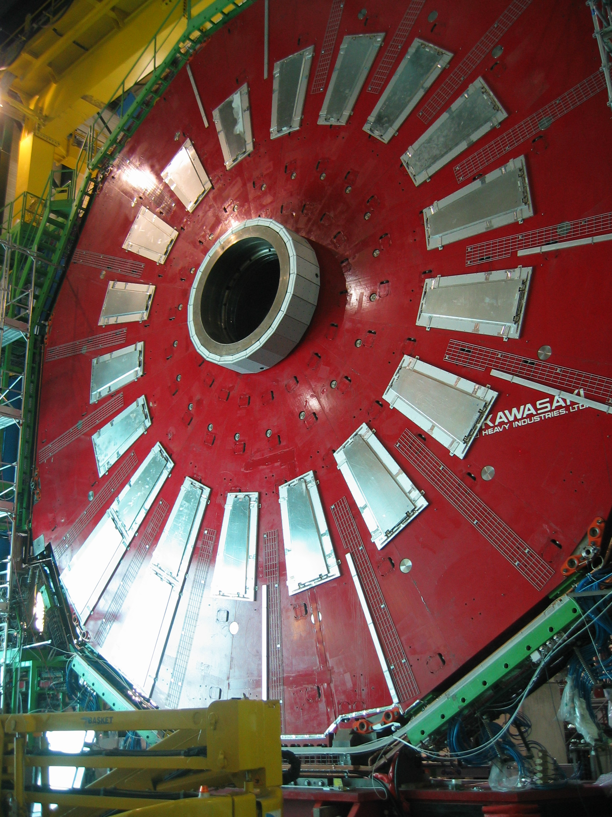
1998-2006: Forward RPC

Slide 6
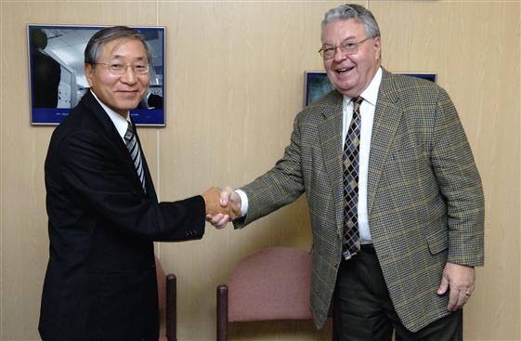
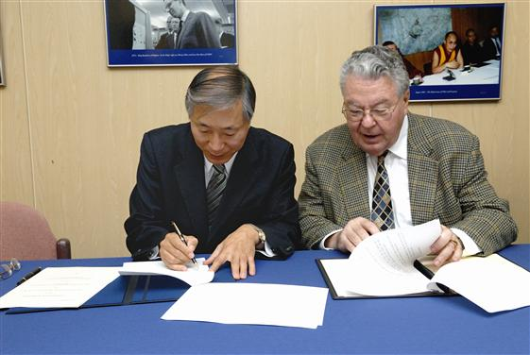
2006: Korea-CERN Program launch
2006: CERN-Korea Collaboration Agreement
      Won-Hwa Park, Ambassador of the Republic of Korea to Switzerland
      Robert Aymar, Director General of the CERN
Followed by K-CMS, K-Alice MOUs
  Yearly budget of ~$1M

Slide 7
New Era of CERN-Korea Program
2007-present: LHC age (federation based)
  Organization
    Ministry, Funding Agency, Research Teams
  Federations of universities
    Korea CMS, Korea ALICE
      Research, communication, competition, evaluation,
      M&O-A, M&O-B, contributions to H/W construction
  Supporting programs, Fellowship, Education
    CMS/ALICE Tier2 computing
    Korea-CERN Theory Fellowship
    High-School Teacher Education
What will be the future?
  Evolution to a National Laboratory / a HEP Organization.
    KEK (Japan), FNAL, BNL (USA), DESY (Germany), CERN (EU)
    IN2P3 (France), INFN (Italy)

Slide 8
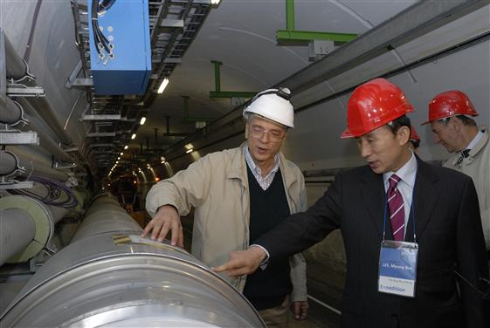
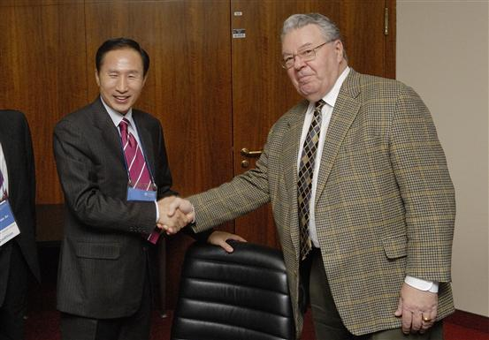
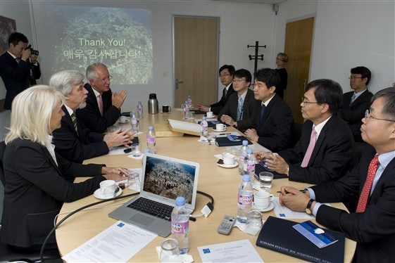
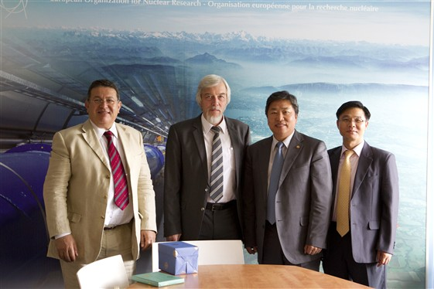
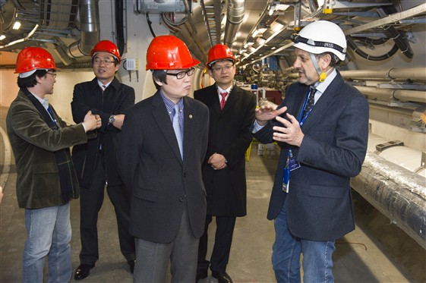
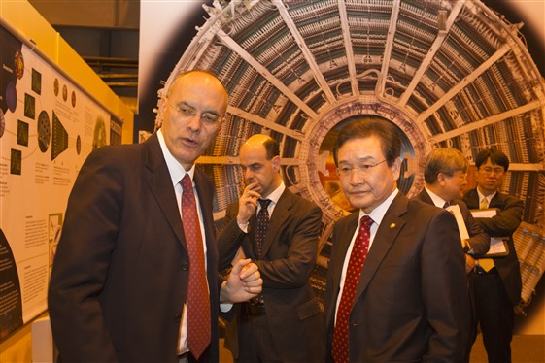
2006 – present : Visitors
2006:
Mayer of Seoul
…
2010:
Nat’l Assembly
Ambassador
Minister & Vice Min.
2011:
Vice Min.
National Assembly
National Labs.
Media : KBS, MBC, EBS
Journalists

Slide 9



K-CERN Program Organization
CERN-Korea Committee (CKC)
K-CERN Program
Review Committee
Korea
CMS
Korea ALICE
Tier2
LCG
Theory
HST
7 univs.
70 members
4 univs.
40 members
CMS: KNU
ALICE: KISITI
KPS
PP div.
High School
Teacher Program

Slide 10
K-CERN Program budget
Budget profile
  Small bang → inflation → slow down → accelerating expansion..
    Contribution to CMS/ALICE upgrade (LHC LS1, LS2)
      Dark Energy : MEST / NRF + visitors + media …
(Unit: 1BWon~M$)
CERN-Korea Programs | Host | 2007 | 2008 | 2009 | 2010 | 2011 | 2012
KCMS | UOS | 0.8 | 0.75 | 1.50 | 1.42 | 1.45 | 1.78
KoALICE | PNU | 0.2 | 0.25 | 0.50 | 0.58 | 0.55 | 0.72
CMS Tier2 | KNU | - | - | 0.20 | 0.20 | 0.20 | 0.20
ALICE Tier2 | KISTI | - | 0.1 | 0.20 | 0.20 | 0.20 | 0.20
Theory | KPS | - | - | 0.25 | 0.35 | 0.35 | 0.35
M&O-A | NRF | 0.14 | 0.17 | 0.30 | 0.30 | 0.30 | 0.27
Total |  | 1.14 | 1.27 | 2.95 | 3.05 | 3.05 | 3.52

Slide 11
Main talk
KCMS report

Slide 12

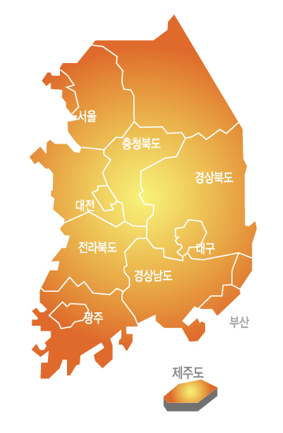







Korea CMS institutions
SNU
(Sep. 2012)
Univ. of Seoul
Kangwon
Korea Univ.
Kyungpook
SKKU
KCMS in number
Faculties: 12
Postdocs, scientists: 15
  CERN (6), short-term visit (9)
Graduate Students: 35
  Ph.D. (21), MS (14)
  CERN (9), short-term visit (26)
Staffs, technicians: 5
  Secretary (1), SI (1)
  Engineers (3)
Chonbuk
Chonnam
7 institutions & ~ 70 participants

Slide 13
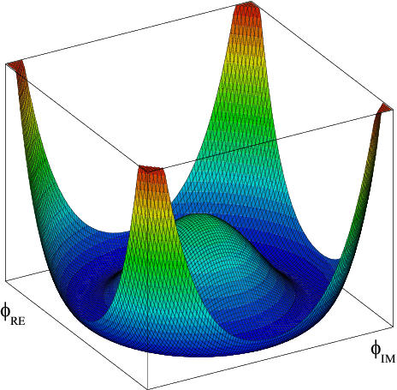

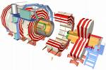
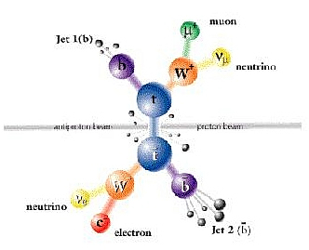

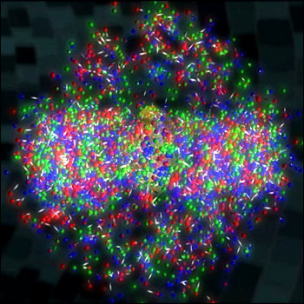
Korea CMS Organization
RPC Det.
Higgs & NP
CMS Upgrade
Top & SM
Launch in 2012
KNU Tier2
Heavy Ion
UOS Tier3
KCMS Office
KCMS Board
monthly
twice / year
CMS Office
CKC

Slide 14
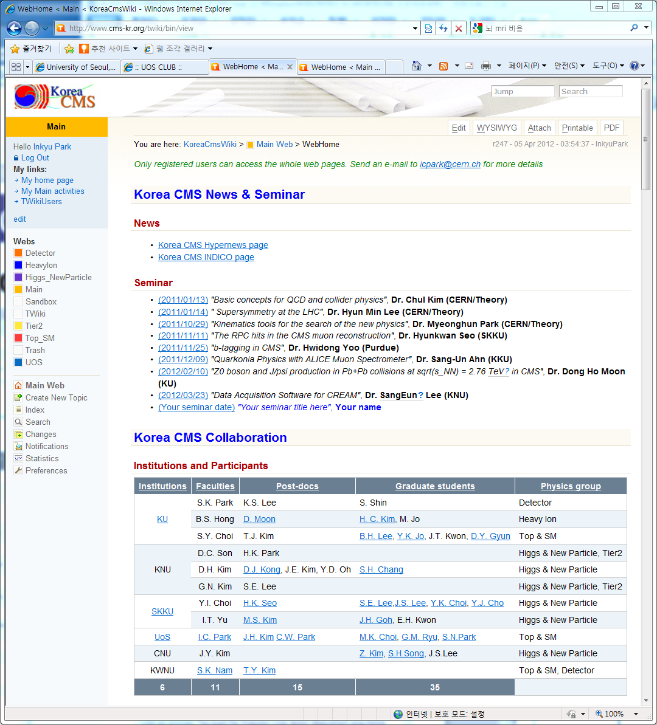
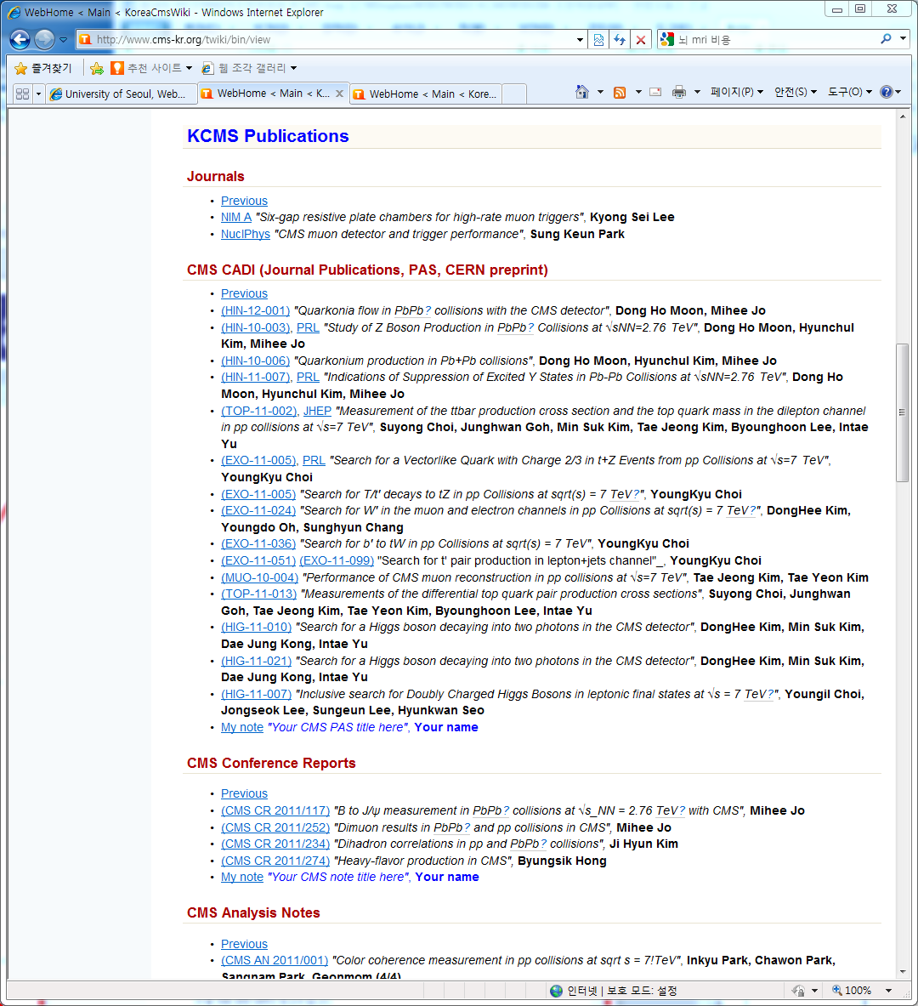
2011 highlight : Th-Exp seminar
http://www.cms-kr.org
14 PAS with
KCMS participants
KCMS seminar at CERN :
Th-Exp cowork

Slide 15
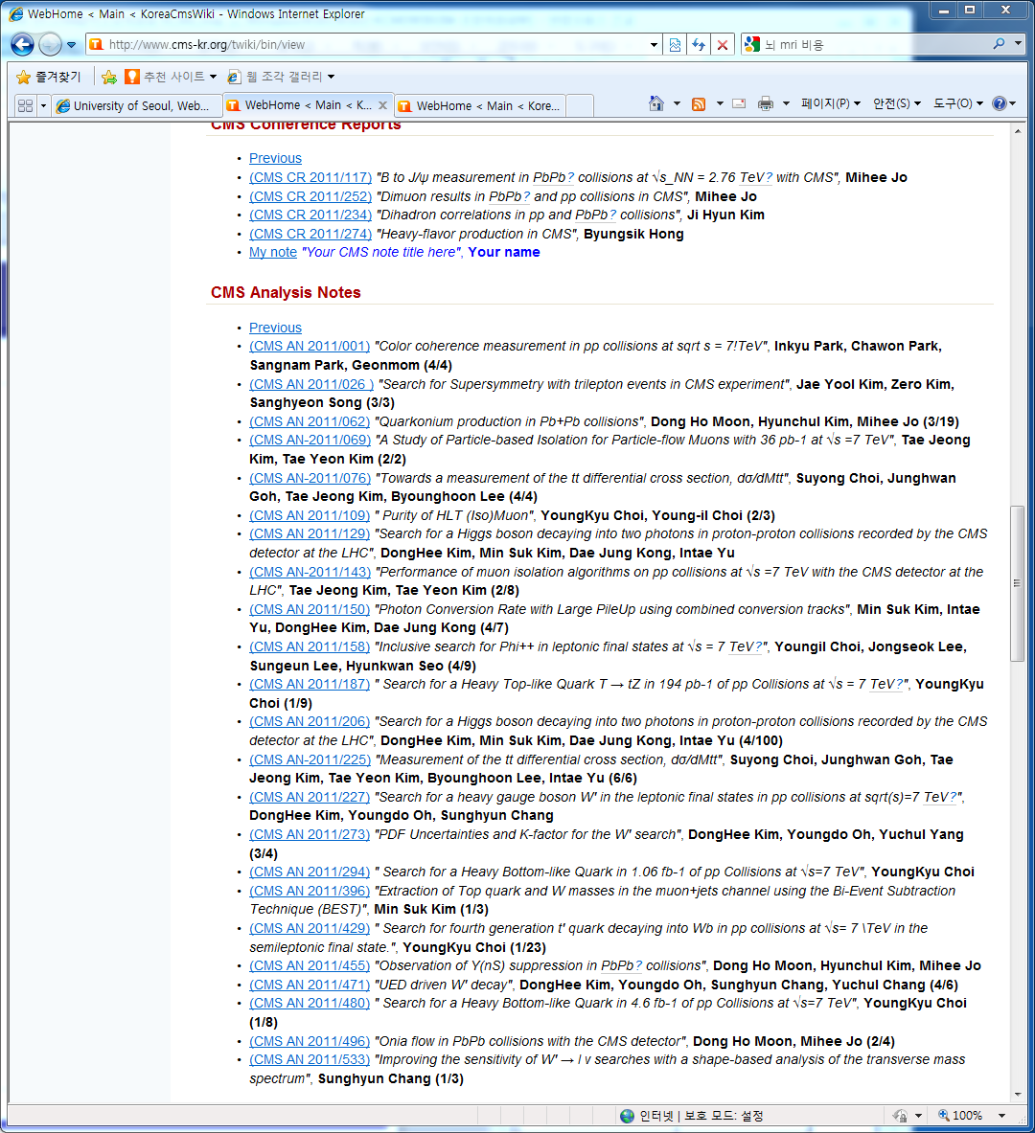
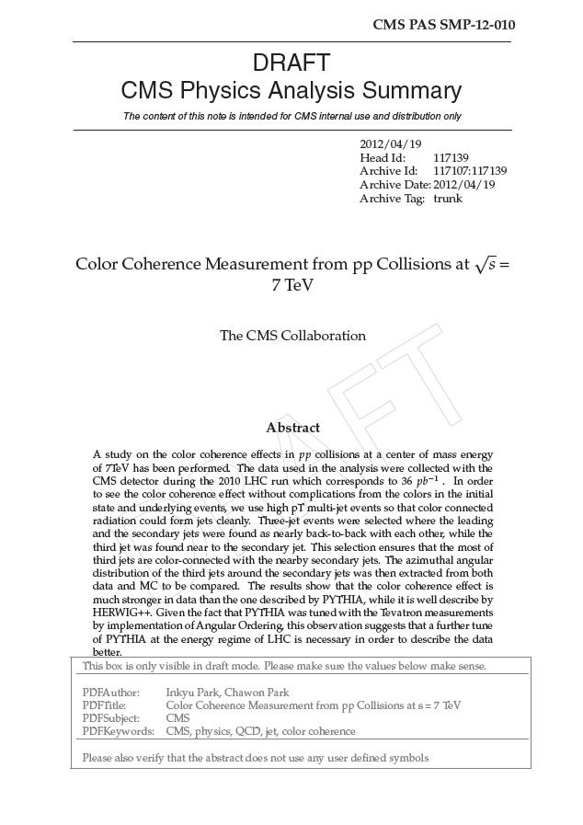
2011 highlight : Physics output
Total CMS AN = 536
  with KCMS authors = 22 (KCMS authors only = 6)
    4% of total CMS AN
    M&O-A share ~ 1.5%
SMP-J PAS for PRL submission:
(100% KCMS authors)

Slide 16
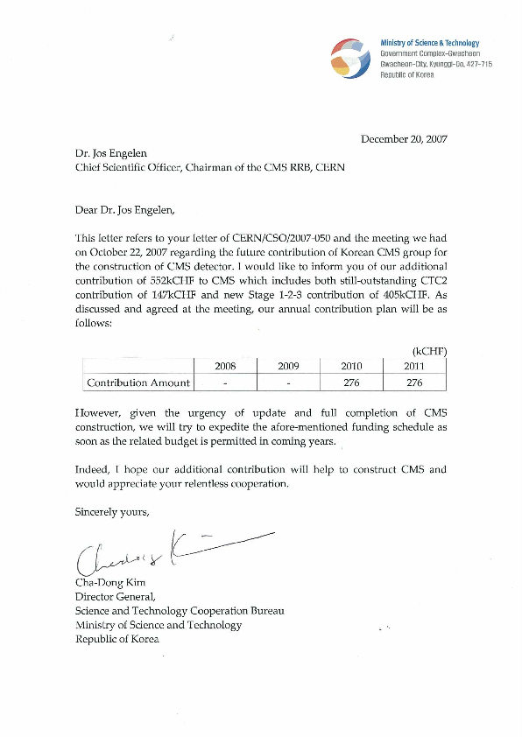
2011 highlight : RPC Step3
MOU signed in 2007
  Cash contribution of 405kCHF
  RPC Up-scope Step3
Completed in 2011
  405,000CHF cash contribution
    KODEL received 360,000CHF to produce 660 RPC gaps
    Production has been started.
Year | Cash contribution (CHF)
2008.05 | 113,992
2009.05 | 57,035
2010.05
2011.09 | 233,973
Total | 405,000

Slide 17
2012 will be a busy year
Year | Authors | M&O-A | M&O-B (CMS) | M&O-B (RPC) | RPC (Upgrade) | CMS CF (Upgrade) | Budget
2007 | 12 | 99,637
2008 | 12 | 117,535 | 39,118 |  | 113,992 |  | 750MW
2009 | 12 | 112,000 | 31,400 | 5,000 | 57,035 |  | 1,500MW
2010 | 18 | 180,538 |  | 48,000 |  |  | 1,420MW
2011 | 21 | 217,620 |  | 45,300 | 233,973 |  | 1,450MW
2012 | 20 (22) | (241,797) |  | 37,200 | ? | ? | 1,780MW
2012 Budget contents
  KCMS (1,780MWon)
    Subsistence, Materials
    M&O-B, CMS upgrade
  NRF (180MWon)
    M&O-A for 2013
      2013: # of authorship increased to 22!
        Detail setup will be commented by Andrzej
RPC Step3 Gap production
= 405kCHF
CMS Upgrade Common Fund
~ 95kCHF
RPC Chamber production
~ 140kCHF
GEM RD51
in discussion
~ TBA

Slide 18

Summary
Continue to contribute H/W construction
  1997-2006 : Magnet Swiveling table, DAQ, RPC
  2007-2011 : RPC gap production
  2012-2014 : RPC chamber production
  2012-2017 : CMS Upgrade in LS1 & LS2 periods
Enhance our activities & visibility
  new institutions, new manpower
    Chonnam (Apr), SNU (Sep)
  more activity in the CMS Upgrade
    RPC chamber, GEM-RD51
  ~ 20 physics analyses / year
    First pure PRL?
  KCMS Board : Goal change
    stable operation → boost up!
Thank you

Slide 19
Back up slides

Slide 20
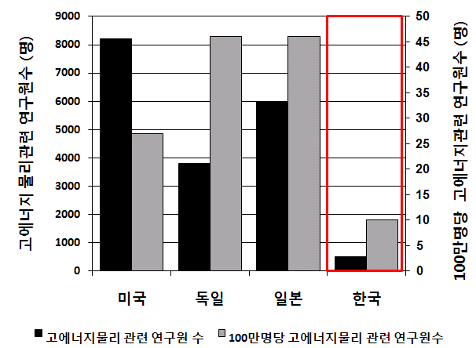
Future of Korea HEP
~500 HEP community (including grad students)
      MEST report (Sunkee Kim et al., 2010/07)
Current funding → chopped up for many projects
  They amount ~$10M / Y already
Korea HEP Lab a la INFN, IN2P3
  $100M/Y seems to be a unit
Country | Labs | Year | Employees | Budget
USA | FNAL | 1967 | 1800 | $310M
 | JLab | 1985 | 617 | $100M
Europe | CERN | 1954 | 3000 | $1,200M
Germany | DESY | 1959 | 1560 | $250M
 | GSI | 1969 | 900 | $110M
England | RAL | 1957 | 1200 | $690M
Italy | INFN | 1951 | 2014 | $450M
Japan | KEK | 1971 | 699 | $400M
China | IHEP | 1973 | 1087 | $100M
Canada | TRIUMF | 1970 | 384 | $56M
 Number of HEP researchers
 HEP researchers / population (1M)
USA Germany Japan Korea
HEP researchers  HEP researchers/population

Slide 21
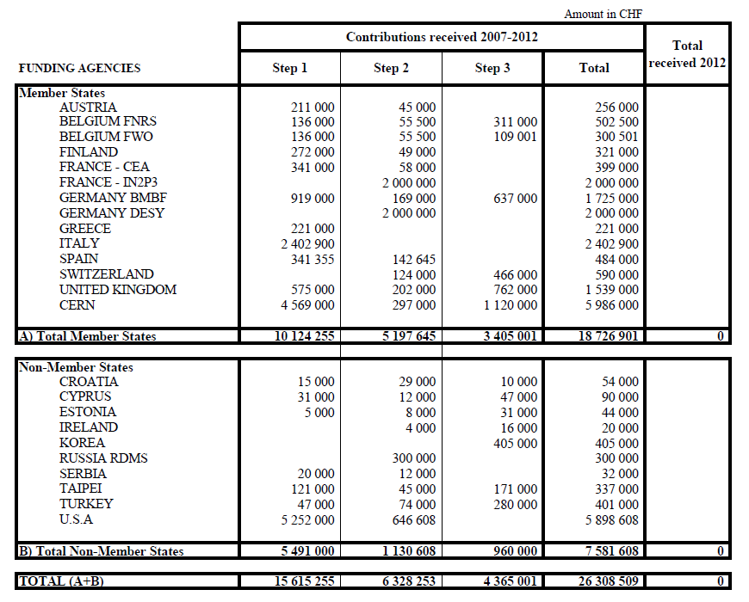
Financial Plan in 3 Steps : 2007-2012
2nd biggest among non-member states

