Slide 1
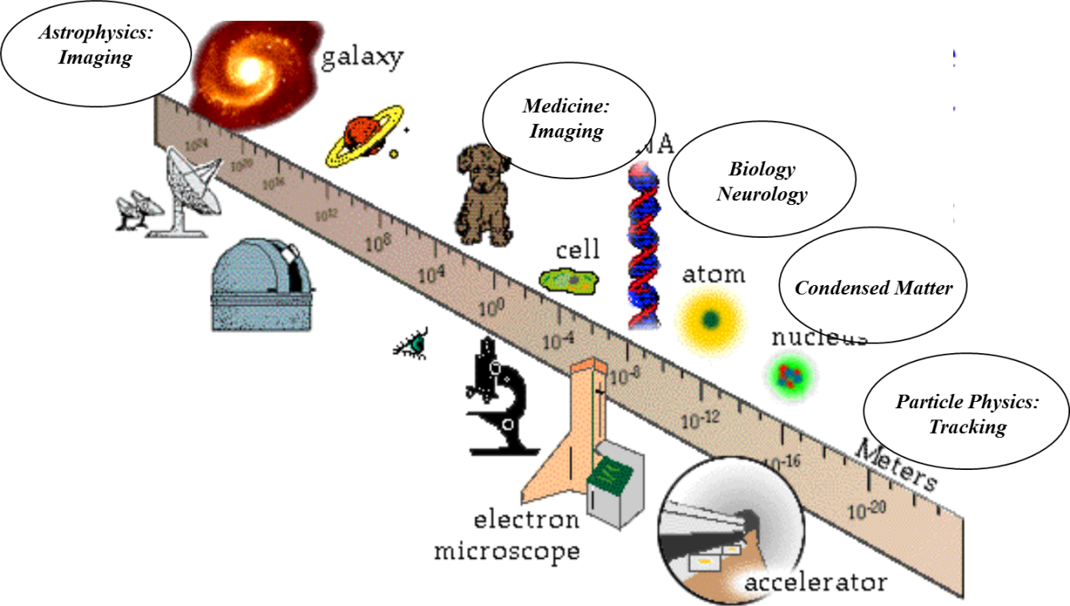
Particle Detector
Applications in Medicine
Hartmut F.-W. Sadrozinski
SCIPP, UC Santa Cruz, CA 95064 USA

Slide 2
Medical Applications
Low-energy instrumentation,
small systems (until commercialization..) profiting from HEP and (even more so) from Astrophysics heritage
Scintillators & Semiconductors (for WCC heritage: Peskov, Nygren talks)
Dosimetry, EH&S
Imaging: Radiography, Tomography
  Photons
  X-ray CT
  SPECT
  PET & TOF-PET & PET/MRI & PET/CT
  Hadrons (MedAustron)
  Intercation Vertex Imaging IVI
  Proton CT

Slide 3
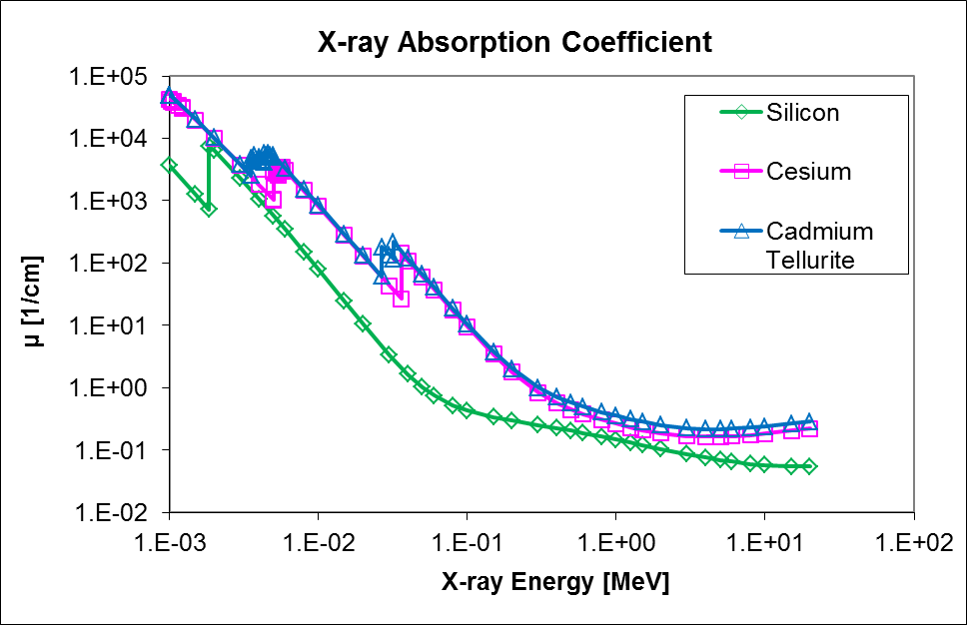
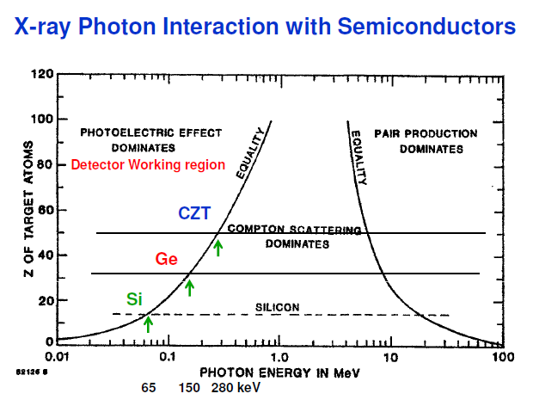
Absorption of Photons N(x) = N_{o}e^{- µ x}
Photons of Medical Interest, Energies & Resolution
µ-waves: MRI (10’s µm)
10-100keV: X-ray radiography and CT (10’s µm)
500 keV: PET and SPECT (mm)
No directional information with exception of Compton
High bone contrast 1-100 keV
Advantage of high-Z detectors:
Shift of Compton region to higher E
reduced range of Compton electrons
reduced range of positron in PET
Larger energy reach (depends on thickness)
300 µm
1 mm
2 cm

Slide 4
Clinical Dosimetry
Silicon:
Routinely clinical use for Q/A in X-ray therapy
High sensitivity, very reliable, well established, and low cost technology
Zero bias operation:: no leakage current & in-vivo applications
New developments:
Pre-irradiation (Sensitivity decrease with total dose),
Pt doping (Total dose and dose rate dependence)
P-type, low-resistivity and epitaxial bulk (Dose rate dependence)
Diamond
Tissue equivalent
small size and good dosimetric properties, small dose rate dependence
New developments:
Effort to replace expensive natural diamond with CVD grown devices
.

Slide 5
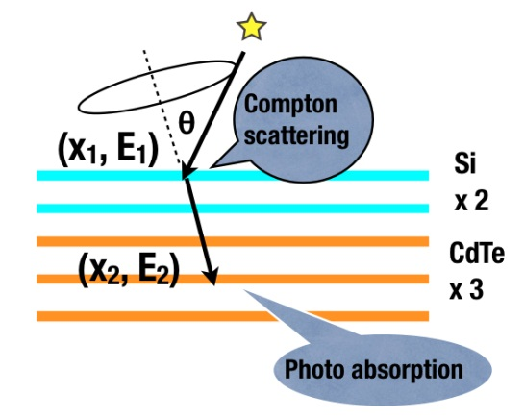
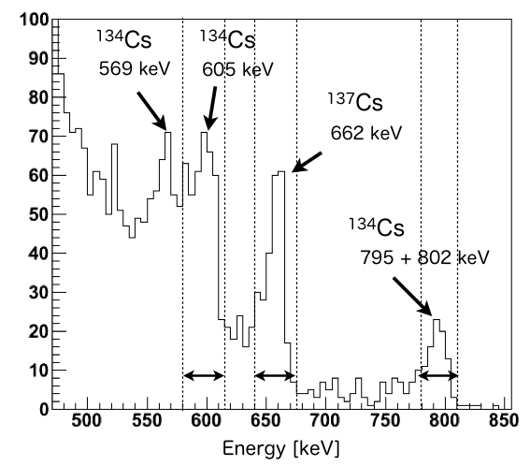
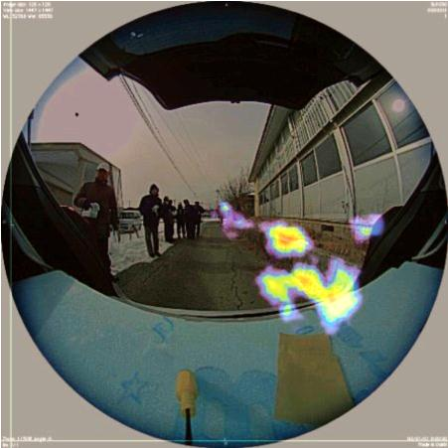
Environmental Health & Safety
Compton Camera:
Also used in SPECT
Remote Sensing: Emergency Dosimetry
Compton Camera: Tracking + Spectroscopy
(would have been useful at Fukushima)
@ VCI:
Handy Compton camera (1 kg!)
J. Takaoka, 13 Feb 2013 9:25 AM
T. Takahashi et al., R05-1 2012 IEEE NSS-MIC

Slide 6
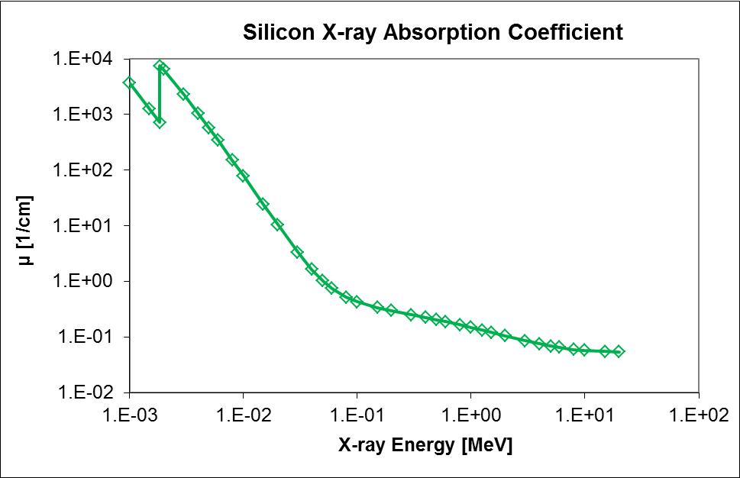
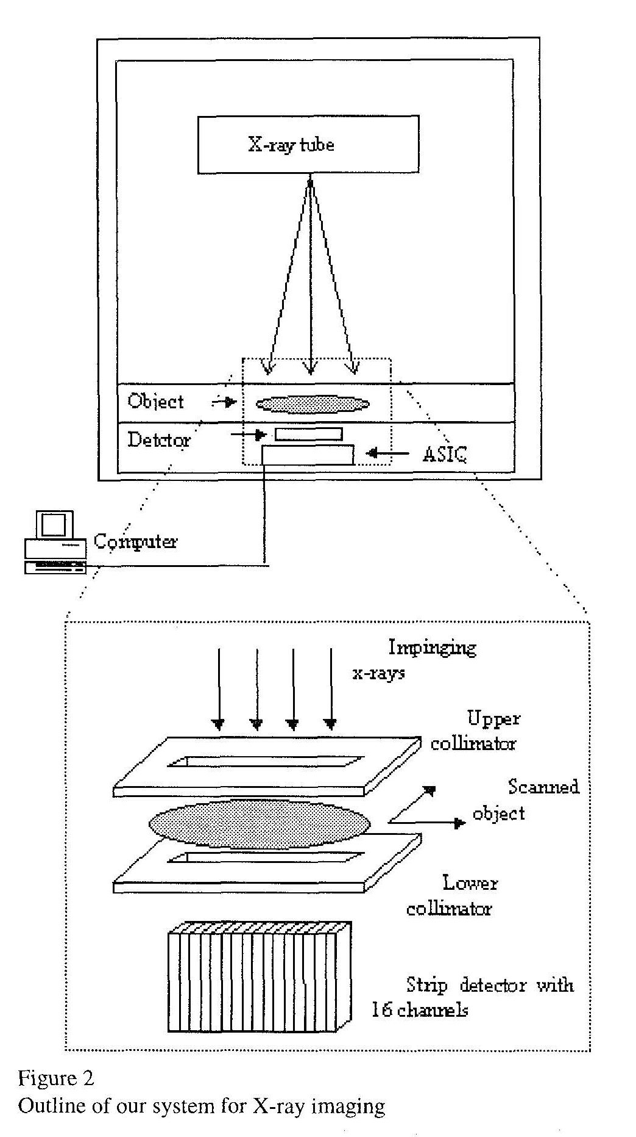
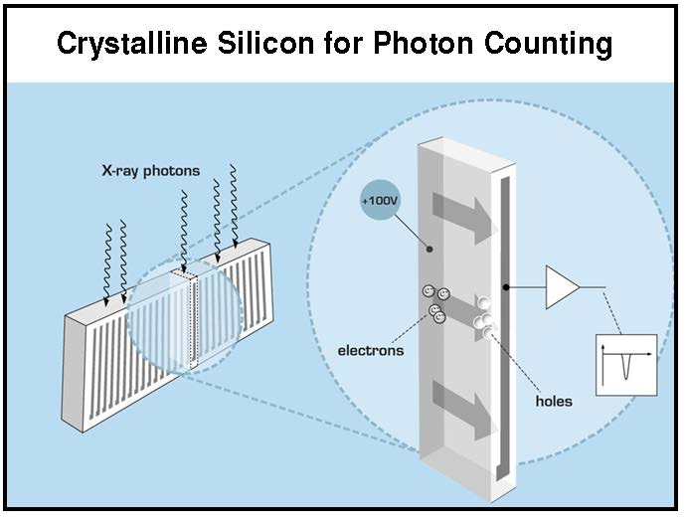
Silicon X-ray Detectors?
X-ray Radiography with Silicon Sensors:
300 µm: ~10 keV
1 mm: ~30 keV
3 cm: ~500 keV
N.B. typical Si wafer thickness 300 µm
“Pixels” on “edge-on” strip sensor:
Depth: ~ strip length ( cm’s)
Area: pitch * wafer thickness
Commercialized
by Sectra Mamea AB (Philips)
IEEE TRANS. NUCL. SCI, VOL. 45, NO. 6, (1998) 3059
High Resolution X-ray Imaging Using a Silicon Strip Detector
E. Beuville, R. Cahn, B. Cederstrom, M. Danielsson , A. Hall, B. Hasegawa, L. Luo, M . Lundqvist, D. Nygren, E. Oltman, J. Walton,

Slide 7
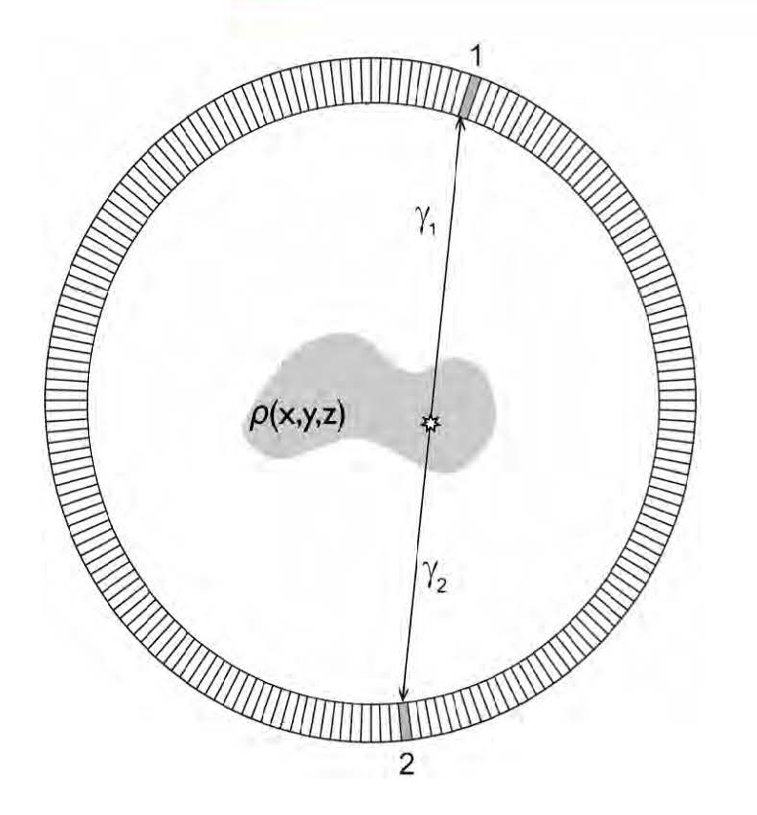
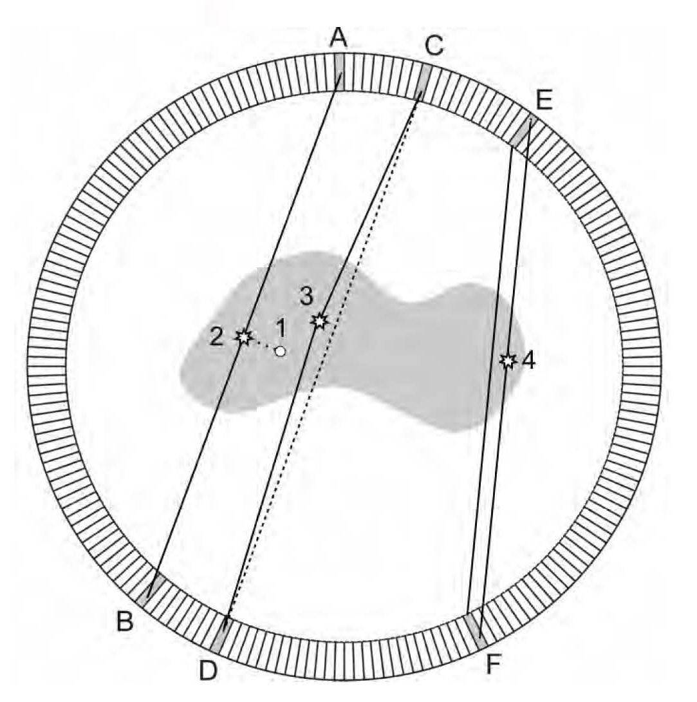
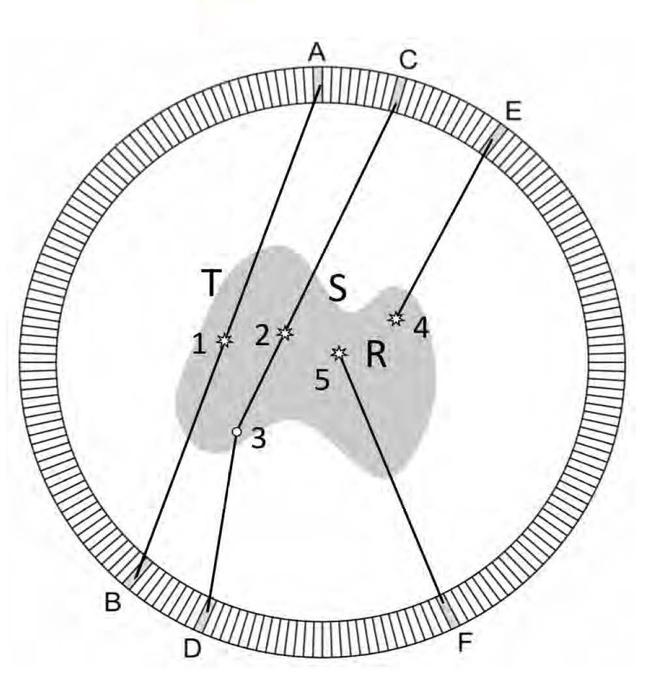
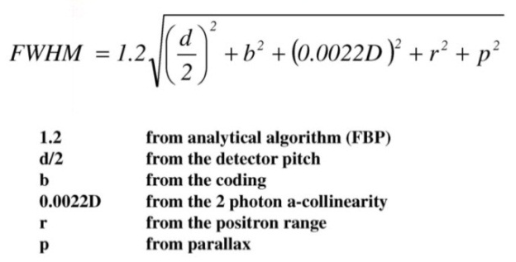
Positron Emission Tomography PET
Study accumulation of radioactive tracers in specific organs.
The tracer has radioactive positron decay, and the positron annihilates within a short
Distance with emission of 511 keV γ pair, which are observed in coincidence.
Perfect Picture:
Resolution and S/N Effects:
Resolution of detector (pitch)
Positron range
A-collinearity
Parallax (depth)
T: true event
S: Compton Scatter
R: Random Coincidence
A. Del Guerra, RESMDD12

Slide 8
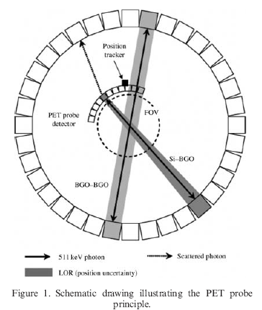
Improving Spatial Resolution in PET
Combination of a standard PET scanner with finely segmented silicon sensors to record the impact position of one or both photons from the annihilation pair.
The high-resolution Si detector is expected to capture a relatively small portion of emitted radiation (2%).
The standard PET image can be locally improved in areas where there is a substantial probability that at least one of the photon pair will interact in a high-resolution detector.
Si detectors 1mm thick, 1 mm x 1 mm pads
vs. cm size crystals.
N. Studen 2012 IEEE NSS-MIC

Slide 9
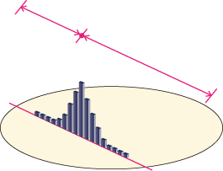
Reduce Accidentals & Improve Image: TOF-PET
PET
t1
t2
TOF-PET
Localization uncertainty:
Δd = c x Δt /2
When Δt = 200 ps
➔ Δd = 3 cm
@ VCI
K. Yamamoto 2012 IEEE NSS-MIC
Notes:
As you know, in Time-Of-Flight Positron Emission Tomography, TOF information provides better localization of the annihilation event and improves the signal-to-noise ratio of the reconstructed image.
For example, when timing resolution is 300ps, position resolution is 4.5cm along the line of response.
In fact, timing resolution depends on the scintillation light yield, detector performance and read out noise.
Multi-Pixel Photon Counter, MPPC is a silicon photomultiplier and expected for use in PET-MR.
Timing resolution required for the MPPC is less than 200ps.

Slide 10
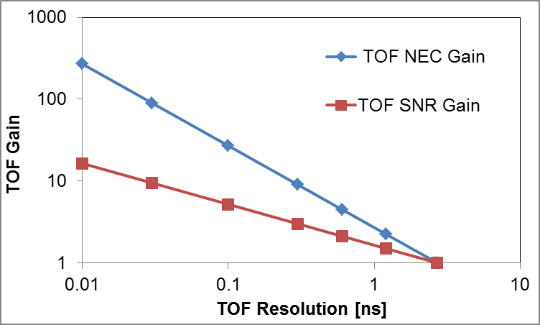
TOF – PET SNR Improvement
The improved source localization due to timing
leads to an improvement in signal-to-noise
and an increase in Noise Equivalent Count NEC
For a given acquisition time and dose to the patient, TOF can provide better image quality and improved lesion detection.
OR
with TOF the scan time and dose can be reduced while keeping the same image quality ( better clinical workflow and added comfort for the patient).
M. Conti, Eur. J. Nucl. Med. MoI Imaging (2011) 38:1147-1157

Slide 11
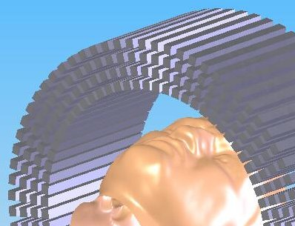
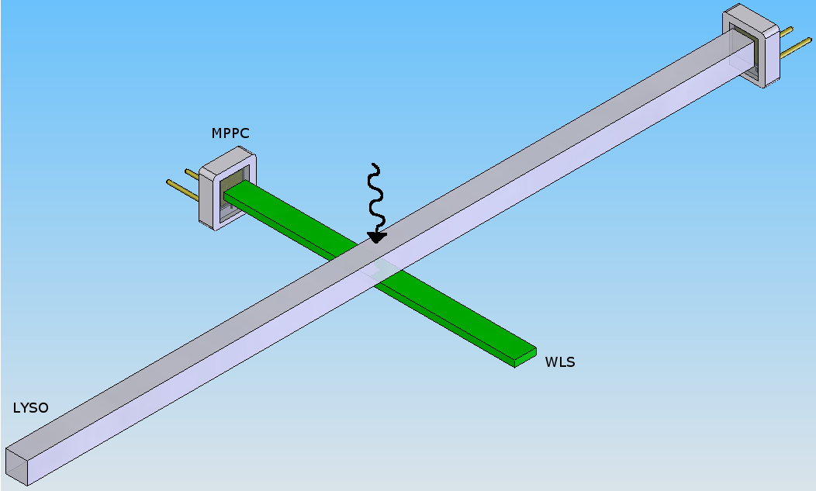
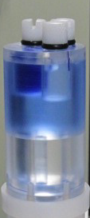
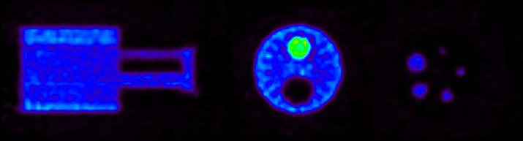
AX-PET
Long axially oriented crystals + orthogonal WLS strips, individually read out by SiPMs
High resolution and high sensitivity, no parallax error
cern.ch/ax-pet
x
Fully operational Demonstrator with two detector modules (96 LYSO crystals, 312 WLS strips).
Evaluated with point sources, phantoms and finally also by imaging small animals
z
y
SiPM
SiPM
3 x 3 mm²,
L = 100 mm
Reconstructed 1 mm rod
=> FWHM ~ 1.6 mm
NEMA mouse phantom, imaged with F-18. (AAA Saint Genis, France).

Slide 12
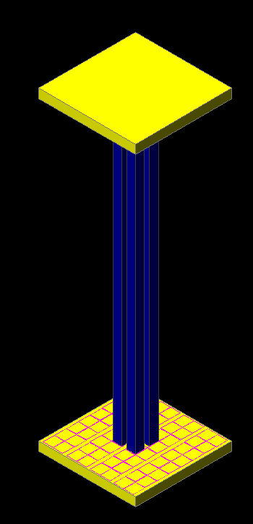
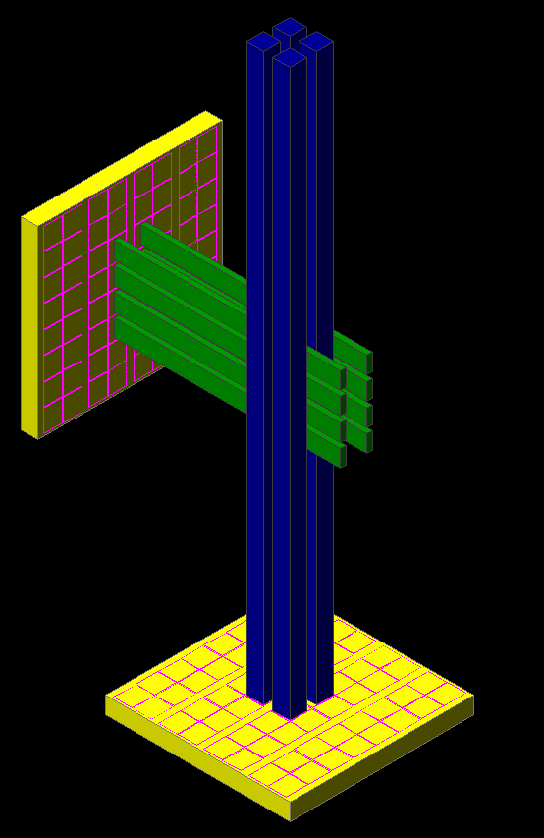

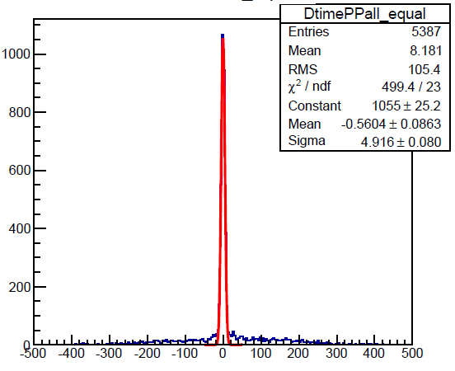
TOF – PET with AX-PET
Single sided readout + WLS strips
Double sided readout
Mini AX-PET like set-ups
with very fast Digital SiPM
→ AX-PET with TOF extension.
Excellent coincidence time resolution even with 100 mm long LYSO crystals, constant over full field-of-view.
= 96 ps
FWHM = 225 ps
@VCI
C. Joram, Friday 15 Feb 2013 4:20 PM

Slide 13
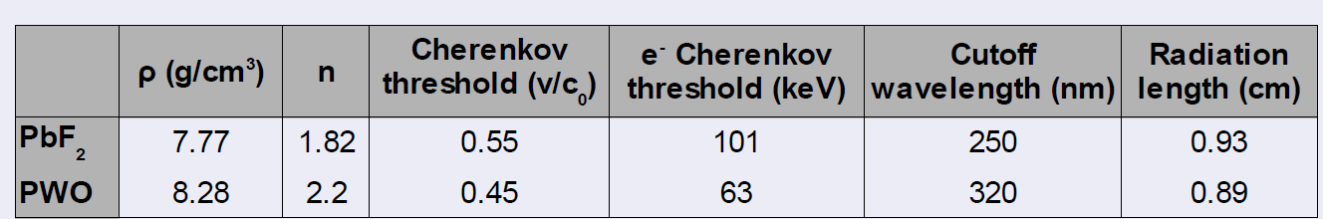
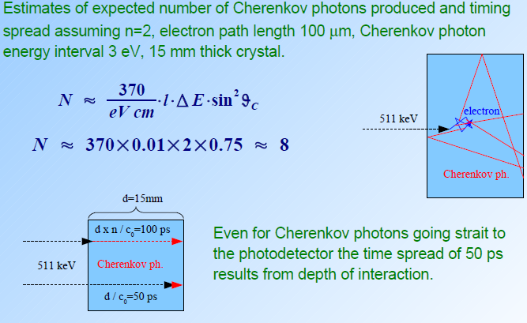
TOF-PET with Cherenkov Light
Cherenkov Light from electrons in the photon conversions
High Z: high electron speed
Hamamatsu MCP-PMT
(prototypes for Belle II TOP):
intrinsic resolution ~ 20 ps
The time resolution obtained with such a system was 116 ps FWHM, with the single detector efficiency of 4.3%.
@VCI
S. Korpar Thu 14 Feb 4:30 PM
S. Korpar, TIPP2011

Slide 14
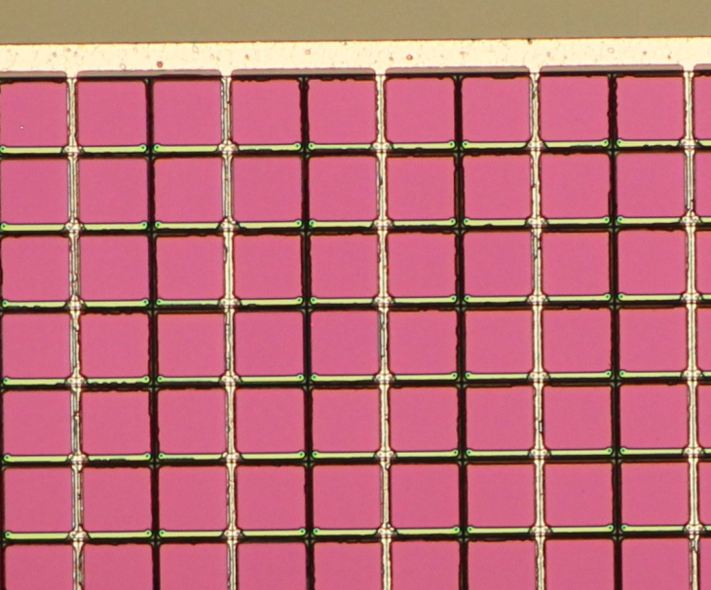
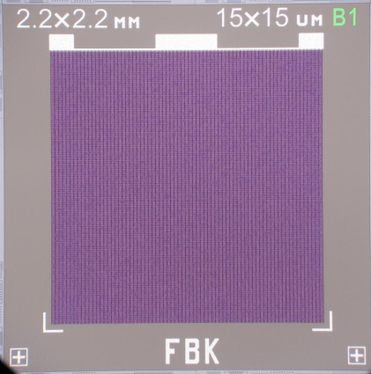
Progress in Photon Detectors
SiPM (Silicon PM) or MPPC (Multi-Pixel Photon Counter)
Solid State Devices good match for Photon Detection
Feature Size, Speed, Power, Low Bias Voltages, Ruggedness, Magnetic Field Insensitivity
Integration: (HPK)
4x4ch discrete array 3x3 mm2 monolithic array
@ VCI:
MPPC (HPK)
K. Yamamoto
H. Sato
Red-Green-Blue High Density SiPM (SRS)
4x4mm2
cell size: 30x30um2
# cells: ~17000
Fill factor = 74%
High Efficiency
2.2x2.2mm2
cell size: 15x15um2
# cells: 21316
Fill factor = 48%
High Dynamic range
@ VCI:
SiPM (SRS)
M. Boscardin
C. Piemonte

Slide 15
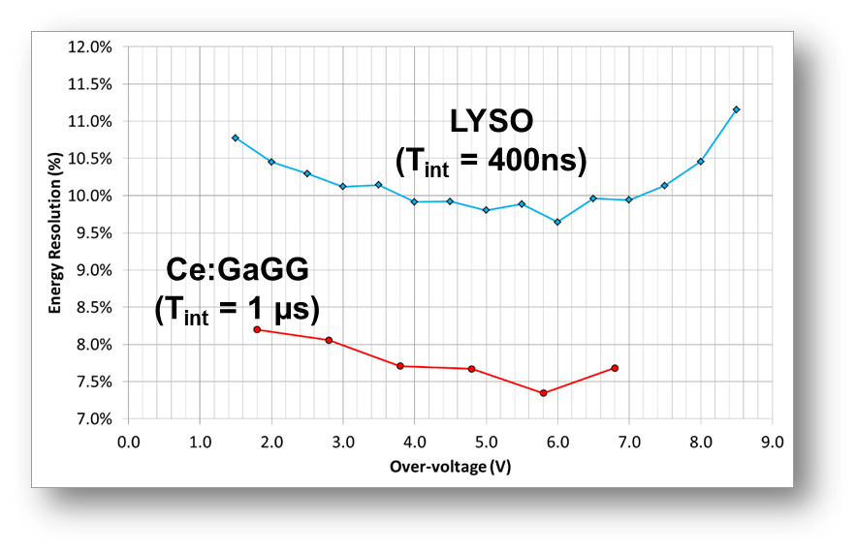
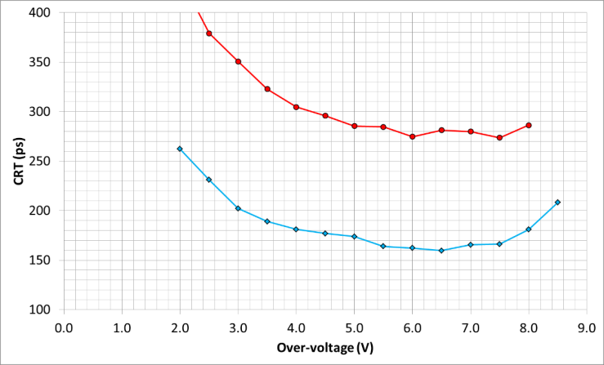
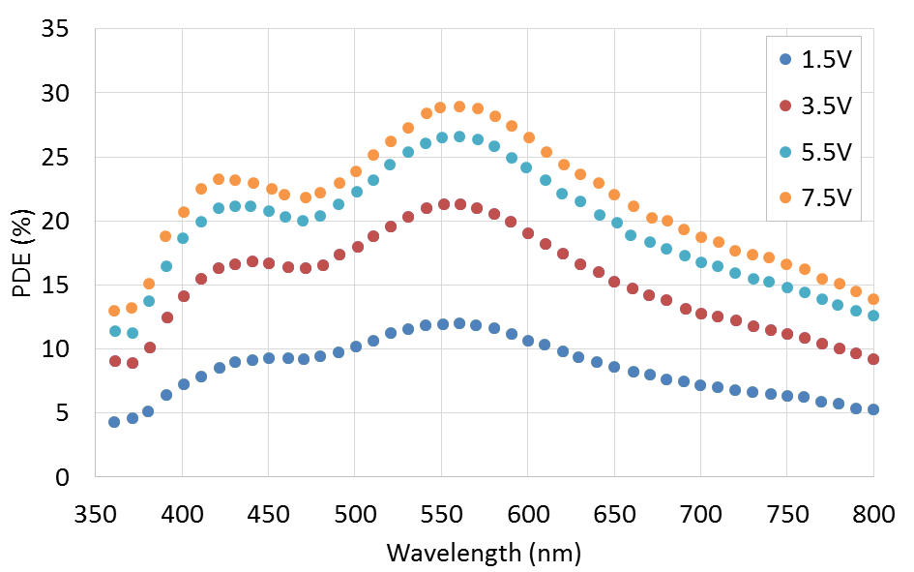
Progress in SiPM: Overvoltage
Resolution in energy and coincidence timing (depence on crystal !)
4x4mm2
:Photon Detection efficiency
2.2x2.2mm²
@ VCI:
SiPM (SRS, FBK)
M. Boscardin
C. Piemonte
Is there a free lunch?
No:
Need to control
the noise rate and the after-pulsing

Slide 16
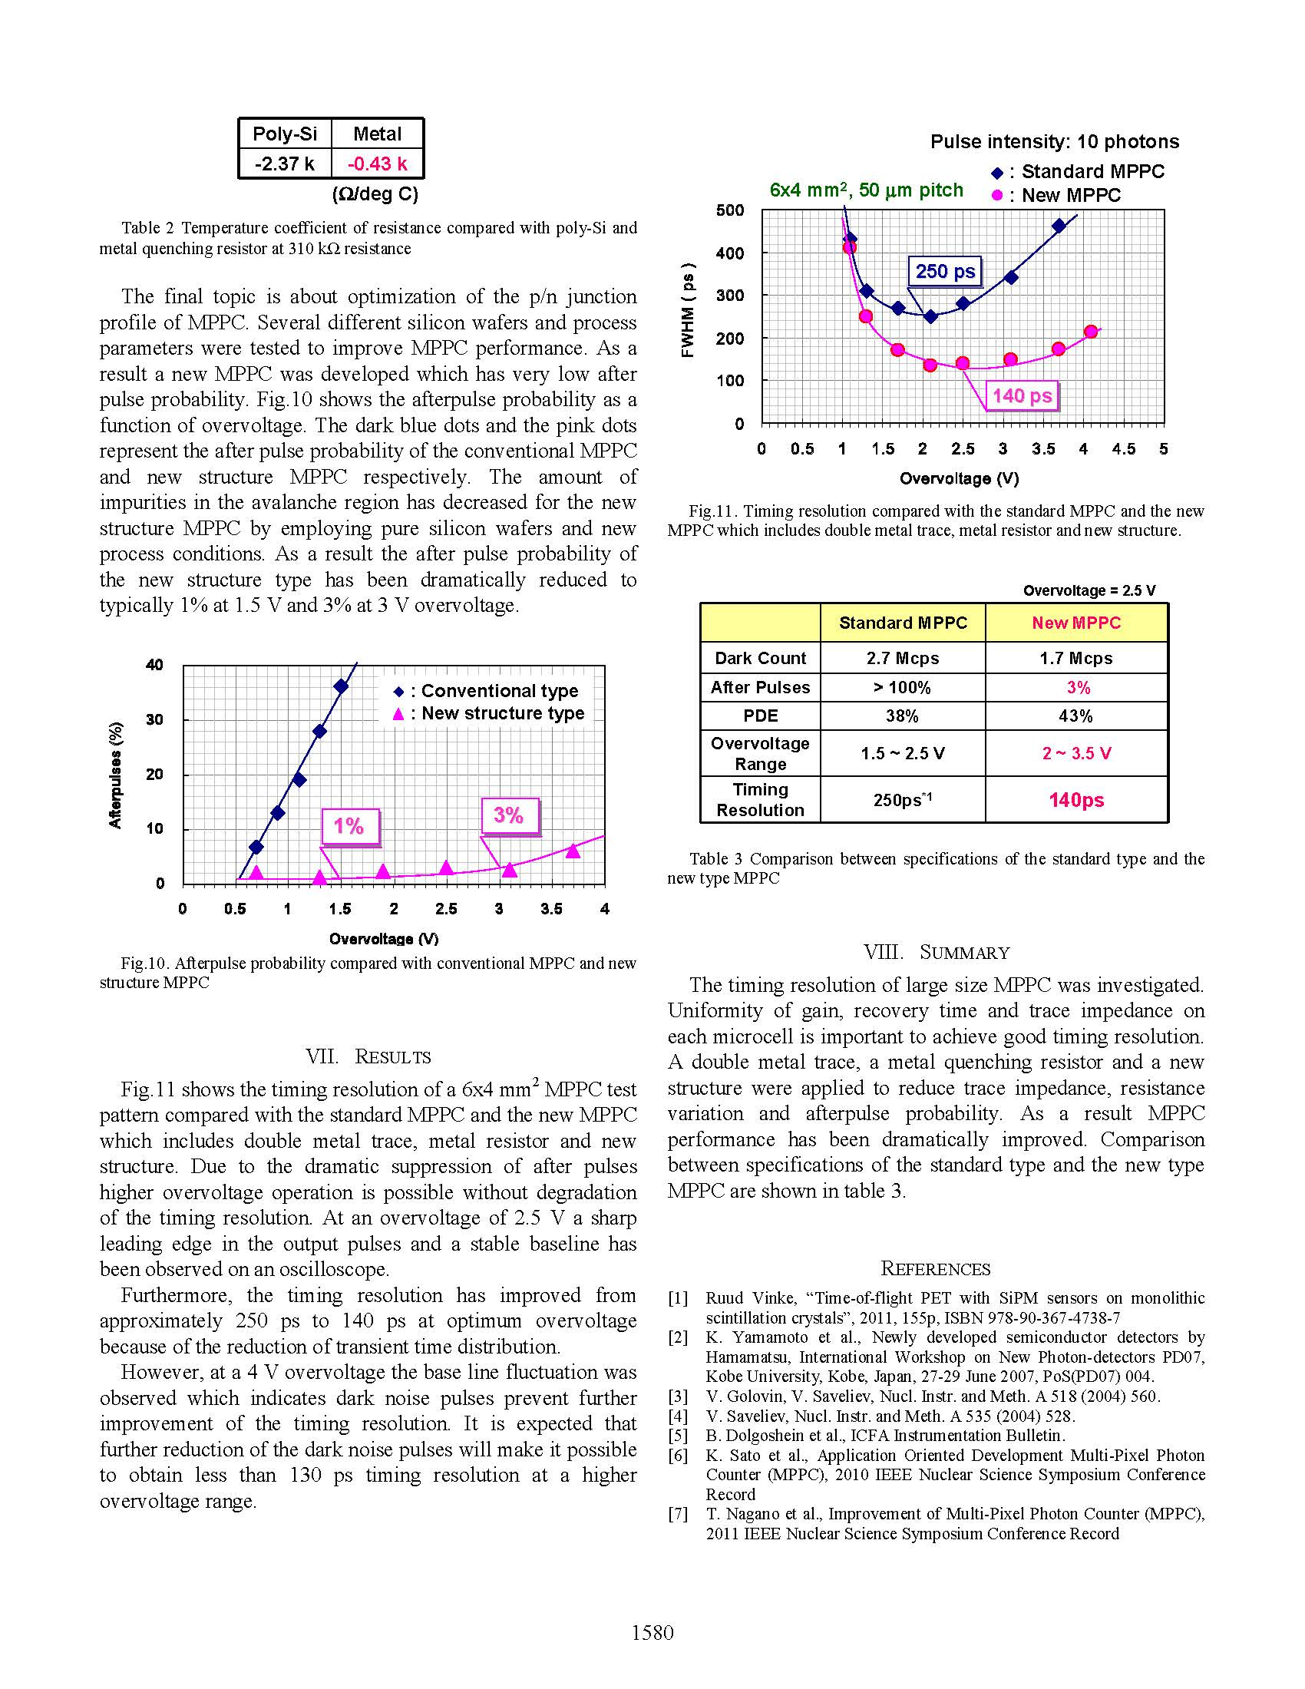
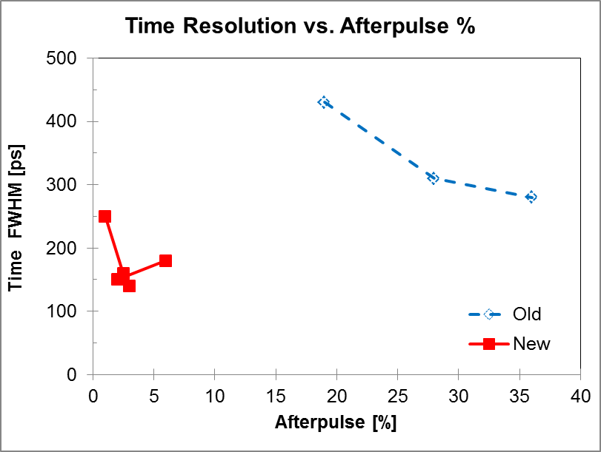
Progress in MPPC: Overvoltage
Expand acceptable overvoltage range
Timing resolution improves from 250 ps to 140 ps
@VCI:
K. Yamamoto (HPK)
T. Nagano et al., 2012 IEEE NSS-MIC.

Slide 17
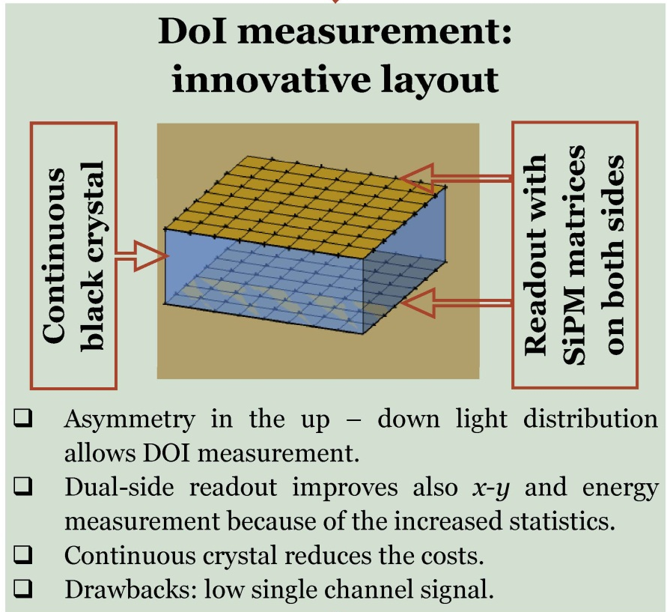
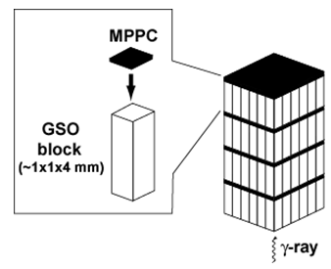
PET Parallax: Depth of Interaction (DOI)
Expected DoI resolution 1 – 2 mm
DoI resolution 1.3 mm
@ VCI:
M. Morrocchi et al.
Thu 14 Feb, 16:55
@ VCI:
K. Yamamaoto (HPK)

Slide 18
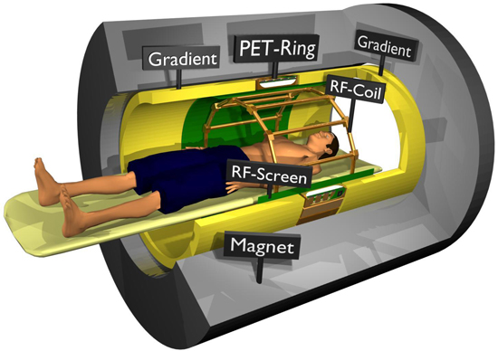
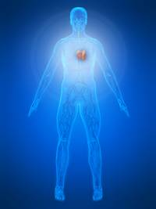
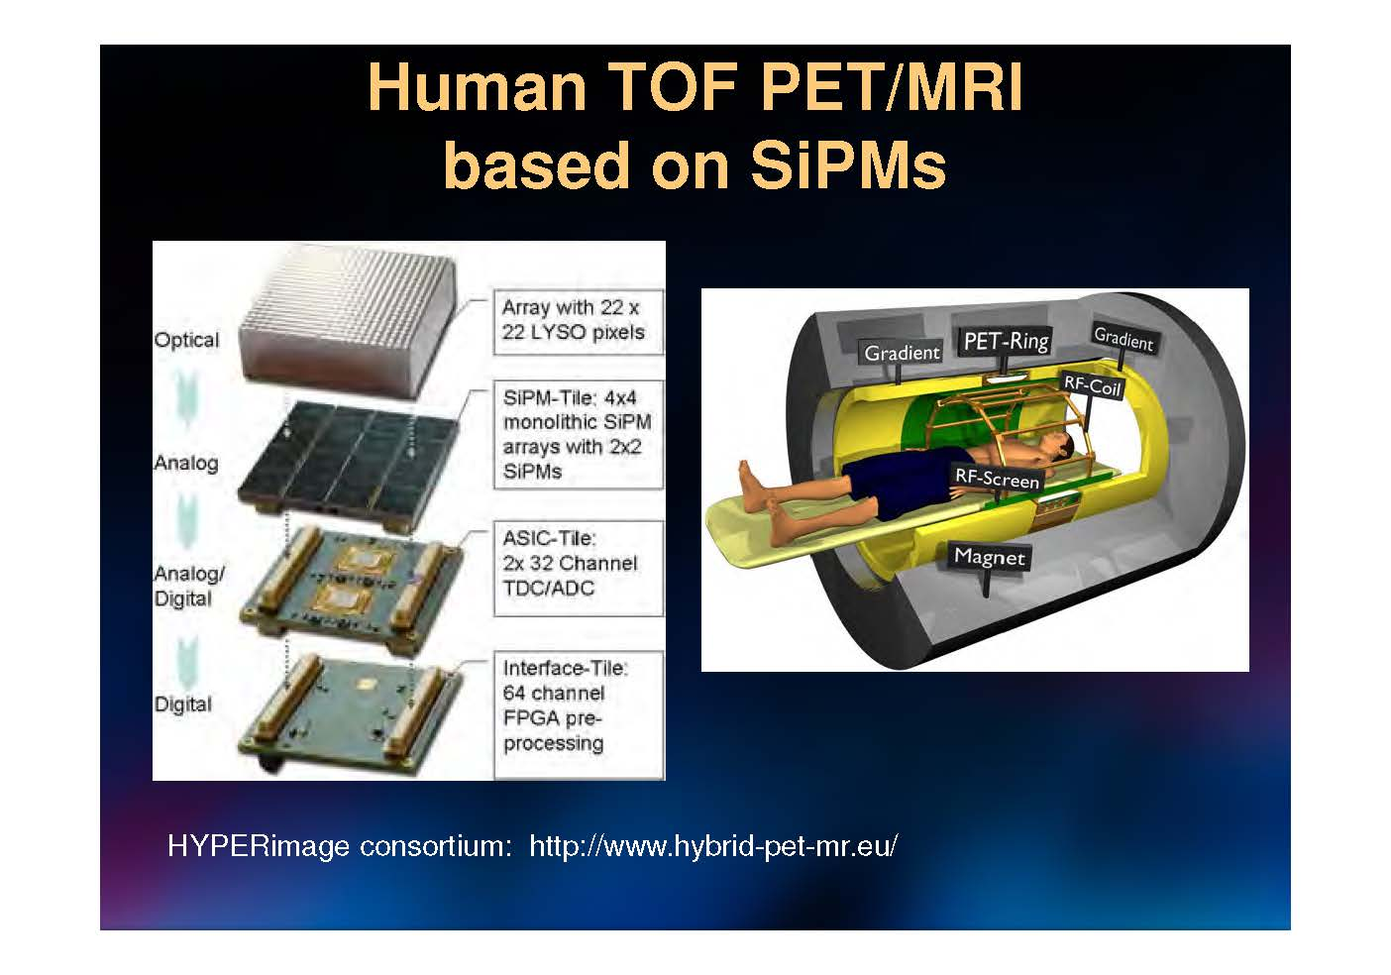
Multi-Modal: PET/CT and PET/MR
PET needs CT data to locate and delineate the tumor and correct for attenuation.
Use of PET in conjunction with MRI has the added advantage that the range of the positrons is greatly reduced in the large magnetic field
@ VCI:
J. NEVES Thu 14 Feb 14:00

Slide 19
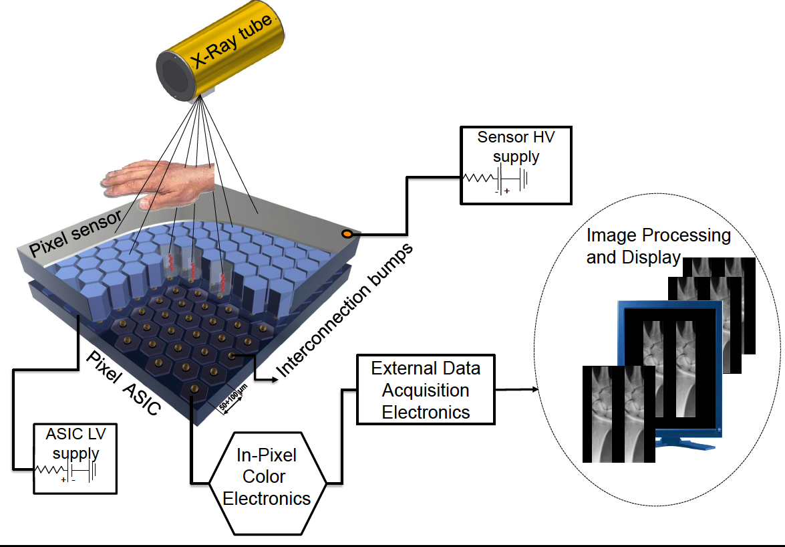
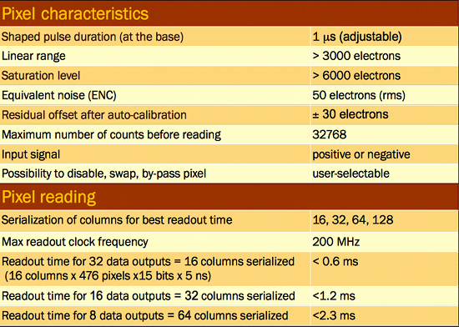
Chromatic X-Ray Counting
Pseudo-analog recording with two
counters per pixel with 2 thresholds
CdTe pixel sensor (ACRORAD Co., Ltd.):
Schottky type diode, electron collection on the pixels
Large area: 30.96 × 24.98 × 0.65 mm
Pixel pitch: 60 μm (on hexagonal matrix)
Very low leakage current @400-500V bias
2 color reading (2 thresholds, 2 counters) or, alternatively, counting in one counter while reading the other one (dead-time free)

Slide 20
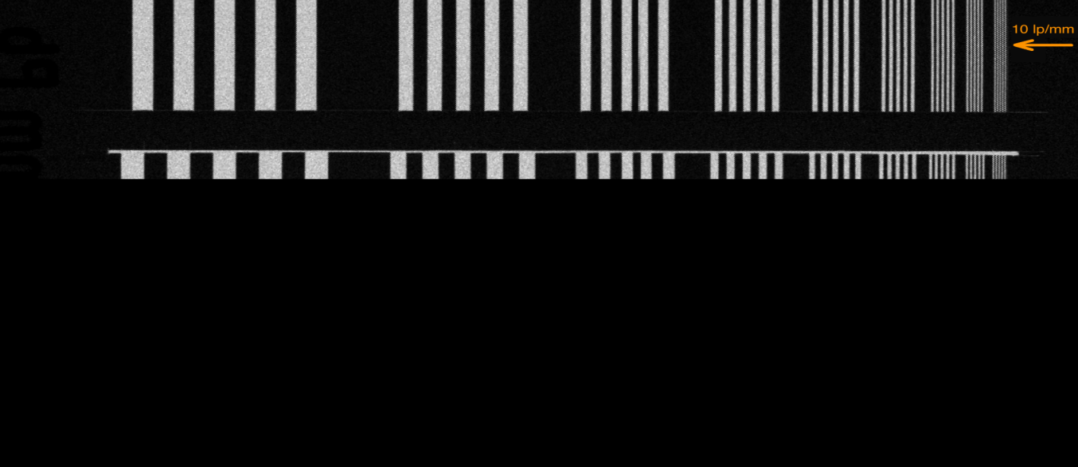
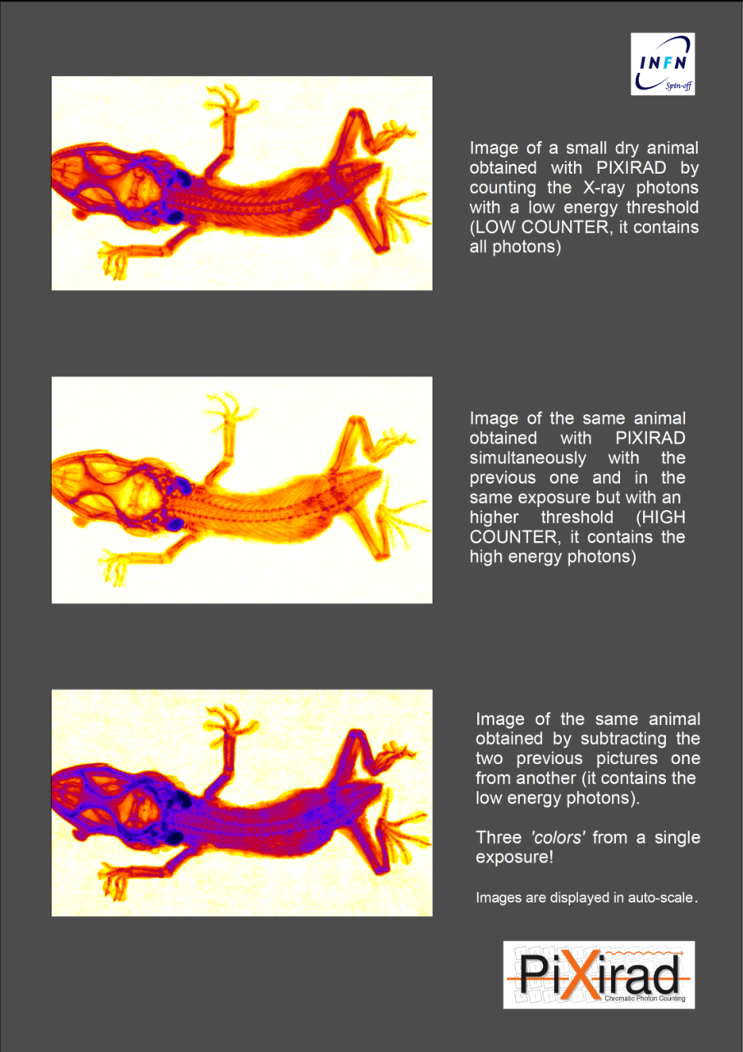
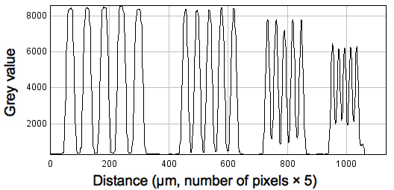
Imaging with Chromatic X-Ray Counting
Pixel rate capability | 10⁶ counts/pixel/s (dead-time corrected)
Global rate capability | 2.4´10¹¹ counts/s (1 chip)
Pixel dead-time | 300 ns
Position resolution | 11 LP/mm at 50% MTF
Energy range | 1-100 keV (with pulse height saturation above 30 keV )
Detection efficiency @10 keV, 50 keV, 100 keV | 100%, 98%, 45%
@ VCI:
R. Bellazzini, Thu 14 Feb 5:45 PM

Slide 21
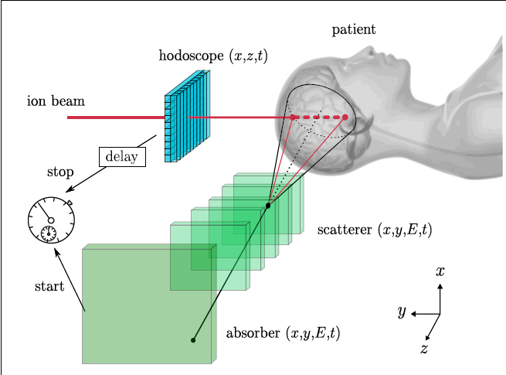
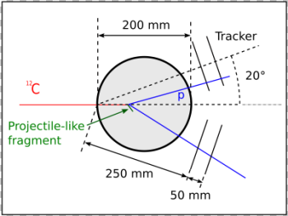
Instrumentation for Hadron Therapy
Highly precise treatment modality due to the Bragg peak is compromised by:
1. Uncertainties localizing patient or beam: ► Interaction Vertex Imaging IVI
2. Patient Stopping power calibration: ► Proton CT pCT
Interaction Vertex Imaging IVI in Carbon Hadron Therapy
γ IVI :
No Range/ MCS
Limitations
Compton Camera
p IVI :
Range and MCS
Limitation:
Thin sensors!
P. Henriquet et al., Phys. Med. Biol. 57 (2012) 1–15

Slide 22
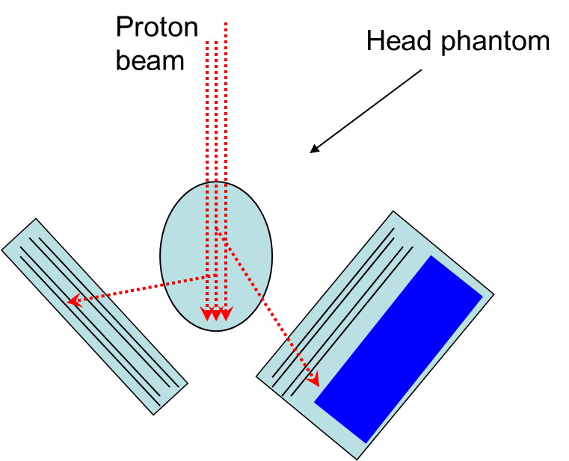
IVI in Proton Therapy
Range and MCS Limitation: Thin sensors!
Single tracks only
Kinematic cut-off at Bragg peak
Small efficiency (but large flux)
Resolution ~ mm
Possibility of Beam line monitoring
M. Battaglia et al.,
2012 IEEE NSS-MIC

Slide 23
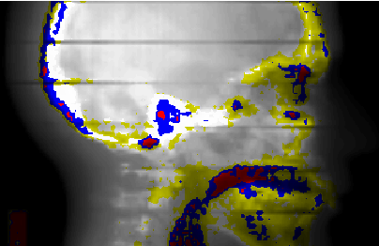
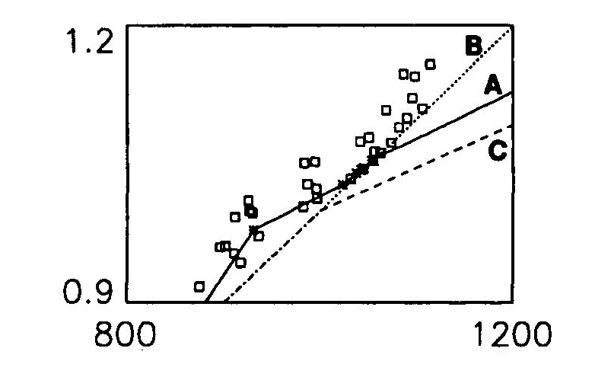
Proton CT Basics
Proton therapy and treatment planning requires the knowledge of the stopping power
in the patient, so that the Bragg peak can be located within the tumor.
X-ray CT has been shown to give insufficiently accurate stopping power (S.P.) maps in
complicated phantoms or from uncertainty in converting Hounsfield values to S.P.
Range Uncertainties
(measured with PTR)
> 5 mm
> 10 mm
> 15 mm
RSP
Schneider U. (1994), “Proton radiography as a tool for quality control in proton therapy,” Med Phys. 22, 353.
Alderson Head Phantom
H
The goal of Proton CT is to reconstruct a 3D map of the stopping power
within the patient with as fine a voxel size as practical at a minimum dose,
using protons (instead of x-rays) in transmission.
In a rotational scan the integrated stopping power is determined for every view
by a measurement of the energy loss.

Slide 24

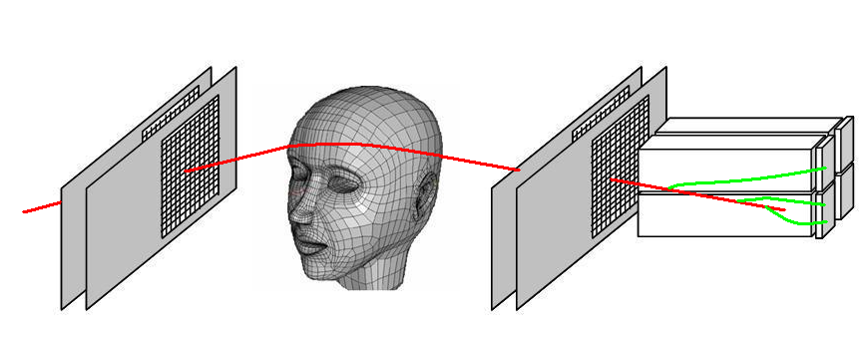
Proton CT (pCT) Concept
Measure Stopping power distribution directly (instead of converting X-ray CT scans
Design of a Proton CT Scanner rotating with the proton gantry
(R Schulte et al. IEEE Trans. Nucl. Sci., 51(3), 866-872, 2004)
An energetic low intensity cone beam of protons traverses the patient
The position and direction (entry & exit) and energy loss of each proton is measured
Proton histories are taken from multiple projection angles
(angular “CT scan”)
Minimal proton loss and high detection efficiency make this a low-dose imaging modality
Tracking of individual protons
Low intensity proton beam

Slide 25
Low Contrast in Proton CT
High contrast in absorption of Photons
N(x) = N_{o}e^{- μ x}
with the linear absorption coefficient µ differing by a factor 10 between bone and soft tissue.
Bethe-Bloch
Low contrast in energy loss of Protons
with the stopping power dE/dl only 50% larger for bone than for soft tissue.
NIST Data

Slide 26
Instrument Solutions to pCT Challenge
Experiment | Tracker | Energy Detector | Typical Proton Energy [MeV]
TERA / CERN U. Amaldi et al., NIM A 629 (2011) pp 337-344 | GEM ~100 μm | Range (3mm) + WLSF + MPPC | 100 upgrade
Firenze / LNS (@ VCI: M. Bruzzi, 14. Feb 5:20 PM ) | SI SSD 80 μm | Fast crystal calorimeter + P.D. | 68 - 200
LLU / UCSC / NIU F. Hurley et al., MEDICAL PHYSICS 39 (2012) 2438-2446 | Si SSD 80 μm | CsI + P.D. | 100 - 200
NIU / FNAL (@ VCI: A. Dychkant Poster 69) | SciFi +MPCC 0.3-0.5 mm | Range (3mm) + WLSF + MPCC | 100 - 200 under construction
LLU /UCSC H. Sadrozinski et al., NIM A 699 (2013) pp:205-210 | Si SSD “Slim edges” 80 μm | Polystyrene Calorimeter + PMT | 100 - 200 under construction

Slide 27
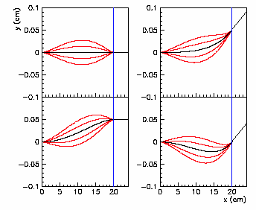
pCT Challenges
#1: Multiple Coulomb Scattering
The proton path inside the patient/phantom is not straight
→ the path of every proton before and after the phantom
has to be measured and its path inside
the patient reconstructed.
D C Williams Phys. Med. Biol. 49 (2004) 2899–2911
From deflection and displacement, calculate the “Most Likely Path MLP”
#2: Proton Data Rate
Data Flow math:
Assuming 100 protons / 1mm voxel and 180 views requires ~ 7*10⁸ protons.
A scan with a proton rate of 2 MHz takes 6 min with a dose of 1.5 mGy.
Image Reconstruction
To reconstruct images with > 10⁷ voxels using ~10⁹ protons is NOT trivial.
Our reconstruction code is already running on GPU’s in anticipation of the much higher data rates of the future.

Slide 28
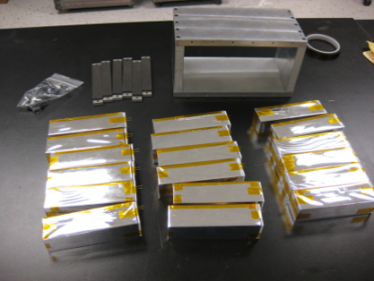

pCT Challenge #4 : Range Straggling
Measure WEPL = Water equivalent Path Length (of proton in phantom)
Range straggling ~ 1% of range ~ 1mm for 100 MeV, ~ 3mm for 200 MeV
Low contrast requires uniform response of WEPL detector
Too slow!
Calibration
elaborate
Existing Hodoscopic
CsI Calorimeter
P.D. Readout
70 plates,
4 mm,
Range Counter
Direct MCPP readout
(signal 3-5x of 3mm+WLSF)
Good performance
on S/N
Polystyrene
Scint.
~ 30 p.e.
SiPM
Multi-stage Scintillator Counter
3 Polystyrene 10cmx10cmx40cm + PM
Uniform Response.
3
-
4”
PMT

Slide 29





3-Stage Multi-Stage Scintillator
10x10x36cm Polystyrene
3’ PMT via light-guide
WEPL Resolution [mm]
pCT Phase I CsI(Tl) calorimeter (F.Hurley et al, 2012 IEEE NSS- MIC )
WEPL Calibration of each stage with
Polystyrene degraders
Calorimeter
3-Stage MSS
(V. Bshkirov et al.,
2012 IEEE NSS- MIC )
Measured Range Counter 4 mm Plates
(Range straggling limit for 200MeV p)
(A. Zatserklyaniy et al., 2012 IEEE NSS- MIC )

Slide 30



Future: 4-D Ultra-Fast Si Detectors ?
Protons of 200 MeV have a range of ~ 30 cm in plastic scintillator. The straggling limits the WEPL resolution.
Replace calorimeter/range counter by TOF:
Light-weight, combine tracking with WEPL determination
Range straggling limit for 200 MeV p
We started a program to develop ultra-fast silicon sensors based on internal charge multiplication, investigated by RD50, with the goal of thin sensors with moderate gain.

Slide 31





pCT Challenge #5: Large Area Si Tracker
Large area coverage requires tiling of 4 sensors,
having ~ 1mm inactive edges which create image artifacts.
Overlapping sensors introduces artifacts requiring additional, non-uniform energy corrections
For Tiling with no Overlap: “Slim Edges”
Si SSD with
900μm dead edge
Cut within 50 μm
of Guard Ring
with guard ring
S-C-P:
Scribing (XeF₂)
+ Cleaving
+ Passivating
(N₂ PECVD)
M. Christophersen et al.,
SSE 81, (2013) 8–12

Slide 32

Hand Radiography: Something New (?)
Hand Phantom imaged with 200 MeV protons
at the Loma Linda Synchrotron,
using the existing pCT scanner.
Color-coded image
of the summed-up
stopping power
in terms of
water-equivalent
thickness [in mm].
Note the varying thickness of the hand
and clear structural details.

Slide 33


A step forward into Imaging History..
X-Rays
200 MeV Protons
Stopping Power
Multiple Scattering
UCSC-LLU-CSUSB 2012, T. Plautz et al., 2012 IEEE NSS-MIC
Wilhelm Roentgen,
Laboratory Radiology (1895)

Slide 34

  With heritage from HEP and Astro, medical applications are supported by active targeted R&D.
  New Materials & ASICS:
  There are new scintillators being developed, and impressive application specific modes for read-out..
  SiPM / MPPC:
  Very active commercial developments because of the many advantages, like their feature size and insensitivity to magnetic fields.
  Multimodality
  PET/CT, PET/MR etc combine high-resolution structural delineation and localization with the organ specific information. Much like multi-wavelength campaigns in Astrophysics.
  Instrumentation in support of Hadron Therapy (MedAustron).
  Both Interaction vertexing and proton CT are being pursued to reduce the uncertainty in treatment.
  Time measurements:
  Evolution towards elevating the 4th dimension to equal status, providing a tool for remote sensing.
  Presentations @ VCI
  2 sessions on Medical Instrumentation,
  & posters, but scour all sessions for ideas, which at the next VCI might appear in the “Medical Application” sessions.
  Steady interest in medical applications
  (It is our body, after all!)
  Working on small systems in a small group is very attractive so is the prospect of commercialization!
Final Remarks

