Slide 1


Recent developments in silicon detectors
G. Casse

Slide 2
Physics and detectors: a virtuous spiral
Physics experiments update their requirements
Detectors change and enable change of physics interests
Detector technologies evolve towards:
Faster rates
Higher resolution
Increase of multiplicities
1920-1950 nuclear emulsions with cosmics cloud chambers 1 frame/week
1950-1980 bubble chambers spark chambers 1 frame/s
1970-2000 wire chambers
1980-now calorimeters
1980-now silicon trackers LHC 10⁷ frames/s

Slide 3


Silicon detectors
“He was a hard-headed man
He was brutally handsome, and she was terminally pretty ................”
Silicon sensors and readout electronics

Slide 4
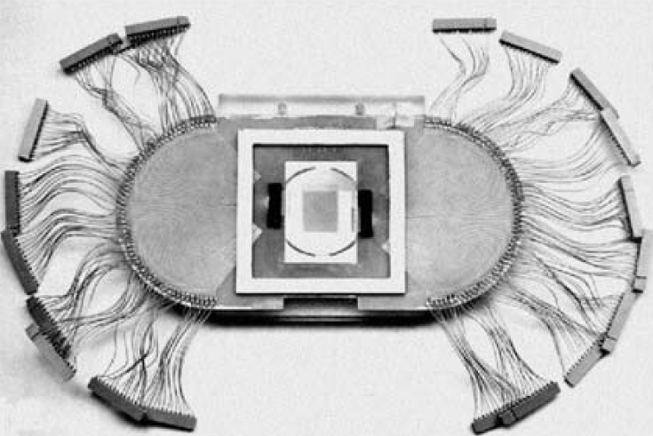
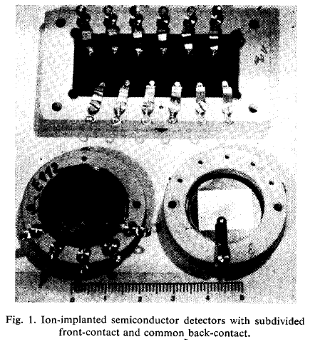
Silicon detectors
Semiconductor detectors developed 1943 (Utrecht) – 1955 (Bell Labs, Oak Ridge)
Surface barrier diodes on Ge (1949) and on Si (1955)
Diffused Si junctions and p-i-n/n-i-p introduced ~1958-1960
Ion-implanted diodes from ~ 1960 by J.Mayer and others (e.g.at Philips Amsterdam)
Several diodes on same slice was done 'right away' at AERE, LBL and CEA Saclay
Patent on double-sided Si 'checker board' detector by Philips (NL) in 1967
1st strip sensor: NIM 97 (1971) 465-469, Striped Semiconductor Detectors for Digital Position Encoding, E.L. Haase, M.A. Fawzi, D.P. Saylor and E. Velten, Karlsruhe, Ge.
Surface barrier microstrip sensors for experiments (1980-NA11, 100-200µm strip pitch)
Thanks to E. Heijne, F. Hartmann

Slide 5
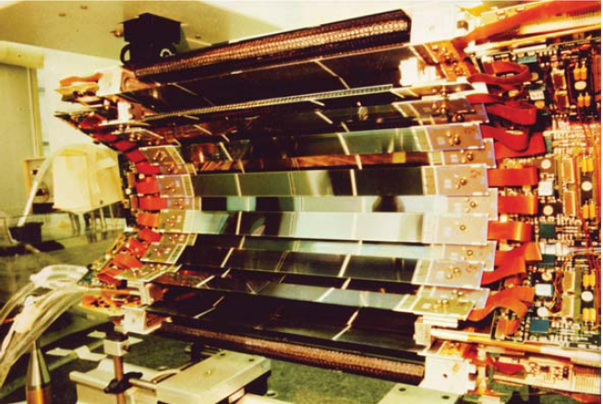
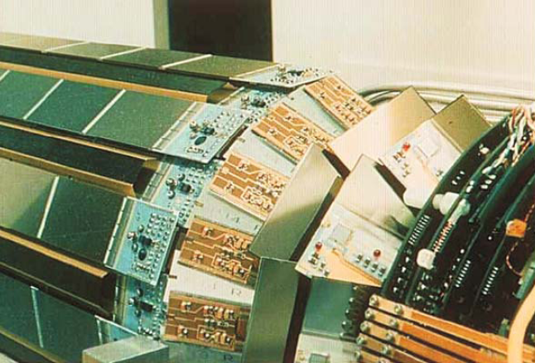
Silicon detectors
With the improvements of readout electronics (in term of size and performances), silicon was more and more extensively used for Vertex and Tracker detectors at collider experiments: LEP and Tevatron!
1994
1997
LEP: DELPHI as an example

Slide 6
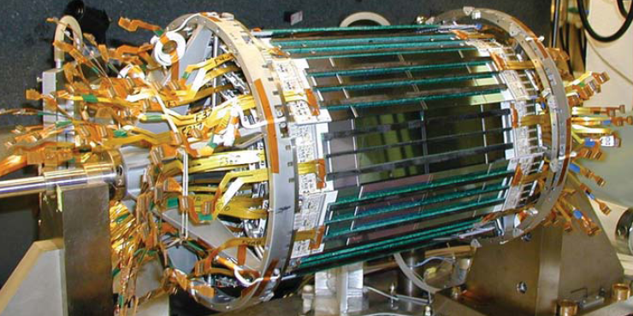
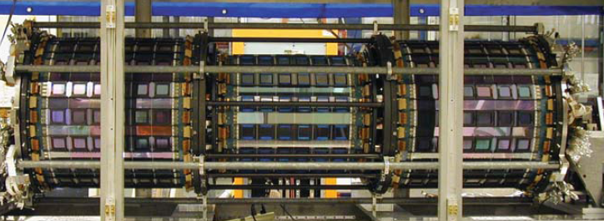
Tevatron: CDF as an example
SVXII
ISL

Slide 7
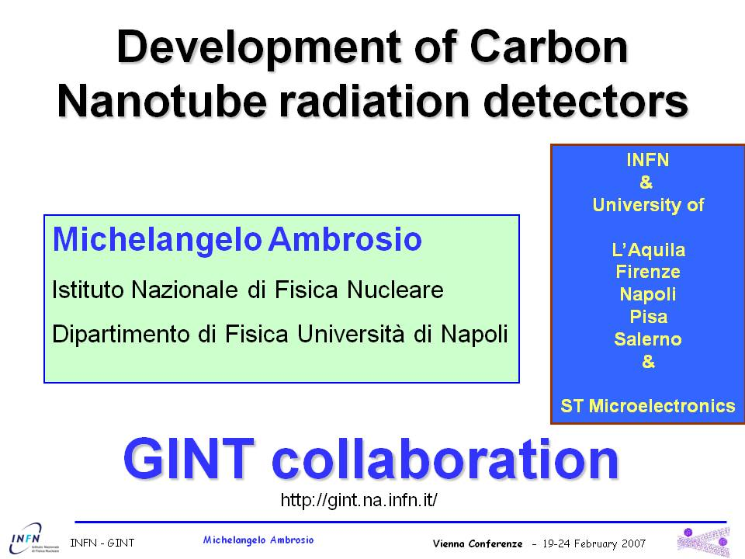
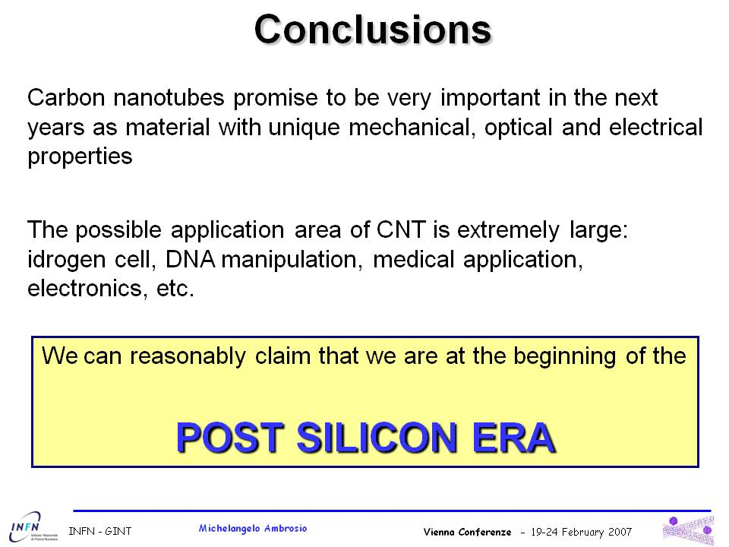

Is the silicon detector development going forward with the same speed?

Slide 8
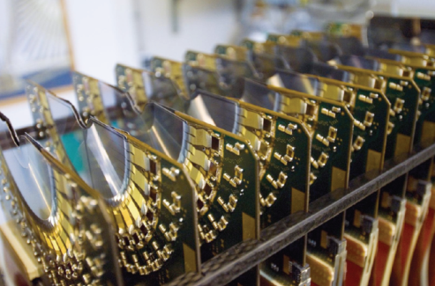
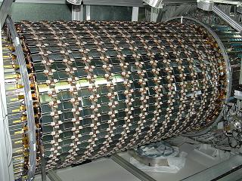
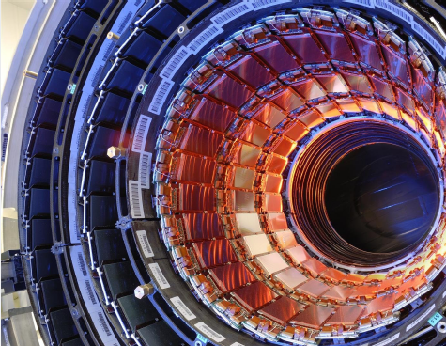
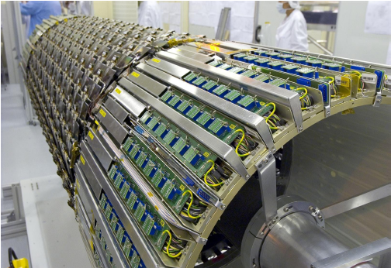
Silicon detectors: status back there
The spectacular sensors in the LHC.
Triumph of silicon technology. Many wonders in the various experimental caverns (silicon drift, silicon microstrip, hybrid pixel sensors):
To get to this quality, a large amount of R&D has been performed to face the occupancy, readout speed and radiation tolerance challenges.
.... but more difficult challenges are to be faced!

Slide 9
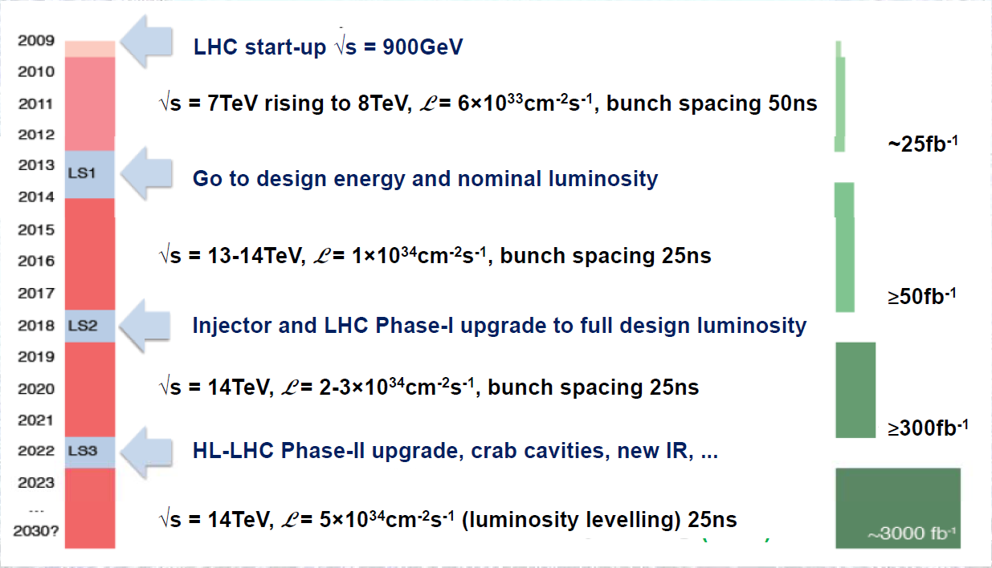
Silicon detectors in the future
The immediate challenge: HL-LHC
Possible 20 Year LHC Schedule

Slide 10
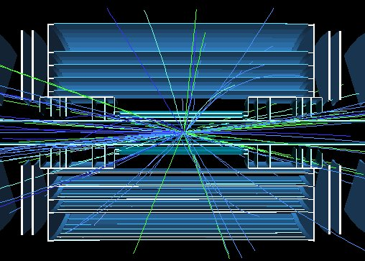
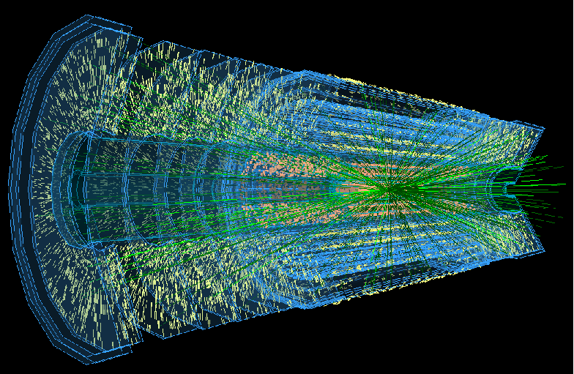
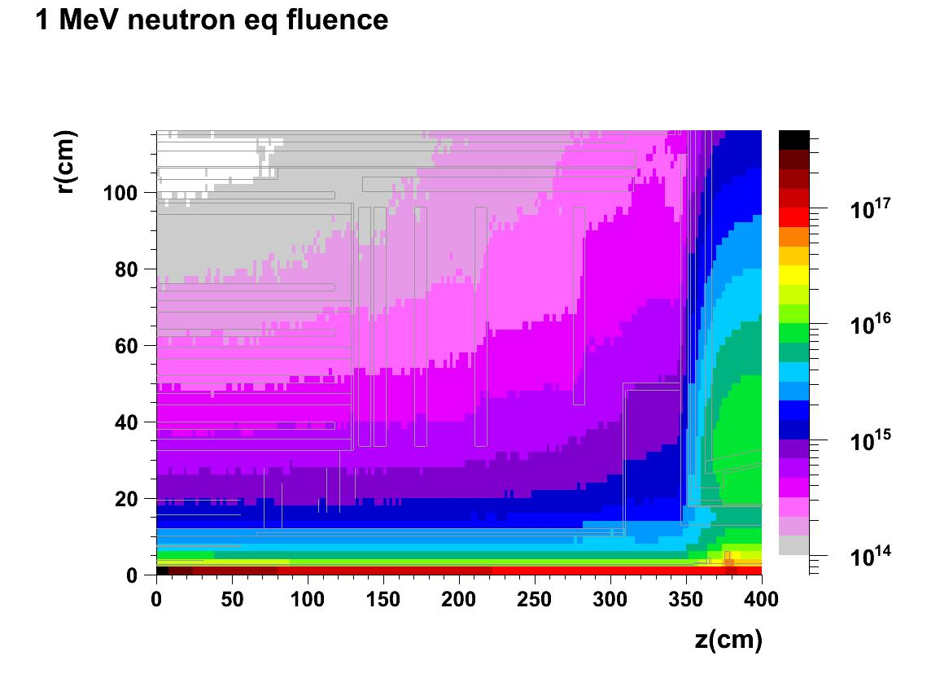
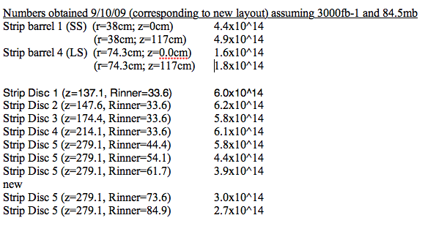
Radiation Background
At inner pixel radii - target survival to 2-3×10¹⁶ n_{eq}/cm²
For strips 3000fb⁻¹
×2 implies survival required up to ~1.3×10¹⁵ n_{eq}/cm²
I. Dawson et al.

Slide 11
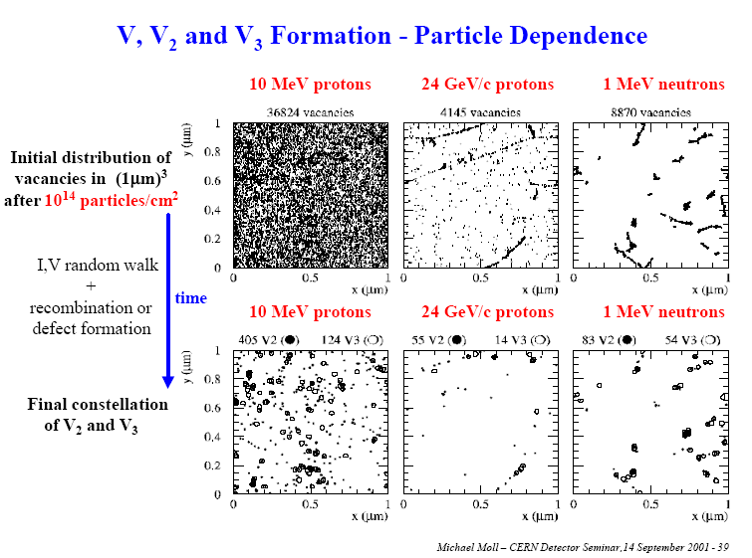
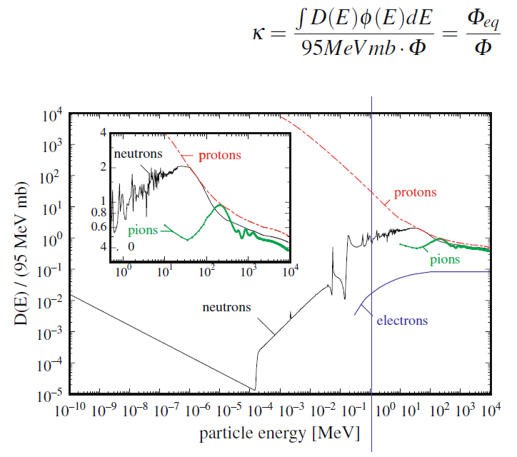
Serious issues: granularity and radiation damage
The increase in radiation dose compromises the ability of the sensors to operate till the and of the physics program.
The increase in granularity required by the increased multiplicity will impact significantly on the services (power in, cooling, data links ....).

Slide 12
Radiation damage
Summary – defects with strong impact on the device properties
positive charge (higher introduction after proton irradiation than after neutron irradiation)
Point defects
E_{i}^{BD} = E_{c} – 0.225 eV
σ_{n}^{BD} =2.3⋅10⁻¹⁴ cm²
E_{i}^{I} = E_{c} – 0.545 eV
  σ_{n}^{I} =2.3⋅10⁻¹⁴ cm²
  σp^{I} =2.3⋅10⁻¹⁴ cm²
Cluster related centers
E_{i}^{116K} = E_{v} + 0.33eV
σ_{p}^{116K} =4⋅10⁻¹⁴ cm²
E_{i}^{140K} = E_{v} + 0.36eV
σ_{p}^{140K} =2.5⋅10⁻¹⁵ cm²
E_{i}^{152K} = E_{v} + 0.42eV
σ_{p}^{152K} =2.3⋅10⁻¹⁴ cm²
E_{i}^{30K} = E_{c} - 0.1eV
σ_{n}^{30K} =2.3⋅10⁻¹⁴ cm²
0 charged at RT
+/- charged at RT
P ^{0/+}
E30K ^{0/+}
VO ^{-/0}
positive charge (high concentration in oxygen rich material)
BD ^{0/++}
V₂ ^{-/0}
leakage current
+ neg. charge
(current after γ irradiation)
I_{p} ^{0/-}
H152K ^{0/-}
H140K ^{0/-}
C_{i}O_{i}^{+/0}
H116K ^{0/-}
Reverse annealing
(neg. charge)
B ^{0/-}
Point defects
extended defects

Slide 13
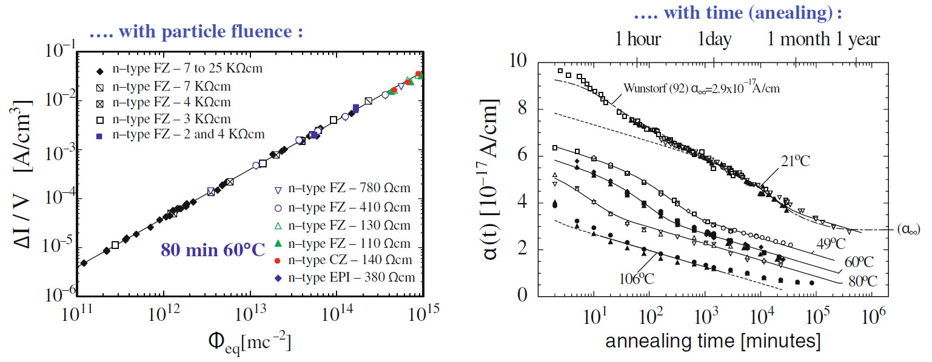
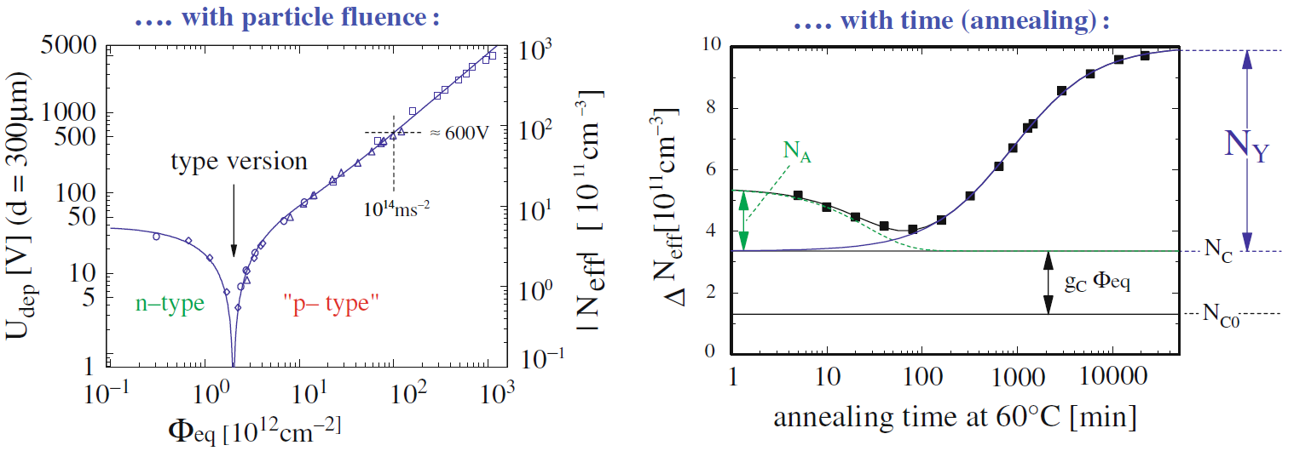
Can silicon survive these doses?
Reverse current increase
N_{eff} changes, V_{FD} increase

Slide 14
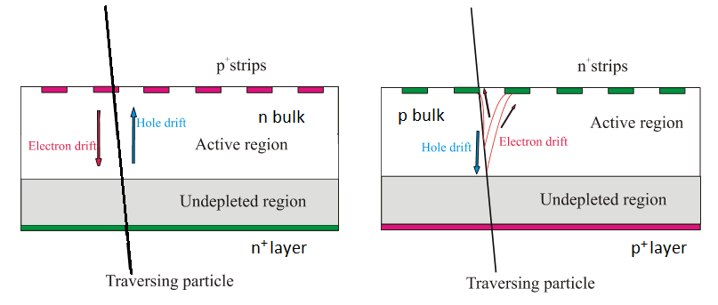
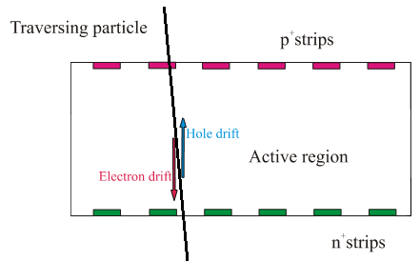
Operation of high resistivity Si detectors
n⁺on-p
p⁺on-n
Double sided
Full depletion for optimal operation!

Slide 15
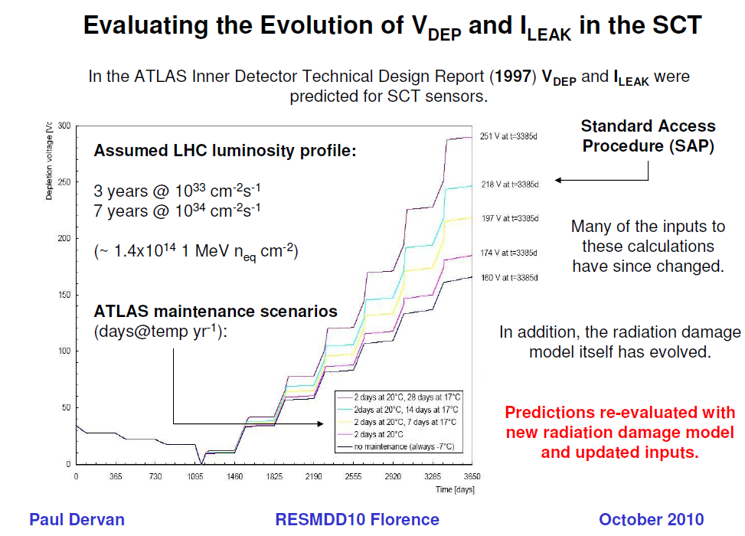
Radiation damage: operation scenario (LHC)

Slide 16
For improved mip charge collection after irradiation p-in-n versus n-in-p (or n-in-n) detectors
n-type silicon after high fluences:
(type inverted)
p-type silicon after high fluences:
(still p-type)
p⁺on-n
n⁺on-p
p-on-n silicon, under-depleted:
Charge spread – degraded resolution
Charge loss – reduced CCE
n-on-p silicon, under-depleted:
Limited loss in CCE
Less degradation with under-depletion
Collect electrons (faster than holes)
Comments:
- Instead of n-on-p also n-on-n devices could be used

Slide 17
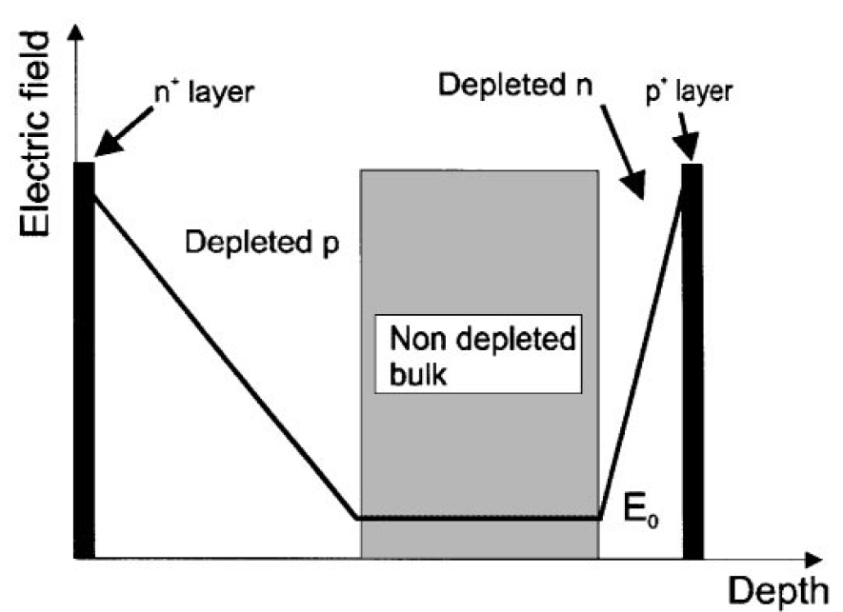
N-side read-out helps radiation tolerance of Si detectors.
Schematic changes of Electric field after irradiation
Effect of trapping on the Charge Collection Efficiency (CCE)
Q_{tc} ≅ Q₀exp(-t_{c}/τ_{tr}), 1/τ_{tr} = βΦ.
Collecting electrons provide a sensitive advantage with respect to holes due to a much shorter t_{c}. P-type detectors are the most natural solution for e collection on the segmented side.
N-side read out to keep lower t_{c}

Slide 18
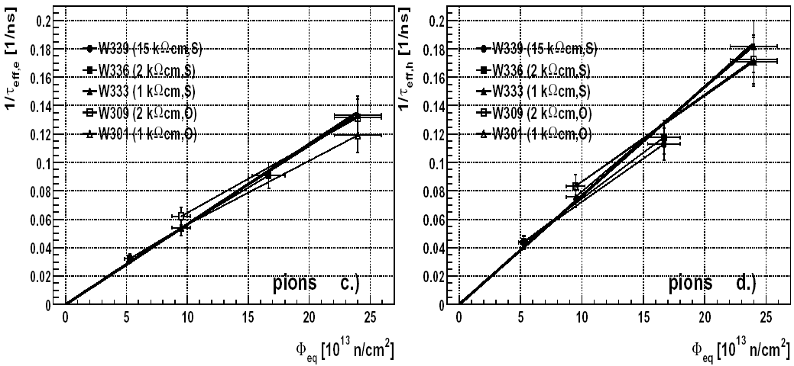

Charge trapping
The Charge Correction Method (based on TCT) for determination of effective trapping times requires fully (over) depleted detector – so far we were limited to 10¹⁵ cm⁻².
G. Kramberger, Trapping in silicon detectors, Aug. 23-24, 2006, Hamburg, Germany

Slide 19
Effect of trapping on the Charge Collection Distance
Q_{tc} ≅ Q₀exp(-t_{c}/τ_{tr}), 1/τ_{tr} = βΦ.
v_{sat,e} x τ_{tr} = λ_{av}
β_{e} = 4.2Ε−16 cm⁻²/ns
G. Kramberger et al., NIMA 476(2002), 645-651.
β_{h} = 6.1Ε−16 cm⁻²/ns
λ_{Max,n} (Φ=1e14) ≅ 2400µm
λ_{Max,n} (Φ=1e16) ≅ 24µm
λ_{Max,p} (Φ=1e14) ≅ 1600µm
After heavy irradiation the charge collection distance (CCD) of silicon sensors becomes much shorter than the detector thickness.
λ_{Max,p} (Φ=1e16) ≅ 16µm
A maximum signal of just over 1500 e⁻ should be expected after 1×10¹⁶ n_{eq} cm⁻². This is a very small signal and it would require extremely low noise electronics for being usable for tracking.

Slide 20
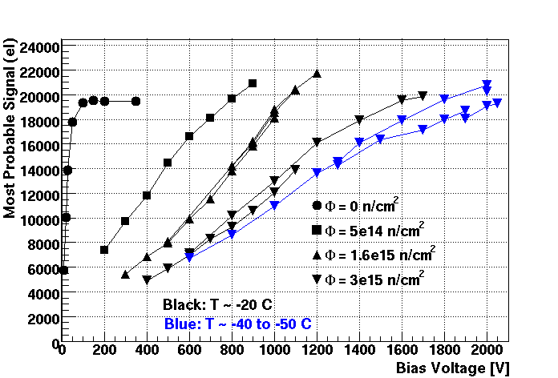
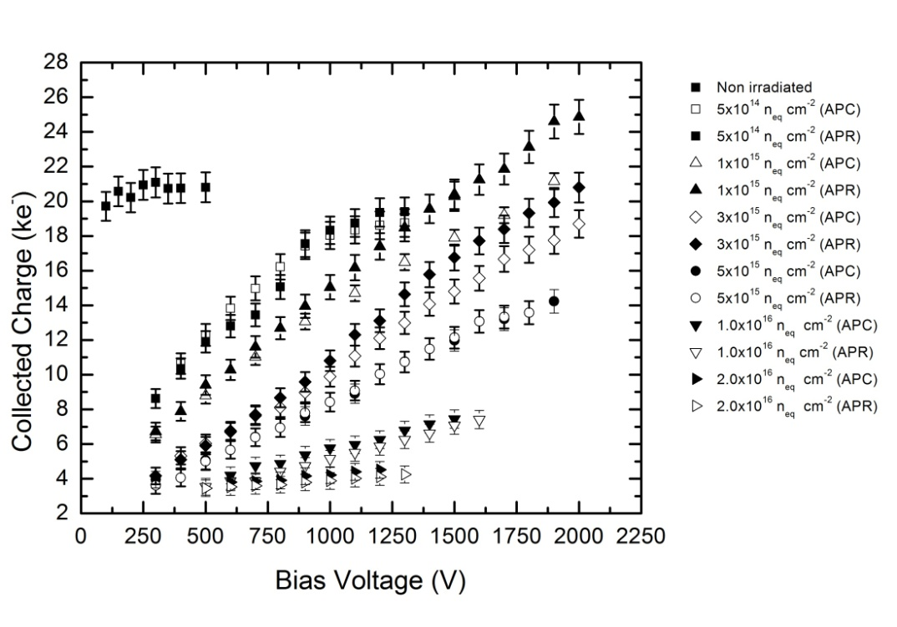
... but the measurements of the most probable value for minimum ionising particles crossing irradiated detectors show more charge than expected from the dependence on fluence of the charge trapping time constant. And even more charge than the one actually ionised by the mip!
I. Mandic (Ljubljana) at the 12th RD50 workshop.
Liverpool

Slide 21
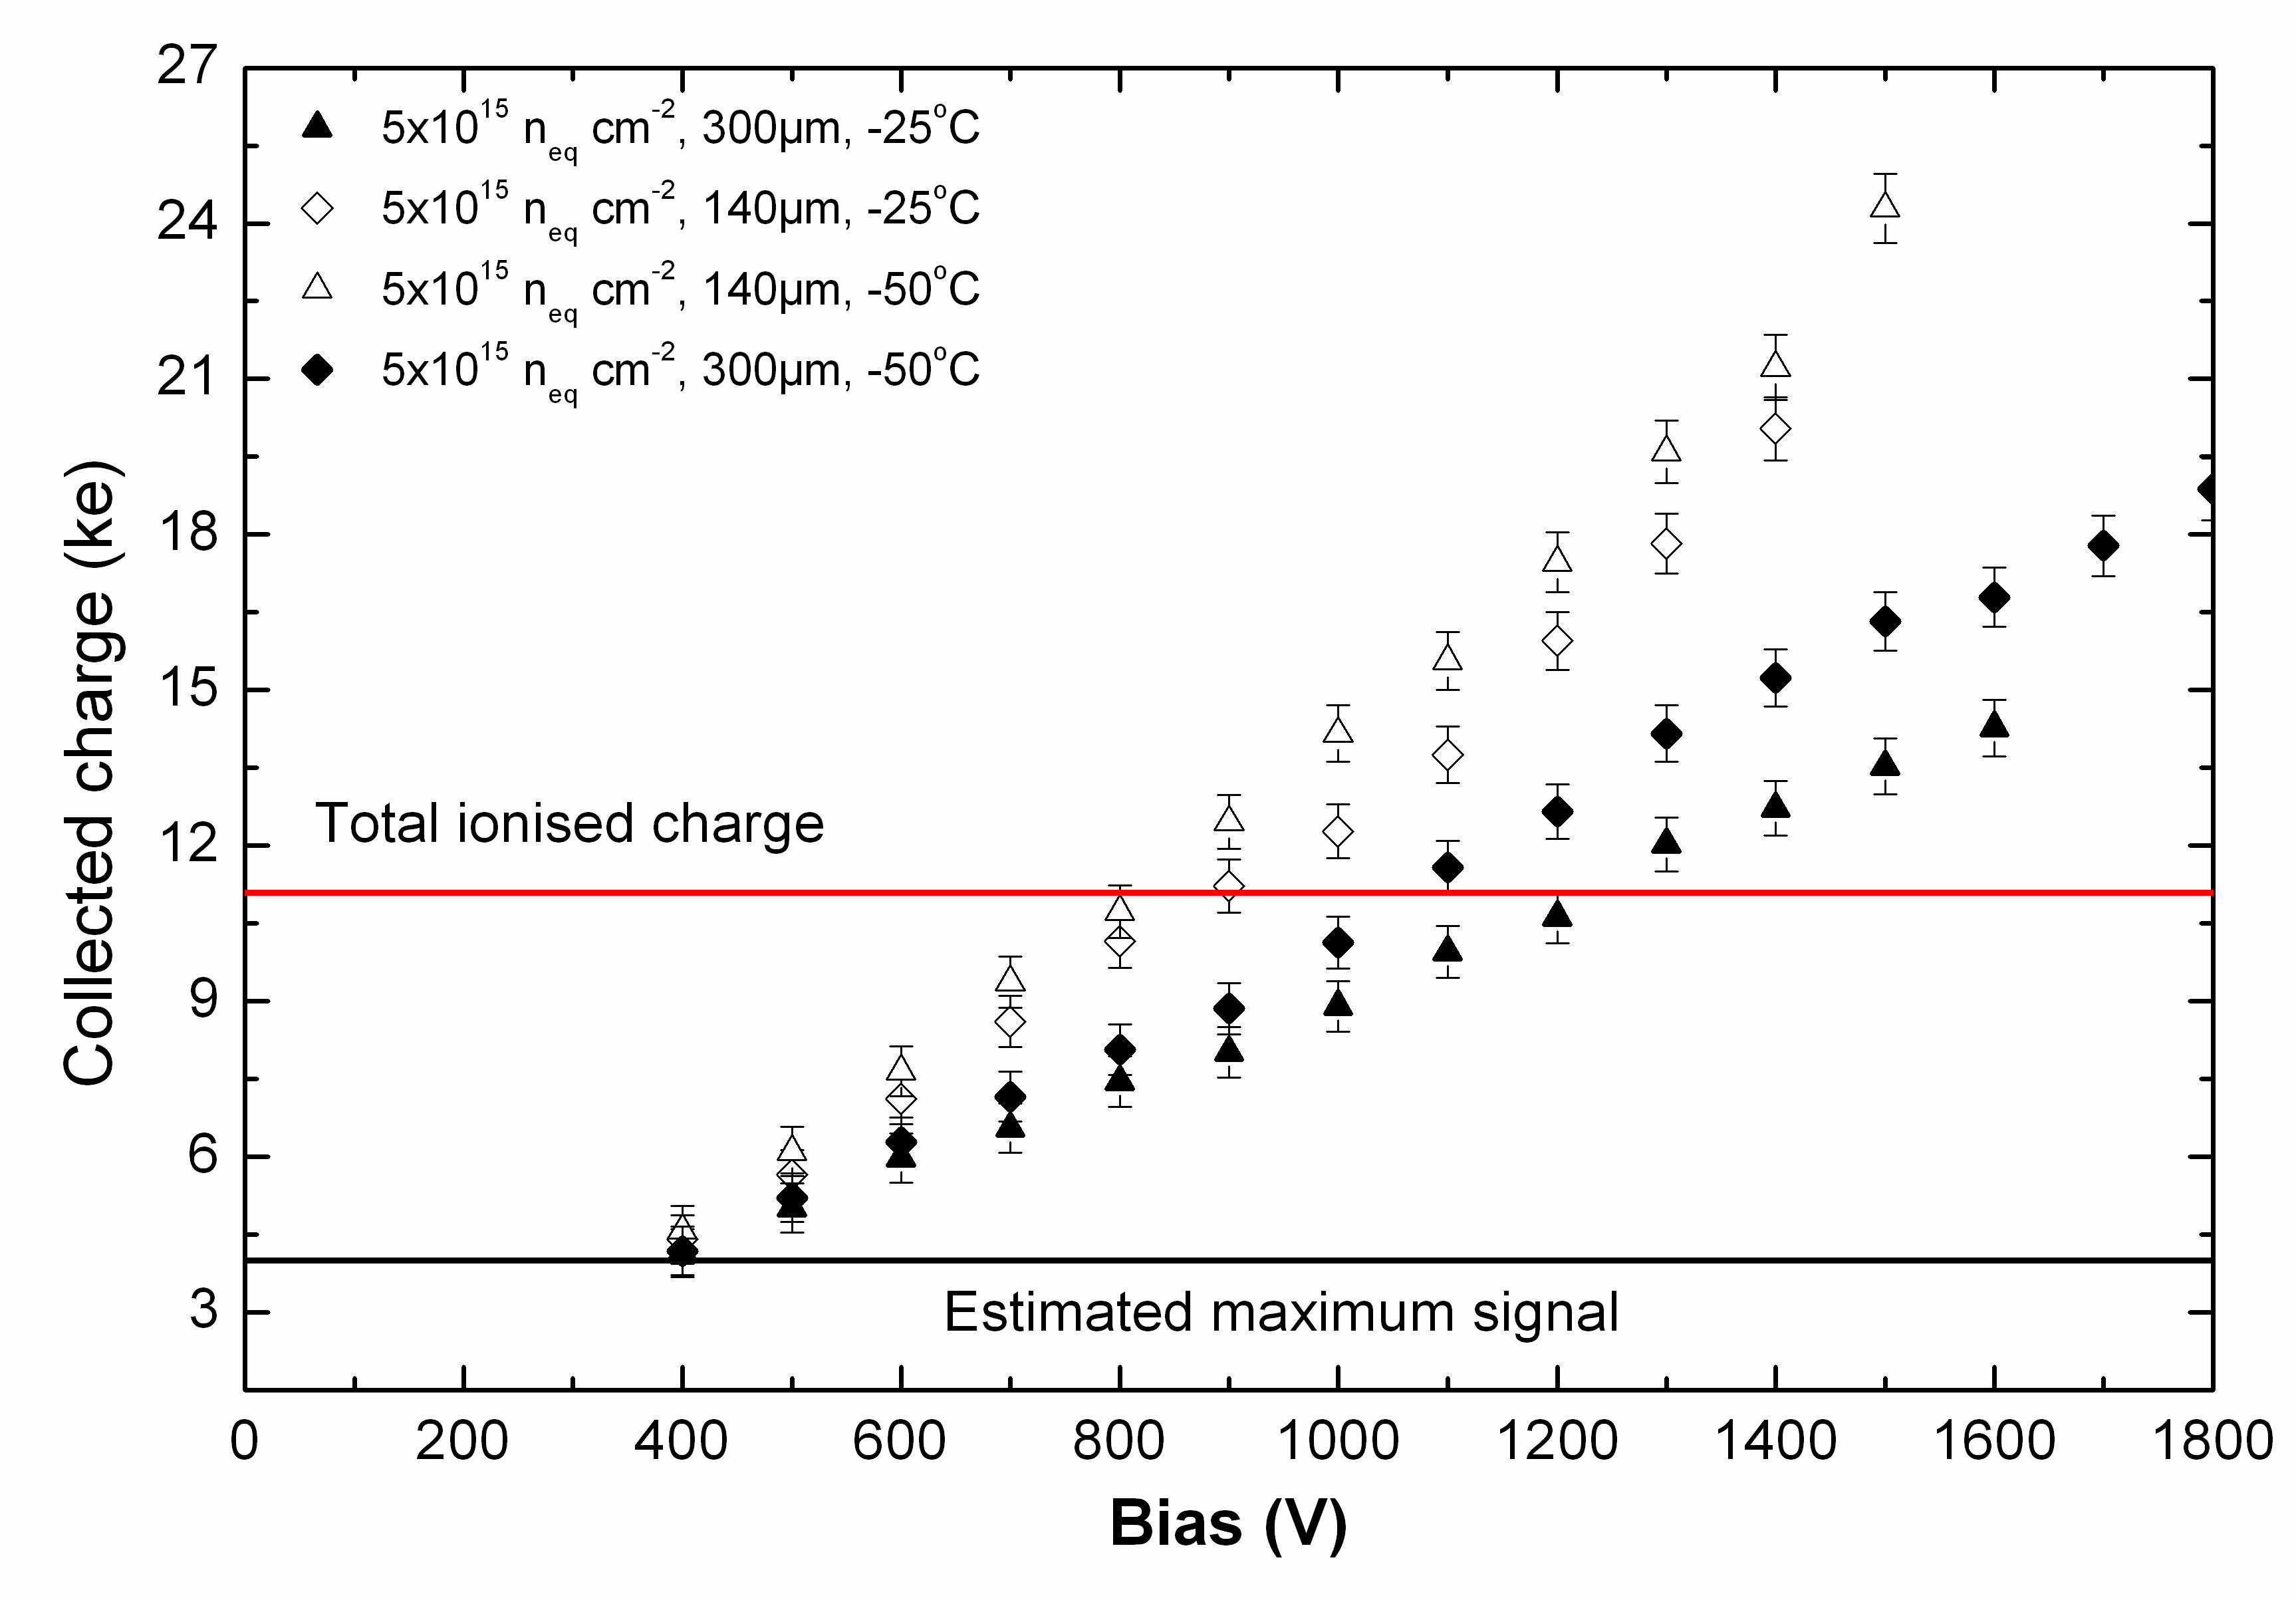
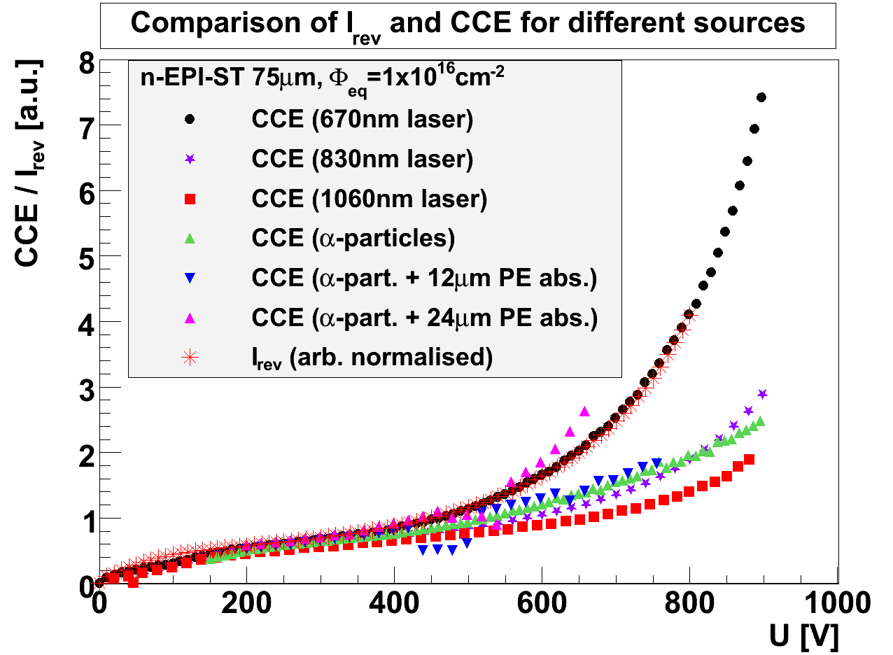
140 and 300 μm n-in-p Micron sensors after 5x10¹⁵ n_{eq} 26MeV p
Evidence of a charge multiplication effect: not only the whole charge is recovered, but increased by f = 1.75
Also CM in diodes (J. Lange, 15th RD50 workshop).

Slide 22
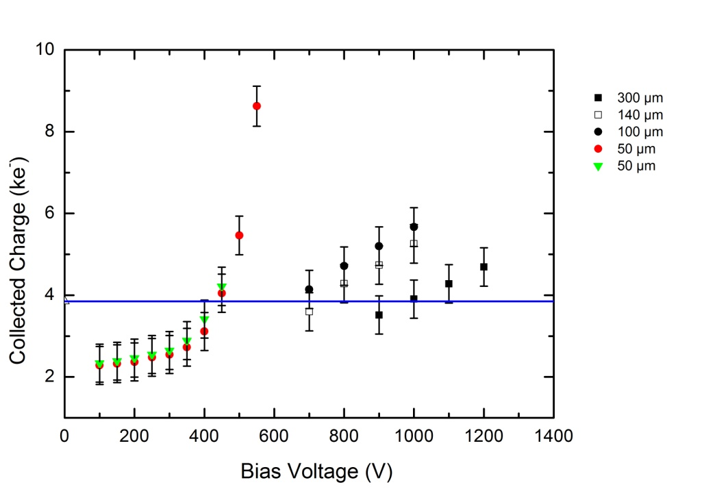
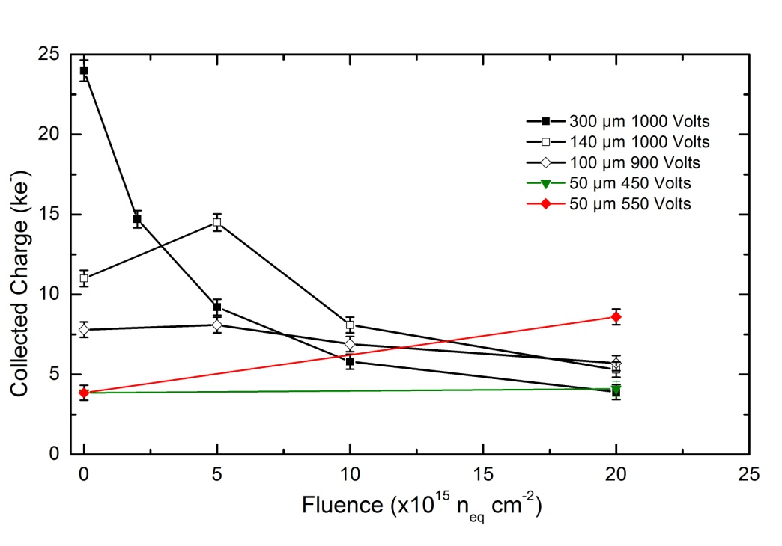
Effect of thickness!
Preliminary results with 100 and 50µm thick microstrip sensors are really encouraging.
MPV (mip illumination, 40MHz electronics) of sensors of various thicknesses after 2×10¹⁶ n_{eq} cm⁻².
Degradation of the collected charge (MPV) with fluence.

Slide 23
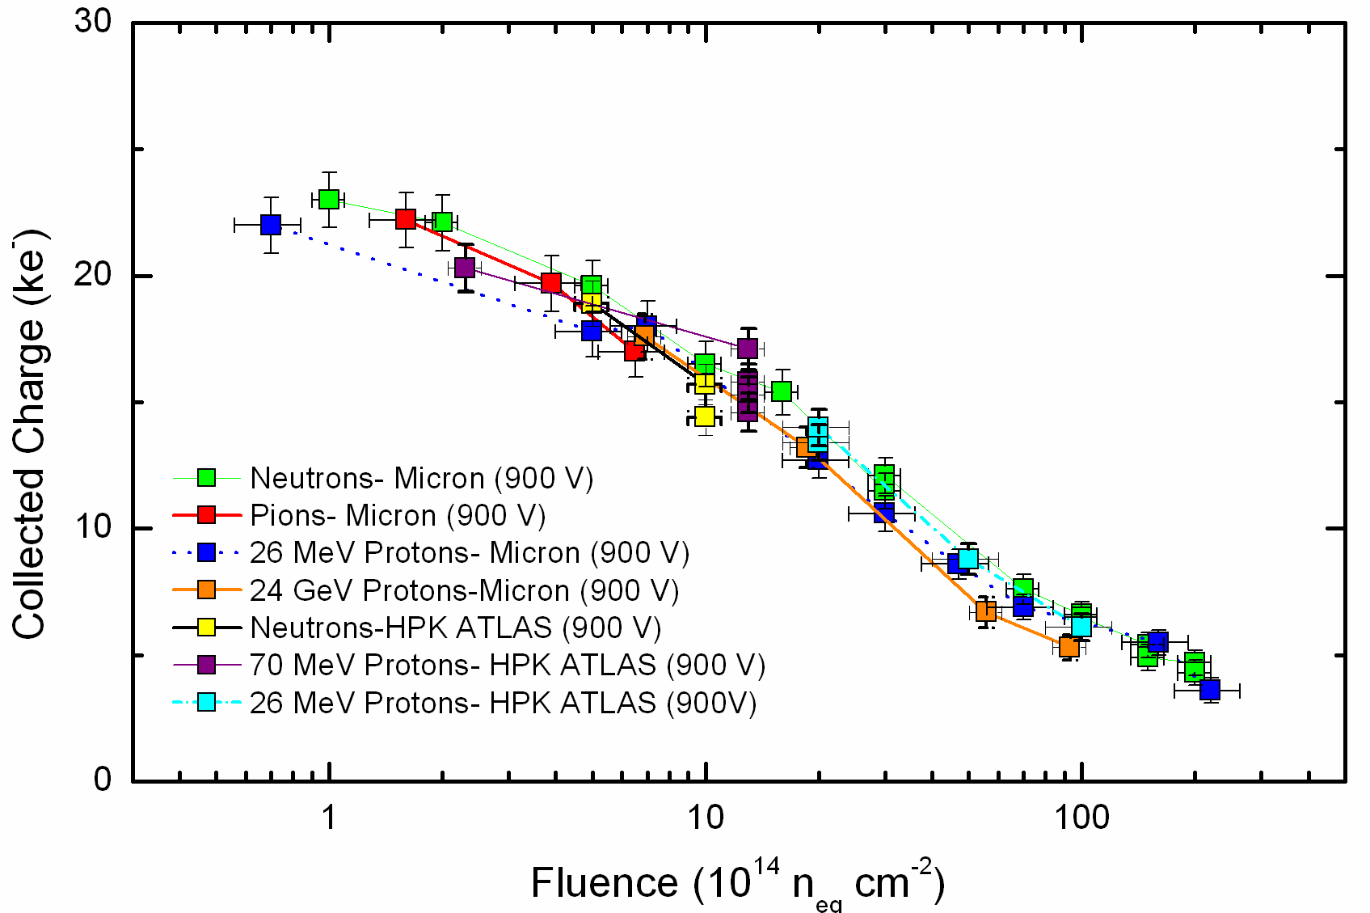
n-in-p Planar FZ Sensor Irradiations
Measurements show consistent results from various manufacturers
900 V
Strip
Doses
Pixel
Doses
1.3×10¹⁵n_{eq}cm⁻²
Gianluigi Casse and Tony Affolder,

Slide 24
Also, good news come from the annealing behaviour of the collected charge: HPK FZ n-in-p, 2E15 n cm⁻² ( 26MeV p irradiation)

Slide 25
.. And after very high (pixel) fluences: FZ n-in-p, 1E16 n cm⁻² (26MeV p irradiation)

Slide 26
Different detector structure: 3D Detectors
Even more radiation hard.
Array of electrode columns passing through substrate
Electrode spacing << wafer thickness (e.g. 30μm:300μm)
Benefits
  V_{depletion} (Electrode spacing)²
  Collection time Electrode spacing
  Reduced charge sharing
More complicated fabrication - micromachining
Planar
3D
+
Proposed by S. Parker and C. Kenney of the University of Hawaii in 1995.
+
ve
ve
-
-
ve
ve
+
+
ve
ve
n
n
-
-
type
type
electrode
electrode
electrons
electrons
300
300
300
300
µ
µ
m
µ
m
µ
m
m
holes
holes
p
p
-
-
type
type
electrode
electrode
Around
Particle
Around
Particle
µ
µ
m
30
m
30
Notes:
MEMS rather than IC fabrication

Slide 27
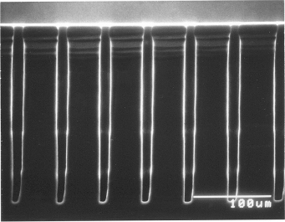
Double-sided 3D Production
Hole etching
Deep Reactive Ion Etching
  F plasma etches away base of hole
  CF₂ coating protects sidewall
  Limit on depth : diameter ratio
  250μm depth, 10μm diameter
250μm
10μm
Charge collection simulation and measurements
D. Pennicard et al., IEEE Trans. Nucl. Sci. 54, 4 (2007)
D. Pennicard et al., Nucl. Instr. Meth. A 592 (2008) 16
Notes:
Note use of F plasma for several seconds to etch, then switch to CF2 to coat inside of hole (Teflon-like) to prevent the hole from widening.

Slide 28
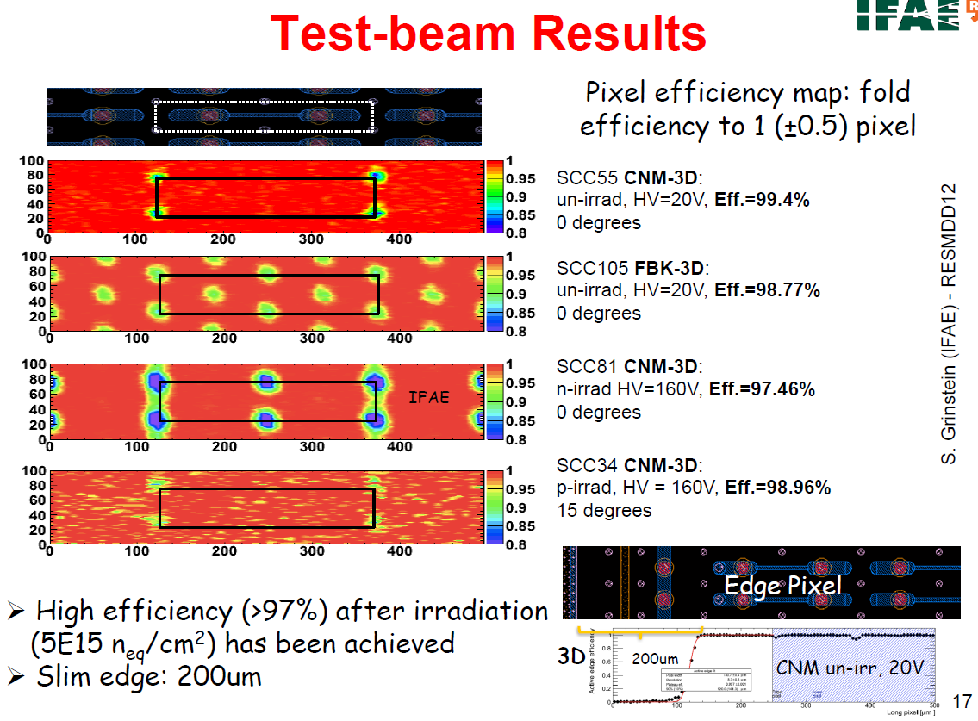

Slide 29
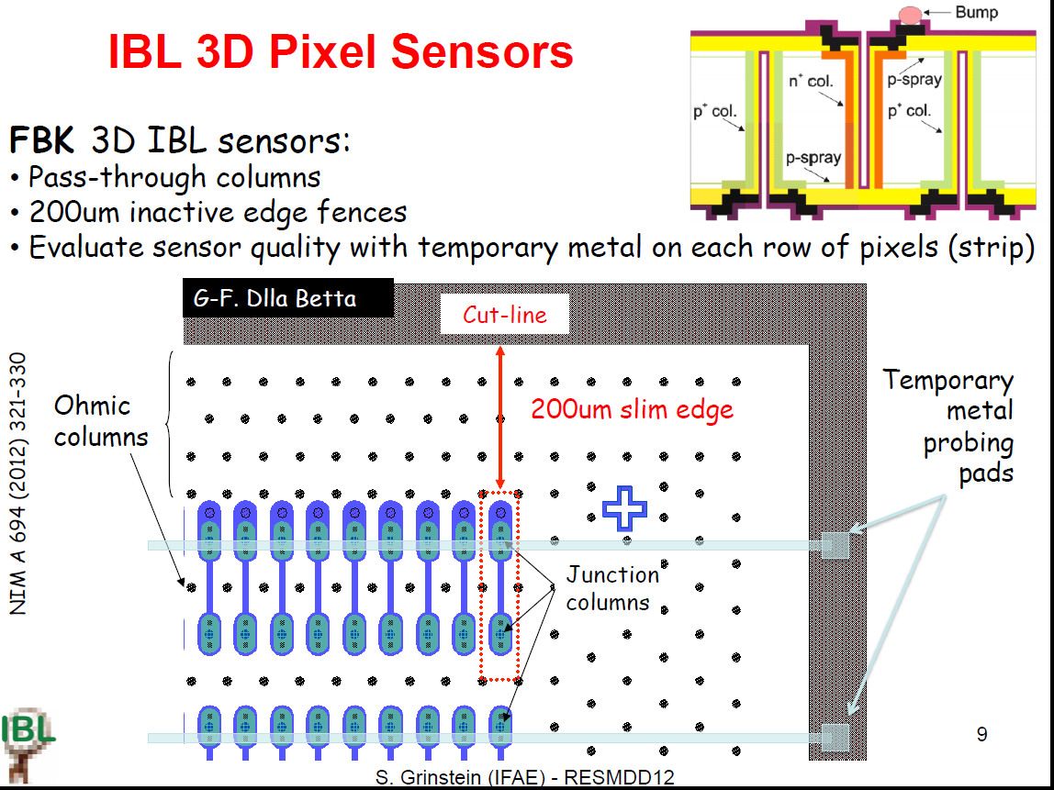
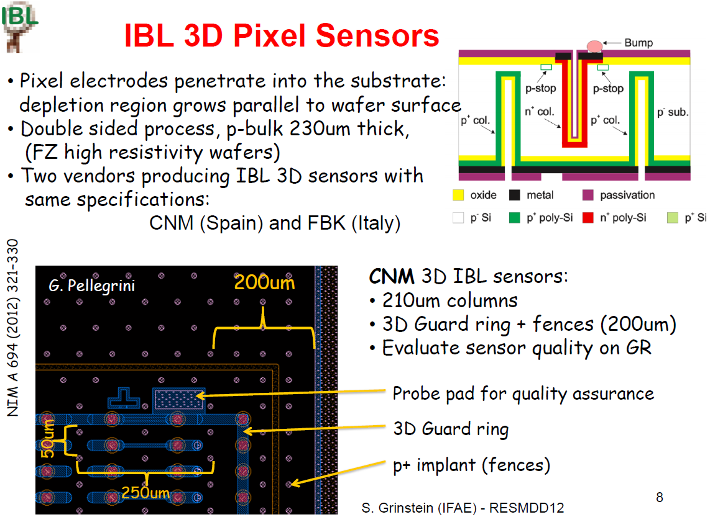
Technology is mature: looking for being installed in part of the ATLAS-IBL pixel detector!

Slide 30
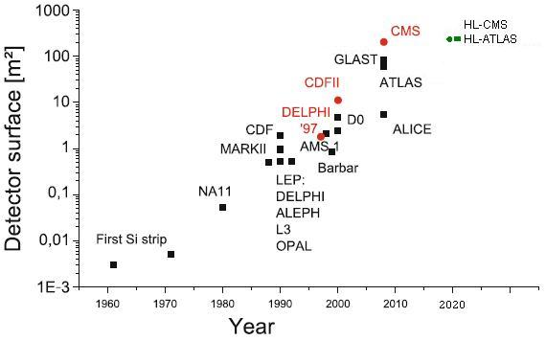
HL-LHC with a large amount of silicon detectors!
In surface ....
.... and channel count (Millions)....

Slide 31
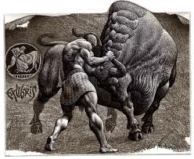
A lot of other activities with Si sensors
In HEP:
HL-LHC, HE-LHC, super KEKB, super B factories, ILC, CLIC, MuC.
Other areas of Science and Technology:
Space Science, Medical Imaging, Inland Security Imaging, FEL, Syncrotron Radiation Sources, TEM, ......
Large variety of sensors and ideas:
Hybrid pixels, microstrips, drift, monolithic pixels, fast CCDs, novel connectivity, edgeless sensors ......
Describing all the silicon detector activities is quite a labour, and of coarse some important development will not be mentioned.....

Slide 32
A lot of other activities with Si sensors
Charge-Coupled Devices (CCDs), CPCCD (Column Parallel CCDs)
Monolithic Active Pixels (MAPS) based on CMOS technology
DEPFETs (DEpleted P channel Field Effect Transistor)
SOI (Silicon on Insulator)
ISIS (Image Sensor with In Situ Storage)
Hybrid Active Pixel Sensors (HAPS) and 3D integration concepts
These basic technologies are coming in different flavours and specific technology combinations:
  Standard CCDs as used in digital cameras are not fast enough, proposed column parallel readout CPCCD helps or Short Column Charge-Coupled Device (SCCCD), where a CCD layer and a CMOS readout layer is bump bonded together.
  Chronopixels are CMOS sensors, with the capability to store the bunch ID (time).
  ISIS sensors combine CCD and active pixel technology, a CCD like storage cell together with CMOS readout implemented.
  Also Flexible Active Pixels (FAPs) integrate storage cells in the traditional MAP cells.
  Fine Pixel CCDs (FPCCDs, 5 x 5 μm²).

Slide 33
Requirements from other future experiments
Beam Parameters | CLIC | ILC
Beam energy | 100s GeV to 3 TeV | 100s GeV to 1 TeV
Train rate (Hz) | 50 | 5
Train length (us) | 0.156 | 910
Bunches per train | 312 | 1300
Bunch separation (ns) | 0.5 | 700
Train separation (ms) | 20 | 200
Duty Cycle (%) | 0.00078 | 0.45
e⁺-e⁻ colliders (ILC, CLIC):
bunched beam structures
Distance from beam axis: ~ 15 mm
Single point resolution: ≤ 5µm
0.1 X₀ per layer (100 µm Si equivalent)
Radiation tolerance ≤ 2×10¹² n_{eq} cm⁻²
SuperB factories:
Distance from beam axis: ~ 15 mm
High granularity (≤ 50µm²)
Radiation tolerance ≤ 5×10¹³ n_{eq} cm⁻²
Possible detector technologies (all requiring significant R&D):
monolithic pixels and hybrid pixels.

Slide 34
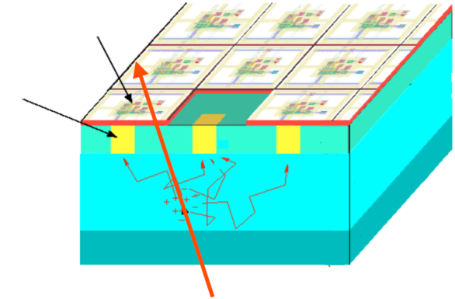
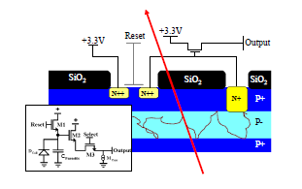
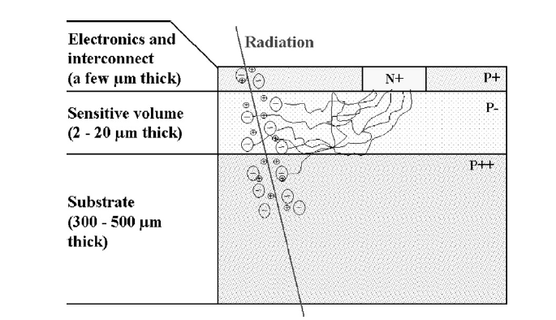
CMOS detectors: MAPs
Standard CMOS processing. Introduced in late 1990s as R&D. Active pixel cell with an NMOS transistor. Charge collected by drift towards the charge collecting diode.
in-pixel
micro-cicuits
charge collecting diode
Electronic layers
Epi-layer =
sens vol
~5 μm
Substrate or bulk
10-20μm
x μm
particle
The absence of drift field is a drawback when radiation damage is involved!

Slide 35
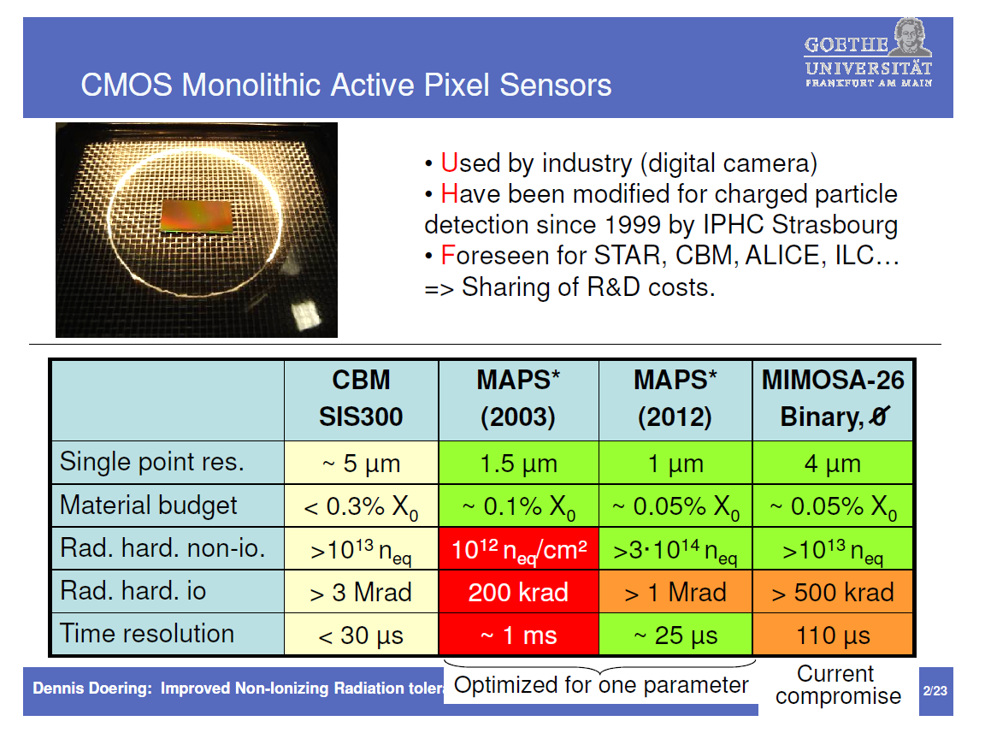
But substantial improvement have been achieved and the current radiation tolerance is in line with many applications!

Slide 36
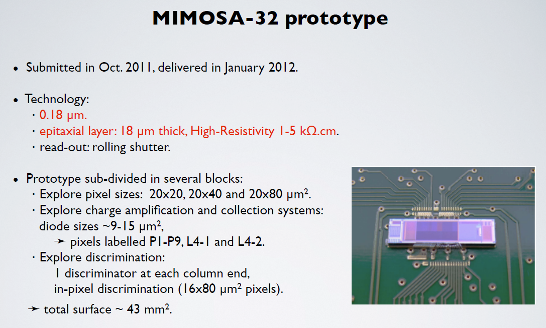
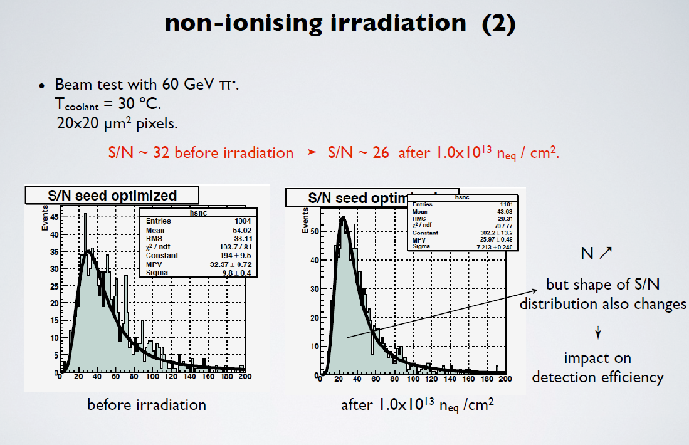
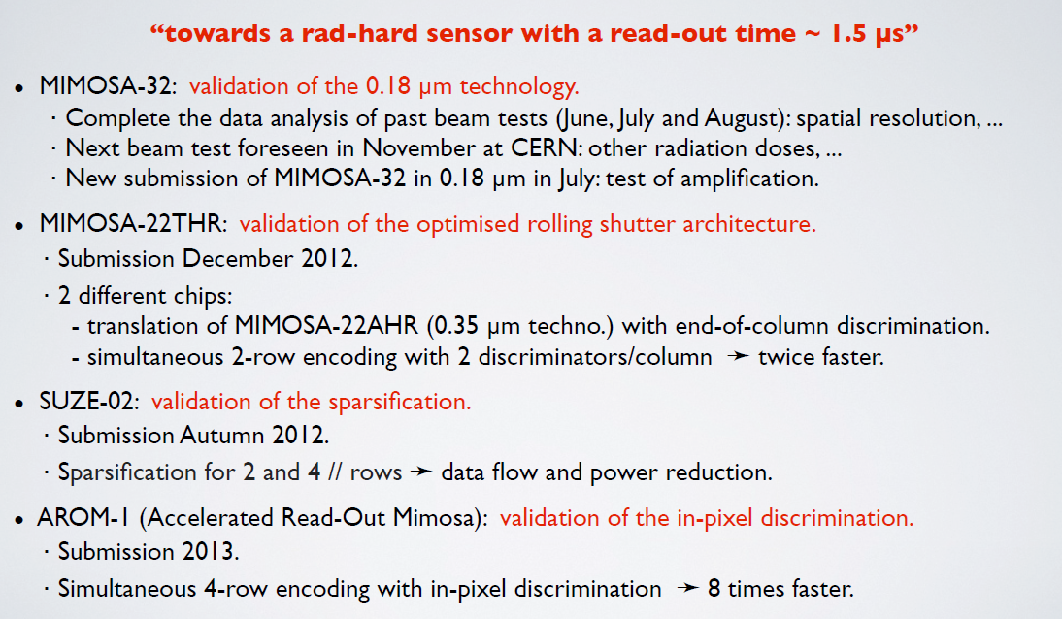
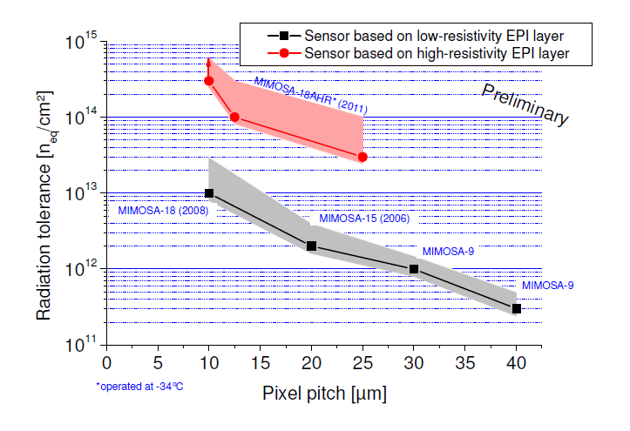
An example of results after irradiation
Isabelle Ripp-Baudot,
September 19th, 2012
SuperB-SVT meeting, Pisa
Dennis Doering,
RESMDD, Florence,
Oct. 2012

Slide 37
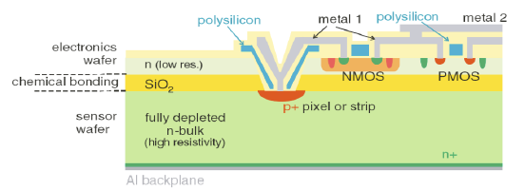
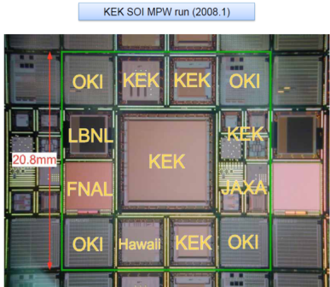
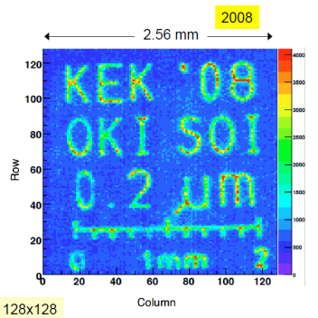
Putting a drift field in Monolithic Pixels
In SOI (Si On Insulator) technology the electronics is implanted on a thin silicon layer on
top of a buried oxide (BOX): this ensures full dielectric isolation and low junction capacitance (lower power consumption, higher speed applications...). The sensor part is a thick (300µm) high resistivity fully depleted (drift field) bulk. The back-gating effect (-V_{FD}) can effects transistor performances. It was introduced in 2003 by ITE, Warsaw (SUCIMA, Silicon Ultra fast Cameras for electron and gamma sources in Medical Applications).
LAPIS (former OKI, Japan) provides a 0.205m Fully Depleted (FD) SOI process on
high resistivity substrates (N-type CZ, 700 Ω×cm)

Slide 38


SOI sensors
low dose implantation through the BOX and through the electronics
• Suppress the back gate effect.
• Less electric field in the BOX which may improve radiation hardness.
S. Mattiazzo, RESMDD Florence, Oct 2012.

Slide 39


Putting a drift field in Monolithic Pixels
In HV-CMOS a deep n-well surrounds the electronics of every pixel. The deep n-wells isolate the pixel electronics from the p-type substrate. The substrate can be reverse biased with no influence on the transistors. A depletion zone in the volume around the n-wells is formed. The n-wells collect electrons mainly by drift (a small contribution comes from diffusion from the substrate). Example AMS 350nm HV-CMOS: reverse bias voltage is 60-100 V, depleted region depth ~15 μm, 20 Ωcm substrate resistance, E-field: 100V/15μm.
100 V

Slide 40



HC-CMOS
Many configuration possible:
Simple charge integrating pixels with pulsed reset and rolling shutter RO.
(Possible applications: ILC, transmission electron microscopy, etc.)
2) Pixels with complex CMOS-based pixel electronics that detect particle signals.
(Possible applications: CLIC, LHC, CBM, etc.)
3) Capacitively coupled pixel detectors (CCPDs) based on a pixel sensor implemented as a smart diode array
.
First publication: I. Peric, “A novel pixelated monolithic particle detector implemented in high-voltage CMOS technology”, Nucl. Instr. Meth. A 582, 876 - 885 (2007)

Slide 41

HV-CMOS
Also other ideas for deep depletion MAPS, e.g. LePix collaboration, using deep submicron (90 nm) and medium resistivity substrates (see next talk by P. Giubilato).

Slide 42



Internal amplfication: DEPFET
The DEPFET (depleted FET) detector is a detector with internal amplification. The n-bulk is fully depleted with a potential minimum below the strips and the structure of a field effect transistor. The electrons created by a charged
particle accumulate in the potential minimum. The field configuration is such that the electrons drift underneath the gate of the transistor modifying the source drain current. An active clear is necessary to remove the electrons. (J. Kemmer and G. Lutz Nucl. Instr. and Meth. A 253 (1987), p. 365 )

Slide 43

Combining technologies: ISIS, In-situ Storage Image Sensor (ILC)
Signal charge collected under an array of photogates into a buried channel (next to pixel)
Charge is transferred to an ‘in-pixel’ register, 20 times during the 1 ms-long train
Readout in the 200 ms-long quiet period after the train; excellent noise performance and immunity to RF pickup during the bunch train
1 MHz column-parallel readout at end of ladder is sufficient, with on-chip edge logic for
  cluster finding, centroid determination and data sparsification
Important additional ISIS feature: easy to drive because of the low clock frequencies:
  20 kHz during capture, 1 MHz during readout
ISIS combines
CCDs
active pixel and
CMOS edge electronics
in one device.
Chris Damerell@ESSD Wildbad Kreuth 2009 & Z Zhang@Vertex 2009 Putten

Slide 44





Important aspect: interconnections
Wire and bump bonding are used to interconnect the sensors to the readout electronics and to the support electronics. It represents a significant part of the cost and the complexity of a detector system. It impacts on the coverage of the tracking volume.

Slide 45

Important aspect: interconnections
Significant effort is taking place for improving connectivity and system aspects. These include R&D at ASIC level (vertical integration), at detector and hybrid electronics level (multi-metals, improvement on the filling factor of sensors, thin film hybrid circuits...).
The various developments can be combined for producing detector systems optimised for a given application.

Slide 46

Vertical integration, a dram that can come true
H-G Moser, Vertex 2012

Slide 47

TSVs (Through Silicon Vias) are the enabler for vertical integration
H-G Moser, Vertex 2012

Slide 48

Examples of the two approaches:
Tezzaron, 2-tier readout ASIC
AIDA (WP3) heterogeneous sensor/ASIC assemblies
H-G Moser, Vertex 2012

Slide 49

Examples of the two approaches:
AIDA (European supported project).
H-G Moser, Vertex 2012

Slide 50

IZM SLID Process
Other aspects of interconnections: beyond bump bonding
Alternative to bump bonding (less process steps “low cost” (IZM)).
Small pitch possible (<< 20 μm, depending on pick & place precision).
Stacking possible (next bonding process does not affect previous bond).
Wafer to wafer and chip to wafer possible.

Slide 51
Other aspects of interconnections: thin film hybrids
  Manage ASIC IO
    Vias in ASIC
    Silicon MCMD
    3 layer stack
Goal is to use a thin film technology “hybrid”
  Option-i: Silicon hybrid (Interposer)
  Option-ii: Post processing on the silicon sensor
  Option-iii: Replace wire-bonding with flip-chip (2nd phase)
Allows to produce also strixels sensors.......
Direct Processing of Hybrid Circuit on Silicon Sensor
(Ultimate reduction in mass and assembly complexity.)

Slide 52

Thin films hybrids possible construction
Allows to produce also strixels sensors.......

Slide 53



Thin films hybrids possible construction
The first processing was done to check that thin films do not alter basic electrical parameters before .......

Slide 54


Thin films hybrids possible construction
.... and after irradiation .......

Slide 55



Slide 56


Other aspects of interconnections: multi-metals
small R
large R
RL width ~ 11um
RL width ~ 10um
strip width ~ 11um
strip width ~ 38um
Strip pitch ~ 40um
Strip pitch ~ 101um
Allows to produce also strixels sensors.......

Slide 57

Breakdown protection : Guard Rings
Typical distance between sensitive area and cut edge for high voltage devices ~ 1mm. Lot of interest for reducing this inactive region.

Slide 58



Improving the area coverage
H. Sadrozinski et al., RD50 Workshop, Nov. 21-23, 2011
M.Christophersen, et al.

Slide 59

Further improving the area coverage:
PLANAR
PLANAR-3D =
PLANAR DETECTOR + DOPANT DIFFUSED IN FROM DEEP ETCHED EDGE THEN FILLED WITH POLYSILICON
GUARD RING
Sinks surface leakage current
E-field
p + Al
p ⁺ + Al
E-field
n ⁺+ Al
Microcracks, chips etc..
n + Al
n ⁺⁺ Al

Slide 60

Incidentally, a further dream:
One of the main feature of MAPS
Can be very thin (~25 µm of silicon in total) and still fully efficient!
Problem: how to handle, interconnect and at the end built a low mass ladder with such a thin device?

Slide 61

Silicon detectors for good timing resoluition: the NA62 GigaTracKer (GTK)
Beam spectrometer
  provide precise momentum, time and angular measurements on all beam tracks
  sustain high and non-uniform rate (~1.5 MHz/mm² in the center, 0.8-1.0 GHz total)
  preserve beam divergence for precise momentum and angular downstream measurements and limit beam hadronic interactions
X/X₀ ~0.5% per station
σ(p_{K})/p_{K} ~0.2%
σ(θ_{K}) ~16 μrad
pixel size 300 μm × 300 μm
σ(t) ~150 ps (rms) on single track

Slide 62

Virtuous spiral
From physics to application, and back.
An example is the Medipix: the ASIC originated from HEP needs has been further developed for X-Ray imaging.
The ASIC has evolved and a new version for application in HEP (VeloPix) is now a candidate for the LHCb-VELO upgrade.
No surprise: HEP has a typical boom and bust cycle. Keeping the R&D going between HEP ‘booms’ has high return value.

Slide 63

around 2015

Slide 64
SUMMARY
Silicon detectors for HEP are operating with spectacular success at the current LHC!! The immediate next challenge, the HL-LHC is generating an intense R&D effort, with results that show that state of the art devices are well on track for facing the new radiation levels, speed requirements and granularity (but watch out for system aspects, powering and cooling...).
ILC and SuperB’s, and other possible high intensity machines are supporting a wide range of extremely creative R&D, and material budget reduction combined with adequate radiation tolerance have been achieved or are in touching distance of many prototypes.
Special effects like Vertical Integration and interconnectivity are pursued.

Slide 65
SUMMARY
Besides the more glamorous development, the technology of sensor allows more sophisticated solutions (and, little by little, more affordable) for tracking at any radii (long and short strips, strixels, ...).
The role of R&D is essential, and sustaining the research also between the HEP ‘cycles’ is a high return enterprise:
”The success of particle physics experiments, such as those required for the high-luminosity LHC,
relies on innovative instrumentation, state-of-the-art infrastructures and large-scale data-intensive
computing. Detector R&D programmes should be supported strongly at CERN, national institutes,
laboratories and universities. Infrastructure and engineering capabilities for the R&D programme
and construction of large detectors, as well as infrastructures for data analysis, data preservation and
distributed data-intensive computing should be maintained and further developed”. (From the Draft of the Update of the European Strategy for Particle Physics).
Concerning of the future of silicon detectors, it looks bright for a number of years! Will there be a paradigm change when the size of CMOS will reach the ‘minimum feature size limit’?

Slide 66

HL-LHC Performance Goals
Leveled peak luminosity: L = 5 ×10³⁴ cm⁻² sec⁻¹
Virtual peak luminosity: L = 10 ×10³⁴ cm⁻² sec⁻¹
w/o luminosity
leveling 10⁻³⁵
with luminosity
leveling 5.10⁻³⁴
Integrated luminosity: 200 fb⁻¹ to 300 fb⁻¹ per year
Total integrated luminosity:
: ca. 3000 fb⁻¹
Finally look to double the energy (HE-LHC)
16.5+16.5 TeV proton collider in the LHC tunnel
Oliver Brüning BE-ABP
66

Slide 67

Draft Target Specifications
Plan for occupancy numbers based on this (see µ values below)
Plan integrated dose figures based on this
µ values going with the peak luminosity figure if achieved with 25ns beam crossing
When we calculate the dose figures which are used to specify the radiation hardness of components which can be reliably tested for post-irradiation performance (eg ASICs, silicon sensors, diamond, ...) apply this safety factor to the dose calculations in setting the radiation survival specification
(Still under discussion)

Slide 68


Results with proton irradiated 300 μm n-in-p Micron sensors (up to 1x10¹⁶ n_{eq} cm⁻²)
Irradiated with reactor neutrons
RED: irradiated with 24GeV/c protons
Other: 26MeV protons

